Slide 1
Welcome
The webinar will begin shortly. If you are joining as a group, please use the chat for roll call (enter your name and region or direct-funded district).
Thank you!
Notes:
Lead: Victor
Time: 5 mins. & 2 mins. before webinar starts
Talking Points: Read slide

Slide 2
Migrant Student Information Network:
Understanding Migratory Child Counts
July 14, 2021
1:00 p.m. – 3:00 p.m.
Notes:
Lead: Victor
Time: 30 secs.
Talking Points:
Repeat that participants who are joining as a group need to do “roll call” through the chat feature (region/direct-funded district number # and names)

Slide 3
Welcome and Introductions
Session Presenters
Juli Auld, Education Research and Evaluation Consultant, California Department of Education (CDE)
Jose Valencia, Migrant Student Information Network (MSIN) Lead, WestEd
Victor Garibay, MSIN Specialist, WestEd
Heather Medina, Migrant Student Information Exchange (MSIX) Lead, WestEd
Meena Kaur, Data Analyst - Migrant Education Special Projects, WestEd
Notes:
Lead: Juli
Time: 3 mins.
Talking Points:
Welcome participants.
Presenters introduce themselves and WestEd staff helping with the webinar.

Slide 4
Welcome and Introductions (2)
Target Audience
Migrant Education Program (MEP) Directors and Managers
MSIN Power Users and Data Specialists
MSIN users who enter Communication Events, Services, or Individual Needs Assessments/Individual Learning Plans (INA/ILP)
Notes:
Lead: Juli
Time: 1 mins.
Talking Points:
Welcome participants.
Presenters introduce themselves and WestEd staff helping with the webinar.

Slide 5
Purpose
This webinar will provide an overview of the child count definitions used for state and federal reporting and how MSIN and the Migrant Student Information Exchange (MSIX) calculate these counts.
The webinar’s purpose is to ensure that subgrantees are fully aware of the count rules and how to maximize their counts, especially because they directly impact state and local funding.
Notes:
Lead: Juli
Time: 1 min.
Talking Points:
(Read or paraphrase bullets)

Slide 6
Session Objectives
Participants will:
review child count definitions and where they come from;
learn child count rules in MSIN and MSIX;
review child count reports in MSIN and MSIX;
review frequently asked questions (FAQs) about child counts in State reports (subgranting and regional application [RA] reports);
learn how to maximize Category 1 and Category 2 counts; and
receive resources to train MSIN users locally.
Notes:
Lead: Juli
Time: 1 min.
Talking Points:
(Read or paraphrase bullets)

Slide 7

Child Count Definitions
Notes:
Transition Slide
Lead: Jose
Time: 10 secs.

Slide 8
What are MEP child counts?
  Category 1: The unduplicated statewide total of children or youth who...
    were eligible for the MEP (based on verified Certificates of Eligibility) during the Performance Period (PP) (i.e., 9/1/2020 – 8/31/2021), AND
    resided in the State for one or more days during the Performance Period, AND
    were ages 3 through 21 during the Performance Period.
  Category 2: Subset of Category 1 AND the children or youth were served one or more days in a MEP-funded summer or intersession program(s) during the Performance Period.
Notes:
Lead: Jose
Time: 3 min
Talking Points:
The conceptual definitions come from Non-Regulatory Guidance (pg. 4):
C2. What are Category 1 and Category 2 child counts?
...the Category 1 child count is an unduplicated count of migrant children aged 3 through 21 who, within 3 years of a qualifying move, resided in the State for one or more days in a 12-month period. The Category 2 child count is an unduplicated count of migrant children who were served for one or more days in MEP-funded summer or intersession programs in the State during a 12-month period.

Slide 9
Why do we need MEP child counts?
  Both Category 1 and Category 2 child counts are used by the Office of Migrant Education (OME) to determine each state’s grant allocation.
  CDE must report these counts annually (along with other data) after the end of each performance period.
  The state allocation formula is found in the Every Student Succeeds Act (ESSA).
Notes:
Lead: Jose
Time: 3 min
Talking Points:
For bullet 2, Guidance (pg. 4):
C2. What are Category 1 and Category 2 child counts?
States must annually submit to the Department, by early December, accurate and unduplicated Category 1 and Category 2 child counts, as well as a written explanation of the procedures used to calculate and validate the accuracy of the two child counts....
For bullet 3, ESSA:
SEC. 1303. [20 U.S.C. 6393] STATE ALLOCATIONS.
(a) STATE ALLOCATIONS.—Except as provided in subsection (c), each State (other than the Commonwealth of Puerto Rico) is entitled to receive under this part an amount equal to the product of—
(1) the sum of—
(A) the average number of identified eligible migratory children aged 3 through 21 residing in the State, based on data for the preceding 3 years; and
(B) the number of identified eligible migratory children, aged 3 through 21, who received services under this part in summer or intersession programs provided by the State during the previous year; multiplied by
(2) 40 percent of the average per-pupil expenditure in the State, except that the amount determined under this paragraph shall not be less than 32 percent, nor more than 48 percent, of the average per-pupil expenditure in the United States.
(b) HOLD HARMLESS.—Notwithstanding subsection (a), for each of fiscal years 2017 through 2019, no State shall receive less than 90 percent of the State’s allocation under this section for the preceding fiscal year.
Link to Every Student Succeeds Act - Gov Info Site: https://www.govinfo.gov/content/pkg/COMPS-11851/pdf/COMPS-11851.pdf

Slide 10
Where do the rules for calculating MEP child counts come from?
  States receive instructions annually for calculating migratory child counts from the United States Department of Education (ED). These instructions are called file specifications and the data is known as EDFacts files.
  States submit the MEP data to the ED in November and December by submitting the EDFacts files.
    For example, the specifications for file number 121 (FS121) provide the rules for calculating child counts, including Category 1. The specifications for file number 122 (FS122) provide the rules for Category 2 child counts.
Notes:
Lead: Jose
Time: 4 min
Talking Points:
Actionable definitions are officially provided through EDFacts file specifications.
Emphasize that current rules for calculating child counts come from EDFacts file specifications.*
These are created by OME and are slightly different than Guidance.
Show website with EDFacts file specs: https://www2.ed.gov/about/inits/ed/edfacts/index.html
Show rules within FS121 (tentative version for 2020-21):
How do States determine which children should be reported in this file?
Only children who have an SEA approved Certificate of Eligibility (COE) documenting their eligibility for the Migrant Education Program and have been entered in the State’s migratory student database should be reported in this file. States should further determine which migratory children to include in this file by using the following criteria:
Age: Eligible children ages birth through 21 within the Performance Period, should be reported in this file. States calculate the child’s age using the child’s birth date.
Eligibility: The child has a Qualifying Arrival Date (QAD) within 36 months of the start of the Performance Period (e.g., the earliest QAD for the 2020-21 Performance Period would be September 2, 2017) and the child’s Eligibility Expiration Date does not occur before the start of the Performance Period.
Note, an Eligibility Expiration Date is used to determine end of eligibility and to account for a child’s eligibility expiring earlier than 36 months from the child’s QAD. A child’s eligibility would end earlier than 36 months from the child’s QAD, if the child is no longer entitled to a free public education (e.g., graduated with a high school diploma, obtained a high school equivalency diploma (HSED), or for other reasons as determined by States’ requirements), or if the child passes away.
Residency: The child resided in the State for one or more days within the Performance Period as calculated by using an enrollment date, withdrawal date, residency date, or residency verification date that occurs within the Performance Period. Include in the Age 3 category, a child who turned three years of age during the performance period only after the child’s residency in the state was verified after turning three.
To get the Category 1 count, OME simply removes the Age/grade 0-2.

Slide 11
Why is it important to understand how Category 1 and Category 2 counts are determined?
Category 1 counts determine 55% of your funding from CDE
Category 2 counts determine 25% of your funding from CDE
Errors in data for these counts will affect your allocation
Notes:
Lead: Jose
Time: 2 min
Talking Points:
Just as OME uses these counts to determine California’s funding, the CDE uses the same count logic to determine your regional or direct-funded district allocations.
This means that your local child counts are also broken down into categories.
(Read slide bullets.)
See your Subgranting Report for details, including additional funding factors.

Slide 12

Questions?
Notes:
Lead: Team
Time: 3 mins.
Use Q&A feature in Zoom

Slide 13
Check for Understanding
  Next, you will see a pop-up window with questions and response options.
  There are three questions for this section; answer them as best you can.
  If you are participating as a group, enter the option chosen by the majority of the group.
  You will get a warning when the poll is about to close.
Notes:
Lead: Victor
Time: 4 mins.
Poll Questions:
The Category 1 count is defined as the unduplicated statewide total of children and youth who:
Were eligible for the MEP during the Performance Period
Lived in the State (i.e., established residence) one or more days during the Performance Period
Were ages 3 through 21 during the Performance Period
All of the above [answer]
2) True or False: The Category 2 count does not affect funding in California.
True
False [answer]
3) The current rules for calculating child counts come from:
The MSIX (Migrant Student Information Exchange) system
EDFacts file specifications [answer]
California Department of Education (CDE)
WestEd

Slide 14
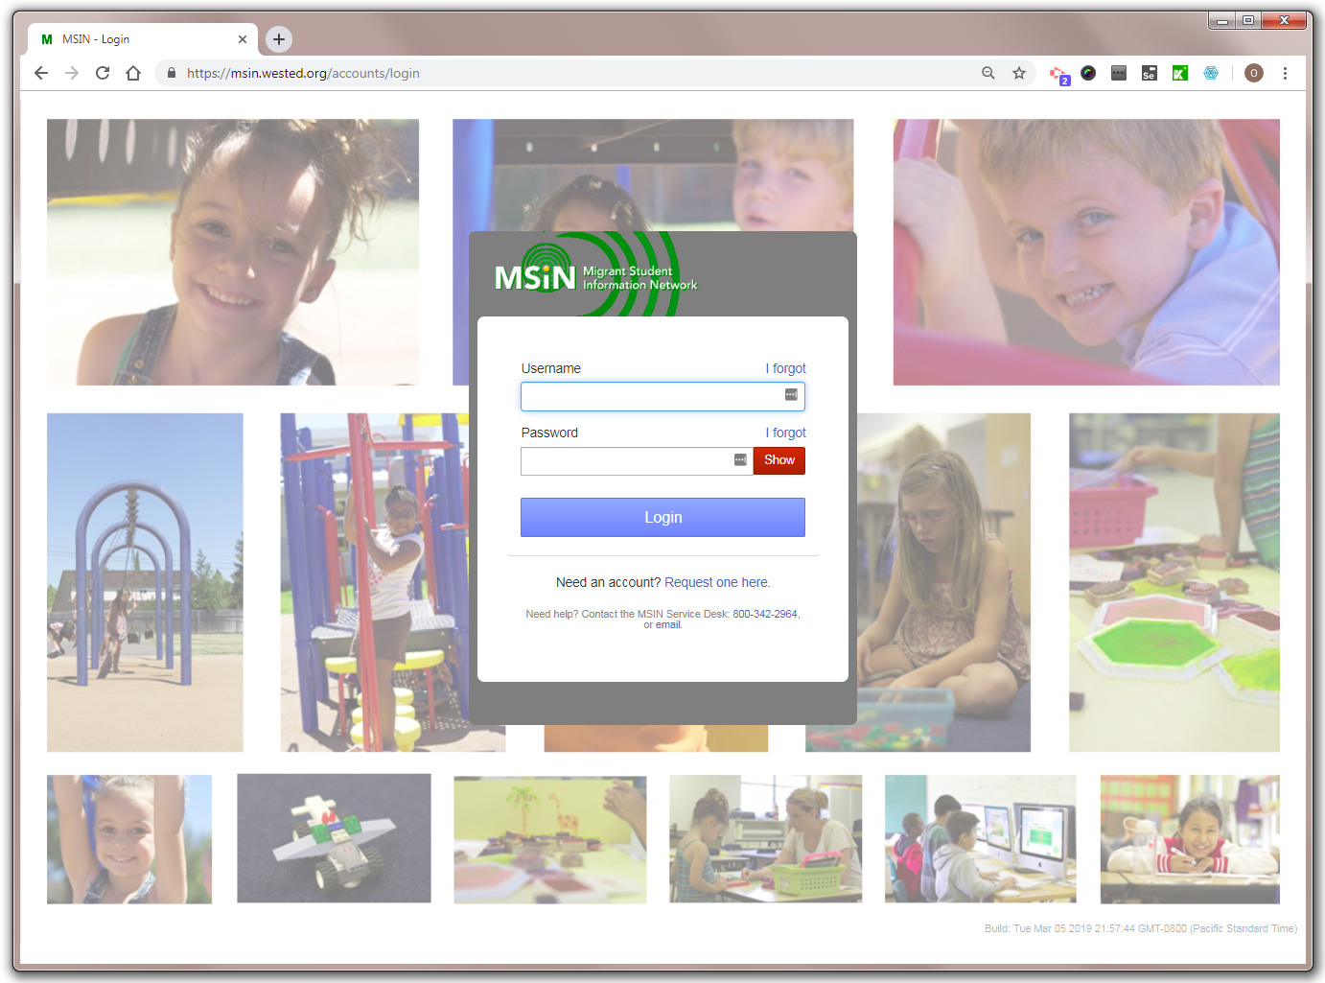
Child Counts in MSIN
Notes:
Transition Slide
Lead: Jose
Time: 10 secs.

Slide 15
How are the MEP child counts shown in MSIN calculated?
  The Counts Report in MSIN uses the same general rules as the MSIX system.
  In addition, MSIN has more specific rules that make it easier for California to show that a child was present during the Performance Period (PP).
    For example, any Communication Event entered in MSIN can serve as a “Residency Verification Date” (evidence of presence in the PP).
Notes:
Lead: Jose
Time: 2 min
Talking Points:
Both systems, MSIN and MSIX, are conceptually aligned (when it comes to child counts).
(Read bullets 2 and 3.)

Slide 16
What else has changed with respect to MEP child counts?
  OME is still planning to use the MSIX system to calculate child counts based on the Minimum Data Elements (MDE) that states provide in their regular MSIX data submissions.
  Within the MSIX system, the “MSIX Child Count” report will soon replace the EDFacts child counts that we submit annually to ED.
Notes:
Lead: Jose
Time: 2 min
Talking Points:
Well, in the last slide we saw that the count logic in the MSIN was aligned with the MSIX. This is because OME plans to use MSIX as the official source of Category 1 & 2 counts, instead of EDFacts files.
This change is scheduled to take place for the 2021-22 Performance Period, which mean the current year could be the last one to be based on EDFacts file submissions.
As a result, California has been following the child count rules used in the MSIX system very closely, as described in the Child Count Logic Reference Guide posted on the MSIX site.
(Read the second bullet.)

Slide 17
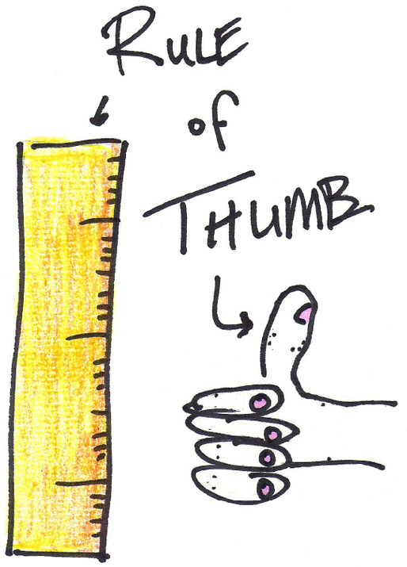
Remembering Child Counts Rules
Add dates to verify residency during the window of time when a child is eligible for MEP-funded services.
Notes:
Lead: Jose
Time: 2 min
Talking Points:
Given all these changes, we want to make the child count rules easy to remember.
When it comes to counts, the Recruiter has done the hardest part. After that, the rest of us can help maximize counts by focusing on entering dates that prove the child was present in California, in your region and your district.
For a child to be counted, their child record must have a date (i.e., “Residency Verification Date”; MDE 73) that is before their End of Eligibility (EOE) date.
To capture this, we have a Rule of Thumb: Add dates to verify residency during the window of time when a child is eligible for MEP-funded services.
This rule tells us what actions to take. Let’s keep this rule of thumb in mind as we go through the next few slides, which include example scenarios.

Slide 18
How the Rules for the Category 1 Count Work in MSIN and MSIX
Sept. 1, 2020
Aug. 31, 2021
Performance Period
Notes:
Lead: Jose
Time: 30 secs.
Talking Points:
We are going to walk through several examples showing the child count rules with diagrams.
We already discussed the rules verbally, so we hope that adding visuals will help us remember even better.
As you can see in the slide, the first thing we need is to represent the performance period, which spans from Sept 1st to August 31st of the following year.
The performance period will be our reference line for everything else.

Slide 19
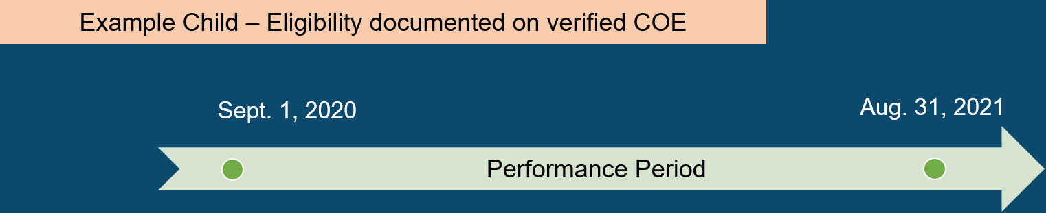
Scenario #1: Child’s eligibility expires during the Performance Period
Notes:
Lead: Jose
Time: 30 secs.
Talking Points:
Now that we have the performance period as a reference (light green arrow in the middle of the slide), we can jump into a specific scenario.
The orange bar represents a 6th grade student who has eligibility for most of the performance period.
Notice that the bar ends before reaching the end of the performance period, which is August 31, 2021.
Our goal is to show when this child would be counted in Category 1 and when they would not be counted.
Let’s keep adding details.

Slide 20
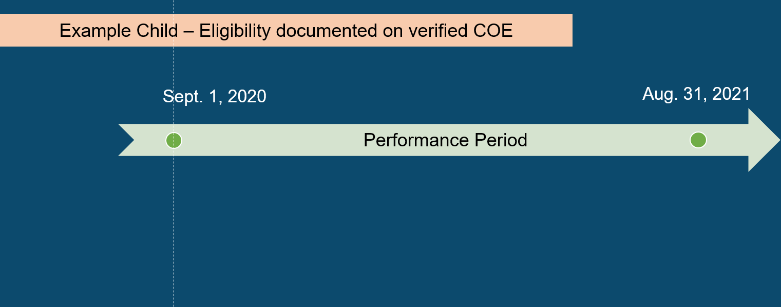
Scenario #1: Child’s eligibility expires during the Performance Period (2)
Notes:
Lead: Jose
Time: 30 secs.
Talking Points:
Because counts are based on the performance period, we’re going to add a dotted line right at the beginning (Sept. 1).
This will help us visualize whether any dates that we add in MSIN will prove that the child was present in California during the performance period.

Slide 21
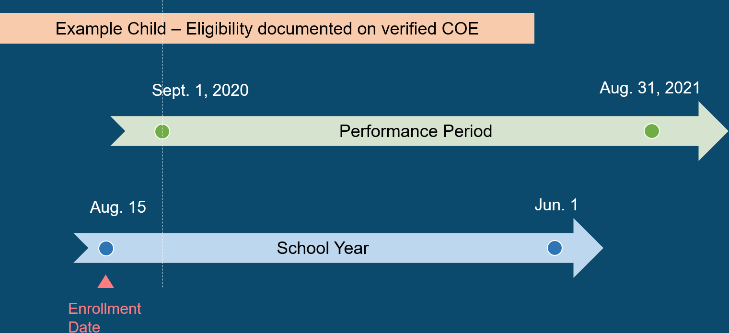
Scenario #1: Child’s eligibility expires during the Performance Period (3)
Notes:
Lead: Jose
Time: 30 secs.
Talking Points:
Next, we are adding a blue bar representing the district calendar for school year 2020-21.
As children begin school, they are also re-enrolled in MSIN.
This means that a Data Specialist in your region or DFD will add an enrollment line for the child that will include an enrollment date (assuming this is an attending child).
The red triangle shows that the enrollment date for our example child was on August 15, 2020.
Question: Will this date help us count this child in the 2020-21 Performance Period?
Answer: No, because the date is before the beginning of the performance period.
* Having the dotted line helps us see that easily.

Slide 22
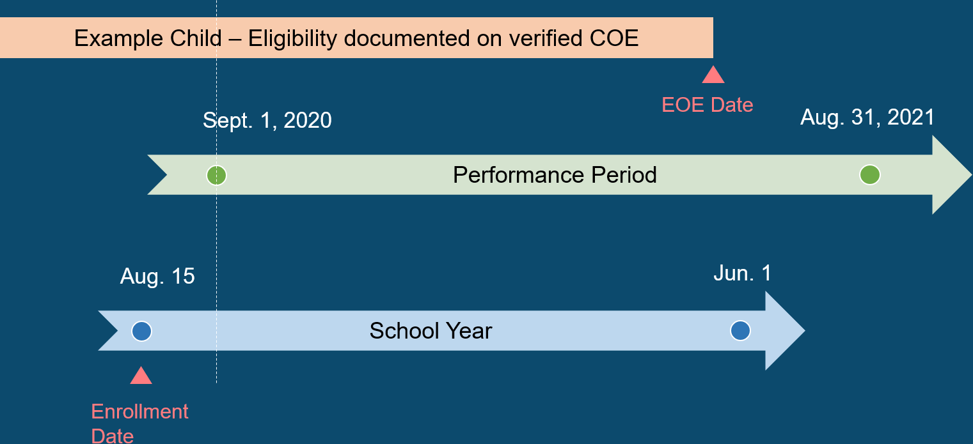
Scenario #1: Child’s eligibility expires during the Performance Period (4)
Notes:
Lead: Jose
Time: 30 secs.
Talking Points:
Earlier we talked about a window of time (in our rule of thumb).
If the dotted line is a visual limit for the beginning, now we need a limit for the end.
In this example, the child’s eligibility ends before the end of the performance period.
So, we will place a red triangle there and labeled it “EOE Date” (for End of Eligibility).
* Note that we have several terms that mean the same thing as “End of Eligibility.” When a child’s QAD expires, that marks the end of their eligibility. When a secondary student graduates, that marks the end of their eligibility. And, if a child passes away, that also marks the end of their eligibility. (Victor will talk a bit more about this later in the presentation).

Slide 23

Scenario #1: Child’s eligibility expires during the Performance Period (5)
Notes:
Lead: Jose
Time: 30 secs.
Talking Points:
Now we will add a dotted line as visual reference of the end.
The “window of time” that we referenced earlier is now framed by the two dotted lines.
If we have dates that fall within this window of time, the dates can be used as evidence that the child was both eligible and present in California.

Slide 24
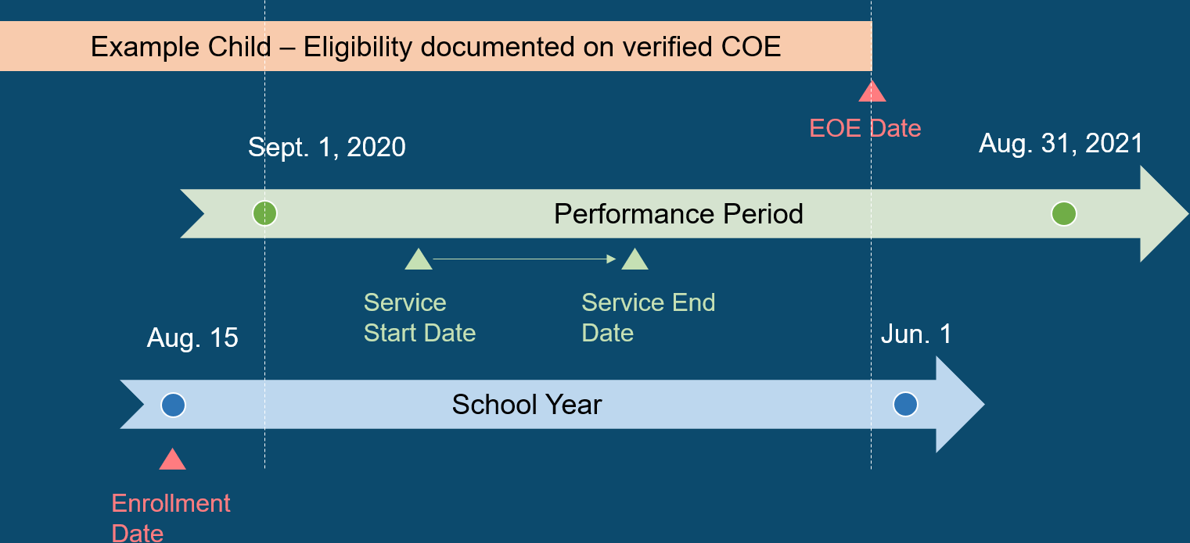
Scenario #1: Child’s eligibility expires during the Performance Period (6)
Notes:
Lead: Jose
Time: 30 secs.
Talking Points:
Now we are going to add a service to this child’s record.
A service includes both the service start date and the service end date.
Question: What do you think? If this child was served during the performance period, does that show that they were eligible and present?
Answer: Yes. Currently (for the 2020-21 Performance Period) we convert service dates to residency verification dates because you can reasonably assume that a child is to present in order to be served. Generally, MEP services have been designed that way.

Slide 25
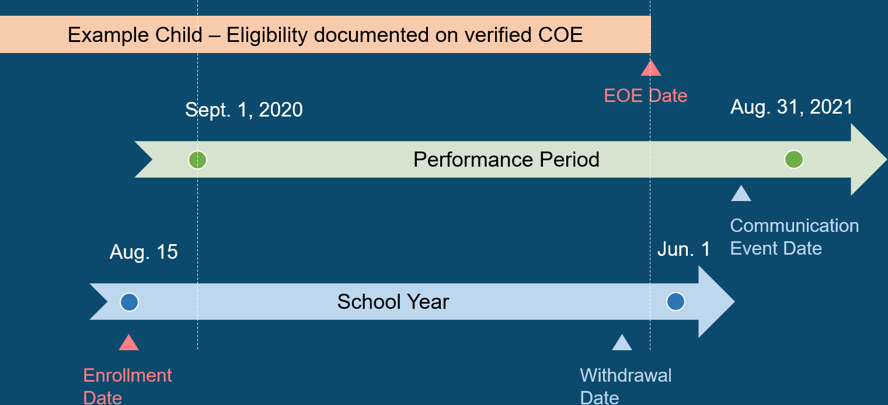
Scenario #1: Child’s eligibility expires during the Performance Period (7)
Notes:
Lead: Jose
Time: 30 secs.
Talking Points:
In this slide, we have removed the service dates and added two other dates:
a communication event and
2) a withdrawal date.
Question 1: Looking at the communication event, can we use it to show that the child was present?
Answer 1: No, because the communication event falls outside the “window of time” when the child was eligible for MEP services.
Question 2: How about the withdrawal date? Can we use it to show that the child was present during the performance period?
Answer 2: Yes, because the withdrawal date is within the “window of time” when the child was still eligible for MEP services.

Slide 26
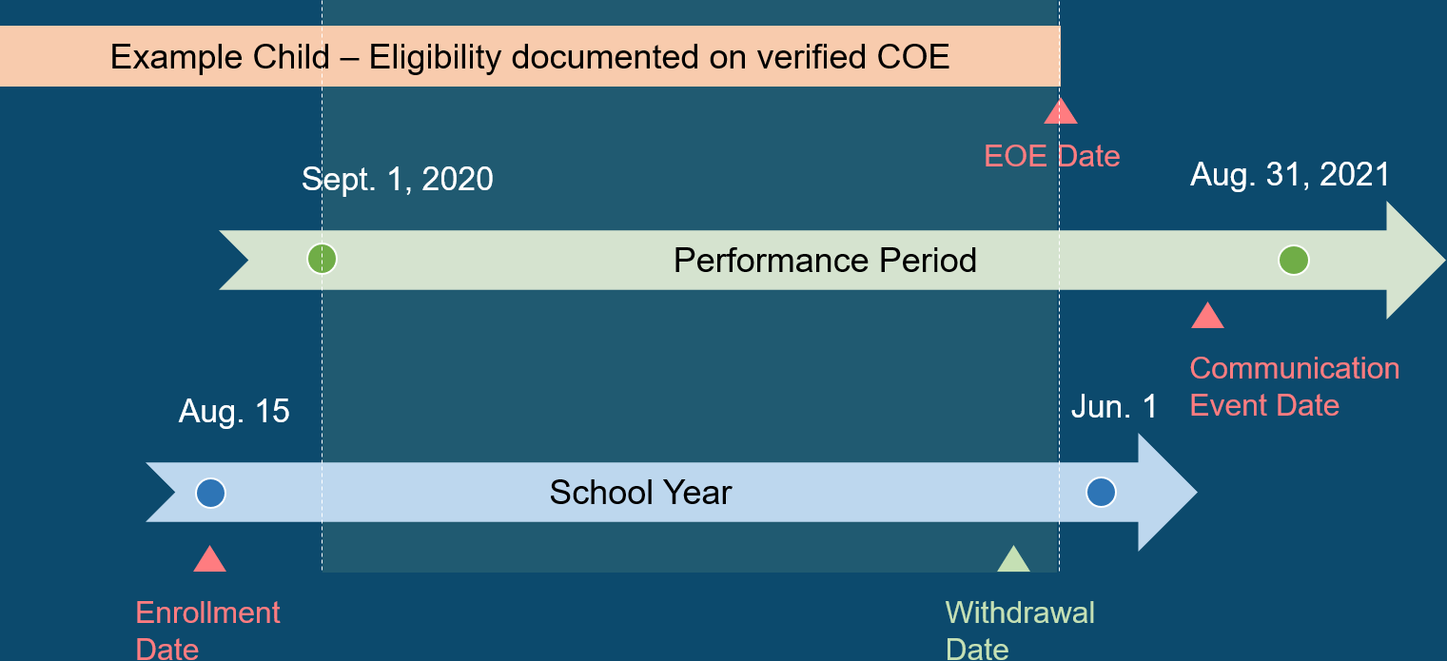
Scenario #1: Child’s eligibility expires during the Performance Period (8)
Notes:
Lead: Jose
Time: 30 secs
Talking Points:
Now, let’s stop for a minute to summarize what we’ve learned so far using this example (Scenario #1).
Recalling our rule of thumb, we are going to highlight the “window of time,” during this performance period, when the child was eligible for MEP services.
Within the shaded region, we can easily see that only the withdrawal date is usable (as proof that the child was present).
The other two dates, Enrollment Date and Communication Event Date, are outside of our “window of time.”
Next, we’re going to look at the definitions again to see how much we’ve covered with Scenario #1.

Slide 27

What are MEP child counts? (2)
  Category 1: The unduplicated statewide total of children or youth who...
    were eligible for the MEP (based on verified Certificates of Eligibility) during the Performance Period (e.g., 9/1/2020 – 8/31/2021), AND
    resided in the State one or more days during the Performance Period, AND
    were ages 3 through 21 during the Performance Period.
  Category 2: Subset of Category 1 AND the children or youth were served one or more days in a MEP-funded summer or intersession program(s) during the Performance Period.
Notes:
Lead: Jose
Time: 1 min
Talking Points:
Returning to the slide with Category 1 and Category 2 definitions, we have covered the first two factors in detail.
In Scenario #1, the child was eligible for most of the Performance Period (factor 1) AND we have a Withdrawal Date as evidence that they lived in the State one or more days during the Performance Period.
Next, we will turn our attention to the third factor, which is age.
Fortunately, this one is pretty easy.
We simply use the child’s DOB to figure out if they are too young to be counted, or they happened to turn 3 years old during the Performance Period, or they were older than 3 during the Performance Period, or they turned 22 during the Performance Period.
The following slides will cover the most common scenarios we see in California. At the same time, we will practice including the child’s age.

Slide 28
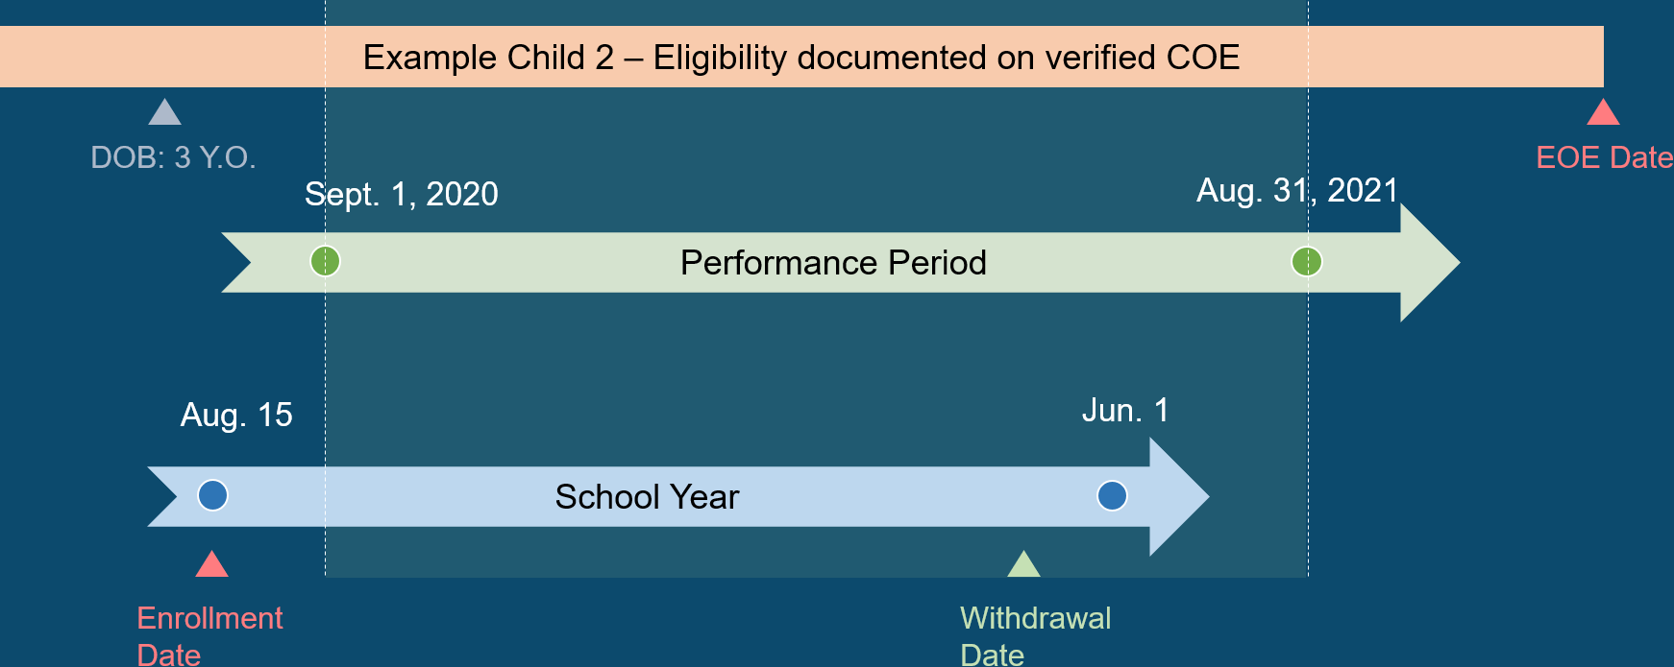
Scenario #2: Child age 3 or older before the PP and eligible for entire PP
Notes:
Lead: Jose
Time: 2 mins.
Notes:
(Walk through graphic and explain which dates can be used as evidence of presence in the PP.)

Slide 29
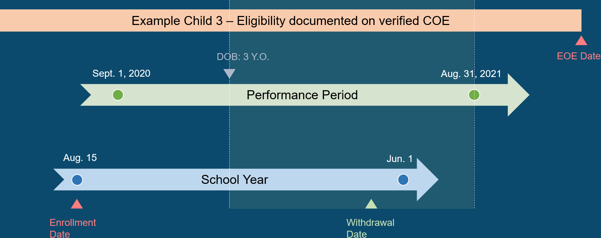
Scenario #3: Child turns 3 years old during the Performance Period
Notes:
Lead: Jose
Time: 2 mins.
Notes:
(Walk through graphic and explain which dates can be used as evidence of presence in the PP.)

Slide 30
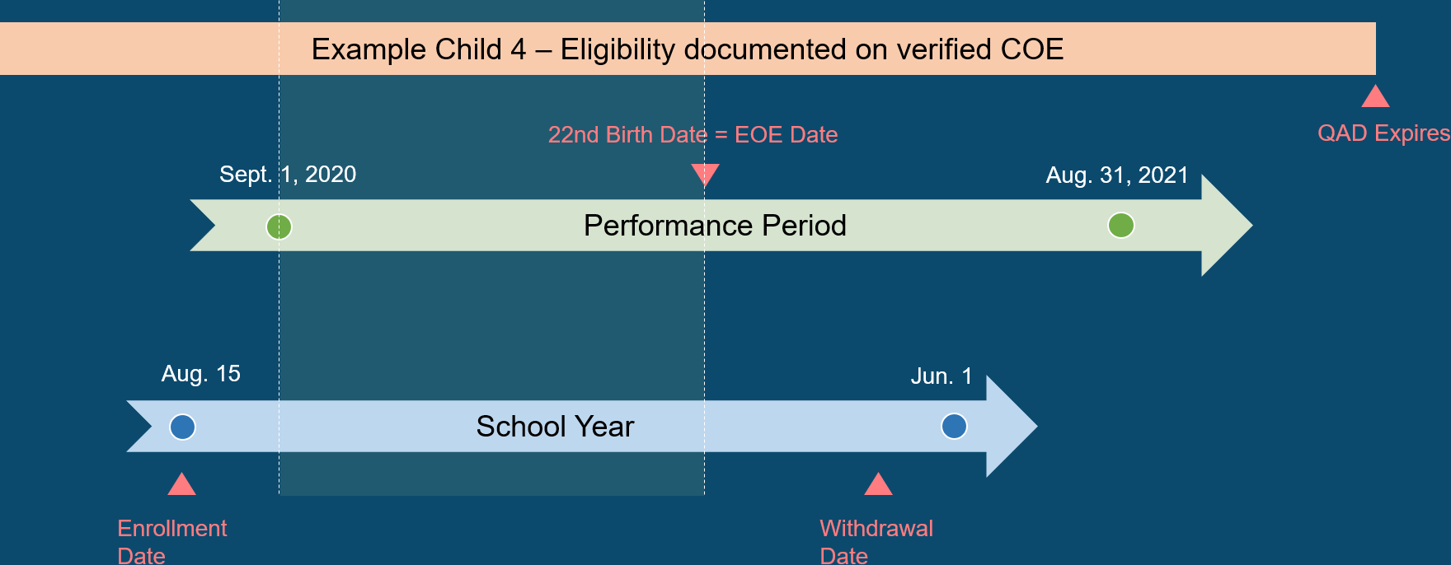
Scenario #4: Youth turns 22 years old during the Performance Period
Notes:
Lead: Jose
Time: 2 mins.
Notes:
(Walk through graphic and explain which dates can be used as evidence of presence in the PP.)
“You will notice that something interesting happened in this scenario. Normally, a child’s eligibility will end 36 months after their QAD. But sometimes it can end earlier.”
Show MDE document (optional) and read definition of MDE 26, Eligibility Expiration Date (EED). Point out that there are several ways that a child’s eligibility can end prematurely.

Slide 31
Clarification: Equivalent Terms
End of Eligibility (EOE) = Eligibility Expiration Date (EED) = Termination Date
Examples include:
  Child’s Qualifying Arrival Date (QAD) expires (i.e., EOE is normally 36 months after a child’s QAD)
  Youth graduates or completes a high school equivalency diploma
  Youth turns 22 years old
  Parent/OSY decline participation in the MEP
  Child/youth passes away
Notes:
Lead: Victor
Time: 1 min
Notes: Read bullets

Slide 32
Key Takeaways
The date that proves presence (i.e., Residency Verification Date) must be while the child is still eligible, which means:
  After they turn 3 years old, and
  Before their “End of Eligibility” date (i.e., before their QAD expires, before graduating, before a youth turns 22 years old, or before the child/youth passes away).
Rule of thumb: Add dates to verify residency during the window of time when a child is eligible for MEP-funded services.
Notes:
Lead: Victor
Time: 2 min
When it comes to counts, the Recruiter has done the hardest part. After that, the rest of us can help maximize counts by focusing on entering dates that prove the child was present in our state, your region, your district.
A child record must have a date (i.e., “Residency Verification Date”; MDE 73) that is before their End of Eligibility (EOE) date for that child to be counted. In California, this means that we must have a Residency Date (from a COE); or an Enrollment Date or Withdrawal Date; or a Communication Event Date, before a child’s EOE date; etc.
Rule of thumb: Verify residency during the window of time when a child is eligible for MEP-funded services.

Slide 33
Questions? (2)
Notes:
Lead: Team
Time: 5 mins.
Use Q&A feature in Zoom.

Slide 34
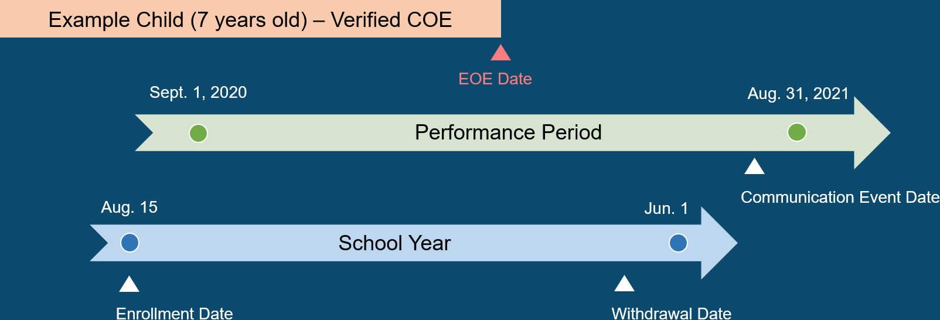
Check for Understanding (2)
  Which date(s) will make this example child part of the Category 1 Count for 2020-2021?
Notes:
Lead: Victor
Time: 3 min
Talking Points:
Show diagram and then polling question:
Which date(s) will make this example child part of the Category 1 Count for 2020-2021?
All 3 dates (enrollment, withdrawal, and communication event)
Only the communication event date
Both the withdrawal date and communication event date
None. This child does not have a date to verify residency after the start of the Performance Period and before their eligibility expired (i.e., EOE date). [answer]

Slide 35
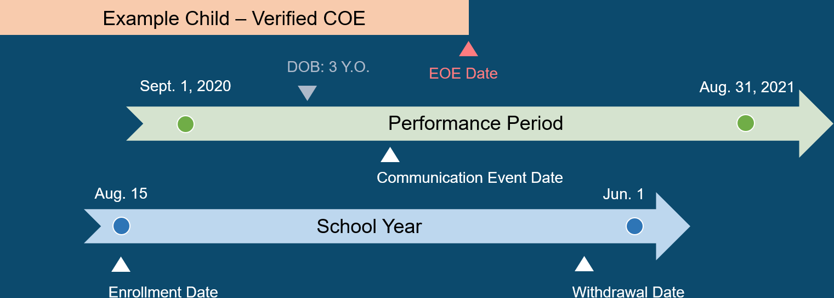
Check for Understanding (3)
  Which date(s) will make this example child (who turned 3 yrs. old) part of the Category 1 Count for 2020-2021?
Notes:
Lead: Victor
Time: 3 min
Talking Points:
Show diagram and then polling question:
Which date(s) will make this example child (who turned 3 yrs. old) part of the Category 1 Count for 2020-2021?
Both the communication event date and the withdrawal date
Only the communication event date [answer]
Only the withdrawal date
None of the above

Slide 36

Category 2 Count Rules in MSIN & MSIX
Notes:
Transition Slide
Lead: Victor
Time: 10 secs.

Slide 37


What are MEP child counts? (3)
  Category 1: The unduplicated statewide total of children or youth who...
    were eligible for the MEP (based on verified Certificates of Eligibility) during the Performance Period (e.g., 9/1/2020 – 8/31/2021), AND
    resided in the State one or more days during the Performance Period, AND
    were ages 3 through 21 during the Performance Period.
  Category 2: Subset of Category 1 AND the children or youth were served one or more days in a MEP-funded summer or intersession program(s) during the Performance Period.
Notes:
Lead: Victor
Time: 1 min
Talking Points:
We’ve already covered the definition of CAT 1, so now we’re going to see the definition of CAT 2.
CAT 2 is a subset of CAT 1 and the only difference is that the children received 1 or more days of a MEP-funded summer or intersession service during the Performance Period.
We’re going to take a look at an example of what CAT 2 looks like with timelines.

Slide 38
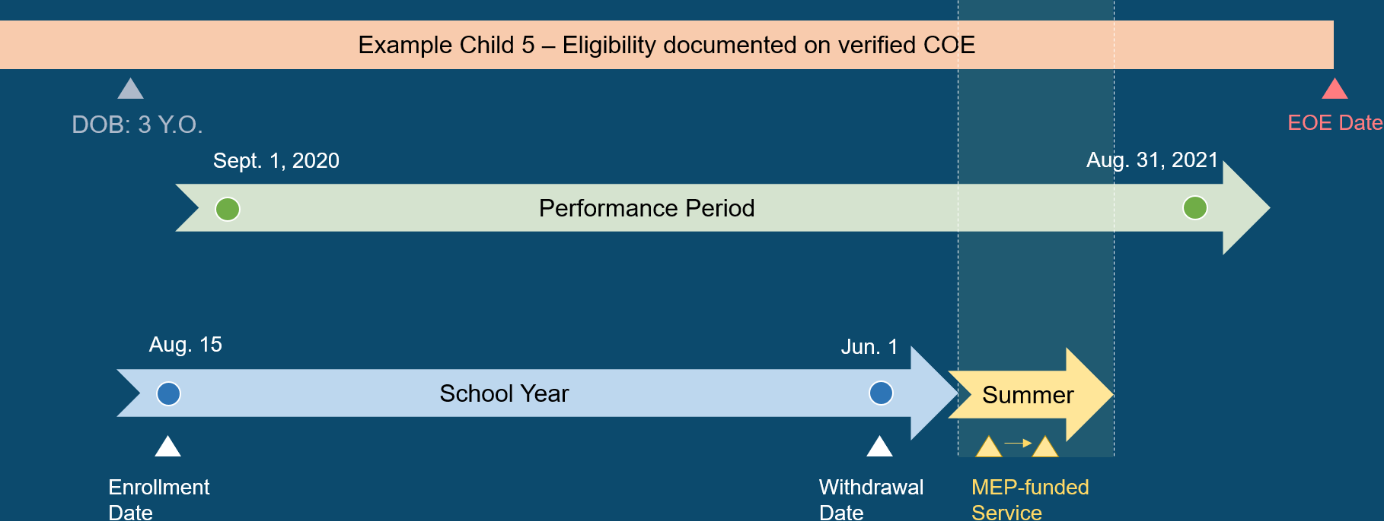
Scenario #5: Child age 3 or older, eligible entire PP, and served in Summer
Notes:
Lead: Victor
Time: 3 minutes
Notes:
To be counted in Category 2, the child must already meet the Category 1 criteria (eligibility-presence-age), AND they were also served in the Summer or Intersession.
Summer and Intersession periods are determined by local district calendars.
Also, Intersession is only for year-round schools.

Slide 39
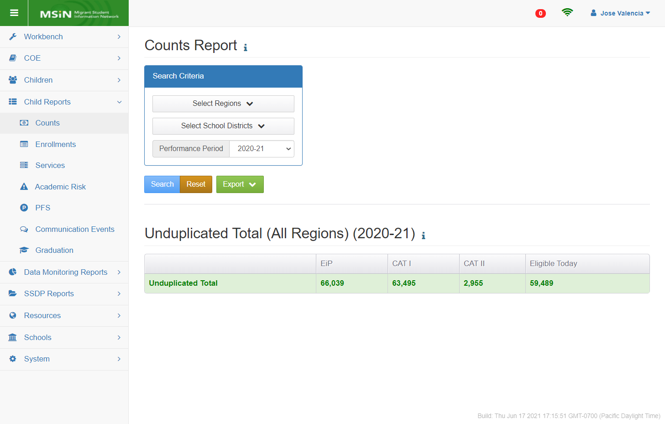
Demonstration: MSIN Child Counts
Notes:
Transition Slide
Lead: Victor
Time: 10 secs.

Slide 40

Child Count Categories
Notes:
Lead: Victor
Time: 2 minutes
Talking Points:
EiP stands for “Eligible in Period” which also means Eligible and Present. This is the group of children, ages 0-21.999, that were both eligible for at least one day in the performance period and their residency was verified while they were still eligible.
The most common way to verify residency is by completing an Annual Verification (a.k.a., Annual Contact).

Slide 41
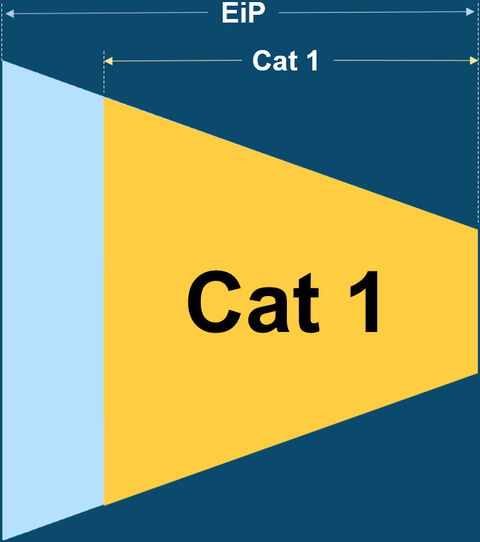
Child Count Categories (2)
Notes:
Lead: Victor
Time: 2 minutes
Talking Points:
Category 1 is a subset of EiP. Category 1 includes all 3 factors that we saw in the definition: Eligible (COE) + Present (residency verified) + age 3-21.999 (DOB).
Note that this child count must be unduplicated (i.e., each child is counted only once in the State).

Slide 42
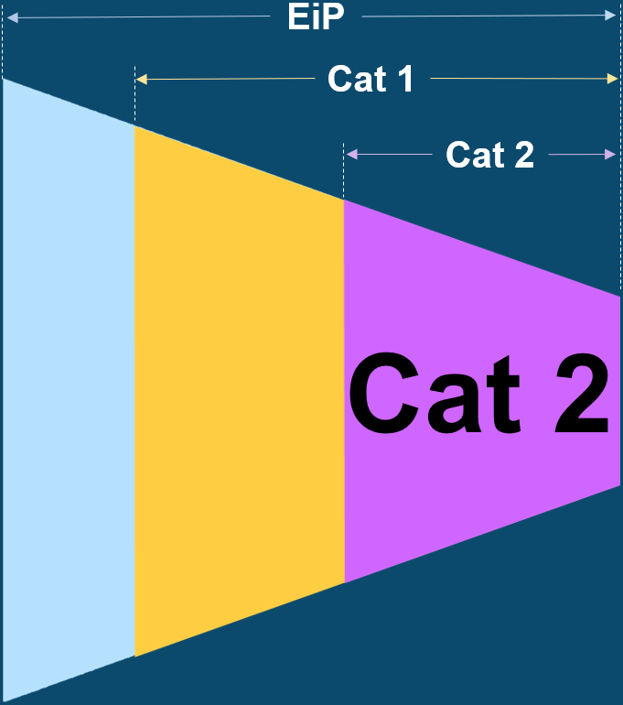
Child Count Categories (3)
Notes:
Lead: Victor
Time: 2 minutes
Talking Points:
Recap what each category means and how we calculate it in MSIN.
EiP – Eligible in Period (Eligible and Present; includes ages 0-2)
Category 1 – Subset of EiP; aged 3 through 21; unduplicated statewide
Category 2 – Subset of Category 1; served in summer or intersession
Transition over to Jose.

Slide 43
What are the rules MSIN uses to determine the unduplicated child count for Category 1?
The Category 1 count includes children who met all the rules in the EiP column, then all the rules in the CAT 1 column, as follows:
Be on a verified COE with a valid QAD (expiration date or termination within or after the PP);
Have a Residency Verification Date within the PP (must be after turning 3 years old and before their eligibility expires);
Be ages 3 – 21.999 during the PP;
Passed the de-duplication process in MSIN; and
Counted only once in the State (i.e., unduplicated count).
Notes:
Lead: Jose
Time: 2 min
Talking Points:
“Let’s review. This slide is a summary of the rules for Category 1, since it is the most important count.”
Read bullets
“Note that subgrantees have greatest influence over the second bullet, which is entering different dates that could be used to verify residency.”
“The fourth and fifth bullets are ongoing processes within MSIN. Resolving duplicates is a task carried out by the system and your Data Specialists. And counting the children only once in the State is handled by the code in the report.”

Slide 44
What are the rules MSIN uses to determine the unduplicated child count for Category 2?
The Category 2 count includes children who met all the rules in the CAT 1 column and the additional rules in the CAT 2 column, as follows:
Are already counted in Category 1; and
Were served by the MEP during the Summer; or
Were served by the MEP during an Intersession (applies only to year-round schools); and
The service dates are within the PP; and
The service dates are after age 3 and before age 21.999.
Notes:
Lead: Jose
Time: 2 min
Talking Points:
“Let’s review the rules for the Category 2 count.”
Read bullets

Slide 45
Questions? (3)
Notes:
Lead: Team
Time: 3 mins.
Use Q&A feature in Zoom

Slide 46
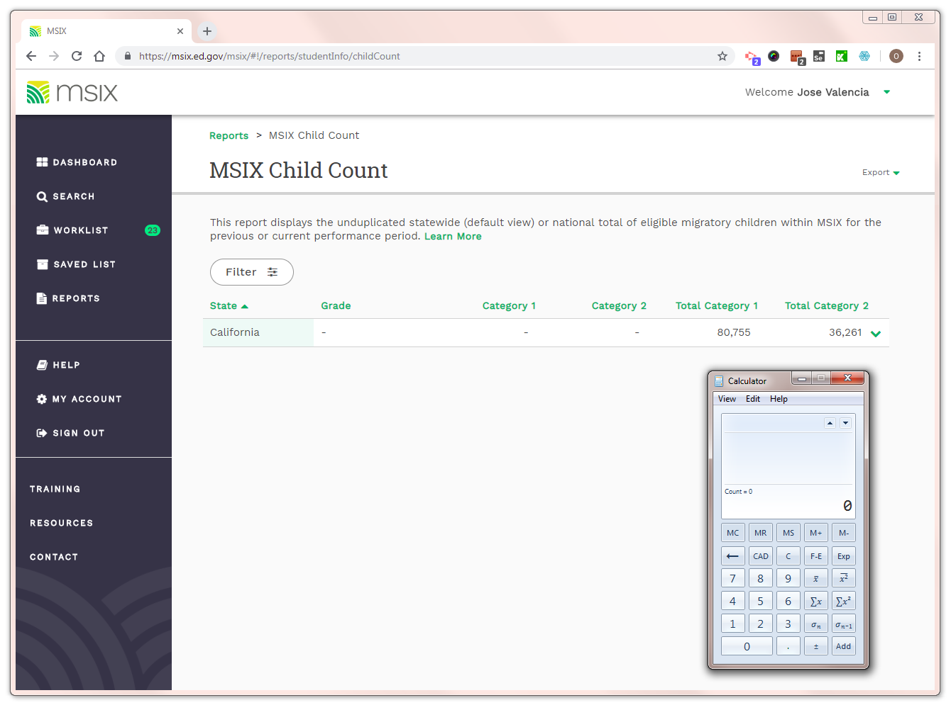
MSIX Demonstration: Child Counts
Notes:
Lead: Heather
Time: 30 secs.
Talking Points: Next, we will demonstrate how the MSIX system shows MEP child counts.

Slide 47
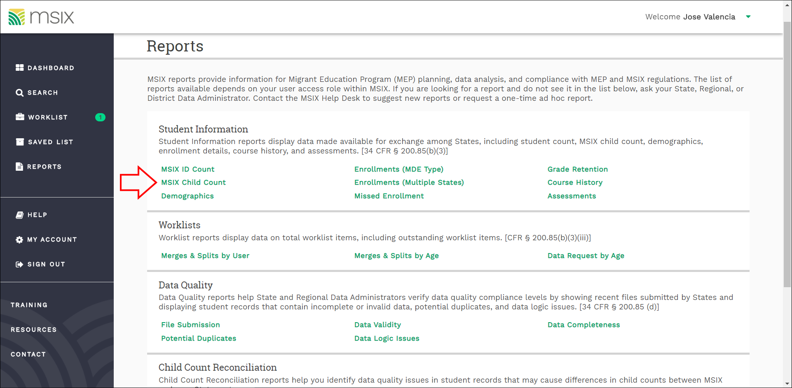
MSIX Child Count Report
Notes:
Lead: Heather
Time: 30 secs.
Talking Points:
Under the “Reports” menu, you can find the “MSIX Child Count” link.
Placeholder Note: Depending on your user role you will have access to this report.

Slide 48
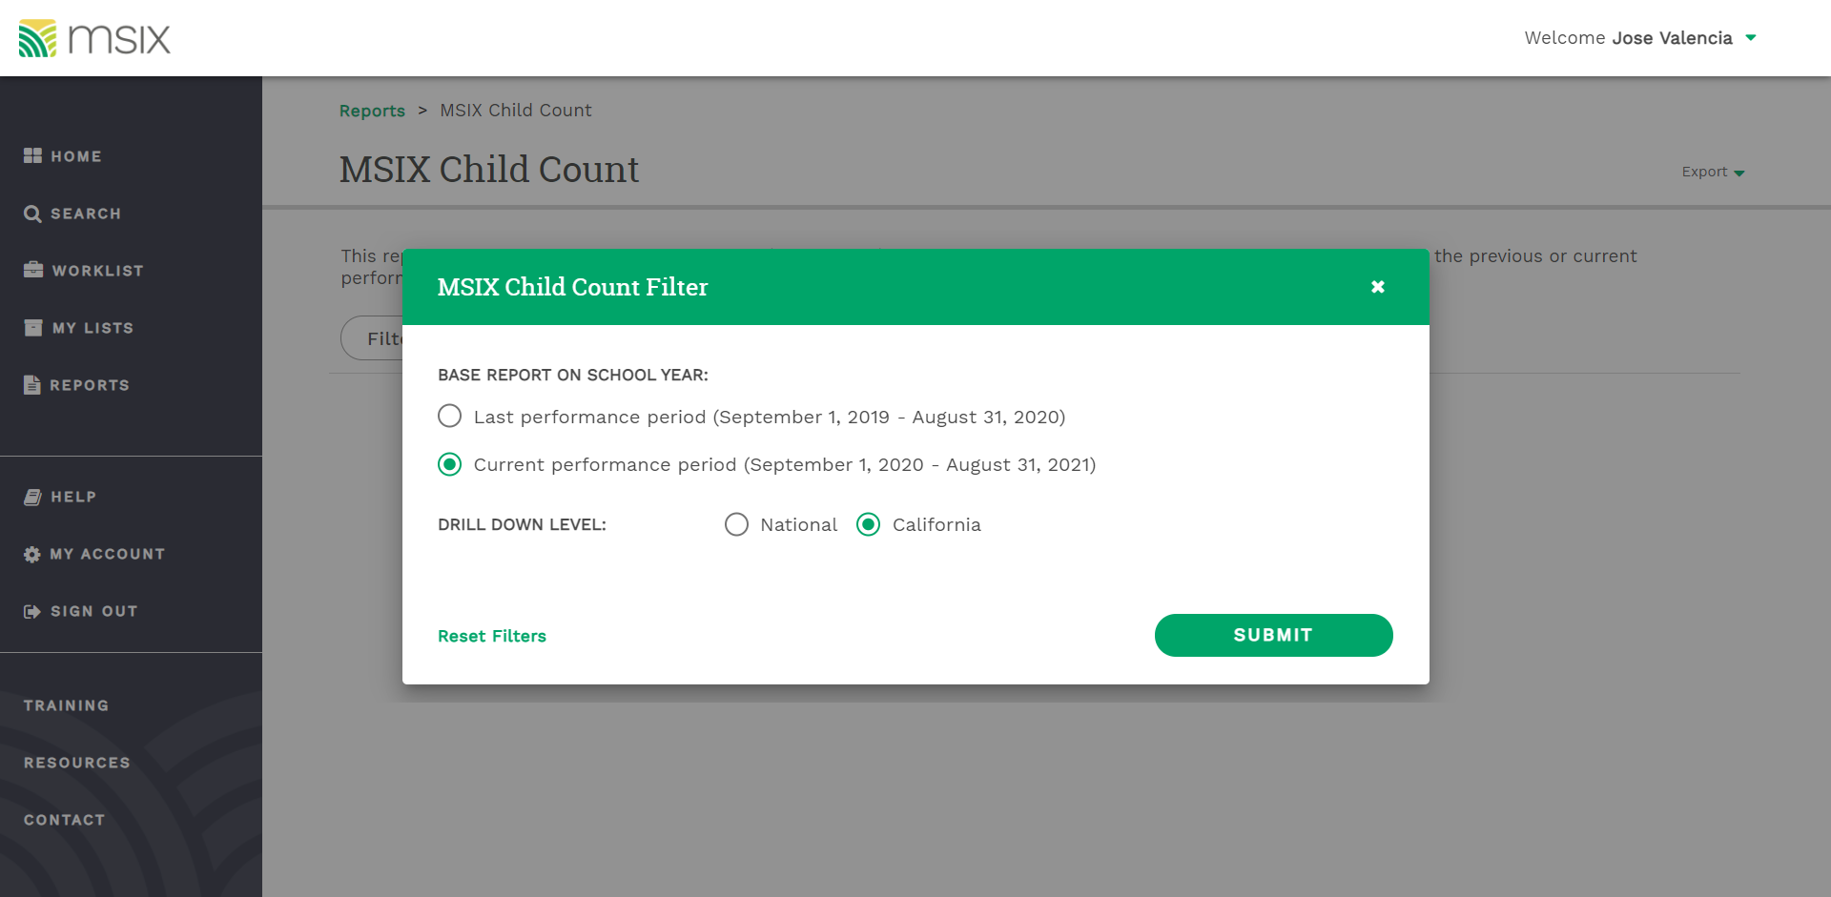
MSIX Child Count Report (2)
Notes:
Lead: Heather
Time: 45 secs.
Talking Points:
By default, this report shows the most recent completed performance period.
Here, we clicked on the “Filter” button to change the report to the current performance period (2020-21).

Slide 49
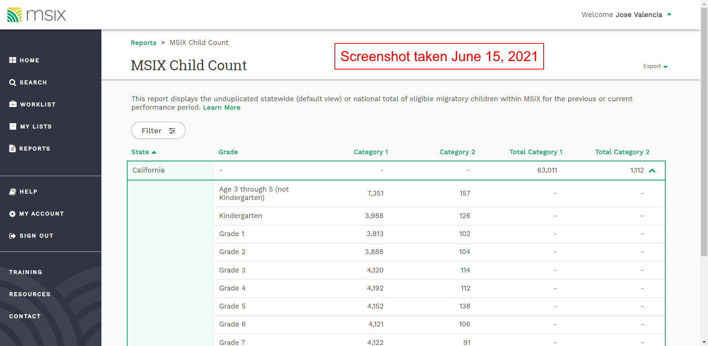
MSIX Child Count Report (3)
Notes:
Lead: Heather
Time: 1 min.
Talking Points:
This screenshot was taken in mid-June, so the Category 2 Counts were still low.
Note that this reports breaks down the counts by age/grade (not be region or district). It only shows statewide totals.
Also note that the first age/grade category is “Age 3 through 5 (not Kindergarten).”

Slide 50
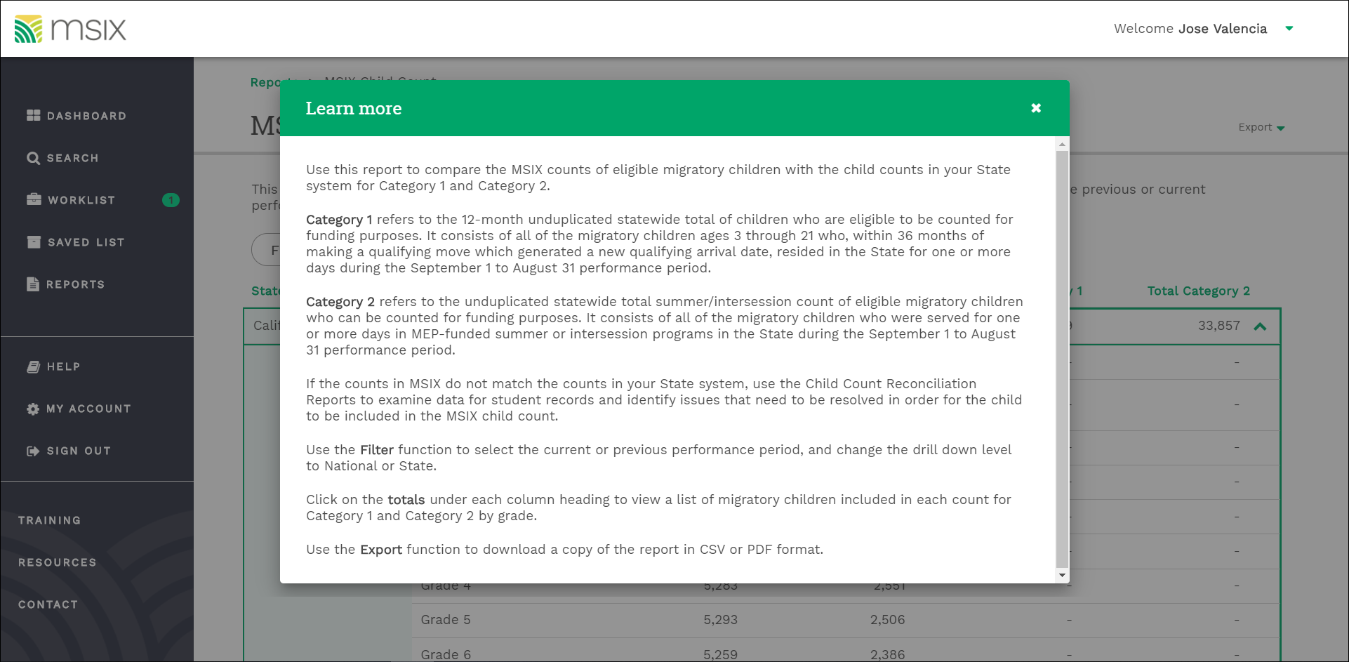
MSIX Child Count Report (4)
Notes:
Lead: Heather
Time: 2 mins.
Talking Points:
You can click on the “Learn more” link to bring up the definitions of Category 1 and Category 2 used in the MSIX system.
If you want even more details, there is guide under the “Resources” menu that describes exactly how they use certain MDE’s to calculate the counts.

Slide 51

Child Counts in State Reports
Notes:
Lead: Heather
Time: 30 secs.
Talking Points: Next, we will demonstrate how the MSIX system shows MEP child counts.

Slide 52
FAQ: Why don’t the child count totals match up across reports?
  Each report has a specific purpose. This means the criteria for counting children will vary across reports, rendering them incomparable.
  For example, the Subgranting Report is meant to help subgrantees calculate grant amounts using a formula with several different types of child counts.
  In contrast, the Demographic Profile (by school) is meant to help subgrantees plan programs by showing how many children they have by school and age/grade. This report is based on the child’s date of birth (DOB) and enrollment data.
Notes:
Lead: Meena
Time: 2 mins
Tips & Clarifications:
Carefully read the definitions provided with each report.
RA/DSA reports are based on the most recent Performance Period (i.e., a complete year of data).
Reports are only as accurate as the data entered in MSIN (e.g., age/grade alignment).

Slide 53
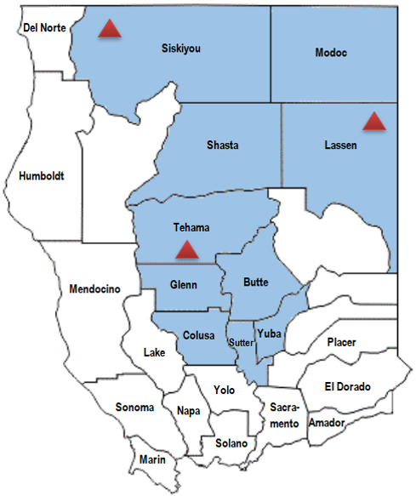
FAQ: What Is the difference between a duplicated and an unduplicated count?
  - Pepe Gomez (student)
  At the regional level (R02):
  Duplicated Count = 3
  Unduplicated Count = 1
Notes:
Lead: Meena
Time: 2 mins.
Talking Points:
Subgrantees get funds based on unduplicated counts (each child counted only once at the regional or DFD level).
Subgrantees then distribute funds to districts based on all the places where the child lived and was enrolled (duplicated counts).
Tip: When reviewing reports, take notice of whether the counts are duplicated or unduplicated.

Slide 54
FAQ: Why are the counts in assessment reports lower?
  The assessment reports in your RA/DSA packet (i.e., RAADS, DAADS, ELPAC, etc.) will have lower student counts than your subgranting and profile reports because:
  Migratory children move often and may miss assessment windows.
  Children are matched to their assessment results using their Statewide Student Identifier (SSID), but only if this number is verified as belonging to the correct child.
  Some subgrantees have large non-attending populations that would not be assessed (e.g., Pre-K children and OSYs).
Notes:
Lead: Meena
Time: 2 mins.
Tips & Clarifications:
Assessments are given to students based on an annual calendar. Because migratory children move often, they may miss assessment windows.
Each migratory child is matched with their assessments results (if taken) by using their California State Student Identifier (SSID). If the child does not have an SSID or WestEd cannot validate their SSID using matching tests, then we will not have assessment results (i.e., were not able to reliably link the child to their results).
Many migratory children are non-attending and would not be assessed. CAASPP assessments are given to grades 3-8 and 11. The ELPAC is given to grades K-12 (an initial upon arrival to a California school and a summative annually).

Slide 55
Questions? (4)
Notes:
Lead: Team
Time: 3 mins.
Use Q&A feature in Zoom

Slide 56

Next Steps & Considerations
Notes:
Transition Slide
Lead: Juli
Time: 10 seconds

Slide 57
How Subgrantees Can Maximize Their MEP Child Counts
  Train local MEP staff to understand the child count rules, especially staff who enter Enrollment Lines, Communication Events, and Services.
  Make sure Annual Verifications (or other Communication Events) are done after a child turns 3, before the child's EOE (End of Eligibility) date, and within the Performance Period.
  Use MSIN Data Monitoring Reports – particularly R Enroll, not EiP and N Enroll, not EiP – to determine which children/youth still need a date to be counted in the PP.
Notes:
Lead: Juli
Time: 2 min
Talking Points:
Read bullets and after first bullet say: It is very important to train local staff, much like we have done here. Feel free to use this PowerPoint.
Remind audience that we are having a Data Close and Data Monitoring Report webinar next month and it covers the Data Monitoring Reports in detail.
To get a head start on the Data Close Deadline, remember to:
Resolve any pending duplicates (because children in the de-duplication queue will not get counted);
Finish verifying any pending COEs (so the children will be eligible in the current performance period).

Slide 58
MSIN Data Privacy and Security
Every MSIN user must follow all local and state measures to protect student data, including (but not limited to) the following:
Never share access to the MSIN (your username and password).
Consider your location when viewing confidential data (anything in the MSIN); others should not be able to see what is on your screen.
Do not email electronic versions of forms and reports (e.g., PDFs, Excel files) unless they are encrypted per CDE standards.
Notes:
Lead: Juli
Time: 2 mins.
Talking Points:
Remember that the MSIN system contains PII for thousands of migratory children and youths, so data security is of paramount importance.
(Read or paraphrase bullets. List continued on next slide.)

Slide 59
MSIN Data Privacy and Security (2)
Store paper forms and reports in a secure location (locked cabinet).
Shred paper forms and reports that are no longer needed, as the MSIN stores electronic versions of Certificates of Eligibility (COEs) and Individual Needs Assessments/Individual Learning Plans (INA/ILPs).
Routinely check your computer’s downloads folder(s) and delete any files that contain PII, whether they are from MSIN or any other student data system.
Notes:
Lead: Juli
Time: 2 mins.
Talking Points:
(Read or paraphrase bullets.)
When conducting local training sessions, please reiterate these points so that all MSIN users hear this repeatedly.
From Elizabeth Wisnia’s presentation on data privacy and security:
“If PII must be collected, CDE is responsible for protecting such data from unauthorized access. If data is collected and stored electronically, passwords, encryption, and other means for electronically limiting access to PII should be employed. If hard copies of the data are collected, such results should be stored in a secure, locked area that is only accessed by authorized personnel. Anyone with access to the data should be properly trained on privacy laws and policies related to data privacy.”
“Occasionally, you may have a legitimate need to print/work with hard copies of confidential data. In such instances, consider where you might securely store such data when the data is not in use. Hard copies of confidential data should only ever be in one of three places: (1) In your hands, (2) In a locked cabinet/secure room, (3) In the shredder. Treat hard copies of confidential data like cash. If you wouldn’t leave a $100 bill sitting unattended and exposed in an insecure location such as your vacant desk, you shouldn’t leave confidential data there either.”
“In this era of smart phones and other ever-present photo/recording devices, please also consider acceptable locations to peruse confidential data. If you’re in a public coffee shop or have a desk with a window that faces a busy street (for example), consider moving to a private location or reconfiguring your desk so that those with too much curiosity or nefarious intentions won’t have access to the confidential information you are reviewing.”
Juli will select which sentences to use or may add her own.

Slide 60
Additional Resources
Subgrantees may use this presentation to train local MEP staff.
User guides, reference documents, and “how-to” videos are found on the MSIN home page.
If any questions arise, MEP staff should consult with their supervisors or local MSIN Power Users first. Remaining questions can be submitted to the MSIN Service Desk.
Notes:
Lead: Juli
Time: 3 min.
Talking Points:
This PowerPoint and supporting materials will be posted on Digital Chalkboard.
In addition to the user guides, remember that definitions, rules, and other information is readily accessible within most screens by clicking the “i” icon next to field titles.
The Training MSIN site is always available so that you can practice and brush up on system features.

Slide 61
Contact Information
Juli Auld
Education Research and Evaluation Consultant
California Department of Education
jauld@cde.ca.gov
916-319-0410
__________________________________________________
MSIN Service Desk
MSINsupport@wested.org
1-800-342-2964, option 2
Notes:
Lead: Juli
Time: 30 secs.
Talking Points:
Thank participants for attending.
Thank WestEd technical staff who assisted with the webinar.

