Slide 1
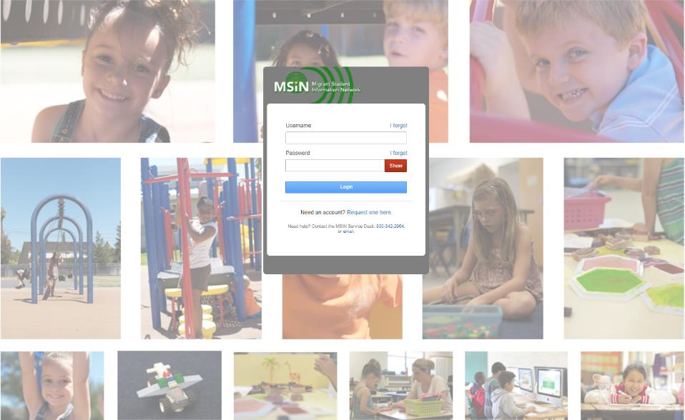
Welcome to the Migrant Student Information Network
2022 Training
We will begin shortly.
Please enter your name and region/district in the chat.

Slide 2
Migrant Student Information Network:
Using Reports to Plan Program Participation and Monitor Migratory Child Data
January 27, 2022
1:00 p.m. – 3:00 p.m.
Notes:
Lead: Victor

Slide 3



Welcome and Introductions
Session Presenters
Juli Auld, Education Research and Evaluation Consultant, California Department of Education (CDE)
Jose Valencia, Migrant Student Information Network (MSIN) Lead, WestEd
Victor Garibay, MSIN Specialist, WestEd
Notes:
Lead: Juli
Time: 3 mins.
Talking Points:
Welcome participants.
Presenters introduce themselves

Slide 4
Purpose
This webinar will review the reports in the MSIN system that are meant to help managers plan program participation, meet the State Service Delivery Plan (SSDP) Measurable Program Objectives (MPOs) and monitor data entry tasks in their region or Direct Funded District (DFD).
The target audience is MEP managers and supervisors.
Notes:
Lead: Juli
Time: 1 min
Talking Points:
(Read or paraphrase bullets)
The session content is a review of key items taken from last year’s training series.
This year, the focus is on sharing and collaborating with your peers.
This session is meant for experienced MSIN users who already have a working knowledge of the reports in the MSIN system.

Slide 5
Session Objectives
Participants will
Review the report categories in the MSIN system;
Review a sample of reports that can help managers plan program participation;
Review a sample of reports that can help managers monitor data entry tasks, such as adding enrollments;
Share and discuss local knowledge regarding these topics; and
Review the resources available around reports in the MSIN system.
Notes:
Lead: Juli
Time: 1 min
Talking Points:
(Read or paraphrase bullets)

Slide 6

Housekeeping
Please mute your speaker in the main session.
Use the chat function to enter your questions.
Participate in breakout room activities.
The PowerPoint for this presentation can be accessed through the link provided in the chat.
Notes:
Lead: Juli
Time: 1 min.
Talking Points:
(Read or paraphrase bullets)

Slide 7
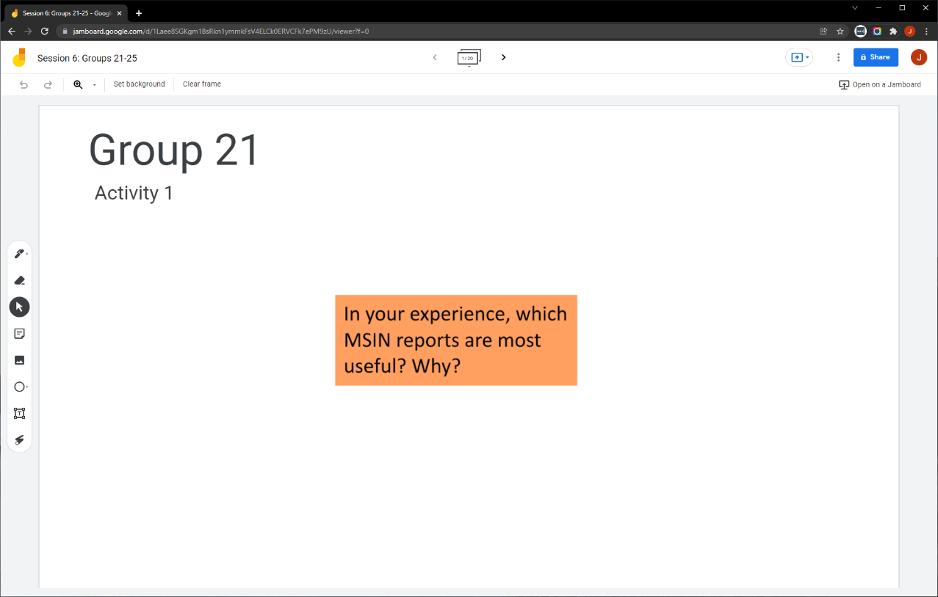
Collaborative Activity 1: Knowledge Wall
Notes:
Lead: Jose
Time: 3 mins.
Talking Points:
Our first collaborative activity is meant to tap into your collective knowledge around MSIN reports and share it with your peers. This is a “Knowledge Wall” activity.
Explain that participants will be placed in breakout rooms with 5 collaborators.
Demonstrate the activity using Jamboard: https://jamboard.google.com/d/1vlleb3II20rHSdDvTXVJopXxomei4cMTUtoMrBZfSaM/edit?usp=sharing
Focus on the prompt in the orange box. Walk through using the post-it (sticky note) and text controls to add content.

Slide 8
Activity 1 Instructions
In your Breakout Room (BR), take 2 minutes to introduce yourselves (name, region/DFD, and job title).
Open the chat window to view the instructions and links.
Click on the Jamboard link that matches your BR number (e.g., BR 21 should go to Jamboard group 21).
Keep two windows open: your BR in zoom and your activity 1 slide in Jamboard.
Add post-its (sticky notes) or text onto the wall.
Discuss your contribution(s) to the wall with the group.
Notes:
Lead: Jose
Time: 10 mins.
Talking Points:
(Read instructions on the slide.)
Send to Breakout rooms – 8 minutes
Paste the instructions in the chat for all breakout rooms.

Slide 9
Review: Report Categories
Child Reports (8) | Data Monitoring Reports (12) | State Service Delivery Plan (SSDP) Reports (15)
Reports that display a group of children based on shared characteristics or criteria. | Reports that display a group of children based on potentially erroneous or missing data. | Reports the display a group of children or services based on Measurable Program Objective (MPO) criteria.
Covered in this session: Enrollment Report Academic Risk Report | Covered in this session: Grade Age Alignment Report | Covered in this session: MPO 1.0 Report MPO 2.0 Report MPO 7.0 Report
Notes:
Lead: Jose
Time: 3 min
Talking Points:
(Read or paraphrase table contents)

Slide 10

Questions?
Notes:
Lead: Team
Time: 3 mins
Answer a few questions about the report categories, if any, or about the collaborative activity.

Slide 11
Planning Program Participation
Notes:
Transition Slide
Lead: Jose
Time: 20 secs.

Slide 12
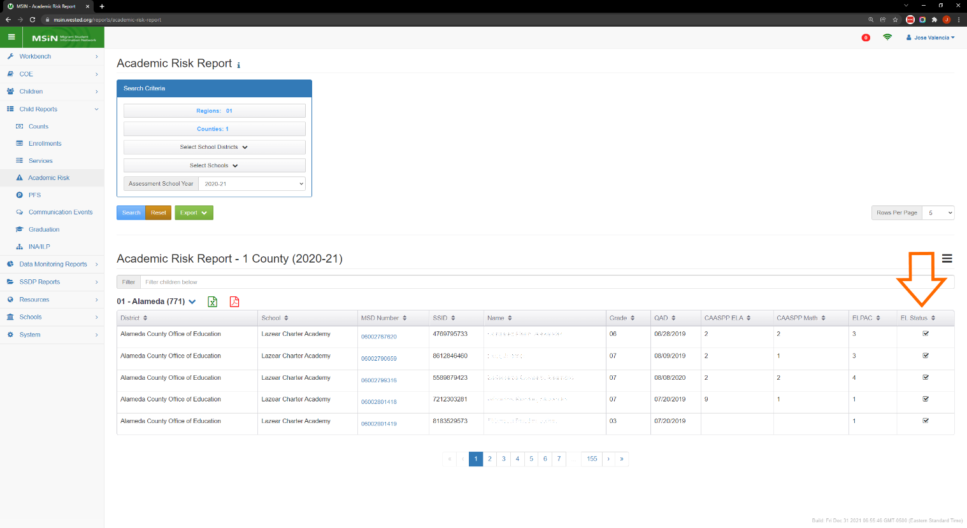
Background: Academic Risk Report
Notes:
Lead: Jose
Time: 3 min
Talking Points:
This section of the presentation will focus mostly on three MPO reports, but we need a little background information first.
Let’s start by reviewing the Academic Risk Report so that we can see how the MPO reports save time and effort when planning service participation (e.g., recruiting students for specific services).
The purpose of the Academic Risk Report is to show which children have academic risk status and why.
Looking at the screenshot, you can see that each student included in the list is below standard on at least one of the assessments (CAASPP ELA, CAASPP Math, ELPAC), and/or they have EL status.
Notice that EL is a new criterion was added for 2021-22. This information comes from CALPADS.
In general, Academic Risk is an indicator of academic need (like PFS, but with fewer criteria that focus primarily on assessments).

Slide 13
Academic Risk Report Details
This is a static annual report that becomes available in late November each year, based on a combination of MSIN child record data from the most recently completed performance period and matching assessment results from the corresponding school year.
Academic Risk is calculated in one year and applies in the following school year (e.g., if a child is assessed in 2020–21, they will be considered at-risk in 2021–22, assuming they meet all criteria).
Academic Risk status is a general indicator of academic need.
Notes:
Lead: Jose
Time: 2 min
Talking Points:
(Read or paraphrase bullets)
A word about timing: A new report becomes available each year in mid to late November (based on data from the prior performance period).
Notice that the criteria for this report is very broad. For example, if a child has Academic Risk status, knowing that is not enough to know if they are below standard on something specific, like CAASPP ELA.
As a result, this report is best for general planning purposes, such as estimating service cohort sizes when writing Regional Applications (RA) and District Service Agreements (DSA).
But to find specific children that need to be included in an ELA or a Math intervention in the current year, we recommend using the MPO 1.0 and 2.0 reports.

Slide 14
MPO Reports
MPO 1.0
MPO 2.0
MPO 5.0/6.0
MPO 5.1/6.1
MPO 7.0
MPO 8.0
MPO 9.0
MPO 9.1
MPO 10.0
MPO 10.1
MPO 10.2
MPO 11.0
MPO 11.1
MPO 13.0
MPO 13.1
Notes:
Lead: Jose
Time: 1 min.
Talking Points:
Here is a list of all the MPO reports currently active in MSIN.
Of the 15 MPO reports, we are going to talk about the 3 reports highlighted in yellow.

Slide 15
MPOs Requiring Service Hours
Some MPOs require a minimum number of service hours to meet the objective.
  MPO 1.0 – ELA Achievement (30 hrs. Regular School Year; 20 hrs. Summer)
  MPO 2.0 – Math Achievement (30 hrs. Regular School Year; 20 hrs. Summer)
  MPO 7.0 – Primary and Secondary Language Development (15 hrs.)
As a result, services mapped to these MPOs require you to select the number of hours a child participated, otherwise you cannot save the service record.
Notes:
Lead: Jose
Time: 2 min
Talking Points:
These 3 MPOs are tougher to meet because we’re also dealing with services hours, not just participation.
(Read or paraphrase the bullets.)
The extra data entry step of adding hours makes these MPOs challenging.
Tip: Use the MPO reports themselves to create the list of children to invite to your services that are designed for specific MPOs.
We can now plan precisely by knowing exactly which children to target for services.
Remember to check your attendance and follow up on absences frequently to ensure students continue to participate and meet the 30 or 20 hour targets.

Slide 16
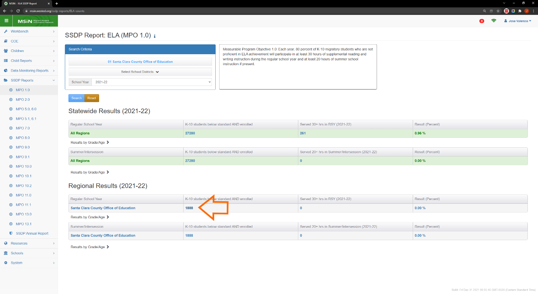
MPO 1.0 Report
Notes:
Lead: Jose
Time: 2 min.
Talking Points:
The MPO 1.0 Report uses more precise criteria than the Academic Risk Report we saw earlier.
To be included in this count (see the orange arrow), a student
must have scored below standard on the CAASPP ELA or ELPAC assessments in the prior year, and
they must be enrolled in the selected school year (2021-22 above) in grades K-10.
For more details, you can always click on the help text (i) and it explains the report logic.
Clicking on the count brings up a window with all the children who meet the criteria and will therefore be used in the calculation for the MPO 1.0 percentage.

Slide 17
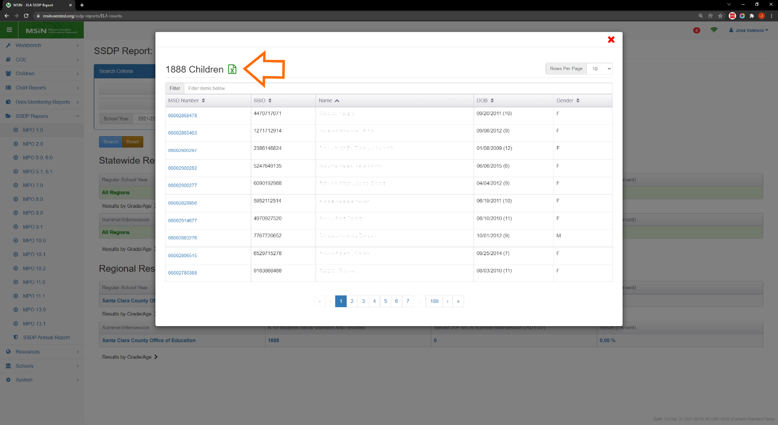
MPO 1.0 Report Export
Notes:
Lead: Jose
Time: 1 min.
Talking Points:
Here we see a screenshot of the child list that appears after clicking on the count.
Notice that you can export the entire list as an Excel file.
You can also search for an individual child in the list by typing their name or an Id number (MSD or SSID) in the filter field found just above the table.

Slide 18

MPO 2.0 Report
Notes:
Lead: Jose
Time: 2 min.
Talking Points:
The MPO 2.0 Report also uses more precise criteria than the Academic Risk Report we saw earlier.
To be included in this count (see the orange arrow), a student
must have scored below standard on the CAASPP Math (for grades 3-8) or ELPAC (for grades K-2) in the prior year, and
they must be enrolled in the selected school year (2021-22 above) in grades K-10.
For more details, you can always click on the help text (i) and it explains the report logic.
Clicking on the count brings up a window with all the children who meet the criteria and will therefore be used in the calculation for the MPO 2.0 percentage.

Slide 19
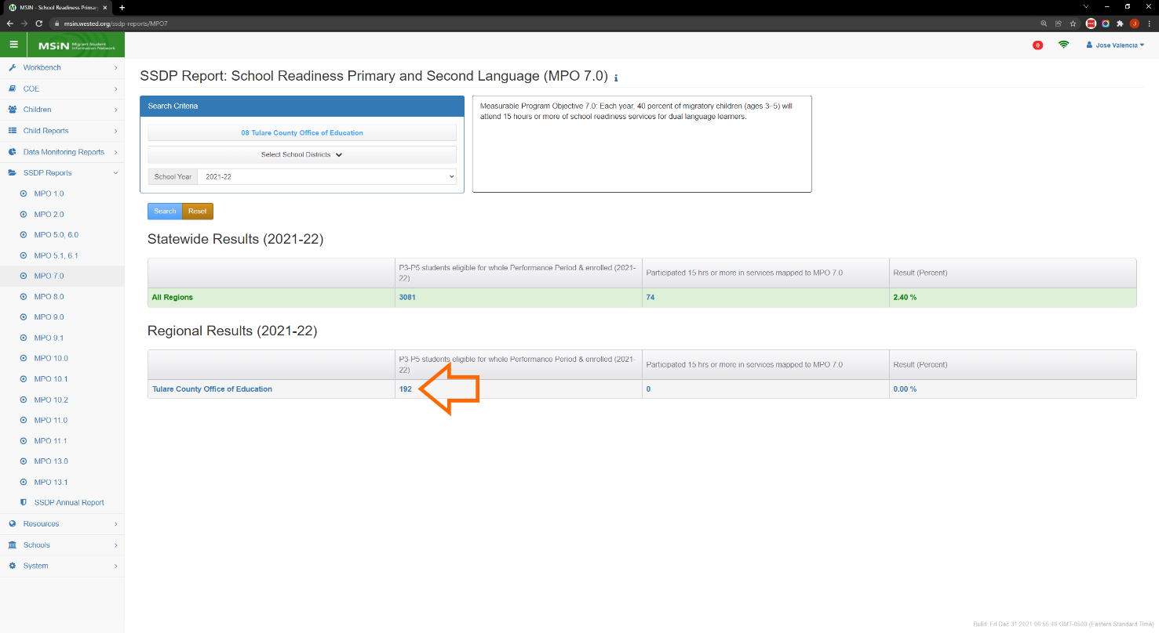
MPO 7.0 Report
Notes:
Lead: Jose
Time: 2 min.
Talking Points:
The MPO 7.0 tracks preschool grades, P3-P5, and therefore does not rely on assessments.
To be included in this count (see the orange arrow), a child
must be enrolled in the selected school year (2021-22 above) in grades P3-P5,
Must have turned 3 years old on or before 9/1 of the selected school year; and
they must not lose eligibility until after the end of the performance period (8/31 of selected school year).
For more details, you can always click on the help text (i) and it explains the report logic.
Clicking on the count brings up a window with all the children who meet the criteria and will therefore be used in the calculation for the MPO 7.0 percentage.
To recap: There are benefits to using the MPO report directly to identify which children should participate in the services you have planned.

Slide 20
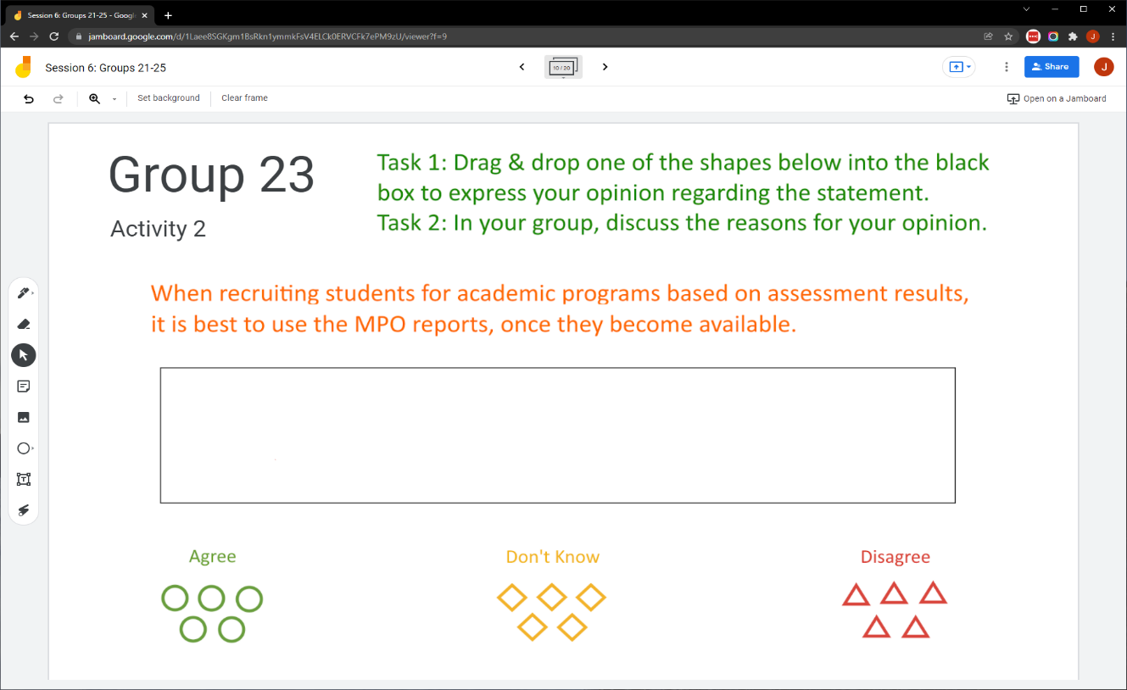
Collaborative Activity 2
Notes:
Lead: Jose
Time: 3 mins.
Talking Points:
This activity is focused on eliciting your opinion on the MPO reports and then discussing the reasons for your opinions.
Explain that participants will be placed in breakout rooms with 5 collaborators. [Randomly assigned; not the same group members as in Activity 1.]
Demonstrate the activity using Jamboard: https://jamboard.google.com/d/1vlleb3II20rHSdDvTXVJopXxomei4cMTUtoMrBZfSaM/edit?usp=sharing
Focus on the tasks in green text.
Show how to move the shapes into the black box to express your “vote.”

Slide 21
Activity 2 Instructions
A) In your BR, take 2 minutes to introduce yourselves (name, region/DFD, job title or role).
B) Open the chat window to view the instructions and links.
C) Click on the Jamboard link that matches your BR number (e.g., BR 14 should go to Jamboard group 14).
D) Keep two windows open: your BR in Zoom and your Activity 2 slide in Jamboard.
E) Select a shape and move it into the black box to express your opinion.
F) Discuss the reasons for your opinion with the group. Add post-its (sticky notes) with your reasons.
Notes:
Lead: Jose
Time: 10 mins.
Talking Points:
(Read instructions on the slide.)
Send to Breakout rooms – 8 minutes
Paste the instructions in the chat for all breakout rooms.

Slide 22
Questions? (2)
Notes:
Lead: Team
Time: 3 mins
Answer a few questions about using the MPO reports and/or the collaborative activity.

Slide 23
Check for Understanding
  Next, you will see a pop-up window with questions and response options.
  There are two questions for this section; answer them as best you can.
  You will get a warning when the poll is about to close.
Notes:
Lead: Victor
Time: 4 min
Poll Questions:
1) True or False: For 2021-22, the Academic Risk Report now includes a column for EL status.
a. True [answer]
b. False
c. I don’t know
2) The benefits of using the MPO reports to identify which children should participate in services are:
a. The MPO reports have more precise criteria than the Academic Risk Report.
b. You will know exactly which children are being used in the percentage calculation for the MPO.
c. It is easy to export the list of children who should be served as an Excel file.
d. All of the above (a, b, and c) [answer]
e. I don’t know

Slide 24

Break
Notes:
3-minute break
Stretch, grab coffee or tea, take a bio break.

Slide 25
Monitoring Migratory Child Data
Notes:
Transition Slide
Lead: Jose
Time: 20 secs.

Slide 26
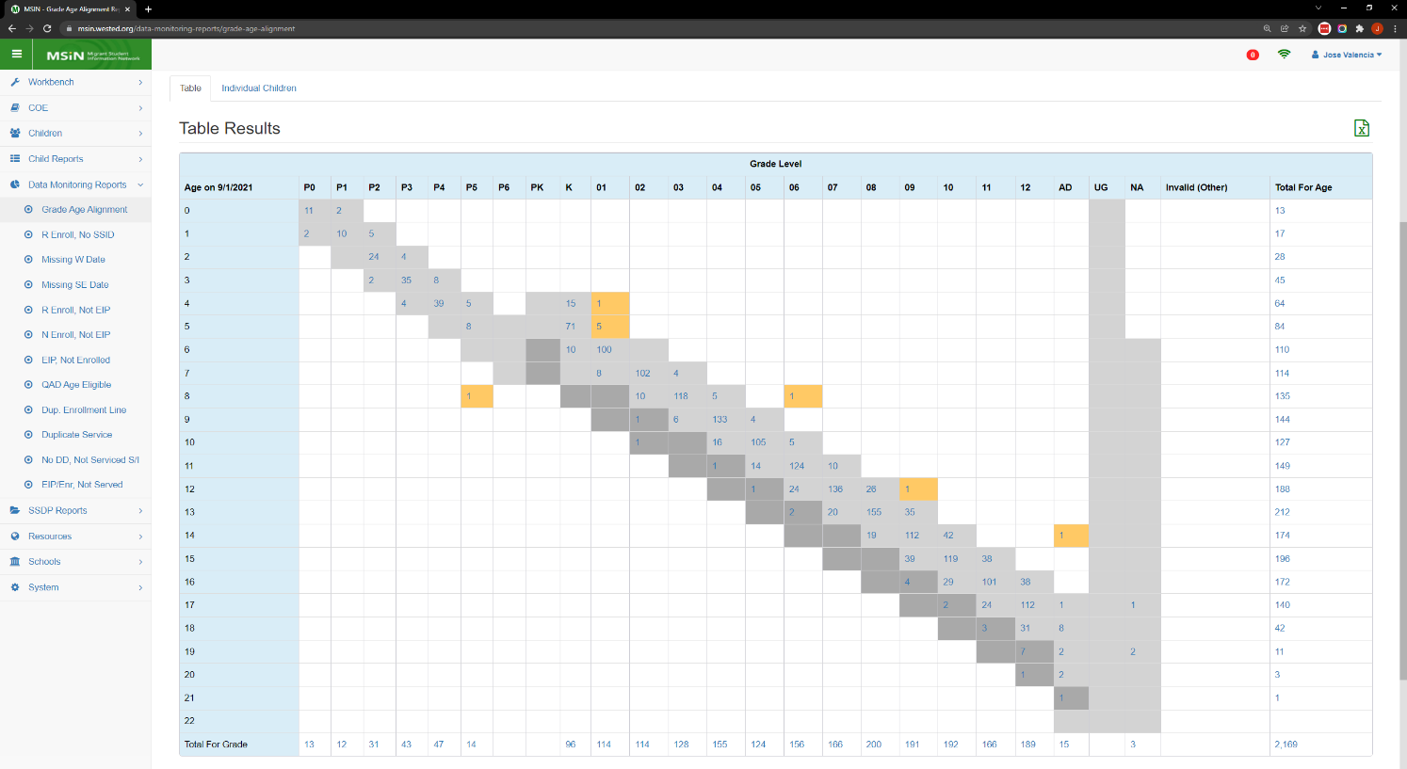
Grade Age Alignment Report
Notes:
Lead: Jose
Time: 3 min
Talking Points:
The Grade Age Alignment report provides users with a cross-tab chart with the grade levels on the x-axis and the Age along the y-axis.
The report is intended to examine, and correct student’s grade based on their age.
Light gray cells - appropriate grade, or one year over or underage.
Dark gray cells - more than one year over age.
Orange cells - possible data errors.
Is it crucially important to review this report and correct students that appear under orange cells which most likely have data errors.
At the same time, this report gives you a “bird’s eye” view of all the current enrollments in your region and allows you to quickly see how many children you have in each grade level.
This is very useful to monitor because having an enrollment line is a pre-requisite for other important data, such as INA/ILPs and services.

Slide 27
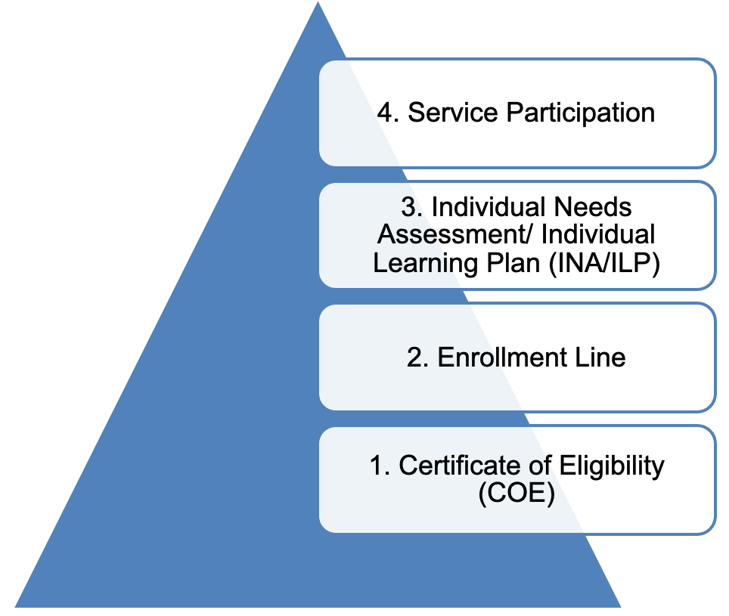
Enrollment Dependencies
An assessed child participates in services.
An enrolled child is assessed for needs.
An eligible child is enrolled in the MEP.
A verified COE confers eligibility.
Notes:
Lead: Jose
Time: 3 min
Talking Points:
If you participated in the session for Data Specialists, the next two slides will be familiar. They are repeated here because we want to emphasize the importance of having complete and accurate enrollment lines for all eligible children in your service area.
The information entered in MSIN is structured a certain way. Like a pyramid, there is a foundation and everything else builds on that.
The foundation is the Certificate of Eligibility (COE). Before anything else can happen, we need a verified COE to confer eligibility for the MEP to the children listed in the COE form.
An eligible child can be enrolled in the MEP (via an enrollment line).
Ideally, the enrolled child will be assessed, and services will be planned for them based on their needs.
The assessed child will participate in MEP services.
Notice that these are all inputs in MSIN. We enter a COE which contains an initial enrollment line, then a re-enrollment line in subsequent years, then an INA/ILP, and ultimately, we can enter service participation data. These different types of information depend on each other. These dependent layers help us keep the data in MSIN logically consistent.
To recap, COEs are the foundation of all data entry in MSIN, and enrollments lines are the critical second layer on top of the foundation.

Slide 28
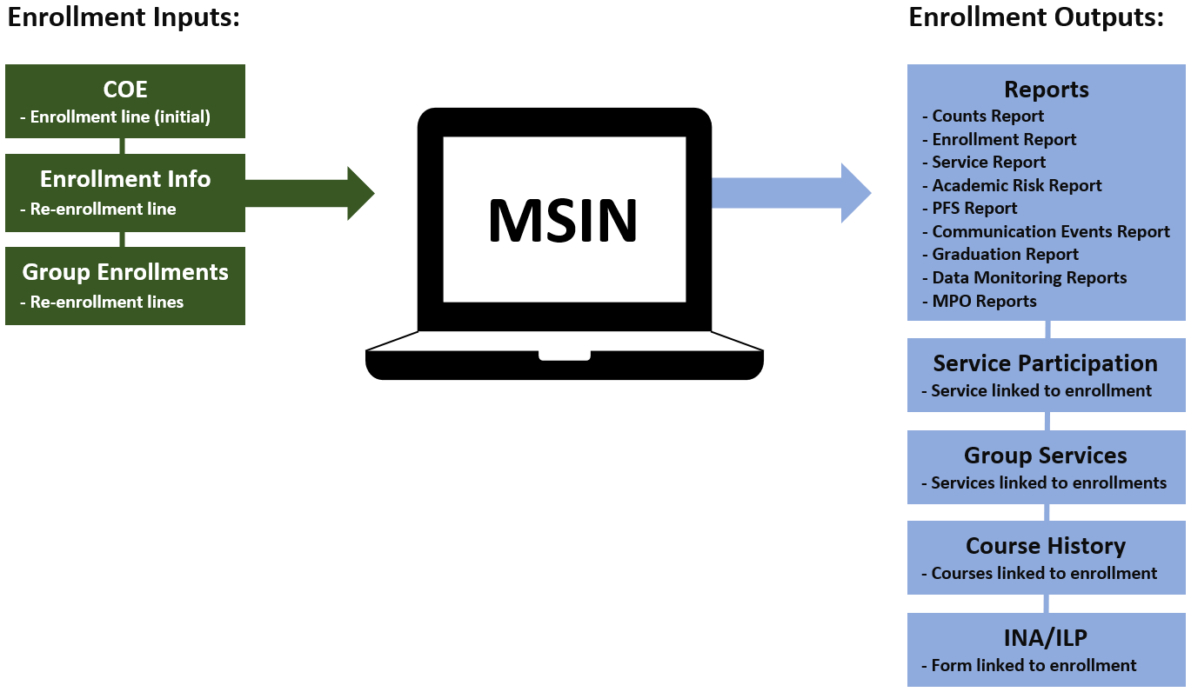
Enrollment Inputs and Outputs
Notes:
Lead: Jose
Time: 3 min
Talking Points:
Enrollments are also important because they affect so many reports and data entry screens.
The green boxes represent how enrollment information enters MSIN. (Go over each green box)
The blue boxes represent the places in MSIN where that enrollment information appears again, for various purposes. (Go over each blue box)
As you can see, enrollment information is foundational and ubiquitous.
And, as we saw earlier, being enrolled is a criterion for children to appear in the correct MPO reports.

Slide 29
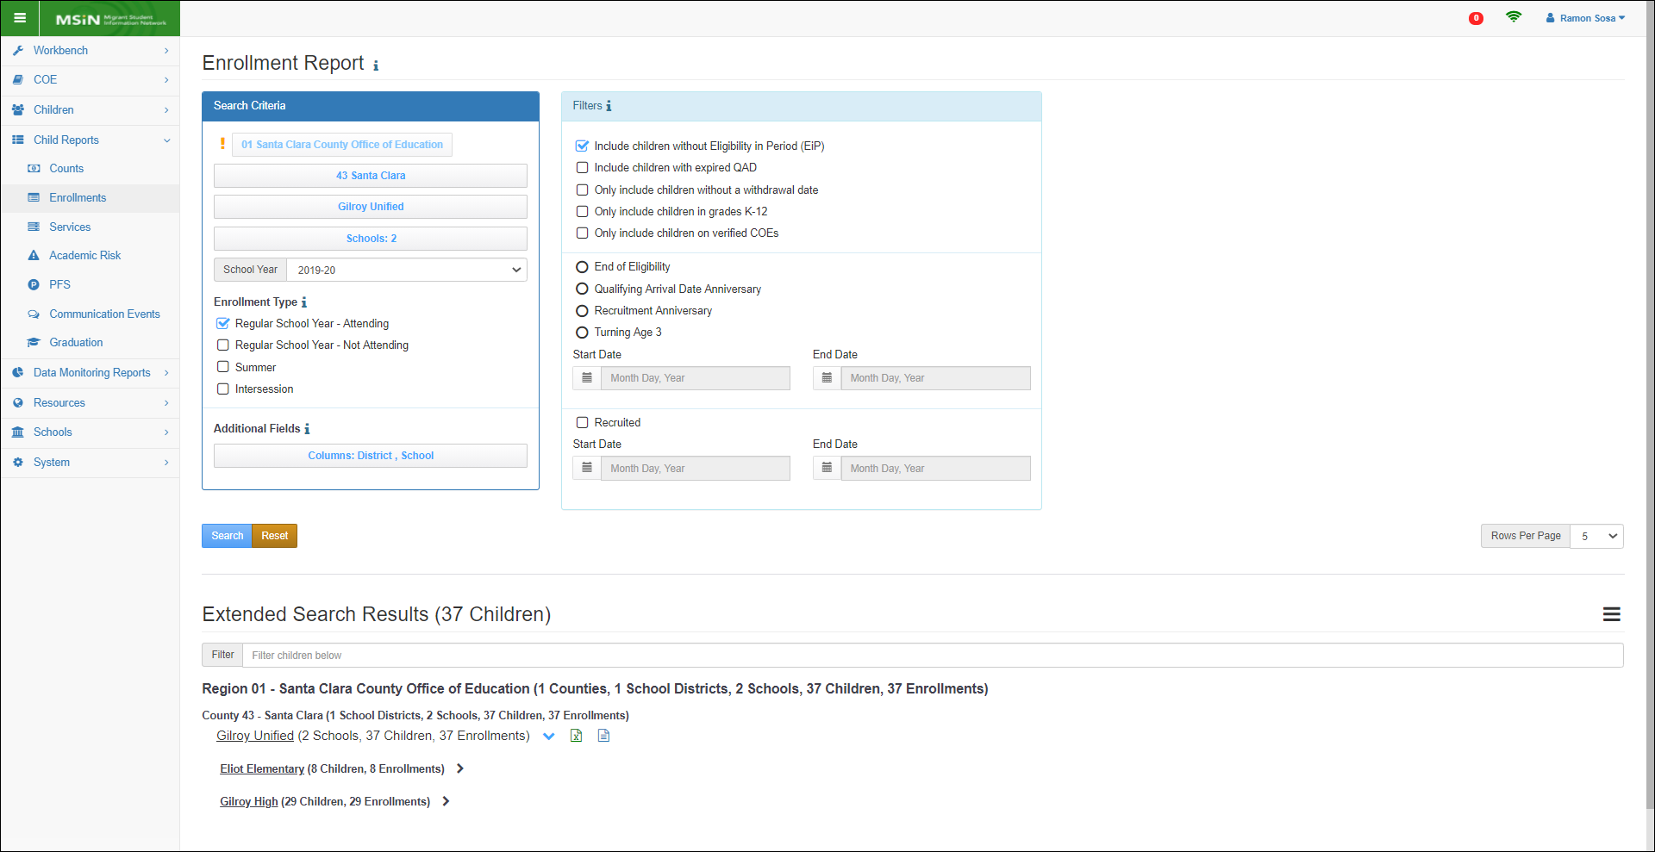
Enrollment Report
Notes:
Lead: Victor
Time: 2 min
Talking Points:
Although the Grade Age Alignment Report is great for monitoring enrollment counts, sometimes you may need more details.
In those cases, we recommend using the Enrollment Report.
This is probably the most versatile report in MSIN 6.0.
We will cover why in the next slides.
Ask: In the chat, let us know if you use this report (yes/no).

Slide 30
Enrollment Report Content
This report extracts enrollment information from the MSIN 6.0 database. Migratory child enrollment information includes:
The child or youth’s identifying information and eligibility dates (i.e., MSD, SSID, name, date of birth, QAD, EOE, etc.).
The district and school where a child is either attending or would attend (in the case of non-attending preschool children and Out of School Youth [OSY]).
Enrollment, withdrawal, and departure dates, if applicable.
Indicators linked to enrollment lines (e.g., PFS status).
Other optional fields (e.g., parents, current address, mailing address, phone number, etc.).
Migratory child enrollment data is updated in real time.
Notes:
Lead: Victor
Time: 2 min
Talking Points:
(Read or paraphrase bullets)

Slide 31
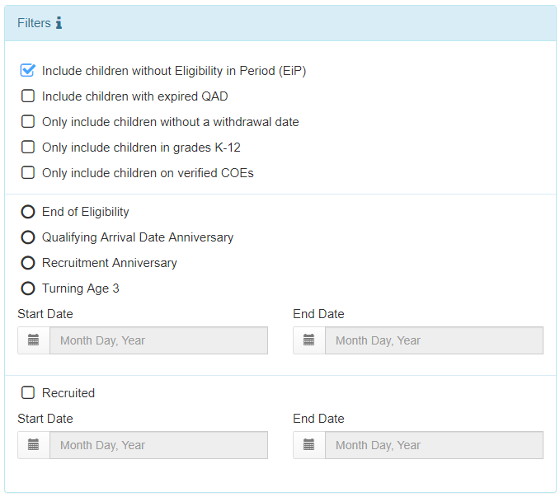
Enrollment Report Tips
This is the most versatile report in the MSIN because it has many filters and potential uses.
For example, you can create a list of attending children in grades K-12 who will have an EOE date before the last day of the school year.
You can create a list of children, with parent and phone number information, to use as a call list for Annual Verifications, based on the family’s recruitment anniversary.
You can create a list of non-attending children who will turn 3 years old before the end of your school’s academic year.
Notes:
Lead: Victor
Time: 2 min
Talking Points:
(Read or paraphrase bullets)
To recap, the Grade Age Alignment report provides a “bird’s eye view” of your enrollments and the Enrollment Report is an excellent resource to extract any needed details, such as family data and contact information.
Both can be used to monitor enrollment progress in your region or DFD.

Slide 32
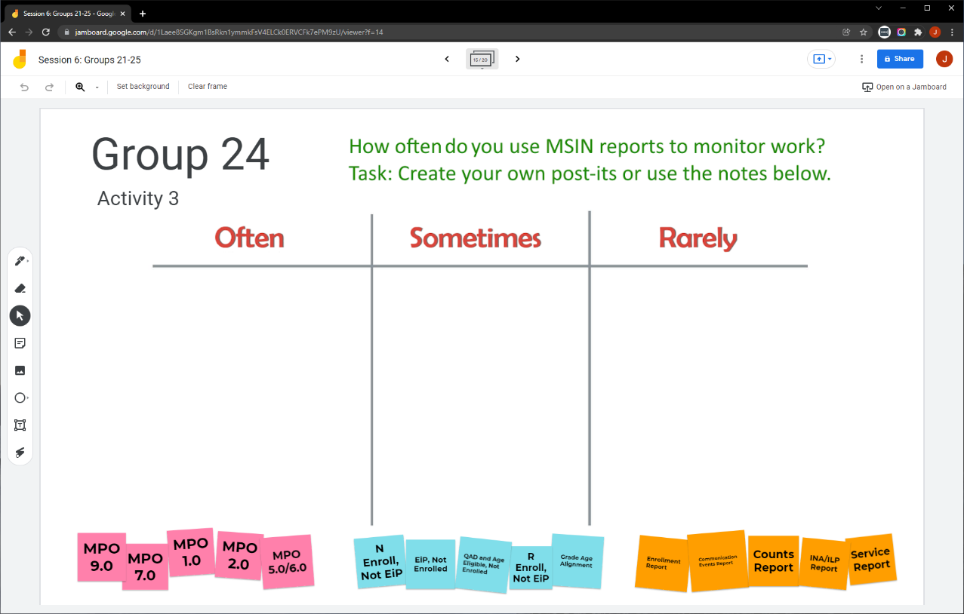
Collaborative Activity 3
Notes:
Lead: Victor
Time: 3 mins.
Talking Points:
This collaborative activity is focused on sharing how frequently you use certain MSIN reports.
Explain that participants will be placed in breakout rooms with 5 collaborators. [Randomly assigned; not the same group members as in Activity 1 or 2.]
Demonstrate the activity using Jamboard: https://jamboard.google.com/d/1vlleb3II20rHSdDvTXVJopXxomei4cMTUtoMrBZfSaM/edit?usp=sharing
Walk through moving existing notes and adding new post-its (sticky notes).

Slide 33
Activity 3 Instructions
In your BR, take 2 minutes to introduce yourselves (name, region/DFD, and job title).
Open the chat window to view the instructions and links.
Click on the Jamboard link that matches your BR number (e.g., BR 24 should go to Jamboard group 24).
Keep two windows open: your BR in zoom and your activity 3 slide in Jamboard.
Move or add post-its (sticky notes) in each category.
Share your contributions with the group. Do you notice anything unexpected?
Notes:
Lead: Victor
Time: 10 mins.
Talking Points:
(Read instructions on the slide.)
Send to Breakout rooms – 8 minutes
Paste the instructions in the chat for all breakout rooms.

Slide 34
Questions? (3)
Notes:
Lead: Team
Time: 3 mins
Answer a few questions about the enrollment-related reports and/or the collaborative activity.

Slide 35
Check for Understanding (2)
  Next, you will see a pop-up window with questions and response options.
  There are two questions for this section; answer them as best you can.
  You will get a warning when the poll is about to close.
Notes:
Lead: Victor
Time: 4 min
Poll Questions:
1) True or False: The Grade Age Alignment Report can also be used to see a breakdown of all your enrollments for monitoring purposes.
a. True [answer]
b. False
c. I don’t know
2) Which of the following statements is/are true?
a. A Data Specialist can add a service to child’s record even if the child is not enrolled.
b. Whether a child is enrolled or not has no impact on the MPO reports.
c. The Enrollment report is versatile because it has many filters and potential uses. [answer]
d. A and C
e. I don’t know

Slide 36
Resources and Closing Activity
Notes:
Transition Slide
Lead: Juli
Time: 10 secs.

Slide 37
Resources
Subgrantees may use this presentation to review requirements and recommendations.
User guides and how-to videos for the features covered today are available on the MSIN home page, under User Guides: https://drive.google.com/drive/folders/0BxgpmxyQ79rmWVhRajVpdXF1UDg?resourcekey=0-QTg5G4KEQC7bj6jyurzeHA&usp=sharing
If any questions arise, please consult with your local management team first. Policy questions about MPOs should be submitted to your CDE consultant or Melissa Mallory. MSIN questions or concerns can be submitted to the MSIN Service Desk.
Notes:
Lead: Juli
Time: 1 min
Talking Points:
In addition to the user guides, remember that definitions, rules, and other information is readily accessible within most screens by clicking the “i” icon next to field titles.
Finally, don’t forget that the Training MSIN site is always available so that you can practice and brush up on system features.

Slide 38
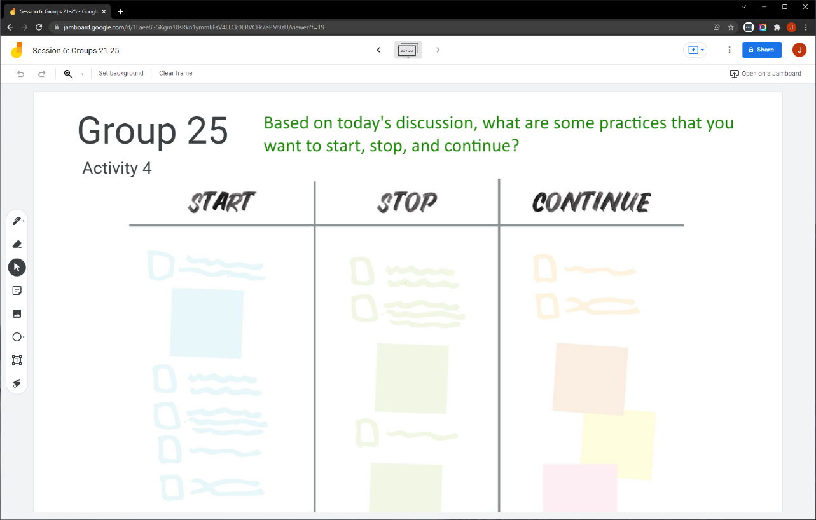
Collaborative Activity 4
Notes:
Lead: Juli
Time: 3 mins.
Talking Points:
Our last collaborative activity for this session is meant for you to reflect and discuss any key points that you are thinking of integrating into your local practices going forward. This activity is called “Start – Stop – Continue.”
Explain that participants will be placed in breakout rooms with 5 collaborators. [Randomly assigned; not the same group members as in the prior activities.]
Demonstrate the activity using Jamboard: https://jamboard.google.com/d/1vlleb3II20rHSdDvTXVJopXxomei4cMTUtoMrBZfSaM/edit?usp=sharing
Focus on the task in green text.
Add post-its (sticky notes) or text to the 3 categories, based on what you learned, remembered, and reinforced during this collaborative session.

Slide 39
Activity 4 Instructions
A) In your BR, take 2 minutes to introduce yourselves (name, region/DFD, job title or role).
B) Open the chat window to view the instructions and links.
C) Click on the Jamboard link that matches your BR number (e.g., BR 25 should go to Jamboard group 25).
D) Keep two windows open: your BR in Zoom and your Activity 4 slide in Jamboard.
E) Add a post-it (sticky note) or text in each of the categories.
F) Discuss anything that you find surprising or unexpected.
Notes:
Lead: Juli
Time: 10 mins.
Talking Points:
Read instructions on the slide.)
Send to Breakout rooms – 8 minutes
Paste the instructions in the chat for all breakout rooms.

Slide 40
Questions? (4)
Notes:
Lead: Team
Time: 3 mins
Answer a few questions about this session’s topics and/or the final collaborative activity.

Slide 41
Contact Information
Juli Auld
Education Research and Evaluation Consultant
California Department of Education
jauld@cde.ca.gov
916-319-0410
__________________________________________________
MSIN Service Desk
MSINsupport@wested.org
1-800-342-2964, option 2
Notes:
Lead: Juli
Time: 30 sec
Talking Points:
Thank participants for attending.

