Slide 1
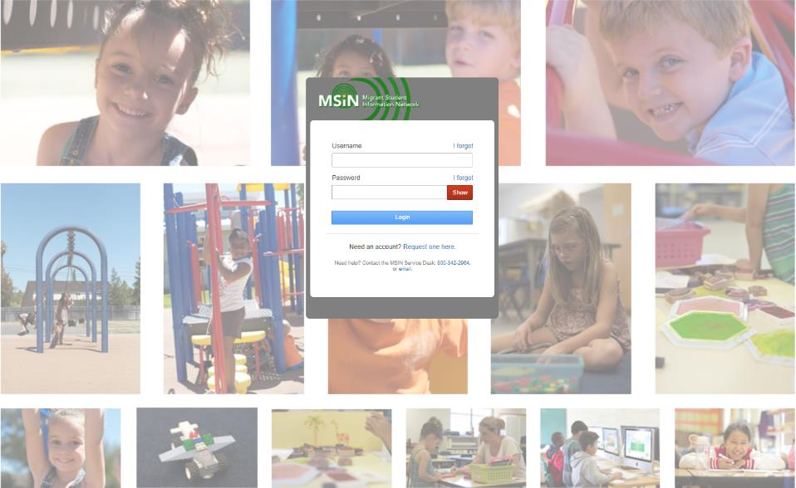
Welcome to the Migrant Student Information Network
2022 Training
We will begin shortly.
Please enter your name and region/district in the chat.

Slide 2
Migrant Student Information Network:
Setting Up, Entering, and Extracting Services
January 27, 2022
10:00 a.m. – 12:00 p.m.
Notes:
Lead: Victor
Time: 30 secs.
Talking Points:
Repeat that participants who are joining as a group need to do “roll call” through the chat feature (region/direct-funded district number # and names)

Slide 3



Welcome and Introductions
Session Presenters
Juli Auld, Education Research and Evaluation Consultant, California Department of Education (CDE)
Jose Valencia, Migrant Student Information Network (MSIN) Lead, WestEd
Victor Garibay, MSIN Specialist, WestEd
Notes:
Lead: Juli
Time: 3 mins.
Talking Points:
Welcome participants.
Presenters introduce themselves

Slide 4
Purpose
This webinar will review the service administration features in the MSIN system, including the impact of service setup on the service entry screens used by MEP staff who enter services.
The target audience is MEP managers and staff who create and maintain local services.
Notes:
Lead: Juli
Time: 1 min
Talking Points:
(Read or paraphrase bullets)
The session content is a review of key items taken from last year’s training series.
This year, the focus is on sharing and collaborating with your peers.
This session is meant for experienced MSIN users who already have a working knowledge of services in the MSIN system.

Slide 5
Session Objectives
Participants will:
Review the definition of MEP services;
Review how to manage existing services in the MSIN system;
Review how to add new services, including those that impact Measurable Programs Objectives (MPOs);
Share and discuss local knowledge regarding these topics; and
Review the resources available to support service-related tasks in the MSIN system.
Notes:
Lead: Juli
Time: 1 min
Talking Points:
(Read or paraphrase bullets)

Slide 6

Housekeeping
Please mute your speaker in the main session.
Use the chat function to enter your questions.
Participate in breakout room activities.
The PowerPoint for this presentation can be accessed through the link provided in the chat.
Notes:
Lead: Juli
Time: 1 min.
Talking Points:
(Read or paraphrase bullets)

Slide 7
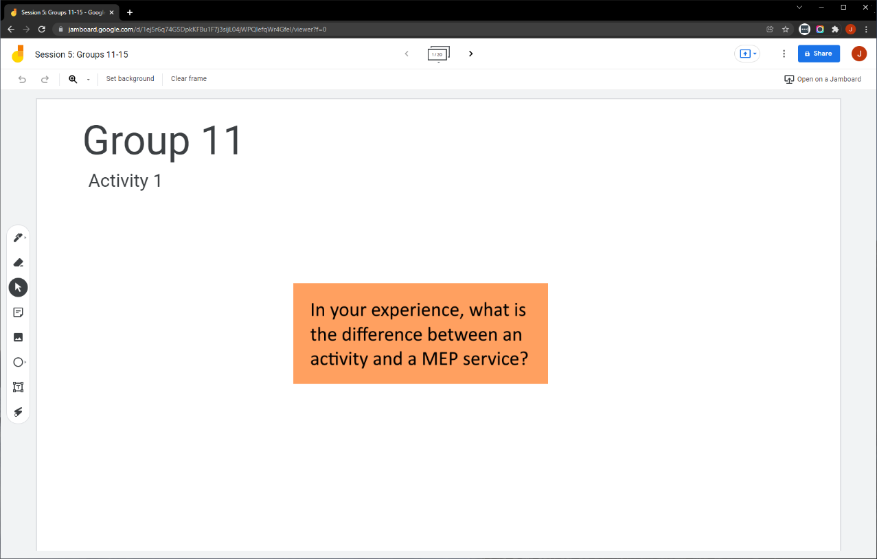
Collaborative Activity 1: Knowledge Wall
Notes:
Lead: Jose
Time: 3 mins.
Talking Points:
At this point, managers and Data Specialists have been setting up services in MSIN for many years. So, our first collaborative activity is meant to tap into your collective knowledge and share it with your peers. This is a “Knowledge Wall” activity.
Explain that participants will be placed in breakout rooms with 5 collaborators.
Demonstrate the activity using Jamboard: https://jamboard.google.com/d/1bzR3wR3yUTfV8bqNrCqZ11JaYx8NqW7EY9FqJ_kU_vA/edit?usp=sharing
Focus on the prompt in the orange box. Walk through using the post-it (sticky note) and text controls to add content.

Slide 8
Activity 1 Instructions
In your Breakout Room (BR), take 2 minutes to introduce yourselves (name, region/DFD, and job title).
Open the chat window to view the instructions and links.
Click on the Jamboard link that matches your BR number (e.g., BR 11 should go to Jamboard group 11).
Keep two windows open: your BR in zoom and your activity 1 slide in Jamboard.
Add post-its (sticky notes) or text onto the wall.
Discuss your contribution(s) to the wall with the group.
Notes:
Lead: Jose
Time: 10 mins.
Talking Points:
(Read instructions on the slide.)
Send to Breakout rooms – 8 minutes
Paste the instructions in the chat for all breakout rooms.

Slide 9
Background: MEP Definition of Services
“Services” are a subset of all the activities that the MEP provides through its programs and projects. “Services” are those educational or educationally related activities that:
Directly benefit a migrant child;
Address a need of a migrant child consistent with the state education agency’s (SEA) comprehensive needs assessment and service delivery plan;
Are grounded in scientifically based research or, in the case of support services, are a generally accepted practice; and
Are designed to enable the program to meet its measurable outcomes and contribute to the achievement of the State’s performance targets.
https://www.cde.state.co.us/migrant/mep-non-regulatory-guidance page 53
Notes:
Lead: Jose
Time: 4 min
Talking Points:
Given the topics we are covering today, it is important to review the definition of “services” because the term has a specific meaning in the MEP.
(Read or paraphrase bullets.)
(Show definitions in FS145): Activities related to identification and recruitment, parental involvement, program evaluation, professional development, or administration of the programs are examples of allowable activities and are not considered services. Another example would be handing out leaflets to migrant families on available reading programs as part of an effort to increase the reading skills of migrant children. Although this is an allowable activity, it is not a service because it does not meet all of the criteria for a service: (1) it does not directly benefit migrant children; (2) it is not grounded in scientifically based research; and (3) in and of itself, the activity will not increase children’s reading skills and thereby increase their ability to meet the state’s performance targets.
In COEstar and MSIN 5.25, we used to see many activities listed as if they were services (even though they did not meet all the criteria). As a reminder, only services need to be entered into MSIN 6.0.
Definition source:
U.S. Department of Education, Office of Elementary and Secondary Education, Office of Migrant Education, Non-Regulatory Guidance for the Title I, Part C Education of Migratory Children, Washington, D.C., 2017.

Slide 10

Questions?
Notes:
Lead: Team
Time: 3 mins
Answer a few questions about the MEP services definition versus allowable activities.

Slide 11
Managing Existing Services in MSIN
Notes:
Transition Slide
Lead: Jose
Time: 20 secs.

Slide 12
Services and MSIN User Roles
MEP staff with the following MSIN user roles can search, view, enable/disable, and add services:
Regional Administrators (MEP Directors)
Program Managers
Data Specialists
MEP staff with the following MSIN user roles can search and view services but cannot enable/disable or add new services:
I&R Manager
Student Services
Notes:
Lead: Jose
Time: 2 mins.
Talking Points:
Before we get into the service administration tasks, we need to cover MSIN user roles. It is helpful to know which MSIN user roles have access to service administration features.
(Read or paraphrase slide.)
I you would like more information about what each role can do, please refer to the MSIN user roles documents, if needed. These are found in the User Guides section on the MSIN home page.
Note that in the past, only Data Specialists could create new services. Now, Regional Administrators and Program Managers can also do this.

Slide 13
Service Administration Tasks
Deactivate any remaining activities (which do not meet the definition of an MEP service)
Deactivate services that you no longer provide
Align active services with recent grant applications
  Align service names
  Align service descriptions
  Check service code mapping (local to state service codes)
  Check applicable MPO and SSDP Component mapping
Notes:
Lead: Jose
Time: 3 min.
Talking Points:
After covering some background information, now we can get into the specific responsibilities.
These are the tasks which should be done periodically with existing services.
(Read or paraphrase bullets.)
Key Point: It is very important to edit or align the services because
1) service data must be accurate given that it is sent to the U.S. Department of Education; and
2) most MPO reports depend on service participation data to provide correct percentages.

Slide 14
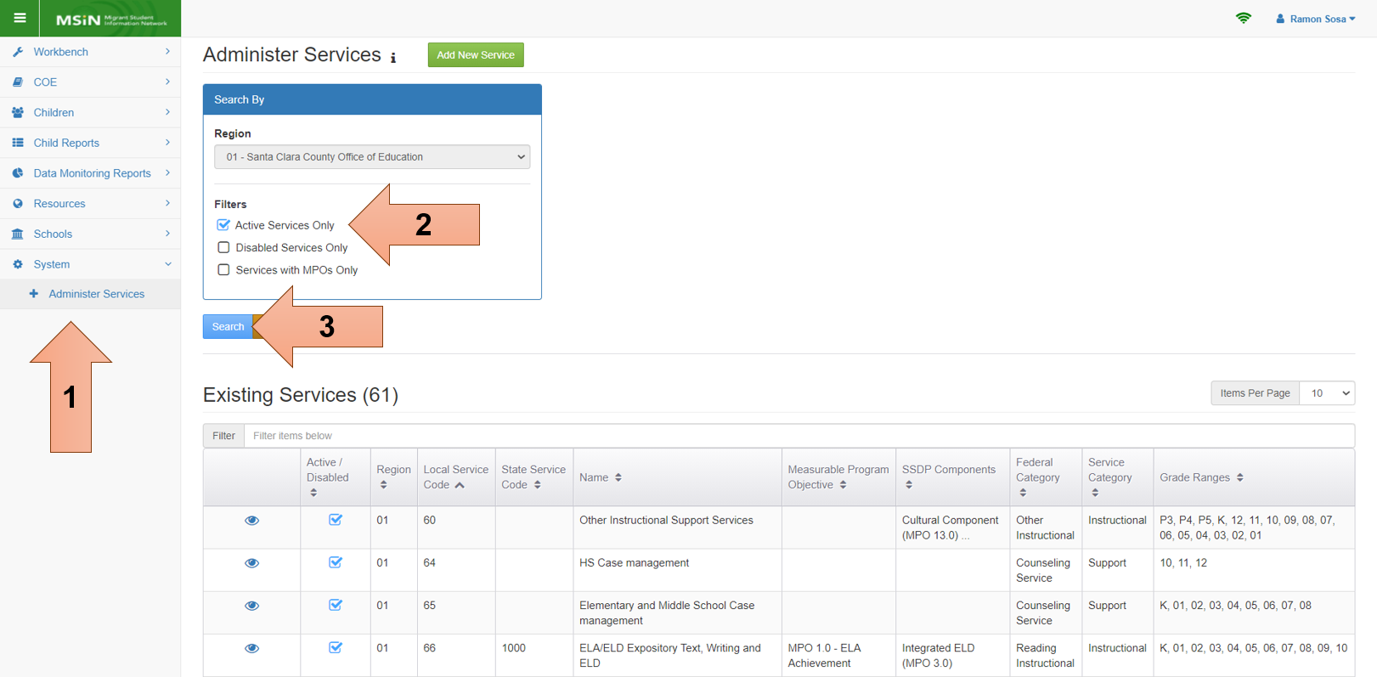
Search Services
Notes:
Lead: Jose
Time: 4 min
Talking Points:
Next, we will review how to bring up your existing services to deactivate the ones that are no longer needed, according to the tasks we just covered.
(Walk through search steps.)
(Review data elements in search results.)
Notice that the results table includes two icons: one to view the service (eye icon) and another to enable/disable the service (checkmark box).

Slide 15
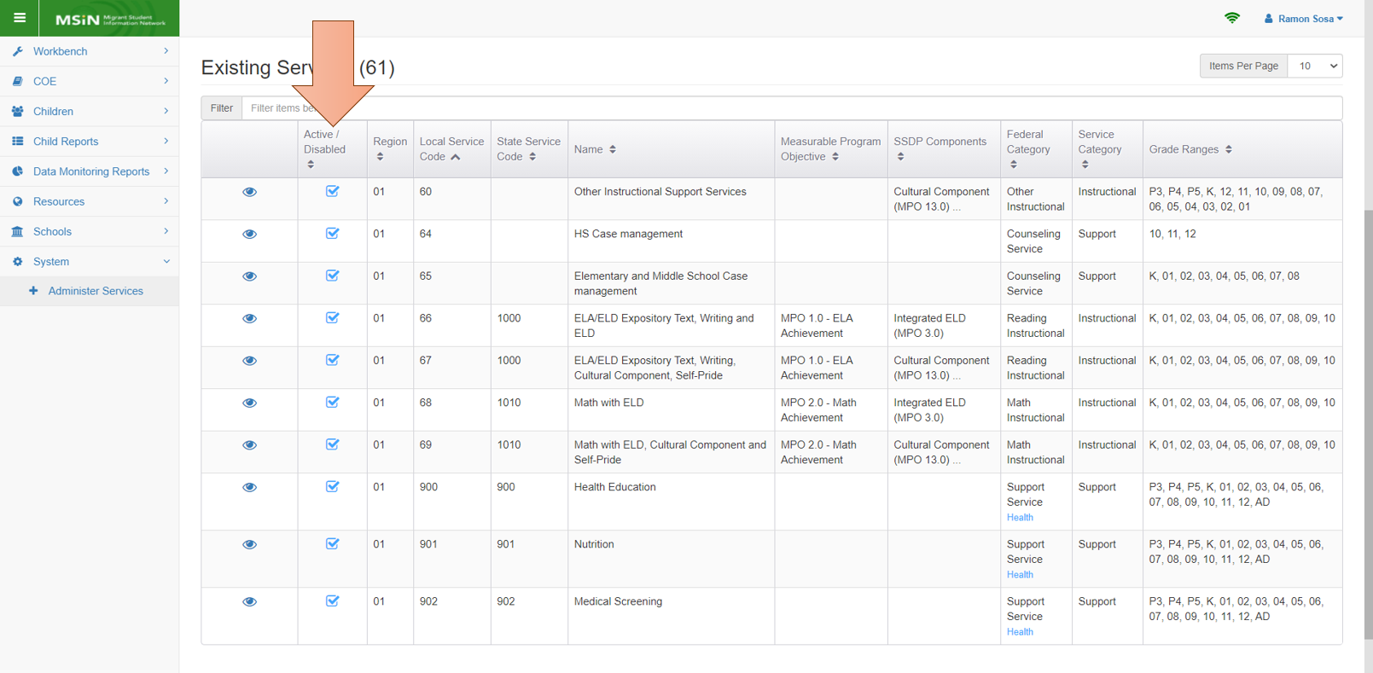
Enable/Disable Services
Notes:
Lead: Jose
Time: 3 min.
Talking Points:
First, we will focus on the second set of icons, the checkmark boxes. These allow you to enable or disable each service.
Service vs. Activity – As we said earlier, please review your local services and deactivate any entries that are not services. The service entry screens are meant to collect service data, not activity data.
Deactivate services your region or district no longer provides. This is very important because it affects your MPO report percentages.
Remember that most MPO reports depend on service participation data to provide correct percentages.
(Repeat: Leaving unused or old services as active services will negatively impact the percentages.)
Next, we will click on the view (or eye) icon to open a service and review the data elements within.

Slide 16
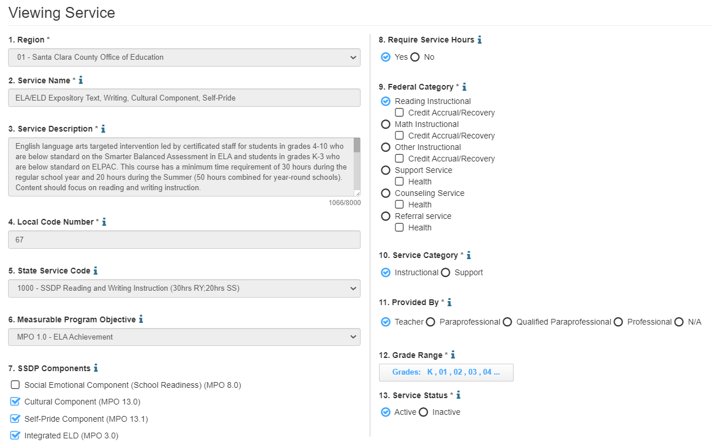
View Services
Notes:
Lead: Jose
Time: 5 min.
Talking Points:
This is local service code 67 in Region 1.
(Review each data element in the “Viewing Service” screen.)
(Reminder: Each field has a “help text” icon (i) next to the field title. Clicking on the “i” brings up definitions and instructions.)
Notice that there isn’t a field for school year. This is because local MEP services are often repeated for many years (with slight modifications). If we had a school year field, your services would need to be set up annually, which would be an unnecessary burden. In the current design, any service you create persists until you decide to deactivate it.
It is important to make sure your services, particularly local codes, are set up correctly because this will affect what service entry staff will see on their data entry screens.
How does this work? We will provide an example in the next slide.

Slide 17
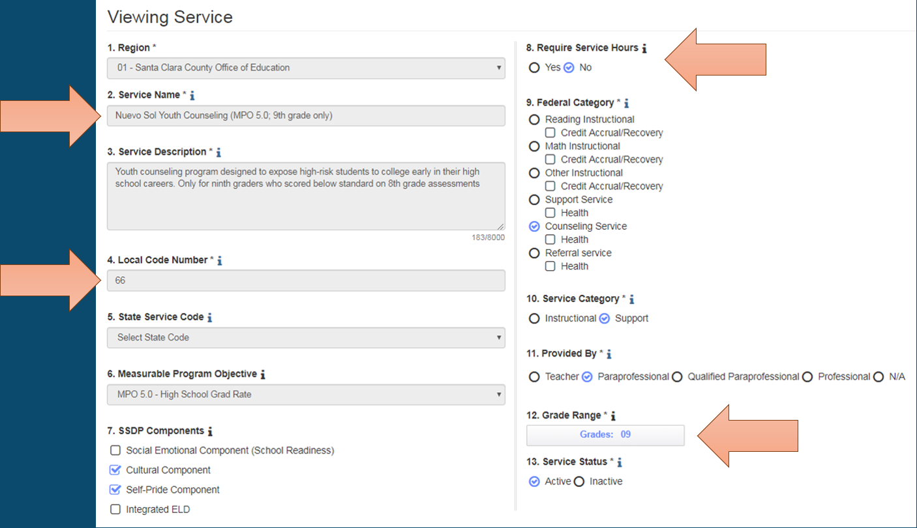
Fields That Impact Service Entry Screens
Notes:
Lead: Jose
Time: 2 min
Talking Points:
Certain fields in each active service setup will also appear in the service entry screens.
Looking at this screenshot, which is R01’s local code 66, the orange arrows indicate which fields directly affect the Service Name drop-down list.
This service will only be shown for 9th graders.
It will be displayed as “66- Nuevo Sol Youth Counseling (MPO 5.0, 9th grade only)”.
And it will not require service hours.

Slide 18
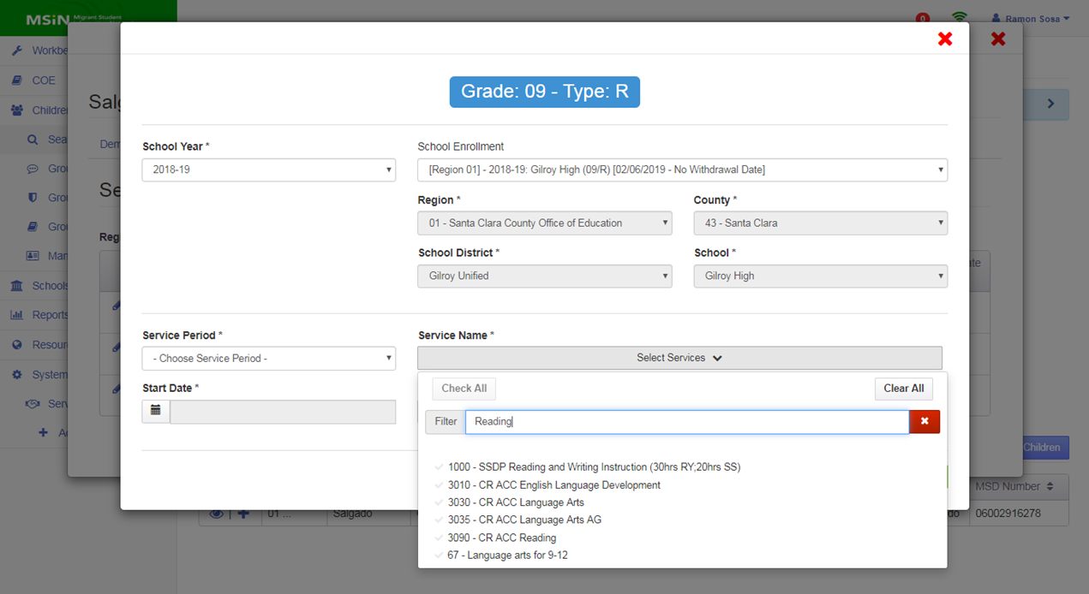
Service Setup Impacts Service Entry
Notes:
Lead: Jose
Time: 4 min
Talking Points:
Now let’s take a look at entering service data. (Think aloud how you arrived at this screen)
What we are shooting for when setting up services in MSIN is to make the service drop-down list as simple and easy-to-understand as possible so that users who enter services can do this quickly and accurately.
When services are set up properly, the “Service Name” drop-down will only show
active services, and
services that apply to the child’s grade level.
(Walk through the service entry screenshot, emphasizing the grade, active services list, and the ability to filter by key word. Note the format: code – service name.)
Notice that three data elements shown on this screen do not appear in the service set up screen we just reviewed.
When you enter a service, you are linking it to a school year, an existing enrollment line in that year, and to a service period (e.g., regular year, summer, or intersession).
Repeat: These data elements are only on the service entry screen but not on the service set-up screens. (Hint: This info is important for your next collaborative activity).
To summarize, the key point is that properly setting up services is a pre-requisite before MEP staff can begin to use the service entry screens. They should be able to quickly find the services they need in the drop-down menu shown above.

Slide 19
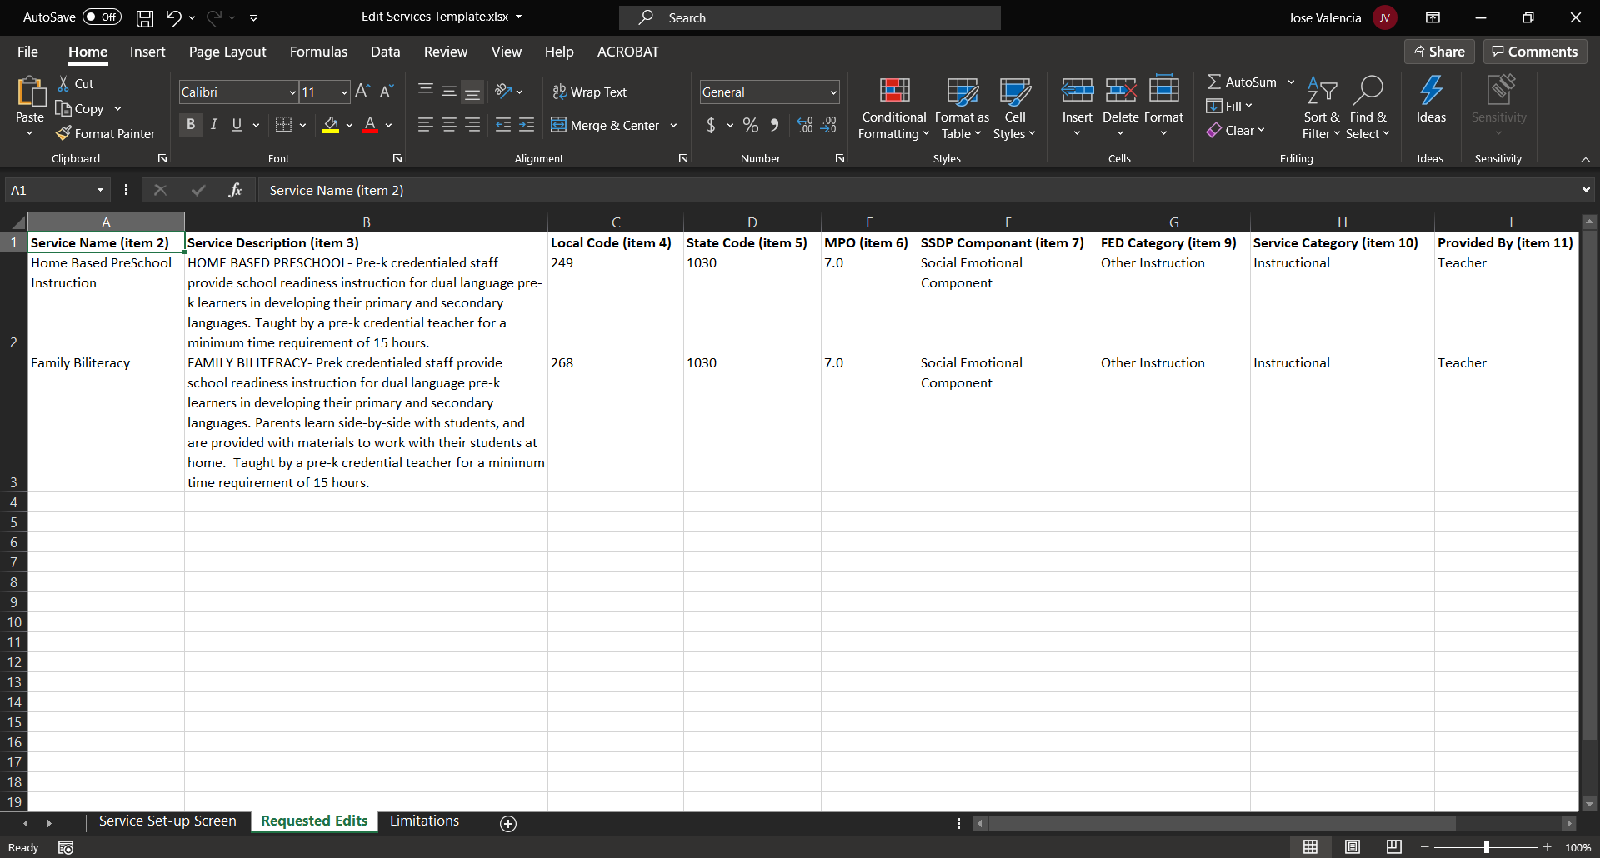
Requesting Service Edits
Notes:
Lead: Jose
Time: 3 mins.
Talking Points:
Existing services can be edited by requesting support from the MSIN Service Desk.
The MSIN Service Desk agent will ask you to fill out a change request template.
It contains the same fields on the service setup screen and one additional column for notes.
We currently don’t allow subgrantees to edit existing services on their own.
This is done so that a second person at WestEd (and/or CDE) reviews the requested change.
This 2-step process helps make sure there is alignment with the SSDP requirements, and the data elements within each service set-up are logically consistent.

Slide 20
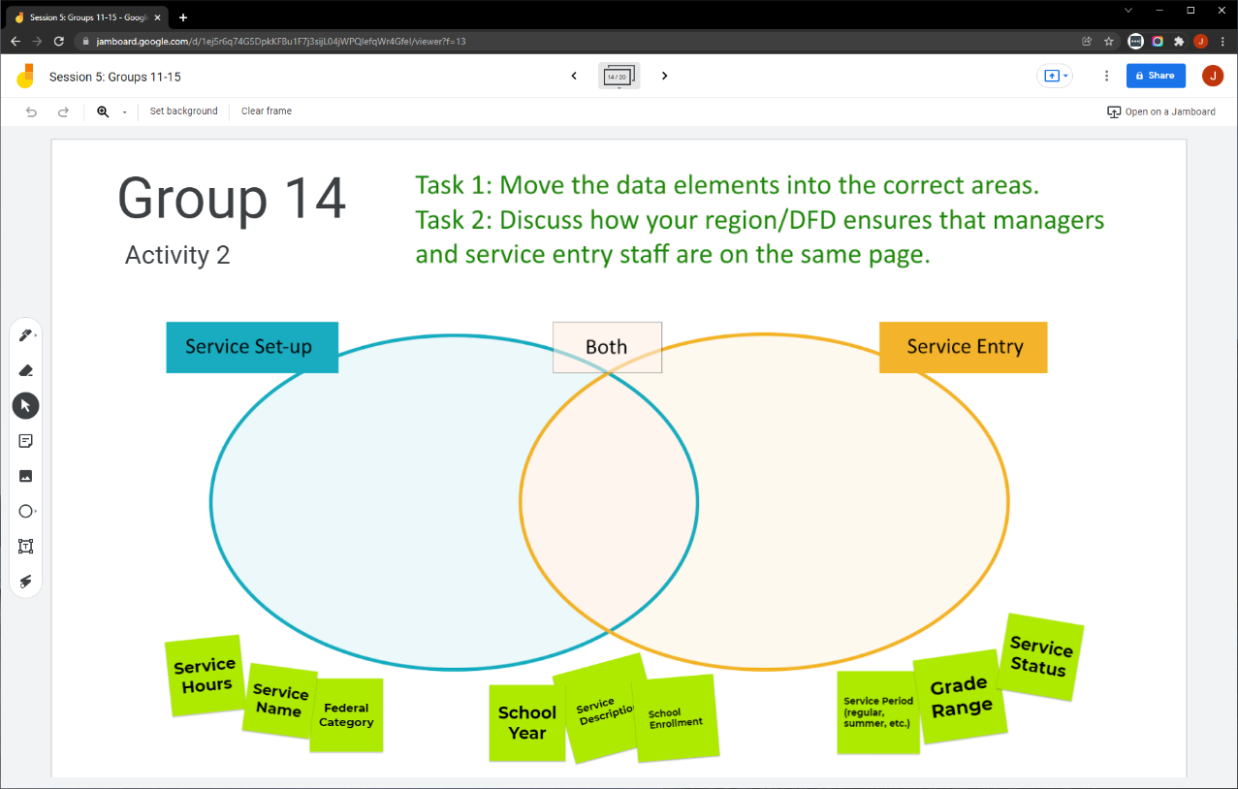
Collaborative Activity 2
Notes:
Lead: Jose
Time: 3 mins.
Talking Points:
This activity is focused on a matching task and then discussing your local process ensuring that managers and service entry staff have a common understanding of their local services.
Explain that participants will be placed in breakout rooms with 5 collaborators. [Randomly assigned; not the same group members as in Activity 1.]
Demonstrate the activity using Jamboard: https://jamboard.google.com/d/1bzR3wR3yUTfV8bqNrCqZ11JaYx8NqW7EY9FqJ_kU_vA/edit?usp=sharing
Focus on the tasks in green text.
Show how to move the existing post-its (sticky notes) and how to add new ones.

Slide 21
Activity 2 Instructions
A) In your BR, take 2 minutes to introduce yourselves (name, region/DFD, job title or role).
B) Open the chat window to view the instructions and links.
C) Click on the Jamboard link that matches your BR number (e.g., BR14 should go to Jamboard group 14).
D) Keep two windows open: your BR in Zoom and your Activity 2 slide in Jamboard.
E) Move the data elements into the correct areas of the Venn diagram.
F) Discuss how your region/DFD ensures that services are understood by everyone (i.e., managers and services entry staff).
Notes:
Lead: Jose
Time: 10 mins.
Talking Points:
(Read instructions on the slide.)
Send to Breakout rooms – 8 minutes
Paste the instructions in the chat for all breakout rooms.

Slide 22
Questions? (2)
Notes:
Lead: Team
Time: 3 mins
Answer a few questions about managing existing services and/or the collaborative activity.

Slide 23
Check for Understanding
  Next, you will see a pop-up window with questions and response options.
  There are three questions for this section; answer them as best you can.
  You will get a warning when the poll is about to close.
Notes:
Lead: Victor
Time: 4 min
Poll Questions:
1) True or False: Some activities that are allowable in the MEP are not actually services, as defined in Guidance.
a. True [answer]
b. False
c. I don’t know
2) Common service administration tasks include:
a. Enabling and disabling existing services, as needed
b. Checking to make sure the active, or enabled, services are in alignment with local grant applications
c. Requesting support from the MSIN Service Desk if an existing service needs to be edited
d. All of the above (a, b, and c)
e. I don’t know
3) True or False: Most of the MPO reports in MSIN depend on service participation data.
a. True [answer]
b. False
c. I don’t know

Slide 24

Break
Notes:
3-minute break
Stretch, grab coffee or tea, take a bio break.

Slide 25
Setting Up New Services
Notes:
Transition Slide
Lead: Victor
Time: 20 secs.

Slide 26
Background: Gather Reference Materials
Before adding a new service, it is extremely helpful to gather reference materials, such as the following:
Regional Application and District Service Agreements
State Service Delivery Plan (most recent amended version)
State Service Codes spreadsheet
  Home page→ User Guides→ Services→ Services Administration
SSDP service set-up “how-to” videos on MSIN
Service-related user guides on MSIN
Notes:
Lead: Victor
Time: 3 min.
Talking Points:
(Read or paraphrase bullets.)
In addition, you can resolve any doubts by testing service set-up and entry on the Training MSIN website.

Slide 27
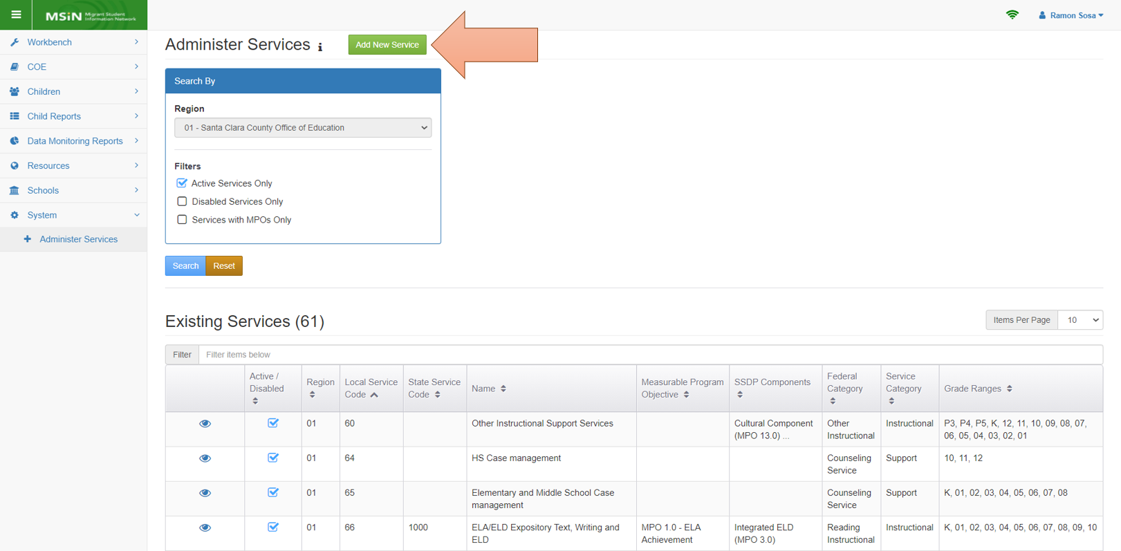
New Service Setup Window
Notes:
Lead: Victor
Time: 1 min
Talking Points:
(Review the location of the Administer Services menu and then point out the location of the “Add New Service” button.)

Slide 28
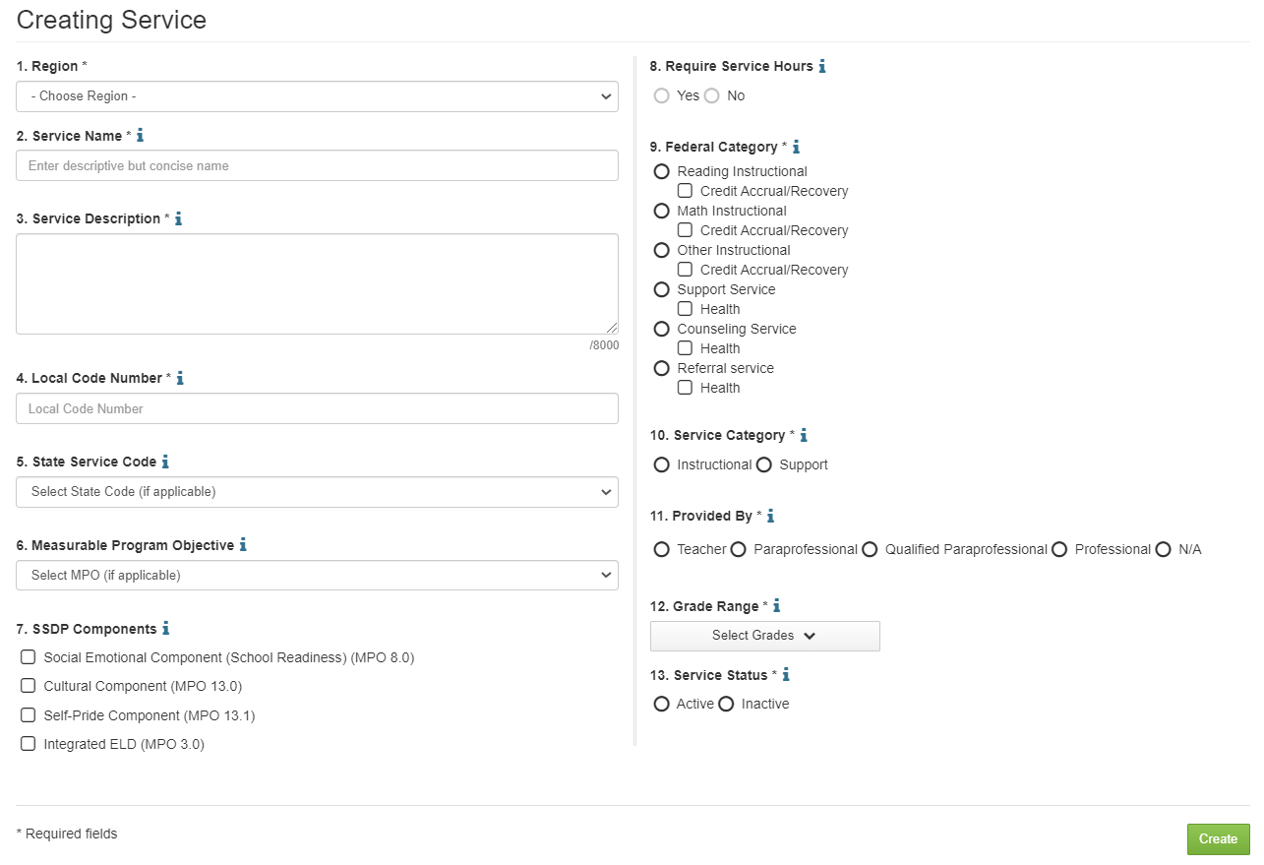
Service Setup Fields
Notes:
Lead: Victor
Time: 4 min
Talking Points:
These are the same fields we reviewed earlier, shown now in edit mode.
The best way to learn how this screen works is to practice creating services on the Training MSIN website. This is our number one recommendation.
For today, we would like to emphasize a few key items.
The required fields have an asterisk next to the field title. You cannot save the new service without completing all required fields.
Notice that every field has a help text icon (i), containing definitions and instructions.
All the MPOs that can be collected through MSIN, as services, have been added to the drop-down menu in #6.
Some MPOs require the collection of service hours (MPO 1.0, 2.0, & 7.0); depending on the MPO selection, #8 will automatically be marked yes or no.
All MPOs specify particular grades; the drop-down menu in #12 displays which grades may receive the service.
This service set-up screen has a lot of preset mapping to ensure that selections are logically consistent. This improves data quality.
Again, we strongly recommend getting familiar with this screen on the Training MSIN website.

Slide 29
Common Service Setup Scenarios
The subgrantee would like to use an existing State Service Code “as is.” No setup is needed.
The subgrantee considers their local service to be a variation of an existing State Service Code.
The subgrantee thinks their local service is different from all State Service Codes but still addresses an MPO.
The subgrantee thinks their local service does not match a State Service Code or an MPO, but it meets the definition of “service” provided in Guidance.
Notes:
Lead: Victor
Time: 6 min
Talking Points:
There are a few ways to approach setting up new services.
Here we have a list of common service setup scenarios.
(Read or paraphrase the slide bullets.)
The first scenario requires the least amount of work. The user only needs to make sure that the State Service Code they want to use is enabled (i.e., the checkmark box is checked).
For the remaining scenarios, 2-4, we have short “how-to” videos on the MSIN home page. The videos are only between 2-5 minutes long.
(Demonstrate where the how-to videos for scenarios 2-4 are located and summarize what the videos cover.)
Additional reference info (do not read during the live presentation):
Scenario 1: No setup needed because these state codes have been pre-set (reference document with state service codes and descriptions). Just ensure that the service is active (will have a checkmark when viewed in the Administer Services screen).
Scenario2: On the Creating Service screen, the user creates a local service name (#2), description (#3) and local code (#4), then selects an existing State code (#5) to populate most other options on the page.
Scenario 3: On the Creating Service screen, the user creates a local service name (#2), description (#3) and local code (#4), then skips over #5 (State Service Code) and selects the appropriate MPO (#6) to populate most other options on the page.
Scenario 4: On the Creating Service screen, the user creates a local service name (#2), description (#3) and local code (#4), then they skip #5 and #6, manually enter #7 (SSDP Component), skip #8 (Require Service Hours; not user selectable), and manually enter #9 (Federal Category), which populates most of the remaining fields. This sounds complex but it is straightforward when making selections on the screen.
For all of these, we recommend practicing on the Training MSIN website (https://trainingmsin.wested.org).

Slide 30
Data Entry Calendar
Activity | Due Date
Fall term services entered into MSIN | 3rd Friday in January: 01/21/22
Spring term services entered into MSIN | 3rd Friday in July: 07/15/22
Summer term services entered into MSIN | 3rd Friday in September: 09/16/22
Data Completeness Reports are reviewed, and issues are resolved | 3rd Friday in September: 09/16/22
All performance period data collection cutoff (e.g., Enrollments, Services, Certificates of Eligibility) | 3rd Friday in September: 09/16/22
Notes:
Lead: Victor
Time: 3 min
Talking Points:
When creating new services (or modifying old ones), give yourself enough time to train the field.
Staff who enter services should be very familiar with both the services and the MEP Data Entry Calendar.
(Read or paraphrase the table contents.)
You will notice that there is an emphasis on entering services throughout the school year, especially after each term. This is important because subgrantees can check progress on meeting MPOs and can revise their instructional plans to meet more MPOs.
Exception: If you have year-long services that include service hours, subgrantees should wait until the service ends to add student participation.
This is preferable because you would only enter the service and the total hours of student participation just once.
Even though you don’t have to enter those year-long services into the MSIN until the end of the service, it’s very important that you continue to check attendance and follow up on absences frequently in order to meet the hour requirements of those MPOs.

Slide 31
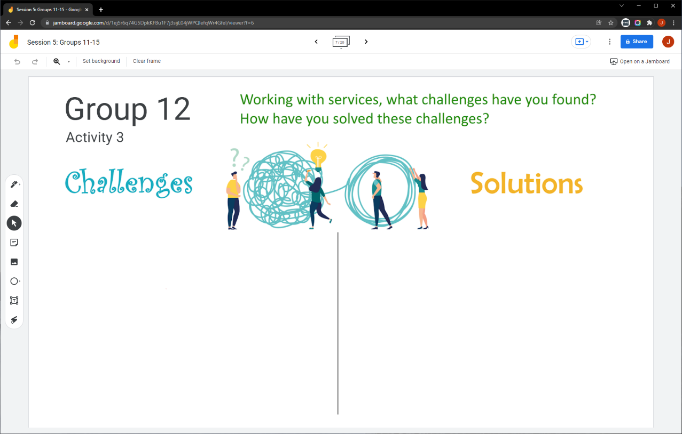
Collaborative Activity 3
Notes:
Lead: Victor
Time: 3 mins.
Talking Points:
This collaborative activity is focused on sharing challenges and solutions you have found when working with services.
Explain that participants will be placed in breakout rooms with 5 collaborators. [Randomly assigned; not the same group members as in Activity 1 or 2.]
Demonstrate the activity using Jamboard: https://jamboard.google.com/d/1bzR3wR3yUTfV8bqNrCqZ11JaYx8NqW7EY9FqJ_kU_vA/edit?usp=sharing
Focus on the tasks in green text.
Walk through adding post-its (sticky notes).

Slide 32
Activity 3 Instructions
In your BR, take 2 minutes to introduce yourselves (name, region/DFD, and job title).
Open the chat window to view the instructions and links.
Click on the Jamboard link that matches your BR number (e.g., BR 12 should go to Jamboard group 12).
Keep two windows open: your BR in zoom and your activity 3 slide in Jamboard.
Add post-its (sticky notes) or text in each category.
Share your contributions with the group.
Notes:
Lead: Victor
Time: 10 mins.
Talking Points:
(Read instructions on the slide.)
Send to Breakout rooms – 8 minutes
Paste the instructions in the chat for all breakout rooms.

Slide 33
Questions? (3)
Notes:
Lead: Team
Time: 3 mins
Answer a few questions about setting up services and/or the collaborative activity.

Slide 34
Check for Understanding (2)
  Next, you will see a pop-up window with questions and response options.
  There are three questions for this section; answer them as best you can.
  You will get a warning when the poll is about to close.
Notes:
Lead: Victor
Time: 4 min
Poll Questions:
1) True or False: If you want to set up a new service, it is important to gather all relevant reference materials before you begin creating the service in MSIN.
a. True [answer]
b. False
c. I don’t know
2) Which of the following statements is/are true?
a. All the fields in the service setup window have help text icons which open definitions and instructions.
b. When setting up a new service, grade range is a required field.
c. You can’t enter services for anyone over 18 years old because they are already adults.
d. A and B [answer]
e. I don’t know
3) True or False: On the MSIN home page, you can access several how-to videos that explain common service setup scenarios.
a. True [answer]
b. False
c. I don’t know

Slide 35
Resources and Closing Activity
Notes:
Transition Slide
Lead: Juli
Time: 10 secs.

Slide 36
Resources
Subgrantees may use this presentation to review requirements and recommendations.
User guides and how-to videos for the features covered today are available on the MSIN home page, under User Guides: https://drive.google.com/drive/folders/0BxgpmxyQ79rmQWkzU2lEZ2hkc2s?resourcekey=0-uPcgFBas0hDKwW332DQ4jg&usp=sharing
If any questions arise, please consult with your local management team first. Specific questions about MPOs should be submitted to your CDE consultant or Melissa Mallory. Other questions or concerns can be submitted to the MSIN Service Desk.
Notes:
Lead: Juli
Time: 1 min
Talking Points:
In addition to the user guides, remember that definitions, rules, and other information is readily accessible within most screens by clicking the “i” icon next to field titles.
Finally, don’t forget that the Training MSIN site is always available so that you can practice and brush up on system features.

Slide 37
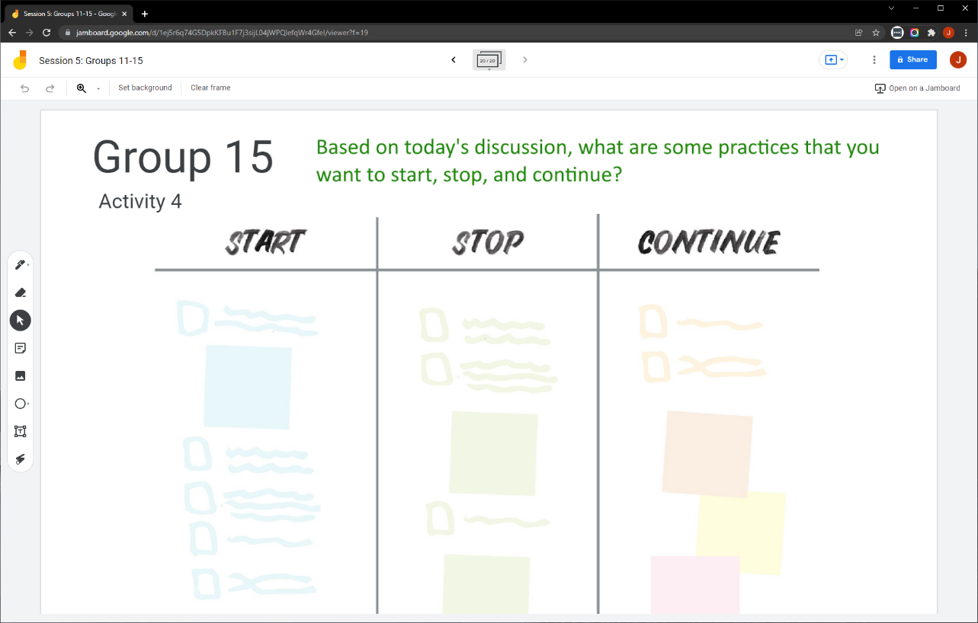
Collaborative Activity 4
Notes:
Lead: Juli
Time: 3 mins.
Talking Points:
Our last collaborative activity for this session is meant for you to reflect and discuss any key points that you are thinking of integrating into your local practices going forward. This activity is called “Start – Stop – Continue.”
Explain that participants will be placed in breakout rooms with 5 collaborators. [Randomly assigned; not the same group members as in the prior activities.]
Demonstrate the activity using Jamboard: https://jamboard.google.com/d/1bzR3wR3yUTfV8bqNrCqZ11JaYx8NqW7EY9FqJ_kU_vA/edit?usp=sharing
Focus on the task in green text.
Add post-its (sticky notes) or text to the 3 categories, based on what you learned, remembered, and reinforced during this collaborative session.

Slide 38
Activity 4 Instructions
A) In your BR, take 2 minutes to introduce yourselves (name, region/DFD, job title or role).
B) Open the chat window to view the instructions and links.
C) Click on the Jamboard link that matches your BR number (e.g., BR 15 should go to Jamboard group 15).
D) Keep two windows open: your BR in Zoom and your Activity 4 slide in Jamboard.
E) Add a post-it (sticky note) or text in each of the categories.
F) Discuss anything that you find surprising or unexpected.
Notes:
Lead: Juli
Time: 10 mins.
Talking Points:
Read instructions on the slide.)
Send to Breakout rooms – 8 minutes
Paste the instructions in the chat for all breakout rooms.

Slide 39
Questions? (4)
Notes:
Lead: Team
Time: 3 mins
Answer a few questions about this session’s topics and/or the final collaborative activity.

Slide 40
Contact Information
Juli Auld
Education Research and Evaluation Consultant
California Department of Education
jauld@cde.ca.gov
916-319-0410
__________________________________________________
MSIN Service Desk
MSINsupport@wested.org
1-800-342-2964, option 2
Notes:
Lead: Juli
Time: 30 sec
Talking Points:
Thank participants for attending.

