Slide 1
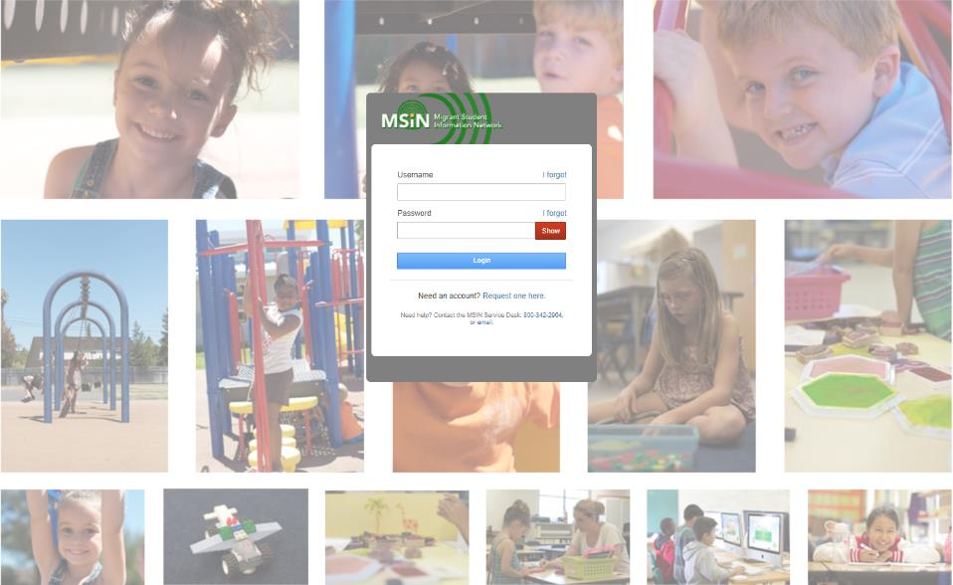
Welcome to the Migrant Student Information Network
2022 Training
We will begin shortly.
Please enter your name and region/district in the chat.

Slide 2
Migrant Student Information Network:
Managing Migratory Child Records for Data Specialists
January 26, 2021
1:00 p.m. – 3:00 p.m.

Slide 3



Welcome and Introductions
Session Presenters
Juli Auld, Education Research and Evaluation Consultant, California Department of Education (CDE)
Jose Valencia, Migrant Student Information Network (MSIN) Lead, WestEd
Victor Garibay, MSIN Specialist, WestEd
Notes:
Lead: Juli
Time: 3 mins.
Talking Points:
Welcome participants.
Presenters introduce themselves

Slide 4
Purpose
This webinar will review key aspects of managing child records in the MSIN system from the perspective of Data Specialists, as they actively ensure overall MEP data quality.
The target audience is MEP staff with the Data Specialist role.
Notes:
Lead: Juli
Time: 1 min
Talking Points:
(Read or paraphrase bullets)
The session content is a review of key items taken from last year’s training series.
This year, the focus is on sharing and collaborating with your peers.
This session is meant for experienced MSIN users who already have a working background as active Data Specialists.

Slide 5
Session Objectives
Participants will:
Know Data Specialists’ unique responsibilities;
Review the Demographics and Enrollment tabs in the Child Record Modal, including data dependencies around enrollments;
Review the Services and Course History tabs in the Child Record Modal;
Share and discuss local knowledge regarding these topics; and
Review the resources available to support Designated SEA Reviewers.
Notes:
Lead: Juli
Time: 1 min
Talking Points:
(Read or paraphrase bullets)

Slide 6

Housekeeping
Please mute your speaker in the main session.
Use the chat function to enter your questions.
Participate in breakout room activities.
The PowerPoint for this presentation can be accessed through the link provided in the chat.
Notes:
Lead: Juli
Time: 1 min.
Talking Points:
(Read or paraphrase bullets)

Slide 7
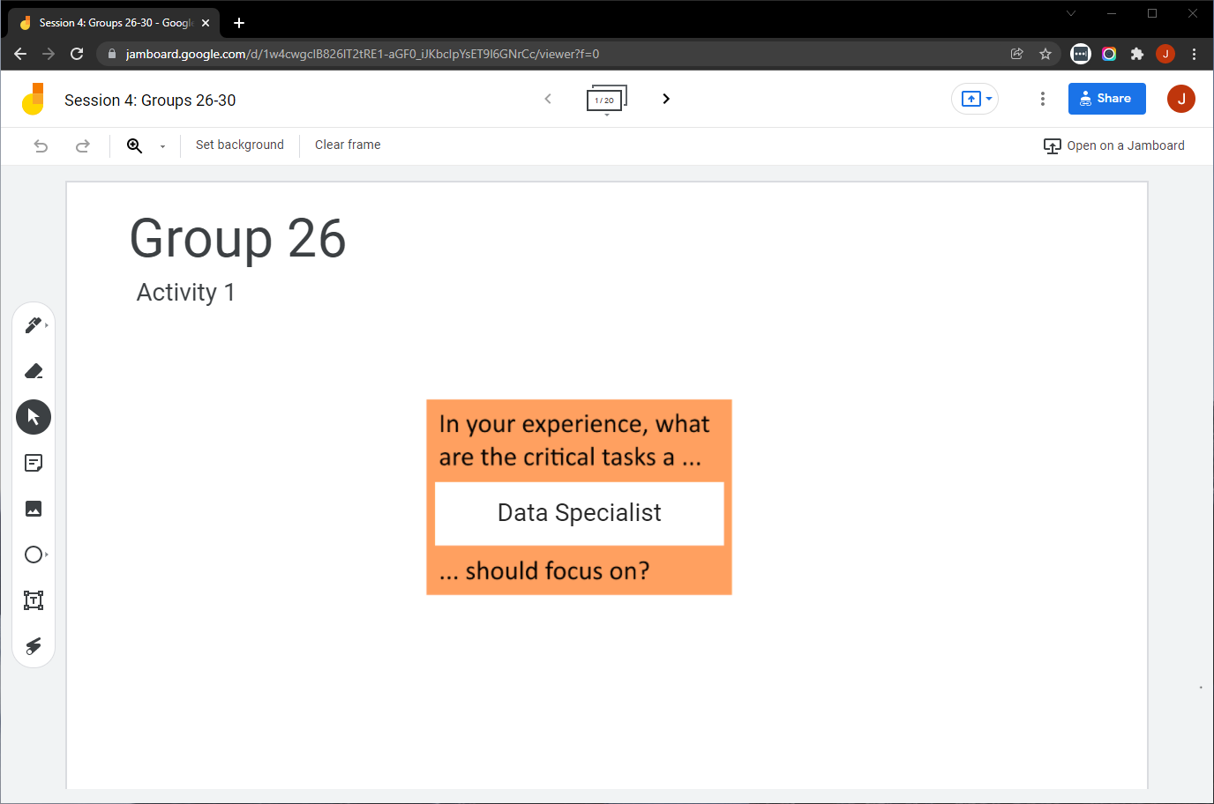
Collaborative Activity 1: Knowledge Wall
Notes:
Lead: Jose
Time: 3 mins.
Talking Points:
At this point, Data Specialists have been working with child records in MSIN for many years. So, our first collaborative activity is meant to tap into your collective knowledge and share it with your peers. This is a “Knowledge Wall” activity.
Explain that participants will be placed in breakout rooms with 5 collaborators.
Demonstrate the activity using Jamboard: https://jamboard.google.com/d/1K_CVMYceh6o0f18WKGaQQBEb8zG8b6gHLQYH4WWs0co/edit?usp=sharing
Focus on the prompt in the orange box. Walk through using the post-it (sticky note) and text controls to add content.

Slide 8
Activity 1 Instructions
In your Breakout Room (BR), take 2 minutes to introduce yourselves (name, region/DFD, and job title).
Open the chat window to view the instructions and links.
Click on the Jamboard link that matches your BR number (e.g., BR 26 should go to Jamboard group 26).
Keep two windows open: your BR in zoom and your activity 1 slide in Jamboard.
Add post-its (sticky notes) or text onto the wall.
Discuss your contribution(s) to the wall with the group.
Notes:
Lead: Jose
Time: 10 mins.
Talking Points:
(Read instructions on the slide.)
Send to Breakout rooms – 8 minutes
Paste the instructions in the chat for all breakout rooms.

Slide 9
Data Specialist Role in MSIN
For children/youth in their own region/Direct-funded District (DFD), Data Specialists can:
View and edit child records (i.e., an edit button is available in most tabs within the Child Record Modal);
View/enter/edit/delete individual child enrollment lines and use the Group Enrollment feature to complete annual re-enrollments;
View/enter/edit/delete individual child service participation lines and use the Group Services feature to complete service entry for groups of children after the end of each term;
View and create regional/DFD service codes using the Administer Services features;
Notes:
Lead: Jose
Time: 2 min
Talking Points:
Review slides (next 3). Much of this will probably be on your knowledge walls.
Data Specialists perform a greater number of critical tasks in MSIN than any other user role.
We consider them the local data experts.
The next two slides contain an overview of the tasks typically performed by Data Specialists.
(Read or paraphrase bullets)

Slide 10
Data Specialist Role in MSIN (2)
View/enter/edit/delete Communication Events for individual children and groups;
View/enter/edit/delete partial Course History for secondary students who moved away mid-year, when applicable;
View/enter/edit/delete Individual Needs Assessment/Individual Learning Plan (INA/ILP) forms;
View school information and resolve Provisional Schools;
Resolve duplicate child records in the MSIN so that other system components can produce accurate unduplicated child counts (i.e., Category 1 and 2 counts); and
View all Child Reports and Data Monitoring Reports.
Notes:
Lead: Jose
Time: 1 min
Talking Points:
(Continued from prior slide)

Slide 11
Unique Responsibilities
Data Specialists are responsible for entering accurate information in the MSIN.
Data Specialists, with local managers, are also responsible for ensuring that information entered by other users in their region/DFD is accurate.
To assist with these Quality Assurance (QA) tasks, the MSIN is equipped with data monitoring reports specifically for QA and the ability to download reports (for review and analysis using Excel).
At the subgrantee level, MEP Directors and other managers typically ask Data Specialists to pull reports and review their contents for various purposes. Other local users may also request data-related support.
To summarize, Data Specialists are local data experts who are expected to know and understand their local information best.
Notes:
Lead: Jose
Time: 1 min
Talking Points:
(Read or paraphrase bullets)

Slide 12

Questions?
Notes:
Lead: Team
Time: 3 mins
Answer a few questions about Data Specialist responsibilities.

Slide 13
Child Records: Demographic and Enrollment Data
Notes:
Transition Slide
Lead: Victor
Time: 20 secs.

Slide 14
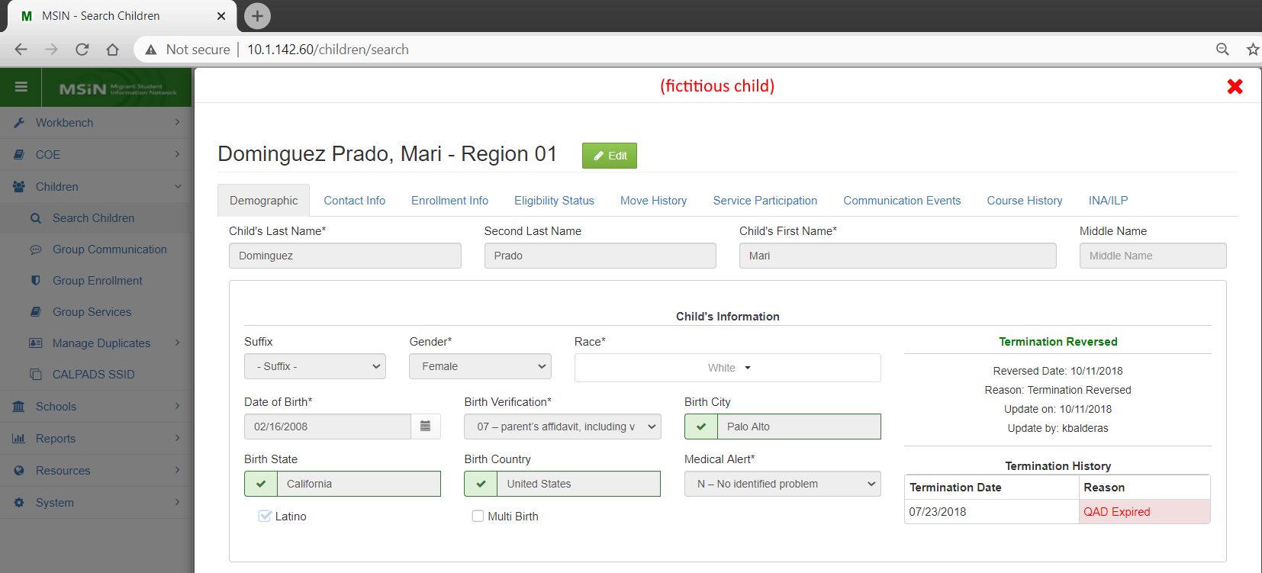
Using the Child Record Modal
Notes:
Lead: Victor
Time: 2 mins
Talking Points:
Once a child is added to MSIN through a verified COE, their information can be edited through the Child Record Modal (as shown in the screenshot).
Today we will review only a few of the most important tabs in the Child Record Modal, beginning with the Demographic tab.
This tab shows the child’s personal information (including a preferred phone number & email), termination information, parent/guardian information, and identification numbers.
Notice the green “Edit” button along the top. Clicking on this puts the tab in edit mode and allows Data Specialists to make changes in the tab.

Slide 15
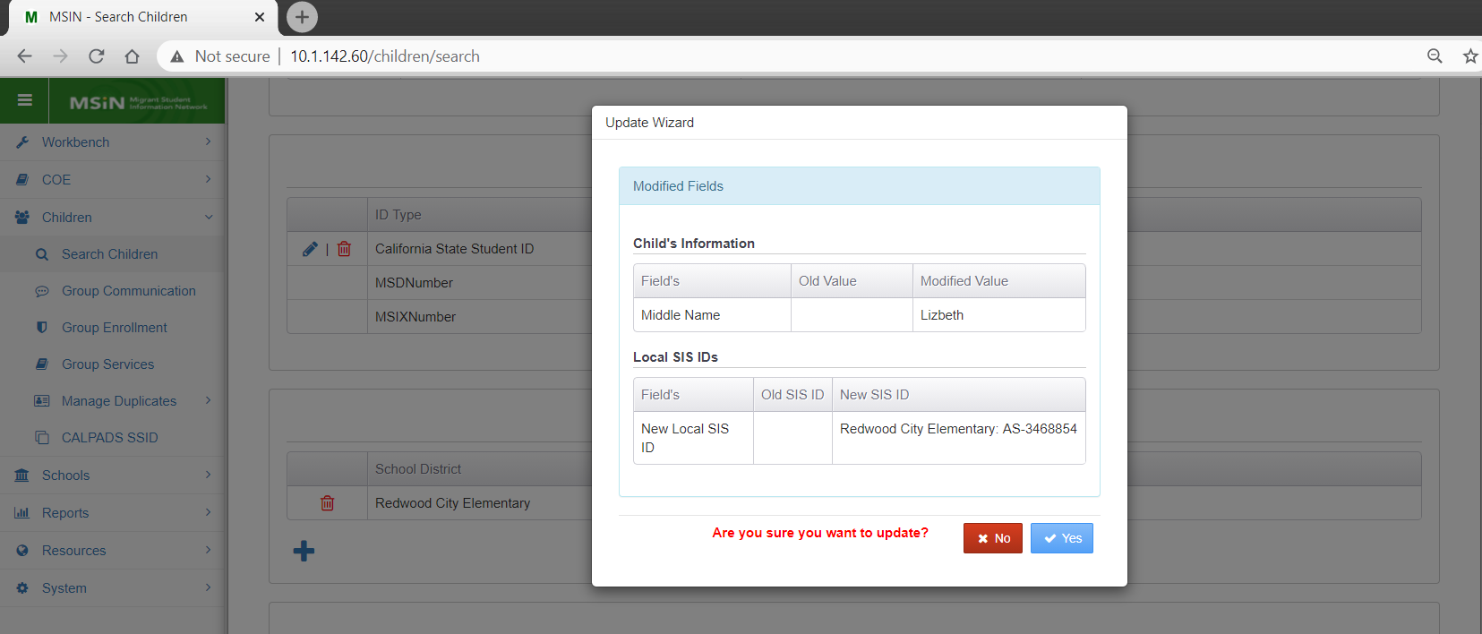
Editing the Demographic Tab
Notes:
Lead: Victor
Time: 2 min
Talking Points:
Once you have made all the required changes, they must be saved using the green “Save” button on the bottom right corner. (not shown)
As shown in this screenshot, a confirmation window will display “before and after” values for the modified fields (e.g., added middle name, added local SIS identification number).
If all changes are correct, you click “Yes” to confirm and apply the updates.
* The examples shown here is a fictitious child in the testing server.

Slide 16
Caveats: Demographic Tab
Before making any changes to the child’s name, Date of Birth (DOB), parent/guardians, and identification numbers, consider the reliability of the source.
  Has a current parent/guardian confirmed the change(s) you are about to make?
When using local databases or the California Longitudinal Pupil Achievement Data System (CALPADS) as sources for changes, take great care to ensure that you are truly looking at the same child in both systems.
Changing a child’s demographic information essentially changes their identity, thus affecting any future de-duplications in MSIN and Migrant Student Information Exchange (MSIX).
The MSIN Student Identifier (MSD) and the MSIX ID numbers are static fields, whereas the State Student Identifier (SSID) can be edited.
Notes:
Lead: Victor
Time: 3 min
Talking Points:
(Read or paraphrase bullets)
When making changes, the rule of thumb is Evidence + Permission = Edit Student Record. Following this rule of thumb is especially critical for Demographic information.

Slide 17
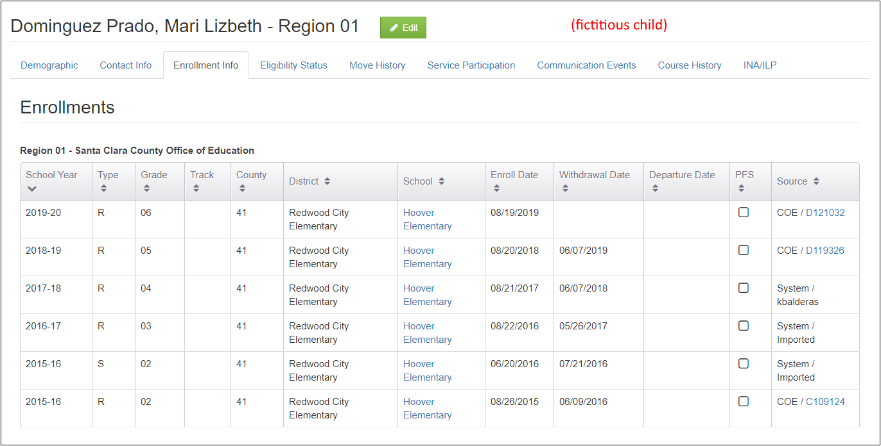
Editing the Enrollment Info Tab
Notes:
Lead: Jose
Time: 2 min
Talking Points:
Now we are moving on to the Enrollment Info tab.
Notice the green “Edit” button along the top. This allows Data Specialists to make changes in this tab.
We will only cover a few key points about enrollments during this presentation because of limited time.
There is a comprehensive MSIN user guide on working with enrollments posted on the MSIN home page, under the User Guides section.
All Data Specialists should read the guide carefully and make sure they understand all definitions and instructions.
Let’s start with an explanation of why enrollment data is so important in MSIN.
* The examples shown here is a fictitious child in the testing server.

Slide 18
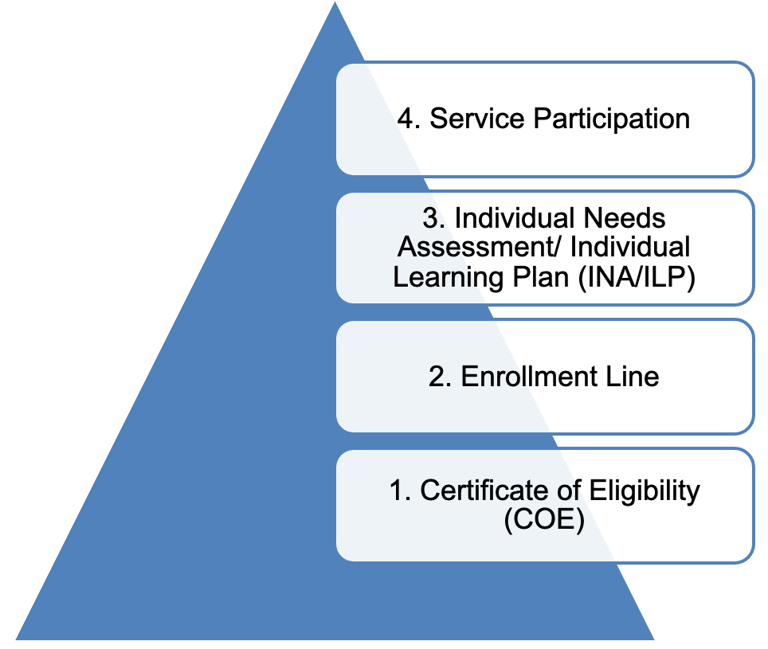
Enrollment Dependencies
An assessed child participates in services
An enrolled child is assessed for needs.
An eligible child is enrolled in the MEP.
A verified COE confers eligibility.
Notes:
Lead: Jose
Time: 3 min
Talking Points:
The information entered in MSIN is structured a certain way. Like a pyramid, there is a foundation and everything else builds on that.
The foundation is the Certificate of Eligibility (COE). Before anything else can happen, we need a verified COE to confer eligibility for the MEP to the children listed in the COE form.
An eligible child can be enrolled in the MEP (via an enrollment line).
Ideally, the enrolled child will be assessed, and services will be planned for them based on their needs.
The assessed child will participate in MEP services.
Notice that these are all inputs in MSIN. We enter a COE which contains an initial enrollment line, then a re-enrollment line in subsequent years, then an INA/ILP, and ultimately, we can enter service participation data. These different types of information depend on each other. These dependent layers help us keep the data in MSIN logically consistent.
(Ask questions: Can I re-enroll a child with expired COE? Can I create an INA/ILP for a child who does not have an enrollment line in the target school year? Can I add services to a child’s record if they are not enrolled?)
To recap, COEs are the foundation of all data entry in MSIN and enrollments lines are the critical second layer on top of the foundation.
All these inputs are necessary so that we can get important outputs. In the next slide we will summarize the inputs and outputs related to enrollments.

Slide 19
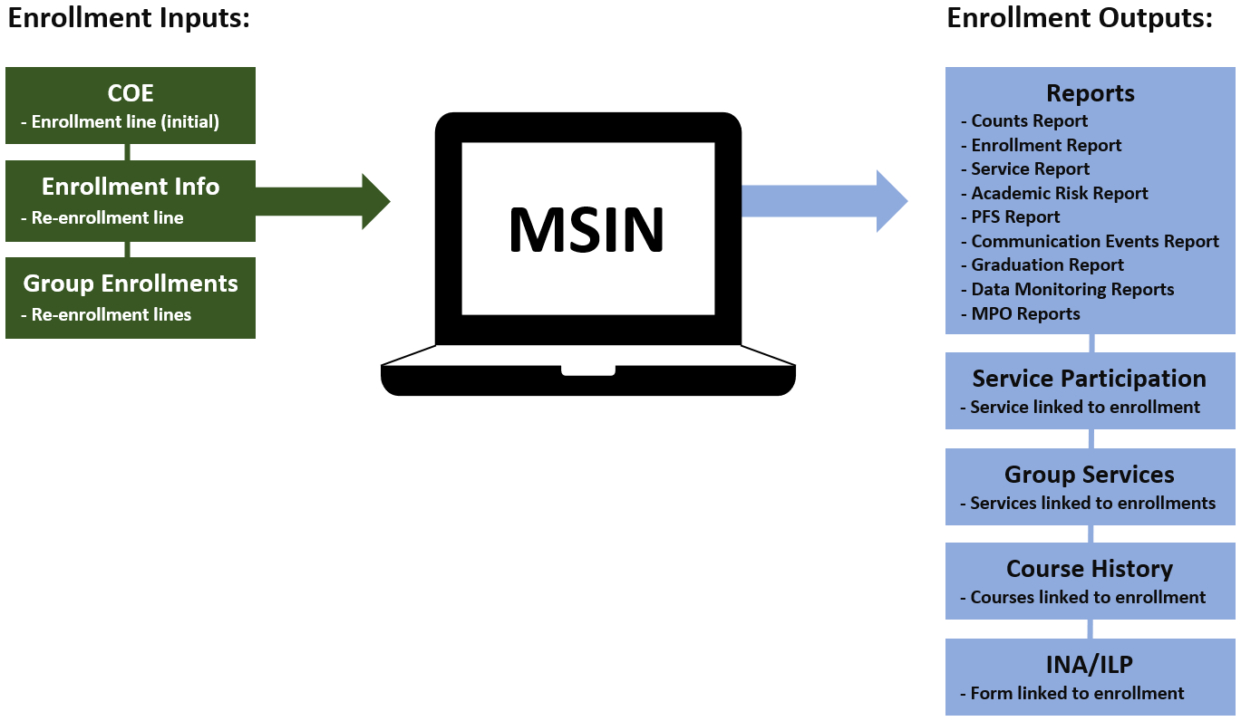
Enrollment Inputs and Outputs
Notes:
Lead: Jose
Time: 3 min
Talking Points:
The green boxes represent how enrollment information enters MSIN. (Go over each green box)
The blue boxes represent the places in MSIN where that enrollment information appears again, for various purposes. (Go over each blue box)
As you can see, enrollment information is foundational and ubiquitous.

Slide 20
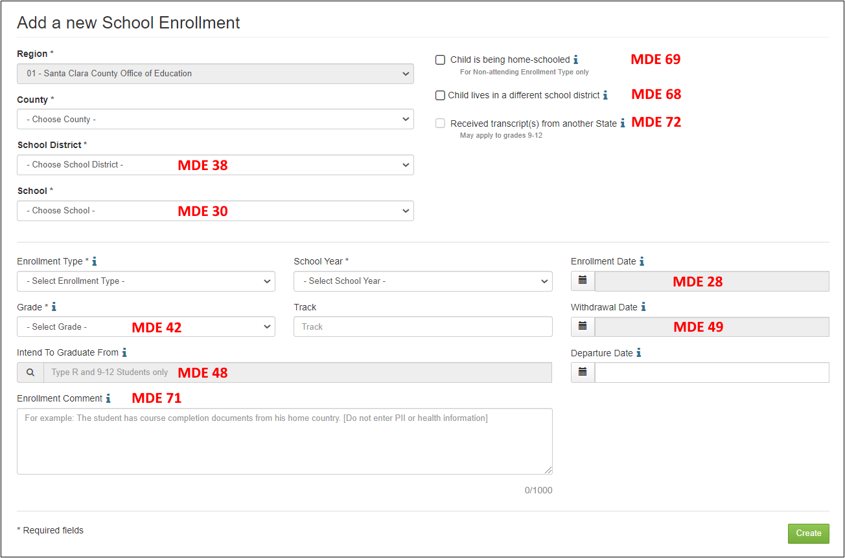
Enrollment Info for MSIX
Notes:
Lead: Jose
Time: 2 min
Talking Points:
Enrollment records contain many Minimum Data Elements (MDE) for the MSIX system.
These MDEs may be edited or added by opening the Enrollment Info tab in the Child Record Modal and making changes, as needed.
Please pay particular attention to MDE 72 (or Received transcripts from another State). Your region/DFD should have a process in place to meet the MSIX regulations for this item. Click on the help text “i” for details and consult the enrollments user guide.
For MDE 71, which is optional, note that any comments you add here will be visible to all MSIX users in the country. Do not enter any PII or protected health information (such as medical conditions, diagnoses, or medications). Instead, any information entered here should be related to the child’s enrollment in the selected school (i.e., academic topics).

Slide 21
Caveats: Enrollment Info
Before making any changes to the child’s enrollment information, consider the reliability of the source.
When using local databases or CALPADS as sources for changes, take great care to ensure that you are truly looking at the same child in both systems.
Read all enrollment-related MSIN user guides and ask questions if you have any doubts. Your local MSIN Power Users and management team will provide the first tier of support, and Data Specialists may also contact the MSIN Service Desk, if needed.
If you have not used an enrollment-related feature recently and feel a little rusty, always practice first by using the MSIN Training site.
Notes:
Lead: Jose
Time: 2 min
Talking Points:
The first two points are so important that we are going to repeat them.
(Read of paraphrase bullets)
This concludes our review of the Demographic and Enrollment Info tabs.
Now we will move on to the second collaborative activity.

Slide 22
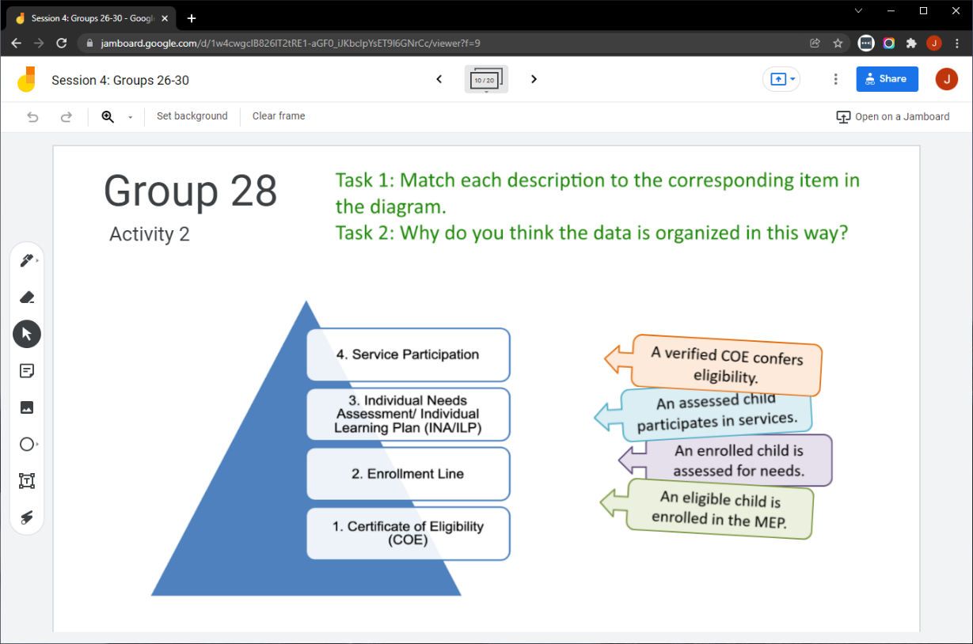
Collaborative Activity 2
Notes:
Lead: Jose
Time: 3 mins.
Talking Points:
This activity is focused on a matching task and then discussing why the data is organized this way.
Explain that participants will be placed in breakout rooms with 5 collaborators. [Randomly assigned; not the same group members as in Activity 1.]
Demonstrate the activity using Jamboard: https://jamboard.google.com/d/1K_CVMYceh6o0f18WKGaQQBEb8zG8b6gHLQYH4WWs0co/edit?usp=sharing
Focus on the tasks in green text.
Show how to move the steps in order and how to add post-its (sticky notes) based on the group’s discussion.

Slide 23
Activity 2 Instructions
A) In your breakout room, take 2 minutes to introduce yourselves (name, region/DFD, job title or role).
B) Open the chat window to view the instructions and links.
C) Click on the Jamboard link that matches your breakout room number (e.g., breakout room 28 should go to Jamboard group 28).
D) Keep two windows open: your breakout room in Zoom and your Activity 2 slide in Jamboard.
E) Match each description to the correct level in the data dependency pyramid.
F) Discuss why the data is organized with the dependencies shown in the diagram.
Notes:
Lead: Jose
Time: 10 mins.
Talking Points:
(Read instructions on the slide.)
Send to Breakout rooms – 8 minutes
Paste the instructions in the chat for all breakout rooms.

Slide 24
Questions? (2)
Notes:
Lead: Team
Time: 3 mins
Answer a few questions about the Demographic and Enrollment Info tabs.

Slide 25
Check for Understanding
  Next, you will see a pop-up window with questions and response options.
  There are three questions for this section; answer them as best you can.
  You will get a warning when the poll is about to close.
Notes:
Lead: Victor
Time: 4 min
Poll Questions:
Changing a child’s demographic information essentially changes their identity.
True [answer]
False
I don’t know
2) When comparing information in two different databases, such as MSIN and a district database, it is very important to be sure you are looking at the same child in both systems.
True [answer]
False
I don’t know
3) Most information that is entered in MSIN must be linked to a child’s existing enrollment lines.
True [answer]
False
I don’t know

Slide 26

Break
Notes:
3-minute break
Stretch, grab coffee or tea, take a bio break

Slide 27
Child Records: Service Participation & Course History Data
Notes:
Transition Slide
Lead: Victor
Time: 20 secs.
As we reviewed earlier, Data Specialist do so much in MSIN. We could spend a full day talking about the details. But given our limited time together, we are going to focus on just two of the most important data categories: Services and Course History.

Slide 28
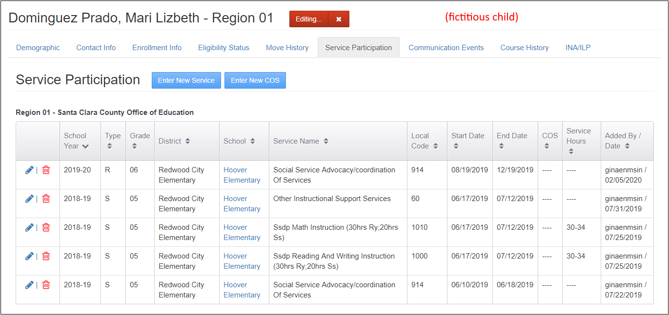
Editing the Service Participation Tab
Notes:
Lead: Victor
Time: 2 min
Talking Points:
Now we will continue reviewing the Child Record Modal and cover the Service Participation tab.
There is a user guide for entering services on the MSIN homepage. Please read it carefully and make sure you understand all definitions and instructions.
(Go over button/icons in the screenshot)
* The examples shown here is a fictitious child in the testing server.

Slide 29
Service Participation Dependencies
3. Enrollments and Services appear as options in service entry screens
4. Service Participation data appears in services reports
2. Service Administration
1. Enrollment line
Notes:
Lead: Victor
Time: 3 min
Talking Points:
Like the pyramid we used for Enrollments, this graphic representation is read from bottom to top.
Before you can enter services, two things need to be in place:
The child must have an enrollment line in the applicable school year, and
The service must be set up and active (via the Service Administration screen).
Generally, Data Specialists complete re-enrollments and work with their management teams to ensure that the correct services are in MSIN and are active.
With managers, Data Specialists do the set-up work so that enrollment and service options appear in the service entry screens (e.g., Service Participation tab in the Child Record Modal and Group Services under the “Children” menu) so that MEP staff with the Student Services role can link an active service to a child’s existing enrollment line.
Finally, once services are entered for a student, that information contributes to the Service Report, which can be run after-the-fact to double check service participation data at the school, district, and regional levels.

Slide 30
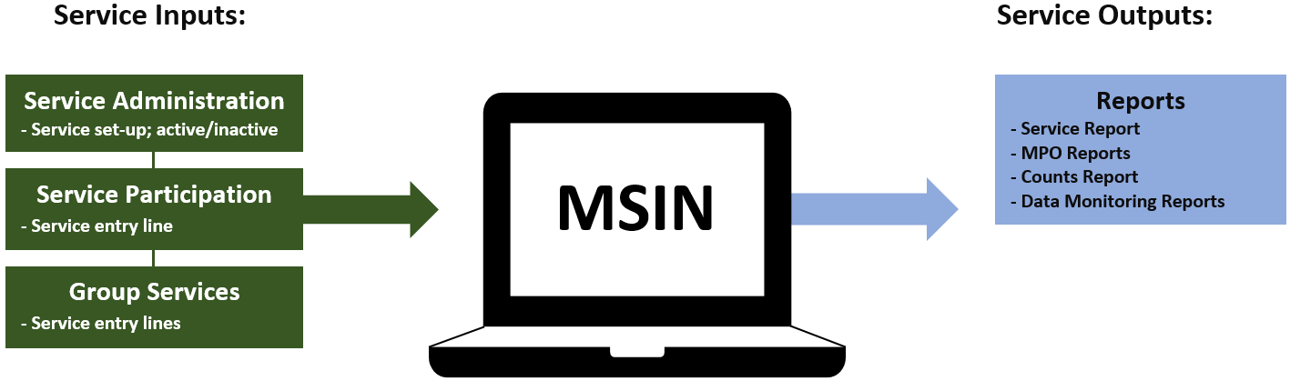
Service Participation Inputs and Outputs
Notes:
Lead: Victor
Time: 2 min
Talking Points:
This diagram shows the Service Participation inputs and outputs.
The green boxes represent how service information enters MSIN. (Go over each green box)
The blue boxes represent the places in MSIN where that service information appears again. (Go over each blue box)
We don’t see as many outputs as we did with enrollments because we are much closer to the end-goal. Providing services to migratory children is the core intervention made by the MEP program (so that every child has the opportunity to graduate from high school or the equivalent). As a result, the service participation outputs we find in MSIN are reports to see how the program is doing.

Slide 31
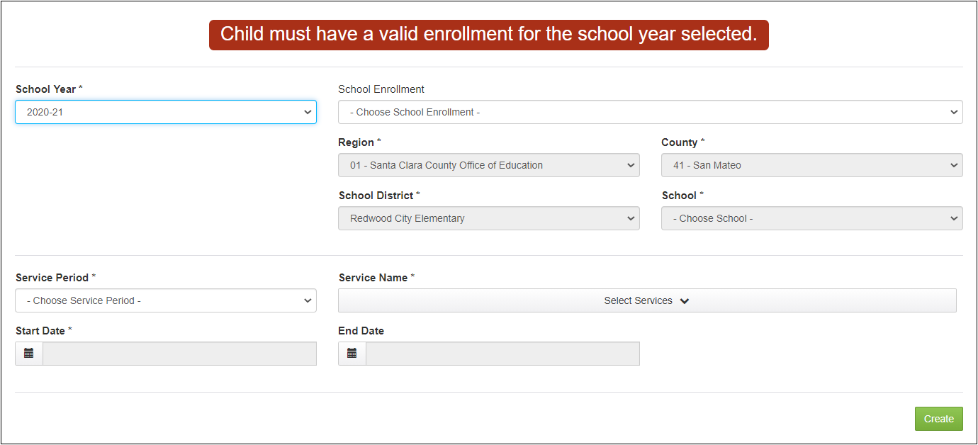
Service Participation Data Entry
Notes:
Lead: Victor
Time: 2 min
Talking Points:
As explained earlier, notice that a new service participation entry is always linked to an existing enrollment line.
Once an enrollment line is selected, the four grey fields are populated automatically using the enrollment line info (Region, County, School District, School).
Next, the user selects the Service Period, which can be Regular Year, Summer, or Intersession. This selection should be based on the school’s calendar.
The user can now select one or more services that were provided during the same date range.
Lastly, the user enters the State Date and End Date for the service(s). Note that these dates must “fit inside” the enrollment dates, for logical consistency. If the child is non-attending and does not have enrollment dates, then the service dates must fall within the school year.
Consult the MSIN user guide on entering services for exact date limits.
The system will also display the date limits when the user clicks on these fields.

Slide 32
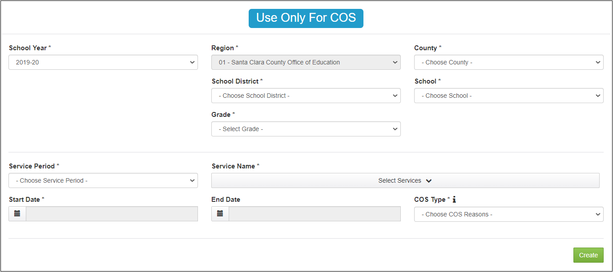
Continuation of Services Data Entry
Notes:
Lead: Victor
Time: 2 min
Talking Points:
Continuation of Services (COS) is a set of special exceptions for continuing to serve certain children whose eligibility for the MEP has expired.
There are three types: COS1, COS2, and COS3. Consult the MSIN user guide for specific definitions that come from Guidance.
In contrast to the prior screen, this one does not load enrollment lines because you would only use this screen if the child’s eligibility has already expired, so linking to a valid COE and enrollment line is not needed.
Only the Region field populates based on the user’s account. The remaining fields must be selected to indicate the school (i.e., MEP project) that provided services and the child’s grade level.
Service Period and Service Name work the same way as the service entry screen.
In a COS entry, the Start Date must be after the EOE (End of Eligibility) date in the same school year. This ensures that only COS information is entered.
The End Date has a limit based on the selected school year.
Lastly, a COS type must be selected (e.g., COS1, COS2, or COS3).
COS entries appear in the Student Services Report, with the appropriate label, because they are a type of service provided by the MEP.

Slide 33
Caveats: Service Participation
Collecting accurate service participation information is important because many of the Measurable Program Objectives (MPO) in the State Service Delivery Plan (SSDP) are measured using service participation data.
Accurate Summer/Intersession service participation data is crucial for Category 2 counts, which affect State and local funding.
Summer/Intersession services are linked to any enrollment line in the corresponding school year.
To maintain logical consistency, service participation dates must fall within enrollment dates and within corresponding school years.
Service Start and Service End dates can serve as Residency Verification Dates for children/youth to be counted in the performance period.
Notes:
Lead: Victor
Time: 2 min
Talking Points:
(Read or paraphrase bullets)
(Bullet 2: Emphasize this one. Remind them that subgrantees should have backup documentation (logs, sign-in sheets, etc.) for services entered in MSIN.)
Remember that Data Specialists are local data experts and other staff in the region/DFD may look to them to answer questions or resolve problems. This is particularly true for local staff who have the Student Services role.
For example, as the region/DFD works on Data Monitoring Reports, local Data Specialists often lead that work and provide support.

Slide 34
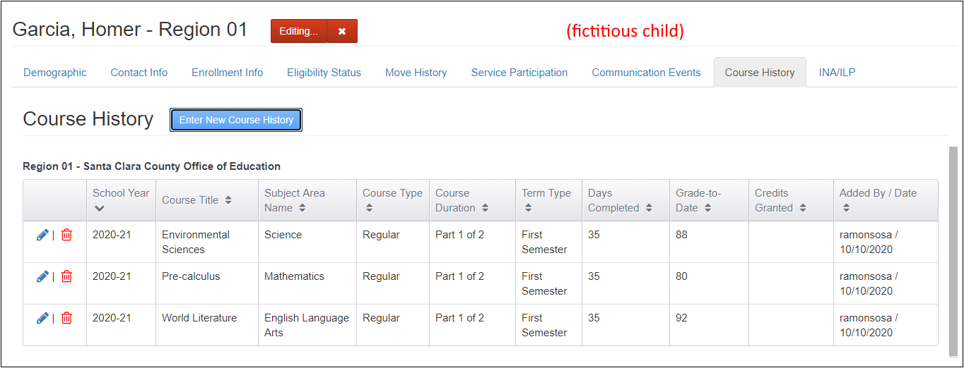
Editing the Course History Tab
Notes:
Lead: Jose
Time: 3 min
Talking Points:
Next, we will move on to Course History (second to last tab in the Child Record Modal).
There is a user guide for Course History on the MSIN homepage. Please read it carefully and make sure you understand all definitions and instructions.
This tab only applies to secondary students (grades 9-12) who moved away from your region/DFD mid-year.
If a secondary student moved early in the school year, then all of their classes will be partially completed.
In contrast, if the secondary student moved away during their second semester, their first semester classes will be completed (i.e., grades and credits granted), whereas their second semester classes will be partially completed.
(Walk through the example in the screenshot)
* The examples shown here is a fictitious child in the testing server.

Slide 35
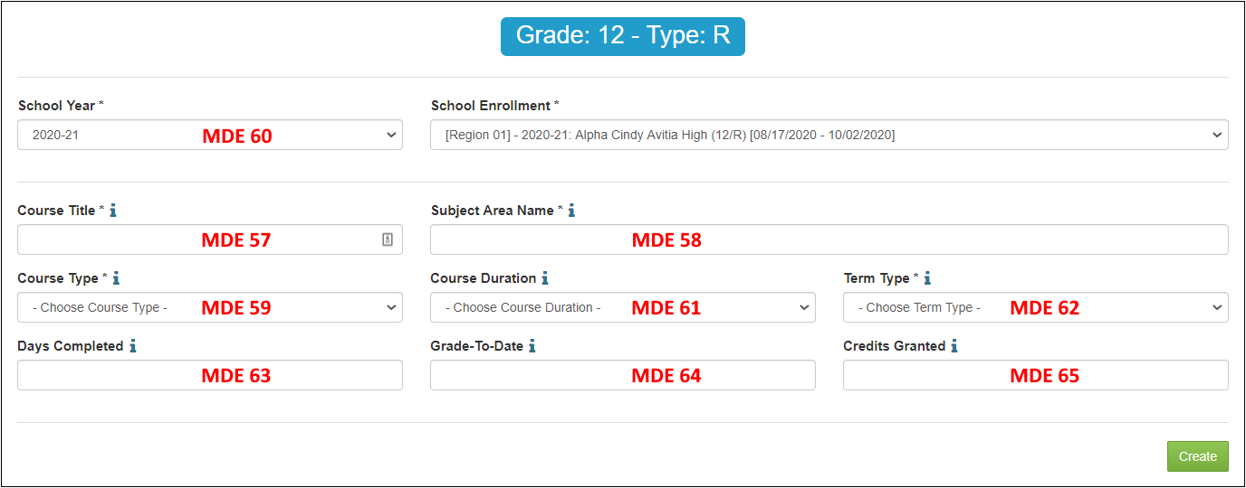
Adding Course History
  Follow the instructions in the help text (i) next to each field title. Fields with an Asterix need to have a value entered or selected.
Notes:
Lead: Jose
Time: 3 min
Talking Points:
The fields shown on this data entry screen are MSIX MDEs and are therefore required, per MSIX regulations.
(Walk through MDEs.)

Slide 36
Caveats: Course History
Federal regulations for the MSIX require the timely collection and submission of partial course history for secondary students that move away from your region/DFD mid-year, before completing their courses for the academic year (Legal reference: 34 Code of Federal Regulations § 200.85).
Subgrantees must develop local processes to identify secondary students who moved elsewhere mid-year, before completing their courses.
If local MEP staff do not have access to district databases, they will need to coordinate with districts directly to obtain specific course data for the applicable students.
This tab only works for secondary students who have an existing enrollment line with grades 9 through 12.
Notes:
Lead: Juli
Time: 2 min
Talking Points:
(Read or paraphrase bullet points)
This concludes our review of the Service Participation and Course History tabs.
Now we will move on to the third collaborative activity.

Slide 37
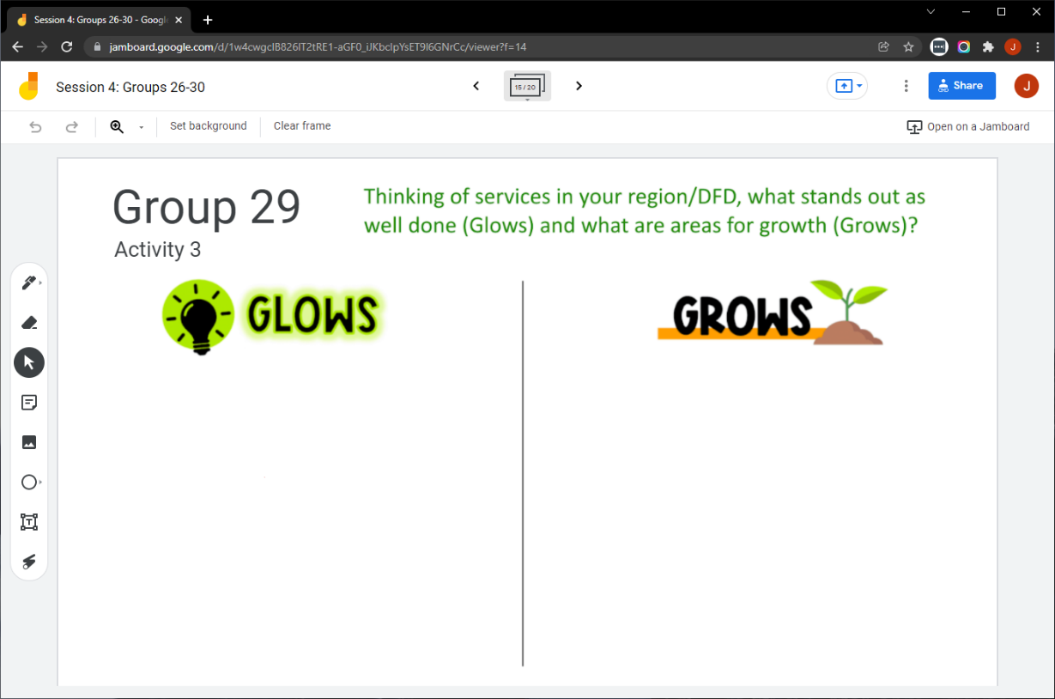
Collaborative Activity 3
Notes:
Lead: Victor
Time: 3 mins.
Talking Points:
This collaborative activity is focused on sharing and discussing what you are doing well (Glows) and what still needs development (Grows) with respect to your services tasks.
Explain that participants will be placed in breakout rooms with 5 collaborators. [Randomly assigned; not the same group members as in Activity 1 or 2.]
Demonstrate the activity using Jamboard: https://jamboard.google.com/d/1K_CVMYceh6o0f18WKGaQQBEb8zG8b6gHLQYH4WWs0co/edit?usp=sharing
Focus on the tasks in green text.
Walk through adding post-its (sticky notes).

Slide 38
Activity 3 Instructions
In your BR, take 2 minutes to introduce yourselves (name, region/DFD, and job title).
Open the chat window to view the instructions and links.
Click on the Jamboard link that matches your BR number (e.g., BR 29 should go to Jamboard group 29).
Keep two windows open: your BR in zoom and your activity 3 slide in Jamboard.
Add post-its (sticky notes) or text in each category.
Share your contributions with the group.
Notes:
Lead: Victor
Time: 10 mins.
Talking Points:
(Read instructions on the slide.)
Send to Breakout rooms – 8 minutes
Paste the instructions in the chat for all breakout rooms.

Slide 39
Questions? (3)
Notes:
Lead: Team
Time: 3 mins
Answer a few questions about the Service Participation and Course History tabs.

Slide 40
Check for Understanding (2)
  Next, you will see a pop-up window with questions and response options.
  There are two questions for this section; answer them as best you can.
  You will get a warning when the poll is about to close.
Notes:
Lead: Victor
Time: 4 min
Poll Questions:
1) Summer and Intersession services affect funding, so this information must be entered accurately.
True [answer]
False
I don’t know
2) If a high school student moves to another state just after finishing their first semester, then Course History must be entered in their child record.
True [answer]
False
I don’t know

Slide 41
Resources and Closing Activity
Notes:
Transition Slide
Lead: Juli
Time: 10 secs.

Slide 42
Resources
Subgrantees may use this presentation to review requirements and recommendations.
User guides and how-to videos for the features covered today are available on the MSIN home page, under User Guides: https://drive.google.com/drive/folders/0BxgpmxyQ79rmSHJPd2tQSlM5M1U?resourcekey=0-Jkd_AcZsKXCoWM_3MOMVCQ&usp=sharing
If any questions arise, Data Specialists should consult with their supervisors first. Remaining questions or concerns can be submitted to the MSIN Service Desk.
Notes:
Lead: Juli
Time: 1 min
Talking Points:
In addition to the user guides, remember that definitions, rules, and other information is readily accessible within most screens by clicking the “i” icon next to field titles.
Finally, don’t forget that the Training MSIN site is always available so that you can practice and brush up on system features.

Slide 43
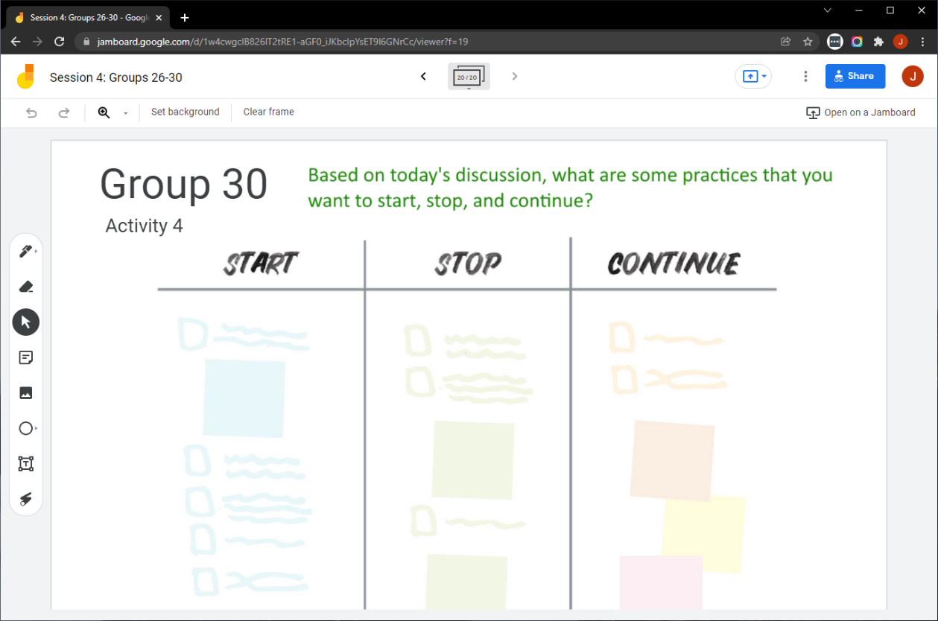
Collaborative Activity 4
Notes:
Lead: Juli
Time: 3 mins.
Talking Points:
Our last collaborative activity for this session is meant for you to reflect and discuss any key points that you’re thinking of integrating into your local practices going forward. This activity is called “Start – Stop – Continue.”
Explain that participants will be placed in breakout rooms with 5 collaborators. [Randomly assigned; not the same group members as in Activity 1 or 2.]
Demonstrate the activity using Jamboard: https://jamboard.google.com/d/1K_CVMYceh6o0f18WKGaQQBEb8zG8b6gHLQYH4WWs0co/edit?usp=sharing
Focus on the task in green text.
Add post-its (sticky notes) or text to the 3 categories, based on what you learned, remembered, and reinforced during this collaborative session.

Slide 44
Activity 4 Instructions
A) In your BR, take 2 minutes to introduce yourselves (name, region/DFD, job title or role).
B) Open the chat window to view the instructions and links.
C) Click on the Jamboard link that matches your BR number (e.g., BR 9 should go to Jamboard group 9).
D) Keep two windows open: your BR in Zoom and your Activity 4 slide in Jamboard.
E) Add a post-it (sticky note) or text in each of the categories.
F) Discuss anything that you find surprising or unexpected.
Notes:
Lead: Juli
Time: 10 mins.
Talking Points:
Read instructions on the slide.)
Send to Breakout rooms – 8 minutes
Paste the instructions in the chat for all breakout rooms.

Slide 45
Questions? (4)
Notes:
Lead: Team
Time: 3 mins

Slide 46
Contact Information
Juli Auld
Education Research and Evaluation Consultant
California Department of Education
jauld@cde.ca.gov
916-319-0410
__________________________________________________
MSIN Service Desk
MSINsupport@wested.org
1-800-342-2964, option 2
Notes:
Lead: Juli
Time: 30 sec
Talking Points:
Thank participants for attending.

