Slide 1
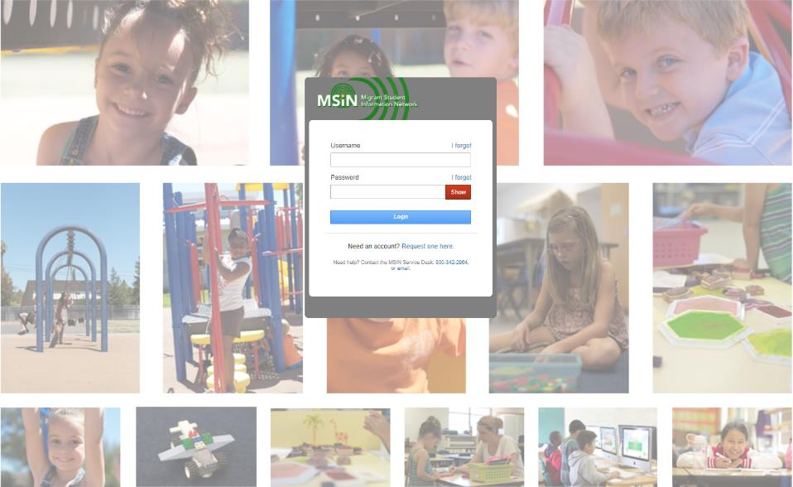
Welcome to the Migrant Student Information Network
2022 Training
We will begin shortly.
Please enter your name and region/district in the chat.

Slide 2
Migrant Student Information Network:
User Account Management
January 25, 2022
1:00 p.m. – 3:00 p.m.

Slide 3
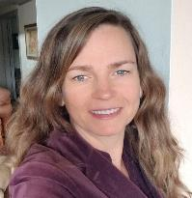
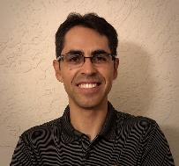

Welcome and Introductions
Session Presenters
Juli Auld, Education Research and Evaluation Consultant, California Department of Education (CDE)
Jose Valencia, Migrant Student Information Network (MSIN) Lead, WestEd
Victor Garibay, MSIN Specialist, WestEd
Notes:
Lead: Juli
Time: 3 mins.
Talking Points:
Welcome participants.
Presenters introduce themselves

Slide 4
Purpose
This webinar will review MSIN account management processes, particularly as they relate to system security and data privacy.
The target audience is MEP staff with the Regional User Approver role.
Notes:
Lead: Juli
Time: 1 min.
Talking Points:
(Read or paraphrase bullets)
The session content is a review of key items taken from last year’s training series.
This year, the focus is on sharing and collaborating with your peers.
This session is meant for experienced MSIN users who already have a working background as active Regional User Approvers.

Slide 5
Session Objectives
Participants will:
Know the MSIN account request process for new users;
Know how to manage existing MSIN user accounts;
Know how MSIN users can manage their own profile;
Share and discuss local knowledge regarding these topics; and
Review the resources available to support Regional User Approvers.
Notes:
Lead: Juli
Time: 1 min.
Talking Points:
(Read or paraphrase bullets)

Slide 6

Housekeeping
Please mute your speaker in the main session.
Use the chat function to enter your questions.
Participate in breakout room activities.
The PowerPoint for this presentation can be accessed through the link provided in the chat.
Notes:
Lead: Juli
Time: 1 min.
Talking Points:
(Read or paraphrase bullets)

Slide 7
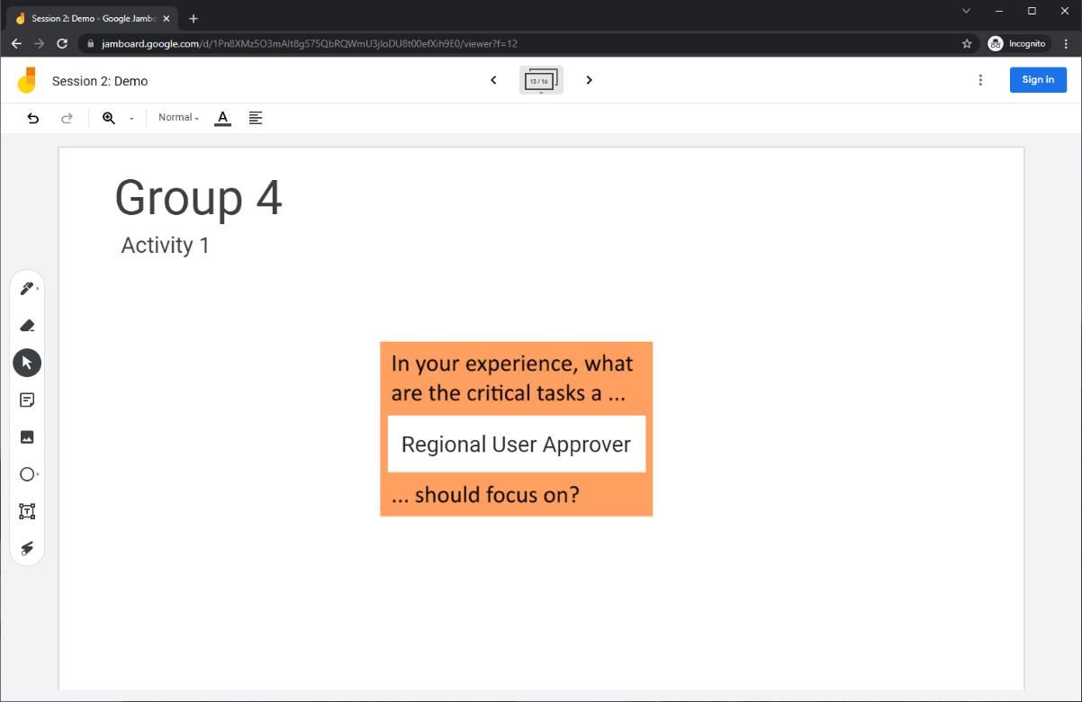
Collaborative Activity 1: Knowledge Wall
Notes:
Lead: Jose
Time: 3 mins.
Talking Points:
At this point, Regional User Approvers have been working with user accounts in MSIN for many years. So, our first collaborative activity is meant to tap into your collective knowledge and share it with your peers. This is a “Knowledge Wall” activity.
Explain that participants will be placed in breakout rooms with 5 collaborators.
Demonstrate the activity using Jamboard: https://jamboard.google.com/d/1Pn8XMz5O3mAlt8g575QbRQWmU3jloDU8t00efXih9E0/edit?usp=sharing
Focus on the prompt in the orange box. Also think of the information you learned/reviewed this morning with Elizabeth Wisnia around data privacy and security.
Walk through using the post-it (sticky note) and text controls to add content.

Slide 8
Activity 1 Instructions
In your Breakout Room (BR), take 2 minutes to introduce yourselves (name, region/DFD, and job title).
Open the chat window to view the instructions and links.
Click on the Jamboard link that matches your BR number (e.g., BR 4 should go to Jamboard group 4).
Keep two windows open: your BR room in zoom and your activity 1 slide in Jamboard.
Add post-its (sticky notes) or text onto the wall.
Discuss your contribution(s) to the wall with the group.
Notes:
Lead: Jose
Time: 10 mins.
Talking Points:
In your breakout room, take 2 minutes to introduce yourselves (name, region/DFD, job title or role).
Open the chat window to view the instructions and links.
Click on the Jamboard link that matches your breakout room number (e.g., breakout room 4 should go to Jamboard group 4).
Keep two windows open: your breakout room in Zoom and your Activity 1 slide in Jamboard.
Add post-its (sticky notes) or text onto the wall.
Discuss your contribution(s) to the wall with the group.
Send to Breakout rooms – 8 minutes
Paste the instructions in the chat for all breakout rooms.

Slide 9
Regional User Approver Role in MSIN
Regional User Approval Role Definition: MEP staff who are responsible for managing local user accounts in the MSIN system, including the review of new account requests.
The Regional User Approver role is intended for local managers, or designees, who can verify the identity of their staff and can make decisions regarding each staff member’s level of access in the MSIN system.
Because the data in MSIN is sensitive personally identifiable information (PII), MEP staff with the Regional User Approver role are responsible for actively monitoring local user access and revoking access to anyone who no longer needs it.
Notes:
Lead: Jose
Time: 2 mins.
Talking Points:
Review slide: Key definition
(Read or paraphrase slide.)
(For bullet 1, emphasize the critical importance that Regional User Approvers know their users (who they are) and the need to collaborate with management to give appropriate access.)
(For bullet 2, emphasize that active management is a very important responsibility as it greatly increases the chance of catching a potential security issue.)

Slide 10

You Control Access to Your Region/DFD
Regional User Approvers are the “gatekeepers” of the regional and district information. As such, it is important to:
Know who your users are and where they work.
Be familiar with the information your users are accessing and for what purposes.
Report any unusual activity to your manager and WestEd/CDE.
Notes:
Lead: Jose
Time: 2 mins.
Talking Points:
Review slide
(Read or paraphrase bullets.)
What we mean by “unusual activity” is open to interpretation. In general, it means anything that seems questionable or suspect to you. It is better to err on the side of caution and contact the MSIN Service Desk right away.
For example, WestEd staff have created test accounts in the past and subgrantee staff immediately noticed the new accounts. They immediately contact the MSIN Service Desk to verify that they were legitimate accounts. This is exactly what you should do.

Slide 11

Questions?
Notes:
Lead: Team
Time: 3 mins.
Use the chat feature to submit questions about Regional User Approver responsibilities.

Slide 12
New MSIN User Account Requests
Notes:
Transition Slide
Lead: Victor
Time: 20 secs.

Slide 13
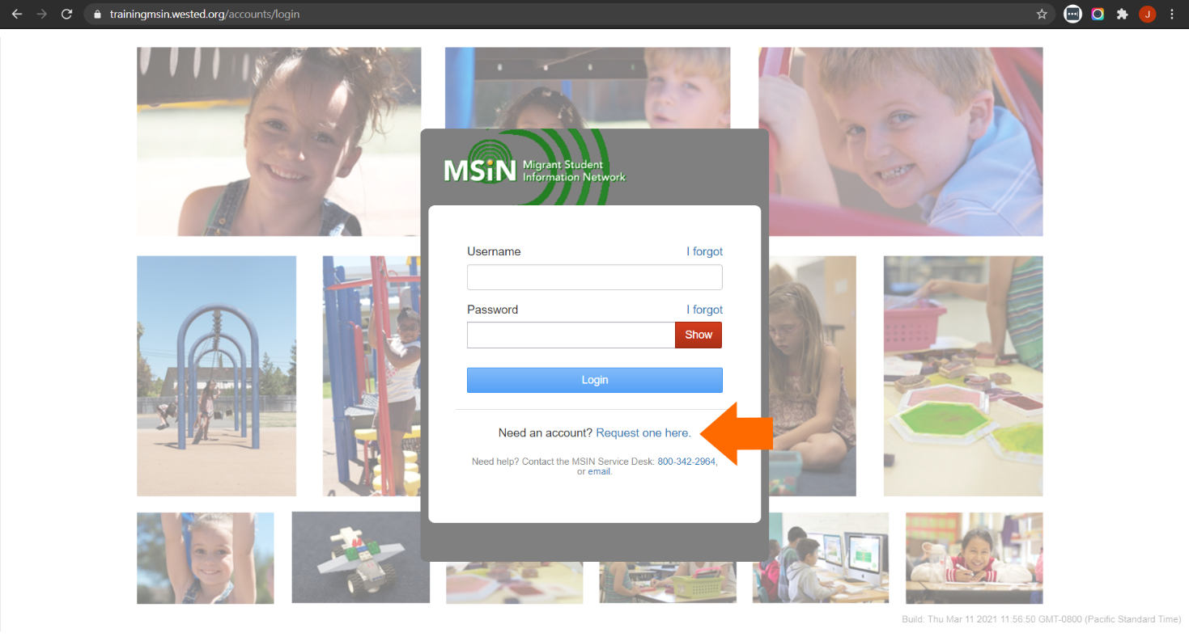
Request an Account
Notes:
Lead: Victor
Time: 1 min.
Talking Points:
This screenshot shows the link to the account request application, found on the MSIN login page.
During this portion of the presentation, we will use the terms “applicant” and “requester” interchangeably.

Slide 14
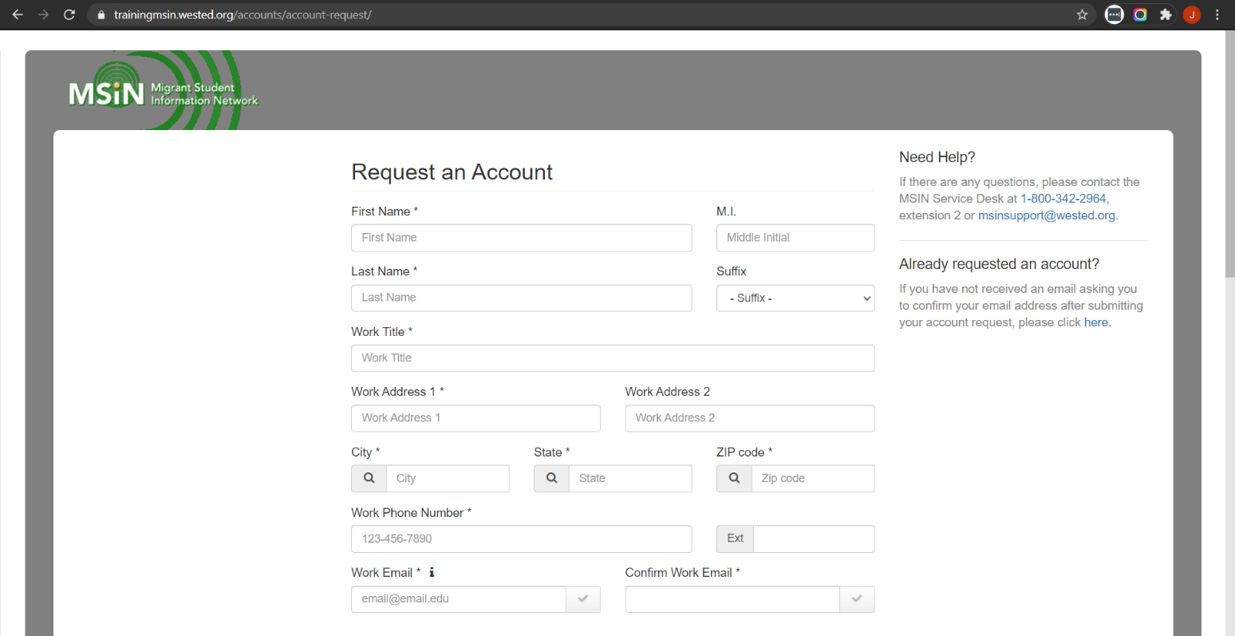
Account Request Application
Notes:
Lead: Victor
Time: 2 mins.
Talking Points:
New applicants provide the information shown in the screenshot so that we can verify their identity.
At the end of the form, new applicants must also agree to the Rules of Behavior before signing and submitting their application.
Most of your account applicants work for the MEP; we refer to them as MEP-funded applicants. But we do have some users who work for other MEP-affiliated organizations (like Mini-Corps, CAMP, etc.)
Today we are just covering applications from MEP-funded staff, not other organizations.

Slide 15
Steps in Account Creation Workflow
Level 1: Subgrantee Review
Level 2:
State Review
Potential user submits online application
Regional User Approver completes review and assigns user role(s)
State User Approver completes second review and approves account
New user receives approval confirmation and sets their username and password
Notes:
Lead: Victor
Time: 2 mins.
Talking Points:
The Account Creation workflow has several steps, represented here in a simple diagram. This gives us the big picture of how new accounts are processed.
(Walk through steps in the diagram.)
Key Point 1: During the first step, MSIN will automatically send the applicant a message to verity their email address.
Key Point 2: This process has two levels of review (subgrantee and state).
Next, we are going to focus on what you would do as a Regional User Approver when you receive a new request, so just the first half of the diagram, including the Subgrantee Review.

Slide 16
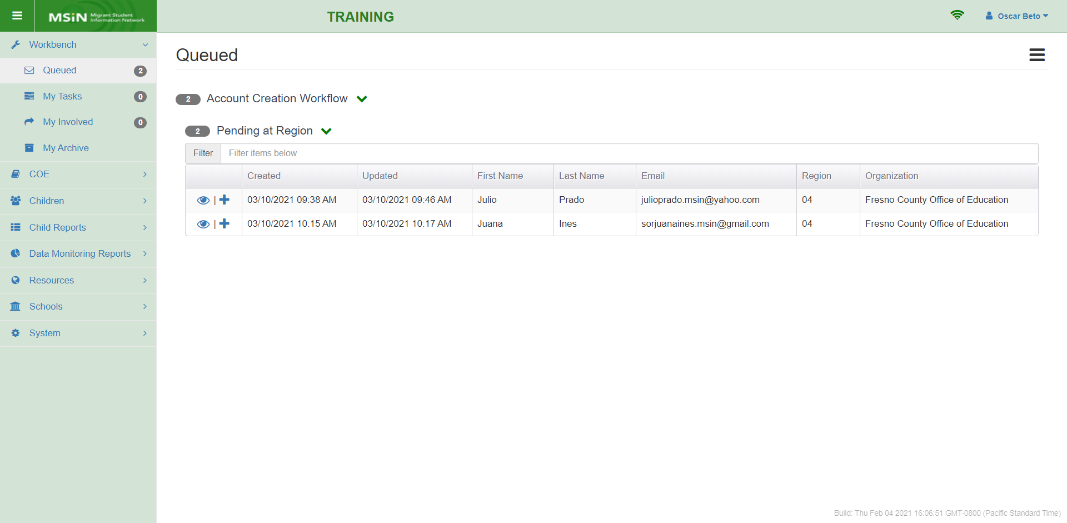
Account Creation Workflow in Workbench
Notes:
Lead: Victor
Time: 2 mins.
Talking Points:
New account requests come in through the Workbench and are organized in the Queued folder.
If any account requests are pending the first level of review, they will show up under “Pending at Region.” That includes DFDs.
(Review the contents of the screenshot. A fictitious Regional User Approver, Oscar Beto, is logged in.)
To claim the request and move it to the My Tasks folder, the Regional User Approver will click on the plus icon.
Key Point: In large regions with multiple Regional User Approvers, a local process should be created to divide up the account approval work.
Next, we will claim Juana’s application (2nd row in screenshot) to move it to My Tasks.

Slide 17
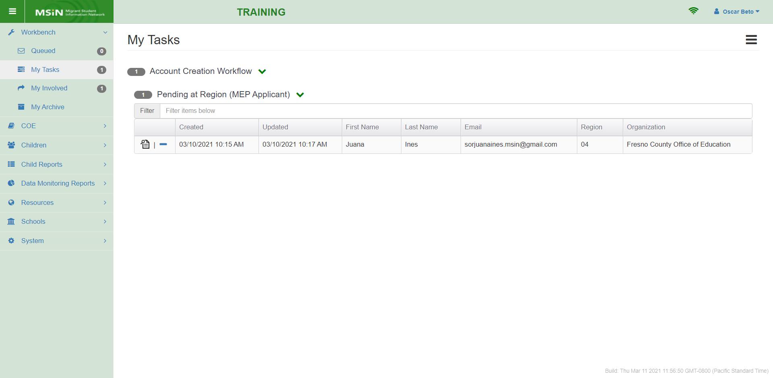
Local Review Process
Notes:
Lead: Victor
Time: 30 secs.
Talking Points:
After an application is in My Tasks under the Workbench tab, the Regional User Approver will open it by clicking on the document icon.

Slide 18
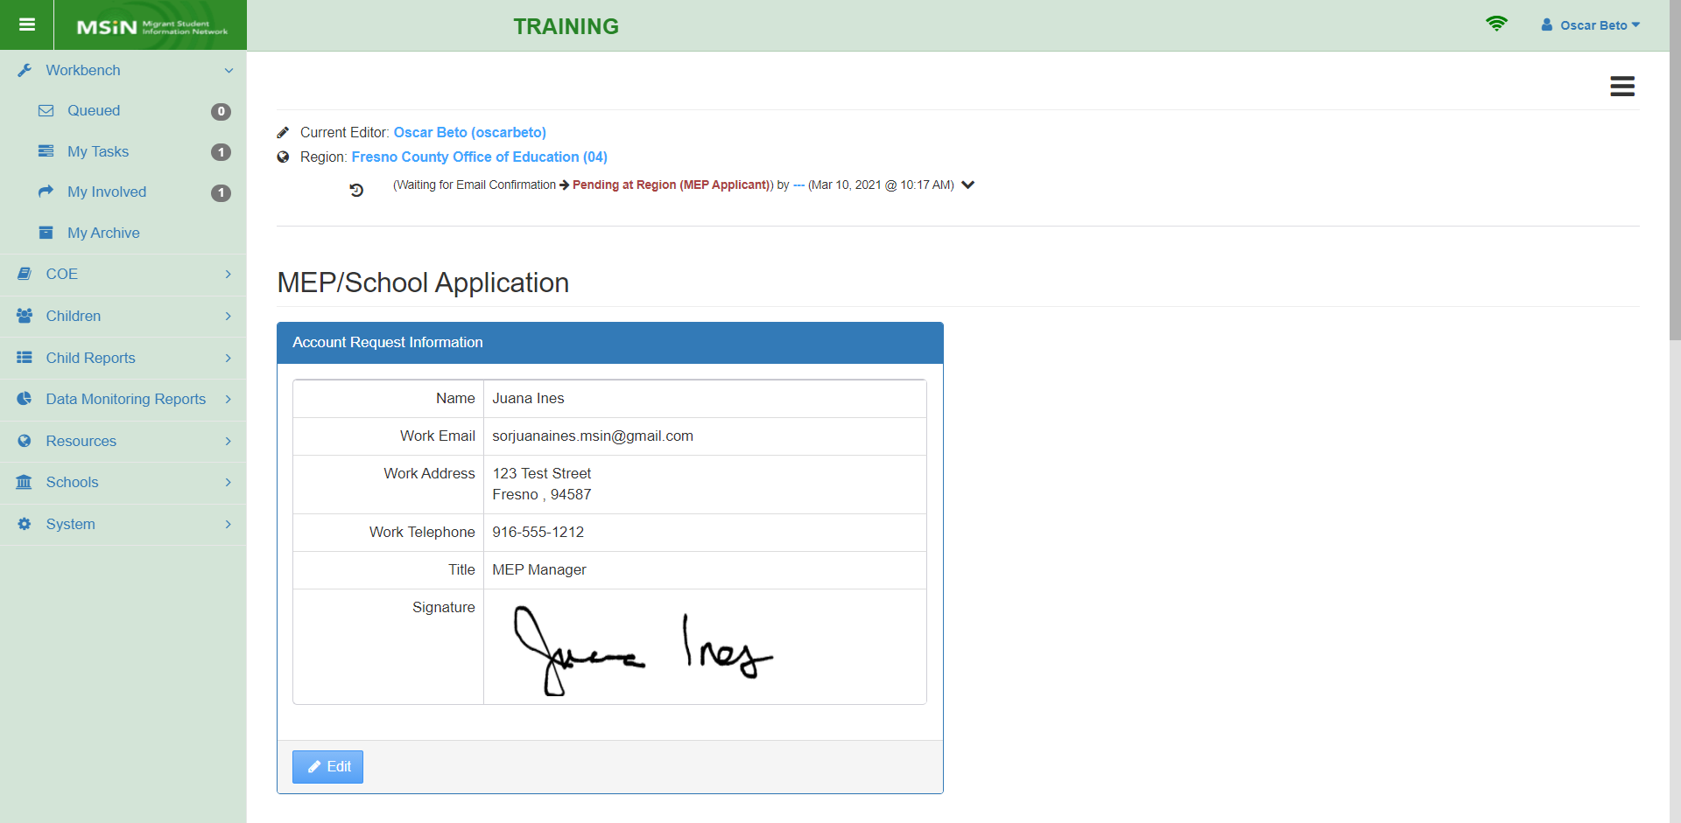
Local Approval: Step 1
Notes:
Lead: Victor
Time: 2 mins.
Talking Points:
The first step in the local approval process is always to verify the applicant’s identity by
checking the full name;
checking the email address (must be a work email) – very important because email is used for password resets;
checking the phone number (must be a work phone number); and
checking the address (must be a work address).
Prompt: Is this what you do? How do you verify the new user's identity? This question will be in an upcoming activity.
If needed, minor edits can be made, using the blue Edit button.

Slide 19
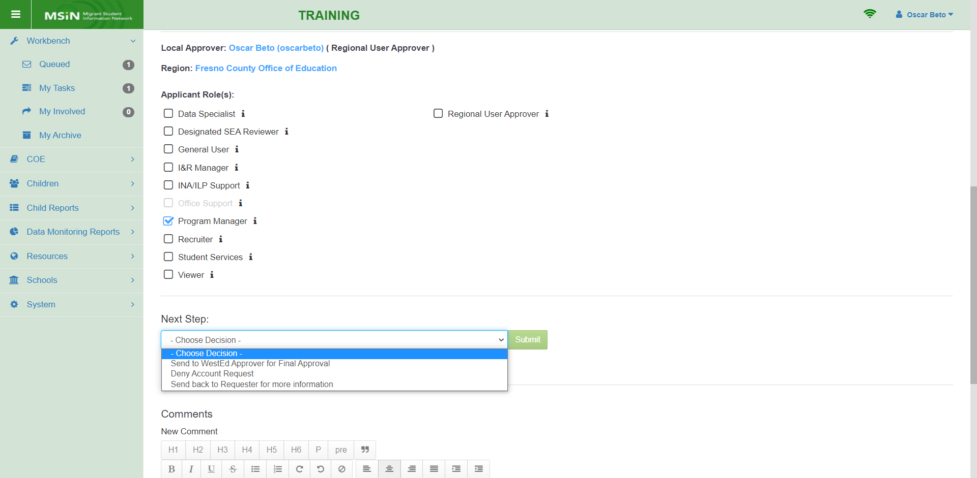
Local Approval: Steps 2 & 3
Notes:
Lead: Victor
Time: 2 mins.
Talking Points:
The second step in the local approval process is to decide which role, or combination of roles, the new user will have.
Consult the user guide documents and tables to remind yourself of what each role can do in MSIN.
This step may also require consulting with your management team, so the new user has the appropriate level of access.
For the third step, the Regional User Approver will make a selection from the Next Step drop-down menu.
In this example, we will forward the request to the second level of review (done by WestEd/CDE), which is the top option in the drop-down menu.

Slide 20
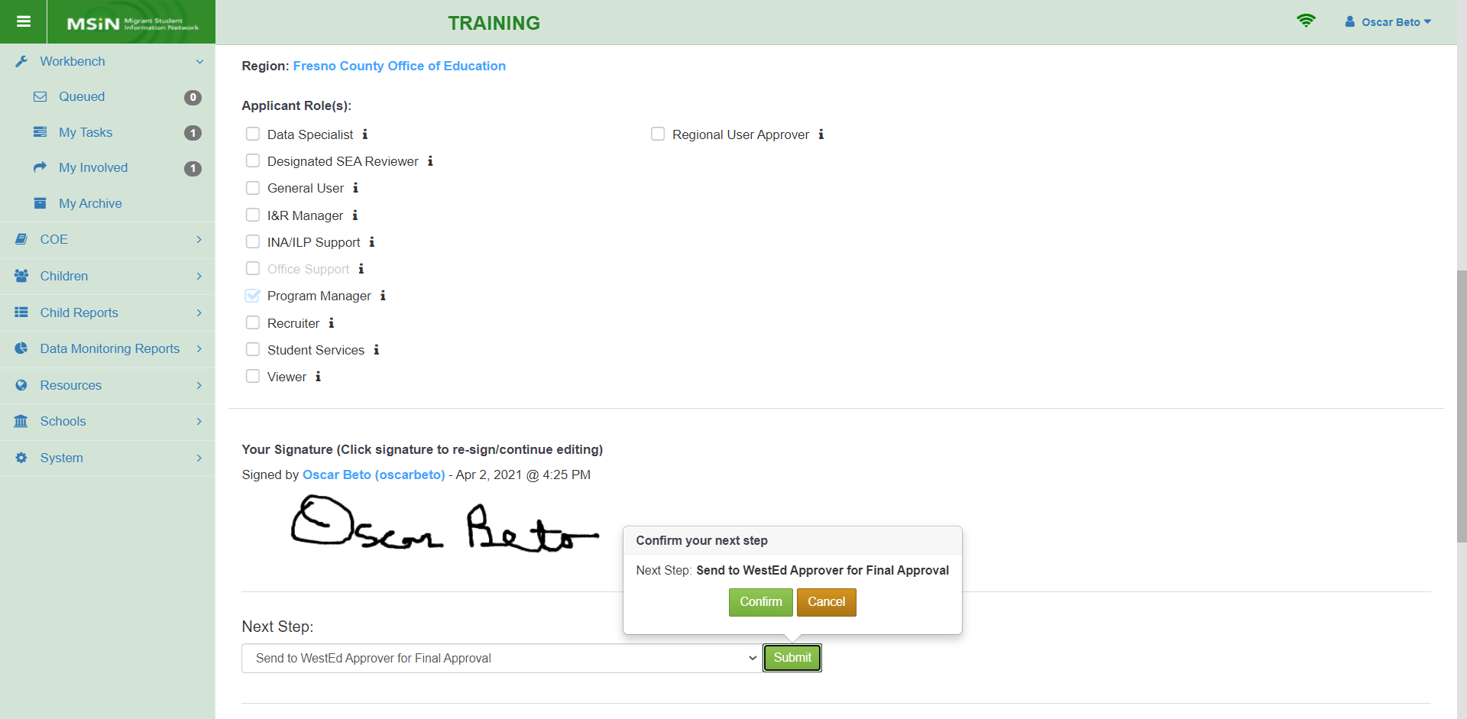
Local Approval: Steps 4 & 5
Notes:
Lead: Victor
Time: 2 mins.
Talking Points:
If the request is approved, the Regional User Approver will:
sign the account request application; and
confirm that the request is approved.
After confirming, the request will be in Final Approval state, which means that it has moved on to WestEd for the second level of review.
Someone at WestEd will check the application contents a second time before granting access to the applicant.
From the Regional User Approver perspective, you are finished.
This concludes the account approval process from the Regional User Approver’s perspective.

Slide 21
Questions? (2)
Notes:
Lead: Team
Time: 3 mins.
Use the chat feature to submit questions about new account requests.

Slide 22
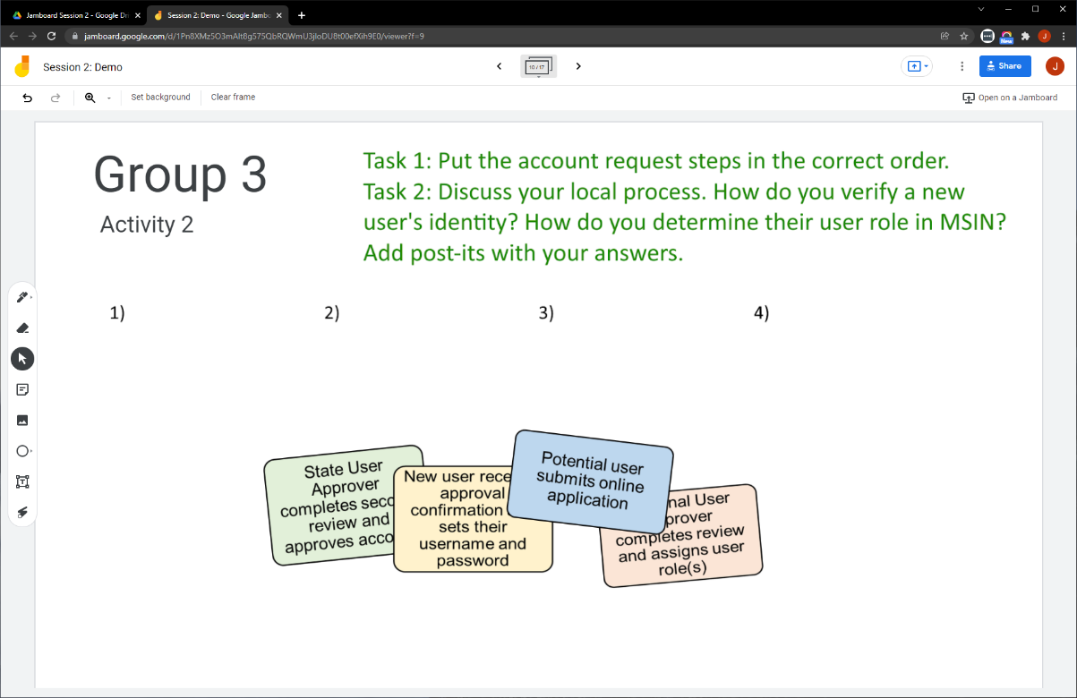
Collaborative Activity 2
Notes:
Lead: Jose
Time: 3 mins.
Talking Points:
This collaborative activity is focused on sharing and discussing your local process for reviewing new account requests.
Explain that participants will be placed in breakout rooms with 5 collaborators. [Randomly assigned; not the same group members as in Activity 1.]
Demonstrate the activity using Jamboard: https://jamboard.google.com/d/1Pn8XMz5O3mAlt8g575QbRQWmU3jloDU8t00efXih9E0/edit?usp=sharing
Focus on the tasks in green text.
Walk through moving the steps in order and on adding post-its (sticky notes) based on the group’s discussion.

Slide 23
Activity 2 Instructions
A) In your breakout room, take 2 minutes to introduce yourselves (name, region/DFD, job title or role).
B) Open the chat window to view the instructions and links.
C) Click on the Jamboard link that matches your BR number (e.g., BR 3 should go to Jamboard group 3).
D) Keep two windows open: your breakout room in Zoom and your Activity 2 slide in Jamboard.
E) Put the account request steps in the correct order.
F) Discuss your local process and add post-its (sticky notes) with your answers.
Notes:
Lead: Jose
Time: 10 mins.
Talking Points:
In your breakout room, take 2 minutes to introduce yourselves (name, region/DFD, job title or role). [Randomly assigned; not the same group members as in Activity 1.]
Open the chat window to view the instructions and links.
Click on the Jamboard link that matches your breakout room number (e.g., breakout room 3 should go to Jamboard group 3).
Keep two windows open: your breakout room in Zoom and your Activity 2 slide in Jamboard.
Put the account request steps in the correct order.
Discuss your local process and add post-its (sticky notes) with your answers.
Send to Breakout rooms – 8 minutes
Paste the instructions in the chat for all breakout rooms.

Slide 24
Check for Understanding
  Next, you will see a pop-up window with questions and response options.
  There are three questions for this section; answer them as best you can.
  You will get a warning when the poll is about to close.
Notes:
Lead: Victor
Time: 4 mins.
Poll Questions:
1) True or False: Local staff with the Regional User Approver role will provide the first level of review for MEP-funded applicants in their region or district.
True [answer]
False
I don’t know
2) After a new account request is submitted by a MEP-funded applicant,
MSIN will automatically send the applicant/requester an email to confirm their email address.
The new user will automatically get a new Instagram account.
The application will go through 2 levels of review (subgrantee & state), if successful.
A and C [answer]
I don’t know
3) True or False: Regional User Approvers should either know the users in their region/DFD or be able to verify their identities by working with their local managers.
True [answer]
False
I don’t know

Slide 25
Managing Existing User Accounts
Notes:
Transition Slide
Lead: Jose
Time: 1 min.
Talking Points:
Now we will cover the processes used to manage existing accounts. This is especially useful because the bulk of the MEP community in California already has an MSIN account.
We have well over 800 active accounts (as of December 2021), but there are actually more because some users reactivate their accounts on a seasonal basis (Revoked by System – after 120 days of inactivity).
Regional User Approvers will spend most of their efforts doing management tasks with their existing user accounts.

Slide 26
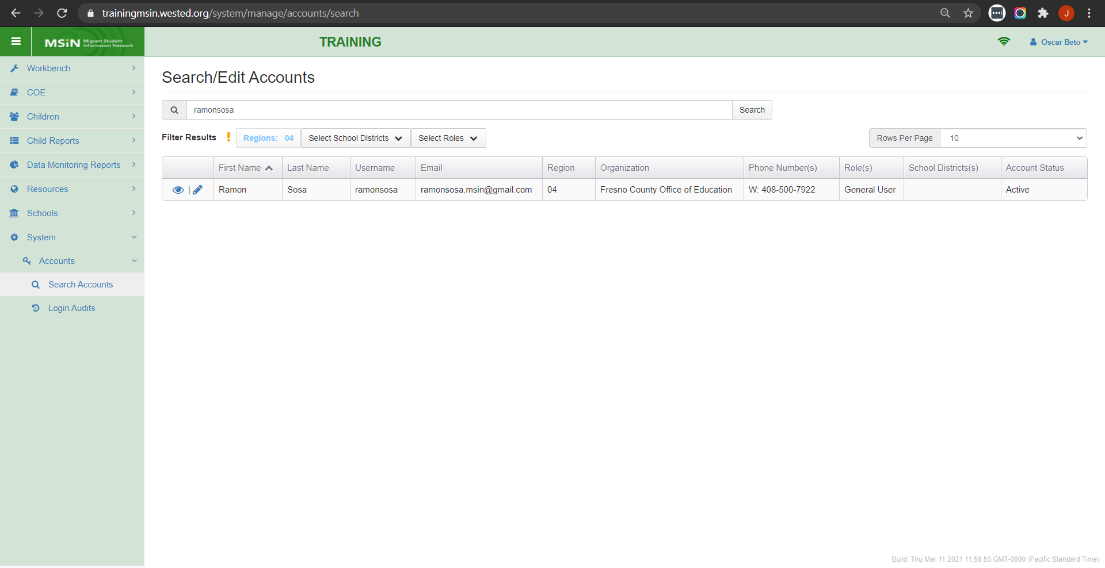
Searching and Editing User Accounts
Notes:
Lead: Jose
Time: 1 mins.
Talking Points:
This is a screenshot of Search/Edit Accounts screen. You can find the Search Accounts tab under the System tab in the menu.
We will click on the edit icon (pencil) to open a window with 3 tabs, called the user account modal.

Slide 27
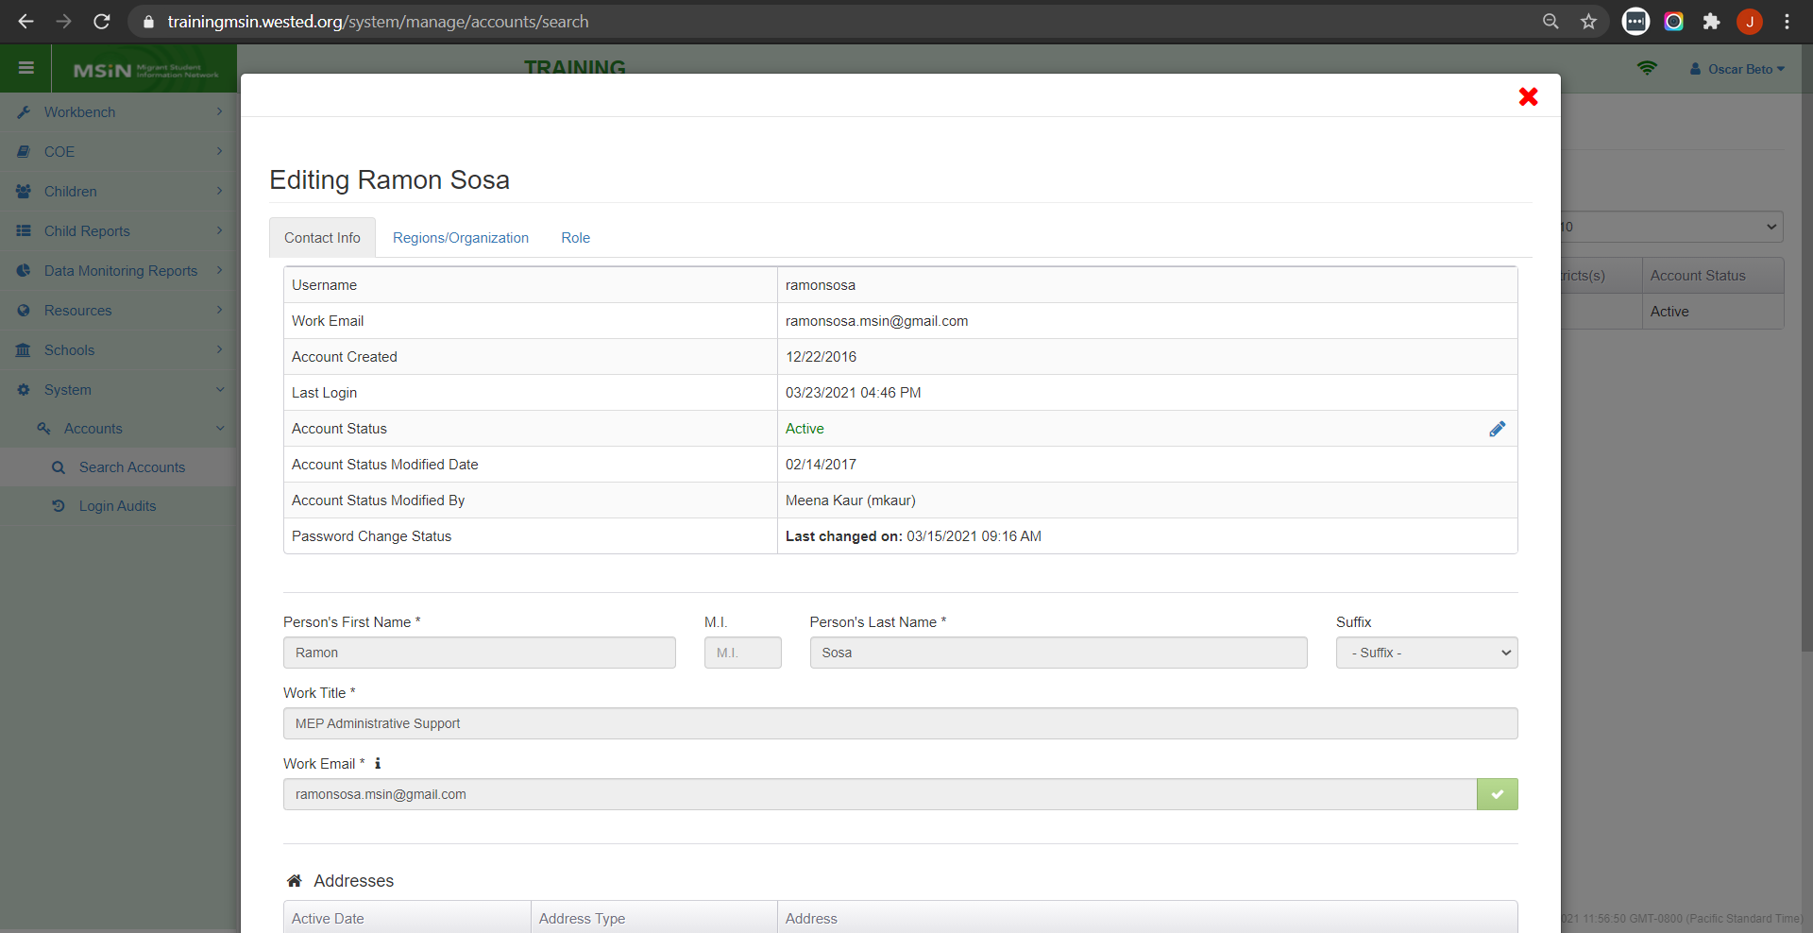
Account Modal: Contact Info
Notes:
Lead: Jose
Time: 1 min.
Talking Points:
The user account modal looks like a pop-up window and has three tabs along the top edge. The first tab is “Contact Info.”
Notice the edit icon (pencil) in the Account Status row. We are going to click on that next.

Slide 28
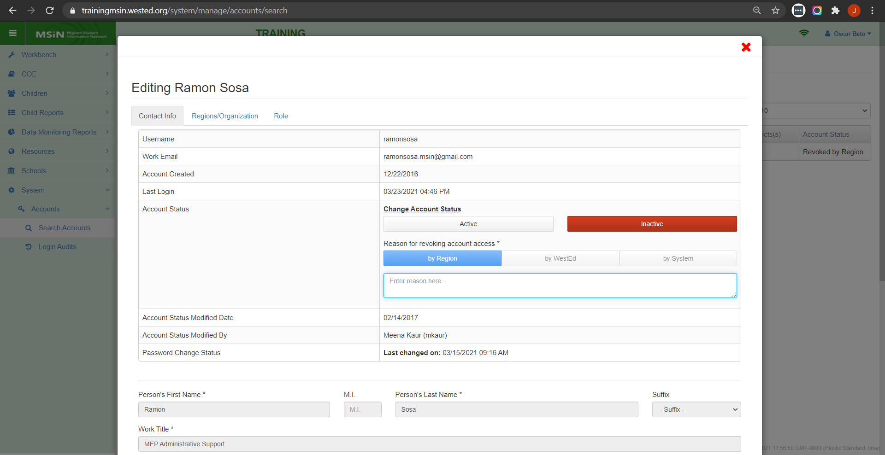
Account Modal: Contact Info (2)
Notes:
Lead: Jose
Time: 4 min.
Talking Points:
In the Account Status row, you can change the user’s account status, meaning that you can revoke access to MSIN for staff who no longer work in your region or Direct Funded District (DFD)(e.g., have changed jobs, have been let go, have retired, etc.).
Key Point 1: Regional User Approvers are responsible for making sure the accounts in their region/DFD are current. This includes revoking accounts as needed (e.g., a staff person is no longer employed by the MEP).
In the screenshot, notice that there are three was that an account can become Inactive or revoked : by Region, by WestEd, and by System (after 120 days of inactivity).
Key Point 2: Within the Contact Info tab, you can also edit work addresses and phone numbers. We have noticed that many users do not have a phone number listed. Is that the case with some of your users? Have you checked recently?
Demonstrate how you would check lots of accounts for missing information.
Also emphasize that it’s important to notice the account statuses and be sure that accounts that were revoked for inactivity are accurate. For example, did the user retire or move on to a different job? Or did they simply stop using MSIN for 4 months? It is important to verify what is happening.
What do you think? How often should you check your accounts? We will come back to this question in the next collaborative activity.
Before getting to that, let’s finish up with the 3 tabs in the Account Modal.

Slide 29
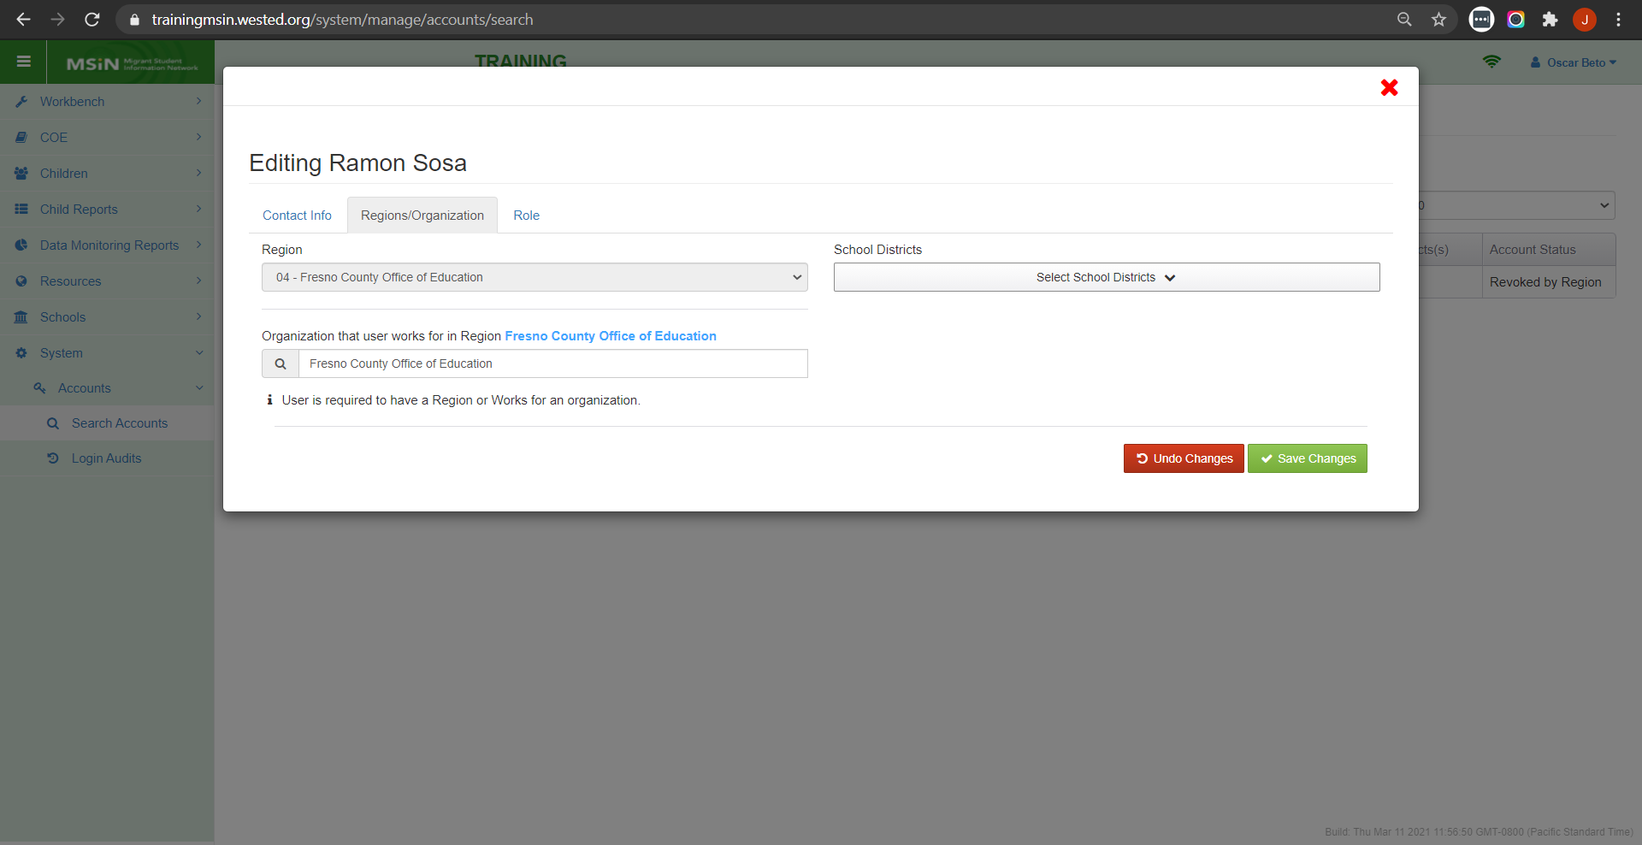
Account Modal: Regions/Organization
Notes:
Lead: Jose
Time: 1 min.
Talking Points:
The second tab is “Regions/Organization.” It shows the user’s region, and it allows the Regional User Approver to restrict the user to one of more districts.
Key Point 1: We have noticed that some users have all School Districts selected. This should not be the case.
If a user should have access to all districts, then do not use this drop-down because it is meant to restrict access to 1 or more districts (just a few). Think of the School District drop down as a restriction.
Returning to the idea of checking your users from time to time, this is also something you can look for.

Slide 30
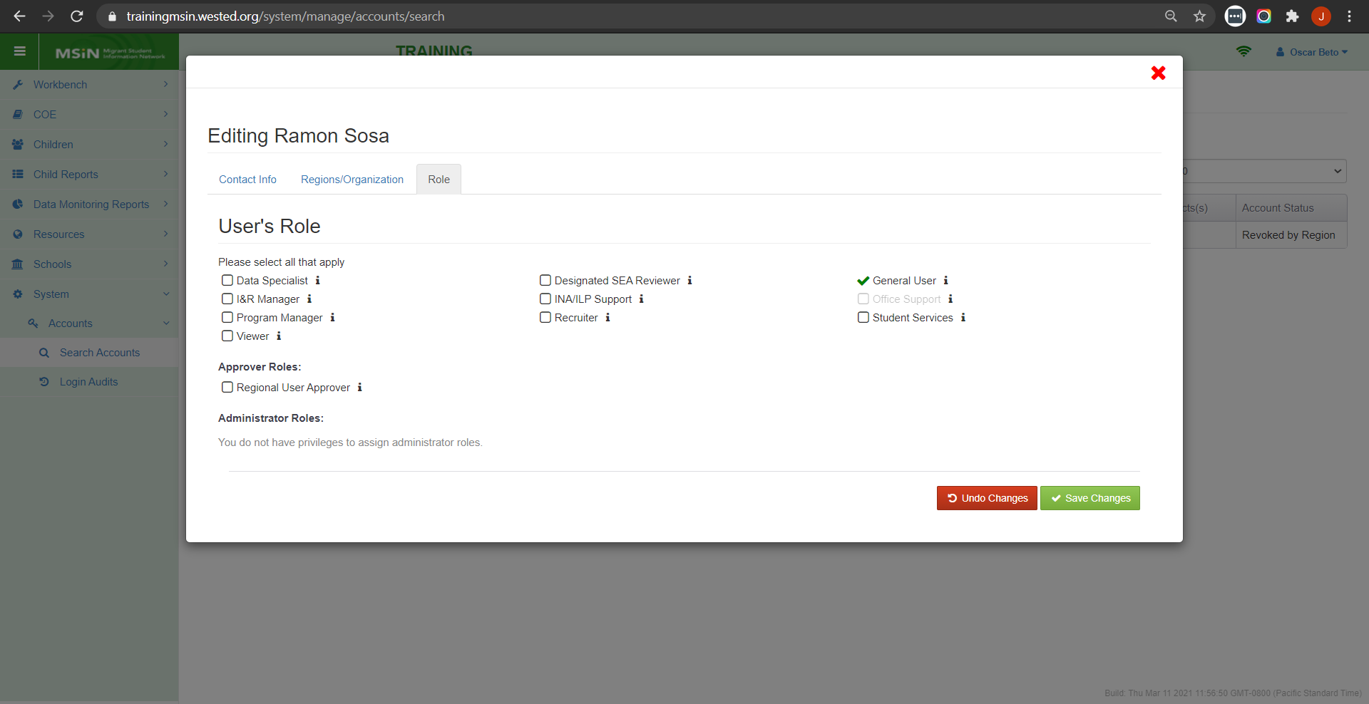
Account Modal: Role
Notes:
Lead: Jose
Time: 3 min.
Talking Points:
The third tab is “Role.” Regional User Approvers can select one or more roles for the user.
(Demonstrate reference tables found on the MSIN home page, which should be used to help determine the correct roles.)
Key Point 1: Regional User Approvers are responsible for making sure the accounts in their region/DFD are current and are assigned the correct role(s).
Key Point 2: Users should not be given more access than they need for their job. This means giving them the fewest roles that still allow them to perform their duties. (What they need but not more.)

Slide 31
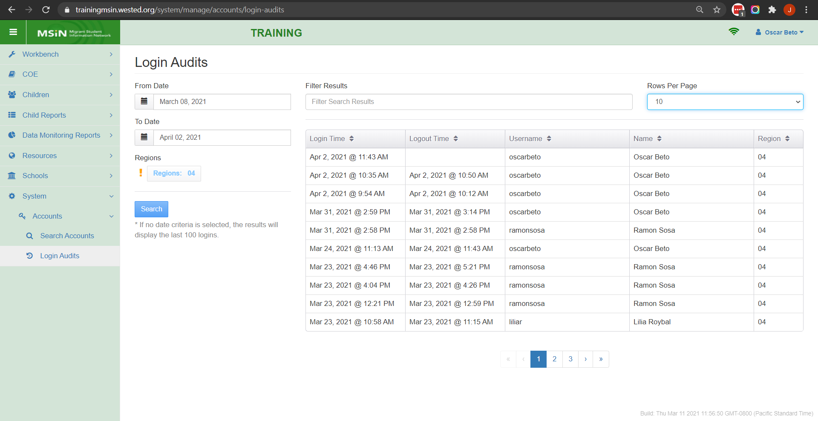
Monitoring Activity with Login Audits
Notes:
Lead: Jose
Time: 3 mins.
Talking Points:
Under the System menu, you’ll find Login Audits. The Login Audits page allows Regional User Approvers to monitor login sessions of users in their region/DFD by date, login time, logout time, username, and name.
(Walk through screenshot and explain search options and results fields.)
This feature can be used to monitor any user’s activity for support purposes.
It can also be used to confirm that a new user has successfully accessed MSIN.
Note that the results table shows the most recent information at the top (from most recent to least recent).

Slide 32
Questions? (3)
Notes:
Lead: Team
Time: 3 mins.
Use the chat feature to submit questions.

Slide 33
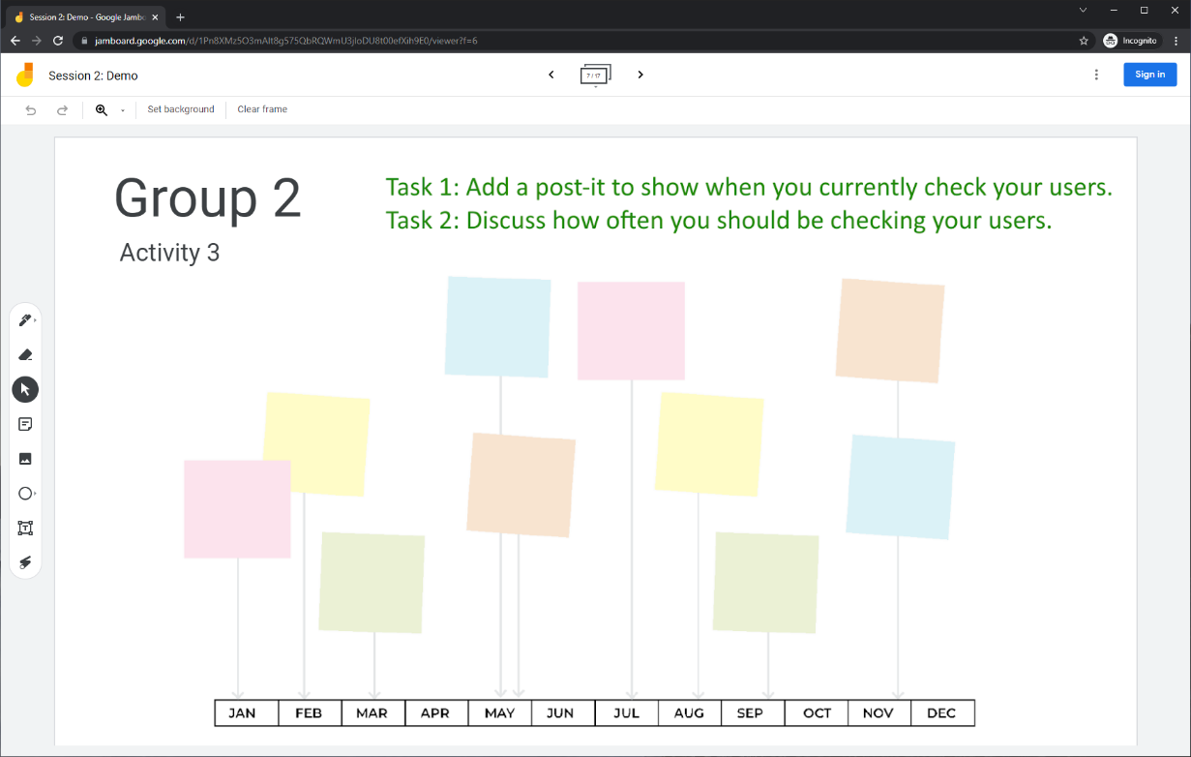
Collaborative Activity 3
Notes:
Lead: Jose
Time: 3 mins.
Talking Points:
This collaborative activity is focused on sharing and discussing your ideas around periodically checking your user accounts.
Explain that participants will be placed in breakout rooms with 5 collaborators. [Randomly assigned; not the same group members as in Activity 1 or 2.]
Demonstrate the activity using Jamboard: https://jamboard.google.com/d/1Pn8XMz5O3mAlt8g575QbRQWmU3jloDU8t00efXih9E0/edit?usp=sharing
Focus on the tasks in green text.
Walk through adding post-its (sticky notes).

Slide 34
Activity 3 Instructions
In your BR, take 2 minutes to introduce yourselves (name, region/DFD, and job title).
Open the chat window to view the instructions and links.
Click on the Jamboard link that matches your breakout room number (e.g., BR 2 should go to Jamboard group 2).
Keep two windows open: your BR in zoom and your activity 3 slide in Jamboard.
Add a post-it (sticky note) on the timeline to show when you check your users.
Discuss: how often should you be checking your users going forward?
Notes:
Lead: Jose
Time: 10 mins.
Talking Points:
In your breakout room, take 2 minutes to introduce yourselves (name, region/DFD, job title or role).
Open the chat window to view the instructions and links.
Click on the Jamboard link that matches your breakout room number (e.g., breakout room 2 should go to Jamboard group 2).
Keep two windows open: your breakout room in Zoom and your Activity 3 slide in Jamboard.
Add a post-it (sticky note) on the timeline to show when you check your users.
Discuss: How often should you be checking your users going forward?
Send to Breakout rooms – 8 minutes
Paste the instructions in the chat for all breakout rooms.

Slide 35
Check for Understanding (2)
  Next, you will see a pop-up window with questions and response options.
  There are two questions for this section; answer them as best you can.
  You will get a warning when the poll is about to close.
Notes:
Lead: Victor
Time: 4 mins.
Poll Questions:
1) If a user is no longer employed by the MEP, the local Regional User Approver should:
Wait for the MSIN system to automatically revoke the account due to inactivity
Immediately revoke the user’s account [answer]
Call their local I&R Manager
I don’t know
2) True or False: Regional User Approvers should assign the fewest roles to each user; they should not give users more access than they need.
True [answer]
False
I don’t know

Slide 36
User Profile
Self-Management
Notes:
Transition Slide
Lead: Victor
Time: 20 secs.

Slide 37
The User Profile
A user can self-manage certain aspects of their account, including:
Changing their password at any time
Changing their username
Editing their name (first, middle, last)
Editing their work email address
Editing their work title
Adding to or editing their work address(es)
Adding to or editing their phone number(s)
Notes:
Lead: Victor
Time: 2 mins.
Talking Points:
(Read or paraphrase slide text.)

Slide 38
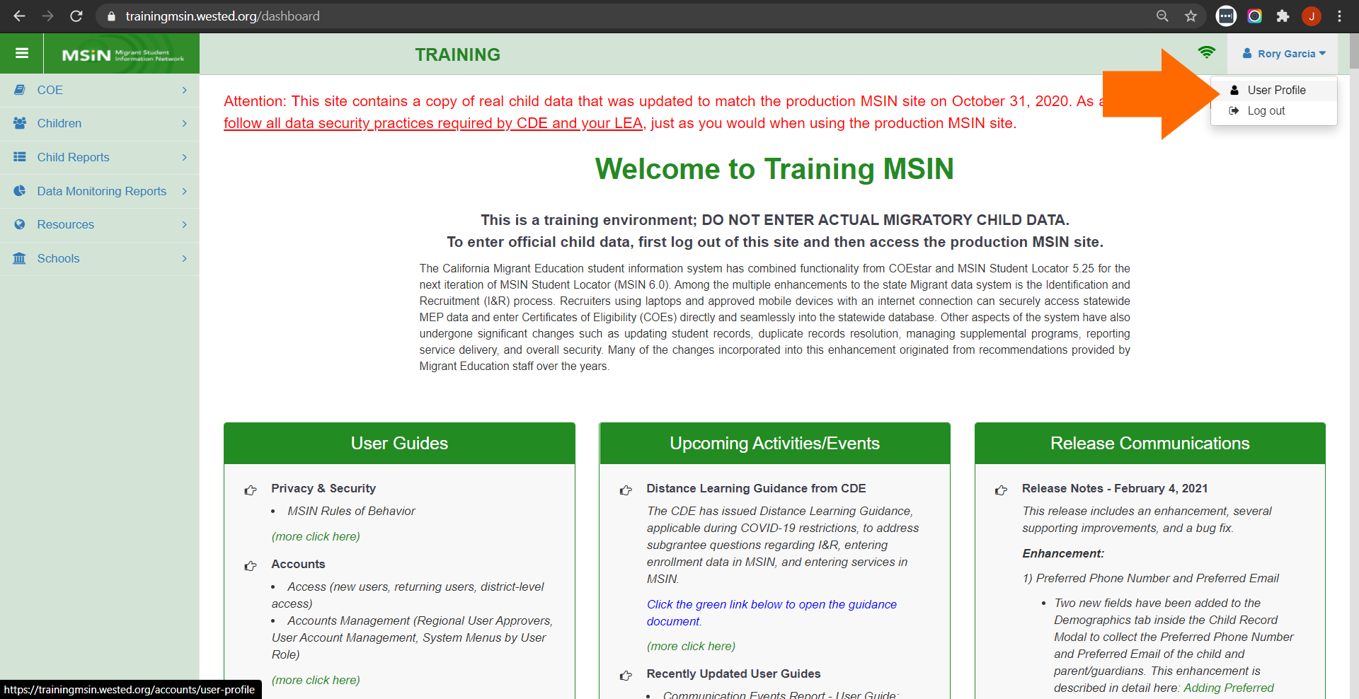
Accessing the Profile Screen
Notes:
Lead: Victor
Time: 1 min.
Talking Points:
(Review screenshot and point out location of the User Profile link.)

Slide 39
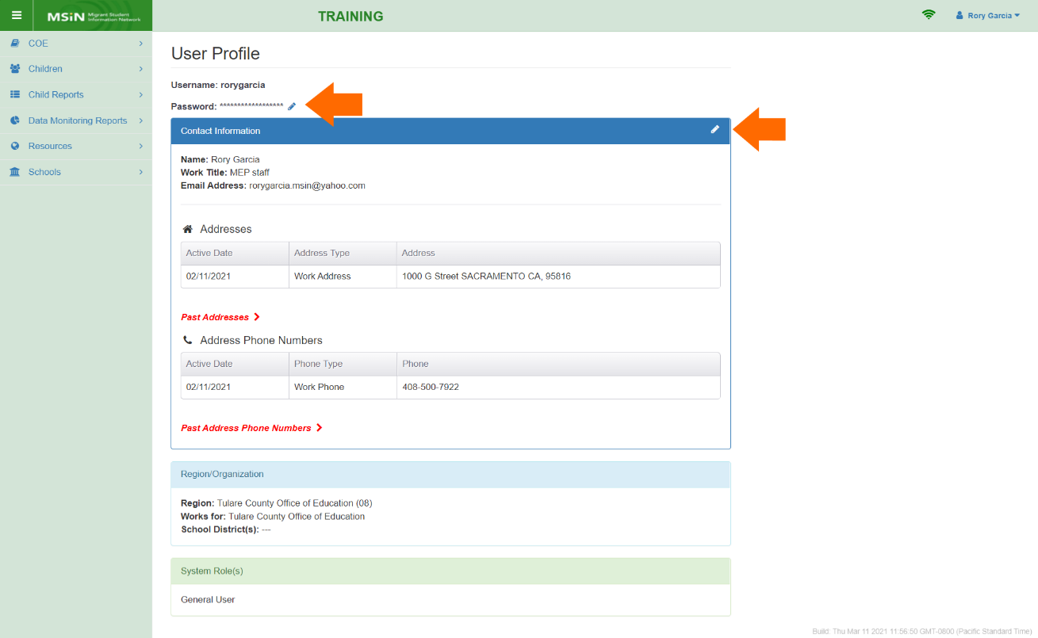
Editing Your Profile
Notes:
Lead: Victor
Time: 1 mins.
Talking Points:
The User Profile screen has two edit icons:
One to change your password (on the top left), and
Another one to edit personal and contact information (on the top right).
On the next slide, we are going to talk about #1: changing the password.

Slide 40
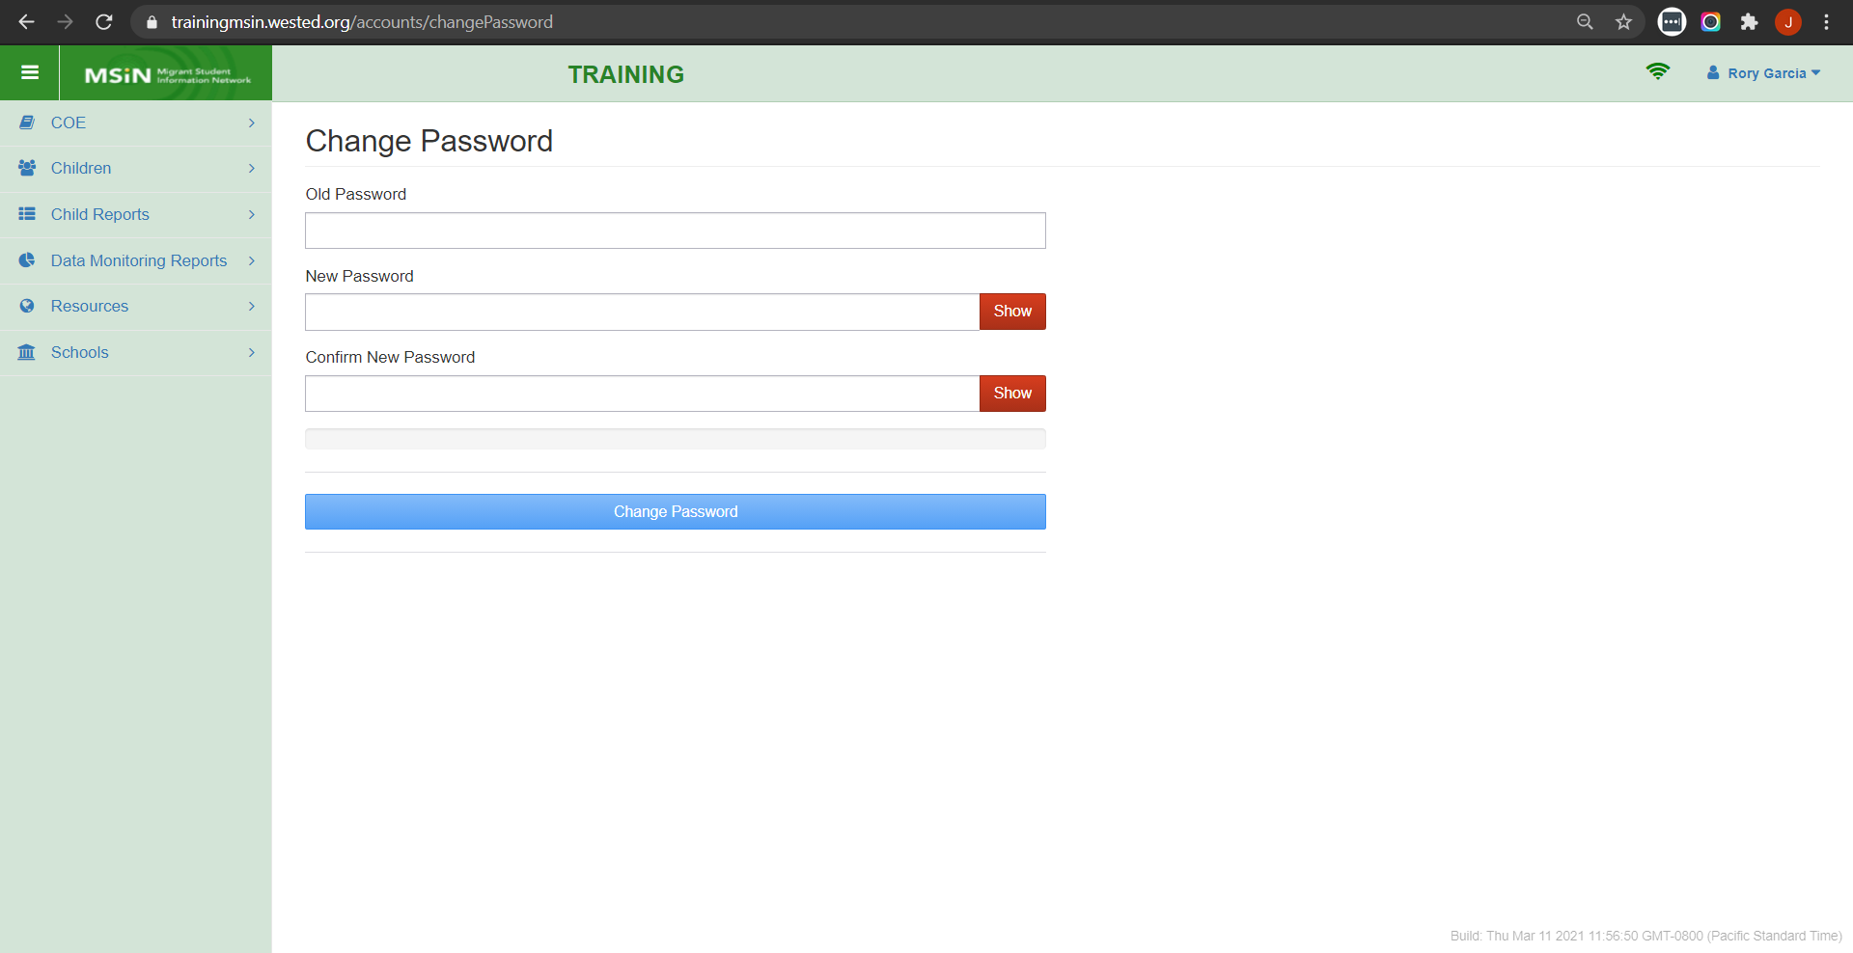
Changing Your Password
Notes:
Lead: Victor
Time: 1 mins.
Talking Points:
A user can change their password at any time.
As the new password is being entered, the system will remind the user of the minimum requirements.

Slide 41
MSIN Password Policy
Passwords must have at least 8 characters.
They must include at least one character from each of the four main character classes:
    Uppercase letters (A–Z)
    Lowercase letters (a–z)
    Non alphanumeric special characters (!, @, #, etc.)
    Numbers (0–9)
Users may not re-use their previous passwords.
Passwords must be changed after 90 days of use.
Accounts are revoked after 120 days of inactivity.
Notes:
Lead: Victor
Time: 2 mins.
Talking Points:
Let’s review the password requirements for the MSIN system.
(Read or paraphrase the slide contents.)
This policy is very similar to the MSIX password policy.

Slide 42
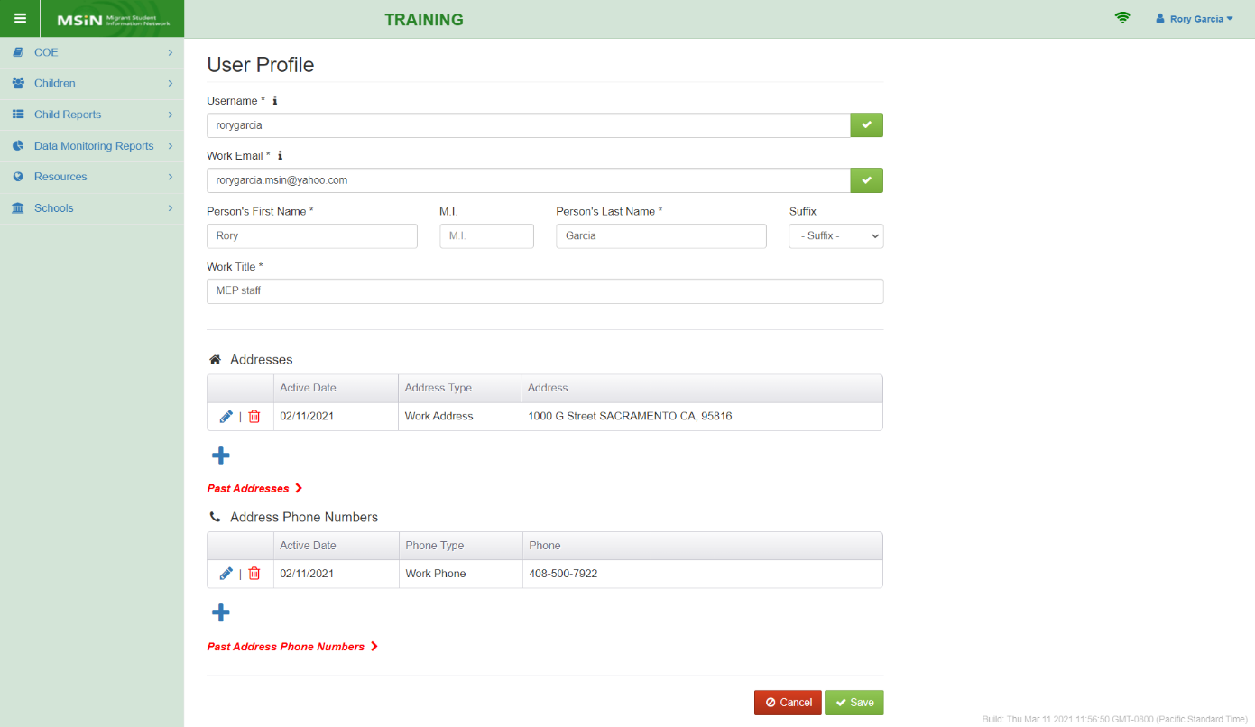
Editing Personal & Contact Information
Notes:
Lead: Victor
Time: 2 mins.
Talking Points:
In addition to changing the password, the user can edit or add other profile fields.
(Review the fields that may be edited.)
Key Point 1: Users should keep their name, email, and work title information up to date.
(Review the items that can be added – addresses and phone numbers – allowing for multiple entries.)
Key Point 2: Users should keep their work address and phone number(s) information up to date.

Slide 43
Questions? (4)
Notes:
Lead: Team
Time: 3 mins.
Use the chat feature to submit questions.

Slide 44
Check for Understanding (3)
  Next, you will see a pop-up window with questions and response options.
  There are two questions for this section; answer them as best you can.
  You will get a warning when the poll is about to close.
Notes:
Lead: Victor
Time: 4 mins.
Poll Questions:
1) True or False: An existing MSIN user can never change their own username or work email address.
True
False [answer]
I don’t know
2) True or False: An MSIN user must change their password every 90 days and they cannot re-use old passwords.
True [answer]
False
I don’t know

Slide 45
Resources and Closing Activity
Notes:
Transition Slide
Lead: Juli
Time: 10 secs.

Slide 46
Access & Account Management Guides
User Guide Title | Target Audience
Requesting an MSIN Account | New users who would like to request an account. Covers each step in the process.
Recover Your Username or Password | Existing MSIN users who forgot their username or password.
Approving a New MSIN Account | Subgrantee staff with the Regional User Approver role. Covers each step in the process.
User Account Management | Subgrantee staff with the Regional User Approver role. Covers editing accounts.
MSIN User Roles & Menu Options | Subgrantee staff with the Regional User Approver role. Covers system appearance and access per user role.
Notes:
Lead: Juli
Time: 1 mins.
Talking Points:
Several user guides are available for your reference on the MSIN home page.
(Read or paraphrase slide contents.)
In addition to these guides, we have 2 tables to help Regional User Approvers decide which role(s) to assign:
MSIN_Roles&Menus_Table.pdf This is a condensed version of the “MSIN User Roles & Menu Options” user guide, in table format.
MSIN_Roles_Access_Levels.pdf This is a table showing the levels of access the user roles have relative to each other.

Slide 47
Additional Resources
Subgrantees may use this presentation to review requirements and recommendations.
Subgrantees are encourages to practice using system features in the Training MSIN site.
Account-related user guides and reference documents are found on the MSIN home page, under the Accounts heading: https://drive.google.com/drive/folders/0BxgpmxyQ79rmeTRQLU5nT3p4cFE
If any questions arise, Regional User Approvers should consult with their supervisors first. Remaining questions or concerns can be submitted to the MSIN Service Desk.
Notes:
Lead: Juli
Time: 1 min.
Talking Points:
In addition to the user guides, remember that definitions, rules, and other information is readily accessible within most screens by clicking the “i” icon next to field titles.

Slide 48
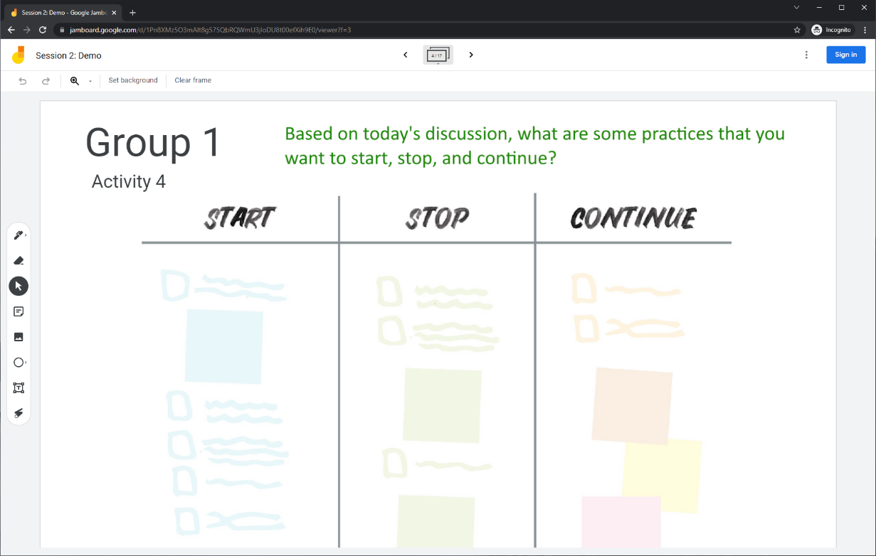
Collaborative Activity 4
Notes:
Lead: Juli
Time: 3 mins.
Talking Points:
Our last collaborative activity for this session is meant for you to reflect and discuss any key points that you’re thinking of integrating into your local practices going forward. This activity is called “Start – Stop – Continue.”
Explain that participants will be placed in breakout rooms with 5 collaborators. [Randomly assigned; not the same group members as in Activity 1 or 2.]
Demonstrate the activity using Jamboard: https://jamboard.google.com/d/1Pn8XMz5O3mAlt8g575QbRQWmU3jloDU8t00efXih9E0/edit?usp=sharing
Focus on the task in green text.
Add post-its (sticky notes) or text to the 3 categories, based on what you learned, remembered, and reinforced during this collaborative session.

Slide 49
Activity 4 Instructions
A) In your BR, take 2 minutes to introduce yourselves (name, region/DFD, job title or role).
B) Open the chat window to view the instructions and links.
C) Click on the Jamboard link that matches your BR number (e.g., BR 1 should go to Jamboard group 1).
D) Keep two windows open: your BR in Zoom and your Activity 4 slide in Jamboard.
E) Add a post-it (sticky note) or text in each of the categories.
F) Discuss anything that you find surprising or unexpected.
Notes:
Lead: Juli
Time: 10 mins.
Talking Points:
In your breakout room, take 2 minutes to introduce yourselves (name, region/DFD, job title or role).
Open the chat window to view the instructions and links.
Click on the Jamboard link that matches your breakout room number (e.g., breakout room 1 should go to Jamboard group 1).
Keep two windows open: your breakout room in Zoom and your Activity 4 slide in Jamboard.
Add a post-it (sticky note) or text in each of the categories.
Discuss anything that you find surprising or unexpected.
Send to Breakout rooms – 8 minutes
Paste the instructions in the chat for all breakout rooms.

Slide 50
Questions? (5)
Notes:
Lead: Team
Time: 3 mins.
Use the chat feature to submit questions.

Slide 51
Contact Information
Juli Auld
Education Research and Evaluation Consultant
California Department of Education
jauld@cde.ca.gov
916-319-0410
__________________________________________________
MSIN Service Desk
MSINsupport@wested.org
1-800-342-2964, option 2
Notes:
Lead: Juli
Time: 30 secs.
Talking Points:
Thank participants for attending.
Thank WestEd technical staff who assisted with the webinar.

