Slide 1
Data Privacy PLUS: Laws, Policies, and Best Practices for Living in a Digital World
Presented by:
Elizabeth Wisnia
Education Programs Consultant Education Data Office
Educational Data Management Division

Slide 2
Today’s Presentation...
Make sure your screen name reflects who you are to ensure credit for attendance
Please mute yourself unless you’re speaking
Three ways to ask questions: raise hand, put it in chat, wait for periodic pauses
A soft copy of the presentation will be provided after the session

Slide 3

Gluten Free Chocolate Chip Cookies

Slide 4
Background/Disclaimer
Disclaimer 1: I am NOT…
  an attorney
    Consult Legal Division for specific legal questions
  a technology expert
    Consult the Technology Services Division (TSD) for specific technical questions
Disclaimer 2: We will not cover everything
Data Privacy Experience
  State of California
  University of California Davis
Notes:
First and foremost, let me start by letting you know that I am NOT an attorney! As such, nothing in this training should be considered formal legal advice. While Legal was consulted when developing this training, if you have specific legal questions pertaining to data privacy, those are best directed to Legal.
Second, please be aware that while I hope to impart a basic understanding of what must be done to protect data privacy, I am NOT savvy enough to understand the technical ins and outs of encryption and secure electronic transfer of data. If you have any specific questions related to the secure handling, storage, and/or transfer of electronic data, contact the Technology Services Division’s Information Security and Privacy Office.
My third disclaimer is this: There are MANY data privacy laws and statutes. We will NOT be covering all of them during this training. Hopefully we will touch on the ones that are most pertinent to functions here at CDE.
Having said all of this, I have been working with data privacy for many years—first as a researcher and Test Validation/Development Specialist and Personnel Selection Consultant for the State and then as an Information Practices Analyst for UC Davis. I started my tenure in the UC Davis Office of the Campus Counsel just months before the now-infamous “Pepper Spray” incident. This experience provided quite the crash course in data access and data privacy laws as I assisted in responding to the mountain of public records requests received by the campus in the wake of that event. In addition to public records requests, I have experience with litigation support, responding to subpoenas, and have also prepared many documents for release in connection with confidential processes such as personnel investigations. As such, I am hoping that some of what I have picked up along the way will prove useful as a general overview of data privacy considerations that are important when gathering/sharing data, and working as a public employee.

Slide 5
Setting the Stage
#CuturalContext

Slide 6
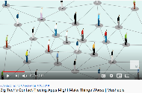
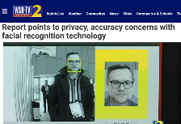
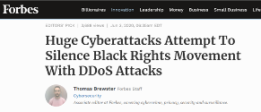

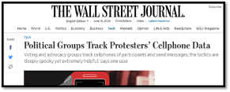


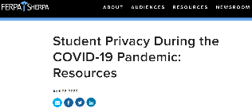
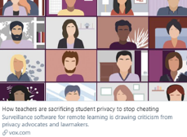
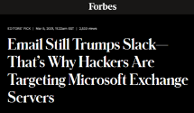
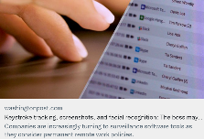
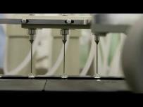

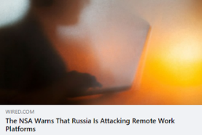
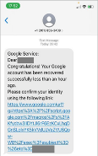
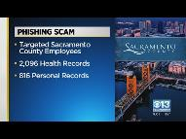
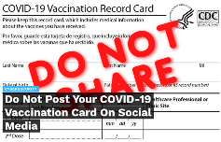

Privacy During the Pandemic

Slide 7
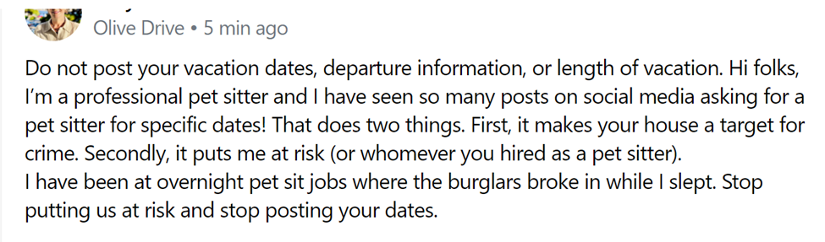
Don’t Help the Bad Guys!

Slide 8
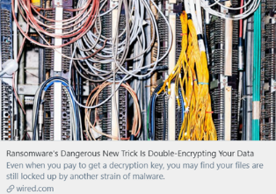
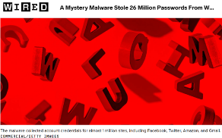
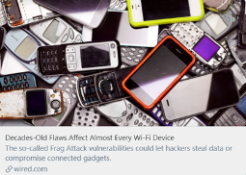
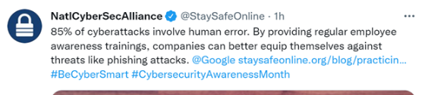
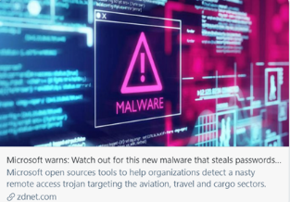
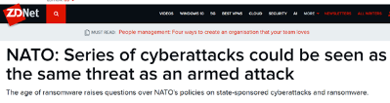
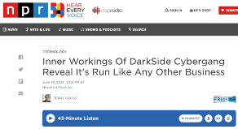
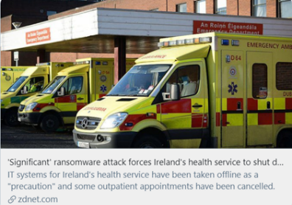
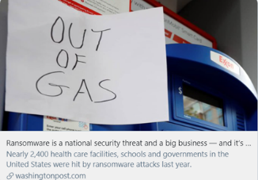
Emerging & Ongoing Threats

Slide 9

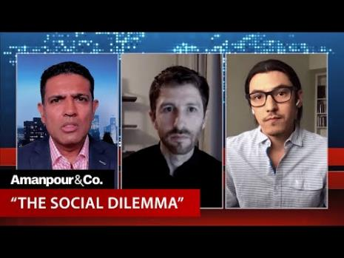
Real Life Truman Show

Slide 10
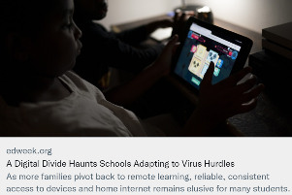
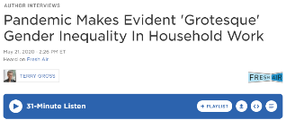
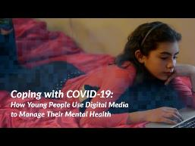
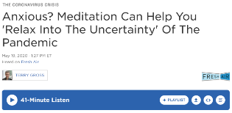

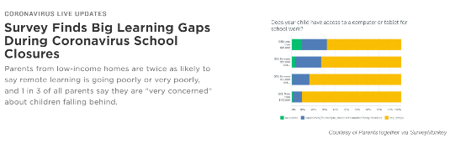

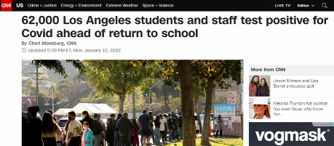
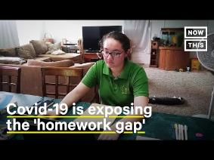

Privacy & Learning in Anxious, Unsettled Times

Slide 11
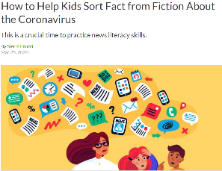
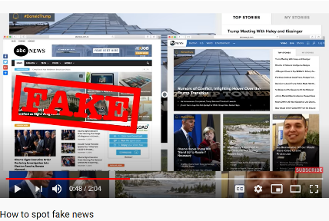

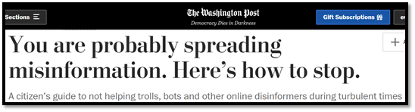



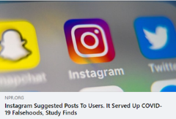

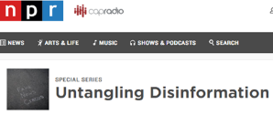
Fact or Fiction?

Slide 12
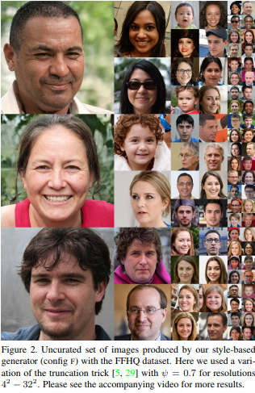
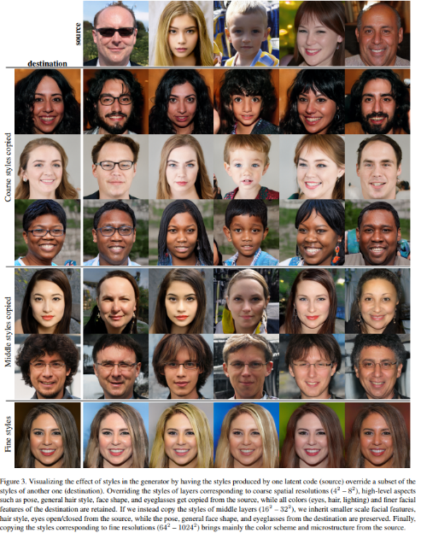
Unreal!
Notes:
Question: Can you guess what the pictures on the left have in common?
Answer: They’re ALL fake! All of these photos were created using artificial intelligence that combines more than one face (see the table on the right) to create a new unique face that can be used to create a fake social media profile.

Slide 13
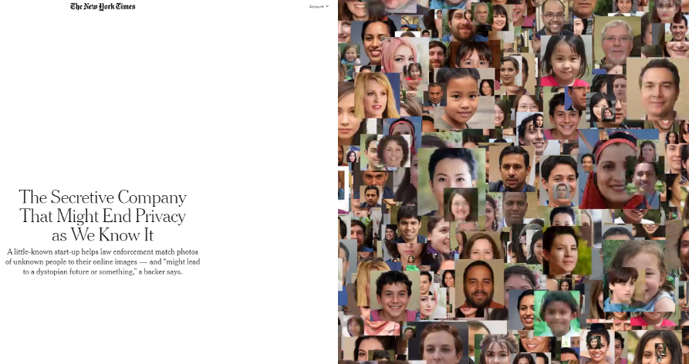
Perfect Match???

Slide 14


Oversharing

Slide 15
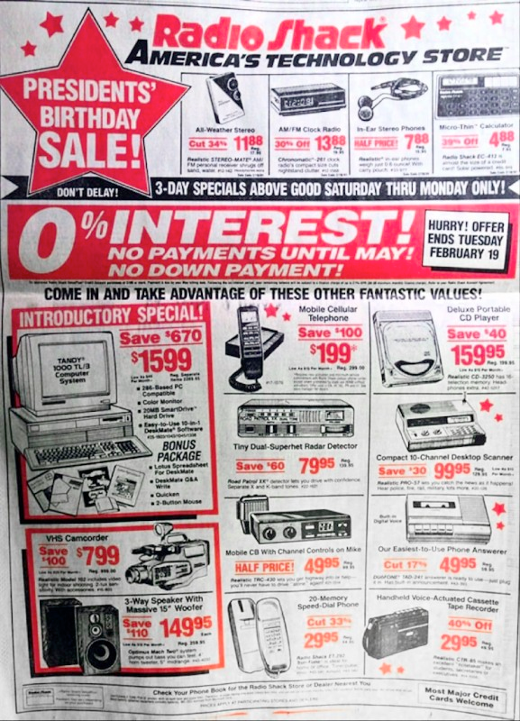
The Good Ole Days…
Notes:
If you caught a good sale in 1991…for about $3000, you could purchase all the devices you see here (desktop computer, phone with answering machine, CD player, stereo, radar detector, mobile CB radio, radio alarm clock) and STILL not be able to capture, store, and share data as efficiently as you can now with the smart phone that you probably have in your pocket. Our ability to create and share content has expanded exponentially and become so convenient. Both possibilities and risks have increased in kind.

Slide 16
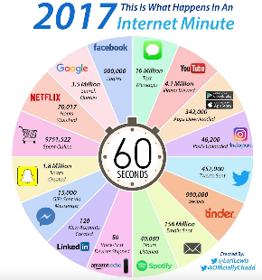
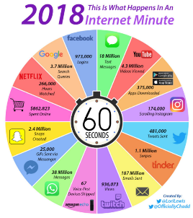
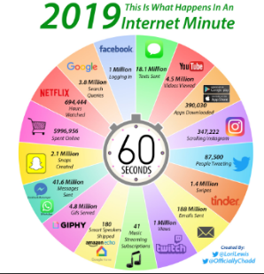

What Happens in One Tech Minute?

Slide 17
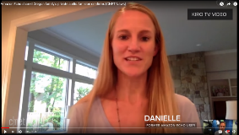
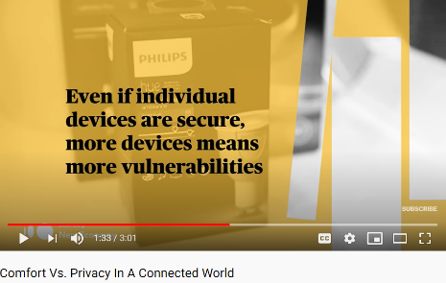

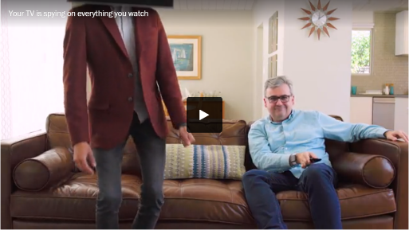
I0T: Convenience & Comfort v. Privacy
Notes:
When purchasing new tech, always consider privacy implications! In these video, Washington Post Tech Columnist Geoffrey Fowler explores the creepy potential of doorbell cameras. Here’s the link to the video: https://www.youtube.com/watch?v=cFJUuO7pQWE

Slide 18
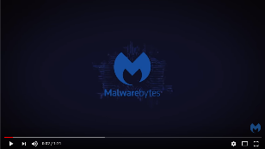
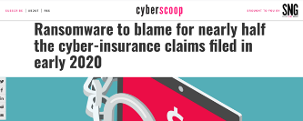

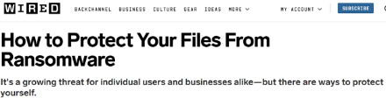

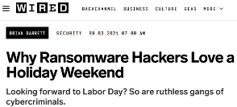





Your Data Has Been Encrypted
Notes:
On Friday, May 12, 2017, North Korea launched an attack which ultimately affected:
Over 150 countries (including the U.S.) affected
More than 300,000 computers affected
Inspiring imitators
More than 40,000 businesses & institutions in China affected
The attack started with a leaked NSA document detailing a vulnerability in Microsoft Windows. Computers that had patched this vulnerability avoided being affected. This is an important reminder to install patches and updates.
The video linked here provides a heat map visual representation of the spread of the attack over 3 days: https://www.youtube.com/watch?v=IEAtGCkbq5Y

Slide 19

Scams are Evolving, Becoming More Sophisticated
Notes:
So…some of you have probably heard of “phishing.” Phishing involves a cyber attacker masquerading as a trustworthy source (e.g., a bank, a large company) to obtain sensitive information (e.g., user names, passwords, credit card information). Email blasts containing links or attachments that contain malicious software (or malware) are sent to a large number of recipients. Anyone who clicks on the link or attachment downloads or opens the malicious software and the computer becomes infected/compromised in ways that permit malicious activity (e.g., theft of data on the computer). As the public has become more aware of such attacks, cyber thieves have responded with more sophisticated attacks. These include “spear phishing.” Spear phishing involves studying publicly available online profiles on social media, company Web sites, etc., to craft and send legitimate-looking targeted messages to specific individuals in hopes that said individuals will be fooled into thinking the email is from someone they know so that they will feel comfortable clicking malicious content (e.g., links) to download malware. An even more sophisticated cyber attack that is becoming more prevalent is “whaling.” The term “whaling” is used to describe the practice of posing as the “big fish” or “whale” in an organization for the purpose of transferring funds or sensitive data to illegitimate accounts. In one instance of whaling, the Tech Firm Ubiquiti lost $46 million to cyber thieves. In the Spring of 2016, a “whaler” posed as the superintendent of a school district to trick a district employee into releasing payroll data of more than 2,100 district employees, including 630 teachers. Whenever requests for large sums of money or data are received via email, a best practice is always to contact the requestor by phone or in person to ensure that the request is legitimate before sending anything.

Slide 20

Privacy v. Security
PRIVACY | SECURITY
Policies | Hardware
Procedures | Software
Laws/Guidance | Encryption Methods/Access Rights
Behavioral Best Practices | Infrastructure Best Practices
Notes:
Though privacy and security go hand in hand, it’s important to distinguish between the two. Security is designed to limit access while privacy is designed to establish behavioral expectations for those who have been given access. To use a metaphor, imagine a city surrounded by a strong, impenetrable wall. If the gate to the city is left open, the strength of the wall is irrelevant. Security is the wall around the city. Privacy is ensuring that those who have been given keys understand the policies and procedures for safely opening the gate.

Slide 21
Privacy in Schools
#Educational Context

Slide 22

The K-12 Cyber Incident Map
1,180 KNOWN Incidents since
Jan 1, 2016
BLUE: phishing attacks
PURPLE: breaches or hacks resulting in the disclosure of personal data
YELLOW: ransomware attacks
GREEN: denial-of-service attacks (green pins); and
RED: other cyber incidents resulting in school disruptions & unauthorized disclosures
Notes:
The map above reflects how many K12 institutions have reported cyber incidents since January 2016 (over 1000). These are just KNOWN incidents. The number of actual incidents is probably much higher. These attacks include:
Phishing attacks
Breaches/hacks resulting in the disclosure of personal data
Ransomware attacks
Denial of Service attacks
Other cyber incidents resulting in school disruptions/unauthorized disclosures

Slide 23





Developing Minds + Varying Levels of Skill + Insufficient Training + Hackers = …

Slide 24




Creepy!
Notes:
Hackers are increasingly using scare tactics in when infiltrating school servers. One recent email hoax took over a popular gaming server used by Mincecraft players to send spam threats to schools throughout the US, resulting in increased security and school cancellations throughout the US. The Dark Overload hack represents a terrifying new trend where hackers use cell phone and associated student info found in breached student information systems to contact parents directly to threaten kids as a means for extorting money. School closures in Iowa and other states have resulted from this hack.

Slide 25



Digital Citizenship & Training Matter!

Slide 26

Cybersecurity Tips for Schools
Notes:
Link to video outlining steps schools districts can take to protect privacy: https://video.edweek.org/detail/video/6016071761001/k-12-cybersecurity-steps-districts-can-take-to-protect-themselves?autoStart=true&cmp=eml-enl-vid-p4

Slide 27
Privacy @ CDE
#OrganizationalContext

Slide 28


Practical Example

Slide 29

Protecting Privacy at the CDE
External Data Governance Resources for LEAs
Now Available on the CDE Web Site!
Notes:
Here are some of the ways CDE protects data privacy:
Educational Data Governance (EDGO) Program. Web site with more info here: https://www.cde.ca.gov/ds/ed/index.asp
Annual in-person data privacy training required for all CDE employees with access to student data
Annual online data privacy training required for all CDE employees, regardless of access
CDE staff attending and presenting at conferences to gain and hone data privacy expertise
CDE’s Data Privacy Web page: https://www.cde.ca.gov/ds/ed/dataprivacy.asp
@cdeprivacy Twitter, Facebook, and Instagram accounts

Slide 30
Privacy Policies
Department of Education Administrative Manual (DEAM) sections 10600 and 10601
  The CDE only allows access to personally identifiable information (PII) when required/allowed by law
  The CDE has established policies and procedures to ensure secure handling of PII
  Key takeaway: The CDE DOES NOT share personally identifiable information unless permitted or required by law!
Notes:
First, let’s talk about important privacy information here at CDE. The DEAM (Department of Education Administrative Manual) articulates CDE’s policies related to a wide variety of topics, including privacy. All of these policies can be found on the CDE intranet. Section 10600 outlines general policies related to data privacy, including CDE’s general monitoring of employee activities related to data privacy. 10600 also states that “We do not disclose personally identifiable information to external parties, unless it is permitted or required by law.” Since data privacy policies are currently being updated, I encourage you to read up on these policies in their current form now and to check back in a couple of months to make sure you are aware of the most up-to-date versions of the policies.
DEAM section 10601 pertains to student data. In addition to describing the student data CDE collects, section 10601 clarifies CDE’s responsibilities related to student data privacy.
Key takeaway: CDE DOES NOT share personally identifiable information unless permitted or required by law!

Slide 31
There Ought to be a Law!
#LegalContext

Slide 32

Changing Landscape of Data Privacy
Notes:
https://ferpasherpa.org/state-laws/
In preparation for this second round of training, I received many questions about why this training is recurring. In addition to the fact that an important topic like data privacy (like driver safety) is good to revisit occasionally, info graphics such as this one produced by the Data Quality Campaign illustrate how much the data privacy landscape is constantly changing.
With big data breaches in the news daily (OPM, Anthem Blue Cross to name a couple of the recent big ones) and increased sophistication of identity thieves and data hackers; legislators, law enforcement, and others are scrambling to keep up with the latest scams and best practices. This results in a lot of proposed legislation, new laws, and enhanced guidance.
As shown here, 28 different data privacy bills became law in 2015. Much more legislation was proposed. Laws and proposed legislation are often indicators of trends in data privacy. As an example, Illinois, Maryland, Georgia, and 7 other states passed laws this year that were at least in-part modeled after California’s 2014 SOPIPA law. SOPIPA greatly clarifies and expands responsibilities for vendors, service providers, and others who knowingly access, use, or maintain student data.

Slide 33
Student Privacy: It is the Law!
  Family Educational Rights and Privacy Act (FERPA) (20 U.S.C. sections 1232(g)/Title 34 Code of Federal Regulations [CFR] Part 99)
  Designed to protect student and parental rights related to student privacy.
  Prohibits release and re-release of personally identifiable student data unless very nuanced, legally complex conditions are met.
Notes:
Since so much of the data we handle here at CDE is student data, let’s talk about the main law pertaining to student data. As many of you are probably aware, the main law governing the handling of student data is FERPA (The Family Educational Rights to Privacy Act). FERPA is the federal law that was established to prevent the unauthorized release of student data. FERPA articulates both student and parental rights related to educational records. Except under very specific, complex, and strict conditions—release of student data is strictly prohibited.

Slide 34

FERPA 101
Notes:
Link to accessible version of the Privacy Technical Assistance Center’s FERPA 101 video which provides a brief overview of FERPA: https://www.youtube.com/watch?v=nhlDkS8hvMU

Slide 35
FERPA Facts
  Local educational agencies (LEAs) have primary obligation to safeguard student data and are allowed to share student data with the CDE under very specific provisions of state and federal laws.
  At the CDE, legal and executive approval are required for any release of personally identifiable student data!
Notes:
Here are some important facts to understand about FERPA. First—since FERPA is the authoritative source for educational records—both LEAs and state agencies like the CDE must rely upon federal guidance to ensure compliance with FERPA. Because FERPA is complex and the particulars of each situation dictate how it should be applied, the CDE does not provide guidance to LEAs on local FERPA issues. Instead, the CDE advises local agencies to consult their own counsel since they are in the best position to understand and advise on local FERPA issues.
Per CDE policy, ANY disclosure or re-disclosure of CDE’s student information requires approval from both CDE Legal and the Executive Office. Even when sharing data with other State agencies or when seeking to fulfill mandated reporting requirements, terms for sharing student data must be vetted and approved before ANY sharing of student level data can occur. Given that the collection of student data is so controversial (with parent groups and others lobbying to stop it), it is essential that we are cautious and diligent when collecting, maintaining, and/or sharing data.

Slide 36
FERPA Exceptions: Consult CDE Legal Staff
      Examples…
      Emergencies/Health and Safety
      Subpoenas/Court Orders
      Authorized representatives acting for/on behalf of an LEA or State Educational Agency (SEA) for (and ONLY for) specific purposes designated in a written agreement that articulates obligations under both state and federal laws
Notes:
In most cases, FERPA prohibits the disclosure/sharing of personally identifying student data without the prior written consent of the student’s legal guardian (for students under 18) or the student him/herself (if the student is over 18).
There are some limited exceptions that permit disclosure or sharing of personally identifying student data without consent. This said, all FERPA exceptions are legally complex and require consultation with CDE Legal to ensure that the specific conditions of disclosure or re-disclosure are met prior to the release of data.
Some examples of FERPA exceptions include the health and safety exception which permits disclosure of student-level data in emergency situations such as a natural disaster or a circumstance where there is concern that a student may be a danger to him/herself or others. In such situations, FERPA permits sharing personally-identifying student data with law enforcement and emergency personnel to ensure student safety. Other exceptions include information provided in response to a subpoena or court order (e.g., in response to custody-related court cases) and exceptions related to the activities of those who have been designated as authorized representatives of an LEA to perform a specific function outlined by FERPA. This might includes contractors (e.g., psychologists) who are performing services that would normally be performed by the school/LEA.
With regard to these FERPA exceptions or any others, the key takeaway is that CDE Legal must ALWAYS be consulted to ensure that any sharing of student data complies with the complexities and nuances of FERPA and other applicable state and federal laws. If ever you are asked to share student-level data—even if you believe that a FERPA exception might apply—CONSULT CDE LEGAL!

Slide 37

COPPA Overview
Notes:
This Common Sense Media Video (https://www.youtube.com/watch?v=0dStr6yIE_s) provides a brief overview of the Children’s Online Personal Privacy & Protection Act (COPPA).

Slide 38
  CALIFORNIA EDUCATION CODE
(EC sections 49079.5 -.7 and Section 60607)
  At least as restrictive as FERPA, sometimes more
  Provides some guidance for interagency data sharing
  Provides specific restrictions on the release of assessment data (EC Section 60607) and school lunch information (EC Section 49558)
Notes:
With regard to student privacy, the California Education Code is at least as restrictive as FERPA. In the case of assessment data, the CEC is actually more restrictive than FERPA. CDE employees who handle assessment data should be familiar with section CEC 60607 which articulates requirements related to the management of student assessment data. In part, EC 60607 articulates that except in very narrow circumstances, “…a pupil's results or a record of accomplishment shall be private, and may not be released to any person, other than the pupil's parent or guardian and a teacher, counselor, or administrator directly involved with the pupil, without the express written consent of either the parent or guardian of the pupil if the pupil is a minor, or the pupil if the pupil has reached the age of majority or is emancipated.”

Slide 39
California Student Data Privacy Laws
Student Online Personal Information Protection Act (SOPIPA)
AB 1584 (Contracts)
AB 1442 (Social Media)
SB 178 (Electronic Devices)
Notes:
In addition to FERPA and the California Education Code, three new laws related to student data privacy came into effect on January 1, 2016. The Student Online Person Information Protection Act (SOPIPA) prohibits anyone who knowingly has access to student data from using, disclosing, compiling, or allowing a 3rd party to use, disclose, or compile the personal information of a minor for anything other than the educational purpose for which the student data was provided. This includes prohibition of marketing/advertising to a minor and/or their parents/legal guardians, using data to amass a profile about a K–12 student, selling a student’s information, or disclosing the student’s information. SOPIPA further requires anyone with access to electronic student data to implement and maintain reasonable security procedures and practices that protect information from unauthorized access, destruction, use, modification, or disclosure. Finally, SOPIPA requires deletion of student data if a school or district requests deletion of data under the control of the school or district. SOPIPA is being used as a model for legislation in other states and SOPIPA’s language is also being considered at the federal level to update FERPA (which is 40 years old).
AB 1584 is a companion bill to SOPIPA and requires that any contracts involving student data contain specific provisions to protect student data privacy. The key takeaways from these two new laws is this:
These laws shift the burden of protecting student data from the LEA/SEA to the vendor. Under SOPIPA and AB 1584, anyone who knowingly has access to student data is responsible for protecting it as specified under these new laws.
The laws apply even if the LEA/vendor hasn’t yet updated their contract language to reflect these new requirements (i.e., ignorance of the law is NOT an excuse).
With regard to AB 1584, this is a narrow and specific bill that requires that if a school or district plans to monitor the social media activities of students, they must FIRST have a public hearing to discuss the matter with parents and the broader community.
The Student Online Person Information Protection Act (SOPIPA) prohibits anyone who knowingly has access to student data from using, disclosing, compiling, or allowing a 3rd party to use, disclose, or compile the personal information of a minor for anything other than the educational purpose for which the student data was provided. This includes prohibition of marketing/advertising to a minor and/or their parents/legal guardians, using data to amass a profile about a K–12 student, selling a student’s information, or disclosing the student’s information. SOPIPA further requires anyone with access to electronic student data to implement and maintain reasonable security procedures and practices that protect information from unauthorized access, destruction, use, modification, or disclosure. Finally, SOPIPA requires deletion of student data if a school or district requests deletion of data under the control of the school or district. SOPIPA is being used as a model for legislation in other states and SOPIPA’s language is also being considered at the federal level to update FERPA (which is 40 years old).
AB 1584 is a companion bill to SOPIPA and requires that any contracts involving student data contain specific provisions to protect student data privacy. The key takeaways from these two new laws is this:
These laws shift the burden of protecting student data from the LEA/SEA to the vendor. Under SOPIPA and AB 1584, anyone who knowingly has access to student data is responsible for protecting it as specified under these new laws.
The laws apply even if the LEA/vendor hasn’t yet updated their contract language to reflect these new requirements (i.e., ignorance of the law is NOT an excuse).
With regard to AB 1442, this is a narrow and specific bill that requires that if a school or district plans to monitor the social media activities of students, they must FIRST have a public hearing to discuss the matter with parents and the broader community.
SB 178 has implications for any school/district involved in 1:1 device deployment since this law requires a warrant or written consent from the devices’ “authorized user” to search any electronic device. LEAs/schools involved in 1:1 device deployment should work with their legal counsel to ensure that the implications of this law have been considered and addressed in district policies and contracts with student/parents who will be using electronic devices issued by the school/district.

Slide 40
Laws Balancing Personal Privacy and Public Access
  Affirm the public’s right to access information regarding how public money is managed/spent
  Inform conditions for release of public records (including permissible exemptions for nondisclosure)
  “Balance” often achieved through redaction of exempt material
Notes:
In addition to student data, CDE gathers and manages a fair amount of non-student data. This includes teacher data and CDE staff data. When thinking about non-student data, it’s important to know about laws balancing personal privacy and public access. Since CDE is a public agency, funded by public funds—most laws recognize and assert the public’s right to access records that provide information about what’s being done with their money. Generally speaking, this means that the public has a right to ask for and (in many cases) receive records (such as emails, reports, memos, etc.) that are held by public agencies. Having said this, the law also recognizes the rights of individuals to maintain certain privacies—even if they work for a public agency. They further recognize the importance of protecting the integrity of confidential processes such as consultations with attorneys and doctors and investigations. For this reason, several laws, statutes, provisions, and exemptions have been put into place to balance public access and personal privacy. Balance is often achieved by redacting personal information (such as home email, address, phone number, etc.) before producing information in response to a request.
Laws that balance public access and personal privacy include the “Federal Freedom of Information Act” (FOIA) which pertains to federally-held public records; the California Information Practices Act (IPA) which determines what PII can be gathered, prevents release of info the third parties, and gives individuals rights to access what’s being collected about them; and the California Public Records Act (PRA). The PRA is the law that most pertains to requests for records received by CDE.

Slide 41
Laws Balancing Personal Privacy and Public Access
  Includes laws such as the federal Freedom of Information Act (FOIA) (5 U.S.C. Section 552), the California Information Practices Act (IPA) (Civil Code sections1798 et seq. 1798.3) and…
  The California Public Records Act (PRA) (Government Code sections 6250-6276.48)

Slide 42
California Public Records Act
  (Govt. Code sections 6250-6276.48)
  Modeled after FOIA, details conditions for release of State and local public records
  Defines records broadly to include hard copy records, electronic records, video and audio recordings, etc.
  Provides permissible exemptions for nondisclosure
Notes:
The law that is most relevant to records held by public agencies in California is the California Public Records Act (PRA). The PRA is modeled after FOIA and provides guidance on when and how records are shared. The PRA also details permissible exemptions for non-disclosure.

Slide 43
Potential PRA Exemptions: Examples
Records exempted/prohibited from disclosure by federal or state law (e.g., educational records protected by FERPA) (Government Code Section 6254[k])
Personnel, medical, or similar files (Government Code Section 6254[c])*
Drafts, notes, and memoranda not kept as part of normal business practice (Government Code Section 6254[a])*
*Best practice is to delete/destroy records that are no longer needed for business necessity since ANY records that are retained could be subject to disclosure in response to a records request or subpoena.
Notes:
Here are a few examples of PRA exemptions that might be considered when responding to a PRA request. If it can reasonably be argued that release of the information would harm the public (e.g., undermine confidence in an important governmental function), then it might be permissible to withhold information in accordance with PRA exemption provisions. If—on the other hand—it can reasonably be argued that release of information would benefit the public, chances are that a court would order release of the information. For example, private personal information (such as your home address and phone number), privileged communications, records related to ongoing confidential processes (such as investigations)…these are all records that are protected from disclosure under the PRA. There are many examples which point to the importance of protecting the privacy of individuals and the integrity of important fact-finding processes. For this reason, sometimes drafts and records related to a decision-making can also be withheld.
However, it’s good to keep in mind that if records are TRULY temporary, the best practice is to get rid of them as soon as there isn’t a compelling reason (such as a mandate) to keep them. Since laws are changing all the time and records are evaluated on a case by case basis, it’s best to assume that ANY records that are retained could be subject to disclosure in response to a records request or subpoena. It’s also important to remember that information such as your work email/phone number and basic job information such as name, title, and salary are NOT covered by exemptions. As a public employee, these bits of information are considered public.
Since the PRA has other exemptions, this is not an exhaustive list. These are just examples of the kinds of information that might be withheld if there is a compelling reason for doing so. As with all release of data, CDE Legal should be consulted prior to the release of information to ensure consideration of and compliance with applicable state and federal laws.

Slide 44
Potential PRA Exemptions: Examples
Privileged communications (Government Code Section 6254[k])
Records Reflecting Deliberative Process of Decision Makers (Government Code Section 6255, Times Mirror Co. V. Superior Court, 53 Cal.3d 1325 [1991])*
Records that could impact an ongoing investigation, litigation, or law enforcement process
*Note: All of these exemptions employ the public interest balancing test to determine if they apply.

Slide 45
Important PRA Considerations
The CDE must provide a written response within 10 days of receiving a request indicating what responsive records (if any) exist, what determinations have been made about the records, and when records are estimated for production.
  Legal and Communications Divisions must both be informed when PRA requests are received.
Notes:
Here are a few important things to keep in mind with regard records requests filed under the PRA:
CDE must acknowledge the request and provide a reasonable estimated response date within 10 days of receiving the request. In some cases, a 14 day extension of this requirement is possible. The key takeaway is that if you receive a request—please be in contact with Legal ASAP to coordinate a response within 10 days of the request’s receipt to minimize litigation risks. Communications should also be contacted—especially if the request is known to be from a reporter. It is important for Communications to be prepared to respond to any inquiries that may be submitted in relation to the request.
With the exception of requests involving PII, most exemptions are discretionary. This means that if CDE Legal in consultation with the Executive Office decides it is in CDE’s best interest to share exempt information—CDE Legal/Execs may opt to share records—even if the information being sought would normally be withheld. For example—say The Sacramento Bee submits a records request seeking records on a high-profile decision made by the Superintendent. CDE may opt to share records related to the decision making process in this case even if said records would normally be exempt under the deliberative process privilege. In the hypothetical example provided, it might be in the agency’s best interest to waive the exemption and share a more comprehensive picture of how the decision was made. Keep in mind that there ARE situations (e.g., educational records under FERPA) when records MUST be withheld in accordance with law.
It’s good to remember that just because some information is exempt from disclosure, doesn’t mean that the entire record can be withheld. If a record contains both public information and exempt information, the record should be provided in redacted form.
Recent case law shows a trend toward more openness and broader public disclosure. In one recent case, the court ruled that public employees were required to release information from their PERSONAL electronic devices (such as emails and texts) since the court deemed that the information being sought was relevant to the public’s business. Even though this case was overturned on appeal, the message here is: Be mindful that—even when communicating privately or after work hours—there is always a possibility that any records related to your work as a public employee could be subject to disclosure. Follow the same best practices you would at work (such as being polite and deleting records that do not need to be retained.)
The PRA also contains the “Public Interest Balancing Test.” This means that in some cases, it may be determined that the public’s interest is best served by withholding information rather than providing it. The court decision that is most often cited when discussing the balancing test is Times Mirror Co. v. Superior Court. In that case, a newspaper had requested detailed information regarding daily operations at the governor’s office. The governor’s office argued (in part) that many of the requested details (e.g., specifics of his travel schedule) would pose a security risk since those with nefarious intentions would have ready access to his schedule. The case was argued all the way to the Superior Court and—in the end—the court sided with the governor’s office. It was determined that the public’s interest was best served by withholding some of the requested information.
Turn to the person on your right and let’s spend 5 minutes discussing some other instances in which the public’s interest might be better served by withholding information rather than providing it.

Slide 46
Important PRA Considerations
For discretionary exemptions, the CDE Legal Division and Executive Office can determine whether or not to assert permissible exemptions.
  Note: Some laws (e.g., FERPA) prohibit disclosure of PII. Such info must be withheld.
Exemption of some materials or records does not equal withholding of ALL materials. Redactions are often in order before providing materials.
Public Interest Balancing Test
  Input from the CDE Legal Division is always required.

Slide 47
California Information Practices Act (IPA)
(Civil Code sections 1798 et seq. 1798.3)
Articulates…
  What personal information public agencies can collect maintain and disseminate
  What information can be disclosed to third parties without consent of the individual(s) who could be identified/affected if records were released
  Access rights individuals have to records maintained about them by a public agency
Note: Employees are entitled to see what is said about them in records created by their supervisors.
Notes:
The IPA is not a law that most CDE employees will encounter or need to worry about. This said, I’m slipping in a brief mention to promote general awareness for the few who may come across a situation involving the IPA (e.g., an HR investigation) during their time at CDE. As a reminder, the IPA determines what personal information can be gathered, prevents release of personal info the third parties, and gives individuals rights to access what’s being collected about them. The intent is to prevent the indiscriminate collection, maintenance and dissemination of personal information and to provide adequate remedies when the government goes to far.
An example of when the IPA may come into play is if an individual has been involved in an HR investigation, they may wish to see a copy of the final investigation report. Since individuals are only entitled to see information about themselves, all personally identifying information (such as names, descriptors, pronouns) related to others must be redacted before providing records. Essentially—in most cases—the individual is entitled to see what was said about them but not who said it. The one notable exception to this is that if someone in a supervisory position says something about the requestor, the requestor is entitled to see the supervisor’s identifying information. Personal information that is NOT related to the requestor must also be redacted. It is not uncommon for personal information (e.g., who was on leave and when) about other individuals to be divulged during investigations. If that information ends up in the report, such information must also be redacted before providing records.
So…let’s take a moment to reflect back on what’s been learned so far. Break into groups of 3 and take the next 5 minutes to come up with at least 2 actions that should be taken when a public records act is received. Bonus points if you can think of more.

Slide 48

GDPR???

Slide 49





CCPA & CPRA
CCPA passed/signed June 28, 2018!
Notes:
This ballot measure (which was removed from the ballot after the passage of the CCPA), is an attempt to mirror some GDPR provisions.

Slide 50

Legislation Effective January 1, 2020:
California Consumer Privacy Act of 2018 (CCPA)
Notice: Guarantees consumers the right to know what data is being collected
Consent: Guarantees consumers the right to opt out of that data collection
Deletion: Guarantees consumers the right to delete all their private data
Access: Guarantees consumers the rights to access, download, or transfer their data
Kids' Rights: Kids under 16 must opt in to consent to the sale of their data
Enforcement: The attorney general can levy fines, consumers can sue for breaches
Notes:
What CCPA will do:
Provide all consumers in California with the following rights: the right to know what personal information is being collected about you; the right to know whether your personal information is sold or disclosed and to whom; the right to say no to the sale of your personal information; the right to access, download, and transfer your personal information; and the right to equal service and price if you exercise your privacy rights.
Create special protections for your kids.
Companies would be required to get permission before selling the data of any child under 16.
For kids under 13, parental consent would be required.
Allow consumers to sue in the event of a data breach of certain personal information.
Be otherwise enforced by the California Attorney General and funded by the Consumer Privacy Fund.

Slide 51

The Plot Thickens
Highlights
Creation of CA Privacy Agency to enforce CCPA
Stricter Definitions for “Sensitive Personal Info,” including account credentials, financial info, precise geolocation, race/ethnic origin, religious beliefs, genetic data, biometric data, contents of mail/email/text

Slide 52
So Now What?
#Digital Citizenship
#MediaLiteracy

Slide 53





Empower Students & Parents!

Slide 54




Tap into Resources!
Notes:
This screenshot of Common Sense Media’s “What Is…” (https://www.commonsensemedia.org/video/what-is) video offerings shows all the great content that is available to help parents and educators understand the apps kids are using and tips for helping kids use them safely.

Slide 55

Stay Current!
Notes:
All of the Common Sense Media “What Is…” videos are chocked full of great information. After this presentation, you’re encouraged to check out all the “What Is…” videos (homepage linked at the end of the presentation). Here is just one example explaining the Musical.ly app that kids are using to make and share music videos.

Slide 56

Futureproof Yourself!

Slide 57


Share Tips with Those Around You!
Notes:
This video (linked on the resources page at the end of this presentation) provides 5 simple tips for teachers concerned about student data privacy.

Slide 58

Be Mindful of Bias!
Notes:
http://teachingkidsnews.com/fakenews/
http://www.pbs.org/newshour/extra/tag/fake-news/
https://newsroom.fb.com/news/2018/05/inside-feed-pbs-newshour-junk-news/

Slide 59




Stay Informed & Create/Share/Curate Carefully!

Slide 60

Think Before You Post!

Slide 61




Stay Current!

Slide 62
Delete/Destroy What is Not Needed
Establish and implement a schedule for destroying (e.g., shredding, deleting electronic files) confidential data, consistent with the State Administrative Manual (SAM)
Note: Any records that are retained may be subject to release – even if their business necessity has been exhausted.
Notes:
Regularly purging records that are no longer needed is a great way to stay organized and protect privacy. In addition to facilitating internal processes such as finding and storing important records, regular dispensation of records minimizes the risk of data privacy breaches. When data no longer exists, it does not need to be managed, maintained, or stored to protect privacy. Data that has been destroyed during the course of normal business also does not need to be recreated for production in response to any records requests that may be submitted.
So…who can share some of the strategies they use to make sure unnecessary data gets purged regularly? What works well for you that might work well for others too?
If you can’t think of any examples of what you’re already doing, what kind of strategies can you imagine implementing after this training to keep data manageable and relevant?

Slide 63
Gather and Store Confidential Data Securely
First Name/Initial & Last Name in Combo with Any of These:
SSN*
Driver’s License #
Government ID Card #
Financial Account Number
Credit or Debit Card #
Codes/ Passwords for Accessing Financial Information
Health Information
Encrypt confidential electronic data.
Store hard copies of confidential data in locked cabinets/drawers/secure rooms.
Ensure that individuals with access to confidential data maintain a current understanding of data privacy laws, policies, and best practices…including notice-triggering elements.
*Note: There are special statutes in California limiting collection, storage and release of SSNs (Govt. Code sections 1798.85-1795.89).
Notes:
If PII must be collected, CDE is responsible for protecting such data from unauthorized access. If data is collected and stored electronically; passwords, encryption, and other means for electronically limiting access to PII should be employed. If hard copies of the data are collected, such results should be stored in a secure, locked area that is only accessed by authorized personnel. Anyone with access to the data should be properly trained on privacy laws and policies related to data privacy. Training should include information on notice-triggering data elements such as:
Social Security Numbers
Driver’s License Numbers
Government ID Numbers (e.g., CA or Military ID Card Numbers)
Financial Account Numbers
Credit/Debit Card Numbers
Codes/Passwords for Accessing Financial Information
Confidential Health Information
It’s important to note that there are special statutes in California limiting collection, storage and release of SSNs.

Slide 64



Collaborate & Stay Engaged!
@cdeprivacy
privacy@cde.ca.gov
Notes:
One great way to stay informed about what’s happening with data at the CDE is to attend quarterly EDGO events! Watch your email for details!

Slide 65
Still With Me?
#CheckingIn
Notes:
Let’s talk about some ways to protect data privacy.

Slide 66
Perfect Match: Match the Law to the Description…
LAW | DESCRIPTION
FERPA (34 CFR Part 99) PRA [Government Code Section 6254(c)] IPA (Civil Code Section 1798.24) SOPIPA AB 1584 SB 178 | California law prohibiting marketing to students/their families California law requiring written consent/a warrant to access electronic devices California law outlining contractual requirements for vendors with access to student data California law outlining requirements for collecting/accessing data about public employees California public records law Federal student data privacy law
Notes:
Let’s review! See if you can remember which description fits with which law.

Slide 67



Name the 3 Places its OK to Have Hard Copy Documents Containing PII
Notes:
Occasionally, you may have a legitimate need to print/work with hard copies of confidential data. In such instances, consider where you might securely store such data when the data is not in use. Hard copies of confidential data should only ever be in one of three places: (1) In your hands, (2) In a locked cabinet/secure room, (3) In the shredder. Treat hard copies of confidential data like cash. If you wouldn’t leave a $100 bill sitting unattended and exposed in an insecure location such as your vacant desk, you shouldn’t leave confidential data there either.
In this era of smart phones and other ever-present photo/recording devices, please also consider acceptable locations to peruse confidential data. If you’re in a public coffee shop or have a desk with a window that faces a busy street (for example), consider moving to a private location or reconfiguring your desk so that those with too much curiosity or nefarious intentions won’t have access to the confidential information you are reviewing.

Slide 68
Two of a Kind: Name the Two CDE Offices/Divisions that Must be Notified When…
Responding to a Public Records Act request
Your division is considering sharing PII
Notes:
When responding to PRAs, you must blind copy Communications and Legal.
Prior to sharing any PII, Legal and Exec MUST provide approval.

Slide 69
Living the DEAM
According to the CDE’s policy manual (i.e., the Department of Education Administrative Manual or DEAM) and the State Administrative Manual (SAM), how often is data privacy training required for CDE staff with access to student data?
Bi-Annually
Every 2 Years
Annually
Every 4 Years
Notes:
How often is in-person Data Privacy Training required for CDE employees with access to student data?
Answer: C

Slide 70
Questions/Discussion
Data privacy-related fact you learned/relearned today
Data privacy-related strategy you’ll use going forward
Data privacy-related resource you’ll be using to stay current with data privacy issues
Questions/Suggestions
Notes:
Before we end our time together, let’s quickly review what we’ve discussed about data privacy.
Name one new data privacy-related fact you learned today
Name one new data privacy-related strategy you’ll be employing going forward
Name one data privacy-related resource you’ll be using to stay current with data privacy issues

Slide 71
Stay Informed & Keep Exploring!
#Resources

Slide 72

Review & Share the Basics!

Slide 73
Student Data Privacy Law References
Resource | Web site
Data Privacy Guidebook | http://ccsesa.org/wp-content/uploads/2015/09/Data-Privacy-Guidebook.pdf
SB 178 (Electronic Devices) | https://leginfo.legislature.ca.gov/faces/billNavClient.xhtml?bill_id=201520160SB178
California Consumer Privacy Act of 2018 | https://leginfo.legislature.ca.gov/faces/billTextClient.xhtml?bill_id=201720180AB375
The Policymaker’s Guide to Student Privacy | https://ferpasherpa.org/resource/the-policymakers-guide-to-student-privacy/
Student Privacy Compass Guide to State Student Privacy Laws | https://studentprivacycompass.org/state-laws/
Notes:
Here are some resources for staying abreast of laws related to student data privacy.

Slide 74
Student Data Privacy Resources
Resource | Website
US Department of Education’s Student Privacy Web Page | https://studentprivacy.ed.gov/
National Center for Education Statistics (NCES) Forum Guide to Education Data Privacy | http://nces.ed.gov/pubs2016/2016096.pdf
Common Sense Education Privacy Program | https://www.commonsense.org/education/privacy
NCES’s Data Stewardship: Managing PII in Student Education Records Report | http://nces.ed.gov/pubsearch/pubsinfo.asp?pubid=2011602
Student Privacy Compass Student Privacy Resource Center | https://studentprivacycompass.org/
The CDE’s Data Privacy Web Page | http://www.cde.ca.gov/ds/dp/
Utah Board of Education Student Privacy YouTube Channel | https://www.youtube.com/channel/UCu1bCN7xLIpA1-9sT_mvqiw
K-12 Cybersecurity Resource Center | https://k12cybersecure.com/
Future Ready Framework | https://futureready.org/about-the-effort/framework/
California IT in Education (CITE) Resources | https://cite.org/page/StuPrivacy
Notes:
Here are some resources for staying abreast of student data privacy best practices.

Slide 75
Privacy, Digital Citizenship, & Media Literacy Resources
Resource Title | Website
Common Sense Media’s Digital Citizenship Page | https://www.commonsense.org/education/digital-citizenship
Common Sense Media’s “What Is…” Videos | https://www.commonsensemedia.org/video/what-is
US Department of Ed Student Privacy Page | https://studentprivacy.ed.gov/
Student Privacy Compass | https://studentprivacycompass.org/
#ICanHelp: Ed & Empowerment to Help Students to Use Social Media Positively | https://www.icanhelpdeletenegativity.org/
Teaching Tolerance: Equity & Justice Resources | https://www.tolerance.org/
PBS News Hour Junk News Segments | https://www.pbs.org/newshour/tag/junk-news
News Literacy Project | https://newslit.org/
National Cybersecurity Alliance | https://staysafeonline.org/stay-safe-online/
Cybersecurity & Information Security Agency’s Stop Ransomware Website | https://www.cisa.gov/stopransomware
Notes:
Here are some great resources for helping yourself, your fellow educators, and your students understand data privacy and apps.

Slide 76

Questions?
Elizabeth Wisnia
Education Programs Consultant
Education Data Office
Educational Data Management Division
916-319-0586
ewisnia@cde.ca.gov
privacy@cde.ca.gov
edgo@cde.ca.gov
Mark Lourenco
Information Security Officer
Information Security and Privacy Office
Technology Services Division
916-322-8334
mlourenco@cde.ca.gov
iso@cde.ca.gov
@cdeprivacy
Notes:
Should you have questions after you leave today, here are the various ways you can reach me:
Email: ewisnia@cde.ca.gov
Email: privacy@cde.ca.gov
Email: edgo@cde.ca.gov
Desk Phone: 916.319.0586
You can also check out the CDE Privacy Web page at: https://www.cde.ca.gov/ds/ed/dataprivacy.asp, the CDE Educational Data Governance Web page at: https://www.cde.ca.gov/ds/ed/index.asp, and follow @cdeprivacy on Twitter, Facebook, and Instagram
You can also reach the CDE’s Information Security Officer (Mark Lourenco) by phone (916.322.8334) or email (iso@cde.ca.gov or mlourenco@cde.ca.gov).

