Slide 1
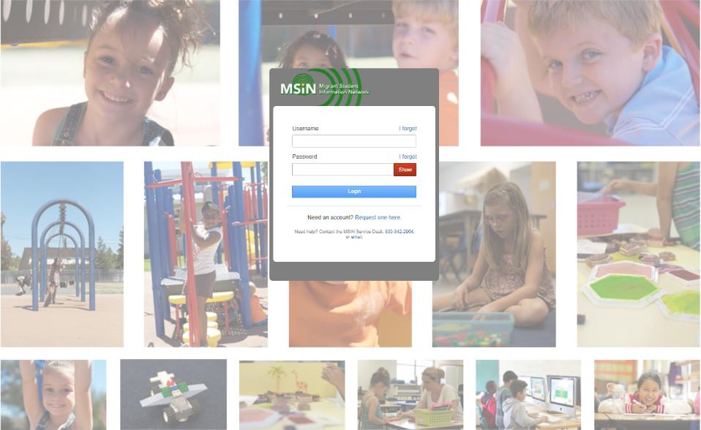
Welcome to the Migrant Student Information Network
2022 Training
We will begin shortly.
Please enter your name and region/district into the chat.

Slide 2
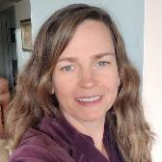
Migrant Student Information Network:
2022 Training
Juli Auld, Education Research and Evaluation Consultant, Migrant Education Office
January 25 – 27, 2022
Notes:
Good morning everyone and thank you very much for joining us this morning for the MSIN Data Privacy and Security Webinar. My name is Juli Auld and I’m the consultant from the Migrant Education Office of the California Department of Education who is responsible for the Migrant Student Information Network. Before we begin the Data & Security Webinar I’d like to provide a little more information about our week of training on the Migrant Student Information Network and talk about some of the things that we’ve accomplished this year.

Slide 3
New Training Format
Session # | Topic | Who should attend | Date | Time
1 | Data Privacy & Security | All roles | Tuesday, January 25th | 10a.m. - 12p.m.
2 | User Account Management | Regional User Approver role | Tuesday, January 25th | 1p.m. - 3p.m.
3 | I&R Features for Reviewers | Designated SEA Reviewer role | Wednesday, January 26th | 10a.m. - 12p.m.
4 | Managing Migratory Child Records | Data Specialist role | Wednesday, January 26th | 1p.m. - 3p.m.
5 | Setting up, Entering, and Extracting Services | MEP manager roles | Thursday, January 27th | 10a.m. - 12p.m.
6 | Using Reports to Monitor and Manage Migratory Child Data | MEP manager roles | Thursday, January 27th | 1p.m. - 3p.m.
Notes:
First let’s review the training schedule for the week. Last year we provided a series of webinars throughout the year in order to create a library of resources for new users to the MSIN. In 2022 we will only be providing training on MSIN during this week and one other time just before data close. We queried the field for topics that you all felt you needed more information about and the way you wanted to receive that information. Based on that feedback, we’ve created this three day series of six sessions starting with the presentation that will begin in a just a few minutes about Data Privacy and Security. Later today there will be another session from 1-3pm for those of you who have the Regional User Approver role called User Account Management. Tomorrow there are two more sessions starting with a morning session about I&R Features for Reviewers that all of you with the role Designated SEA Reviewer were invited to. Tomorrow afternoon the Data Specialists will attend the session entitled Managing Migratory Child Records and Thursday both sessions are for those of you who have a MEP Manager role (I&R Manager, Program Manager, Regional Administrator). The first one is called Setting up, Entering, and Extracting Services and the afternoon session is called Using Reports to Monitor and Manage Migratory Child Data. Sessions 2-6 will include several activities and opportunities for everyone to collaborate with their counterparts.
If you have not yet registered for a session that you have the MSIN role for, I strongly encourage you to do so as soon as possible. The next five sessions are specifically for users with the roles listed there so registration will not be approved if you don’t have that role. If you have any questions about any of these sessions, please chat me directly during this webinar or email me later.

Slide 4

Welcome and Introductions
Notes:
Now I’d like to introduce all of the people that helped put together these three days of training and who will also ensure that it runs smoothly. I’ll start with the amazing team at WestEd beginning with Jose Valencia, the Migrant Student Information Network Lead…

Slide 5
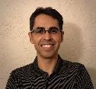

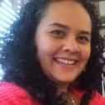
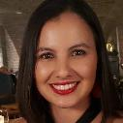

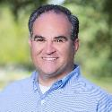

WestEd Team
Jose Valencia, Migrant Student Information Network (MSIN) Lead
Victor Garibay, MSIN Specialist, WestEd
Elvira Raya, Identification & Recruitment (I&R) Lead
Gabriela Garibay, Training and Technical Assistance Specialist
Heather Medina, I&R and Migrant Student Information Exchange (MSIX) Specialist
Marc Greenfield, Project Manager
Nesau Azadan, Program Assistant
Notes:
Lead: Juli
Time: 2 mins.
Talking Points:
Next I’d like to introduce Victor Garibay, the MSIN specialist, who along with Jose and I will be presenting in sessions 2-6. This morning we have a guest presenter from the CDE who I will introduce shortly.
In sessions 2-6 we’ll be spending lots of time in breakout rooms and you’ll see these other WestEd folks in there with you to help you navigate the activities. (Read other names)

Slide 6




Data Advisory Committee Members
Sarah Williams, Migrant Education Program (MEP) Director, Region 2
Simi Pannu, Enrollment Data Specialist Lead, Region 1
Susanne Melton, MEP Director, Region 18
Viridiana Morales, Data Specialist, Region 7
Notes:
Lead: Juli
Time: 2 mins.
Talking Points:
You will also see some members of our Data Advisory Committee in breakout rooms during sessions 2-6 to help you navigate the activities.

Slide 7

Migrant Student Information Network
(MSIN) Accomplishments in 2021
Early data close date
Migration to the cloud
SSDP Reports
INA/ILP Report
New Service Codes for Mini-Corps
Phone Numbers and Emails
Country State Change
Partial Course History Initiative
Notes:
In 2021 the MSIN went through many changes and we accomplished a great deal so I’d like to take a minute and highlight a few of those accomplishments. First, I know you all remember that there was a change to the data close date which occurred much earlier in 2021 than in previous years. This change was driven by a change to the federal reporting requirement timeline and we successfully met those new dates without any issues. Even with that tight timeline we had the smallest decline in the number of eligible migrant students in the 2020-21 performance period that we’ve had in over a decade. I know that took a lot of work on your part so I’d like to thank everyone for getting everything done in a much shorter time span.
One thing that happened in 2021 that you probably didn’t even notice is that we migrated the MSIN from our own servers to the cloud. Even though you may not have noticed, it was a great deal of behind the scenes work for our teammates at WestEd in 2021. Even with all of that happening, we were also able to create many new reports related to the State Service Delivery Plan or SSDP, as well as the INA/ILP Report. We also created new service codes for Mini-Corps, added the capacity to attach emails and phone numbers to specific people, and change the state field requirement for countries not the US, Canada, or Mexico.
We also made a great deal of progress toward complying with federal requirements with our Partial Course History Initiative. (Get stats) We’ve had partial course history data entered into the MSIN by ? Subgrantees for a total of ? Students. We should be able to up those numbers by the end of this academic year and begin 2022-23 with well established practices of entering partial course history when a secondary student moves before the end of a term.

Slide 8


Areas for Improvement
Partial Course History
INA/ILP Completion
Meeting Measurable Program Objectives
Notes:
In the last slide I talked about what a great job we’ve been doing with the Partial Course History but it’s on this slide because we have a long way to go. 2021-22 began without many partial course history entries being made but will end with many more. We need to begin 2022-23 with Partial Course History entry as a regular, integrated process.
INA/ILPs within the system is also relatively new and we can see that not all of them are getting done in a timely manner. That should be an area of focus in the upcoming year.
Finally, with all of the tools we’ll be talking about in these trainings, the new SSDP reports, and Melissa’s help we hope to see improvement toward meeting the MPOs

Slide 9


MSIN Plans for 2022
Refacturing
Interoperability
Partial Course History
Notes:
We have a couple of huge projects related to MSIN that we’ll begin in 2022. Refacturing was a new term for me so let me give you the dictionary definition and then explain what that means for us. Refactoring consists of improving the internal structure of an existing program’s source code. What that means in layman's terms is that we need to rewrite the entire code source that MSIN was built on. There are a couple of reasons why we need to do that. First, the language that was used to create MSIN is no longer being supported. Refactoring is also necessary because every time you add new functionality, cohesion of the system decreases. The refactoring of MSIN is just getting under way and will take longer than a year. Eventually you may notice that some of the colors change and the system may look a little more modern, but it won’t affect functionality.
The second, equally large project that we will be working on in 2022 is the interoperability project with the California Longitudinal Pupil Achievement Data System or CALPADS. In year one of the interoperability project, or 2022, our goals are to connect the systems to do SSID matching from CALPADS as we enter new students into the MSIN. We also hope to send the migrant indicator to CALPADS directly from the MSIN rather than hoping district staff will add the program to the child’s record. Those are phase one goals of a project that has three phases so I’ll talk about the second two phases at a later date.
This may look like a short list but the amount of work required to do both of these projects is enormous… probably just like your workload. So thank you for taking the time to join us this morning and for all the work you do for the Migrant Education Program.
In 2022 the MSIN will continue to undergo a lot of behind the scenes work to keep up with security and other changes to its technology.
Speaking of security, it’s time to get started with our presentation on Data Privacy & Security.

Slide 10
Migrant Student Information Network:
Data Privacy and Security
January 25, 2022
10:00 a.m. – 12:00 p.m.
Notes:
Now I’d like to introduce our presenter for this morning’s session.

Slide 11
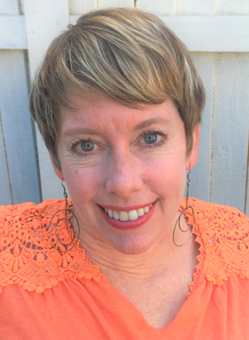
Please Welcome
Elizabeth Wiznia, Education Programs Consultant, Educational Data Management Division, California Department of Education

