Slide 1
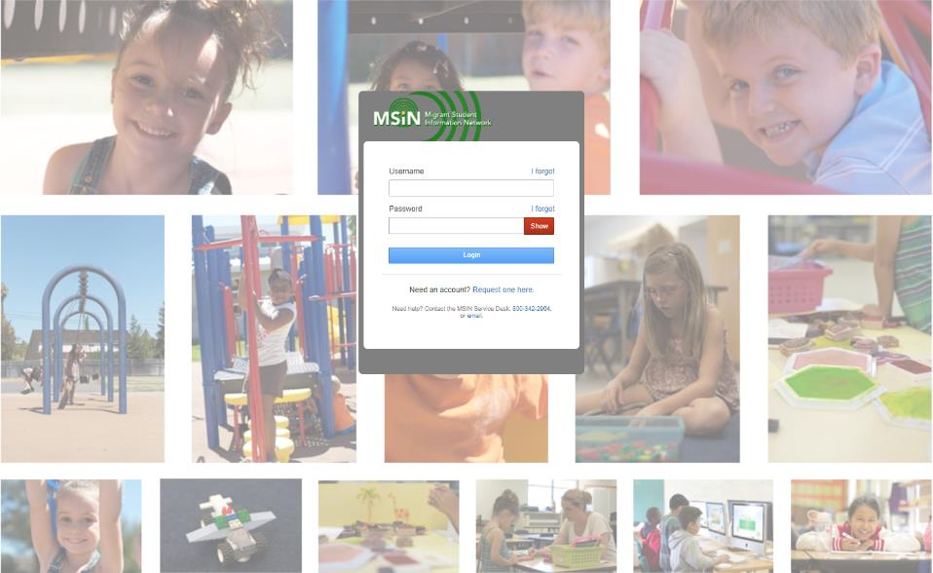
Welcome to the Migrant Student Information Network
2022 Training
We will begin shortly.
Please enter your name and region/district in the chat.

Slide 2
Migrant Student Information Network:
Key Features for Designated
State Education Agency Reviewers
January 26, 2021
10:00 a.m. – 12:00 p.m.

Slide 3
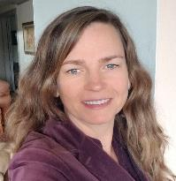
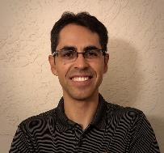

Welcome and Introductions
Session Presenters
Juli Auld, Education Research and Evaluation Consultant, California Department of Education (CDE)
Jose Valencia, Migrant Student Information Network (MSIN) Lead, WestEd
Victor Garibay, MSIN Specialist, WestEd
Notes:
Lead: Juli
Time: 3 mins.
Talking Points:
Welcome participants.
Presenters introduce themselves

Slide 4
Purpose
This webinar will review MSIN features used by Designated State Education Agency (SEA) Reviewers to evaluate and track their Certificate of Eligibility (COE) work.
The target audience is MEP staff with the Designated SEA Reviewer role.
Notes:
Lead: Juli
Time: 1 min
Talking Points:
(Read or paraphrase bullets)
The terms Designated SEA Reviewer, SEA Reviewer, and Reviewer are used interchangeably.
The session content is a review of key items taken from last year’s training series.
This year, the focus is on sharing and collaborating with your peers.
This session is meant for experienced MSIN users who already have a working background as active Reviewers.

Slide 5
Session Objectives
Participants will:
Know key aspects of the COE review screen in MSIN;
Review the logic behind each feature and its intended use;
Review tips and caveats for relevant system features;
Share and discuss local knowledge regarding these topics; and
Review the resources available to support Designated SEA Reviewers.
Notes:
Lead: Juli
Time: 1 min
Talking Points:
(Read or paraphrase bullets)

Slide 6

Housekeeping
Please mute your speaker in the main session.
Use the chat function to enter your questions.
Participate in breakout room activities.
The PowerPoint for this presentation can be accessed through the link provided in the chat.
Notes:
Lead: Juli
Time: 1 min.
Talking Points:
(Read or paraphrase bullets)

Slide 7
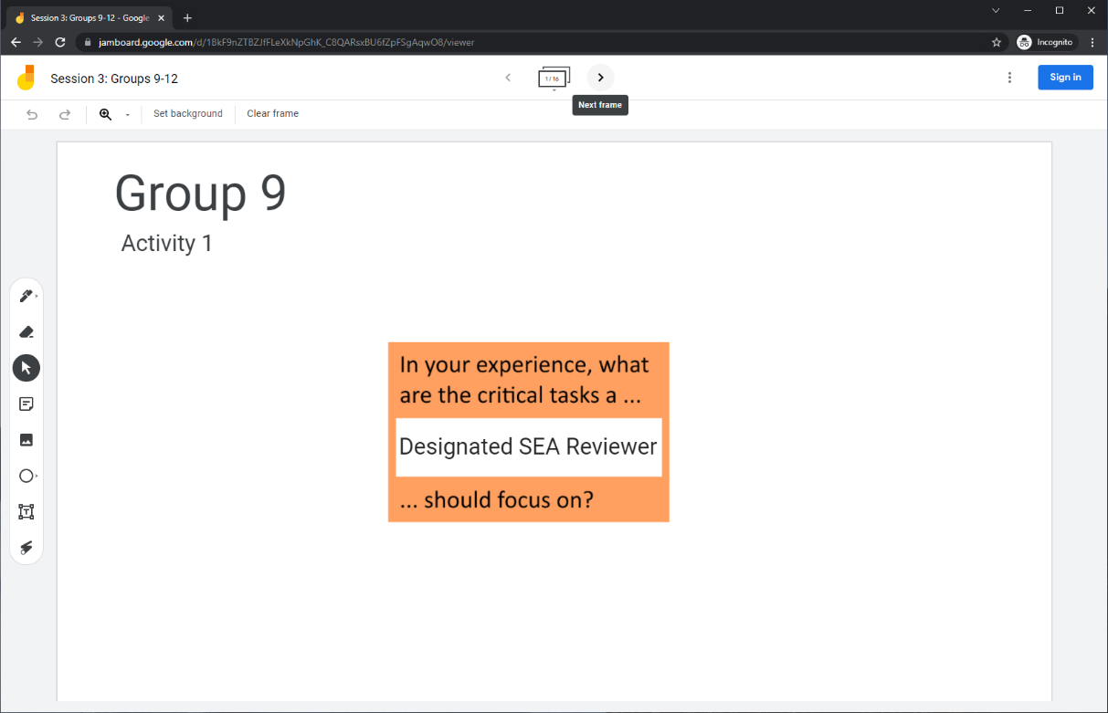
Collaborative Activity 1: Knowledge Wall
Notes:
Lead: Jose
Time: 3 mins.
Talking Points:
At this point, Designated SEA Reviewers have been working with the COE review process in MSIN for many years. So, our first collaborative activity is meant to tap into your collective knowledge and share it with your peers. This is a “Knowledge Wall” activity.
Explain that participants will be placed in breakout rooms with 5 collaborators.
Demonstrate the activity using Jamboard: https://jamboard.google.com/d/1uwF7h5KRsfTGBjL8KuZS_Uc9rdLqdsGcOw4TcyApZrs/edit?usp=sharing
Focus on the prompt in the orange box. Walk through using the post-it (sticky note) and text controls to add content.

Slide 8
Activity 1 Instructions
In your Breakout Room (BR), take 2 minutes to introduce yourselves (name, region/DFD, and job title).
Open the chat window to view the instructions and links.
Click on the Jamboard link that matches your BR number (e.g., BR 9 should go to Jamboard group 9).
Keep two windows open: your BR in zoom and your activity 1 slide in Jamboard.
Add post-its (sticky notes) or text onto the wall.
Discuss your contribution(s) to the wall with the group.
Notes:
Lead: Jose
Time: 10 mins.
Talking Points:
(Read instructions on the slide.)
Send to Breakout rooms – 8 minutes
Paste the instructions in the chat for all breakout rooms.

Slide 9
Designated SEA Reviewer Role in MSIN
Definition: MEP staff who are responsible for reviewing Certificates of Eligibility and ensuring that all eligibility criteria are met prior to verification.
The Designated SEA Reviewer role is intended for local MEP staff with the following qualifications:
Have a deep knowledge of all eligibility criteria and the COE;
Participate in all local and state training sessions around I&R;
Have been selected (i.e., designated) by local managers, including the MEP Director, to review and verify COEs; and
Have been trained by local managers to use the MSIN system accordingly.
Notes:
Lead: Jose
Time: 2 min
Talking Points:
Now we will review the official definition of the Designated SEA Reviewer role in MSIN and recommended guidelines for their selection/training.
(Read or paraphrase bullets)
When reviewing COEs, Designated State Education Agency (SEA) Reviewers are actually representing the State.
In MSIN, the Designated SEA Reviewer system role is meant to describe a function performed by staff who may have other local job titles.
Note that local responsibilities vary greatly among subgrantees, so not every example or scenario covered today will apply to your region or Direct Funded District (DFD).
Guidance reference (pg. 40): A10 - Is the SEA responsible for ensuring the accuracy of a recruiter's eligibility determinations?
Yes. The SEA and its local operating agencies are responsible for ensuring the accuracy of the information used to determine each child’s eligibility for the MEP.

Slide 10

Questions?
Notes:
Lead: Team
Time: 3 mins

Slide 11
COE Review Process
Notes:
Transition Slide
Lead: Victor
Time: 20 secs.

Slide 12
Simplified Workflow for eCOEs
Recruiter submits their COE to Review (Queued folder)
Reviewer adds the COE to their My Tasks folder
Reviewer uses the review screen to approve/ reject the COE
If approved, child(ren) on the verified COE are added to the MSIN database
Notes:
Lead: Victor
Time: 2 min
Talking Points:
(Describe the steps in the diagram above.)
During this session, we are going to focus on the 3rd box, which is where Reviewers spend most of their effort.

Slide 13
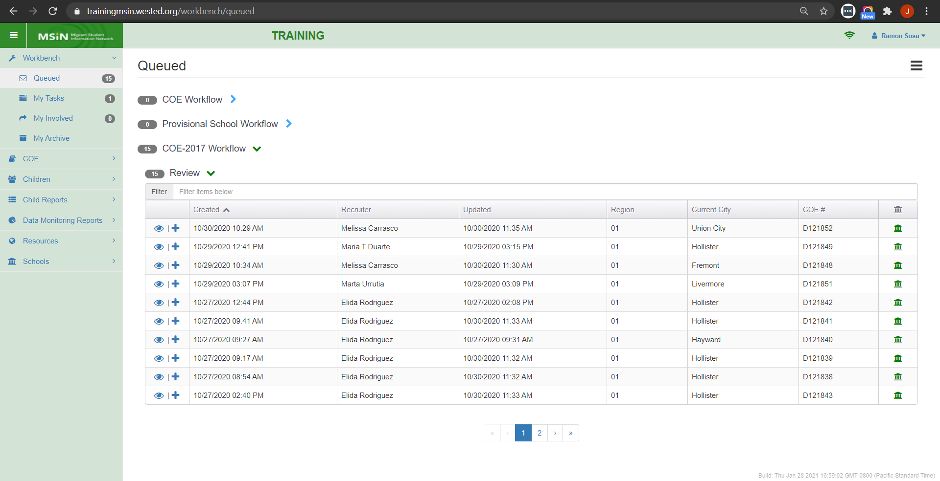
Queued: COE-2017 Workflow
Notes:
Lead: Victor
Time: 3 min
Talking Points:
Reviewers are typically assigned to specific recruiters, geographical areas, or districts.
This table, under the COE-2017 workflow, shows all the Region 01 COEs that were transitioned to Review state and are now waiting to be claimed and reviewed.
Clicking on the plus icon moves the worklist item into the user’s My Tasks folder.
Intended use: The Queued folder is meant to show subgrantees their pending work so that it can be distributed equitably when there is more than one Designated SEA Reviewer.
This is especially important for large subgrantees that need to balance the reviewing workload among several Reviewers.

Slide 14
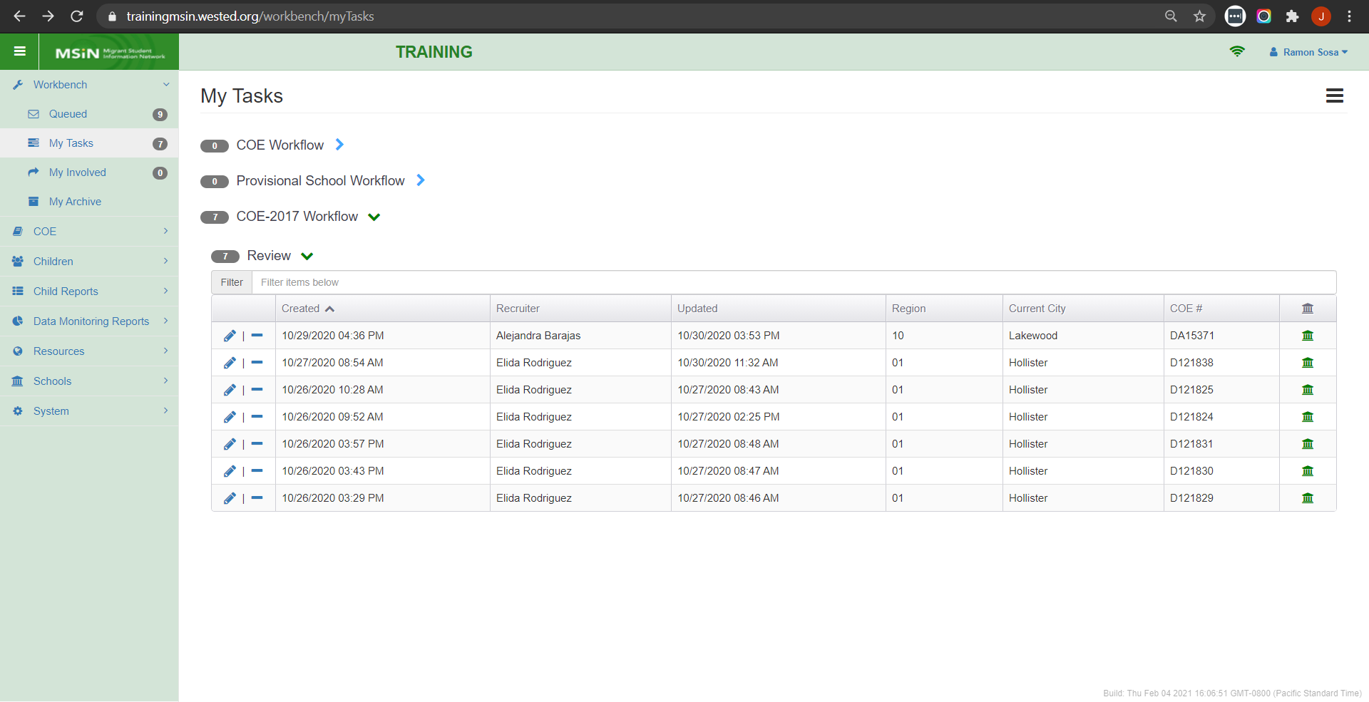
My Tasks: COE-2017 Workflow
Notes:
Lead: Victor
Time: 2 min
Talking Points:
Here we see 7 COEs that were claimed by this Reviewer (Ramon Sosa) and now appear in his My Tasks folder.
Note that if a Reviewer goes on vacation, on sick leave, or is assigned other urgent tasks, they can return any COEs they have not reviewed back into the Queued folder.
This is done by clicking on the minus icon.
This design allows for flexibility to accommodate changing work schedules and unexpected absences.

Slide 15
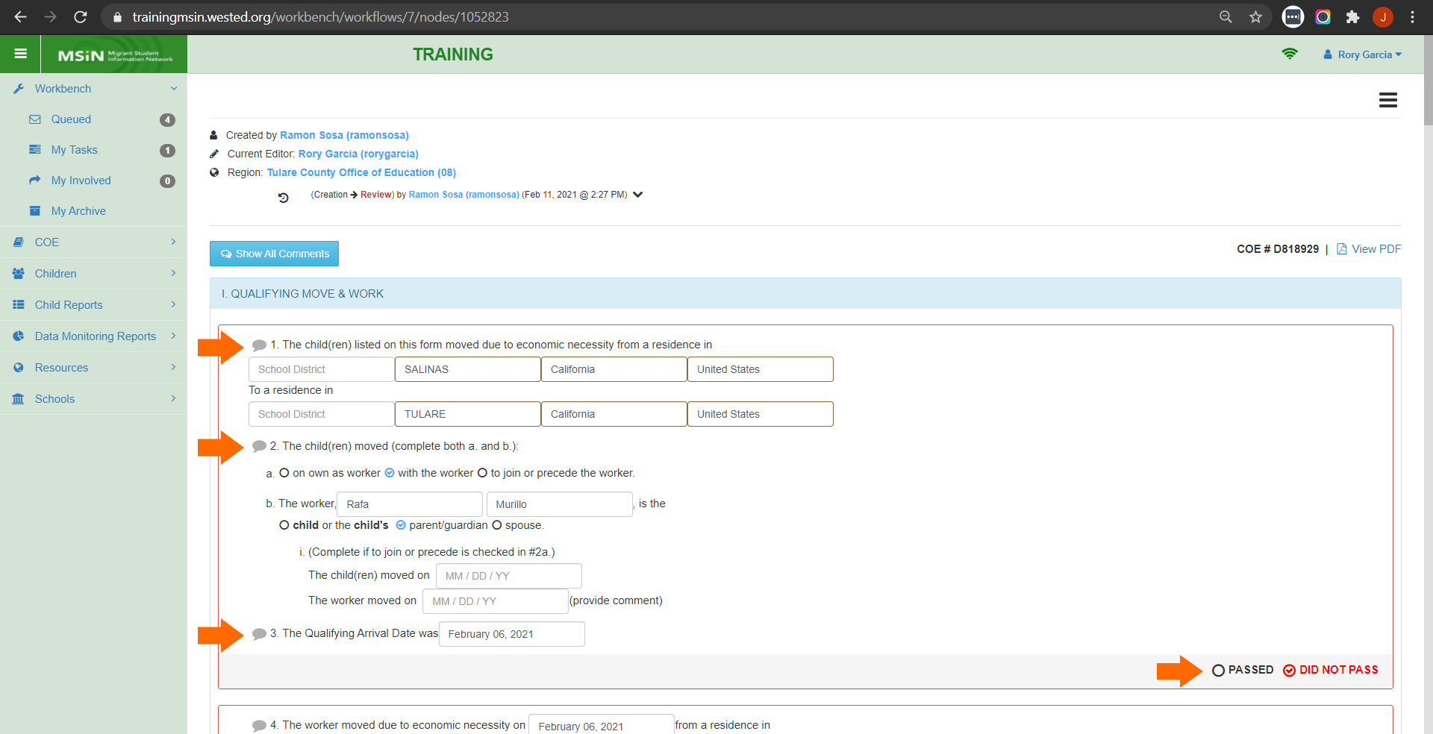
Working with the COE Review Screen
Notes:
Lead: Jose
Time: 3 min
Talking Points:
When a COE is claimed from the Queued folder and then opened in edit mode (pencil icon), you will see the COE Review Screen.
The COE’s appearance changes slightly, as follows:
The COE workflow history is added on top, before the COE form (walk through the lines in the screenshot)
Callout comments (grey callout comment icons) are added next to key statements (see orange arrows on the left)
When comments are added, the grey callout comment icon will turn red and display a tally representing the number of comments within.
Key COE sections have “PASSED” and “DID NOT PASS” radio buttons (see orange arrow on the bottom right corner)

Slide 16
COE Review Screen: Passed/Did Not Pass
The COE form is broken up into sections so that Reviewers evaluate key eligibility components one at a time, in a paced and consistent manner.
The COE sections with Pass/Did Not Pass decision points are:
  Section 1a: The child and worker’s qualifying move
  Section 1b: The worker’s qualifying move
  Section 3: Actively sought work and recent history of moves, if applicable
  Section 4: Round trip move, if applicable
  Section 6: Child data
  Section 7: School and health data
Notes:
Lead: Jose
Time: 2 min
Talking Points:
(Read or paraphrase bullets)

Slide 17
COE Review Screen: Callout Comments
Reviewers should add callout comments when a COE will be returned to the Recruiter for corrections or clarifications.
  Callout comments are needed every time a Reviewer marks a COE section as DID NOT PASS, as shown in the instructional videos under the User Guides section of the MSIN homepage: https://drive.google.com/drive/folders/0BxgpmxyQ79rmVFUwWFFfZ0dvYU0
If a COE is returned without callout comments, the COE Review Screen will not have an explanation of why the Reviewer initiated the return.
Notes:
Lead: Jose
Time: 2 min
Talking Points:
(Read or paraphrase bullets)
Later in the presentation, we will also see that adding callout comments is not only important to have a complete COE Review Screen, but also to have a useful COE Review Log as well.

Slide 18
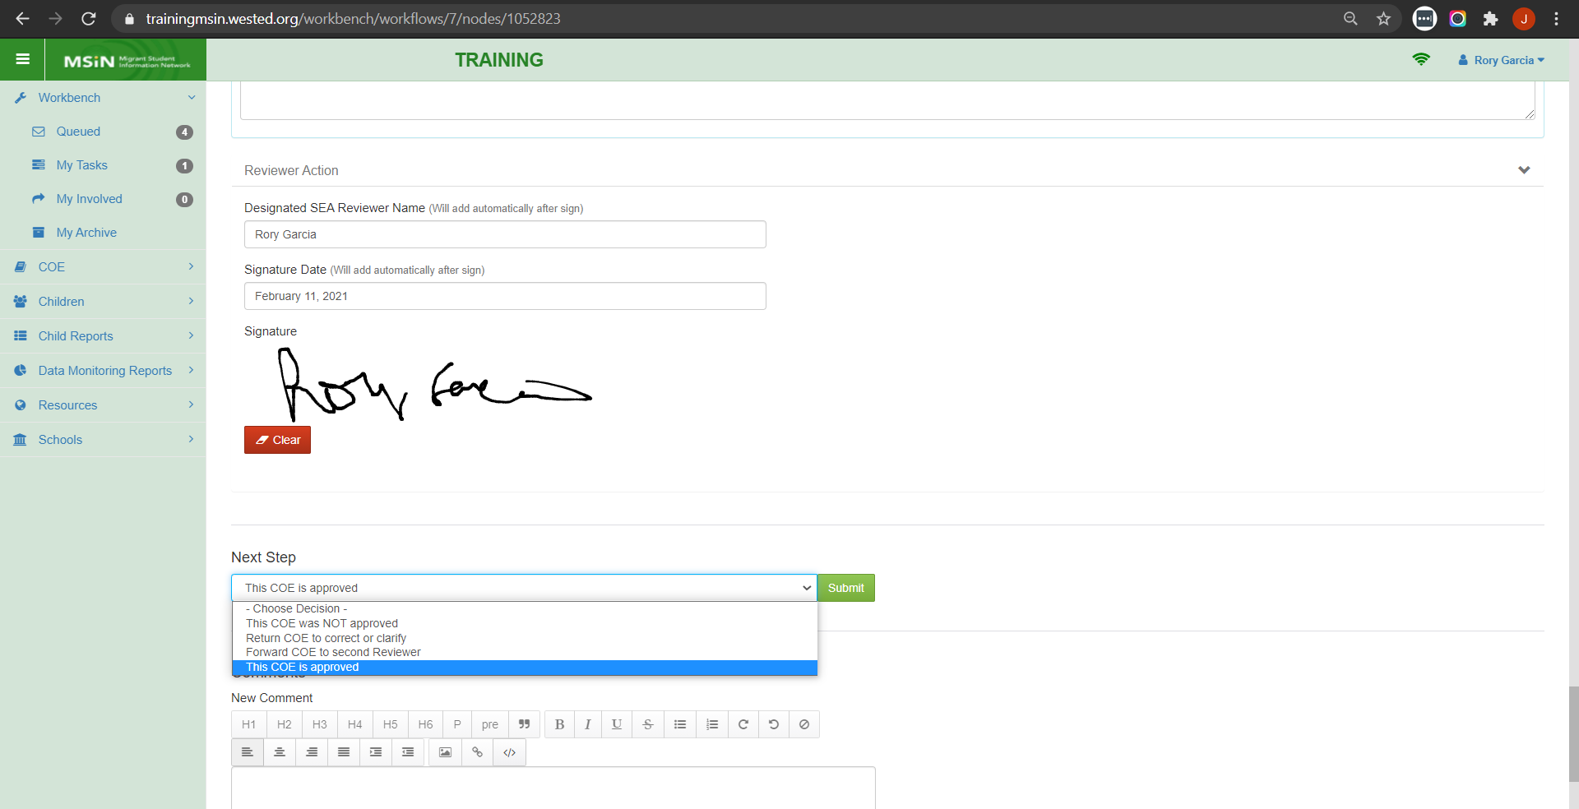
COE Review Screen: Next Step Options
Notes:
Lead: Jose
Time: 4 min
Talking Points:
If all the COE sections are marked as PASSED, then the Reviewer signature box will appear. Alternatively, if any section is marked as DID NOT PASS, the form will not display the signature box.
This is an important quality control function that prevents the accidental signing and approval of COEs that did not pass review.
If all sections have passed review, the Reviewer will sign and go to the Next Step drop-down menu, where they will select “This COE is approved”.
As shown earlier in the simplified diagram of the review process, when a COE is approved the children listed in the form get added or updated in the MSIN database.
Other options are also possible, as follows:
Some subgrantees have a COE review process in which 2 Reviewers approve each COE. In this case, the 1st Reviewer has the option to transition the COE to the 2nd Reviewer by selecting “Forward COE to second Reviewer”.
Another option is to deny the COE by selecting “This COE was NOT approved”.
Another option is to return the COE to the Recruiter by selecting “Return COE to correct or clarify”. We will go into more detail regarding this option in the next slide.

Slide 19
Caveats: Returning COEs
The Reviewer’s primary function is to evaluate the information on the COE form to ensure that all eligibility criteria have been met.
If the Reviewer judges the information on the COE to be incomplete or contradictory, they may decide to return the COE to the Recruiter.
Returns should be based on questions or concerns around eligibility-related information.
In contrast, minor errors that are not eligibility-related should not trigger a return. Minor corrections (e.g., misspellings, enrollment mistakes, grade errors) can be made in the child record after verifying the COE.
Notes:
Lead: Jose
Time: 2 min
Talking Points:
(Read or paraphrase bullets)
Note: Regarding the last bullet, while it is important to address these type of minor errors not related to eligibility, doing so through one-on-one or group training and coaching may be more effective and efficient than creating a large and unnecessary backlog of returned COEs.
This concludes our review of the COE review screen and related features.
Now we will move on to the second collaborative activity.

Slide 20
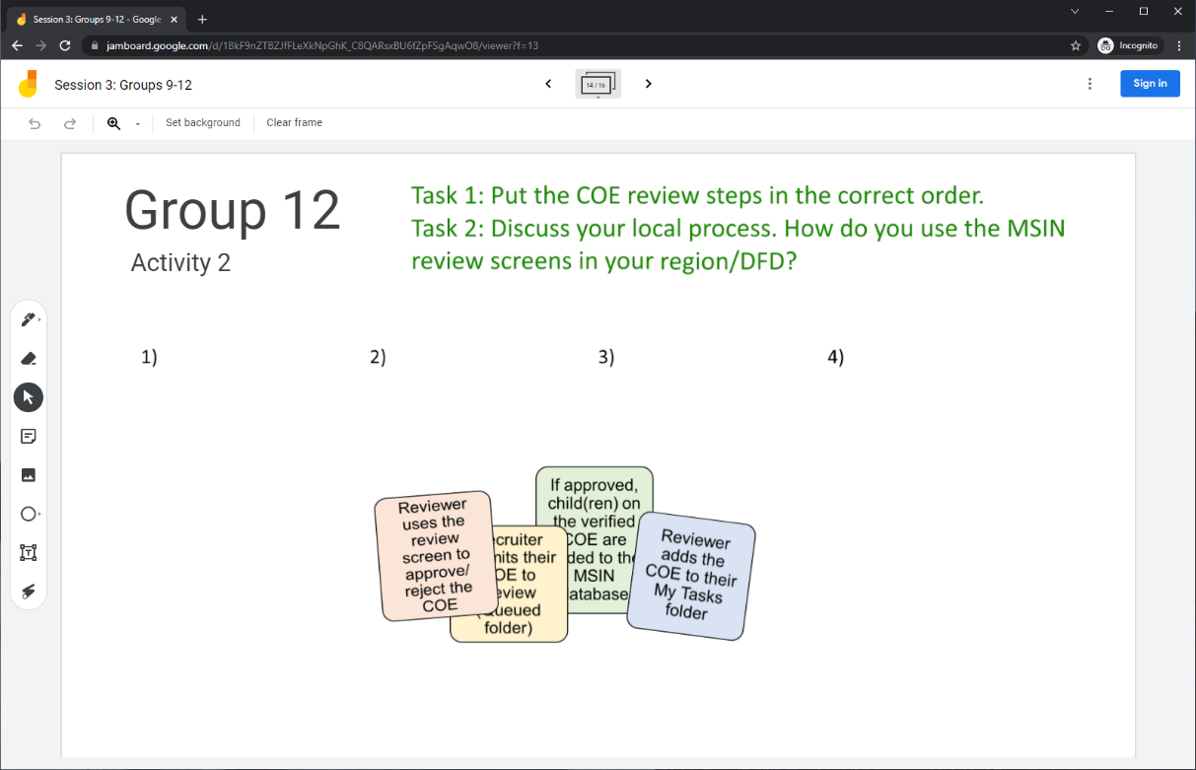
Collaborative Activity 2
Notes:
Lead: Jose
Time: 3 mins.
Talking Points:
This activity is focused on sharing and discussing your local process for reviewing COEs.
Explain that participants will be placed in breakout rooms with 5 collaborators. [Randomly assigned; not the same group members as in Activity 1.]
Demonstrate the activity using Jamboard: https://jamboard.google.com/d/1uwF7h5KRsfTGBjL8KuZS_Uc9rdLqdsGcOw4TcyApZrs/edit?usp=sharing
Focus on the tasks in green text.
Show how to move the steps in order and how to add post-its (sticky notes) based on the group’s discussion.

Slide 21
Activity 2 Instructions
A) In your breakout room, take 2 minutes to introduce yourselves (name, region/DFD, job title or role).
B) Open the chat window to view the instructions and links.
C) Click on the Jamboard link that matches your breakout room number (e.g., breakout room 12 should go to Jamboard group 12).
D) Keep two windows open: your breakout room in Zoom and your Activity 2 slide in Jamboard.
E) Put the COE review steps in the correct order.
F) Discuss your local process. How do you use the review screens in your region/DFD?
Notes:
Lead: Jose
Time: 10 mins.
Talking Points:
(Read instructions on the slide.)
Send to Breakout rooms – 8 minutes
Paste the instructions in the chat for all breakout rooms.

Slide 22
Questions? (2)
Notes:
Lead: Team
Time: 3 mins

Slide 23
Check for Understanding
  Next, you will see a pop-up window with questions and response options.
  There are three questions for this section; answer them as best you can.
  You will get a warning when the poll is about to close.
Notes:
Lead: Victor
Time: 4 min
Poll Questions:
Reviewers must claim each COE they will review by going to the Queued folder and clicking the plus sign next to each COE. This will transition the COEs to the Reviewer’s My Tasks folder.
True [answer]
False
I don’t know
2) COEs are reviewed within a special COE Review Screen that includes the following details:
The COE is broken up into sections that must be marked as PASSED or DID NOT PASS.
Callout comment icons are available next to key statements so that Reviewers can add notes.
The COE’s workflow history is summarized at the top of the COE Review Screen.
All of the above. [answer]
I don’t know
3) The Reviewer can send back COEs that need eligibility-related corrections or clarifications.
True [answer]
False
I don’t know

Slide 24

Break
Notes:
3-minute break
Stretch, grab coffee or tea, take a bio break

Slide 25
Monitoring COE Data Quality
Notes:
Transition Slide
Lead: Victor
Time: 20 secs.

Slide 26
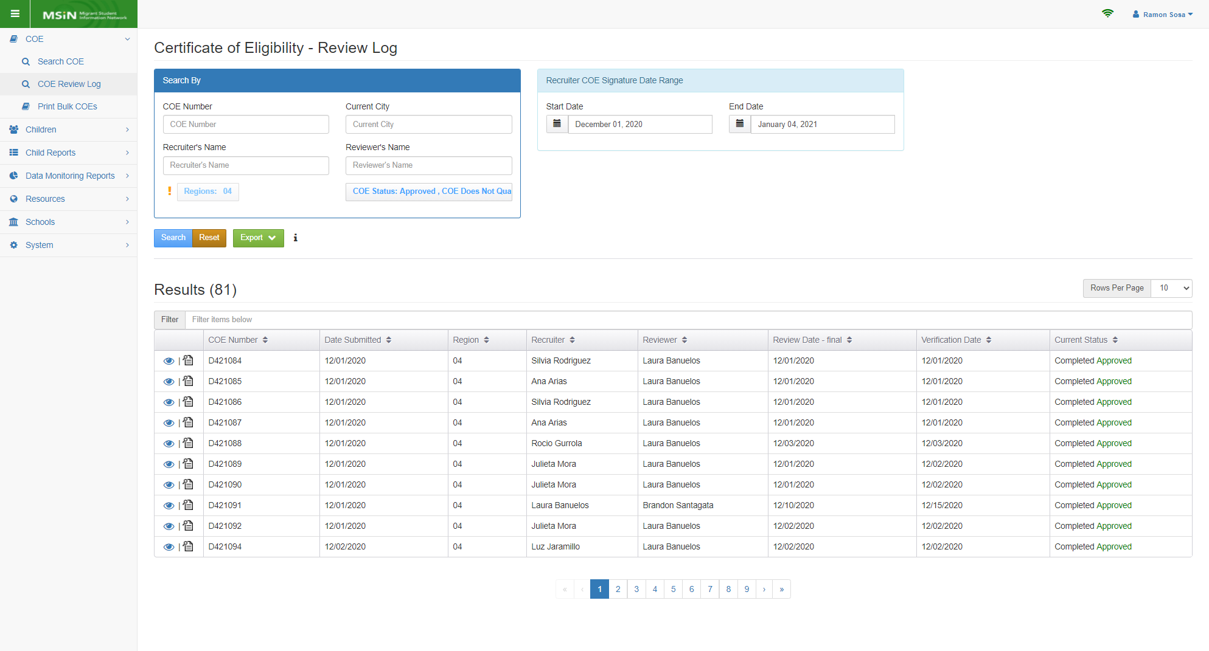
COE Review Log
Notes:
Lead: Victor
Time: 3 min
Talking Points:
The COE Review Log features are intended to help you monitor COE quality and the COE Review process.
The COE Review Log was also created to replace local Quality Control (QC) logs.
(Briefly review the columns in the results table)
Like almost all reports in MSIN, the search options limit you to your own region/DFD (the Region field automatically populates with the user’s region; the exclamation point means that this field cannot be changed).
The results table returns a maximum of 1,000 records.

Slide 27
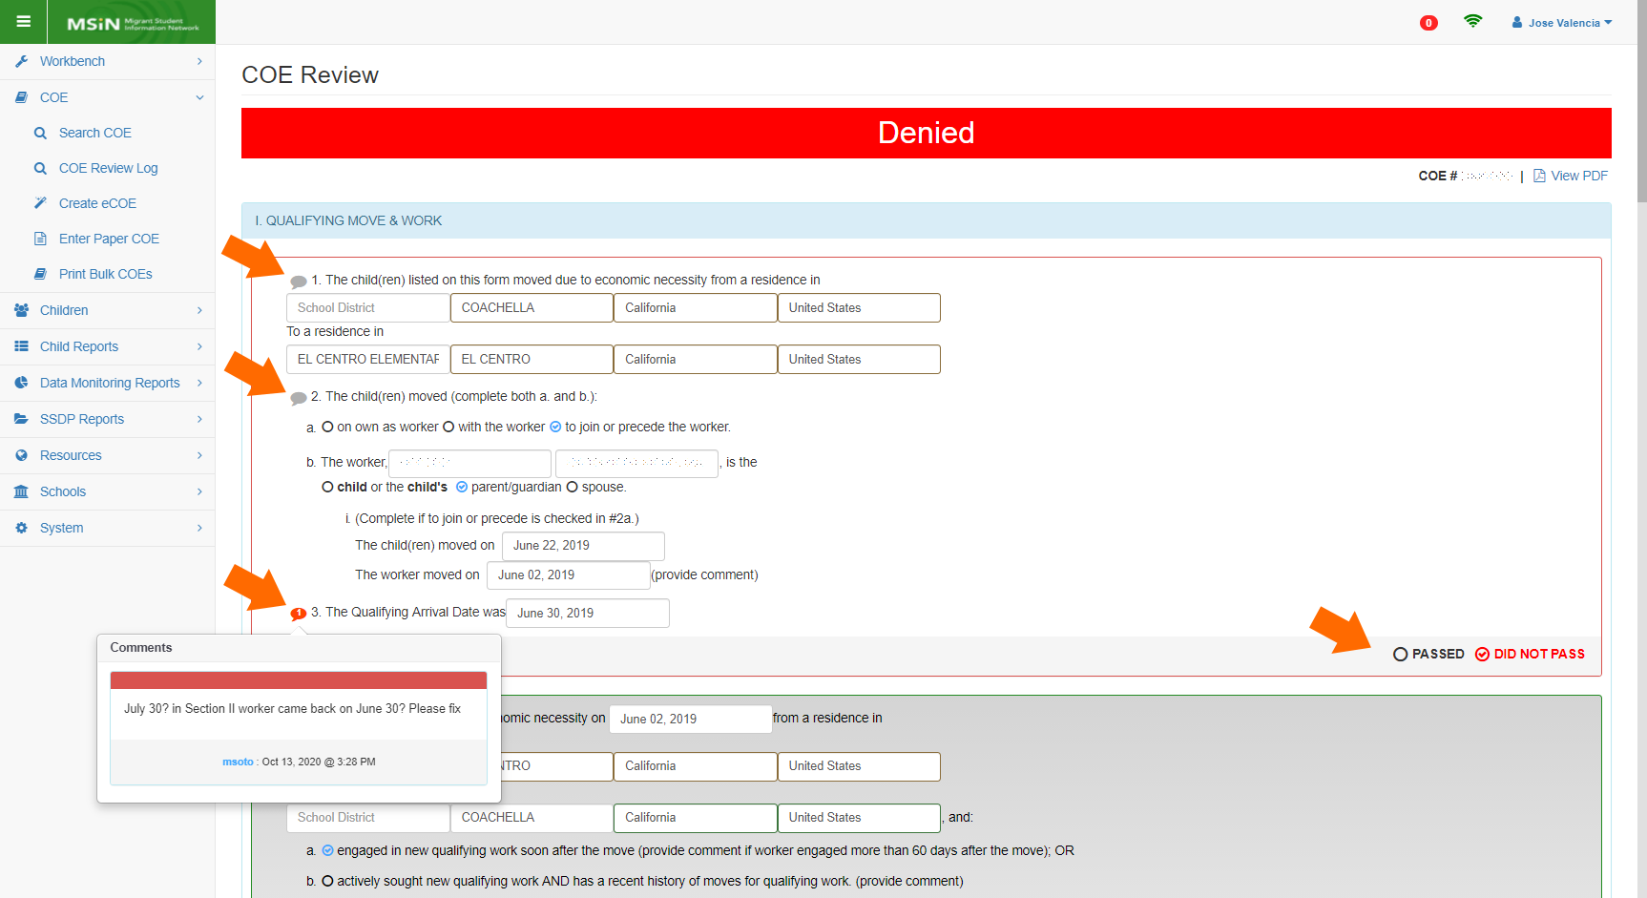
COE Review Screen
Notes:
Lead: Victor
Time: 2 min
Talking Points:
The data shown on the COE Review Log comes from each COE’s Review Screen.
As we covered earlier, when a COE is sent to Review, the form’s appearance changes slightly because callout icons are added next to key statements and each COE section must be evaluated (e.g., marked PASSED or DID NOT PASS).
Notice the red callout comment icon. It displays a tally of 1 to represent the number of comments within.

Slide 28
COE Review Log Export
Exporting the report adds the following fields to an Excel spreadsheet:
COE Type (values: paper COE, electronic COE)
Recruiter Sign Date (when the Recruiter signed the COE)
Review Date — initial (the first time the COE was sent to Review)
Times in Fix Status (tally of COE returns for corrections or notes)
COE marked ineligible (if applicable, due to Quality Control findings)
Child removed (if applicable, due to quality control findings)
COE Section 1a passed? (values: yes, no)
  Section 1a, item 1 (tally of separate notes)
  Section 1a, item 2 (tally of separate notes)
  Section 1a, item 3 (tally of separate notes)
Notes:
Lead: Victor
Time: 4 min
Talking Points:
Reviewers can export a spreadsheet file that includes more fields than shown on the search screen results table (e.g., on slide 24).
The additional data in the export file allows Designated SEA Reviewers (and managers) to create many kinds of summary reports, as described in the user guide for this feature.
(read or paraphrase bullets)
Again, it is very important to understand that the COE Review Log is only useful if it contains information that it collects from each COE review screen.
If notes are not added in the COE Review Screen, then the COE Review Log will be blank as well.
This is most relevant when COEs are returned to the Recruiter for corrections.
If notes are not added in the COE review screen, then it will not be possible to tell why the COE was returned using the COE Review Log.

Slide 29
COE Review Log Export (2)
COE Section 1b passed? (values: yes, no)
  Section 1b, item 4 (tally of separate notes)
  Section 1b, item 5 (tally of separate notes)
  Section 1b, item 6 (tally of separate notes)
COE Section 2 (tally of separate notes)
COE Section 3 passed? (values: yes, no)
  Section 3, sought work (tally of separate notes)
  Section 3, move 1 (tally of separate notes)
  Section 3, move 2 (tally of separate notes)
COE Section 4 passed? (values: yes, no)
  Section 4, item 3 (tally of separate notes)
  Section 4, item 4 (tally of separate notes)
Notes:
Lead: Victor
Time: 1 min
Talking Points:
The log include all the section on Side 1 of the COE form.
(read or paraphrase bullets)

Slide 30
COE Review Log Export (3)
Section 5, parent names (tally of separate notes)
Section 5, addresses (tally of separate notes)
Section 6 passed? (values: yes, no)
  Section 6, child data (tally of separate notes)
Section 7 passed? (values: yes, no)
  Section 7, school & health (tally of separate notes)
Section 9, signature (tally of separate notes)
Section 10, signature (tally of separate notes)
Section 11, signature (tally of separate notes)
Section 12, comment (tally of separate notes)
Notes:
Lead: Victor
Time: 1 min
Talking Points:
The log also includes all the sections on Side 2 of the COE form.
(read or paraphrase bullets)
So there are many opportunities to write callout comments when a potential error is found.

Slide 31
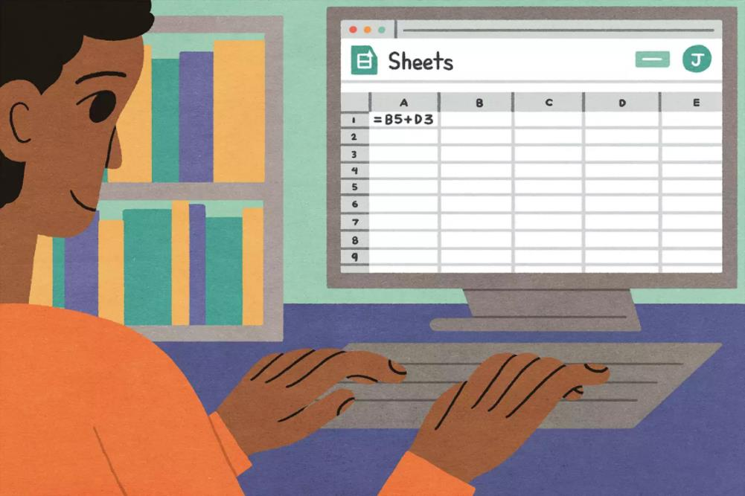
COE Review Log Export — Demonstration
Notes:
Lead: Jose
Time: 3 min
Talking Points:
(Show an exported log and point out how columns are read).
Point out the importance of the callout comment tallies (i.e., they help managers identify areas where Recruiters my need more support).

Slide 32
COE Review Log Tips
Read the “COE Review Log — MSIN User Guide,” found on the MSIN home page (under Identification & Recruitment). This guide explains three use cases in detail:
  SEA Reviewers can export the COE Review Log to analyze their own work history, such as their COE approvals versus the COEs they have denied.
  I&R Managers and SEA Reviewers can determine if they are meeting their own goals for COE review times.
  I&R Managers and SEA Reviewers can determine which sections of the COE have the most issues.
Notes:
Lead: Jose
Time: 4 min
Talking Points:
(Read or paraphrase bullets.)
(Show the user guide and the example graphs.)
The biggest tip that we have for you today is to use the COE Review Screen as intended, otherwise it will not be possible to perform in-depth analyses, such as #3.
For example, we have noticed that some Reviewers are not adding callout comments even though they are sending COEs back to Recruiters for corrections or clarifications. If comments are not added within the COE Review Screen, then the COE Review Log will be missing information.

Slide 33
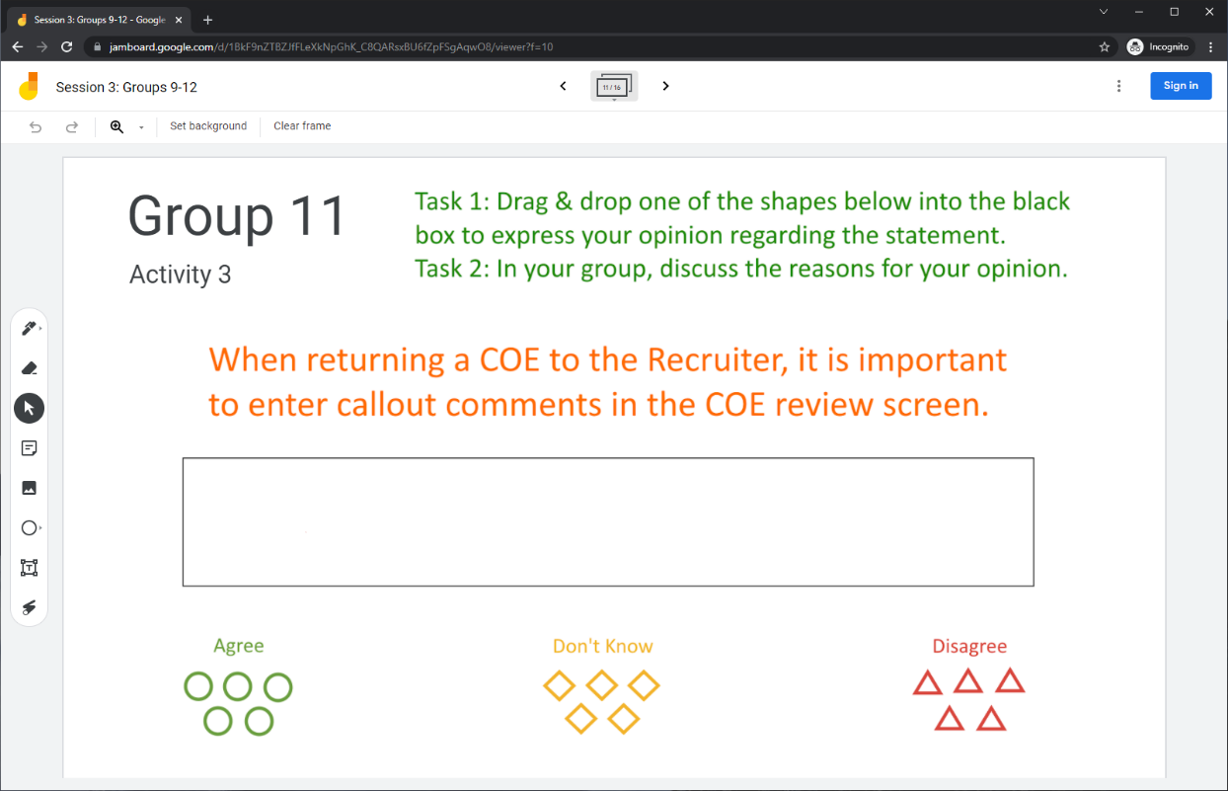
Collaborative Activity 3
Notes:
Lead: Victor
Time: 3 mins.
Talking Points:
This collaborative activity is focused on sharing and discussing your ideas around callout comments and their impact on Recruiters and the COE Review Log.
Explain that participants will be placed in breakout rooms with 5 collaborators. [Randomly assigned; not the same group members as in Activity 1 or 2.]
Demonstrate the activity using Jamboard: https://jamboard.google.com/d/1uwF7h5KRsfTGBjL8KuZS_Uc9rdLqdsGcOw4TcyApZrs/edit?usp=sharing
Focus on the tasks in green text.
Walk through adding post-its (sticky notes).

Slide 34
Activity 3 Instructions
In your BR, take 2 minutes to introduce yourselves (name, region/DFD, and job title).
Open the chat window to view the instructions and links.
Click on the Jamboard link that matches your BR number (e.g., BR 11 should go to Jamboard group 11).
Keep two windows open: your BR in zoom and your activity 3 slide in Jamboard.
Choose a shape and drag it into the black box to express your opinion.
Discuss the reasons for your opinion.
Notes:
Lead: Victor
Time: 10 mins.
Talking Points:
(Read instructions on the slide.)
Send to Breakout rooms – 8 minutes
Paste the instructions in the chat for all breakout rooms.

Slide 35
Questions? (3)
Notes:
Lead: Team
Time: 3 mins

Slide 36
Check for Understanding (2)
  Next, you will see a pop-up window with questions and response options.
  There are two questions for this section; answer them as best you can.
  You will get a warning when the poll is about to close.
Notes:
Lead: Victor
Time: 4 min
Poll Questions:
1) The COE Review Log was created to monitor COE data quality and to replace local Quality Control (QC) logs.
True [answer]
False
I don’t know
2) It is important to add callout comments when a COE will be returned for corrections or clarifications, otherwise the COE Review Log will be missing callout comment tallies, which highlight areas where recruiters may need additional support.
True [answer]
False
I don’t know

Slide 37
Resources and Closing Activity
Notes:
Transition Slide
Lead: Juli
Time: 10 secs.

Slide 38
Resources
Subgrantees may use this presentation to review requirements and recommendations.
User guides and how-to videos for the features covered today are available on the MSIN home page, under User Guides: https://drive.google.com/drive/folders/0BxgpmxyQ79rmTUkyZE5ubnJoejA
The COE Review Log was presented during the “State Training for I&R Leads and Designated SEA Reviewers 2019”: https://drive.google.com/drive/folders/1zGwJxEErWxQj_DVvBhlxBlgmd5CdNvGz
If any questions arise, Reviewers should consult with their supervisors first. Remaining questions or concerns can be submitted to the MSIN Service Desk.
Notes:
Lead: Juli
Time: 1 min
Talking Points:
In addition to the user guides, remember that definitions, rules, and other information is readily accessible within most screens by clicking the “i” icon next to field titles.
Finally, don’t forget that the Training MSIN site is always available so that you can practice and brush up on system features.

Slide 39
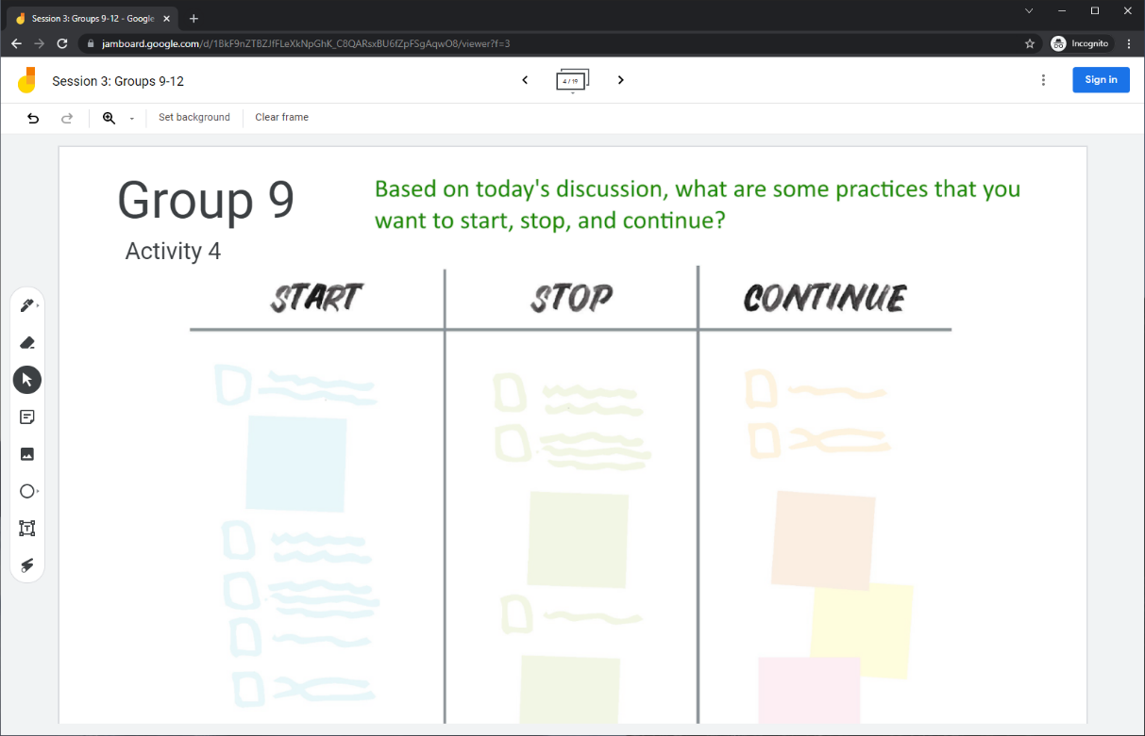
Collaborative Activity 4
Notes:
Lead: Juli
Time: 3 mins.
Talking Points:
Our last collaborative activity for this session is meant for you to reflect and discuss any key points that you’re thinking of integrating into your local practices going forward. This activity is called “Start – Stop – Continue.”
Explain that participants will be placed in breakout rooms with 5 collaborators. [Randomly assigned; not the same group members as in Activity 1 or 2.]
Demonstrate the activity using Jamboard: https://jamboard.google.com/d/1uwF7h5KRsfTGBjL8KuZS_Uc9rdLqdsGcOw4TcyApZrs/edit?usp=sharing
Focus on the task in green text.
Add post-its (sticky notes) or text to the 3 categories, based on what you learned, remembered, and reinforced during this collaborative session.

Slide 40
Activity 4 Instructions
A) In your BR, take 2 minutes to introduce yourselves (name, region/DFD, job title or role).
B) Open the chat window to view the instructions and links.
C) Click on the Jamboard link that matches your BR number (e.g., BR 9 should go to Jamboard group 9).
D) Keep two windows open: your BR in Zoom and your Activity 4 slide in Jamboard.
E) Add a post-it (sticky note) or text in each of the categories.
F) Discuss anything that you find surprising or unexpected.
Notes:
Lead: Juli
Time: 10 mins.
Talking Points:
Read instructions on the slide.)
Send to Breakout rooms – 8 minutes
Paste the instructions in the chat for all breakout rooms.

Slide 41
Questions? (4)
Notes:
Lead: Team
Time: 3 mins

Slide 42
Contact Information
Juli Auld
Education Research and Evaluation Consultant
California Department of Education
jauld@cde.ca.gov
916-319-0410
__________________________________________________
MSIN Service Desk
MSINsupport@wested.org
1-800-342-2964, option 2
Notes:
Lead: Juli
Time: 30 sec
Talking Points:
Thank participants for attending.
Thank WestEd technical staff who assisted with the webinar.

