Slide 1
The webinar will begin shortly. Please review the Chat and click on the Google Form link to sign-in. Thank you!
Welcome
Notes:
Lead: Victor
Time: min.
Talking Points:
10 mins prior to webinar time
Good morning! We will begin in a few minutes. Please review the Chat and click on the Google Form link to sign-in for this meeting. Thank you.

Slide 2
State Service Delivery Plan
Measurable Program Objective Reports
(Part I)
October 27, 2026
Notes:
Lead: Victor
Time: min.
Talking Points:

Slide 3
Housekeeping
Please mute your microphone.
Use the Q&A function to enter your questions.
This PowerPoint will be available in the state Service Delivery Plan (SDP) Continuous Improvement Box folder and in the Migrant Education Program (MEP) Help Center after the webinar.
Notes:
Lead: Melissa
Time: 1 min.
Talking Points:
Before we get started, let’s review a few housekeeping items (if you haven’t already, please):
--Mute your microphone.
-Sign in to the Google Form attendance sheet; the link is located in the Chat.
-Use the Q&A feature to enter your questions. If your question is not answered during the meeting, the Migrant Education Office (MEO) will email you directly.
-This PowerPoint will be available in the SDP Continuous Improvement Google Drive folder after the webinar.

Slide 4



Facilitators
Melissa Mallory, Education Programs Consultant, Migrant Education Office
Jose Valencia, Migrant Support Project Manager, WestEd
Victory Garibay, Senior Migrant Student Information Network (MSIN) Specialist, WestEd
Notes:
Lead: Melissa
Time: 1 min.
Talking Points:
Introduce presenters

Slide 5
Webinar Objectives
Review each available Service Delivery Plan 2026 Measurable Program Objectives (MPO) Report.
Explain how to use the available SDP 2026 MPO Reports in support of service delivery and to meet the MPOs.
Understand why certain students show up in the reports.
Review which questions on the Individual Needs Assessment (INA) provide need data to various MPO Reports.
Notes:
Lead: Melissa
Time: 1 min.
Talking Points:
During today’s webinar we will:
Review the SDP MPO Reports’ features and functions in the Migrant Student Information Network (MSIN).
Explain how to use the available SDP MPO Reports in support service delivery and to meet the MPOs.
Understand why certain students show up in the reports.
Review which questions on the Individual Needs Assessment (INA) provide need data to various MPO Reports.

Slide 6
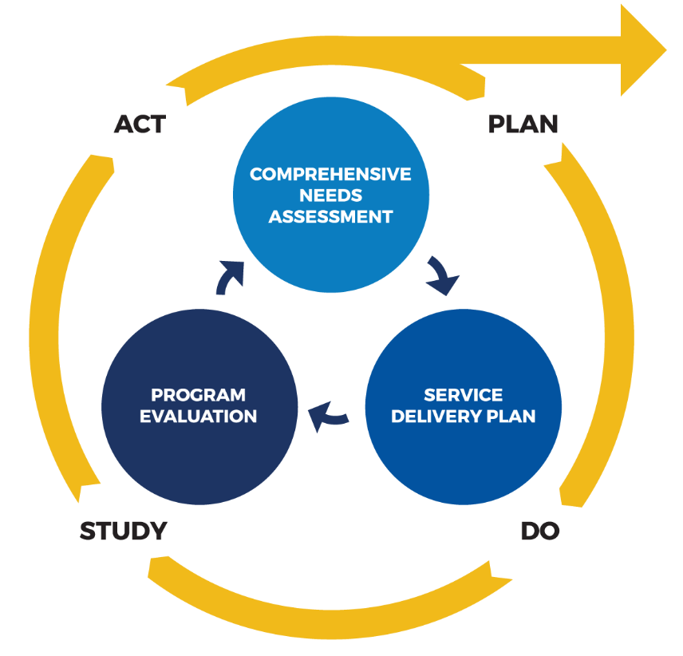
Why do we have MPO Reports?
Elementary and Secondary Education Act (ESEA):
Program Purpose (3): To ensure that migratory children receive full and appropriate opportunities to meet the same challenging State academic standards that all children are expected to meet.
The Comprehensive Needs Assessment and the SDP, including MPOs and performance targets for each focus area, are required by ESEA as amended by the Every Student Succeeds Act.
Notes:
Lead: Melissa
Time: 2 min.
Talking Points:
The Migrant Education Program, or MEP, has several purposes – one of which is to ensure that migratory children receive full and appropriate opportunities to meet the same challenging State academic standards that all children are expected to meet. In striving for that purpose, the needs of migratory children need to be met. The comprehensive needs assessment, or CNA, identifies those needs while the SDP identifies strategies to address these needs with the hope of providing migratory students the support needed to meet CA’s common core state standards.
Besides being required to develop and implement the SDP, I think all of us would agree that the utmost importance of the SDP is striving to address students’ needs. Our role as educators is to meet the child where they are and to differentiate instruction so they have increased access to content and opportunities to develop grade-specific knowledge and skills. We do that through consistent review of data to revise policies, practices, and services to efficiently and effectively serve migratory students who need specific services. Continuous improvement is an ongoing process that allows us to fine tune efforts to increase student attendance, engagement, and other practices. The development of the CNA and SDP is the first step in the Plan-Do-Study-Act cycle.

Slide 7
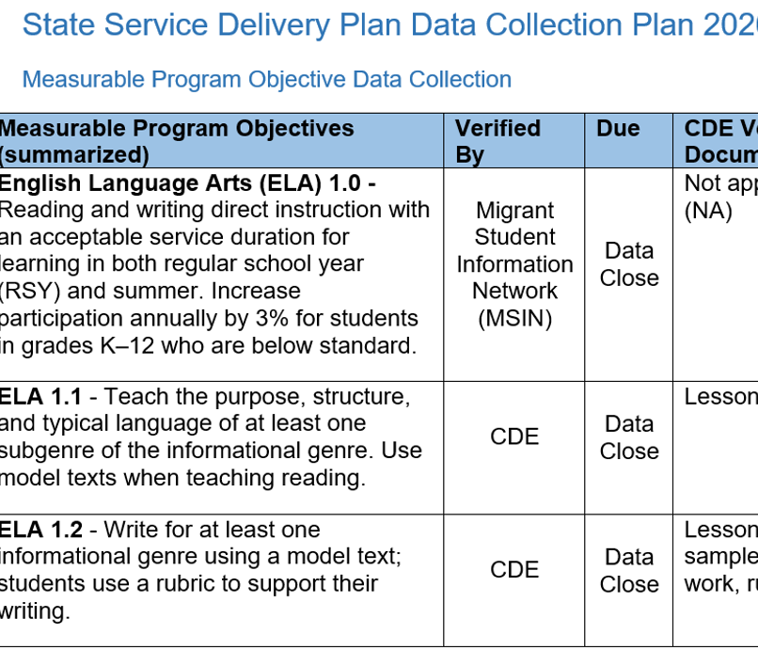
SDP Strategy Verification
You can find the MPO Checklist in the SDP Monitoring Resources folder within the SDP Continuous Improvement Box folder.
Notes:
Lead: Melissa
Time: 2 min.
Talking Points:
By law, we are required to evaluate the implementation of and progress on the SDP. The CDE does that through a two-pronged approach: 1) through MSIN data and 2) through a document review done by your CDE consultant. We try to verify as many MPOs through MSIN as possible, but since MSIN is a student-centered system we aren’t able to verify all strategies and their aligning MPOs. For strategies related to instructional practice, professional development, and parent engagement, the CDE consultant reviews a set of documents to evaluate implementation. The MPO Checklist in the SDP Monitoring Resources folder within the SDP Continuous Improvement folder on Google Drive is helpful in identifying which MPOs are verified by the CDE, including which documents will be requested, and those verified by MSIN.
For our webinar today, we are going to focus on the Strategies and their aligning MPOs that are verified in MSIN.

Slide 8
Reports that Depend on INA/ILPs
MPO 5.0 (Case Management)
  Grades 10-12
MPO 6.0 (Credit Accrual/Recovery)
MPO 9.0 (OSY CTE/Job Training)
MPO 10.0 (OSY English)
MPO 10.1 (OSY GED)
MPO 11.1 (Mental Health)
Notes:
Lead: Jose
Time: 2 min.
Talking Points:
These reports depend on specific responses within students’ INA/ILPS.
(Read bullets – today’s webinar will focus on the MPOs in orange)
Remind participants that the Student Services role have been granted access to the MPO reports. Additional users who have access to these reports include, directors, program managers, data specialists, and now student services role.

Slide 9
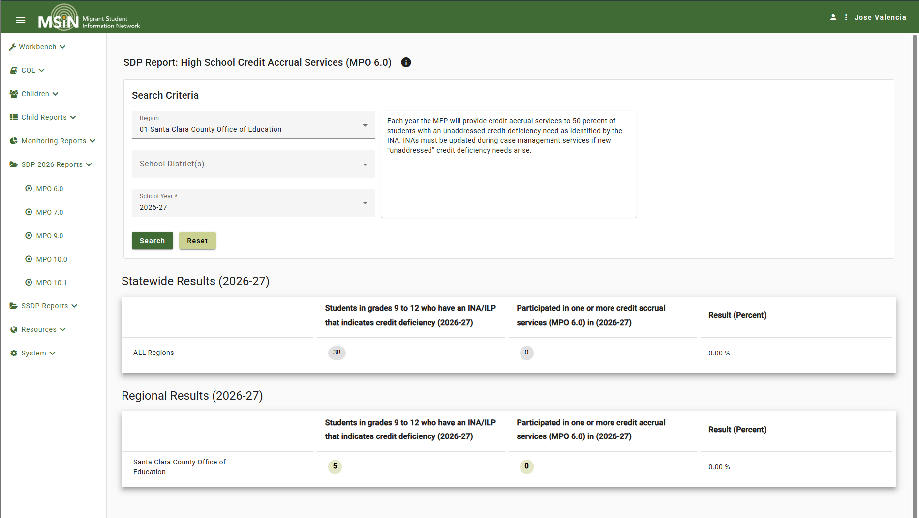
SDP 2026 MPO 6.0 Report
Notes:
Lead: Jose
Time: 2 min.
Talking Points:
Review report criteria.
Denominator = Count of children who met the following criteria:
1) Are enrolled in grades 9-12, and
2) Have a completed INA/ILP that indicates an unaddressed credit deficiency.
Numerator = Subset of the denominator. Count of children who participated in any service mapped to MPO 6.0.
The new credit accrual state codes mapped to MPO 6.0 are:
3011
3021
3026
3031
3036
3041
3046
3051
3061
3066
3071
3086
3091

Slide 10
The INA and MPO 6.0
Inclusion in the report is based on the following selection within a child’s INA/ILP:
Notes:
Lead: Jose
Time: 2 min.
Talking Points:
(Read slide)

Slide 11
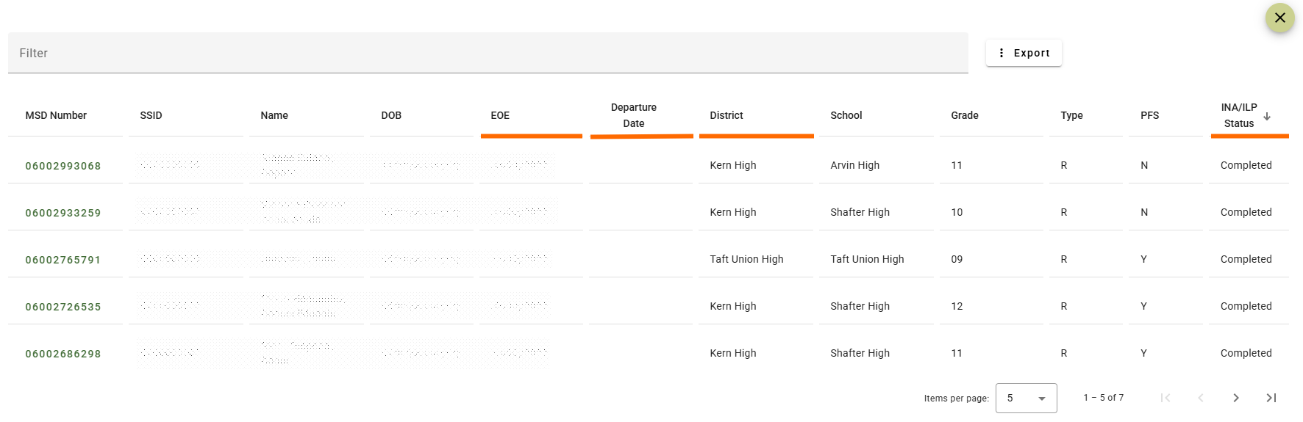
MPO 6.0 Report Child Lists
Notes:
Lead: Jose
Time: 2 min.
Talking Points:

Slide 12
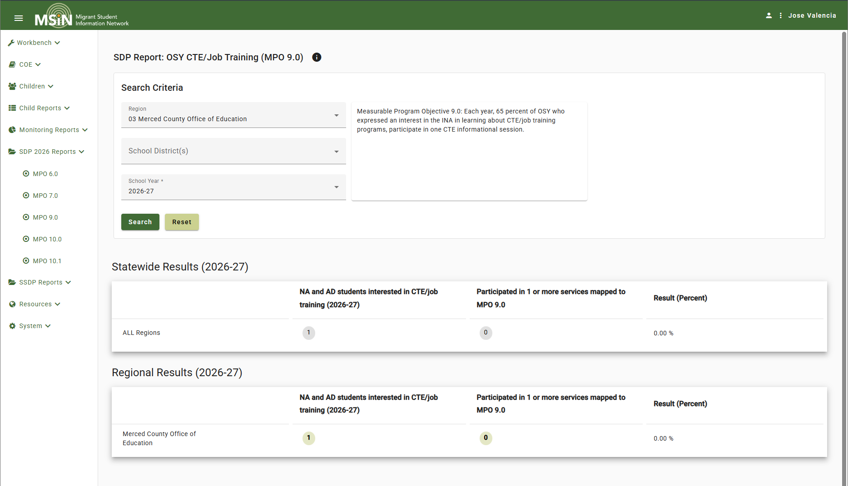
SDP 2026 MPO 9.0 Report
Notes:
Lead: Jose
Time: 2 min.
Talking Points:
Review report criteria.
Denominator = Count of children who met the following criteria:
1) Are enrolled in grade NA or AD, and
2) Have a completed INA/ILP that indicates they want to participate in CTE/job training.
Numerator = Subset of the denominator. Count of children who participated in any service mapped to MPO 9.0.
The new state codes mapped to MPO 9.0 are:
4028 (service)
4029 (referral)

Slide 13
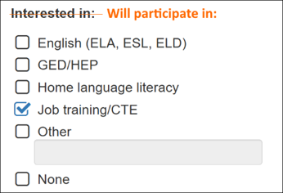
The INA and MPO 9.0
Inclusion in the report is based on the following selection within a child’s INA/ILP:
Notes:
Lead: Jose
Time: 2 min.
Talking Points:
(read slide)

Slide 14

MPO 9.0 Report Child List
Notes:
Lead: Jose
Time: 2 min.
Talking Points:

Slide 15
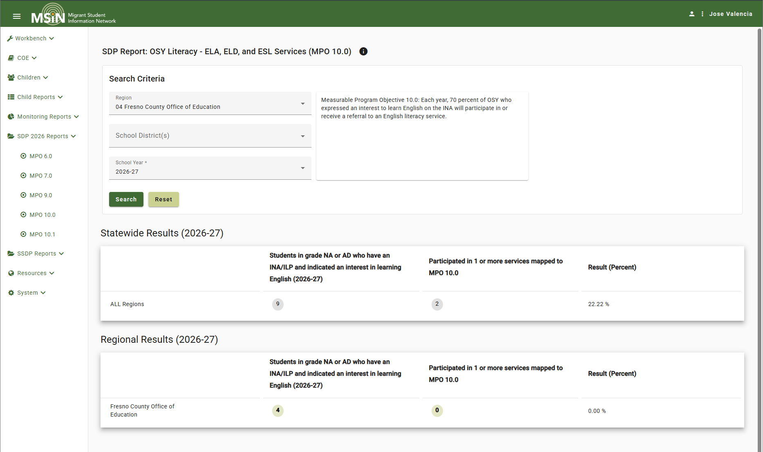
SDP 2026 MPO 10.0 Report
Notes:
Lead: Jose
Time: 2 min.
Talking Points:
Review report criteria.
Denominator = Count of children who met the following criteria:
1) Are enrolled in grade NA or AD, and
2) Have a completed INA/ILP that indicates they want to participate in English literacy services.
Numerator = Subset of the denominator. Count of children who participated in any service mapped to MPO 10.0.
The state codes mapped to MPO 10.0 are:
4016 (service) – existing
4026 (referral) – new

Slide 16
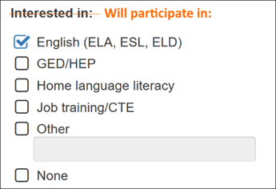
The INA and MPO 10.0
Inclusion in the report is based on the following selection within a child’s INA/ILP:
Notes:
Lead: Jose
Time: 2 min.
Talking Points:
(read slide)

Slide 17
MPO 10.0 Report Child List
Notes:
Lead: Jose
Time: 2 min.
Talking Points:

Slide 18
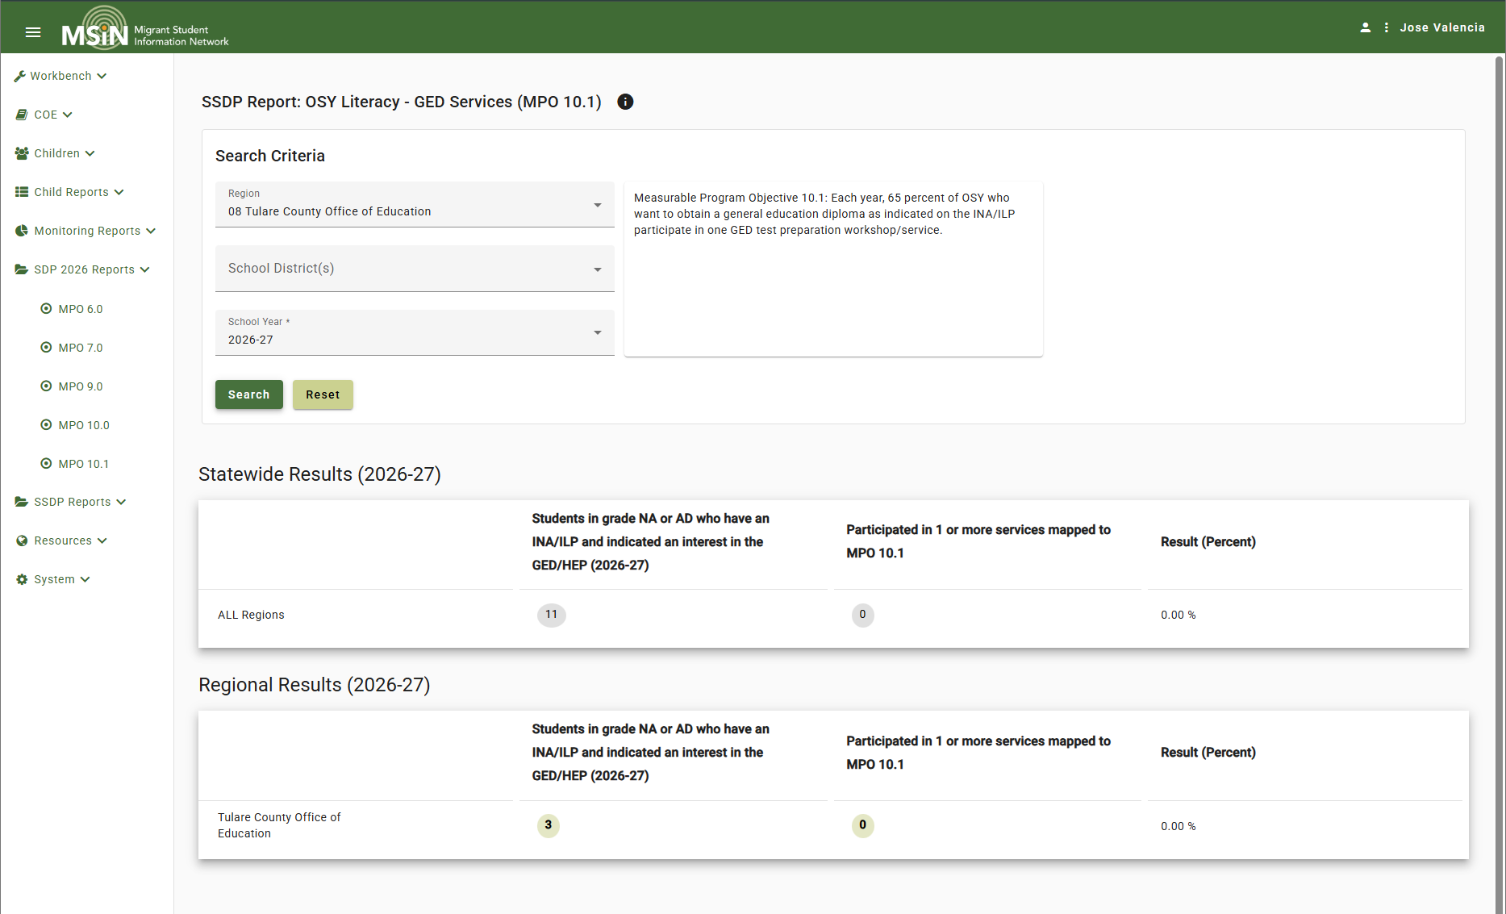
SDP 2026 MPO 10.1 Report
Notes:
Lead: Jose
Time: 2 min.
Talking Points:
Review report criteria.
Denominator = Count of children who met the following criteria:
1) Are enrolled in grade NA or AD, and
2) Have a completed INA/ILP that indicates they want to participate in GED services.
Numerator = Subset of the denominator. Count of children who participated in any service mapped to MPO 10.1.
The state codes mapped to MPO 10.1 are:
4017 (service) – existing
4027 (referral) – new

Slide 19

The INA and MPO 10.1
Inclusion in the report is based on the following selection within a child’s INA/ILP:
Notes:
Lead: Jose
Time: 2 min.
Talking Points:
(read slide)

Slide 20
MPO 10.1 Report Child List
Notes:
Lead: Jose
Time: 2 min.
Talking Points:

Slide 21

Any Questions?
Notes:
Lead: Melissa
Time: 1 min.
Talking Points:
If you have any questions, please add them in the Q&A. I’ll pause for a couple of minutes to see if there are any questions.

Slide 22
Practice Using the 2026 SDP MPO 10.0 Report
As of today, how many Out-of-School Youth (OSY) have an identified need for English literacy services?
Instructions:
Run the MPO 10.0 Report for your region for the 2026–27 school year.
  How many OSY have a need for English classes? Enter this information into the Chat feature.
Click on the denominator and pull up the child list.
Sort by “District” by clicking on the column heading.
  Which district is associated with the most OSY with this need? Identify the district in the Chat feature.
Notes:
Lead: Melissa
Time: 7 min.
Talking Points:

Slide 23
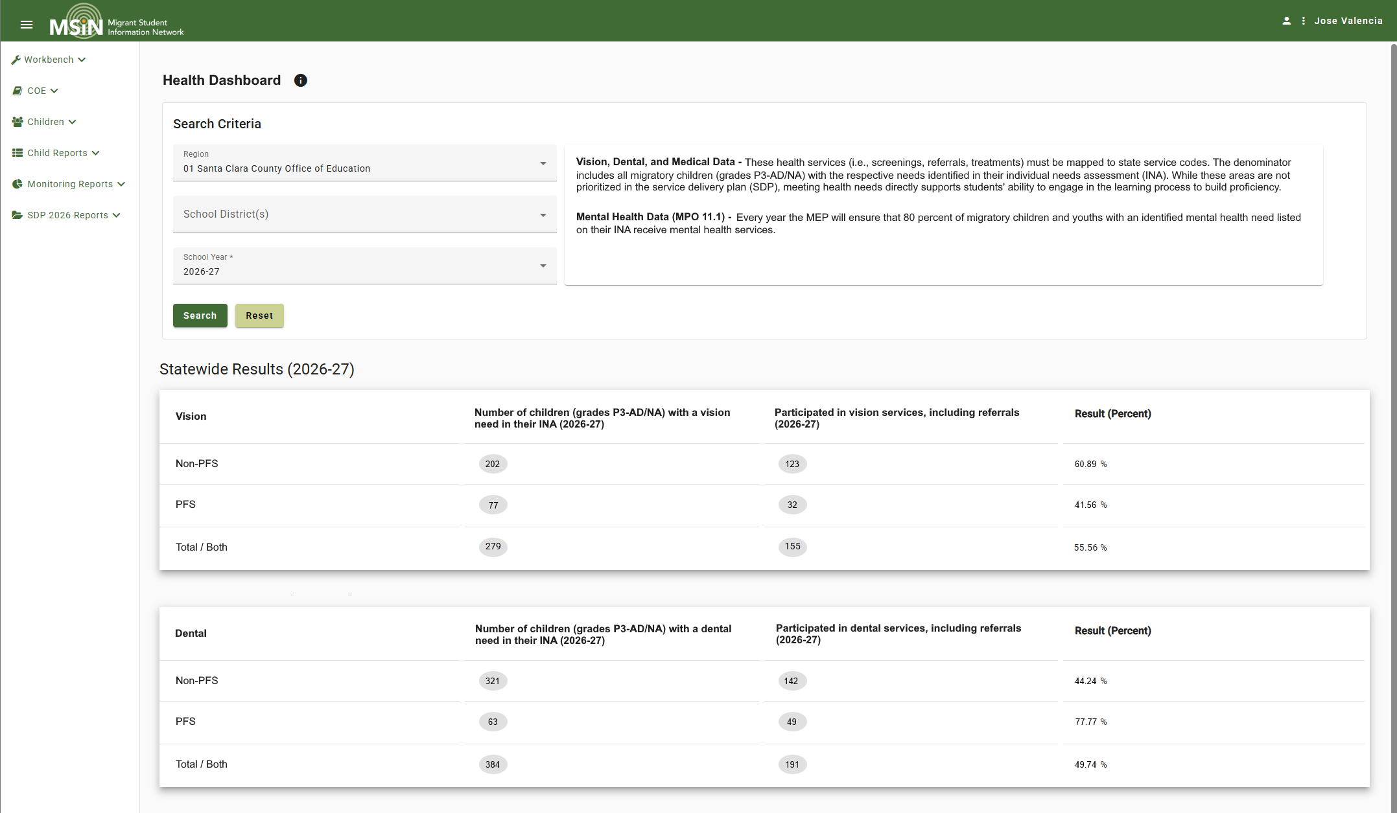
Health Dashboard (MPO 11.1 Report)
Notes:
Lead: Melissa
Time: 2 min.
Talking Points:
*Image is a mockup; final version may vary slightly. This only shows the first two tables (out of 4 for the statewide view and 4 more for the subgrantee view).
If available, demonstrate the actual report.
The “Health Dashboard” page includes 4 separate tables with a common logic pattern, as follows:
Vision
Denominator = Count of children who met the following criteria:
1) Have a completed INA/ILP, and
2) “Vision” is selected in their INA/ILP under "Health Needs:"
Numerator = Count of children who met the following criteria:
1) Are in the denominator (i.e., subset of denominator), and
2) Participated in any service mapped to the medical state codes (905, 906, 907).
Dental
Denominator = Count of children who met the following criteria:
1) Have a completed INA/ILP, and
2) “Dental” is selected in their INA/ILP under "Health Needs:"
Numerator = Count of children who met the following criteria:
1) Are in the denominator (i.e., subset of denominator), and
2) Participated in any service mapped to the medical state codes (908, 909, 910).
…and so on for Medical and Mental Health

Slide 24

The INA and MPO 11.1
Inclusion in the report is based on the following selection within a child’s INA/ILP:
Notes:
Lead: Melissa
Time: 2 min.
Talking Points:
(read slide)

Slide 25
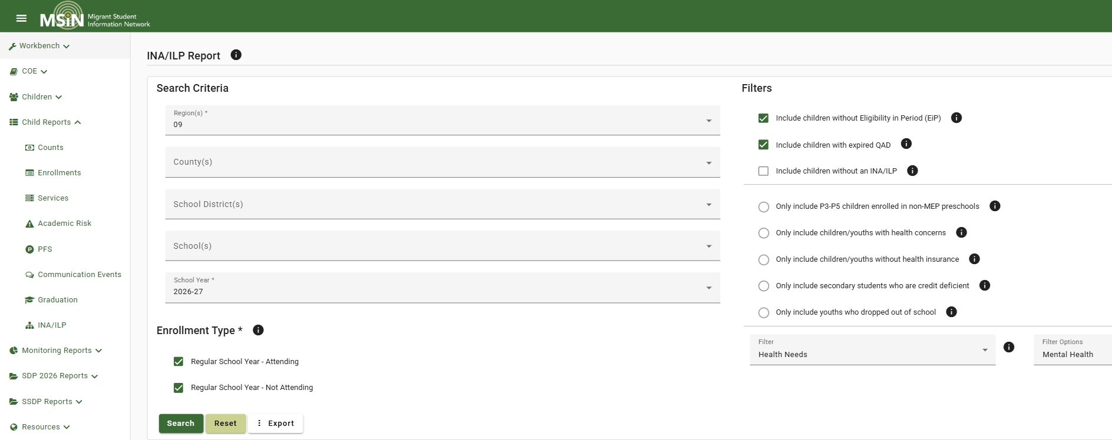
MPO 11.1 Short-term Workaround Using the INA Report
Notes:
Lead: Melissa
Time: 2 min.
Talking Points:
(review slide)

Slide 26
INA Report Queries for Student Needs
Health needs: vision, dental, medical, mental
Emergency needs: clothing, food, housing
Met Assessment Standards: not proficient on a CAASPP exam
OSY Participation: English literacy, GED, career and technical education, home language literacy
Notes:
Lead: Melissa
Time: 2 min.
Talking Points:
(review slide)

Slide 27
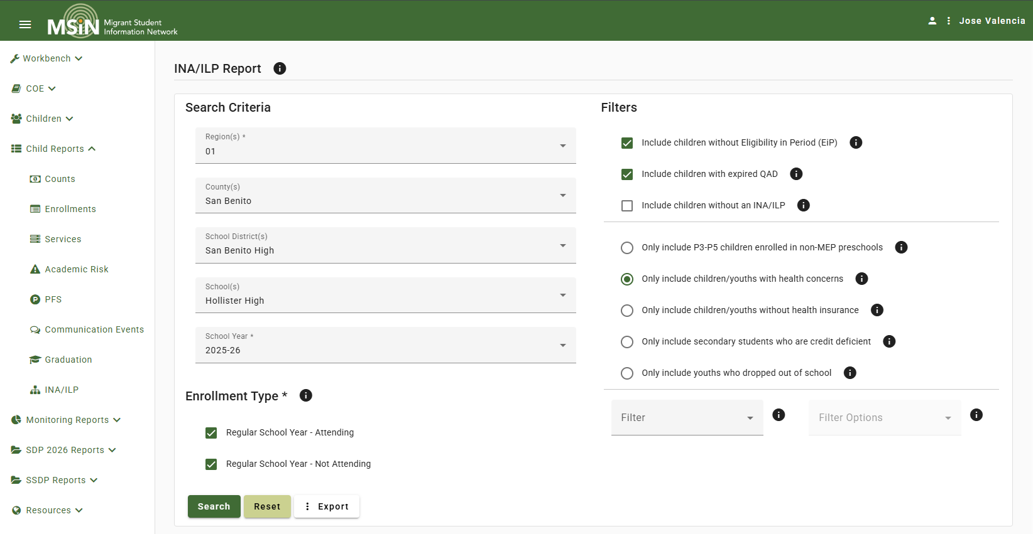
INA Report Demonstration
Notes:
Lead: Jose
Time: 5 min.
Talking Points:
Review how to find students with identified mental health needs, but don’t hit the search button.
Review how to find students with Emergency Services Needs, but don’t hit the search button.

Slide 28
Practice Using the INA Report
As of today, how many migratory children and youth have an identified mental health need?
Instructions:
Run the INA Report for your region for the 2026–27 school year.
Select “Health Needs” for the Filter and “Mental Health” for Filter Options.
  How many migratory children and youths have a mental health need in your program area? Identify this number in the Chat feature.
Notes:
Lead: Jose
Time: 7 min.
Talking Points:

Slide 29
MPO Report Looking at Age/Grade
MPO Report 7.0 School Readiness
Notes:
Lead: Melissa
Time:
Talking Points:
Talk about changes made to the denominator and child lists per feedback collected from the field. Also talk about MPO Reports 1.0, 2.0, 5.0 denominators (child lists) will show you exactly who has a need in ELA, math, or for case management.)
Turn over to Victor.

Slide 30
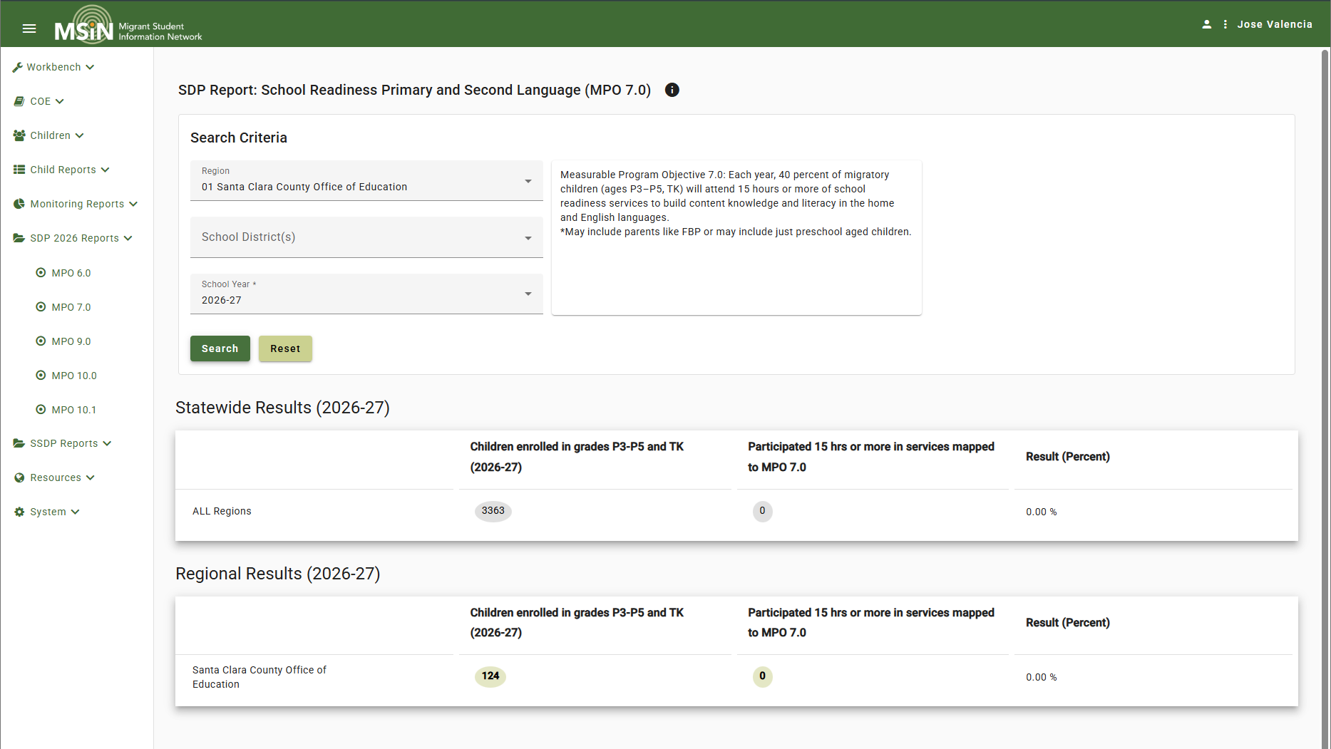
SDP 2026 MPO 7.0 Report
Notes:
Lead: Victor
Time: 3 min.
Talking Points:
Review report criteria.
Denominator = Count of children who met the following criteria:
1) Are enrolled in grades P3-P5 and TK, and
2) Turned 3 years old on or before 9/1 of the selected school year.
Numerator = Count of children who met the following criteria:
1) Are in the denominator (i.e., subset of denominator), and
2) Participated in any service mapped to MPO 7.0, and
3) Their total hours of participation were 15 or more.
The new state code mapped to MPO 7.0 is 1031 and it now includes grades P3-P5 and TK.

Slide 31
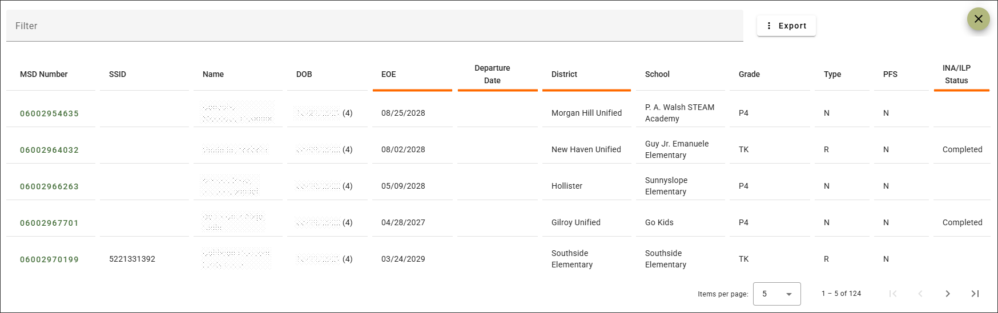
MPO 7.0 Child Lists
Notes:
Lead: Victor
Time: 2 min.
Talking Points:
Notes that there are new columns in the child lists, as shown here (review new columns).

Slide 32
Additional Questions?
Notes:
Lead: Victor
Time: 2 min.
Talking Points:
If you have any questions, please add them in the Q&A. I’ll pause for a couple of minutes to see if there are any questions.

Slide 33
Best Practices
Use the MPO Reports’ child lists (accessed by clicking on the denominator count) throughout the school year to identify which students to serve.
Monitor progress regularly to inform service changes needed to meet students’ needs and achieve the MPOs.
Check the Help Text to understand the conditions that need to be met for a child to be included in the denominator and numerator.
Notes:
Lead: Melissa
Time: 2 min.
Talking Points:
Read bullets

Slide 34
Best Practices (2)
If child counts seem low in any of the MPO Reports, the first thing for your Data Specialists to check is enrollment information.
If you run an MPO Report connected to the INA and there is no indicated need, run the INA Report to verify that all INAs have been completed. If they haven’t, you’ll want to be notified when the INAs have been completed and run the MPO Report again.
Notes:
Lead: Melissa
Time: 2 min.
Talking Points:
Read bullets

Slide 35

Final Questions?
Notes:
Lead: Melissa
Time: 2 min.
Talking Points:

Slide 36
Contact Information
Melissa Mallory
Education Programs Consultant
California Department of Education
mmallory@cde.ca.gov
916-319-0730
__________________________________________________
MSIN Service Desk
MSINsupport@wested.org
1-800-342-2964, option 2
Notes:
Lead: Melissa
Time: 30 sec
Talking Points:
I’d like to thank my colleagues for their assistance during this presentation. If you have any additional questions, please contact me by email at mmallory@cde.ca.gov or by phone at 916-319-0730. Thank you for joining us today and have a wonderful rest of your week.

