Slide 1
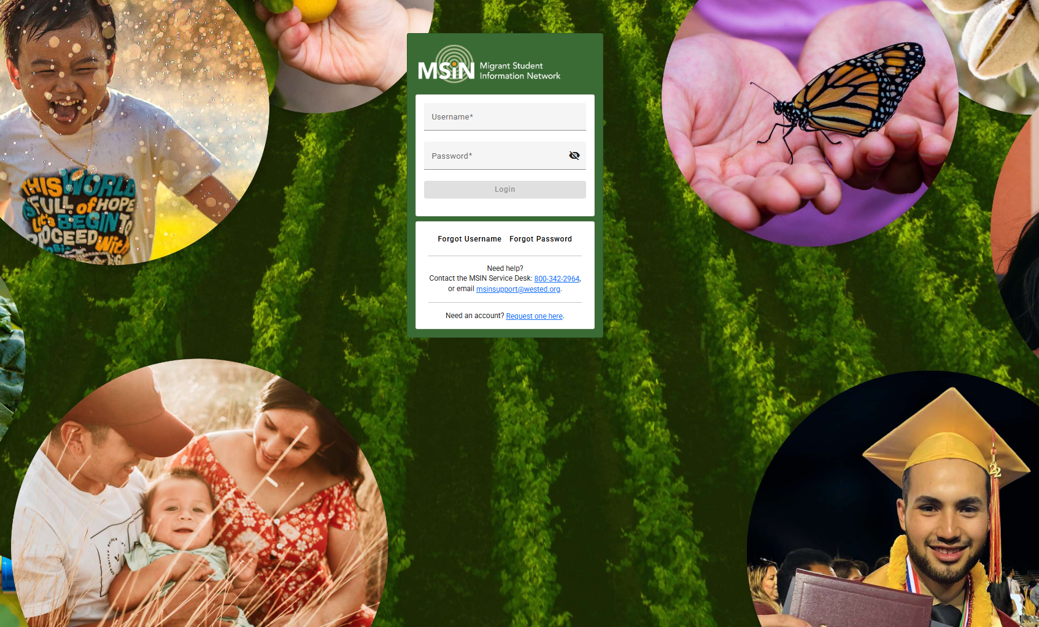
Welcome to this Migrant Student Information Network Training
We will begin shortly.
Please note your attendance by clicking the Google Forms link in the Chat and completing two questions.
Notes:
Victor
Repeat that participants who are joining should click on the link in the chat to record their attendance in the Google Form.
Google Form:https://forms.gle/zsVjnjcebqs4m1Ne7

Slide 2
Migrant Student Information Network:
Setting Up Services that Align to the 2026 Service Delivery Plan
September 29, 2026
Notes:
Lead: Victor
Time: 30 secs.
Talking Points:
Repeat that participants who are joining should click on the link in the chat to record their attendance in the Google Form.
Google Form: https://forms.gle/zsVjnjcebqs4m1Ne7

Slide 3
Housekeeping
Please mute your microphone in the main session.
Use the Q&A function to enter your questions.
Participate in breakout room activities.
The PowerPoint for this presentation can be accessed via the Service Delivery Plan (SDP) Continuous Improvement Box folder. It will also be posted on the California MEP Help Center for those who were not able to attend today.
Notes:
Lead: Melissa
Time: 1 min.
Talking Points:
(Read or paraphrase bullets)

Slide 4
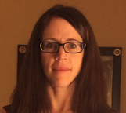
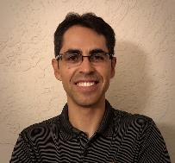

Welcome and Introductions
Session Presenters
Melissa Mallory, Education Programs Consultant, California Department of Education (CDE)
Jose Valencia, Migrant Student Information Network (MSIN) Lead, WestEd
Victor Garibay, MSIN Specialist, WestEd
Notes:
Lead: Melissa
Time: 1 min.
Talking Points:

Slide 5
Purpose
This webinar will review the service set-up features in the MSIN system with a focus on the addition of new services aligned to California’s new Service Delivery Plan (SDP) Measurable Program Objectives (MPOs).
The target audience is Migrant Education Program (MEP) managers and staff who create local services.
Notes:
Lead: Melissa
Time: 30 sec
Talking Points:

Slide 6
Session Objectives
Review the definition of MEP services;
Review how to add new services, including those that impact MPOs;
Understand how the new service codes are mapped in MSIN;
Share and discuss local knowledge regarding these topics; and
Review the resources available to support service-related tasks in the MSIN.
Notes:
Lead: Melissa
Time: 30 sec
Talking Points:
(Read or paraphrase bullets)

Slide 7
Migrant Education Services
Before we begin, let’s take a moment to think about why it’s important to set up services properly in MSIN.
Using the Chat, please identify any negative impacts resulting from setting up services improperly in MSIN.
Notes:
Lead: Melissa
Time: 3 min
Talking Points:
MPO Reports may not be accurate if services aren’t set up properly (e.g., 8.0, 13.0, 13.1) and therefore the incorrect data may be captured on the SSDP Annual Performance Progress Report.
Inaccurate data may be sent to the feds (e.g., mislabeling RI, MI, OI)
Data might not reflect what is happening during the service.
The federal office may increase oversight of our data quality.
Background info (just FYI, not for presentation)
Services data is sent to the feds vis EDFacts file FS145 (https://www2.ed.gov/about/inits/ed/edfacts/eden/non-xml/fs145-19-0.docx) – This has updated definitions this year.
Summer/Intersession services are sent to MSIX as enrollments (summer/intersession program enrollments). MSIX doesn’t actually show any service data, only enrollment info.

Slide 8

Preparing to Set Up New Services
Notes:
Lead: Melissa
Time:
Talking Points:

Slide 9
MEP Definition of Services
“Services” are a subset of all the activities that the MEP provides through its programs and projects. “Services” are those educational or educationally related activities that:
Directly benefit a migrant child;
Address a need of a migrant child consistent with the state education agency’s comprehensive needs assessment and service delivery plan;
Are grounded in scientifically based research or, in the case of support services, are a generally accepted practice; and
Are designed to enable the program to meet its measurable outcomes and contribute to the achievement of the State’s performance targets.
https://www.cde.state.co.us/migrant/mep-non-regulatory-guidance page 53
Notes:
Lead: Melissa
Time: 4 min
Talking Points:
Given the topics we are covering today, it is important to review the definition of “services” because the term has a specific meaning in the MEP.
(Read or paraphrase bullets.)
Activities related to identification and recruitment, parental involvement, program evaluation, professional development, or administration of the programs are examples of allowable activities and are not considered services. Another example would be handing out leaflets to migrant families on available reading programs as part of an effort to increase the reading skills of migrant children. Although this is an allowable activity, it is not a service because it does not meet all of the criteria for a service: (1) it does not directly benefit migrant children; (2) it is not grounded in scientifically based research; and (3) in and of itself, the activity will not increase children’s reading skills and thereby increase their ability to meet the state’s performance targets.
As a reminder, only services should be entered into MSIN.
Definition source:
U.S. Department of Education, Office of Elementary and Secondary Education, Office of Migrant Education, Non-Regulatory Guidance for the Title I, Part C Education of Migratory Children, Washington, D.C., 2017.

Slide 10
Gather Reference Materials
Before adding a new service, it is extremely helpful to gather reference materials, such as the following:
Regional or Direct-funded District Application and District Service Agreements or a Service Code Map developed from the applications
Align active services with recent grant applications
  Align service names
  Align service descriptions
  Check service code mapping (local to state service codes)
  Check applicable MPO and SDP Component mapping
Notes:
Lead: Melissa
Time: 1 min.
Talking Points:
(Read or paraphrase bullets.)
All services in MSIN should also be in the grant application.

Slide 11
Gather Reference Materials (2)
Before adding a new service, it is extremely helpful to gather reference materials, such as the following (continued):
SDP Strategies: What They Are and What They Aren’t
State Service Codes spreadsheet
  California MEP Help Center → MSIN → Search “Administer Services”
SSDP service set-up “how-to” videos on MSIN
  Although the videos are from the previous SSDP, the process to set services up are correct making the videos still extremely helpful.
Service-related user guides on MSIN
Notes:
Lead: Melissa
Time: 1 min
Talking Points:
(Read or paraphrase bullets.)
In addition, you can resolve any doubts by testing service set-up and entry on the Training MSIN website.

Slide 12

Questions?
Notes:
Lead: Team
Time: 3 mins
Answer a few questions about the MEP services definition versus allowable activities.

Slide 13
Checking for Understanding
  Next, you will see a pop-up window with questions and response options.
  There are two questions for this section, answer them as best you can.
  If you are participating as a group, enter what the majority of the group chooses.
  You will get a warning when the poll is about to close.
Notes:
Lead: Victor
Time: 2 min. (need to be strict with timing)
Talking Points:
When setting up a service I need to make sure the following match the grant application (as much as possible):
a. Service names
b. Number of staff
c. Service descriptions
d. A and C (answer)
2. To be considered a “service” the program must:
a. Directly benefit a migrant child
b. Address a need of a migrant child consistent with the state education agency’s (SEA) comprehensive needs assessment and service delivery plan
c. Are grounded in scientifically based research or, in the case of support services, are a generally accepted practice
d. Are designed to enable the program to meet its measurable outcomes and contribute to the achievement of the State’s performance targets
e. All of the above (answer)

Slide 14
Setting Up New Services
Notes:
Lead: Melissa
Time: 30 sec
Talking Points:

Slide 15
Common Service Setup Scenarios
The subgrantee would like to use an existing State Service Code “as is.” No setup is needed.
The subgrantee considers their local service to be a variation of an existing State Service Code.
The subgrantee thinks their local service is different from all State Service Codes but still addresses an MPO.
The subgrantee thinks their local service does not match a State Service Code or an MPO, but it meets the definition of “service” provided in guidance.
Notes:
Lead: Melissa
Time: 3 min
Talking Points:
There are a few ways to approach setting up new services.
Here we have a list of common service setup scenarios.
(Read or paraphrase the slide bullets.)
For our presentation today, we will focus on scenario 2 where a local service is a variation of an existing State Service Code.
Additional reference info (do not read during the live presentation):
Scenario 1: No setup needed because these state codes have been pre-set (reference document with state service codes and descriptions). Just ensure that the service is active (will have a checkmark when viewed in the Administer Services screen).
Scenario 2: On the Creating Service screen, the user creates a local service name (#2), description (#3) and local code (#4), then selects an existing State code (#5) to populate most other options on the page.
Scenario 3: On the Creating Service screen, the user creates a local service name (#2), description (#3) and local code (#4), then skips over #5 (State Service Code) and selects the appropriate MPO (#6) to populate most other options on the page.
Scenario 4: On the Creating Service screen, the user creates a local service name (#2), description (#3) and local code (#4), then they skip #5 and #6, manually enter #7 (SSDP Component), skip #8 (Require Service Hours; not user selectable), and manually enter #9 (Federal Category), which populates most of the remaining fields. This sounds complex but it is straightforward when making selections on the screen.
For all of these, we recommend practicing on the Training MSIN website (https://trainingmsin.wested.org).
Remember, to be compliant with state and federal law anything that goes in MSIN MUST be approved in your grant application. I often see things like “computer literacy” or “tutoring” but these services aren’t included in the application. These services are allowable. If they meet a local need, they are encouraged, so be sure to add these to your grant application.

Slide 16
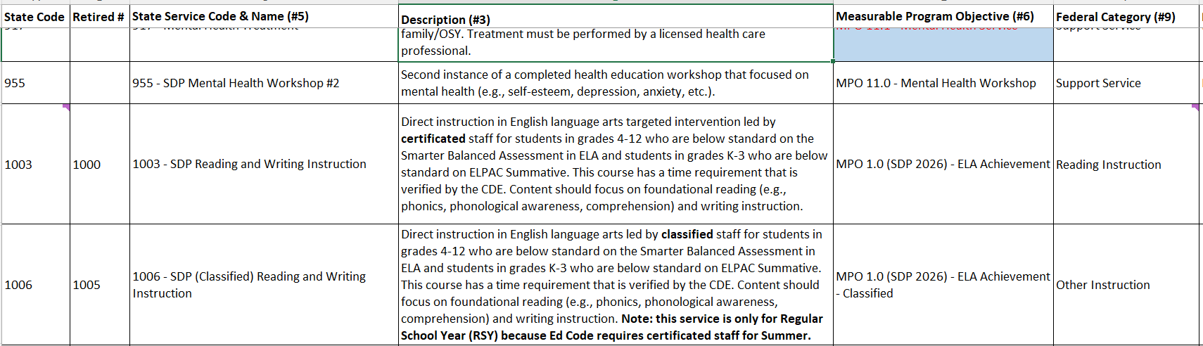
New State Service Codes
After you review the definition for State Codes 1003 and 1006, please indicate in the Chat whether you can use these new state codes as-is based on what you know about the other MPOs.
Notes:
Lead: Melissa
Time: 3 min
Talking Points:
Answer: No, you cannot use the codes as-is because these two codes address core content areas, so at the very least integrated ELD (MPO 3.0) needs to be added. You may also add MPOs 4.2 for SEL integration and 13.0 for culturally sustaining pedagogy.

Slide 17
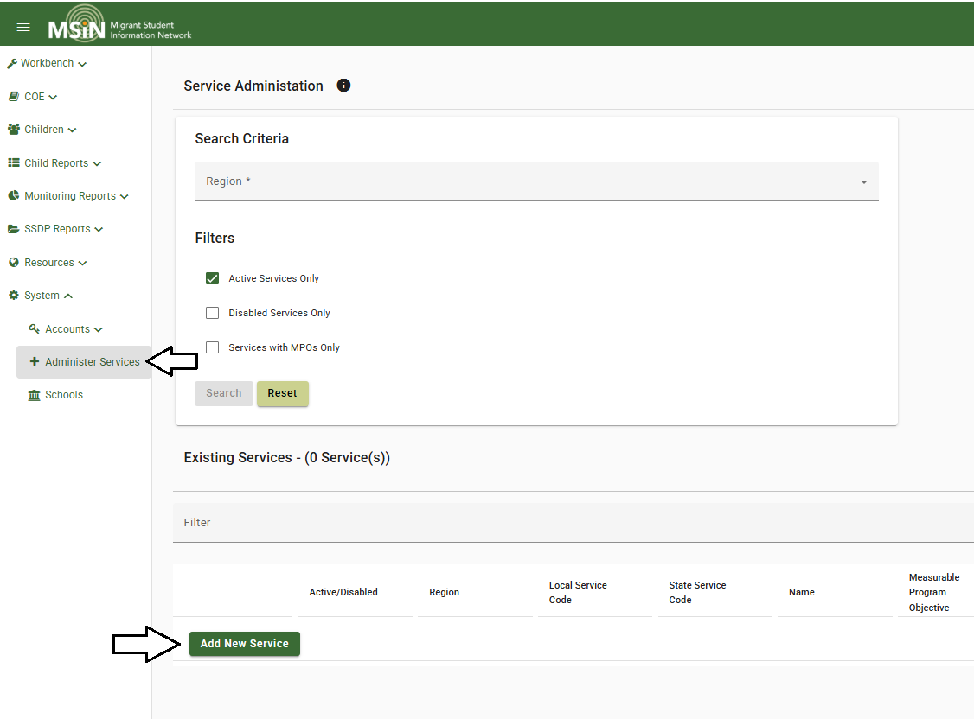
New Service Setup Window
Notes:
Lead: Jose
Time: 2 min
Talking Points:
Review the location of the Administer Services menu
Point out the location of the “Add New Service” button.

Slide 18
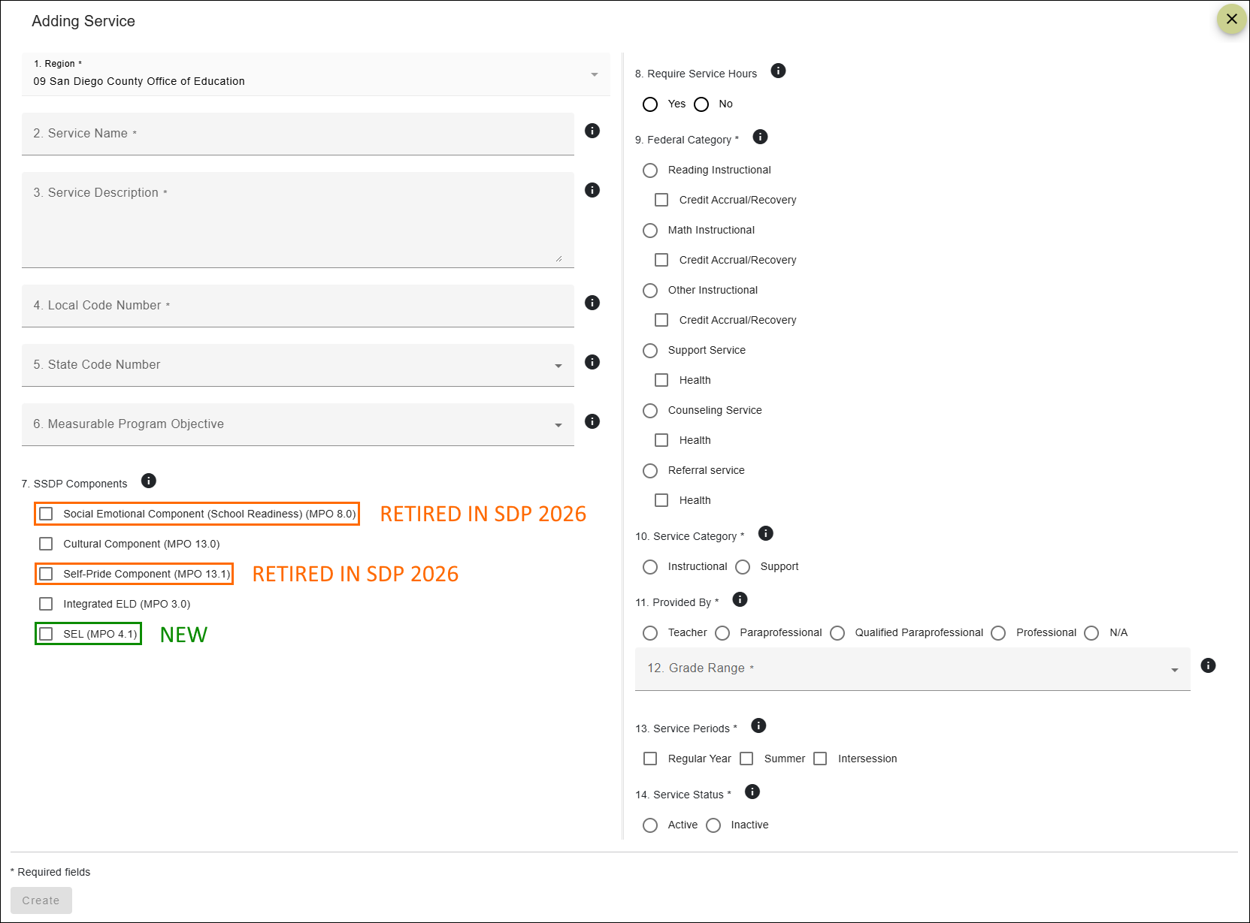
Service Setup Fields
Notes:
Lead: Jose
Time: 4 min
Talking Points:
The best way to learn how this screen works is to practice creating services on the Training MSIN website. This is our number one recommendation.
For today, we would like to emphasize a few key items.
The required fields have an asterisk next to the field title. You cannot save the new service without completing all required fields.
Notice that every field has a help text icon (i), containing definitions and instructions.
All the MPOs that can be collected through MSIN, as services, have been added to the drop-down menu in #6.
Some MPOs require the collection of service hours (MPO 1.0, 2.0, & 7.0); depending on the MPO selection, #8 will automatically be marked yes or no.
All MPOs specify particular grades; the drop-down menu in #12 displays which grades may receive the service.
Number 13 is a field that was created to support the addition of the new state codes for the amended MPOs 1.0 and 2.0 which now allow for classified staff to provide instruction during the RSY. We had to include this field as MPO and MPO 1.0 and 2.0 services taught by classified staff may only occur in the RSY given the CA Ed Code requirement Melissa has reviewed with you during past trainings.
This service set-up screen has a lot of preset mapping to ensure that selections are logically consistent. This improves data quality.
Again, we strongly recommend getting familiar with this screen on the Training MSIN website.

Slide 19
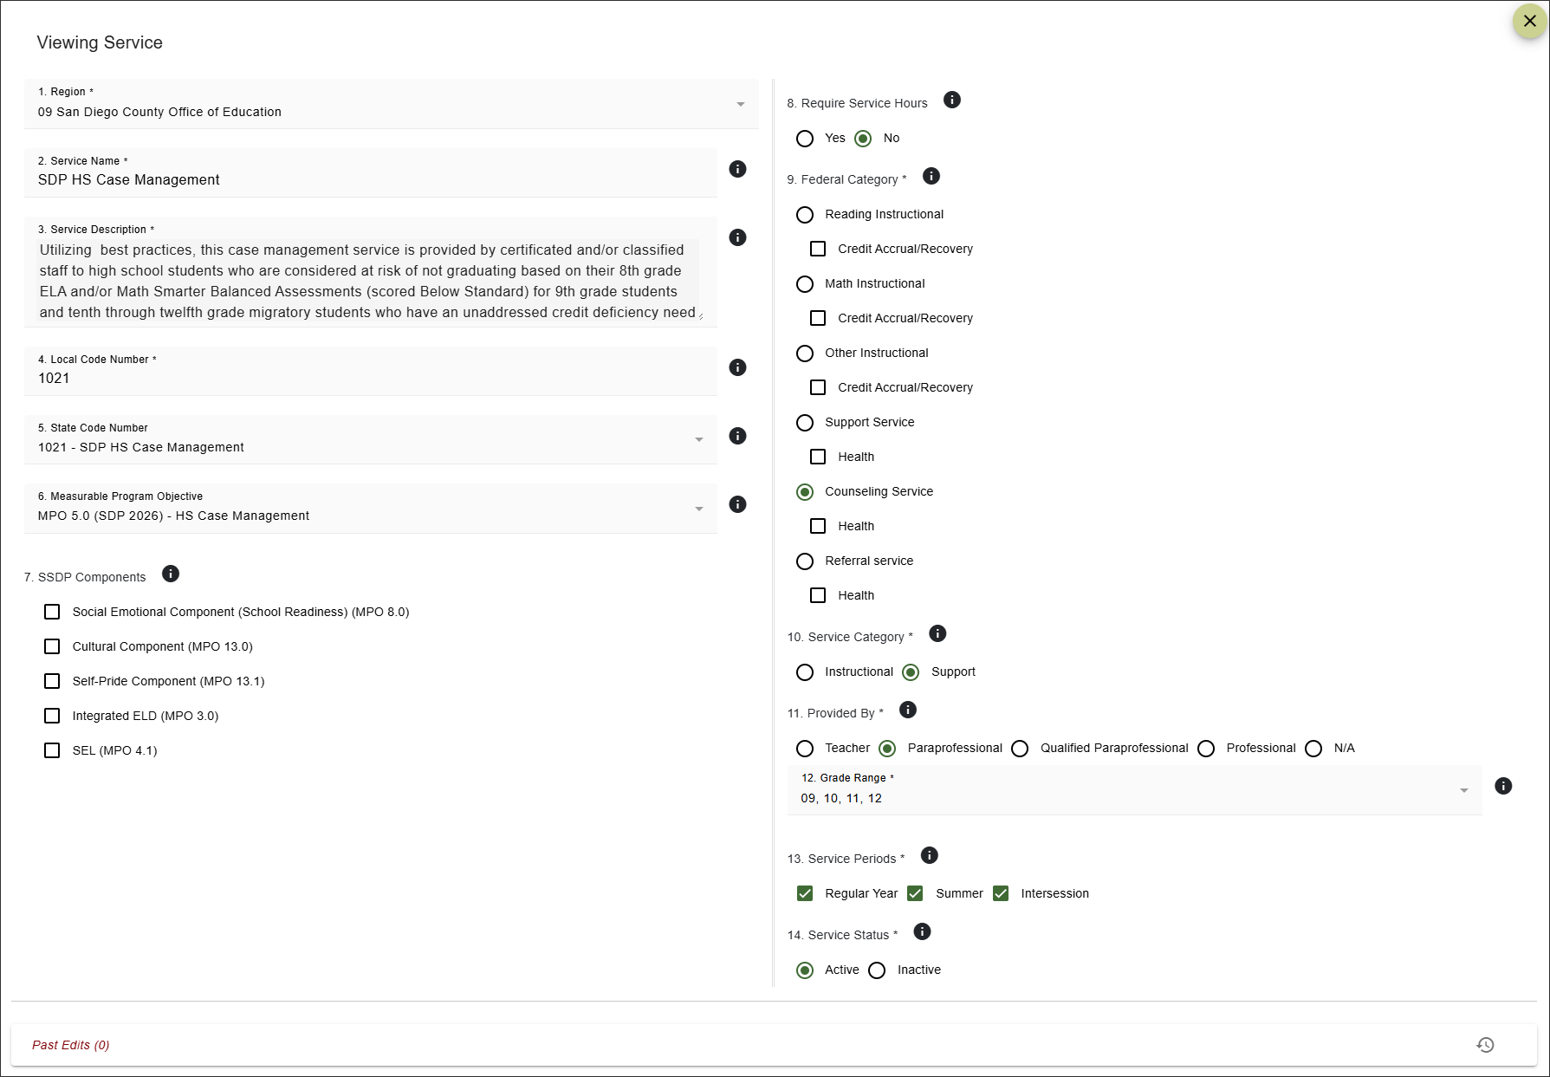
Using a State Code As Is: MPO 5.0 Example
Notes:
Lead: Jose
Time: 4 min
Talking Points:
We’re going to review two examples for you. The first will focus on using a state code as is and the second will illustrate the process to add SDP components. The first example will align to MPO 5.0 which is a case management service.
Title: SDP Case Management Service
Description: The region will provide case management services to migratory students in grades 9-12 who are credit deficient or at risk of being credit deficient. The region will collaborate with school counselors to provide a needs-based case management service that includes goal setting to minimize current gaps in knowledge/skills and for future career or college options.

Slide 20
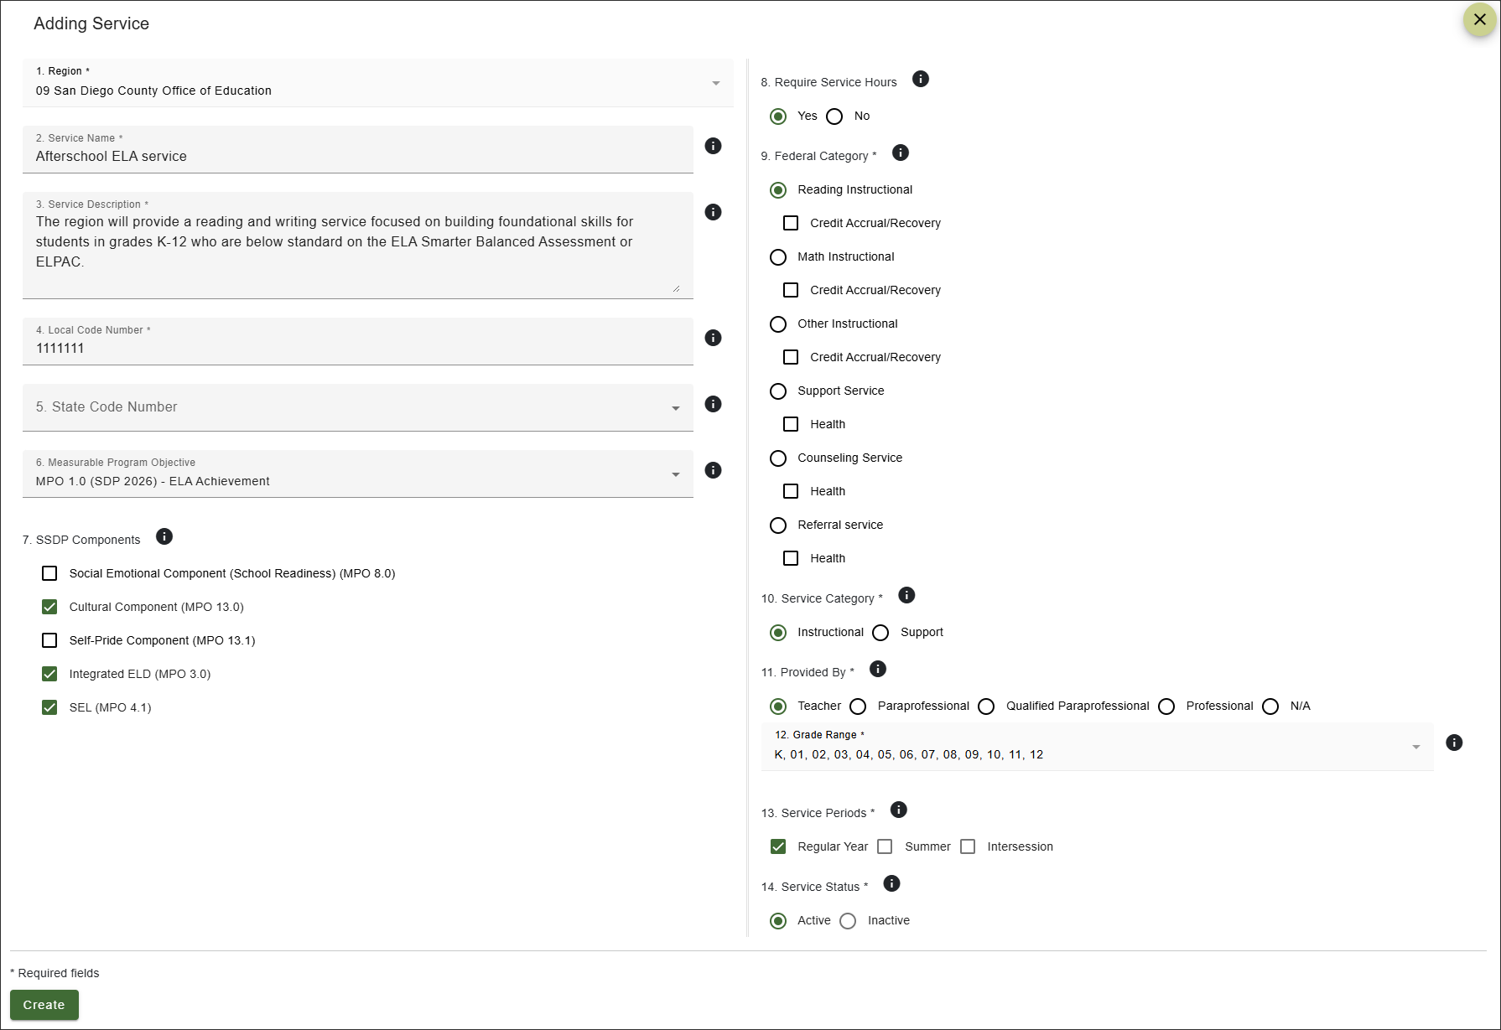
Mapping to an MPO: MPO 1.0 Example
Notes:
Lead: Jose
Time: 4 min
Talking Points:
Now, this second service is going to require us to map to an MPO so that we can add several SDP components and a specific service period (Regular Year).
Review service set up fields and entries with staff]
[When you get to the components…]
We know from the SDP that all services that address core content areas, excluding credit accrual and CA Mini-Corps services, must include integrated ELD. So, we’ll select that. The application also noted that class would being with a 5-10 minute SEL routine to center the class and help the teacher understand who might need extra support. Therefore, we’ll select 4.1 as well. Finally, the service in the application selected the culturally sustaining pedagogy (CSP) strategy. The teacher is going to be using strategies that support collectivist cultures like collaborative grouping, call and response, and will focus on critical pedagogy frameworks, including examining multiple viewpoints. So, we’ll select MPO 13.0, too.
Title: Afterschool ELA service
Description: The region will provide a reading and writing service focused on building foundational skills for students in grades K-12 who are below standard on the ELA Smarter Balanced Assessment or ELPAC.
SDP Components: ELD (3.0), 4.1 (SEL0, and 13.0 (CSP).
Staff: certificated
RSY

Slide 21
Increased Service Setup Flexibility
Because of the Service Period property, you can limit services to only the applicable period(s)—Regular Year, Summer, or Intersession.
For new local codes, you can select the applicable service period(s).
Existing local codes are currently set to all three service periods, but you can request edits via the MSIN Service Desk.
  Note that state codes cannot be changed (they come pre-set based on CDE’s specifications).
Notes:
Lead: Jose
Time: 3 min
Talking Points:

Slide 22
Recap: Key Steps for New Services
As you set up new services aligned to the new SDP strategies, keep in mind the following key steps:
Choose an unused local code number.
Map it to a state code or MPO that aligns to the service approved in the application.
Check applicable SDP components (MPOs 3.0, 4.1, and 13.0) to be included in the service.
Notes:
Lead: Jose
Time: 3 min
Talking Points:
Read/paraphrase slide content

Slide 23
Practice: Setting Up a Service
In Breakout Rooms, you will practice setting up services using a prompt describing the service and identifying which SDP strategies were selected.
You’ll have 10 minutes to set up one service. When suggesting what to include in each field to set up each service, please provide your reasoning so we can learn from each other.
Your slides will be the same number as your group number. There are two prompts, so please use the slide to identify the prompt your group will respond to. Remember to select a facilitator to support your group while they engage with the content, a notetaker, and a volunteer to report out on how you set up the service based on the prompt.
Notes:
Lead: Melissa
Time: 17 minutes (2 minutes for directions, 10 minutes for breakout rooms, 5 minutes for reporting out)
Google Drive: https://docs.google.com/presentation/d/1NEOCw-K26VnsI_ByFUj7snWwt6vzEApXc0-FDCkF3_U/edit?usp=sharing

Slide 24
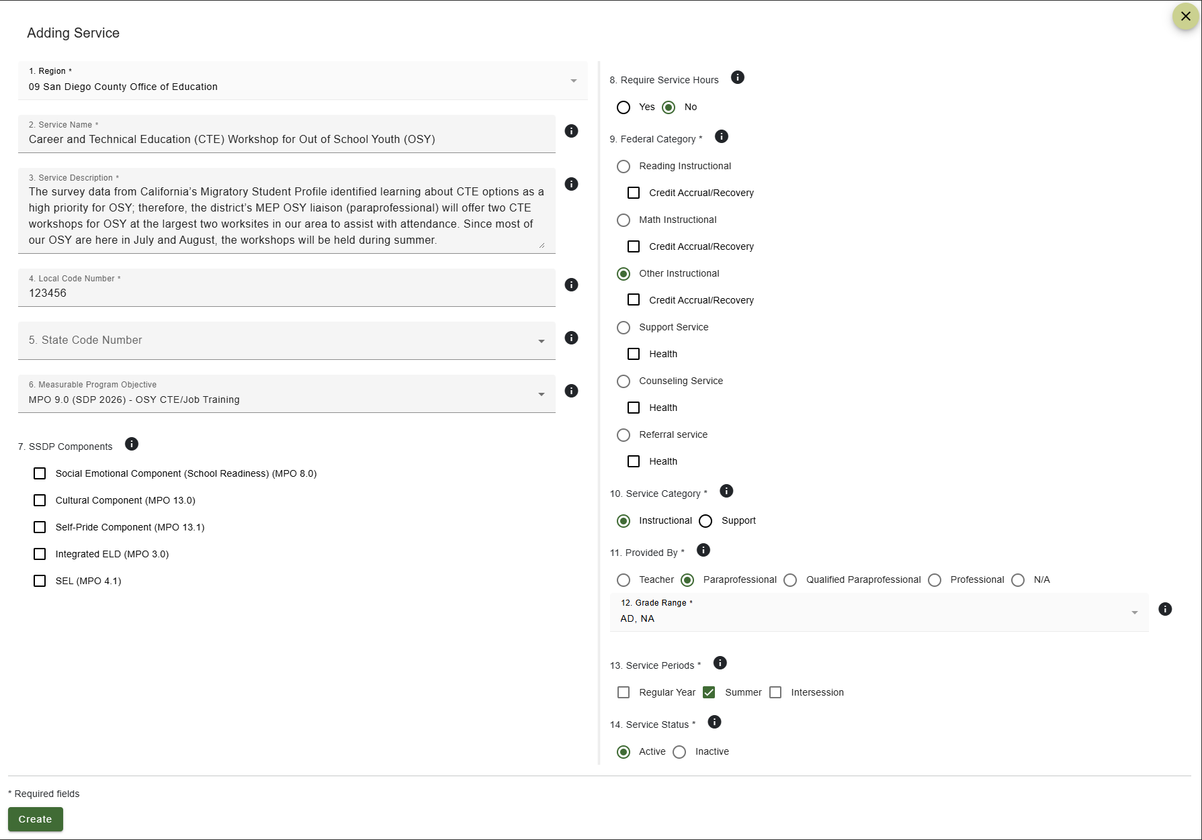
Example from Prompt 1
Notes:
Lead: Melissa
Time: min
Talking Points:
Title: Career and Technical Education (CTE) Workshop for Out of School Youth (OSY)
Description: The survey data from California’s Migratory Student Profile identified learning about CTE options as a high priority for OSY; therefore, the district’s MEP OSY liaison (paraprofessional) will offer two CTE workshops for OSY at the largest two worksites in our area to assist with attendance. Since most of our OSY are here in July and August, the workshops will be held during summer.
SDP Strategies Selected: 9.0 only

Slide 25
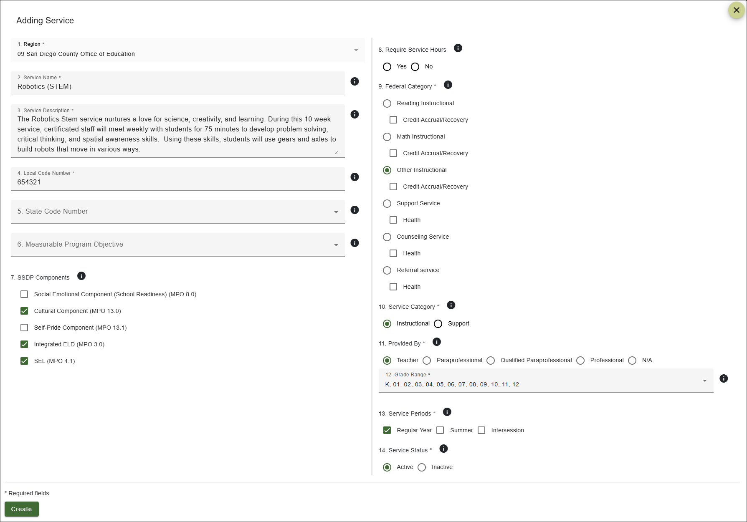
Example from Prompt 2
Notes:
Lead: Melissa
Time: min
Talking Points:
Title: Robotics (STEM)
Description: The Robotics Stem service nurtures a love for science, creativity, and learning. During this 10 week service, certificated staff will meet weekly with students for 75 minutes to develop problem solving, critical thinking, and spatial awareness skills. Using these skills, students will use gears and axles to build robots that move in various ways.
SDP Strategies Selected: 3.0, 4.1, 13.0

Slide 26

Any Other Questions?
Notes:
Lead: Team
Time: 2 mins
Answer a few questions about setting up services and/or the collaborative activity.

Slide 27
Service Entry Considerations
Notes:
Lead: Victor
Time:
Talking Points:

Slide 28
Service Setup Affects Service Entry
How a service is set up determines if end users will see it when they try to enter service participation data.
Specifically, when entering services, staff will only see:
Services that apply to the child’s grade, and
Services that apply to the selected service period
The second bullet is relatively new, so you may get questions from the field about why a service they expected to see in the Service Name dropdown menu is not displayed as an option.
Notes:
Lead: Victor
Time: 1 min
Talking Points:

Slide 29
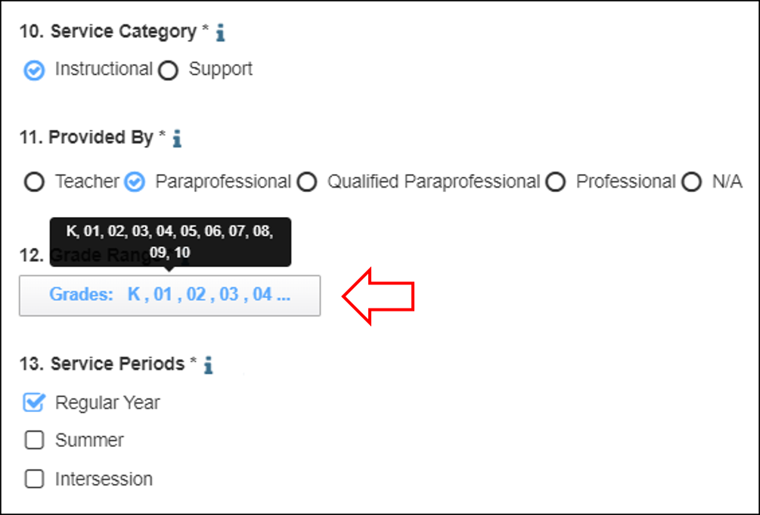
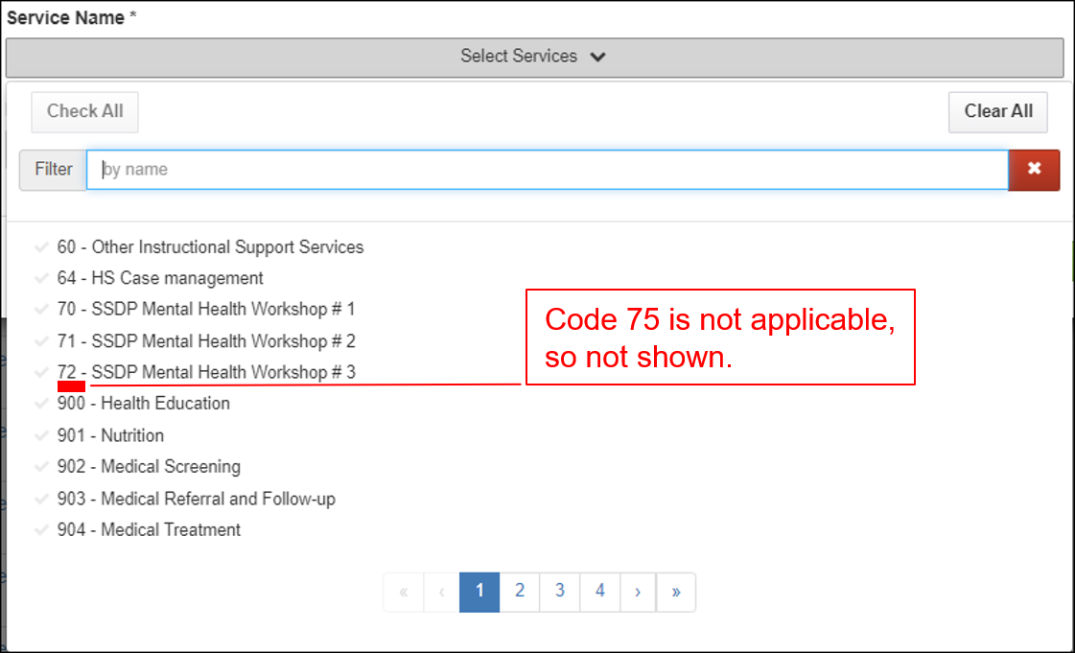
Impact of Grade on Service Entry
For example, Region 1’s ELA service provided by Classified staff, code 75, is setup for students in grades K-10 only.
As a result, when entering services for a student in grade 11 or 12, you will not see code 75 in the Service Name field.
Notes:
Lead: Victor
Time: 2 min
Talking Points:

Slide 30
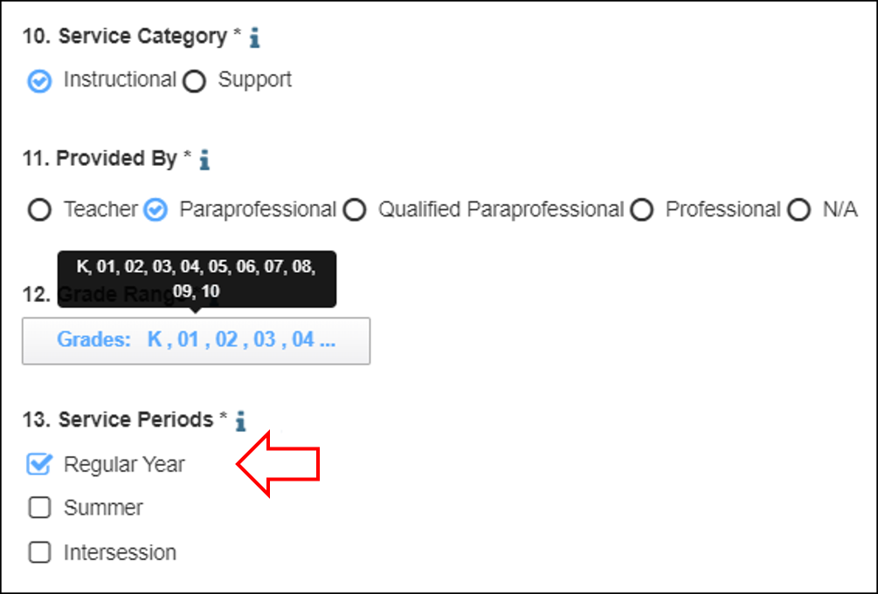
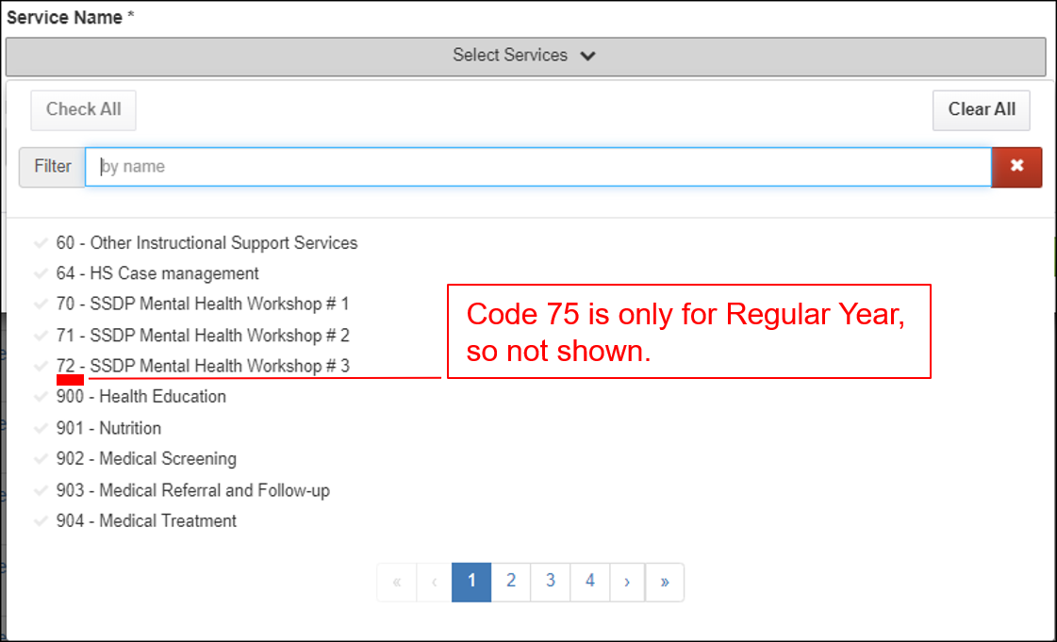
Impact of Service Period on Service Entry
For example, Region 1’s ELA service provided by Classified staff, code 75, is setup for Regular Year only.
When entering services, if you select Summer or Intersession, then you will not see code 75.
Notes:
Lead: Victor
Time: 2 min
Talking Points:

Slide 31
Resources and Next Steps
Notes:
Lead: Melissa
Time: 10 seconds
Talking Points:

Slide 32
Resources
Subgrantees may use this presentation to review requirements and recommendations.
User guides and how-to videos for the features covered today are available on the California MEP Help Center.
If any questions arise, please consult with your local management team first. Specific questions about MPOs should be submitted to your CDE consultant or Melissa Mallory. Other questions or concerns can be submitted to the MSIN Service Desk.
Practice on: https://trainingmsin.wested.org/login
Notes:
Lead: Melissa
Time: 30 seconds
Talking Points:
In addition to the user guides, remember that definitions, rules, and other information is readily accessible within most screens by clicking the “i” icon next to field titles.
Finally, don’t forget that the Training MSIN site is always available so that you can practice and brush up on system features.
Training MSIN link: https://trainingmsin.wested.org/login

Slide 33

Last Chance for Questions
Notes:
Lead: Team
Time: 2 mins
Answer a few questions about this session’s topics and/or the final collaborative activity.

Slide 34
Contact Information
Melissa Mallory
Education Programs Consultant
California Department of Education
mmallory@cde.ca.gov
916-319-0730
__________________________________________________
MSIN Service Desk
MSINsupport@wested.org
1-800-342-2964, option 2
Notes:
Lead: Melissa
Time: 30 sec
Talking Points:
Thank participants for attending.

