Slide 1
Welcome
The webinar will begin shortly. If you are joining as a group, please use the chat for roll call (enter your region or direct-funded district and your names).
Thank you!
Notes:
Lead: Victor
Time: 5 mins. & 2 mins. before webinar starts
Talking Points: Read slide

Slide 2
Migrant Student Information Network:
Data Close and Data Monitoring Reports
August 21, 2026
10:00 a.m. – 12:00 p.m.
Notes:
Lead: Victor
Time: 30 secs.
Talking Points:
Repeat that participants who are joining as a group need to do “roll call” through the chat feature (region/direct-funded district number # and names)

Slide 3





Welcome and Introductions
Loan Tran, Education Research and Evaluation Consultant, California Department of Education (CDE)
Jose Valencia, Migrant Student Information Network (MSIN) Lead, WestEd
Victor Garibay, Senior MSIN Content Specialist, WestEd
Meena Kaur, Data Analyst - Migrant Education Special Projects, WestEd
Elvira Raya, Identification & Recruitment Senior Specialist, WestEd
Notes:
Lead: Loan
Time: 3 mins.
Talking Points:
Welcome participants.
Presenters introduce themselves and WestEd staff helping with the webinar.

Slide 4
Target Audience and Purpose
This webinar will review topics related to the Data Close Deadline for the 2025-26 Performance Period.
The target audience includes Migrant Education Program (MEP) Directors, Managers, MSIN Power Users, and Data Specialists.
The webinar’s purpose is to ensure that subgrantees are familiar with the end-of-year timeline and the tools available in MSIN to help them submit accurate MEP data as well as maximize their child counts.
Notes:
Lead: Loan
Time: 1 min.
Talking Points:
(Read or paraphrase bullets)

Slide 5
Session Objectives
Participants will:
understand why having accurate MSIN data is important;
know the MEP Data Calendar Data Entry/Close Deadlines for the 2025–26 Performance Period;
review Frequently Asked Questions (FAQs) about the data close process;
learn how to maximize migratory child counts (Category 1 and 2) using the Data Monitoring Reports; and
receive tips and resources to train MSIN users locally.
Notes:
Lead: Loan
Time: 1 min.
Talking Points:
(Read or paraphrase bullets)

Slide 6

Frequently Asked Questions
Notes:
Transition Slide
Lead: Loan
Time: 10 secs.

Slide 7
Why is accurate MSIN data important?
Code of Federal Regulations, Subpart C, 200.84(a) requires that each state determine the effectiveness of its MEP through a written evaluation that measures the implementation and results achieved by the program against the State’s performance targets.
The Consolidated State Performance Report (CSPR) is the instrument the State uses to report to the U.S. Department of Education (ED) on the Migrant Education Program.
ED’s Office of Migrant Education (OME) then uses this information to report to Congress on how the State is serving migratory children.
Notes:
Lead: Loan
Time: 2 minutes
Talking Points:
Review bullet points
The federal office, OME, uses this data to determine the number of migrant students in each state. Based on the data submitted through the CSPR and the Migrant Student Information Exchange (MSIX), funds are given to each state. In turn, the state uses the information for subgrantee allocations. Therefore, it is critical that the information is correct and that all deadlines are met.

Slide 8
When is the Data Close Deadline?
For the 2025–26 Performance Period, all pending Certificates of Eligibility (COE) with Qualifying Arrival Dates (QAD) within the Performance Period must be processed by September 18, 2026.
In addition, all enrollment and service data must be entered into MSIN by September 18, 2026.
This deadline cannot be extended because MSIN data is required by other offices at CDE to meet their EDFacts files due dates, as established by the US Department of Education.
Notes:
Lead: Loan
Time: 2 minutes
Talking Points:
Read slide

Slide 9
MEP Data Calendar
Activity | Due Date
Fall term services entered into MSIN | 3rd Friday in January: 01/16/26
Spring term services entered into MSIN | 3rd Friday in July: 07/17/26
Summer term services entered into MSIN | 3rd Friday in September: 09/18/26
Data Monitoring Reports are reviewed, and issues are resolved | 3rd Friday in September: 09/18/26
All performance period data collection cutoff (e.g., Enrollments, Services, COEs) | 3rd Friday in September: 09/18/26
Notes:
Lead: Loan
Time: 2 minutes
Talking Points:
These activities and due dates very similar to last year.
Read items in calendar

Slide 10

Questions?
Notes:
Lead: Team
Time: 3 mins.
Use Q&A feature in Zoom

Slide 11
Check for Understanding
  Next, you will see a pop-up window with questions and response options.
  There are two questions for this section; answer them as best you can.
  If you are participating as a group, enter the option chosen by the majority of the group.
  You will get a warning when the poll is about to close.
Notes:
Lead: Victor
Time: 4 min
Talking Points:
Show polling questions, as follows:
1) It is important to enter accurate information in MSIN because...
The data is shared with the U.S. Department of Education
The data is used to derive child counts and funding
Both a and b [answer]
None of the options are correct
2) True or False: The Data Close Deadline for the 2025-2026 Performance Period is September 18, 2026.
True [answer]
False

Slide 12
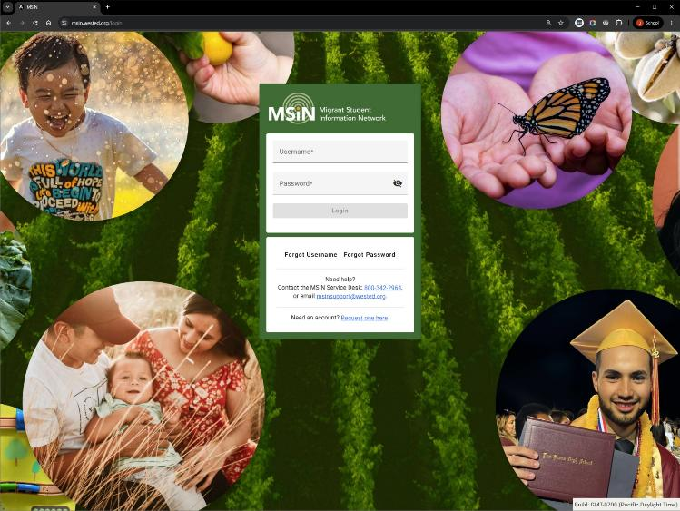
Using the Data Monitoring Reports
Notes:
Transition Slide
Lead: Jose
Time: 10 secs.

Slide 13
How should we use the Data Monitoring Reports?
These reports are designed to help local staff identify potentially missing and incorrect data, to be corrected by the Data Close Deadline, if needed.
Not all records included in a data monitoring report are incorrect. They may be incorrect or incomplete; therefore, they require a person to review them and make that determination.
Notes:
Lead: Jose
Time: 2 min
Talking Points:
Read bullets.
You can run these reports for your whole region, one or more districts, or a specific school.
Again, these reports show information that might be incorrect. Your judgement is needed to decide either way.
Tip: Treat these report as worklists. Do not download and manipulate, as this has the potential to compromise PII. Instead, assign staff to specific schools and districts, asking them to work directly from the screen.

Slide 14
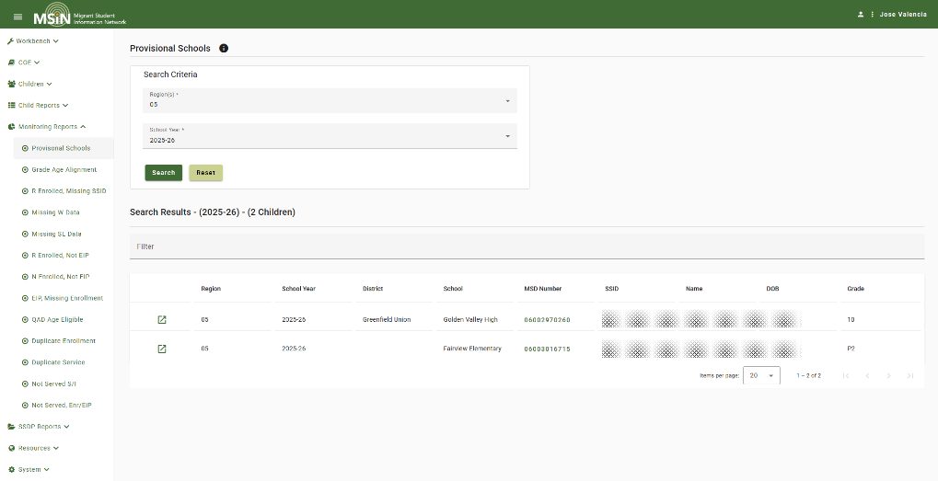
Provisional Schools
Notes:
Lead: Jose
Time: 4 min
Talking Points:
All of the Data Monitoring Reports have help text that you can bring up by clicking the “i” next to the report title. If you need more details, the reports also have user guides available on the California MEP Help Center.
The Provisional Schools Report is new for this year. Please resolve any provisional schools for your region or DFD. A refresher video on how this works is posted on the MEP Help Center.

Slide 15
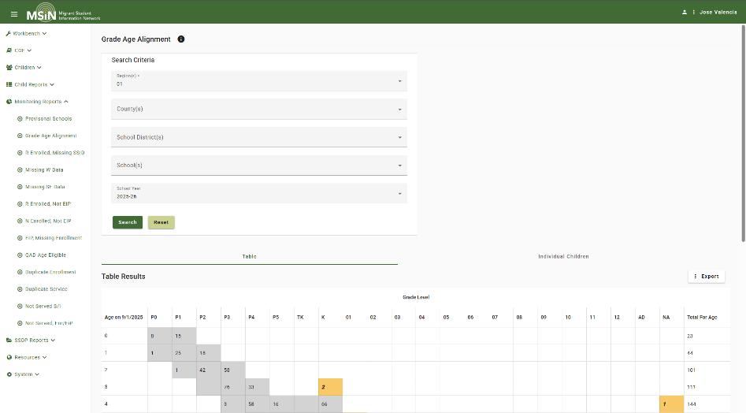
Grade Age Alignment
Notes:
Lead: Jose
Time: 4 min
Talking Points:
The Grade Age Alignment report provides users with a cross-tab chart with the grade levels on the x-axis and the Age on the y-axis. The report can be used to find children who might be in the wrong grade or might have an error in their DOB (date of birth). Let’s see what the cell colors mean:
Light gray cells - means that the child is in their expected grade or very close to it based on their age.
Dark gray cells – means we should double check these children for possible errors in their grade or DOB.
Orange cells – means that child is probably in the wrong grade or that their DOB is probably incorrect. Please check these carefully.
Is it very important to review this report and correct students that appear under orange cells which most likely have data errors. For example, if a child is 5 years old but they are in age/grade P2, the child may not be counted.
Interactive question: Here’s a question for Data Specialists: Do you use this report in other ways? (e.g., this is quick way to get a birds-eye-view of all enrolled children).

Slide 16
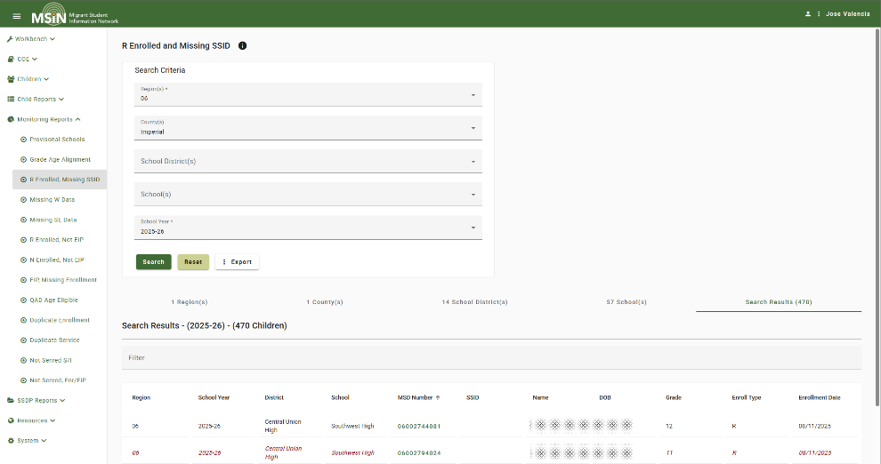
Regular Enrollment & No State Student Identifier
Notes:
Lead: Jose
Time: 3 min
Talking Points:
This is a list of children who have a Type= R (regular) enrollment line in the selected school year, but do not have a Statewide Student Identifier (SSID).
Note: The SSID is entered in the Demographics tab. MSIN has data checks for this field. A valid SSID must include numbers only, be 10-digits long, and must not have leading zeros.
Reminder: Children who have duplicate SSIDs (from legacy data) have been sent to the Resolve Duplicates page. Be very careful when resolving these potential duplicates. Twins and siblings can easily be merged by mistake because their data is so similar.
This report can “go to zero,” meaning that it’s possible that all children with a Type=R enrollment could have an SSID. If so, the report will not produce any results.

Slide 17
Check for Missing Dates
Missing Withdrawal Date – This is a list of children who have an Enrollment Date in the school year, but the enrollment line is missing a Withdrawal Date.
Missing Service End Date – This is a list of children who have a service in the school year, but it is missing a Service End Date.
Notes:
Lead: Jose
Time: 2 min
Talking Points:
Missing W Date:
This report is designed to facilitate completing the school enrollment cycle. School enrollment dates are also used to establish performance period eligibility and are reported to MSIX. If at least one of these dates (enrollment or withdrawal) fall within the performance period, this will serve as evidence of the student’s residency within the region/district, and they will have a greater chance of being counted.
Missing SE Date:
Service End Date one of the dates evaluated for determining that a child is both eligible and present (EiP). As a result, it is necessary for all services to have Start and End dates.
These reports can also “go to zero,” meaning that you could have no missing withdrawal and service end dates. In that case, you won’t get any results.

Slide 18
Identify Uncounted Children
Regular Enrollment & Not Eligible in Period – This is a list of children who are enrolled but not counted. They have a Type=R (regular attending) enrollment line in the school year, but they are not Eligible-in-Period.
Non-Attending Enrollment & Not Eligible in Period – This is also a list of children who are enrolled but not counted. They have a Type=N (non-attending) enrollment line in the school year, but they are not Eligible-in-Period.
Notes:
Lead: Meena
Time: 3 min
Talking Points:
R Enroll, Not EiP:
They are missing a date in the performance period (9/1 to 8/31) to show they are or were present. These children may be counted if evidence of their presence is entered, such as a service date(s), an Annual Verification, or other Communication Event. If no date is entered to show their presence within the performance period, they will not be included in the child count.
Note: This situation (enrolled but not counted) often occurs in districts where school enrollment begins in August (before the performance period begins on 9-1) and no withdrawal date has been entered. Please enter all withdrawal dates before the Data Close Deadline.
N Enroll, Not EiP:
Again, they are missing a date in the performance period (9/1 to 8/31) to show they are or were present. These children may be counted if evidence of their presence is entered, such as a service date(s), an Annual Verification, or other Communication Event. If no date within the performance period is entered, they will not be included in the count.
Non-attending children include 3–5-year-olds and OSYs. Based on the MSIX child count rules, children who turn from 2 years old to 3 within the performance period must have a date that verifies their presence after they turn 3. If that date is before their 3rd birthday, they will not be counted.

Slide 19
Check for Missing Enrollments
Eligible in Period & Not Enrolled – This is a list of children/youth who have EiP status (are eligible and present) in the selected school year, but they do not have an enrollment line in the school year.
Qualifying Arrival Date (QAD) & Age Eligible, Not Enrolled – This is a list of children who have eligibility from a valid COE and are still under 22, but they do not have an enrollment line in the school year.
Notes:
Lead: Meena
Time: 4 min
Talking Points:
EiP, Not Enrolled:
This is a list of children/youth who have EiP status (are eligible and present) in the selected school year, but they do not have an enrollment line in that school year. The most common reason children/youth are listed here is because a Communication Event (such as an Annual Verification) was completed for a child/youth, but they do not have an enrollment line for that school year.
Another common reason children/youth are listed here occurs at the end of each performance period. If a new COE is created just after the end of the performance period, but before the Data Close Deadline, and it has a QAD in the prior year, then the children will also be counted in the performance period that just ended. In addition, an enrollment line is needed in the prior school year so that WestEd knows which district and school should get the counts. The new enrollment line will also give WestEd the children's grade levels, which are needed for federal and state reports.
For each child/youth in this list, please add a 2025-26 enrollment line with the correct district, school and grade information. (Hint: This is very important so try to remember it.)
QAD Age Eligible:
This report was created to help you find children who might be in your area but are not enrolled in MSIN. The report returns a list of children who were enrolled in the recent past, but they do not have an enrollment line in the selected School Year. They could be enrolled (and counted) if they are present because they still have an eligible COE and they are under 22 years old. Therefore, have your MEP staff check with districts for enrollment information in their databases; if the child is present, then add an enrollment line for them in MSIN. If the child is not present, then disregard them, and move on to the next child in the report.
This report may not “go to zero,” meaning that some QAD Age Eligible children could have left your area. The idea is to double check to be sure and enroll all the children who are present.

Slide 20
Check for Duplicate Data
Duplicate Enrollment – This is a list of children who have two (or more) similar enrollment lines in the school year.
Duplicate Service – This is a list of children who have two or more service lines in their statewide child record that appear to be duplicates.
Notes:
Lead: Meena
Time: 3 min
Talking Points:
Duplicate Enrollment:
Having 2 (or more) similar enrollment lines in the same school year may or may not be an error. The idea is to check.
In rare cases students may have dual enrollment, but you should check district records to ensure there is not an error in MSIN.
Duplicate Service:
Please check the services lines by opening the Child Record Modal (i.e., click on the child's MSD number) and then go to the Service Participation tab. Look for the Service Codes identified in this report and make corrections to the child record, as needed.
It is important to delete duplicate service lines because they will probably affect your Measurable Program Objective (MPO) results for the State Service Delivery Plan (SDP). There are several MPOs that include the delivery of services in how they calculate progress.

Slide 21
Identify Unserved Children
Missing Departure Date & No Summer or Intersession Services – This is a list of children who have not received a Summer or Intersession service, even though they might still be in your area (they do not have a Departure Date).
Eligible in Period, Enrolled & Not Served – This is a list of children who have not received any services, even though they were eligible, present (EiP), and enrolled in the school year.
Notes:
Lead: Meena
Time: 3 min
Talking Points:
No DD, Not Serviced S/I:
You can use this report after the regular school year to target students for Summer or Intersession services.
EiP/Enr, Not Served:
This report will show you which migratory students have not received any services, of any kind (regular year, summer, or intersession) in the school year.

Slide 22
Questions? (2)
Notes:
Lead: Team
Time: 5 mins.
Use Q&A feature in Zoom.

Slide 23
Check for Understanding (2)
  Next, you will see a pop-up window with questions and response options.
  There are two questions for this section; answer them as best you can.
  If you are participating as a group, enter the option chosen by the majority of the group.
  You will get a warning when the poll is about to close.
Notes:
Lead: Victor
Time: 4 min
Talking Points:
Show polling questions, as follows:
1) True or False: If a student appears in one of the Data Monitoring Reports, this definitely means there is an error, and you must correct it.
True
False [answer]
2) True or False: The report titled “Eligible in Period and Not Enrolled” shows students who need an enrollment line in the selected school year.
True [answer]
False

Slide 24

Reminders
Notes:
Transition Slide
Lead: Victor
Time: 10 secs.

Slide 25
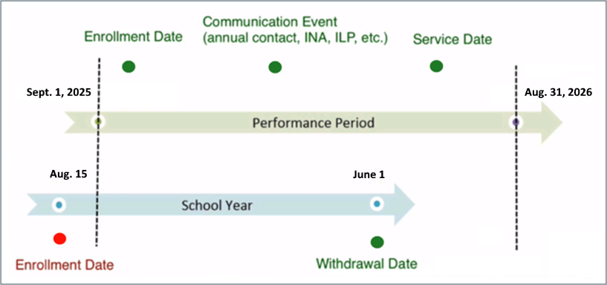
Reminder #1: Add dates strategically; they are critically important for MEP child counts
Add:
Enrollments (withdrawal dates)
Communication Events
Services (start and end dates)
Notes:
Lead: Victor
Time: 2 min
Talking Points:
Read slide
Many children in California were enrolled before 9/1/2025 (since many schools start in August), so adding another date in MSIN can show that the child was present in your region/district during the 2025-26 Performance Period.
Remember: Under the MSIX child count rules, we can only use dates to prove presence if they are after the child turns 3 years old and before the child reaches their End of Eligibility (EOE) date.
For details, please review the MSIX child count logic document found on the MSIX site (under Resources).

Slide 26

Rule of Thumb for Child Counts
Add dates to verify residency during the window of time when a child is eligible for MEP-funded services.
Notes:
Lead: Victor
Time: 2 min
Talking Points:
We’re going to do a collaborative activity. But, before that, let’s take a minute to review our rule of thumb for child counts.
When it comes to counts, the Recruiter has done the hardest part. After that, the rest of us can help maximize counts by focusing on entering dates that prove the child was present in California, in your region and your district.
For a child to be counted, their child record must have a date (i.e., “Residency Verification Date”; MDE 73) that is before their End of Eligibility (EOE) date.
Rule of thumb: Add dates to verify residency during the window of time when a child is eligible for MEP-funded services.
This tells us what actions to take. Keep the rule of thumb in mind as we do the group activity.

Slide 27
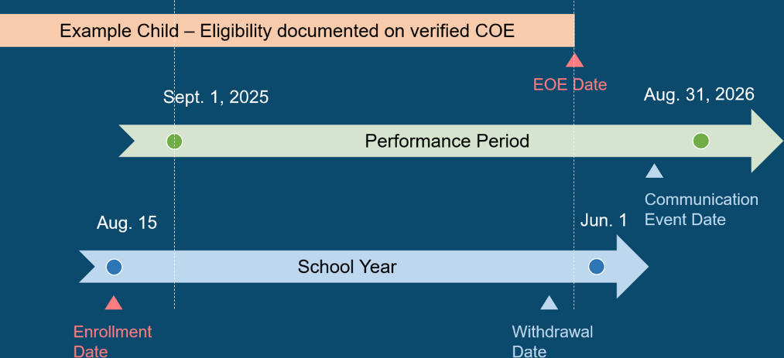
Child Counts Example
Notes:
Lead: Victor
Time: 3 min
Talking Points:
For our Collaborate Activity think of the Rule of Thumb.
1) Can we use the Communication Event date to show the child was present? Use the chat to enter your answer.
2) Can we use the Withdrawal Date to show the child was present? Use the chat to enter your answer.

Slide 28
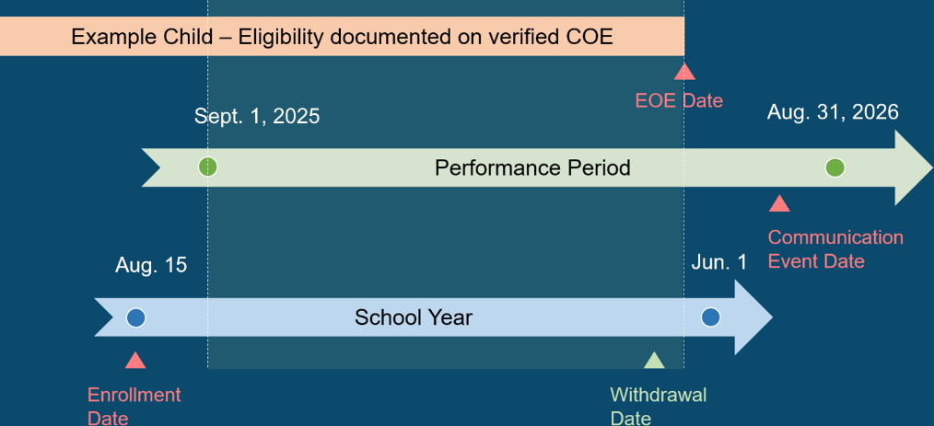
Child Counts Example: Answers
Notes:
Lead: Victor
Time: 4 min
Talking Points:
Now, let’s go over the answers.
Recalling our rule of thumb, we have highlighted the “window of time” during this performance period when the child was eligible for MEP services.
Notice that the child’s eligibility ended (EOE Date) before the end of the performance period.
Within the shaded region, we can easily see that only the withdrawal date is usable (as proof that the child was present).
The other two dates, Enrollment Date and Communication Event Date, are outside of our “window of time.”

Slide 29
Reminder #2: Enter Communication Events, especially for non-attending children
Communication Event dates indicate a child’s presence in your district/region.
Users should enter Communication Events when an activity is completed with the family/youth.
Most user roles (except Viewer) can enter Communication Events using the Group Communication menu item.
Notes:
Lead: Victor
Time: 3 min
Talking Points:
Even if a user wants to add a single communication event for one child, they can do this through Group Communications and click on the second tab (Individual Children Search).
In addition, most user roles (except Viewer) can also enter communication events directly through the child record view by clicking on the Communication Events tab.

Slide 30
Reminder #3: Resolve MSIN duplicates; children in unresolved duplicates do not get counted
In the MSIN menu bar, go to Children → Manage Duplicates → Resolve Duplicates.
Click on the number under the Unresolved column.
Be especially careful with children who have similar names. Twins and siblings might seem to be the same child, but they should not be merged.
Notes:
Lead: Victor
Time: 2 min
Talking Points:
Read slide
Third bullet: It is always a good idea to open the most recent COEs to see if the potential duplicates are two separate children in the same family (i.e., siblings). Sometimes the only difference is a middle name.

Slide 31
Reminder #4: Review and process all COEs, especially for new families and youths
It is very important to process all pending COEs by the Data Close Deadline, as the children with pending COEs may not be counted.
Strategize with your Designated SEA Reviewers to complete this work.
  For example, give priority to processing new COEs over COEs for requalifying families/Out-of-School Youths (OSYs), because “re-QADs” are probably already counted in the performance period.
Notes:
Lead: Elvira
Time: 2 min
Talking Points:
By processing COEs we mean complete, review, and approve or deny COEs in the reviewers’ queues.
We understand that even with everyone's absolute best efforts, there may be a small number of COEs that have legitimate reasons for not being processed by the data close. For example, if it is created on the exact same day of the data close, or if information is missing and unable to be obtained by the data close because recruiters cannot reach the families/OSYs to get it. Such reasons can cause COEs to remain on-hold; however, we hope this is just a small number and not a bulk of COEs.
We have also learned that it is important to clarify that it is very important that subgrantees do NOT purposely slow down or stop recruitment or submission of COEs for review near to the data close deadline for the purpose of being able to "clear" their COE queues by the data close date.
Remember, new COEs for families who were not recently eligible (in the 2025-26 Performance Period) are important to process because those children will not be counted unless the COEs is fully processed before the data close date.
On the other hand, you may have pending COEs from families who re-qualify every year. Processing such COEs wouldn’t be the highest priority if time constrains are an issue because requalifying children have likely been counted for the closing performance period already based on the previous eligibility. This can be checked quickly by looking at their Eligibility Status tab in their child record.

Slide 32
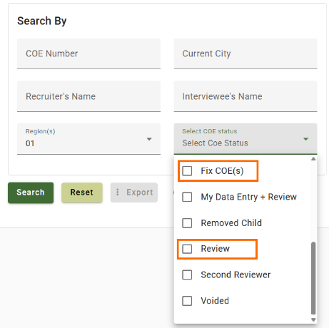
Reminder #5: Use the Certificate of Eligibility Search page to check for pending COEs
To help you ensure all pending COEs are processed by the Data Close Deadline, you can use the Search COE page.
In the status dropdown menu, select Review and FixCOE statuses to identify COEs that you should finish processing before data close.
Notes:
Lead: Elvira
Time: 2 min
Talking Points:
The COE Search has many functions, and one useful function is to identify COEs in Review or FixCOE state to ensure they are processed before data close.
I&R Coordinators and Directors will be receiving weekly emails to remind them of all their pending COEs in their queue and ensure that all COEs are processed, if possible.
I&R Coordinators and Designated SEA Reviewers should have a plan/strategy to monitor and process pending COEs in the COE review queue. This may include ongoing communication with recruiters inquiring about pending COEs in their workbench and why they have not been submitted for review yet.
Please remember to also monitor pending COEs in FixCOE state (meaning those COEs that were sent back from reviewers to recruiters because corrections may be needed).
Please visit the MEP Help Center to review the guide, if needed.

Slide 33
Reminder #6: Resolve SSIDs
Resolve match tasks in the Unresolved SSID Matches queue.
Having each child’s SSID number is critical because MSIN uses it as a “bridge” to match migratory children with their data in CALPADS and assessment files.
The MSIN team creates student lists with SSIDs to request specific data from CDE, such as which students are English learners, have disabilities, or have dropped out of school.
Notes:
Lead: Elvira
Time: 2 min
Talking Points:
(Read or paraphrase bullets)

Slide 34
Reminder #7: Enter High School
Graduation & Equivalency Data
Enter all student graduation information in MSIN, including students who obtained High School Equivalency (HSE) credentials (passed GED or HiSET).
HSE data is needed in the CSPR and for the Migrant Student Information Exchange (MSIX).
Notes:
Lead: Elvira
Time: 2 minutes
Talking Points:
Read slide
Say High School Equivalency (rather than just HSE)

Slide 35
Questions? (3)
Notes:
Lead: Team
Time: 3 mins.
Use Q&A feature in Zoom

Slide 36
Check for Understanding (3)
  Next, you will see a pop-up window with questions and response options.
  There are four questions for this section; answer them as best you can.
  If you are participating as a group, enter the option chosen by the majority of the group.
  You will get a warning when the poll is about to close.
Notes:
Lead: Victor
Time: 4 min
Talking Points:
Show polling questions, as follows:
1) True or False: To maximize your child counts, it is crucial to keep adding dates that prove the child’s residency in your region/district during the 2025-2026 Performance Period.
True [answer]
False
2) True or False: Another way to maximize your child counts is to finish reviewing the pending COEs—especially for new families—before the Data Close Deadline.
True [answer]
False
3) True or False: High School Equivalency data is needed in the CSPR and for the MSIX.
a. True [answer]
b. False

Slide 37

Next Steps & Considerations
Notes:
Transition Slide
Lead: Loan
Time: 10 seconds

Slide 38
MEP Data Close Next Steps
  Assign staff to work on the Data Monitoring Reports.
  Train local staff on the information learned today.
  Implement the reminders/tips provided today.
  Review the webinar PowerPoint, as needed.
  Review the available user guides and tutorial videos on the California MEP Help Center, as needed.
Notes:
Lead: Loan
Time: 2 min
Talking Points:
Read bullets and after first bullet say: It is very important to train local staff, much like we have done here. Feel free to use this PowerPoint.
Stay alert for possible communications from the I&R team at WestEd, because they are reviewing COEs with potential issues and may reach out to you for support.

Slide 39
MSIN Data Privacy and Security
Every MSIN user must follow all local and state measures to protect child data, including (but not limited to) the following:
Never share access to MSIN (your username and password).
Consider your location when viewing confidential data (anything in MSIN); others should not be able to see what is on your screen.
Do not email electronic versions of forms and reports (e.g., PDFs, Excel files) unless they are encrypted per CDE standards.
Notes:
Lead: Loan
Time: 2 mins.
Talking Points:
Remember that the MSIN system contains PII for thousands of migratory children and youths, so data security is extremely important.
(Read or paraphrase bullets. List continued on next slide.)

Slide 40
MSIN Data Privacy and Security (2)
Store paper forms and reports in a secure location (locked cabinet).
Shred paper forms and reports that are no longer needed, as the MSIN system stores electronic versions of Certificates of Eligibility (COEs) and Individual Needs Assessments/Individual Learning Plans (INA/ILPs).
Routinely check your computer’s download folder(s) and delete any files that contain PII, whether they are from MSIN or any other student data system.
Notes:
Lead: Loan
Time: 2 mins.
Talking Points:
(Read or paraphrase bullets.)
When conducting local training sessions, please reiterate these points so that all MSIN users hear this repeatedly.
From Elizabeth Wisnia’s presentation on data privacy and security:
“If PII must be collected, CDE is responsible for protecting such data from unauthorized access. If data is collected and stored electronically, passwords, encryption, and other means for electronically limiting access to PII should be employed. If hard copies of the data are collected, such results should be stored in a secure, locked area that is only accessed by authorized personnel. Anyone with access to the data should be properly trained on privacy laws and policies related to data privacy.”
“Occasionally, you may have a legitimate need to print/work with hard copies of confidential data. In such instances, consider where you might securely store such data when the data is not in use. Hard copies of confidential data should only ever be in one of three places: (1) In your hands, (2) In a locked cabinet/secure room, (3) In the shredder. Treat hard copies of confidential data like cash. If you wouldn’t leave a $100 bill sitting unattended and exposed in an insecure location such as your vacant desk, you shouldn’t leave confidential data there either.”
“In this era of smart phones and other ever-present photo/recording devices, please also consider acceptable locations to peruse confidential data. If you’re in a public coffee shop or have a desk with a window that faces a busy street (for example), consider moving to a private location or reconfiguring your desk so that those with too much curiosity or nefarious intentions won’t have access to the confidential information you are reviewing.”
Loan will select which sentences to use or may add her own.

Slide 41
Additional Resources
Subgrantees may use this presentation to train or review with local MEP staff.
User guides, reference documents, and “how-to” videos are found on the MSIN home page and on the California MEP Help Center (https://mephelpcenter.wested.org/). For data close, the user guides on the Data Monitoring Reports and on Entering Communication Events are especially useful.
If you have any questions while working on data close tasks, please consult with your supervisor or local MSIN Power Users first. Remaining questions can be submitted to the MSIN Service Desk.
Notes:
Lead: Loan
Time: 3 min.
Talking Points:
This PowerPoint will be posted in the California MEP Help Center (https://mephelpcenter.wested.org/), in the MSIN category.
In addition to the user guides, remember that definitions, rules, and other information is readily accessible within most screens by clicking the “i” icon next to titles and fields.
The Training MSIN site is always available so that you can practice and brush up on system features.

Slide 42
Contact Information
Loan Tran
Education Research and Evaluation Consultant
California Department of Education
LTran@cde.ca.gov
__________________________________________________
MSIN Service Desk
MSINsupport@wested.org
1-800-342-2964, option 2
Notes:
Lead: Loan
Time: 30 secs.
Talking Points:
Please thank participants for attending.

