Slide 1


Cybersecurity Webinar
Migrant student information exchange (MSIX)
February 24, 2026
Deloitte

Slide 2

Privacy Reminder
The Migrant Student Information Exchange (MSIX) contains real and sensitive student data that should not be shared with those who are not authorized to view it.
Protecting a child’s Personally Identifiable Information (PII) is paramount when using MSIX.
If there is a PII incident,
contact the MSIX Help Desk immediately.
Notes:
MSIX does contain Personally Identifiable Information (PII), which is information that, alone or in combination, is linkable to a specific child that would allow a person to identify the child with reasonable certainty.
Please note that information or data in all screenshots are fictitious. We take great care in protecting sensitive information, and you should do the same when handling student data.

Slide 3
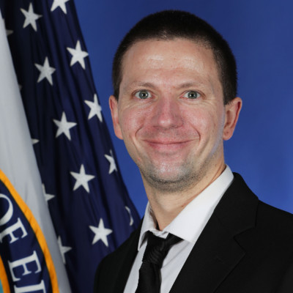


Speakers
Benjamin Starr
US Department of Education
Office of Migrant Education
Lee-Ellen Myles
Deloitte MSIX Team
Tyler Salensky
Deloitte MSIX Team
Audience Engagement – Please chat your name, State and role in the MEP.
Notes:
Introduce speakers

Slide 4

MSIX Help Desk
Dan Boland
MSIX Help Desk
A certificate for attending this webinar will be sent to all MEP State directors via the MEPSTATE listserv. Attendance at this webinar will satisfy the requirement of annual training put forth in the MSIX Rules of Behavior.
Contact the MSIX Help Desk via Email: MSIXSupport@deloitte.com or Telephone: 1-866-878-9525.
Help Desk Hours: 9:30 AM - 6:30 PM ET, Monday through Friday, except Federal Holidays.
Notes:
A certificate for attending this webinar will be sent to all MEP State directors via the MEPSTATE listserv. Attendance at this webinar will satisfy the requirement of annual training put forth in the MSIX Rules of Behavior. Additionally, if you would like a certificate for attending this webinar, you may contact the Help Desk.
*Post Help Desk Contact Info in the chat*

Slide 5

Icebreaker
What’s your favorite snow day activity?

Slide 6

Agenda
1
MSIX Overview
2
Cybersecurity & Privacy Awareness Training
3
Closing & Survey

Slide 7
MSIX Overview
MSIX is a web-based application that links State migrant systems to produce a single Consolidated Student Record containing the Migrant Education Program (MEP) minimum data elements (MDEs) to not only analyze national migrant trends, but also facilitate:
Enrollment
Placement
Credit Accrual
MEP Participation
Notes:
As you know, migratory children move from place to place, often on short notice, and families may not have time to gather their children’s education and health documentation before re-enrolling them in a new school district. This can delay enrollment or result in misplacement in grade or course level. MSIX ensures that a migratory children’s academic progress is documented in a central system accessible wherever they go.
To do this, MSIX is a web-based application that links State migrant systems to produce a single Consolidated Student Record composed of minimum data elements, or MDEs. This not only allows for the generation and analysis of national migrant trends, but primarily assists authorized personnel to make informed decisions on enrollment, grade or course placement in a new school, accrual of credits towards graduation, and participation in the Migrant Education Program.
Statute: Part C of Title I of the Elementary and Secondary Education Act (ESEA) of 1965, as amended by No Child Left Behind Act of 2001(NCLB) – Sections 1304(b)(3) and 1308(b). Section 1304(b)(3) requires State Education Agencies (SEAs) to promote interstate and intrastate coordination by providing for educational continuity through the timely transfer of pertinent school records (including health information) when children move from one school to another, whether the move occurs during the regular school year.

Slide 8
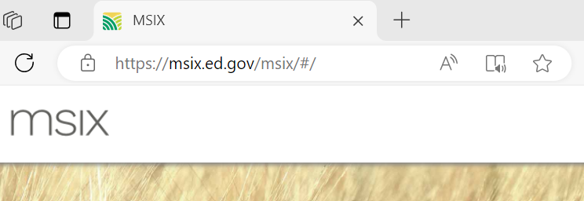
MSIX Overview | Secure Access
Notes:
To check that a website is safe:
Look for the “S” in HTTPS. HTTPS indicates that security is provided by an SSL certificate which protects sensitive information entered into the site as it travels from the site to a server.
Look for the padlock next to site address as indicated in the slide with the green arrow. A padlock indicates a secure site. A padlock with a yellow warning triangle indicates that the connection is only partially secure and a padlock with a red strike over it indicates that content is being delivered via an insecure protocol such as HTTP or FTP.

Slide 9

Cybersecurity & Privacy Awareness Training

Slide 10

Poll Question #1
Which of the following best describes your password practices today?
Notes:
(8 Poll Options, users can select as many options as they would like)
I use Passkeys (Face ID / fingerprint scanning)
I use MFA via an Authenticator App
I use MFA via text messages
I use SSO (single sign-on)
I use PINs and device unlock codes
I reuse a few passwords
I use the same password everywhere
Other

Slide 11
Cybersecurity References
Federal Government
Federal Information Security Modernization Act of 2014 (FISMA)
National Institute of Standards and Technology (NIST) Special Publication (SP) 800-53A Revision 5
Department of Education
ACSD-OCIO-004: Cybersecurity Policy
MSIX Specific
MSIX System Security Plan
MSIX Privacy Impact Assessment
MSIX System of Records Notice
Interconnection Security Agreements
Memoranda of Understanding
MSIX Rules of Behavior
Notes:
There are many different directives and security policies that MSIX must follow to maintain a secure environment for hosting the data of migratory children. At the Federal Government level there is the Federal Information Security Modernization Act of 2014 (also known as FISMA).
FISMA codifies the Department of Homeland Security’s role in administering the implementation of information security policies for federal Executive Branch civilian agencies, overseeing agencies’ compliance with those policies, and assisting OMB in developing those policies.
Also, at the Federal Government level is the National Institute of Standards and Technology (NIST) Special Publication (SP) 800-53A which provides a catalog of security and privacy controls for federal information systems and organizations and a process for selecting controls to protect organizational operations (including mission, functions, image, and reputation), organizational assets, individuals, other organizations, and the Nation from a diverse set of threats including hostile cyber attacks, natural disasters, structural failures, and human errors (both intentional and unintentional). All Federal Government information systems are required to comply with FISMA and follow the NIST SP 800-53A.
The overarching cybersecurity policy for the Department of Education is ACSD-OCIO-004. This policy specifies the process that manages information security and privacy risk specifically for IT systems at the U.S. Department of Education.
Finally, the MSIX specific security documents include the System Security Plan which documents how MSIX implements the security controls specified by NIST. The Privacy Impact Assessment (PIA) and System of Records Notice (SORN) document the PII contained in the MSIX system, why it is there, and how MSIX protects it. The Interconnection Security Agreements (ISAs) and Memoranda of Understanding (MOUs) are agreements made between the Department of Education and the State Education Agencies for exchanging the Minimum Data Elements (MDEs). Finally, the MSIX Rules of Behavior explains the policies and procedures MSIX Users are expected to follow when accessing the MSIX system.
It is important to follow these policies and understand the types of cybersecurity threats out there to avoid falling victim to an attack and put student data at risk. That is the reason we take the time each year to review Cybersecurity and Account Management. The more you know, the less susceptible you are!

Slide 12
Cybersecurity Statistics
1
2
3
Total cybercrime losses exceeded $16 billion in 2024.
Phishing is the most common form of cyber crime.
Identity-related cyber crime is happening at massive scale.
The FBI’s Internet Crime Complaint Center reported more than $16.6 billion in losses¹ from internet crime complaints in 2024 – a record high for the United States.
In the FBI’s 2024 Internet Crime Report, phishing and spoofing topped all complaint categories with 193,407 reported incidents out of 800,000+ total complaints – ahead of extortion and personal data breaches.
Microsoft’s 2024 Digital Defense Report states that organizations face over 600 million identity attacks per day, and its systems blocked 7,000 password-based attacks every second in the past year.
¹ Figure only reflects reported complaints. Because many cybercrime incidents are never reported, actual losses are likely higher.
Notes:
Resources:
FBI’s 2024 Internet Crime Report: https://www.ic3.gov/AnnualReport/Reports/2024_IC3Report.pdf
FBI’s 2024 Internet Crime Report: https://www.ic3.gov/AnnualReport/Reports/2024_IC3Report.pdf
Microsoft’s 2024 Digital Defense Report: https://cdn-dynmedia-1.microsoft.com/is/content/microsoftcorp/microsoft/final/en-us/microsoft-brand/documents/Microsoft%20Digital%20Defense%20Report%202024%20%281%29.pdf
Footnote verified via GAO’s Reporting Mechanisms Vary, and Agencies Face Challenges in Developing Metrics: https://www.gao.gov/products/gao-23-106080

Slide 13
Mobile Apps
Mobile apps are often the cause of unintentional data leakage. By selecting "accept" to the questions that display on your screen when installing a mobile app, you may be granting the app significantly more permissions than it needs to function.
Many apps request access to your contacts, photos, location, camera, and more. Excessive permissions or outdated apps can expose users to data misuse, tracking, or compromise.
Be mindful of the apps you install and the data you allow them to access!
Best Practices
Review app permissions and remove unnecessary permissions.
Limit location permissions.
Keep device and app software up to date.
Uninstall apps you do not need to avoid unnecessary data collection.
Be cautious when signing into apps with social network accounts.
Notes:
Starting with apps on your smartphone or other devices can of course be convenient tools to access the news, get directions, pick up a ride share, play games, or learn the latest dance steps. But these tools can also put your privacy at risk.
When you download an app, it may ask for permission to access personal information from your device so it is important to be careful when downloading apps.
Some best practices for protecting your privacy when it comes to apps are:
To download them from official app stores only such as your device’s manufacturer or operating system app store.
Review app permissions. Ensure your installed apps only have access to the information they need and remove unnecessary permissions from each app. Consider removing apps with excessive permissions. Pay special attention to apps that have access to your contact list, camera, storage, location, and microphone.
Limit location permissions. Some apps have access to the mobile device’s location services and thus have access to the user’s approximate physical location. For apps that require access to location data to function, consider limiting this access to when the app is in use only.
Keep app software up to date. Apps with out-of-date software may be at risk of exploitation of known vulnerabilities. Protect your mobile device from malware by installing app updates as they are released.
Delete apps you do not need. To avoid unnecessary data collection, uninstall apps you no longer use.
Be cautious with signing into apps with social network accounts. Some apps are integrated with social network sites—in these cases, the app can collect information from your social network account and vice versa. Ensure you are comfortable with this type of information sharing before you sign into an app via your social network account. Alternatively, use your email address and a unique password to sign in.

Slide 14
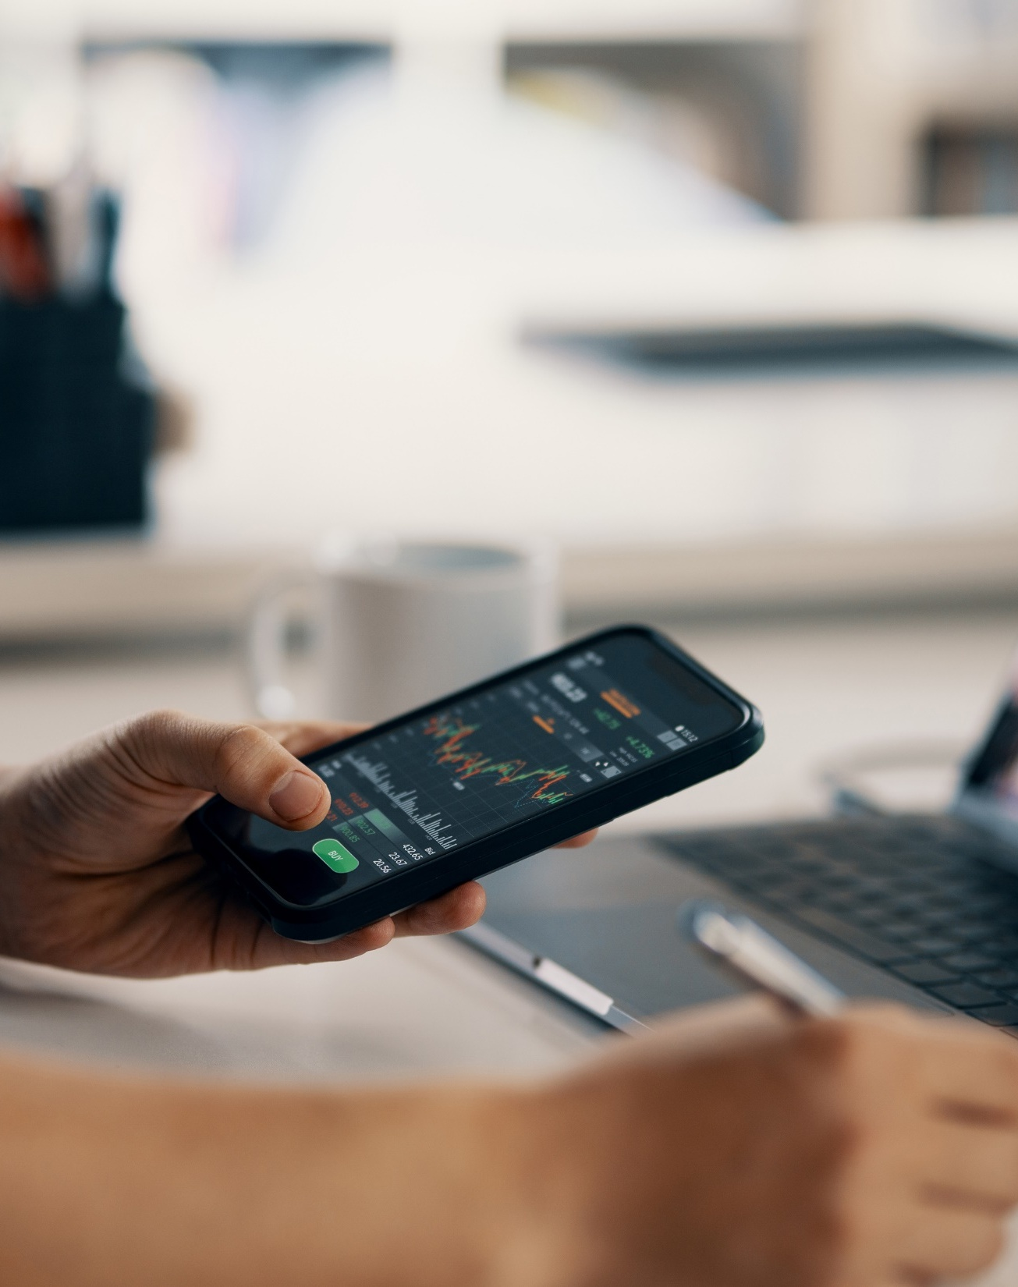
Social Media | Risks
Bad actors don’t just target systems – they target people. They may use their connections with you to gather information, such as common answers to security challenge questions, which may be used to carry out attacks into your associated work systems. This can lead to gaining unauthorized access to sensitive information.
Risk: Retrieve your personal information from social media to steal your identity and potentially commit fraud.
Outcome: Attempt to compromise your computer via a malicious link embedded in an email or contained in a chat.
Notes:
Bad actors don’t just target systems – they target people.
Social media can give them the clues they need to impersonate staff or bypass security. For example, an attacker might see a post about someone starting a new role at a school, then send a very convincing email pretending to be IT asking them to reset their password. Because it feels personal and timely, it’s much more likely to succeed.

Slide 15
Social Media | Best Practices
Privacy
Keep social media accounts private but also regularly check your settings to ensure it stays that way.
Always assume that everything that you post on the internet will, at some point, become public information.
Exercise caution when posting information about yourself, your job, and your contacts on social media, as it could draw unwanted attention from criminals.
Only accept known individuals as friends and, if possible, validate requests through other means before accepting them.
Network
Avoid social media quizzes or games that request your information, as they may be a social mining tool for collecting targetable details and responses to security questions.
Use caution with links received in messages, even from your friends, on your social media or web-based email site. Always hover your mouse over a link without selecting it to display where the link is really taking you.

Slide 16
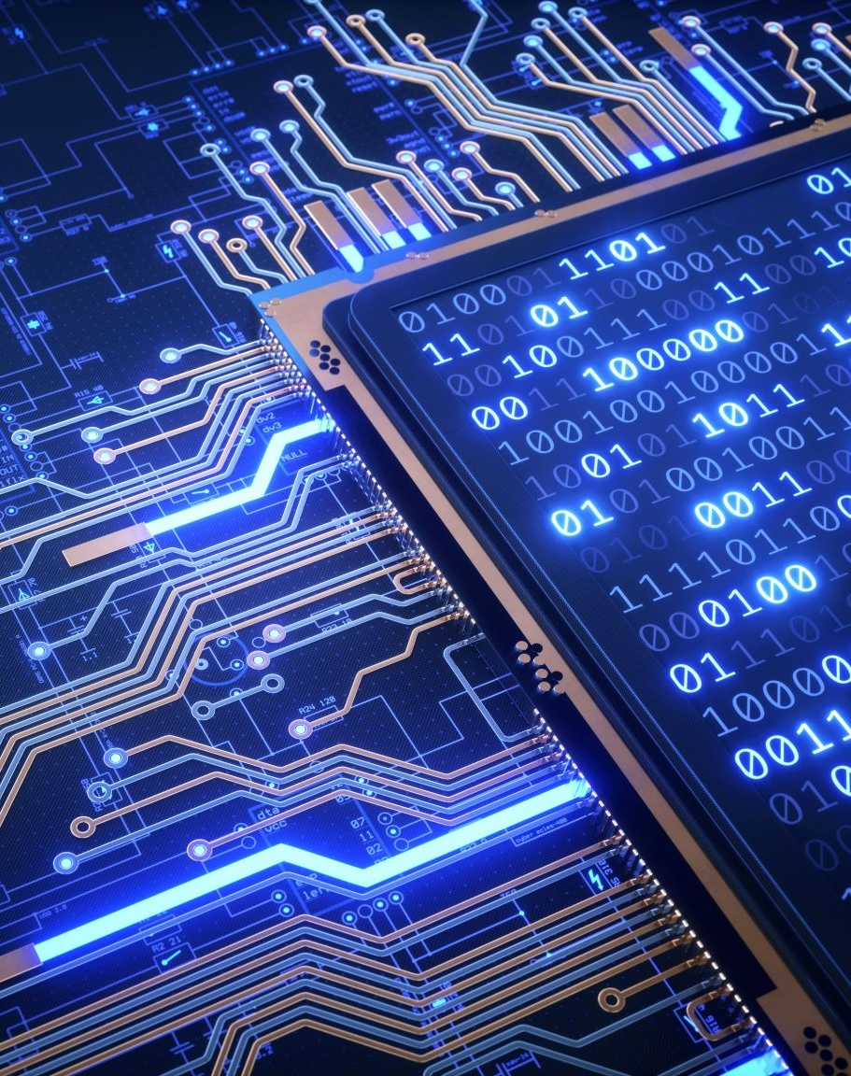
Artificial Intelligence
Artificial Intelligence (AI) is a machine-based system that can make predictions, recommendations, or decisions that impact real or virtual environments, based on human-defined objectives.
AI systems use machine and human-based inputs, perceives environments, and uses automated analysis to create models which then inform its outputs.
When used responsibly, AI has the potential to help solve urgent challenges while making our world more prosperous, secure, and productive.
Notes:
Given the powerful and customizable nature of AI, especially for providing insights and data analysis, we’re looking to add AI capabilities to MSIX in the future.

Slide 17
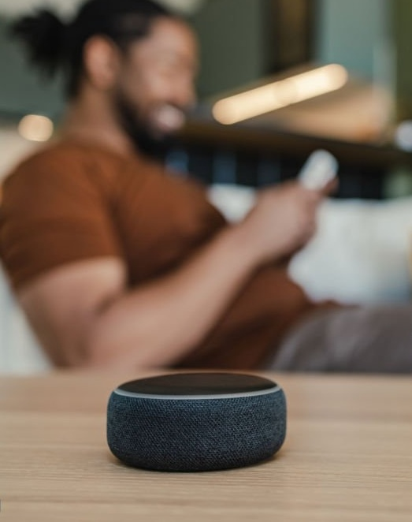
Internet of Things
The Internet of Things (IoT) is a term used to refer to the many physical devices that are connected to the internet, all collecting and sharing data.
Examples: Appliances, thermostats, security cameras, door locks, light bulbs, monitor displays, home speakers.
Tip: If you choose to use digital assistants, be sure to turn them off before participating in meetings.
Notes:
The Internet of Things or IoT is a term used to refer to the many physical devices that are connected to the internet, all collecting and sharing data. Examples include: Smart TVs, Thermostats, Digital Assistants like Siri on iPhones and iPads as well as smart speakers such as Amazon Echo and Google Home.
These devices are configured to constantly listen for commands. Before you use these devices, be mindful of the third-party that may also be listening.
Best practices for IoT devices include:
Disable any digital assistants when participating in meetings
Replace default account names and passwords
Keep software up to date
Connect to other devices carefully
Check which permissions will be granted to mobile apps
Consider creating a separate home wireless network for IoT devices
Stay up to date on the devices you have in your home

Slide 18
Spear Phishing
Spear phishing is a targeted form of phishing where emails or text messages are crafted to appear as though they come from a trusted source, such as a coworker or known organization.
Unlike broad phishing campaigns, spear phishing messages are sent to a specific individual or group and often reference real details, like names or relationships.
The goal is typically to trick the recipient into sharing sensitive information, clicking malicious links, or installing malware on their device.

Slide 19
Malvertising
Malvertising is a cyber tactic used by bad actors to insert malicious ads into legitimate online advertisements. Many legitimate websites rely on advertising to generate revenue and, unfortunately, these ads provide bad actors and other adversaries with another avenue to attack unsuspecting users.
While MSIX does not have ads, it’s important to keep these safe browsing strategies in mind to avoid malvertising scams:
Don't select ads on websites you're browsing. Instead, open a new tab and type the website's URL.
Avoid selecting the first site listed in search engine results. Malvertisers can place malicious ads there, where they appear as search results.

Slide 20

Poll Question #2
What can you do to avoid malvertising when on the internet?
Notes:
(3 Poll Options, correct answers are bolded below)
Type in website URLs
Avoid selecting the first site listed in search engine results
Click every banner ad you see

Slide 21
Avoiding a Social Engineering Attack
DO
DON’T
Be suspicious of unsolicited phone calls, visits, or email messages from people asking about employees, computer systems, or internal information.
Try to verify the identity of any unknown person who claims to be from a legitimate organization.
Remember legitimate personnel will NEVER ask you for your password.
Give your passwords to anyone.
Enter your credentials into a website accessed by clicking a link in an email message.
Allow an unknown individual remote access to your computer in response to an unsolicited telephone call or onscreen pop-up message.
Notes:
Do:
Be suspicious of unsolicited phone calls, visits, or email messages from people asking about employees, computer systems, or internal information
Try to verify the identity of any unknown person who claims to be from a legitimate organization. If you receive an unsolicited email from a financial institution such as your bank, PayPal, or even amazon asking you to call a number or click on a link from an email, the best thing you can do is look up that phone number or directly type that link into a browser that way you can confirm that you are using the correct one and not one that was maliciously sent to you trying to steal information or install malware onto your computer.
Remember legitimate personnel will NEVER ask you for your password – This includes the MSIX help desk. The Help Desk will NEVER ask you for your password so please do not send it to them or any other MSIX User administrator.
Don’t:
Give your passwords to anyone
Enter your credentials into a website accessed by clicking a link in an email message
Allow an unknown individual remote access to your computer in response to an unsolicited telephone call or onscreen pop-up message

Slide 22
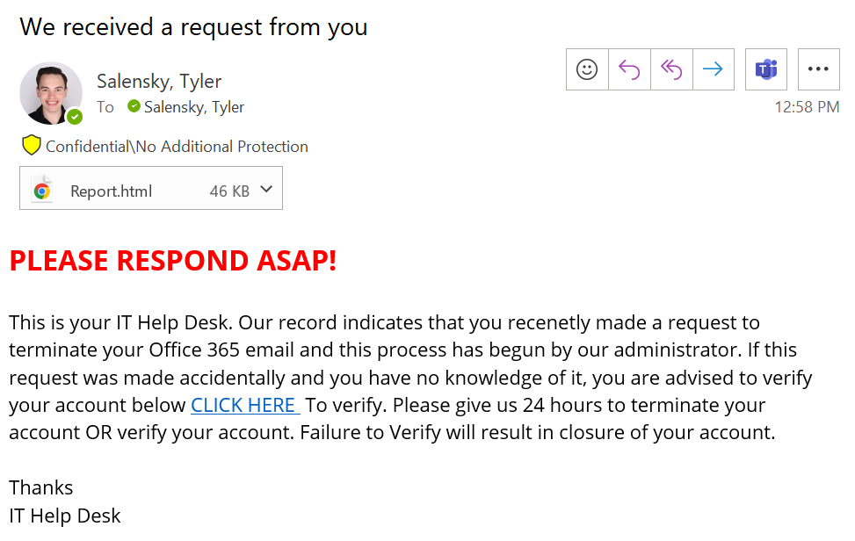

Is This a Phishy Email? (1)
Notes:
BING… you have just received an email from the IT Support Help Desk. After taking a further look you start to notice something phishy. In the chat, please identify the indicators that this email is not legitimate.

Slide 23

Is This a Phishy Email? (2)
Not directed to anyone specifically
Suspicious HTML attachment
Address doesn’t match name AND spelling error
Spelling errors
False sense of urgency
Threat of account lock-out encourages action
Link goes to suspicious website
Notes:
BING… you have just received an email from the IT Support Help Desk. After taking a further look you start to notice something phishy. In the chat, please identify the indicators that this email is not legitimate.

Slide 24
Email Security Best Practices
Do not open unexpected attachments even if you know the sender.
Do not click on suspicious links within emails.
Install and update anti-virus software on all devices.
Learn how to recognize phishing:
      Messages that contain threats to shutdown accounts or devices
      Requests for personal information (passwords or Social Security Numbers)
      Words like “Urgent”
      Forged email addresses
      Poor writing or bad grammar
Don’t give your email address to sites you don’t trust.
Report suspicious emails to your IT Department.
Notes:
Do not open unexpected attachments even if you know the sender – if you weren’t expecting an attachment or link from the sender, use a new email or call them to confirm if the attachment or link is legitimate.
Do not click on suspicious links within emails – An example is if you receive an email from your bank telling you that your account has been frozen and to click a link to resolve the issue. You can manually type in the name of your bank or do a google search to visit the legitimate link to confirm if there are any actions that you need to take. Often, the links in these types of emails are malicious.
Install and update anti-virus software on all devices
Learn how to recognize phishing
Don’t give your email address to sites you don’t trust
Report suspicious emails to your IT Department

Slide 25

Poll Question #3
Indicators of a phishing email attack include which of the following?
Notes:
(4 Poll Options, correct answers are bolded below)
Lack of information in the signature section
Includes a generic greeting
Uses an emotional trigger
The sender’s email address is irregular

Slide 26
Understanding PII, SPII, and PHI
  PII: Personally Identifiable Information
  SPII: Sensitive Personally Identifiable Information
  PHI:
  Protected Health Information
  Any information about an individual that can be used to distinguish or trace an individual's identity alone or when combined with other information linked or linkable to the specific individual.
  PII is considered SPII if its improper release could result in harm, embarrassment, inconvenience, or unfairness to the individual whose name or identity is linked to the information.
  PHI is any personal health information that can potentially identify an individual, that was created, used, or disclosed while providing healthcare services, whether it was a diagnosis or treatment.
Note: MSIX does contain PII but not SPII or PHI. Please do not input a child’s SPII or PHI into MSIX via file submission or using the correspondence feature.
Notes:
While individual data elements alone in MSIX are PII and not SPII, the whole student record can cause embarrassment, inconvenience, or personal harm. Particularly since MSIX contains records for Minors, extra caution should be exercised. Always password protect or encrypt data exported or screen captured from MSIX.
It is the responsibility of every MSIX user to protect the information maintained in MSIX.
When we say protect the information, this covers not just what’s on the screen, but also downloaded files, screenshots, emails, attachments, printed records, etc.
PII should only be shared with those with a specific need. They may be parents, students, counselors, registrars, etc. but make sure the information they receive is pertinent and the correct information for the specific request each time. Ask if the information they are seeking is the right information for the right person at the right time.
Please be aware that MSIX is permitted to store PII but SPII such as social security numbers or PHI such as health conditions are not permitted to be stored in MSIX. Please do not input this kind of data into MSIX either via comment in a file submission or via the correspondence feature on move notices or data requests.
Sensitive information should only be discussed in private, controlled areas and be aware of your surroundings and the people around you
Take care when reading or viewing sensitive information outside of the office. Unauthorized individuals may be able to reach or view the information as well
Be discreet when retrieving messages from smartphones and other media. Don’t include sensitive information in voicemail messages
Do not share sensitive information with anyone else unless he or she has a work-related need to know

Slide 27
Understanding PII in MSIX
  The most frequent occurrence of PII breaches are unencrypted emails to the MSIX Help Desk that include PII.
  Examples of information that would constitute PII include:
  Student’s Name
  Parent’s Name
  Combination of Sex, Birth Date, or Grade Level and other identifying information such as State ID or First Name
While an individual data element may not be considered PII, combination of data elements can be!
Notes:
What PII is in MSIX?
The most frequent occurrence on PII infringements are unencrypted emails to the MSIX Help Desk that include PII.
Examples of a set of information that would constitute PII includes:
Student’s Name
Parent’s Name
Combination of Sex, Birth Date, or Grade Level and other identifying information such as State ID or First Name

Slide 28
Sharing PII
Before sharing PII, ask yourself who you are sending it to and whether they need to know the information.
To prevent accidentally sending information to the wrong person, address your message carefully. Make sure you select the correct recipient.
Follow your State laws to ensure you are using approved transmission methods and required protections (e.g., encryption).
Never download or store PII on personally-owned equipment.
Do not upload PII to an unauthorized online storage site (e.g., Dropbox, wikis, etc.).
PII should never be accessed from public computers or kiosks found in hotel business centers or airports.
TIP! Do not send PII to the Help Desk without first speaking with a Help Desk representative.
Notes:
Did you know common PII incidents for MSIX involved PII sent via unsecured email to the Help Desk.
Emailing sensitive information should only be done after you stop and think about some of these key points.
What information should be shared? Who is the recipient? Do they have a ‘need to know’ for the specific information?
Ensure the email is going to the right person, and now a whole group of people. Are they inside your organization? Are they external partners?
Did you spell the email address correctly?
If PII needs to be shared, follow your State laws for approved transmission methods. This could include password protection or encrypting the attachment before sending it out.
Email is generally not a safe communication method. It can be easily intercepted without your knowledge.
Encryption tools available to each SEA/LEA differ. Each MSIX User must consult their local IT support team and SEA/LEA tools and policies for specific methods to encrypt and protect PII.
Here’s another TIP: The US Dept of ED does not routinely request PII from MSIX users. If the Department needs to review your data, we will provide a secure means to do so. This also goes for the MSIX Help Desk. Please do not send PII to the Help Desk. If they need access to data containing PII, they will work with you to send it in a secure manner.

Slide 29
PII Incident and Procedures
A PII incident often occurs when PII is included in a screenshot or text in in the body of an email. It is not necessary to provide the Help Desk with a screenshot or student details in an email. MSIX IDs and Worklist IDs provide all that is needed to review the records in question.
When the Help Desk receives PII, a ticket is logged to document the incident.
OME is asked to approve Disabling the account of the sender of the PII.
OME reaches out to the State MEP Director to request that the sender of the PII receive cybersecurity retraining.
The sender’s MSIX account is configured to present the Rules of Behavior at the next log in.

Slide 30
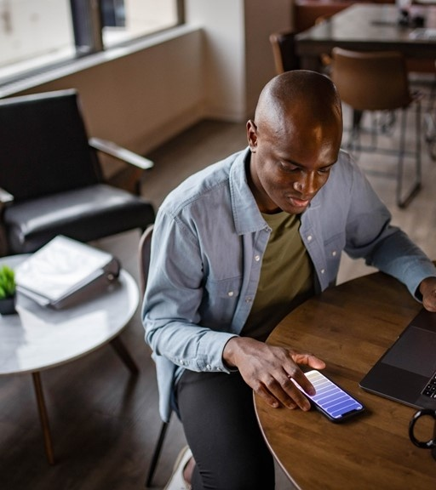
Poll Question #4
Which of the following are you NOT allowed to include in an unencrypted email to the MSIX Help Desk?
Notes:
(3 Poll Options, correct answers are bolded below)
A student’s MSIX ID
A table listing a student’s school history
A parent’s name
The MSIX Help Desk can provide support with just an MSIX ID. The MSIX ID cannot be used to identify a student outside of the MSIX system, so it is not considered PII. No additional screenshots, or child information is needed.
Per the MSIX SORN: The Department may disclose a record in MSIX to authorized representatives of SEAs, LEAs, or other MEP LOAs to facilitate one or more of the following for a student: (a) Participation in the MEP, (b) enrollment in school, (c) grade or course placement, (d) credit accrual, (e) unique student match resolution, and (f) data correction by parents, guardians, and migratory children.

Slide 31
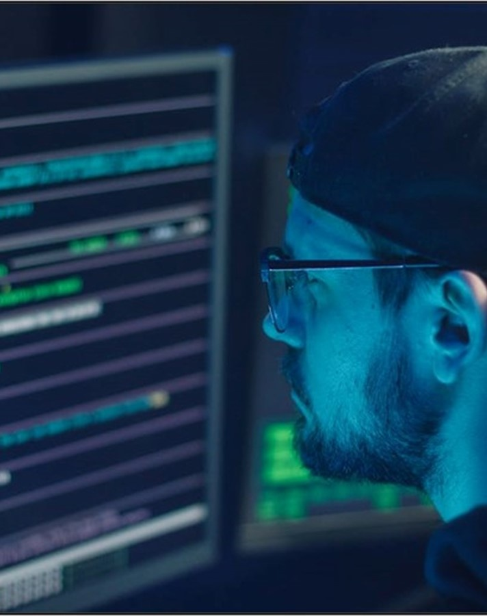
Insider Threats (1)
An insider threat is the threat that an insider will use their authorized access, wittingly or unwittingly, to do harm to the security of organizational operations and assets, individuals, other organizations, and the Nation. Types include:
Disclosure of sensitive information to unauthorized individuals
Theft of intellectual property
Sabotage of computer systems
Fraudulent activity
Misuse of privileges for personal gain
Notes:
1. Disclosure of Sensitive Information to Unauthorized Individuals:
This occurs when an insider intentionally or unintentionally shares confidential information with someone who does not have the right to access it.
Example: An employee emails a confidential client list to a personal email account.
2. Theft of Intellectual Property:
Intellectual property (IP) theft involves stealing proprietary information such as patents, trade secrets, or copyrighted material.
Example: An employee downloads and shares proprietary software code or design documents with a competitor.
3. Sabotage of Computer Systems:
Sabotage involves deliberately damaging or disrupting an organization’s computer systems.
Example: A disgruntled employee installs malware or deletes critical data, causing system outages or data loss.
4. Fraudulent Activity:
Fraud involves deception for personal or financial gain, often through manipulation of data or systems.
Example: An employee manipulates financial records to embezzle funds or creates fake vendor accounts to siphon money.
5. Misuse of Privileges for Personal Gain:
Misuse of privileges occurs when individuals exploit their access rights for unauthorized purposes.
Example: An employee with access to confidential client information uses it for personal investments or sells it to third parties.

Slide 32
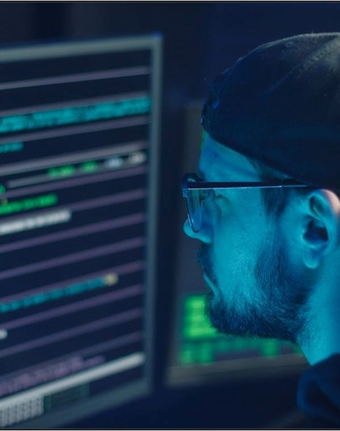
Insider Threats (2)
It’s important to take actionable steps to limit insider threats. Reduce risk with clear controls consistent habits, such as:
Be aware of suspicious activity
Use strong passwords and do not share them
Implement access controls
Train employees on security best practices
Monitor and audit system activity
Notes:
Insider threats can pose a significant risk to your organization's data security. Be vigilant and take steps to mitigate the risk of insider threats.
Implement access controls to limit who has access to sensitive information. Train your employees on security best practices and monitor system activity to detect and prevent suspicious activity. Use strong passwords and do not share them. Remember, your organization's data security is everyone's responsibility.

Slide 33
Working From Home | Best Practices
General
Network
Lock your computer when stepping away from your work area and remember to shut it down when done for the day.
Keep printed or handwritten materials in a locked drawer or filing cabinet when not in use to protect them from disclosure to unauthorized parties.
Duplicate copies of information (non-sensitive), including printed materials, should be destroyed when no longer needed.
If sensitive hardcopy records were created, they must be managed at home according to their retention policy until they can be shredded with a cross-cut shredder.
Secure your Wi-Fi network and your digital devices by changing the factory-set default password and username.
Do not use Wired Equivalent Privacy (WEP), which can be hacked in minutes.
Turn off the identifier-broadcasting feature of your router. Create a guest wireless network just for your laptop.
Connect immediately after logging into your laptop.
Notes:
General
Make sure to always lock your computer when stepping away from your work area.
You want to keep your printed or handwritten materials locked in a drawer or filing cabinet when not in use to protect them from disclosure to unauthorized parties
Duplicate copies of information (non-sensitive), including printed materials, should be destroyed when no longer needed
If sensitive hardcopy records were created, they must be managed at home according to their retention policy until they can be shredded with a cross-cut shredder
Network
Consider your Wi-Fi router the "front door" to your home network and configure it to lock out intruders. Secure your Wi-Fi network and your digital devices by changing the factory-set default password and username. Select a password that is as long as possible and unique to your router. Keep your router software up to date.
Learn about the security features available with your router and enable firewall services when available. The firewall service will provide a barrier between your Wi-Fi network and the internet, protecting your data and network from unsolicited connections or connection attempts. Configure your router to use strong encryption provided by Wi-Fi Protected Access 3 (WPA3) or at minimum protections provided by WPA2. Do not use Wired Equivalent Privacy (WEP), which can be hacked in minutes .
Consider hiding the identity of your wireless network by turning off the identifier-broadcasting feature of your router. Create a guest wireless network just for your ED laptop and other GFES. Isolating your ED GFES equipment helps protect it from personal devices and all IoT devices on your home network which may provide points of entry for cybercriminals.

Slide 34
Login.gov Overview
What
Login.gov securely verifies, stores, and manages user’s digital identity using verified credentials and multi-factor authentication.
The integration of Login.gov with MSIX will provide a secure and centralized authentication system for MSIX users, leveraging multi-factor authentication to protect sensitive data.
How
External users set up and use their Login.gov account
Login.gov verifies a user’s identity through a vetted process
The Department of Education’s Identity, Credential, and Access Management (ICAM) system allows users to access the Department of Education by using their Login.gov credentials
Benefits
Reduces the need for multiple accounts, ensuring a seamless and consistent login experience
No requirement to reset password or set challenge questions

Slide 35

Thank You!
February 24, 2026

