Slide 1


MSIX Data Requests and Move Notices
Identification and Recruitment Consortium (IDRC)
Tuesday, May 19, 2026
Migrant student information exchange (MSIX)
Notes:
Ben
Hello everyone and welcome to this session diving into the MSIX data requests and move notice features and their use for inter and intrastate collaboration.

Slide 2
Privacy Reminder
The Migrant Student Information Exchange (MSIX) contains real and sensitive student data that should not be shared with those who are not authorized to view it.
Protecting a child’s Personally Identifiable Information (PII) is paramount when using MSIX.
Please do not e-mail children’s information or MSIX application screenshots to the MSIX Help desk. If there is a PII incident, contact the MSIX Help Desk immediately.
Contact the MSIX Help Desk via Email: MSIXSupport@deloitte.com or Telephone: 1-866-878-9525.
9:30 AM - 6:30 PM ET, Monday through Friday, except Federal Holidays.
Notes:
1 Min – Ben
This is a reminder that MSIX contains Personally Identifiable Information (PII), which is information that, alone or in combination, is linkable to a specific child that would allow a person to identify the child with reasonable certainty.
In this presentation, you will see screenshots of the MSIX application, but please note that all information or data you see is fictitious. We take great care in protecting sensitive information, and you should do the same when handling student data.
As part of our privacy reminder, we would like to reiterate: please do not send children’s information or MSIX application screenshots to the MSIX Help Desk or members of the MSIX Team. Worklist IDs or MSIX IDs are enough to help us begin to research your issue. If sharing of the application is necessary, we will arrange for a secure way to do so.
The Department may disclose a record in this system of records to authorized representatives of SEAs, LEAs, or other MEP LOAs to facilitate one or more of the following for a student: (a) Participation in the MEP, (b) enrollment in school, (c) grade or course placement, (d) credit accrual, (e) unique student match resolution, and (f) data correction by parents, guardians, and migratory children.

Slide 3


Speakers
Benjamin Starr
US Department of Education
Office of Migrant Education
Tyler Salensky
MSIX Team
Deloitte Consulting LLP
Audience Engagement – Please chat your name, State and role in the MEP.
Notes:
0.5 Min – Ben
Introduce speakers and co-presenters

Slide 4
Agenda
1
MSIX Overview
2
Data Requests and Move Notices
3
Guest Speaker Presentations
4
Q&A and Closing
Notes:
0.5 Min – Ben
Ben and Tyler – 25 minutes
PA and NY – 10-15 minutes
FL and MI – 10-15 Minutes
Q&A – 10 minutes

Slide 5

Icebreaker
What is your signature dish for a barbeque or picnic?
Notes:
1 Min – Ben
Ask participants to put their answers in the chat

Slide 6


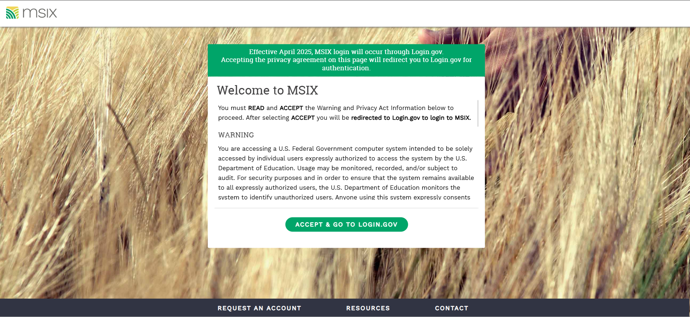

MSIX Overview
Notes:
Ben – 3 Minutes Total

Slide 7
MSIX Overview
MSIX is a web-based application that links State migrant systems to produce a single Consolidated Student Record containing the Migrant Education Program (MEP) minimum data elements (MDEs) to not only analyze national migrant trends, but also facilitate:
Enrollment
Placement
Credit Accrual
MEP Participation
Notes:
1 Min – Ben
As you know, migratory children move from place to place, often on short notice, and families may not have time to gather their children’s education and health documentation before re-enrolling them in a new school district. This can delay enrollment or result in misplacement in grade or course level. MSIX ensures that a migratory children’s academic progress is documented in a central system accessible wherever they go.
To do this, MSIX is a web-based application that links State migrant systems to produce a single Consolidated Student Record composed of minimum data elements, or MDEs. This not only allows for the generation and analysis of national migrant trends, but primarily assists authorized personnel to make informed decisions on enrollment, grade or course placement in a new school, accrual of credits towards graduation, and participation in the Migrant Education Program.
Statute: Part C of Title I of the Elementary and Secondary Education Act (ESEA) of 1965, as amended by No Child Left Behind Act of 2001(NCLB) – Sections 1304(b)(3) and 1308(b). Section 1304(b)(3) requires State Education Agencies (SEAs) to promote interstate and intrastate coordination by providing for educational continuity through the timely transfer of pertinent school records (including health information) when children move from one school to another, whether the move occurs during the regular school year.

Slide 8
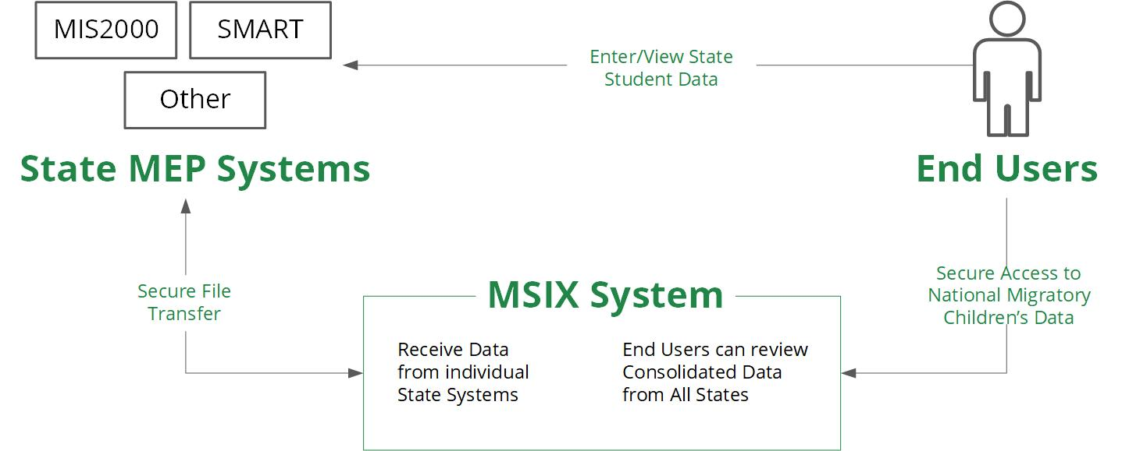
MSIX Overview | System Architecture
Notes:
0.5 Min – Ben
This MSIX System Architecture graphic displays how data flows between the State system, MSIX, and end users.
MSIX receives data through secure file transfers from the State MEP Systems to create the consolidated student record viewed by end users. MSIX currently does not support direct data entry, so the data you see in MSIX is a consolidation of the data in your State system. As such, the State system remains the authoritative source of data. It is important to keep your State data as accurate as possible and ensure that your State makes timely updates to MSIX so the data in MSIX is also as accurate as possible.

Slide 9

Poll Question #1
Do you know who in your State or region is responsible for setting up MSIX accounts, including creating new accounts?
Yes!
I think so
I don’t know
Notes:
1.5 Min – Ben

Slide 10
Move Notices and Data Requests
Notes:
Tyler – 19 Minutes Total

Slide 11
Move Notices | Uses & Types
Move To Notices
Move From Notices
Move From Notices notify recipients that a migratory child has moved out of the Move Notice recipient’s area and into the Move Notice sender’s area.
Move To Notices notify recipients that a migratory child has moved or is moving to the recipient’s area.
Important Considerations:
Users provisioned with the Secondary, Primary or Data Administrator roles can initiate a Move Notice.
Only Data Administrators can receive, reassign, or dismiss a Move Notice.
Users can send a single Move Notice for multiple children by utilizing the Multi-Move Notice feature on the My Lists page.
Notes:
2 Min – Tyler
Move Notices are a powerful tool for both inter and intra state coordination. At its foundation, a Move Notice gives you the ability to alert another State/district/school that a child will or has already changed their location. In your area, when a student is changing location, they are either Moving To or From your location…
As a result, there are two types of Move Notices in MSIX: Move To and Move From notices.
Move To Notices notify the recipient that a migratory child has moved to the recipient’s area. This type of Move Notice is critical to accelerating identification and recruitment efforts. The more information you can provide about the child or the move, the better! It’s especially helpful to include information about the district to which the student is moving and the family’s contact information, if that information is available, so that the recruiters in the new area can find the child. Move From Notices notify the recipient that a migratory child has moved out of the recipient’s area and into the move notice sender’s area.
As a recruiter, say you are working with a family who mentions they are moving tomorrow. You can log into MSIX on the spot via your phone and a send move notification to the appropriate State/District/Region as you are speaking with the family! Move Notices also allow you to log a history of notifications to help identify mobility patterns and to establish your network between States as you interact with other MSIX users.
Some important considerations: first, most user roles in MSIX can initiate a Move Notice. Only Data Administrators can receive, reassign, or dismiss these notifications, which should be routed accordingly if it is not done automatically. All MEP programs should establish procedures so that MSIX move notices are handled promptly.
The Move Notice functionality in MSIX also includes a correspondence feature, this is extremely valuable to providing additional information such as a family’s contact information so that the receiving area can more quickly and easily identify and recruit the family for enrollment in the MEP.
To initiate a Movie Notice, complete a Student Record Search, and open the record, then select “Move Notice” which will open a pop-up window for the request. From here, you can toggle between Move To and Move From Notices’. You can view all requests and correspondence in the Move Notice Worklist. Additionally, a demonstration video for MSIX Move Notices is available on the MSIX page in the Training Section under Videos.

Slide 12
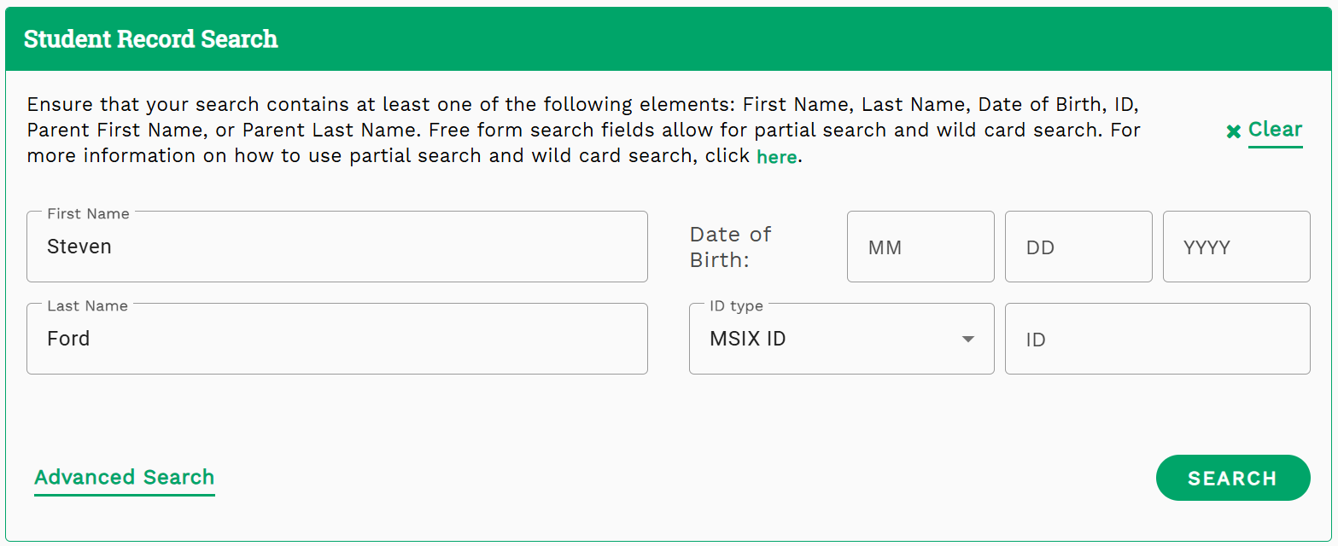
Move Notices | Student Record Search (1)
*Screenshot does not contain real data.
Notes:
0.5 Min – Tyler
Next, we will demonstrate the process of initiating a Move Notice by showing the most common way to access a student record. Please note you can also access a student record through worklist items, reports and students on your My Lists page lists. To begin, search for the student who will be or already has moved to or from your area.

Slide 13
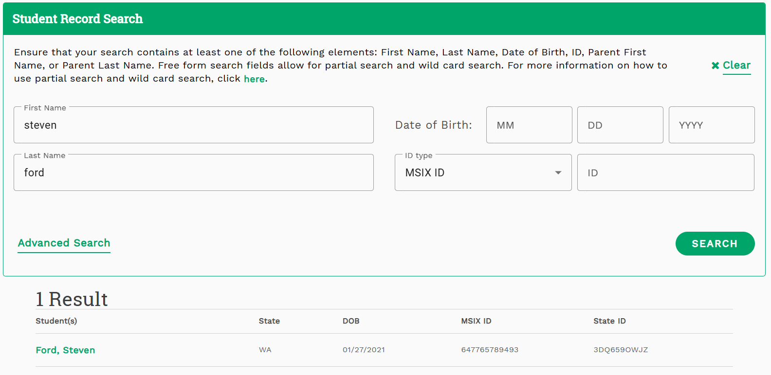
Move Notices | Student Record Search (2)
*Screenshot does not contain real data.
Notes:
0.5 Min – Tyler
Then, select the name of the student from your search results.

Slide 14
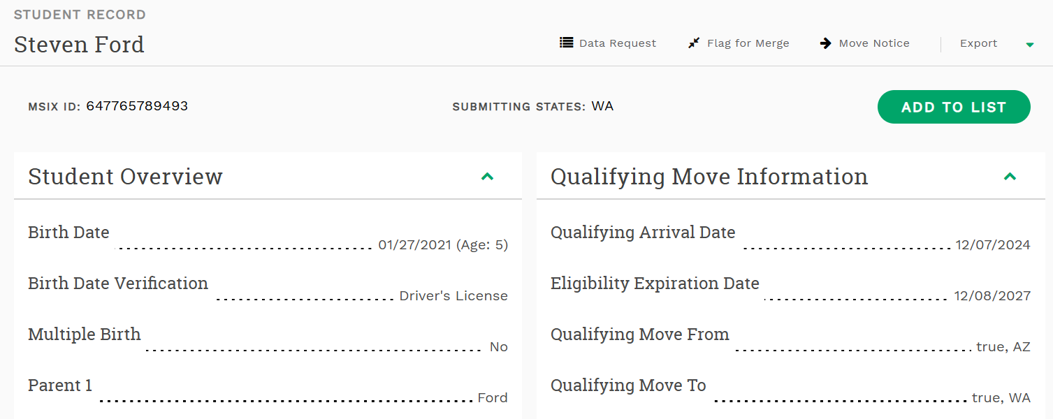
Move Notices | Initiating a Move Notice
*Screenshot does not contain real data.
Notes:
0.5 Min – Tyler
After selecting the student from the search results, you will be navigated to the Consolidated View of the Student Record for that student. In the upper-right corner you will see a link for Move Notice. When you select this link a pop-up modal will appear.

Slide 15
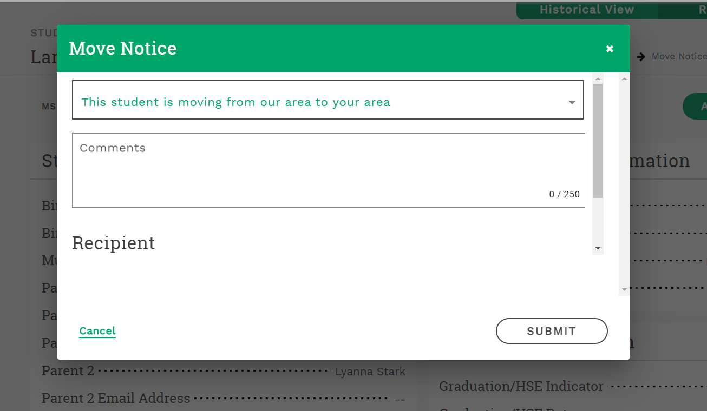
Move Notices | Move To
*Screenshot does not contain real data.
Notes:
1 Min – Tyler
If you are sending a Move To notice, select “This student is moving from our area to your area.”
After you have selected the type of Move Notice, it’s best practice to populate the comments field with any additional information that will be helpful for the recipient such as the type of qualifying work, the area the family is moving to, anticipated move date for the child, or if there are any siblings the recipient should know about. This information is valuable for not only coordinating inter and intra state communication but also assists both states in ongoing recruitment and data quality efforts by ensuring records are up to date.
As an important reminder, Move Notices stay within MSIX so PII information such as phone numbers can be transmitted securely.

Slide 16
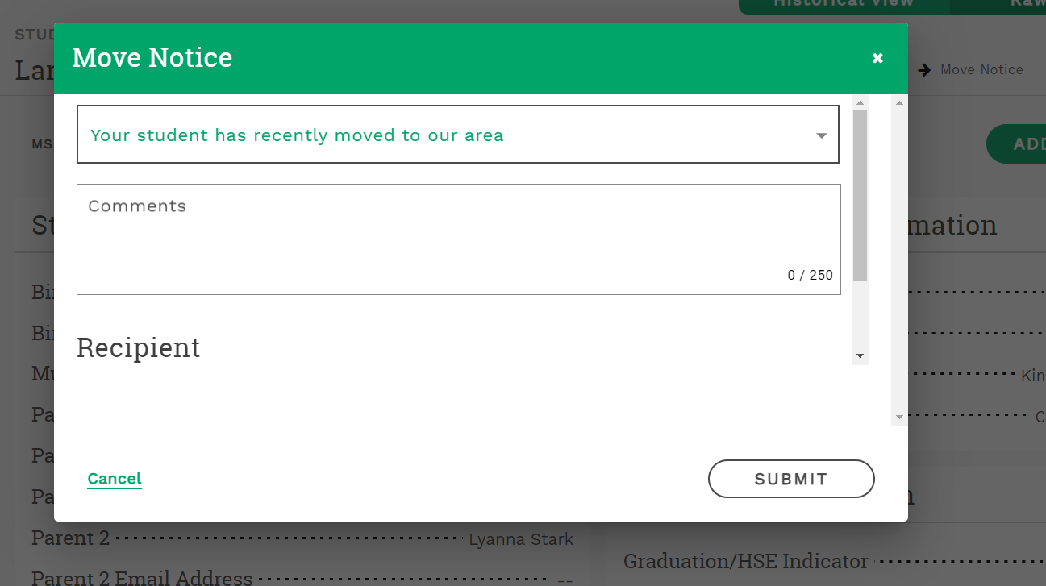
Move Notices | Move From
*Screenshot does not contain real data.
Notes:
0.5 Min – Tyler
On the pop-up modal, you will first select the type of move notice you are sending from the drop-down menu. If you are sending a Move From notice, select “Your student has recently moved to our area”.

Slide 17
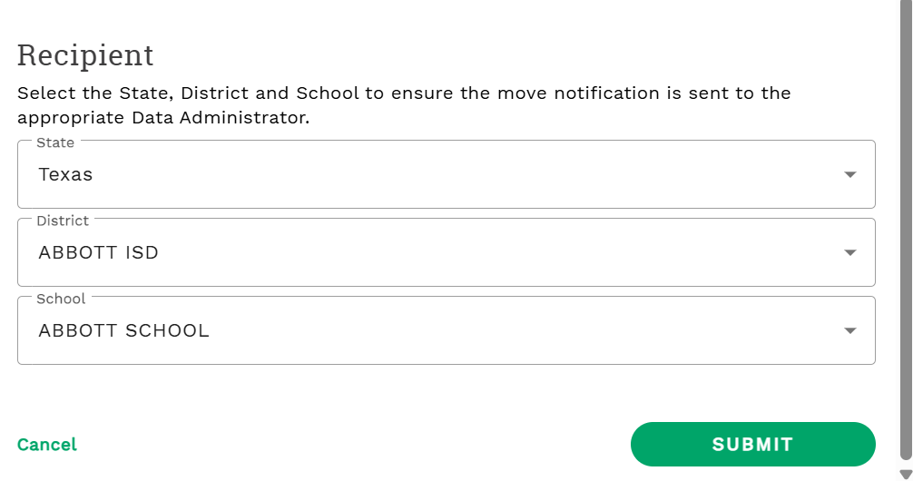
Move Notices | Recipient
*Screenshot does not contain real data.
Notes:
0.5 Min – Tyler
After selecting a move notice type, select the state, district, and/or school from the drop-down menu for the location the child is moving to or moved from, then select submit. Please note that the State field is mandatory, but the school and district fields are optional. If you are unsure of the exact location the migratory child is moving to, you can include potential locations to assist states with recruitment efforts, such as the town or region within the state.
Once the Move Notice has been submitted, MSIX will automatically assign it to the appropriate Data Administrator based on the receiving states regional and district structure. The Move Notice will also be given a Worklist ID.

Slide 18
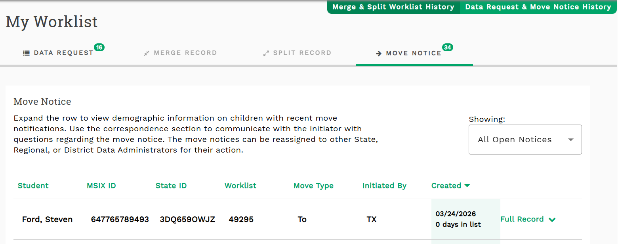
Move Notices | Worklist Page (1)
*Screenshot does not contain real data.
Notes:
1 Min – Tyler
After a Move Notice has been initiated, it will appear in the assigned Data Administrator’s queue on their My Worklist page under the Move Notice tab. You can view any active Move Notices you have initiated or have been assigned to you on this tab. The My Worklist tab will also display important information about a Move Notice including the student’s name, worklist ID, creation date, and a link to their student record page.
Please note that Worklist item tabs will be grayed out if there are no worklist items of that type assigned to you. If you are a Secondary or Primary User, Merge Record and Split Record worklist items cannot be assigned to you and will remain grayed out.

Slide 19
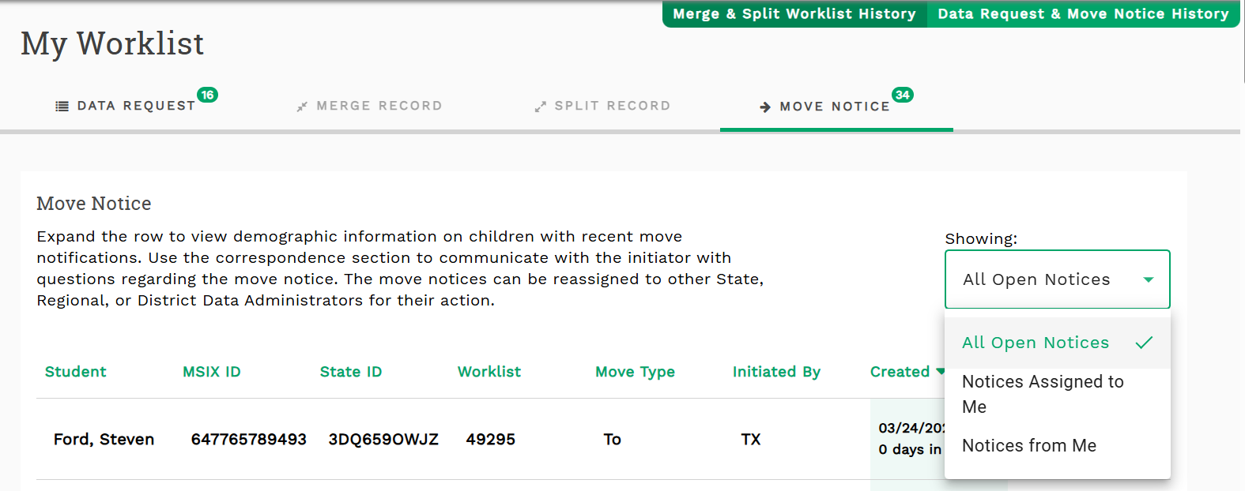
Move Notices | Worklist Page (2)
*Screenshot does not contain real data.
Notes:
0.5 Min – Tyler
Your Move Notice worklist queue also has a drop-down menu which allows you to filter and see only Move Notices assigned to you or created by you. This option is also present on the other worklist tabs.

Slide 20
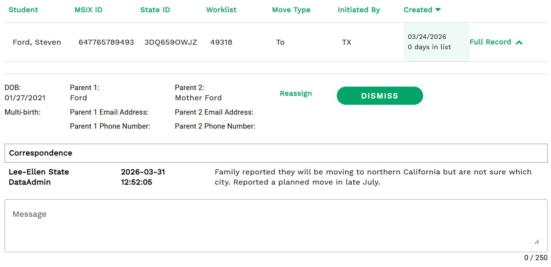
Move Notices | Correspond & Dismiss
*Screenshot does not contain real data.
Notes:
1 Min – Tyler
You can take action on Move Notices created and assigned to you from your worklist queue. To see the option to reassign and dismiss a move notice or communicate with other users assigned to the move notice, select the green caret next to “full record.” This image shows that the user has already expanded the drawer for a move notice.
Data Administrators may reassign Move Notices to other Data Administrators equivalent to their level of Data Administrator role.
Once you have handled a Move Notice according to the procedures in your state, you can use the dismiss button.
The dismiss button will remove a move notices from the queue for all users assigned to it, including the initiator. When dismissing a move notice, a pop-up modal will appear that allows you to add comments to communicate with users assigned to the move notice. We encourage you to add any applicable comments to close out any ongoing communication and let users assigned know the outcome of the move notice. Additionally, it is important to be mindful of timely dismissal of Move Notices, and to keep the initiator and other assigned data administrators informed of status of the Move Notice while it is being handled.
As a reminder, only data administrators have the ability to dismiss a move notice.

Slide 21
Three Move Notice Tips & Reminders
1
2
3
You can find the Data Administrator’s contact information from the “Move Notice and Data Request History”.
Follow your State’s procedures for dismissing Move Notices. Be careful not to dismiss any Move Notices before all appropriate dialogue has occurred.
Data Administrators with Primary or Secondary user role assigned can have the Primary or Secondary user role removed.
Notes:
1 Min – Tyler
Finally, here are some important tips and reminders when utilizing the move notice functionality in MSIX.
If a Move Notice has been in a Data Administrator’s queue for a long time, you can follow-up with the assigned Data Administrator by phone or email. You can locate their contact information on the Worklist History page in the workflow section.
Before dismissing any Move Notices, it is important to ensure you follow the policies and procedures your state has in place for dismissing Move Notices. Be careful not to dismiss any Move Notices before all appropriate dialogue has occurred between the send and receiver of the Move Notice.
If you are a Data Administrator with the Primary or Secondary User role assigned, you will be unable to see the dismiss button and dismiss Move Notices. To resolve this issue, please contact a user administrator in your state and request they remove the Primary or Secondary user role from your account.

Slide 22

Poll Question #2
What State/area do the MEP families you work with most often move to or move from?
Do you know MEP personnel in that State/area that you communicate with?
Notes:
1.5 Min – Tyler

Slide 23
Data Requests
Why send a data request through MSIX?
1
You should receive a response from the other State within four working days, per MSIX regulations
3
You can keep personal data secure within MSIX
MSIX keeps a log of the conversation tied to a student record
4
MSIX automatically routes your request to active Data Administrators
2
*34 § 200.85(b)(3)(iii)(A)]
Notes:
2 Min – Ben
Data Requests should be used to request additional information to serve a migratory child (e.g., final grades, updated course history). Let’s say a child arrives in your State and you notice the child’s record is missing current course history information such as Grade-to-Date or Clock Hours. Even though the child left in the middle of the semester, you can use the Data Request link on the student’s record to ask the sending States/Districts to submit this information to MSIX!
So, why should you use data requests in MSIX, as opposed to sending an email to someone in the other area?
You should utilize data requests in MSIX because MSIX regulations mandate a response back to you within four working days.
MSIX will keep a log of the correspondence, in case you need to refer to it in the future.
You can also keep children’s personal data secure. And once that data is in MSIX, it stays in MSIX. If you have a question about a student’s record, it’s very likely that someone else may have that same question as well. Using data requests to resolve your question ensures that that information stays in MSIX and is available to all MEP staff.
And finally, you should use data requests to ensure that your query is routed to all active data administrators who can respond to it. MSIX also does the work of identifying active data administrators in the area to which you are sending the Data Request, so you don’t have to find their contact information on your own!
To send a data request, complete a Student Record Search, and open the record, then select “Data Request” which will open a pop-up window for the request. You can view all requests and correspondence in the Data Request Worklist. Additionally, a demonstration video for MSIX Data Requests is available on the MSIX page in the Training Section under Videos.
*If you are a user administrator, it is important that your MSIX user accounts and roles are up to date so that the correct people receive Data Requests and Move Notices when they are sent from other areas.
*If you know it, you can also enter the District of Residence for the child instead of the School District. Some States will use this method because it will route the Data Request to the District Data Administrators in the District of Residence, which is helpful for obtaining information about preschoolers, OSY, and other children who may not be enrolled in a school at that time.

Slide 24
Data Requests | Initiating a Data Request
*Screenshot does not contain real data.
Notes:
0.5 Min – Ben
Also in the upper right corner of the Consolidated View of the Student Record you will see a link for Data Request. When you select this link a pop-up modal will appear.

Slide 25
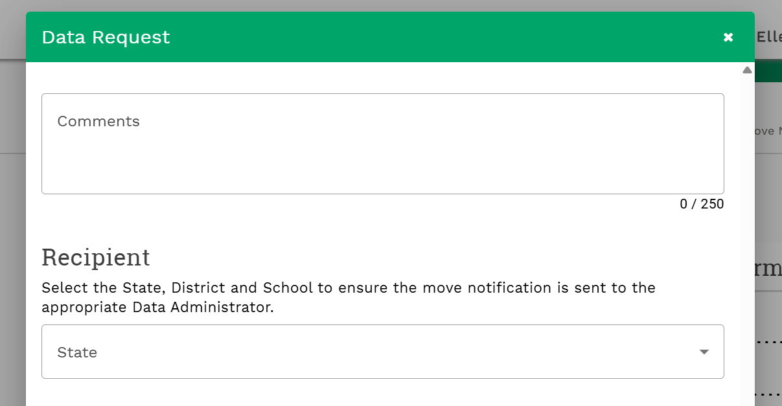
Data Requests | Comments
*Screenshot does not contain real data.
Notes:
0.5 Min – Ben
Enter any comments and the recipient information. For example, you might request the missing Course History information for a student from another state.

Slide 26
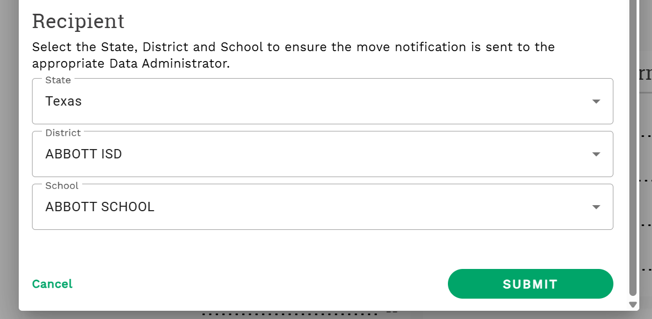
Data Requests | Recipient
*Screenshot does not contain real data.
Notes:
0.5 Min – Ben
Scroll down and enter the state, district and school you would like to send the request to and select submit.

Slide 27
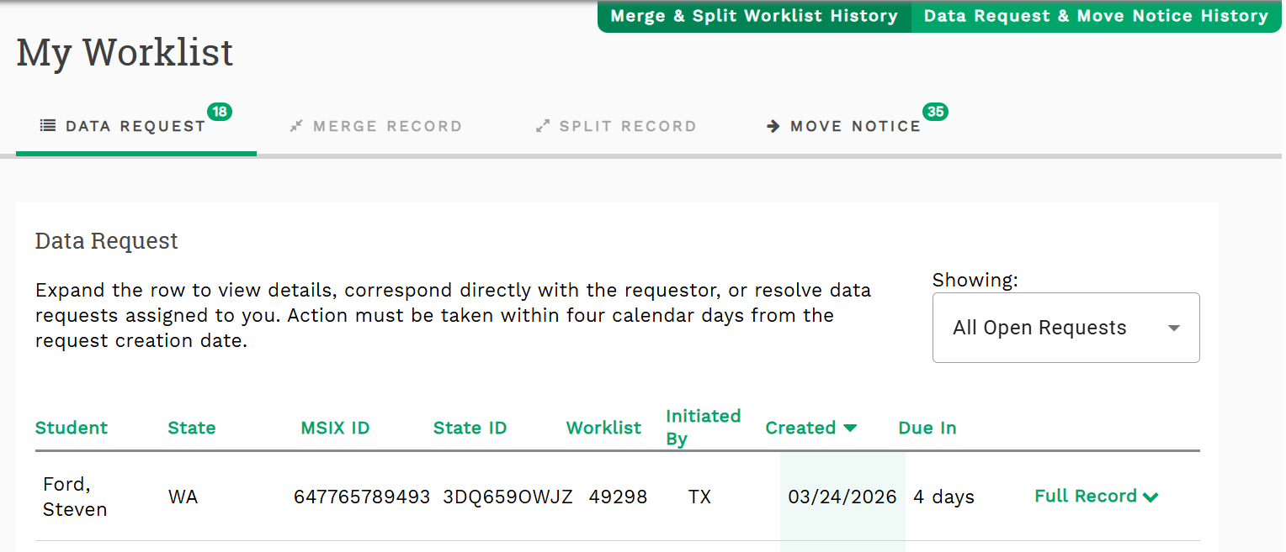
Data Requests | Worklist Page (1)
*Screenshot does not contain real data.
Notes:
0.5 Min – Ben
The data request will appear in the receiver’s Worklist with a Worklist number, creation date and due date.

Slide 28
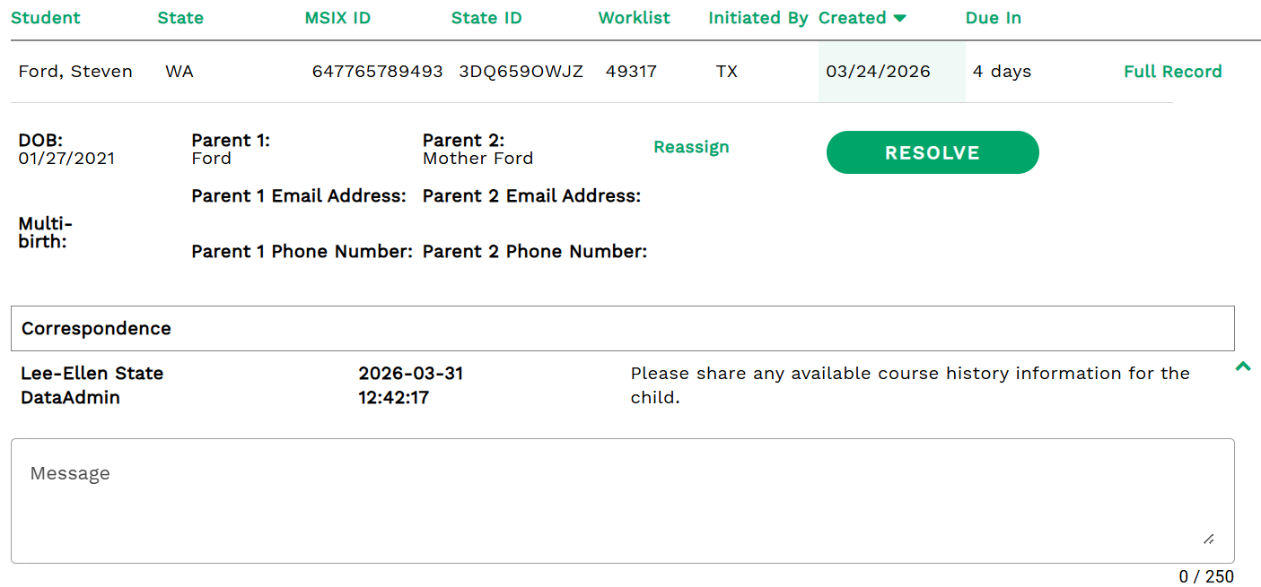
Data Requests | Worklist Page (2)
*Screenshot does not contain real data.
Notes:
0.5 Min – Ben
You can also send additional, secured correspondence with another MSIX user. Select the student name from your Worklist (for both Data Requests and Move Notices). You can enter a message to submit any questions regarding the student and their records.

Slide 29
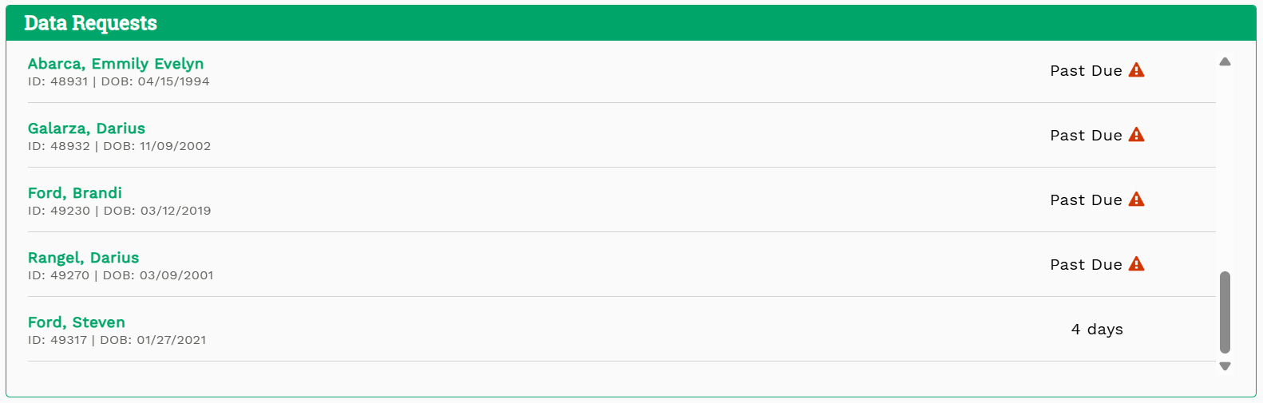
Data Requests | Home Page
*Screenshot does not contain real data.
Notes:
0.5 Min – Ben
The data request will also appear on the receiver’s home page along with the lifetime of the request.

Slide 30

Poll Question #3
What are your methods for collecting and transferring student records?
MSIX
Phone Calls
Emails
In-person
I don’t transfer student records
Notes:
1 Min – Ben

Slide 31
Data Request & Move Notice History (1)
*Screenshot does not contain real data.
Notes:
0.5 Min – Tyler

Slide 32
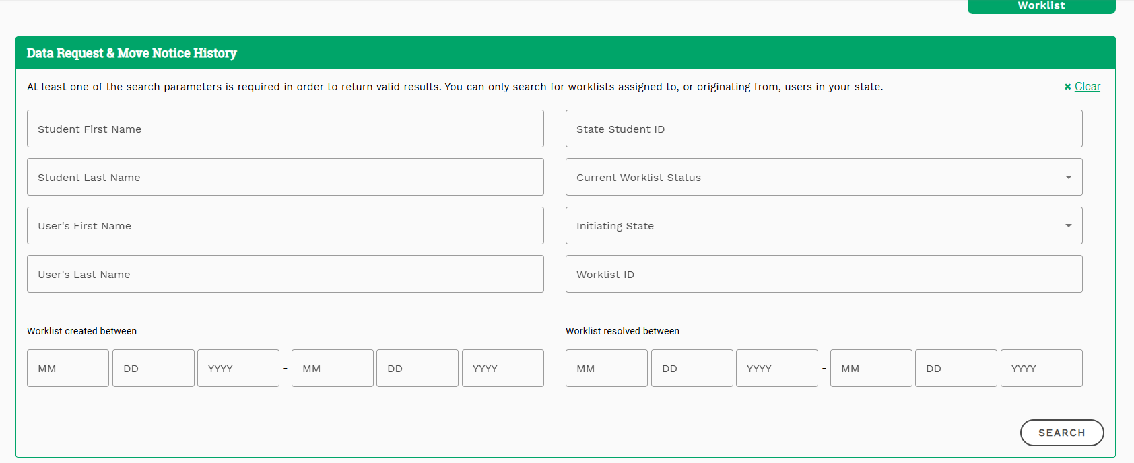
Data Request & Move Notice History (2)
*Screenshot does not contain real data.
Notes:
1 Min – Tyler

Slide 33
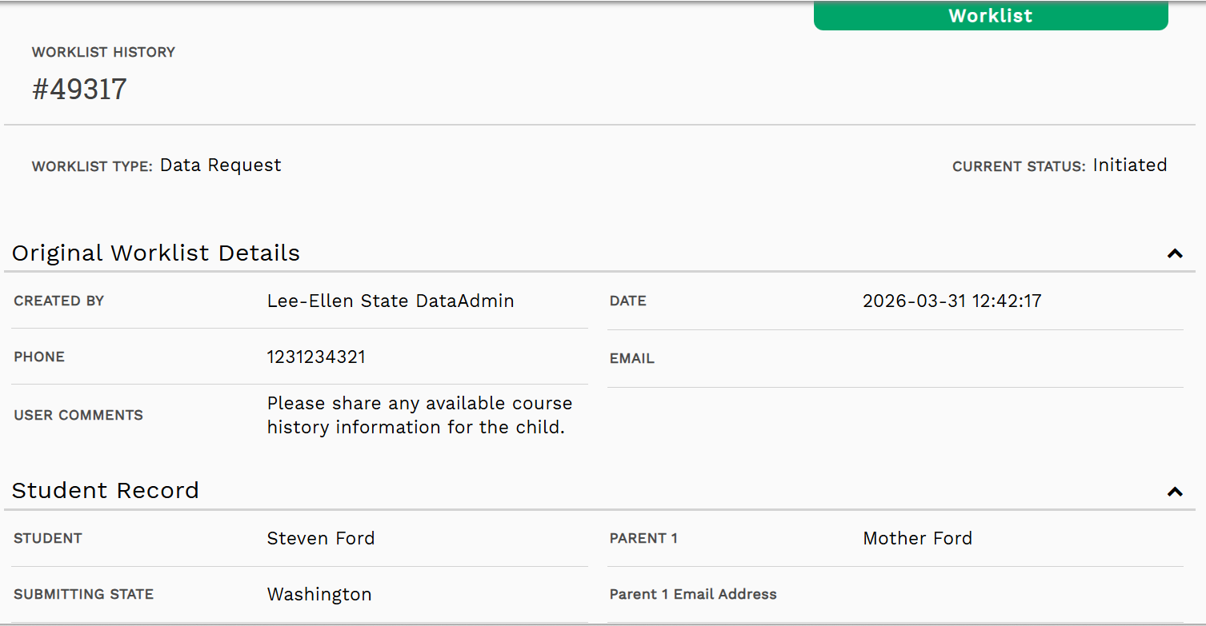
Data Request & Move Notice History (3)
*Screenshot does not contain real data.
Notes:
0.5 Min – Tyler

Slide 34
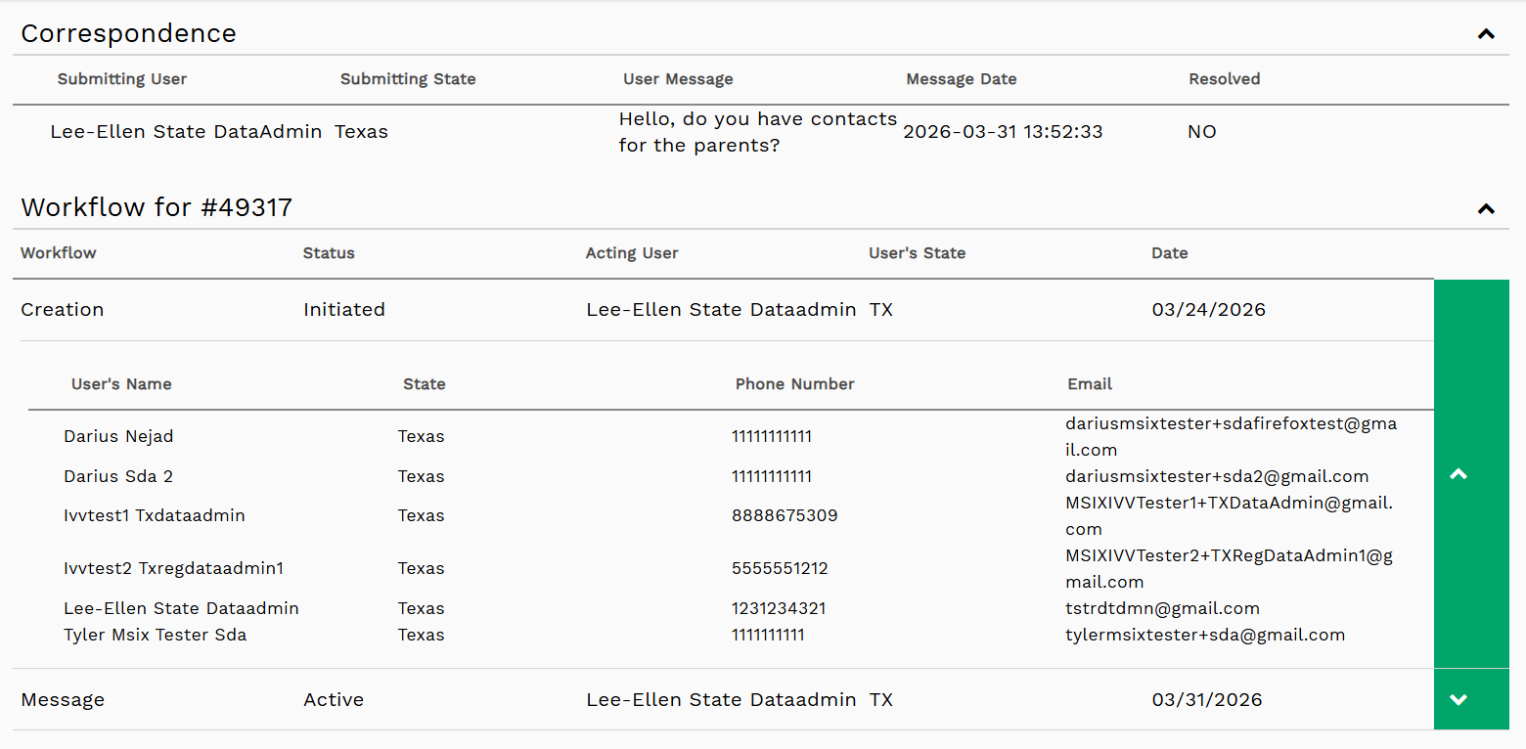
Data Request & Move Notice History (4)
*Screenshot does not contain real data.
Notes:
0.5 Min – Tyler

Slide 35

Guest Speakers
Notes:
Ben passes it off to Guest Speakers
[Placeholder for Guest Speaker Slides – 25-30 Minutes Total]

Slide 36
PA – Obstacles
Obstacles
  Secondary staff
    Lack of follow up once notice is submitted
      Didn’t know to check worklist to see if any correspondence was needed
      Lack of information sent to receiving state or received from sending state
      Staff turnover
  Admin – No Control to edit if sender was not an administrator (regional or state)
  Lack of response from other states
    Limited reply
    Lack of contact information for the families on the move
Notes:
What
Here we’re looking at the key obstacles PA faced with move notices. These included limited communication and follow‑up when notices were initiated by secondary users, missed worklist items, incomplete information, and a lack of response from other states. Together, these gaps often led to delays and confusion for staff and receiving states.
How did we know there was obstacles?
NY reached out to discuss concerns with limited communication and follow‑up from PA. Through those conversations, we reviewed specific move notices, identified where breakdowns were occurring, and recognized the need to modify our process.
Why
PA knew addressing these obstacles was necessary to improve communication, provide clearer and more complete information, and ensure move notices were handled consistently and efficiently.

Slide 37
PA – Modifications
Modifications
  Regional Admin – Data Specialist Control notices
    Secondary Staff – SSS/Recruiters notify DS to create move notice
    DS will create, submit and follow through until dismissal with other states
  Building relationships with other states
    Open communication lines to reach out when other questions arise
Notes:
What
Here we’re looking at the modifications PA made to the move notice process to address the obstacles that were identified.
How
To improve results, PA centralized responsibility with the Data Specialist. Data Specialists have roles that require them to frequently access MSIX in the course of their duties, so they are able to see and respond to move notices more quickly. Secondary Staff notify the DS when a move occurs, and the DS creates, submits, and follows up on move notices through completion. This change improved accountability, communication, and consistency, and helped strengthen working relationships with other states.
Why
By directly linking the problems identified to practical modifications, PA established a more reliable process. These changes set the foundation for the clear steps and successful outcomes that are shown in the next slides.

Slide 38
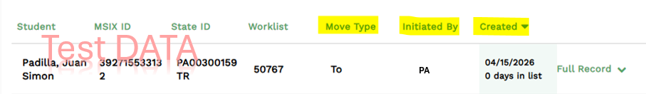
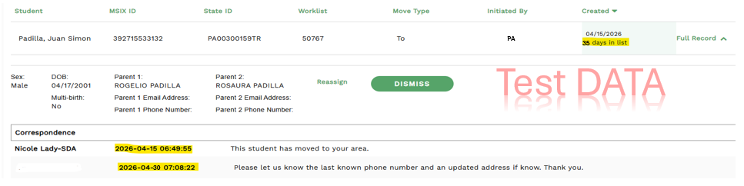
Secondary User Creation With Obstacles
Move notice created by secondary user showing move type, initiated by, and creation date.
Obstacle example of a move notice with missing information and no follow‑up
Notes:
What
This slide shows an example of a move notice created by a secondary user that illustrates the obstacles PA was experiencing. The notice includes missing or incomplete information and shows no follow‑up activity after submission.
How
When secondary users created move notices, required details were sometimes left out, and follow‑up actions were unclear. Because secondary users were not working in MSIX daily, worklist items and correspondence were often missed, which led to delays and unanswered requests from receiving states.
Why
This example helps explain why process changes were necessary. Seeing these gaps clearly supports PA’s decision to adjust roles and centralize responsibility, which directly improves accuracy, follow‑up, and communication you’ll see on the next slide.

Slide 39
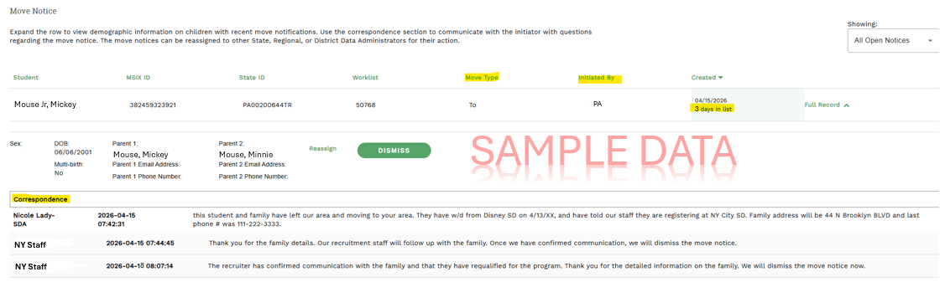
DS Creation After Successful Modifications
MSIX move notice demonstrating Data Specialist follow‑up and successful completion
Notes:
What
This slide shows a move notice created by the Data Specialist that reflects the improved process. It includes complete information, documented follow‑up, and clear communication with the receiving state.
How
With the Data Specialist responsible for creating move notices, details are entered accurately from the start, and worklist items are monitored daily. The DS follows up with receiving states, responds to questions, and documents correspondence directly in MSIX, ensuring nothing is missed.
Why
This example demonstrates the positive result of the process change. By centralizing responsibility, PA improved communication, reduced delays, and strengthened collaboration with other states.

Slide 40
NY- Recruitment Obstacles When Receiving MSIX Move Notifications
Limited or no information within the move notification itself.
  This student moved to your state. No contact information provided, or a phone number that is out of service. Now what?
Delayed or no reply from the state sending the notification.
Move notification includes a phone number, but no other information.
  Who to assign this referral to?
Received a move notification with accurate contact information, but the family or student won’t pick up the phone and/or come to the door.
Family or student is no longer interested in participating in the program.
NY recruiter interviews the family, but makes a different eligibility determination than the sending state did.

Slide 41
NY- Potential Solutions to Obstacles
Limited or no information within the move notification itself.
  This student moved to your state. No contact information provided, or a phone number that is out of service. Now what?
  Reach out to the individual who sent the move notification. Especially if this is a state that you receive notifications from often, work together to set up a system for receiving and sending notifications, timelines for follow up, and what information is needed in order to make a timely and effective follow up. NY and PA have built a great relationship over time, and this effort has resulted in many students being identified and recruited in both states. Remember, more info is always better, but every referral is a good referral!
Delayed or no reply from the state sending the notification.
  Building relationships(Interstate Coordination) with other states is key. We hope that the individual sending move notices follows up, but if not, who do you know from that state that you can reach out to? Participating in CIGS like IDRC helps with relationship building. Belonging to other organizations such as NASDME and IMEC offers other interstate coordination opportunities and helps build relationships.

Slide 42
NY- Potential Solutions to Obstacles (1)
Move notification includes a phone number, but no other information.
  Who to assign this referral to?
  In NY, we have an experienced recruiter who is very skilled in locating families and students with limited information. She is in charge of following up on referrals sent to NY with no address. Assign task to a recruiter within your state, and train on conducting effective remote recruitment.
Received a move notification with accurate contact information, but the family or student won’t pick up the phone and/or come to the door.
  Reach out to sending state to see if they can help make the introduction. Find materials or resources to share with family, and build trust over time. Don’t give up!

Slide 43
NY- Potential Solutions to Obstacles (2)
Family or student is no longer interested in participating in the program.
  Try to find a service or resource that hooks the family or student’s interest. Follow up after some time to see if they have changed their mind. Reach out to the sending state to find out more information about the family’s needs.
NY recruiter interviews the family, but makes a different eligibility determination than the sending state did.
  Each state must make their own individual eligibility determination. We cannot automatically find a student eligible in New York State just because they were determined eligible by a different state. If a student is determined to not be eligible within your state, be sure to follow up with the sending state to let them know.

Slide 44
MSIX Notifications & Data Requests Between MI & FL

Slide 45

It Started with a MI Proposal
How can we improve the response rates for MSIX data requests from Polk & Hillsborough Counties, FL?
Are MSIX Move Notices being acknowledged?
31%
Notes:
In MI the local MEPs are offered the opportunity to apply for funds to cover a demonstrated MEP-specific need that is unable to be met through the allocation. One local district identified the need to collaborate with a couple of counties in FL with the highest concentration of shared migratory children and youth to better understand their MSIX procedures and how we could improve our coordination of services, specifically how can we improve the response rates for MSIX data requests from Polk & Hillsborough Counties and are the MSIX move notices we send even being looked at? Afterall, approximately 31% of the migratory children and youth that come to MI are from FL! The proposal was accepted and planning began by reaching out to Luci Valdivia-Sanchez who connected us with Dee Dee Wright and Carol Mayo.

Slide 46
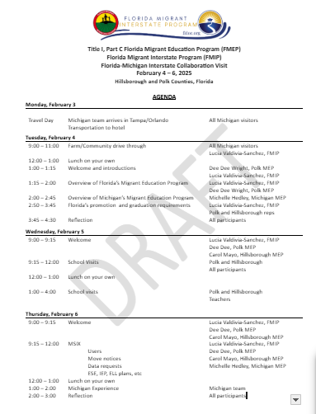



The FL Team Prepared The Visit
Notes:
MI decided it wasn’t enough to just meet virtually, but that an in-person visit was necessary. The FL team from Hillsborough and Polk Counties along with Luci planned the visit.

Slide 47

The Outcome
Sending MSIX Move Notices to the State got MI no responses
  Solution → be more specific; narrow down to at least county/ISD
Requesting testing data in data requests = no response
  Solution → reach out to district advocates instead
  Solution → FL shared list of district advocates for the state with MI representatives
Recommendation when you aren’t getting responses
  Solution → reach out to the contacts listed in MSIX!
Notes:
After doing some school visits and even picking strawberries alongside some H2A workers, we got down to business and talked about the issues. MI was sending MSIX move notices but getting no responses. Sometimes they didn’t see enrollments in MSIX for children & youth they sent move notices about which concerned them. The solution was that MI needed to narrow down who they were sending the move notices too. Many times the notices were just being sent to the state of FL which made it difficult for Luci to and her staff to figure out where to send them. MI was also sending data requests for test results and not getting any response. As we dug down into this barrier we found that the people receiving the data requests didn’t have access to the test data information so they weren’t equipped to answer the data requests. The solution was that FL staff provided MI staff with a list of all the district advocates and their contact information so MI can reach out to them directly when testing data is needed. The overall take away is, when you aren’t getting responses from the notifications and requests you are sending in MSIX, reach out to the contacts listed in MSIX and start a conversation! You’re sure to come up with a solution!

Slide 48

Q&A
Ask us any questions you have! Feel free to also ask questions in the chat
Notes:
5-10 Min – All

Slide 49


Thank You!
May 19, 2026
Notes:
Ben

