Slide 1
Welcome
The webinar will begin shortly. If you are joining as a group, please use the chat for roll call (enter your region or direct-funded district and your names).
Thank you!
Notes:
Lead: Victor
Time: 2 mins. before webinar starts
Talking Points: Read slide

Slide 2
Migrant Student Information Network:
New User Interface
May 4, 2026
10:30 a.m. to 12:00 p.m.
Notes:
Lead: Victor
Proposed date and time, pending approval

Slide 3
Housekeeping
Please mute your microphone during the session.
Use the Q&A function to enter your questions.
We also have Q&A slides throughout, so you can ask questions verbally if you prefer.
The PowerPoint for this presentation will be posted on the California MEP Help Center, for those who could not attend today.
Notes:
Lead: Victor
Time: 1 min.
Talking Points:
(Read or paraphrase bullets)

Slide 4
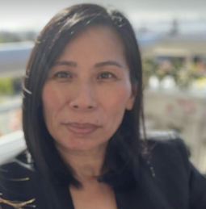


Welcome and Introductions
Session Presenters
Loan Tran, Education Research and Evaluation Consultant, California Department of Education (CDE)
Jose Valencia, Migrant Student Information Network (MSIN) Lead, WestEd
Victor Garibay, MSIN Specialist, WestEd
Notes:
Lead: Loan
Time: 3 min
Talking Points:
Welcome participants.
Facilitators introduce themselves.
Quickly get a sense of what roles are represented (e.g., ask participants to raise their hands as the facilitators mention certain roles –administrator, coordinator,, data specialists, recruiters, other roles)

Slide 5
Session Objectives
Participants will
learn why a new user interface (UI) was built for the Migrant Student Information Network (MSIN) system,
become familiar with changes that affect all user roles in MSIN,
become familiar with key changes that affect Data Specialists,
become familiar with important changes in the Certificate of Eligibility (COE) component that affect Recruiters, and
review suggested next steps to prepare for the new UI rollout on May 18th.
Notes:
Lead: Loan
Time: 1 min
Talking Points:
(Read or paraphrase bullets)

Slide 6
New User Interface
Notes:
Transition slide
Lead: Jose

Slide 7
Why Is MSIN Changing?
In a nutshell, security.
The MSIN system we use today was built 10 years ago. Meanwhile, the cybersecurity landscape has evolved rapidly, with new threats appearing all the time. MSIN needed a significant upgrade to keep data safe.
Notes:
Lead: Jose
Time: 1 min
Talking Points:
(Read or paraphrase bullets)

Slide 8
Which Aspects of MSIN Are Changing?
All pages and windows that users interact with are new. These touch points are called the User Interface (UI).
However, the MSIN database will remain unchanged, meaning that existing data will still be there.
MSIN is essentially getting a new “body” or “shell” for better protection but underneath the data remains the same.
Notes:
Lead: Jose
Time: 3 min
Talking Points:
(Read or paraphrase bullets)
The new UI is built with an up-to-date framework that incorporates current best practices to improve security.
If you would like to know more, you can google “What is 3-tier architecture?”

Slide 9
Changes Affecting All User Roles
Notes:
Transition slide
Lead: Jose

Slide 10
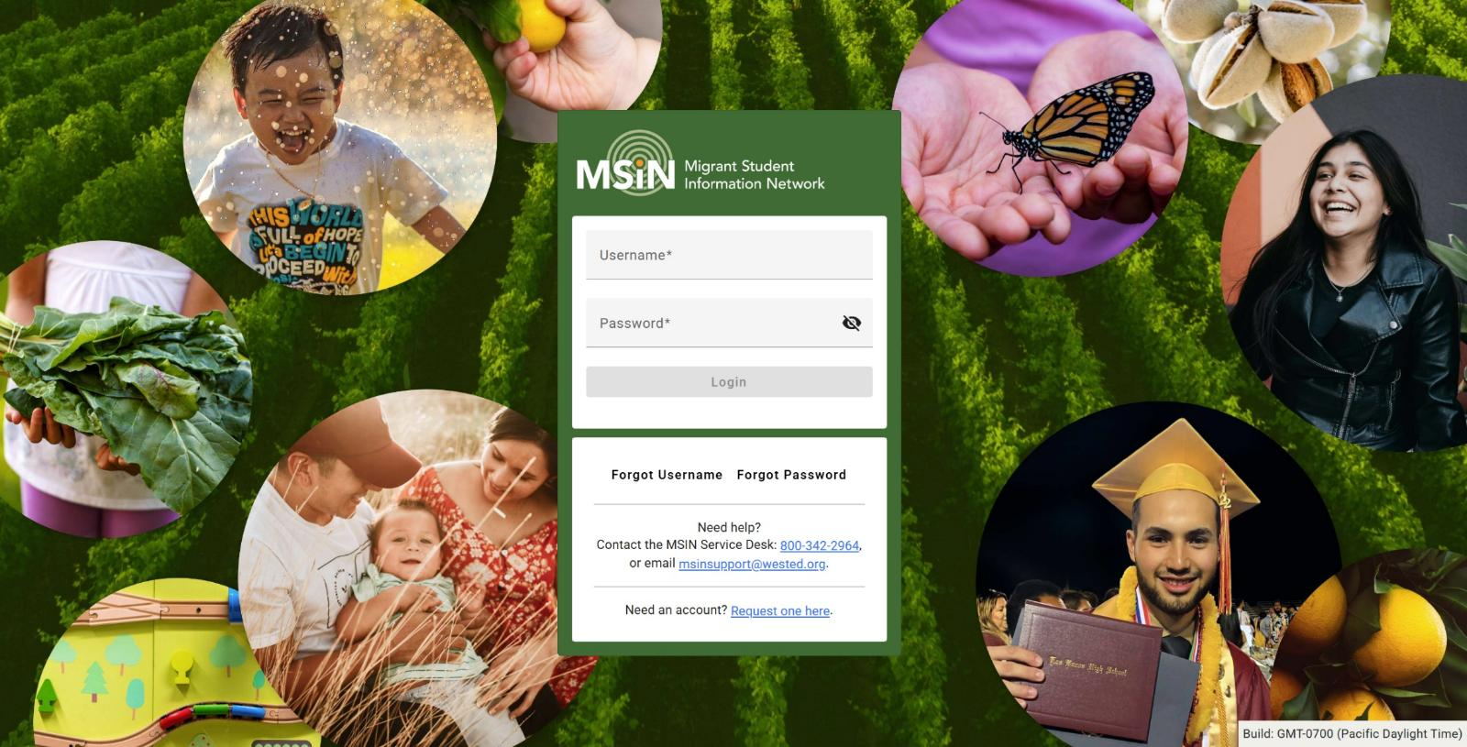
Login Page
The login page looks different but has the same features.
Notes:
Lead: Jose
Time: 1 min
Talking Points:
(Read or paraphrase intro text)
I will demonstrate the features on the Login Page after just two more slides.

Slide 11
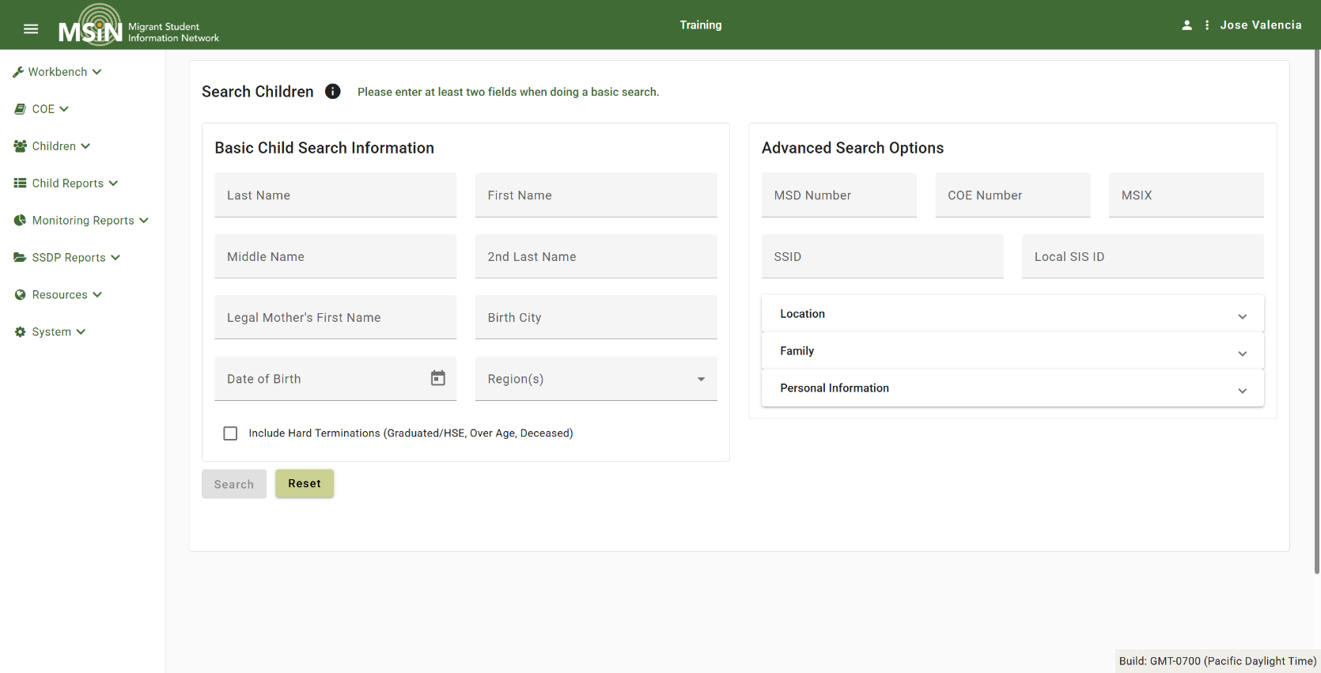
Landing Page
The first page users see after signing in is the Search Children page.
Notes:
Lead: Jose
Time: 1 min
Talking Points:
(Read or paraphrase intro text)
The landing page in Old MSIN is a basic communications dashboard.
In New MSIN, you land on the Search Children page.
“So, if the old communications dashboard is gone, how can you find documentation, guides, and release notes?”
Going forward, all user guides, reference documents, and update information will be posed in the California MEP Help Center.
[Next slide includes demonstrations using this page, Search Children.]

Slide 12
Reduced Vulnerability
Search results, report tables, and child lists do not persist in memory or in the browser, which improves data security.
Example
A user searches for a child on the Search Children page and the search results show several child names and related data.
When the user navigates to another page, their search results will be cleared from memory.
Implications
If the user navigates back to the Search Children page, the previous search selections and results will be blank.
While this is an improvement in terms of data security, some users may find it less convenient until they adapt.
Notes:
Lead: Jose
Time: 12 min
Talking Points:
(Read or paraphrase content)
Demonstrations:
Share Login page
Demonstrate buttons (forgot username; forgot password) and account request form
Mention that dev team re-activated accounts in TrainingMSIN (and active account in prod that had a matching account in TrainingMSIN was rea-activated). You may need to reset your password in TrainingMSIN.,
Go to Search Children.
Demonstrate example child search (with dummy child data).
Demonstrate how to select a date range (DOB) – All date range fields work in the same way.
Show the child record modal for a dummy child.

Slide 13
Highlights for All Users
To improve security, MSIN’s new UI was built using a modern development framework and current best practices.
Although pages and windows look different, most features work in the same way as before.
Sensitive data is not stored in memory or the browser.
Search results, tables, and child lists do not persist when users navigate to different pages.
Notes:
Lead: Jose
Time: 1-2 min.
Taking points:
(Read or paraphrase content)

Slide 14
Questions and Answers
Notes:
Q&A slide
Time: ~5 min

Slide 15
Changes Affecting Data Specialists
Notes:
Transition slide
Lead: Victor

Slide 16
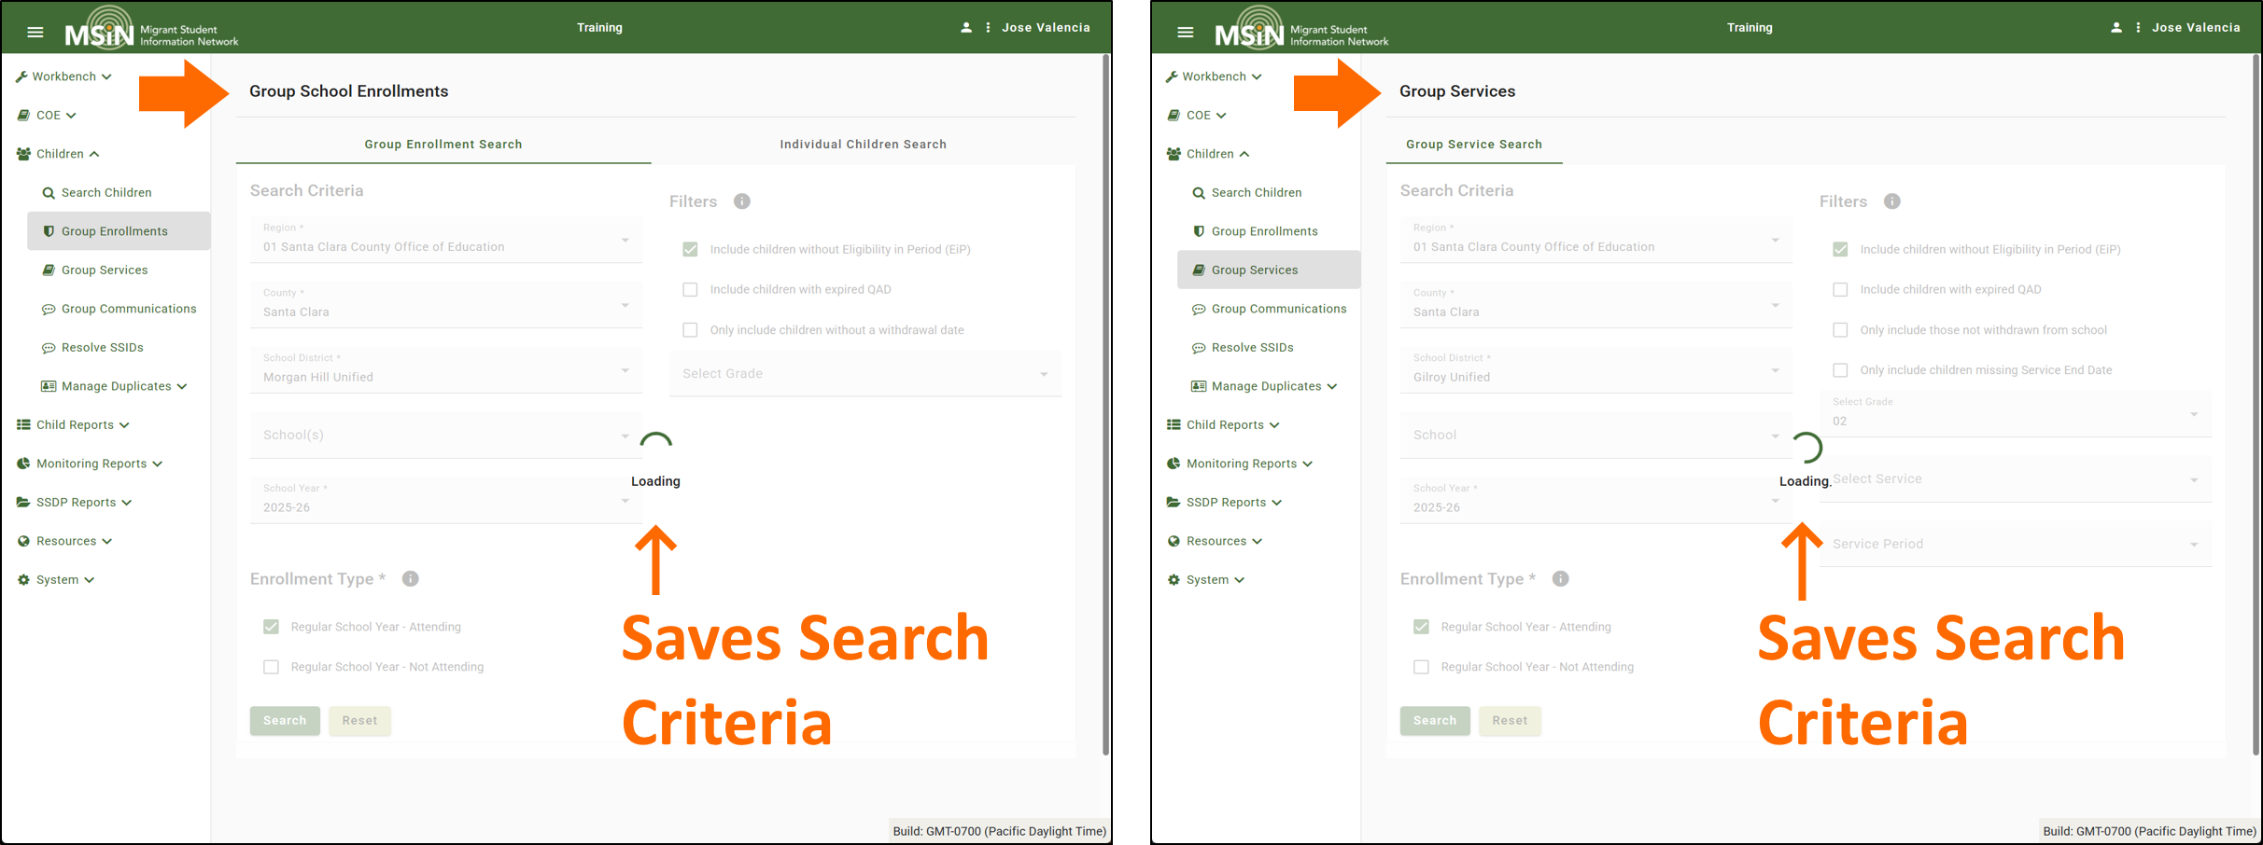
Entering Data for Groups
Although search results no longer persist in memory, the Group pages do save Data Specialist’s search selections, so they can re-create the same child lists more easily, as needed.
Notes:
Lead: Victor
Time: 1 min
Talking Points:
(Read or paraphrase intro text)
“On the left is Group Enrollments; on the right is Group Services. As we will see in the demonstrations, all three “Group” pages save the user’s search criteria.”

Slide 17
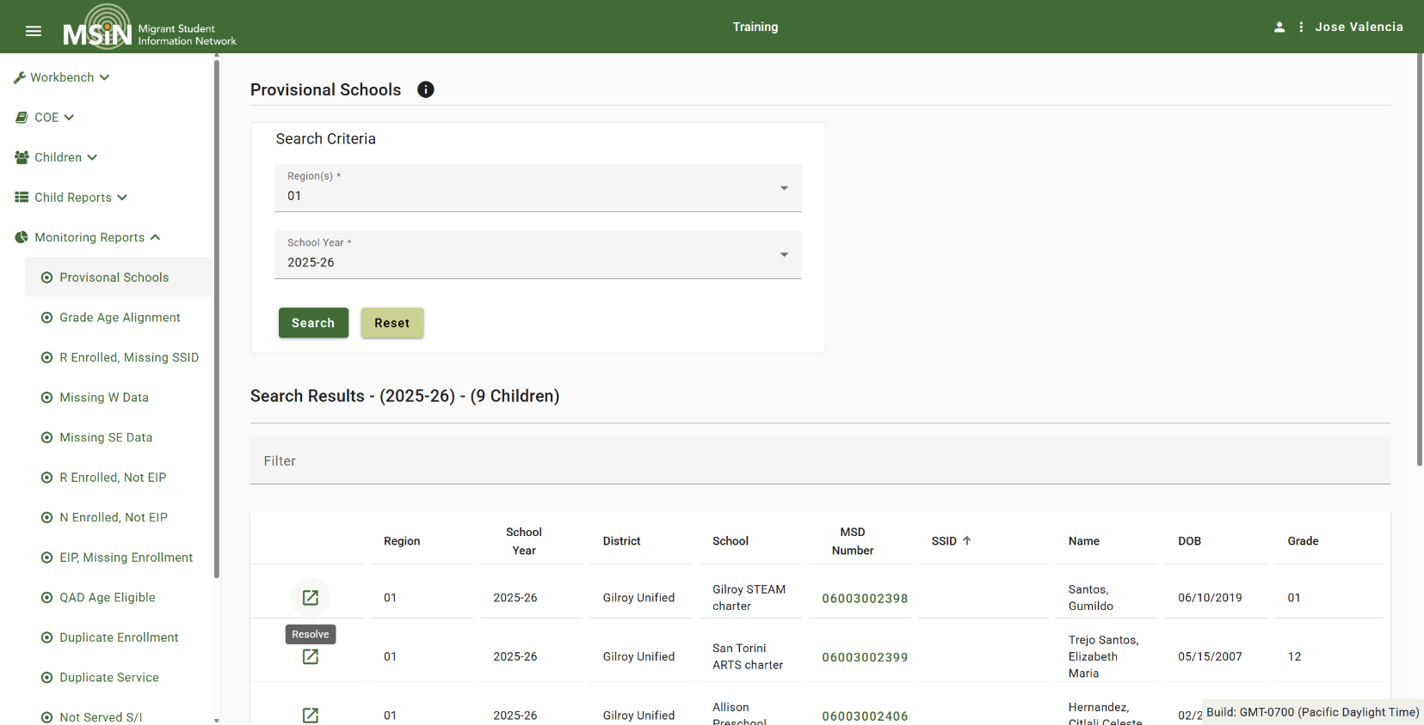
Provisional Schools
The Provisional Schools workflow was streamlined into a report.
Notes:
Lead: Victor
Time: 15-18 min
Talking Points:
(Read or paraphrase intro text)
Demonstrations:
Share screen with Group Enrollments (dummy child data)
Demonstrate how search selections are saved and restored.
Demonstrate opening a second tab to avoid navigating away from search results (as a workaround).
Go to Group Services and briefly demonstrate how search selections are saved.
Demonstrate workaround (when a child they expected is not on the list) – Open separate tab with Search Children…
Go to Group Communications and briefly demonstrate how search selections are saved.
Also show second tab
Go to Provisional Schools Report
Demonstrate how to resolve a school (dummy data)
Even though the appearance is different, the process is the same.
When a school cannot be resolved (new school), users should contact the MSIN Service Desk.

Slide 18
Highlights for Data Specialists
Group Enrollments, Group Services, and Group Communications pages do save the user’s search selections, to help them re-create child lists easily.
Data Specialists can open additional tabs to compare information on different pages. But remember to close additional tabs after use, to avoid confusion.
Data Specialists can now resolve Provisional Schools directly in a report, found under the Data Monitoring Reports menu.
Notes:
Lead: Victor
Time: 2 min.
Taking points:
(Read or paraphrase content)
Note: If you regularly export large files and import/ingest the data into your own local system, there are a couple of things to be aware of. First, the CSV export in the Enrollment Report may have minor formatting changes. Second, the Excel export is now in an Excel format (not XML). Please do test runs in the Training MSIN site to get an idea of how these changes may affect you.

Slide 19
Questions and Answers (2)
Notes:
Q&A slide
Time: ~5 min

Slide 20
Changes Affecting Recruiters
Notes:
Transition slide
Lead: Jose

Slide 21
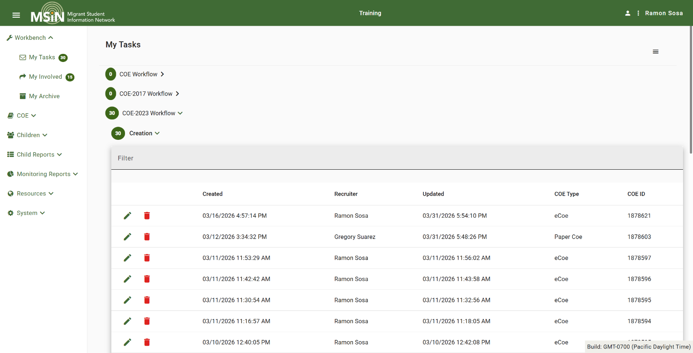
Streamlined COE Workflow
Local Worksheets is gone. Any eCOE or Paper COE you create goes directly to your My Tasks folder.
Notes:
Lead: Jose
Time: 3 min
Talking Points:
(Read or paraphrase intro text)
Walk through a comparison of how this works relative to the old system.

Slide 22
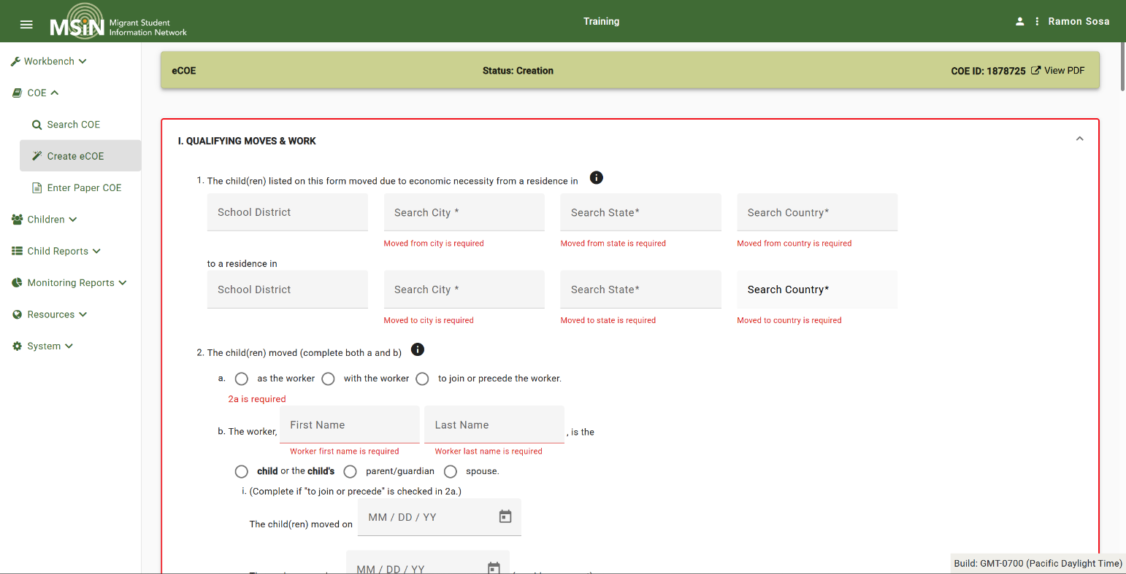
Reminders for Required Fields
The new COE page shows reminders by default and removes them individually as the user enters the required information.
Notes:
Lead: Jose
Time: 3 min
Talking Points:
(Read or paraphrase intro text)
Walk through a comparison of how this works relative to the old system.

Slide 23
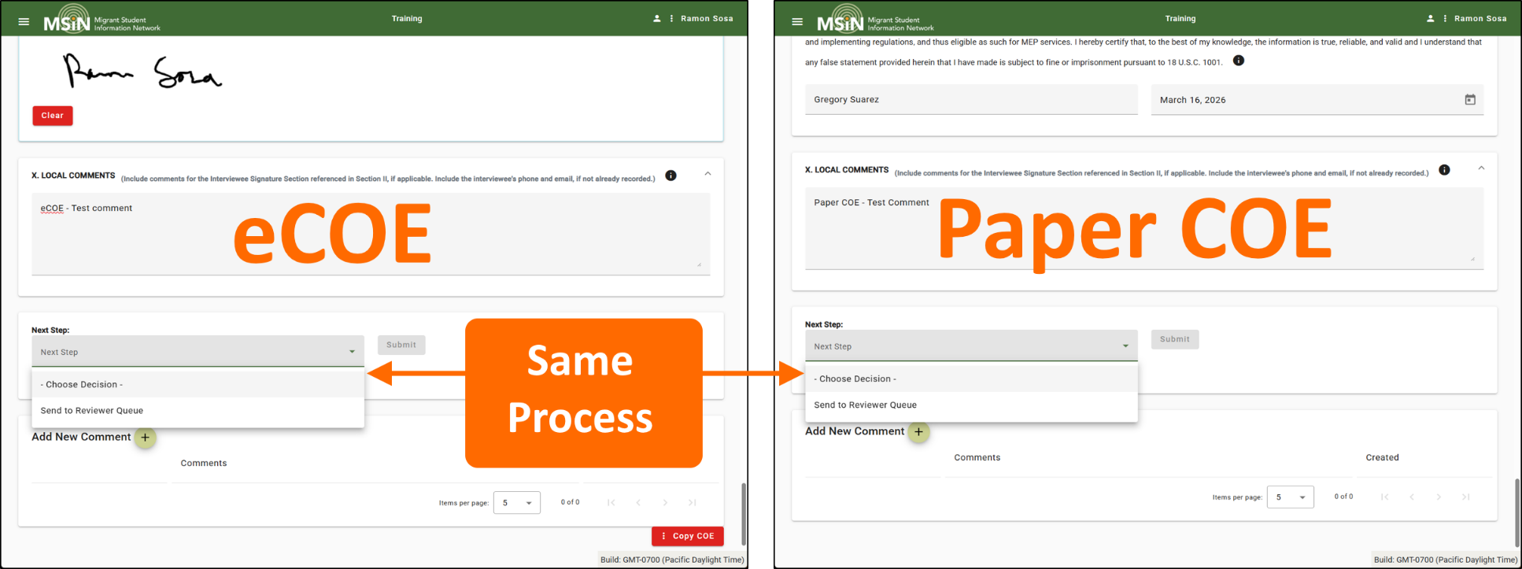
Uniform COE Handoffs
For both eCOEs and Paper COEs, Recruiters now use a Next Step drop-down to submit them for review.
Notes:
Lead: Jose
Time: 15-20 min
Talking Points:
(Read or paraphrase intro text)
“On the left is an eCOE; on the right is a Paper COE. Notice that we use the same process to submit either type.”
Demonstrations:
Share screen and create an eCOE.
Demonstrate how the eCOE gets saved automatically to My Tasks (and continuously saves to the cloud, not locally).
Demonstrate that creating a Paper COE follows the same exact workflow.
Show that COE type (eCOE and Paper) is a new column.
Show that COEs get an initial ID; the COE number is assigned when it is transitioned to Review state.
Open a partially started COE.
Demonstrate how the required field reminders work.
Show that saving happens seamlessly, with data stored in the cloud (not locally).
Demonstrate that adding child and school data is almost the same (share tips).
Show that the Save/Checkform button and associated functionality is gone.
Demonstrate how to confirm that all COE data is truly saved.
Open the My Tasks folder
Demonstrate how an eCOE is transitioned to Review state (i.e., the Reviewer Queue).
Next, open a Paper COE and show that the process is now exactly the same for Paper COEs.
For both types, they are assigned a COE number after they are submitted for review (transitioned to Review state).
As before, both eCOEs and Paper COEs get copied into the user’s My Involved folder after submission.

Slide 24
Highlights for Recruiters
The workflow for creating, managing, and completing eCOEs and Paper COEs is now simpler overall and the same for both types.
COE content is continuously saved in the cloud, rather than in the browser.
Reminders for required fields are shown as the Recruiter completes the COE, rather than listed at the end.
Both COE types are now submitted in the same way.
Notes:
Lead: Jose
Time: 2 min.
Taking points:
(Read or paraphrase content)

Slide 25
Questions and Answers (3)
Notes:
Q&A slide
Time: ~5 min

Slide 26
Next Steps
Confirm you have access to the Training MSIN site (https://trainingmsin.wested.org), which has been updated with the new UI.
Start practicing on all the pages you use regularly.
If you find a bug that prevents you from completing your practice work, consult with a colleague to see if they are experiencing the same issue.
Please contact the MSIN Service Desk if you confirm that a bug is blocking your work.
Notes:
Lead: Loan
Time: 1 min
Talking Points:
(Read or paraphrase content)

Slide 27
Contact Information
Loan Tran
Education Research and Evaluation Consultant
California Department of Education
LTran@cde.ca.gov
__________________________________________________
MSIN Service Desk
MSINsupport@wested.org
1-800-342-2964, option 2
Notes:
Lead: Loan
Time: 30 secs.
Talking Points:
Thank participants for attending.

