Slide 1
Planning Local Health Services Using Data from the Individual Needs Assessment (INA) Report
November 14, 2024
Melissa Mallory, Education Programs Consultant
Migrant Education Office
As you arrive, please respond to the prompt in the Chat: In what ways do you use the INA Report?
Notes:
Melissa
[5 min. before start time] Good morning. We’ll get started in about five minutes. While we wait, please check the Chat for the link to today’s sign-in sheet.
Good morning and thank you for joining us today. My name is Melissa Mallory, and I am a consultant with the Migrant Education Office, or MEO, here at the CA Department of Education, or CDE. Today we will review how to use the Individual Needs Assessment, or INA, Report data to plan local health services.

Slide 2


Facilitation Team
Melissa Mallory, Education Programs Consultant,
Migrant Education Office (MEO)
Loan Tran,
Education Research and Evaluation Consultant, MEO
Notes:
Facilitator: Melissa
Slide duration: 30 seconds
Key Points:

Slide 3
Housekeeping Items
Mute your microphone.
Sign in to the Google Form attendance sheet; the link is in the Chat.
Use the Q&A feature to enter your questions. If your question is not answered during the meeting, the MEO will email you directly.
Please feel free to the Chat to participate in the discussion today.
Review the PowerPoint when questions arise. It will be available in two places within the next few days:
  The State Service Delivery Plan (SSDP) Continuous Improvement Google Drive folder after the webinar. All INA resources will be in the INA/Individual Learning Plan (ILP) Information folder.
  The California Migrant Education Program (MEP) Help Center website.
Notes:
Facilitator: Loan
Slide duration: 1 minute
Key Points:
Read slide

Slide 4
Purpose
This webinar will review the INA Report in the Migrant Student Information Network (MSIN) system to help directors and coordinators plan program services based on the identified needs of their migratory children and youth.
Today’s focus will be on identifying the local health needs of migratory children and youth using local INA data. This data should assist the MEP in designing support services to address these specific needs.
The target audience is MEP INA Report Users.
Notes:
Facilitator: Loan
Slide duration: 1 minute
Key Points:
Data from the California Department of Education (CDE) has shown huge increases in meeting the needs of students when we intentionally plan processes to meet those needs. In this webinar, the CDE reviews measurable program objective (MPO) 11.1 over a three-year period to illustrate the importance of intentionally planned processes. In 2020-21, California only met approximately 16 percent of migratory children and youths’ mental health needs. However, with continued training on the importance of using the MPO reports to register students for services connected to their individual needs and annual individual meetings with subgrantees focused on continuous improvement, 80 percent of migratory children and youths’ mental health needs were met in 2022-23. This focus on mental health can serve as a model for the MEP to increase it’s ability and effectiveness in meeting the dental, vision, and medical needs of migratory children and youths. The CDE encourages the use of the INA Report, similar to that of the MPO Report for mental health, to connect students with dental, vision, and medical services aligned to that need. This webinar provides instruction and practice for using the INA Report to identify dental, vision, and medical needs to plan local services.

Slide 5
Objectives
Participants will:
review health data from 2020–21 through 2022–23;
review how INA Report data supports data-driven planning for program services;
understand how different filters support student registration into services that align to specific needs identified during the INA interview;
identify local health need data; and
share and discuss local knowledge regarding use of the INA Report to plan services.
Notes:
Facilitator: Loan
Slide duration: 1 minute
Key Points:
(Read or paraphrase bullets)

Slide 6
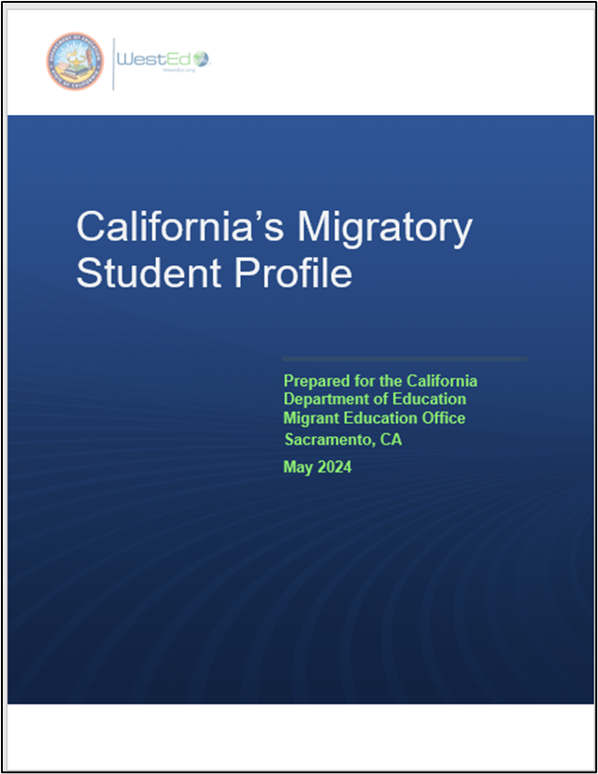
California’s Migratory Student Profile (MSP)
Notes:
Facilitator: Loan
Slide duration: 30 seconds
Key Points:
The Migratory Student Profile, or MSP, is a collection of student achievement data, programmatic data, and qualitative data on the needs and strengths of California’s migratory children, youth, and families. This profile was used in the development of the new comprehensive needs assessment and is the foundation for the next service delivery plan. In order to identify the needs of California’s migratory families, the CDE solicited feedback from MEP parents, staff, and Out-of-School Youth in the form of surveys, interviews and focus groups. Today, Melissa will take us through the health data from the surveys within the MSP to illustrate a need for additional attention to ensuring students health needs are met.

Slide 7



Mental Health Services and Supports
Needed As Reported by Staff and Parents
Figure 1. Grades Kindergarten through Six
(MSP – Exhibit 19)
Figure 2. Grades Seven and Eight
(MSP – Exhibit 20)
Figure 3. Nine through Twelve
(MSP - Exhibit 21)
Source: MEP Staff and Parent Surveys for the MSP
Notes:
Facilitator: Melissa
Slide duration: 1 minute
Key Points:
[Read data from figures]

Slide 8
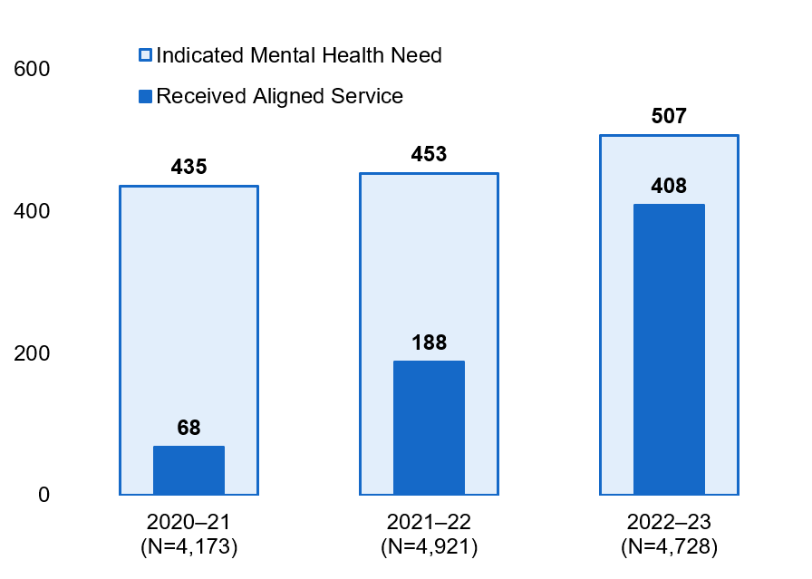
Migratory Children with an Indicated Need for Mental Health Services and the Number Who Received Services
Figure 4. Number of Migratory Children with an Indicated Need for Mental Health Services and the Number Who Received Services Aligned to That Need, 2020–21 Through 2022–23 Performance Periods
(MSP - Exhibit 63)
Source: The MSIN Databases for the MEP, 2020–21 through 2022–23 performance periods
Notes:
Facilitator: Melissa
Slide duration: 2 minutes
Key Points: figure data uses state codes only
[Read data from figures]
In 2020-21: Of the 435 migratory children and youths who identified a mental health need on the INA, only 68 were provided a service that aligned to the need.
In 2021-22, we saw more of an increase: Of the 453 migratory students who identified a mental health need on the INA, only 188 were provided a service that aligned to the need.
In 2022-23 we see a huge increase: Of the 507 migratory students who identified a mental health need on the INA, 408 were provided a service that aligned to the need.
For health needs that are being measured like mental health, more intentionality is being used to address these needs because mental health is included in the SSDP (MPO 11.1). Here we see that once we got the MPO Report 11.1 up and running and provided training for 21-22, we saw an increase. With more training and MEPs revising their processes to link student needs to services by using the MPO Report to identify exactly the students who had mental health needs, we saw an even greater increase in 22-23. Ideally, we’d like to see the same process for identifying and addressing mental health needs applied to all other health areas. And instead of using the MPO Report to focus services on student needs, we can use the INA Report to streamline enrollment or even develop new services based on need.

Slide 9



Health Services and Supports Needed As Reported by Staff and Parents
Figure 5. Grades Kindergarten through Six
(MSP – Exhibit 19)
Figure 6. Grades Seven and Eight
(MSP – Exhibit 20)
Figure 7. Nine through Twelve
(MSP - Exhibit 21)
Source: MEP Staff and Parent Surveys for the MSP
Notes:
Facilitator: Melissa
Slide duration: 1 minute
Key Points:
[Read data from figures]

Slide 10
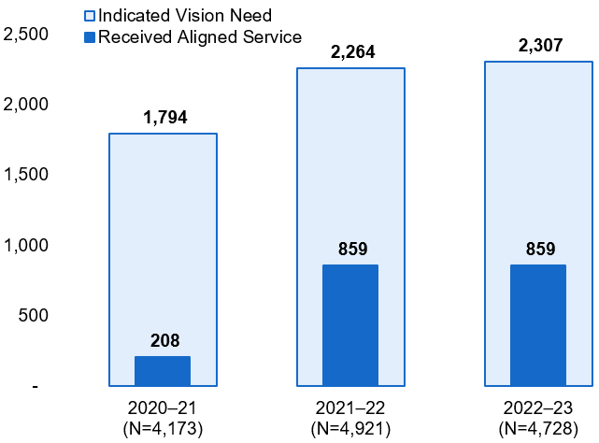
Migratory Children with an Indicated Need for Vision Services and the Number Who Received Services
Figure 8. Number of Migratory Children with an Indicated Need for Vision Services and the Number Who Received Services Aligned to That Need, 2020–21 Through 2022–23 Performance Periods
(MSP - Exhibit 60)
Source: The MSIN Databases for the MEP, 2020–21 through 2022–23
performance periods
Notes:
Facilitator: Melissa
Slide duration: 2 minutes
Key Points: Figure data uses state codes services only
2020-21: Of the 1,794 migratory children and youths with a vision need on the INA, only 208 were provided a service that aligned to the need.
2021-22: Although 2,264 migratory children and youths had a vision need on the INA, only 859 were provided a service that aligned to the need.
2022-23: 859 out of 2,307 migratory children and youths were provided a service that aligned to the identified vision need.

Slide 11
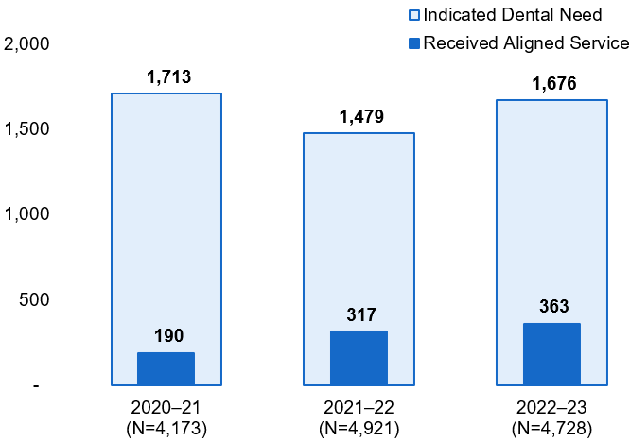
Migratory Children with an Indicated Need for Dental Services and the Number Who Received Services
Figure 9. Number of Migratory Children with an Indicated Need for Dental Services and the Number Who Received Services Aligned to That Need, 2020–21 Through 2022–23 Performance Periods
(MSP - Exhibit 61)
Source: The MSIN Databases for the MEP, 2020–21 through 2022–23 performance periods
Notes:
Facilitator: Melissa
Slide duration: 2 minutes
Key Points: figure uses state code data only
[Read data from figures]
2020-21: Of the 1,713 migratory children and youth with a dental need on the INA, only 190 were provided a service that aligned to the need.
2021-22: 1,479 migratory children and youth had a dental need on the INA, but only 317 of those 1,479 children and youth were provided a service that aligned to the need.
2022-23: 363 out of 1,676 migratory children and youths with an identified dental need were provided a service that aligned to the need on the INA.

Slide 12
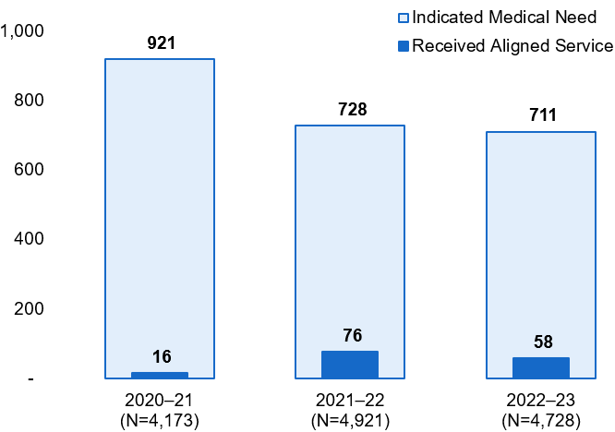
Migratory Children with an Indicated Need for Medical Services and the Number Who Received Services
Figure 10. Number of Migratory Children with an Indicated Need for Medical Services and the Number Who Received Services Aligned to That Need, 2020–21 Through 2022–23 Performance Periods
(MSP - Exhibit 62)
Source: The MSIN Databases for the MEP, 2020–21 through 2022–23 performance periods
Notes:
Facilitator: Melissa
Slide duration: 2 minutes
Key Points: figure uses state code data only
2020-21: 921 migratory students with a medical need on the INA; however, only 16 migratory children or youth were provided a service that aligned to the need.
2021-22: While 728 migratory students had a medical need on the INA, only 76 were provided a service that aligned to the need.
2022-23: 58 out of 711 migratory children and youths with an identified medical need were provided a service that aligned to the need.

Slide 13

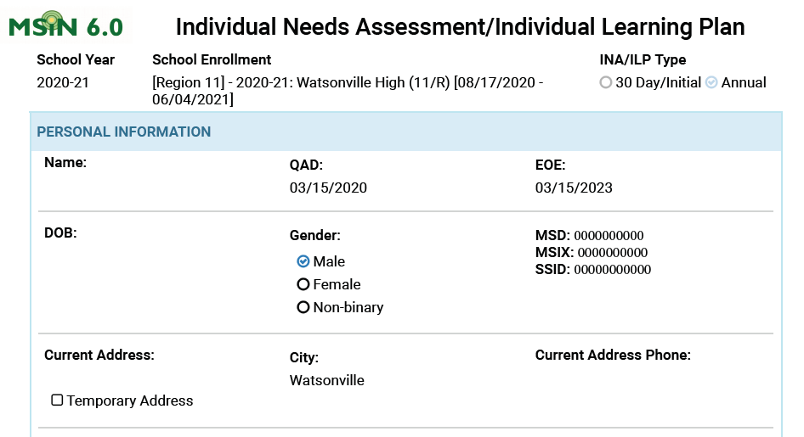
The INA/ILP
Notes:
Facilitator: Melissa
Slide duration: 30 seconds
Key Points:

Slide 14
Federal Guidance on Needs Assessments
  “Local operating agencies conduct individual needs assessments to:
  determine the needs of migrant students and how those needs relate to the priorities established by the State;
  Design local services; and
  select students for the receipt of those services.”
U.S. Department of Education, Office of Elementary and Secondary Education, Office of Migrant Education, Non-Regulatory Guidance for the Title I, Part C Education of Migratory Children, Washington, D.C., 2017. Pg. 43.
Notes:
Facilitator: Loan
Slide duration: 1 minute
Key Points:
Before reviewing the report, I’m going to briefly discuss the INA requirements, how the CDE and WestEd MSIN team developed the INA and individual learning plan, or ILP, and best practices for implementing the INA during the next several slides.
As mentioned during the INA/ILP webinar, non-regulatory guidance provides general reasons why individual needs assessments are useful to local operating agencies.
[Read Slide]

Slide 15
California Education Code
  “54443.1. Migrant education programs shall include all the following:
  An individual assessment of the educational and relevant health needs of each participating pupil within 30 days of enrollment...
  (d) A brief individual learning plan listing the services to be provided to each pupil shall be provided in writing or at a parent conference to the parent or guardian of each participating pupil, annually and each time the pupil moves to a new district.”
Source: California Education Code § 54443
Notes:
Facilitator: Loan
Slide duration: 1 minute
Key Points:
California Ed Code establishes identifies the requirements for INAs:
Specified both educational and relevant health needs
Specified that the INA was for “participating pupils”
Specified that the INA should be completed within 30 days of enrollment (into the MEP).
An ILP is also required for each student:
Annually if the student remains in the same program area or each time the student moves,
And provide a copy to the parent/guardian.

Slide 16
How the Statewide INA/ILP was Created
  While developing the Comprehensive Needs Assessment (CNA) and SSDP, the CNA SSDP Committee identified a need for a standardized INA/ILP.
  The CDE staff gathered existing INAs and ILPs from subgrantees, including versions for PreK children, attending children (i.e., students), and non-attending youths (i.e., Out-of-School Youths [OSY]).
  The CDE staff consolidated elements from the subgrantee versions to form a single document with the INA and ILP components together (i.e., INA/ILP).
  The CDE proposed a statewide version of the INA/ILP and solicited additional feedback from the subgrantee committee before finalizing it.
  WestEd used the paper version of the Statewide INA/ILP as a template to create the web-form version in MSIN.
Notes:
Facilitator: Loan
Slide duration: 2 minutes
Key Points:
While developing the Comprehensive Needs Assessment (CNA) and State Service Delivery Plan (SSDP). The CNA SSDP Committee identified a need for a standardized INA/ILP.
The CDE staff gathered existing INAs and ILPs from subgrantees, including versions for PreK children, attending children (i.e., students), and non-attending youths (i.e., Out-of-School Youths [OSY]).
The CDE staff consolidated elements from the subgrantee versions to form a single document with the INA and ILP components together (i.e., INA/ILP).
The CDE proposed a statewide version of the INA/ILP and solicited additional feedback from the subgrantee committee before finalizing it.
WestEd used the paper version of the Statewide INA/ILP as a template to create the web-form version in MSIN.

Slide 17
Four Distinct INA/ILP Forms
Form for preschool-age children, covering grades P3-P5;
Form for primary school students, covering grades K-8;
Form for secondary school students, covering grades 9-12; and
Form for youths, covering grades NA – OSY and AD (Adult Education).
Notes:
Facilitator: Loan
Slide duration: 1 minute
Key Points:
Note that there are 4 distinct INA/ILP forms for different grade ranges, as follows:
• Form for preschool-age children, covering grades P3-P5,
• Form for primary school students, covering grades K-8,
• Form for secondary school students, covering grades 9-12, and
• Form for youths, covering grades NA (Out-of-School Youth) and AD (Adult Education).
Some data elements are unique to each grade range. Keep this in mind as we describe the report contents.

Slide 18
Best Practices for INA/ILP Implementation
New Student
  Within 30 days of identifying a migrant student, complete an INA by recording any relevant student data from student records and by contacting the student and family.
  Use the INA to determine what services to provide to the student and family. Complete the ILP.
  Once the INA/ILP is complete, provide parents with a copy of the ILP.
Returning Student
  Create a new INA for the new school year. Contact student and family prior to or close the start of school year.
  Use the INA data to determine and create services to provide to the student and family. Develop the ILP.
  Once the INA/ILP is complete, provide parents with a copy of the ILP.
Notes:
Facilitator: Loan
Slide duration: 1 minute
Key Points:
New Student
Within 30 days of identifying a migrant student, complete an INA by recording any relevant student data from student records and by contacting the student and family.
Use the INA to determine what services to provide to the student and family. Complete the ILP.
Once the INA/ILP is complete, provide parents with a copy of the ILP.
Returning Student
Create a new INA for the new school year. Contact student and family prior to the start of school year.
Use the INA data to determine and create services to provide to the student and family. Develop the ILP.
Once the INA/ILP is complete, provide parents with a copy of the ILP.

Slide 19
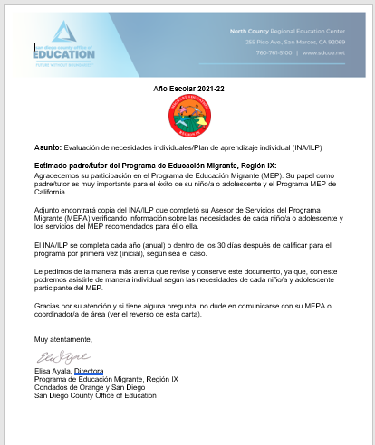
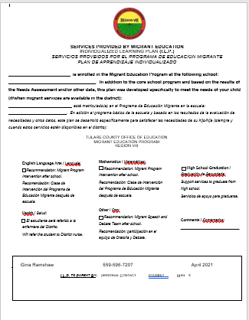
Annual Parent Notification
Notes:
Facilitator: Loan
Slide duration: 1 minute
Key Points:
Please remember that the annual parent notification must be sent home every year per CA Ed Code. The letter should inform parents about the INA/ILP process and can be a form letter that is sent home with a copy of the completed INA/ILP or the letter can inform parents about the INA/ILP process and have checkboxes for the region’s or district’s services. The boxes that are checked should be the services identified in the ILP. Please send these letters home at the beginning of the year, so parents know what services are being provided.

Slide 20

Questions?
Notes:
Facilitator: Melissa
Slide duration: 1 minute
Key Points:

Slide 21

The Poll You Know…
Please select the best answer to the three questions identified in the poll.
Notes:
Facilitator: Loan
Slide duration: 5 minutes
Key Points:
True or False: The INA was created in collaboration with the field.
True (correct)
False
True or False: Parents of migratory children should receive a notification identifying the MEP services to be provided only when the child moves to a new program area.
True
False (correct answer; parents need to be provided annual notification of MEP services being provided to their children)
Why do we complete INAs?
To develop local services based on the needs of migratory students
To enroll students in services that address their needs
Besides being a best practice, it is required by law
All of the above (correct answer)

Slide 22
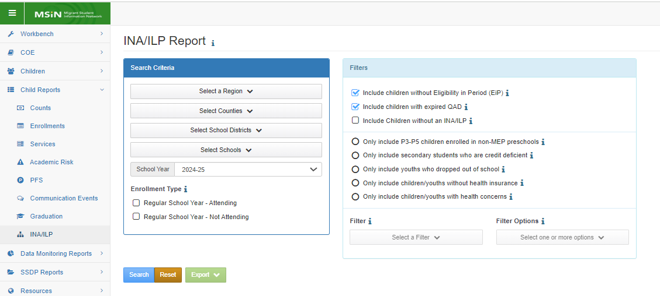
The INA Report
Notes:
Facilitator: Melissa
Slide duration: 1 minute
Key Points:

Slide 23
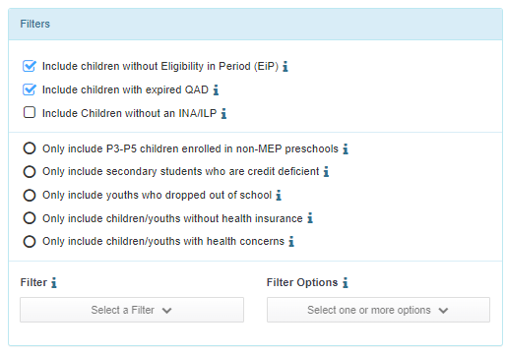
Radio Button Filter: Preschool
Radio Button Filter: Only include P3-P5 children enrolled in non-MEP preschools
Notes:
Facilitator: Melissa
Slide duration: 2 minutes
Key Points:
Initially this radio button was going to be used to support the enrollment of preschool aged children in non-MEP preschools. The MEP is charged with providing opportunities to meet the state’s challenging academic standards. Part of that includes informing parents of the resources available to their students. The earlier students begin their educational journey, the more they are ready for Tk and Kindergarten. However, as a tip, PLEASE use the Enrollment Report instead. The Enrollment report identifies all preK students regardless of whether their INA is completed, while the INA Report only includes children who have an INA. You can also filter the Enrollment report for non-attending children by age, so it is much quicker than using this radio button.

Slide 24
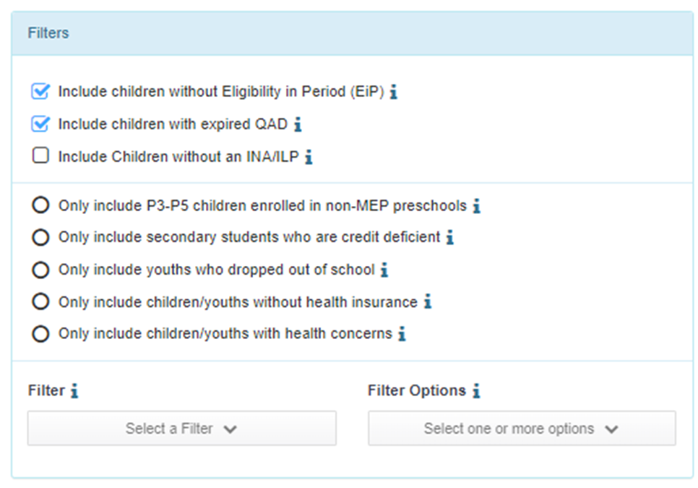

Radio Button Filter:
Secondary Students who are Credit Deficient
Radio Button Filter: Only include secondary students who are credit deficient
Remember, this filter supports the MEP in meeting students’ needs and measurable program objectives (MPOs) 5.1/6.1:
Identifies students who are credit deficient by district and/or school which streamlines student outreach and enrollment to quickly address credit deficiency.
Notes:
Facilitator: Melissa
Slide duration: 2 minutes
Key Points:
The second radio button filter only includes secondary students who are credit deficient. This filter supports MEP subgrantees in meeting students’ needs and MPOs 5.1/6.1 by identifying high school students who are credit deficient by district and/or school which streamlines student outreach and enrollment to quickly address credit deficiency.

Slide 25
Radio Button Filter: Dropped Out
Radio Button Filter:
Only include youths who dropped out of school
Notes:
Facilitator: Melissa
Slide duration: 1 minute
Key Points:
The third radio button filter only includes youths who dropped out of school. While this filter may not be used towards meeting the MPOs, it is extremely helpful in identifying students under the age of 18 who may need to re-enroll due to California’s compensatory education law.

Slide 26

Radio Button Filters: Health
Radio Button Filter: Only include children/youths without health insurance
Beginning January 1, 2024, a new law in California allows adults ages 26 through 49 to qualify for full-scope Medi-Cal, regardless of immigration status. All other Medi-Cal eligibility rules, including income limits, will still apply.​​ Resources available in several languages (e.g., Spanish, Punjabi, Hmong, etc.) on the Department of Health Care Services website.
Notes:
Facilitator: Melissa
Slide duration: 2 minutes
Key Points:
There are two radio button filters for health information. The first includes children/youths without health insurance. If the MEP subgrantee refers parents to different health insurance options, this filter would support those efforts.

Slide 27
Radio Button Filters: Health (2)
Radio Button Filter:
Only include children/ youths with health concerns
Notes:
Facilitator: Melissa
Slide duration: 1 minute
Key Points:
The second filter includes children/youths with health concerns. This filter may be helpful to the MEP subgrantee in planning health services or other services for students with health concerns.

Slide 28
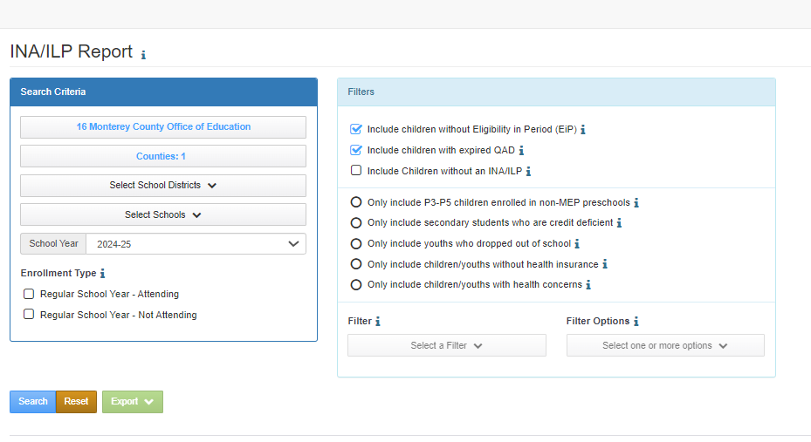
Running the INA Report for Dental Health Needs
Enter your search criteria:
  Select your Region
  Select Counties (if applicable)
  Select School Districts (if applicable)
  Select Schools (if applicable)
  Select School Year
Notes:
Facilitator: Melissa
Slide duration: 1 minute
Key Points:
[Read slide]

Slide 29
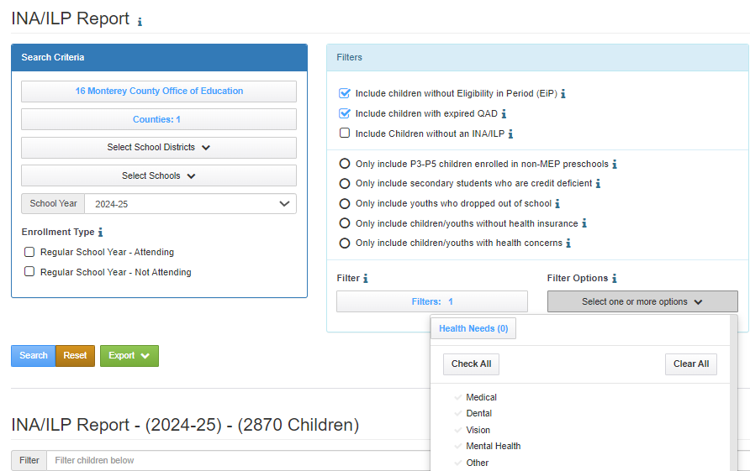
Identifying Dental Health Needs
Choose your filters:
  Two top filters are automatically selected
  Click on Search
  Moving to the lower section of the Filter box, select Filter and click on Health Needs
  Select Filter Option and select a specific health issue (e.g., dental)
Notes:
Facilitator: Melissa
Slide duration: 1 minute
Key Points:
[Read slide]

Slide 30
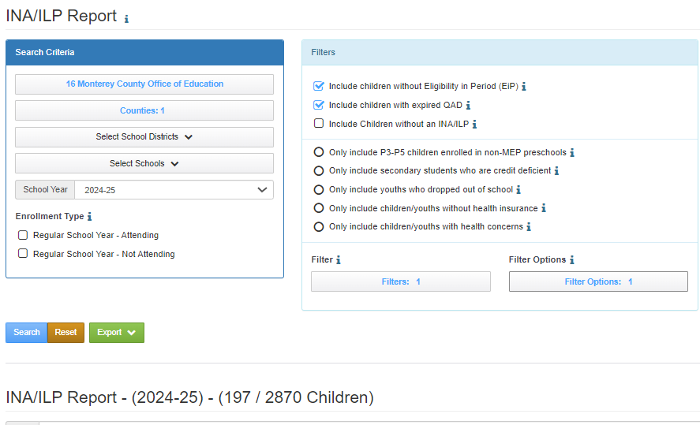
Identifying Dental Health Needs
Notes:
Facilitator: Melissa
Slide duration: 30 seconds
Key Points:
Report screenshot shows that of the 2,870 kids who have a completed INA, 197 of them have dental needs.

Slide 31
What are Your Students’ Dental and Vision Needs?
Log into MSIN and follow the instructions on Slides 28 and 29 to run the INA Report.
First, run the report for student dental needs in your program area for 2024–25 school year. How many of those health needs are dental needs?
Next, run the report for student vision needs in your program area for the 2024–25 school year. How many students have vision needs?
What about your medical needs? How many students have medical needs?
Notes:
Facilitator: Melissa
Slide duration: 7 minutes
Key Points:
[Read slide]
Remind participants to use the INA Report Notetaker to help them organize their data. This can be found in the Google SSDP Continuous Improvement file within the INA Report folder.

Slide 32

Whole Group Share Out
What were your program’s dental, vision, and medical needs?
Now that you know what your local needs are in these two areas, what is the process for serving students with these needs?
What is your process for ensuring students’ mental health needs are being met? Statewide these processes have been successful. Can you adapt that for dental, vision, or medical?
Notes:
Facilitator: Melissa
Slide duration: 10 minutes
Key Points:
[Read slide]

Slide 33
Any Questions?
Notes:
Facilitator: Melissa
Slide duration: 1 minute
Key Points:

Slide 34
Identifying Children and Youth without an INA
Enter your search criteria:
  Select your Region
  Select Counties (if applicable)
  Select School Districts (if applicable)
  Select Schools (if applicable)
  Select School Year
Notes:
Facilitator: Melissa
Slide duration: 1 minute
Key Points:
It’s important that all of your INAs are completed. If they aren’t then there may be some students with needs for which the MEP is unaware. If that’s the case, your data is incomplete. You need to check the INA Report regularly to identify which INAs still need to be completed.
[Read slide]

Slide 35
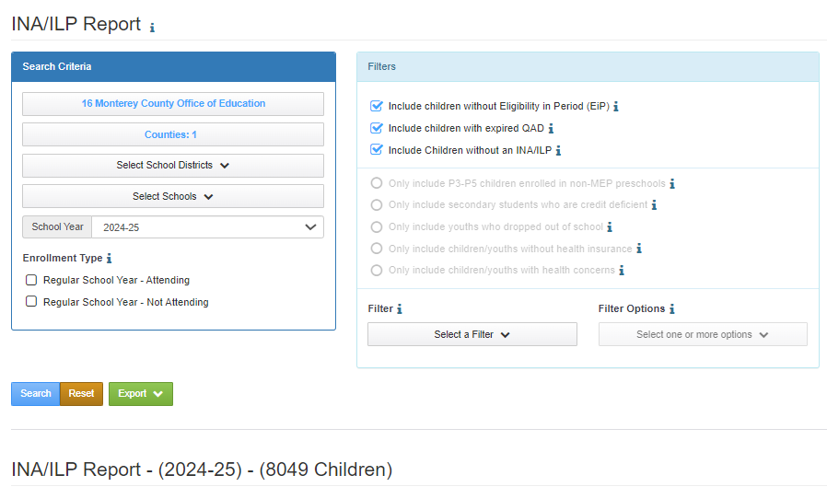
Identifying Children and Youth without an INA/ILP (2)
Choose your filters:
  Two top filters are automatically selected.
  Select the last filter towards the top of the Filter section that reads, “Include children without an INA/ILP.”
  Click the Search button
Notes:
Facilitator: Melissa
Slide duration: 1 minute
Key Points:
[Read slide]

Slide 36
What are Your INA Needs?
Remember that outside of this being a legislative requirement, if the INA/ILPs are not completed, the MEP does not have the data it needs to ensure that student needs are being met in certain areas.
Log into MSIN and follow the instructions on Slides 34 and 35 to run the INA Report for children and youth who DO NOT have a completed INA/ILP.
  A child/youth does not have a completed INA/ILP unless the status is marked as “completed.” You will see a blank or “started” for all INAs/ILPs that still need to be completed.
Notes:
Facilitator: Melissa
Slide duration: 5 minutes
Key Points:
Now we are going to run the INA Report to identify how many children and youths do not have an INA in your program área.
[Read slide]

Slide 37

Final Activity: Breakout Rooms
In Breakout Rooms, you’ll have ten minutes to discuss one best practice for completing INAs/ILPs or for streamlining health services in your program area.
Notes:
Facilitator: Melissa
Slide duration: 10 minutes
Key Points:

Slide 38
Final Activity: Breakout Room Share Out
Chat Waterfall: In the Chat, please identify one thing you’ve learned today that will inform your practice of either completing INAs/ILPs or that will help you streamline services for those who need them.
Take a moment to type in your response and when I say, “Let it fall,” hit “Enter.” Review all the ideas that folks entered based on their experience today.
Notes:
Facilitator: Melissa
Slide duration: 2 minutes
Key Points:

Slide 39
Last Chance for Questions?
Notes:
Facilitator: Melissa
Slide duration: 3 minutes
Key Points:

Slide 40
Thank you for joining us!!
Please contact the CDE with any questions or for additional technical assistance. For any issues with the INA Report itself, please contact:
MSIN Support
msinsupport@wested.org
Melissa Mallory,
Education Programs Consultant,
Migrant Education Office
Email: mmallory@cde.ca.gov
Phone: 916-319-0730
Notes:
Facilitator: Melissa
Slide duration: 30 seconds
Key Points:

