Slide 1
State Service Delivery Plan: Service Code Mapping and Data Reports
December 15, 2020
Melissa Mallory
Education Programs Consultant
Migrant Education Office
Notes:
Welcome to our webinar today on State Service Delivery Plan: Service Code Mapping and Data Reports. We are going to get started in about five minutes. While we wait, please enter your name, title, and region/direct-funded district. Thank you.
Alright, we are going to go ahead a get started with our webinar, State Service Delivery Plan: Service Code Mapping and Data Reports. My name is Melissa Mallory and I am an Education Programs Consultant with the Migrant Education Office at the California Department of Education, or CDE.

Slide 2
Housekeeping Items
Please enter your name, title, and region/direct-funded district.
Mute your speaker.
Use the chat function to enter your questions. If your question is not answered during the meeting, the Migrant Education Office (MEO) will email you directly.
This webinar is being recorded and will be posted on My Digital Chalkboard.
Notes:
A few housekeeping items: if you haven’t already:
Please enter your name, title, and region/direct-funded district.
Mute your speaker.
Use the chat function to enter your questions. If your question is not answered during the meeting, the Migrant Education Office (MEO) will email you directly.
This webinar is being recorded and will be posted on My Digital Chalkboard.

Slide 3
Audience
Directors
Coordinators
Data Specialists (regional and district levels)
Notes:
The audience for this presentation includes Directors, Coordinators, and Data Specialists.

Slide 4
Webinar Objectives
Participants will understand how to map services to the State Service Delivery Plan (SSDP).
Participants will review how to set up services in MSIN to map SSDP measurable program objectives (MPOs) and SSDP Components.
Participants will review the SSDP Reports for MPOs 1.0, 2.0, 7.0, 8.0, and 11.0 to understand how the use of these reports support meeting the MPOs.
Notes:
From our webinar today:
Participants will understand how to map services to the State Service Delivery Plan (SSDP).
Participants will review how to set up services in MSIN to map SSDP measurable program objectives (MPOs) and SSDP Components.
Participants will review the SSDP Reports for MPOs 1.0, 2.0, 7.0, 8.0, and 11.0 to understand how the use of these reports support meeting the MPOs.

Slide 5
Poll (Pretest)
Let’s take a quick poll to assess our knowledge of service codes and MSIN service data entry. Please choose the BEST answer.
Notes:
Let’s take a quick poll to assess our knowledge of service codes and MSIN service data entry. Please choose the BEST answer.
What is a service code?
a. A service code is a unique identifier for a specific MEP service. (Correct answer)
b. A service code is a code that you use for your garage.
c. A service code is helpful in identifying various services.
2. What is a service code map?
A service cope map is an alternative to Google Maps or Waze.
A service code map identifies all of the information needed to set up services correctly in the MSIN.
A service code map contains information from the grant application to ensure all services are correctly mapped to SSDP MPOs and Components.
B and C (correct answer)
3. What elements are required for MPOs 1.0?
a. A credentialed teacher
b. A focus on reading and writing
c. Inclusion of students in grades K-10
d. 30 hours during RSY and 20 hours during SS
e. Inclusion of students who are below standard in grades K-10
f. All of the above
g. A, B, D, E (Correct answer)
4. Where can I locate the SSDP requirements for personnel, duration of service, or grade levels?
In the grant application
The SSDP Strategies identify this information
The SSDP MPOs identify this information (correct answer)

Slide 6
Resources Needed to Develop a
Service Code Map
Grant application
State Code document which includes the Federal and Service Categories
Identification of MPOs collected by MSIN
Excel Service Code Map
Notes:
There are some resources needed to develop a service code map. They include the grant application, State Code document which includes the Federal and Service Categories, identification of MPOs collected by MSIN, and the Excel Service Code Map template.

Slide 7
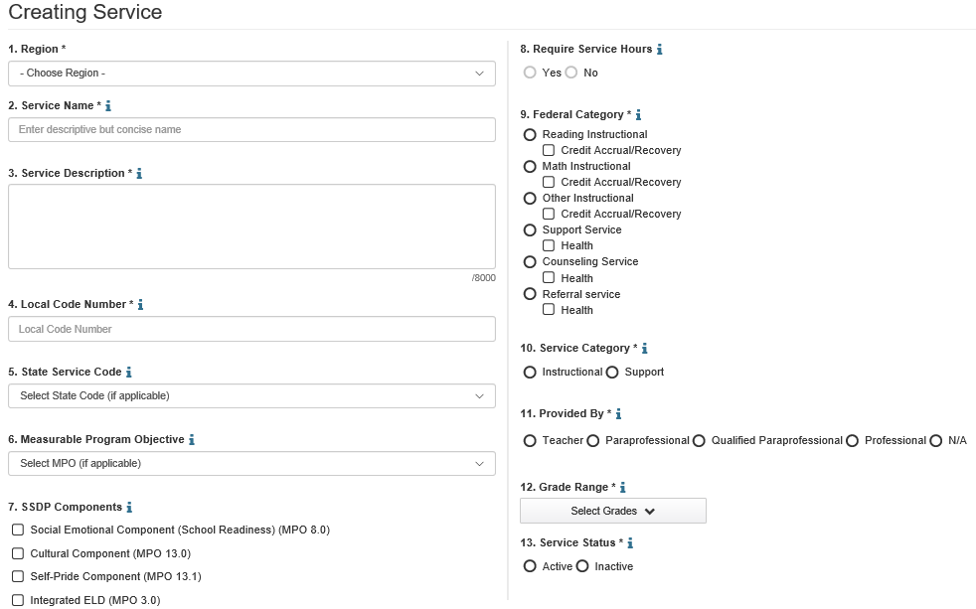
What is a Service Code Map?
Notes:
A service code map identifies all of the information needed to set up services correctly in the Migrant Student Information Network (MSIN).
This screenshot shows all the different fields needed to set up a service in MSIN: region, service name, service description, local code number, state service code, measurable program objective, SSDP component, require service hours, federal category, service category, who the service is provided by, grade range and service status.

Slide 8
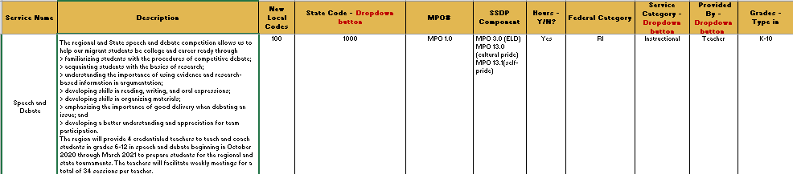
What is a Service Code Map? (1)
A service code map identifies all of the information needed to set up services correctly in the Migrant Student Information Network (MSIN).
Notes:
A service code map identifies all of the information needed to set up services correctly in the Migrant Student Information Network (MSIN).
I’ll walk you trough the process of developing your service code map via a demonstration, but first I’ll just go through each of the columns. Since subgrantees are only allowed to offer services or allowable activities (e.g., parent workshops, professional development, etc.) that have been approved by the CDE, information provided in the application is used for your service code map with the exception of the Local and State codes as well as the Federal and Service Category columns. However, please remember that only student services, not allowable activities, are entered into MSIN and therefore only services will be included in the service code map.
To get started, each row is a separate service. The columns are the different pieces of information needed to properly set up each service in MSIN. You’ll notice that the column headings are the same fields we saw in the last slide.
Service Name – the service name should match the service name in the application.
Service Description – the service description should match what is in the application. This can be found under the Service/Allowable Activity Description tab in the grant application.
New Local Code – a new local code needs to be developed if you want to make any modifications to an existing state code. For example, state code 1000 is for a targeted English language arts, or ELA, intervention service; that’s it, it doesn’t include any of the SSDP components. But if I want to alter my targeted ELA intervention service to add the SSDP components for English language development, or ELD, cultural pride and self pride, I need to create a local code. A local code allows me to tweak the standardized state code in some way.
State code – As you know, there are a number of standardized state codes that you can choose from. Many of them already align with the SSDP, so there is no need to create a new local code for these services. The state codes were attached to the Outlook invitation for this meeting for your reference.
MPOs – here you will include the MPOs aligned to the SSDP Strategies. These can be found under the grant application tab titled SSDP Strategies.
SSDP Components – there are a few MPOs that we have labeled SSDP Components. These are specific MPOs that include an instructional practice or lesson(s). The SSDP Components include MPO 3.0 (integrated ELD), MPO 8.0 (social emotional development), MPO 13.0 (cultural-pride), and MPO 13.1 (self-pride). If a service includes one or more of these MPOs or components, they should be added here.
Hours (Y/N?) – This column identifies which services have the required hour component. MPOs 1.0, 2.0, and 7.0 all have a required hour component. If you select one of these MPOs, MSIN will automatically populate this for you.
Federal Categories – Federal Categories include reading instruction (RI) math instruction (MI), other instruction (OI), support services (SS), referral services (RS), and counseling services. This will need to be identified when you set up your service.
Service Category – This identifies whether or not the service is an instructional service or a support service.
Provided By – this column identifies who provides the service (e.g., a teacher, paraprofessional, etc.). If an MPO identifies a teacher as the one who needs to provide this service, MSIN will automatically populate this for you.
Grades – In the MSIN service set-up screen, you have to identify the grades for various services. If an MPO identifies a grade range, MSIN will automatically populate this for you.

Slide 9
Recommended Responsibilities
Local MEP staff who develop grant applications and are familiar with the services are best suited to create the service code maps.
Once the service code map is complete, the document can be given to data specialists who are tasked with setting up services in MSIN.
Notes:
The CDE recommends the following responsibilities for MEP staff:
Local MEP staff who develop grant applications and are familiar with the services are best suited to create the service code maps.
Once the service code map is complete, the document can be given to data specialists who are tasked with setting up services in MSIN.

Slide 10

Check for Understanding
Notes:
Now I’m going to check for understanding. I will be using a poll so in a few seconds you will see several questions. Please answer them all as best as you can. When everyone is done I will share the results and provide you with the correct answers.
Should allowable activities like parent workshops be entered into MSIN?
Yes
No (correct answer)
Hamburger
2. What is a service code map?
A service cope map is an alternative to Google Maps or Waze.
A service code map identifies all of the information needed to set up services correctly in the MSIN.
A service code map contains information from the grant application to ensure all services are correctly mapped to SSDP MPOs and Components.
B and C (correct answer)
Local codes are needed if services provided deviate from the state codes (True or False).
True (correct answer)
False

Slide 11
Direct-funded District Service Code Map
Notes:
The CDE is providing differentiated guidance to direct-funded districts , or DFDs, and regional subgrantees due to the size of various programs and the inclusion of reimbursable districts at the regional level. First, we will review the Service Code Map for DFDs. Please note that for regions or reimbursable districts with unique service(s), some of your services may be developed in accordance with the guidance provided to DFDs.

Slide 12
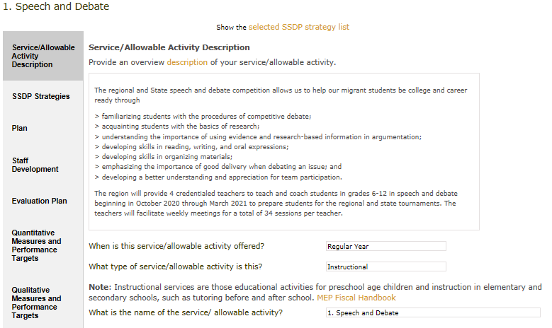
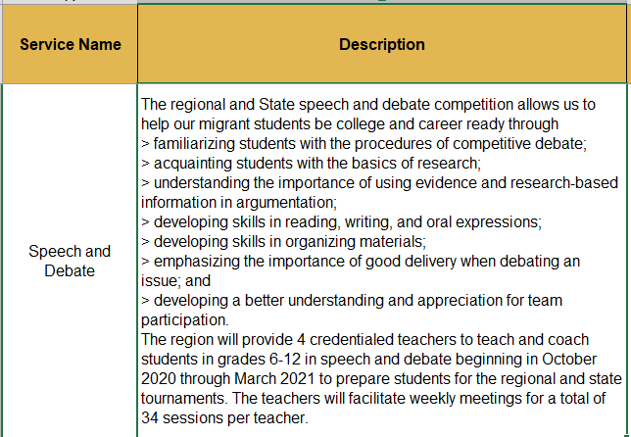
Service Name and Description
Notes:
Many of the things I’m going to review today are going to be pretty self-explanatory, but I just want to do a thorough job reviewing this activity with you all, so for those of you with a solid understanding of service code maps, please bear with me.
I’ll be primarily using the grant application and the Excel Service Code Map for the next several slides. From the application, copy the Service Name and enter it into the Service Code Map under the Service Name column. Then, copy the service description from the application and paste it into the Service Code Map under the Service Description column.

Slide 13
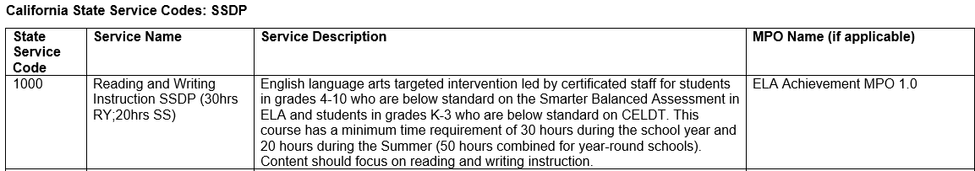
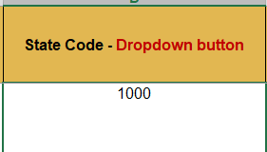
State Service Codes
Notes:
Remember, you’ll need to create a local code if your service is not exactly like the service description for the State Code. So if you add any of the SSDP Components, you’ll have to create a local code.
Review the State Code document to select the appropriate State Code.

Slide 14
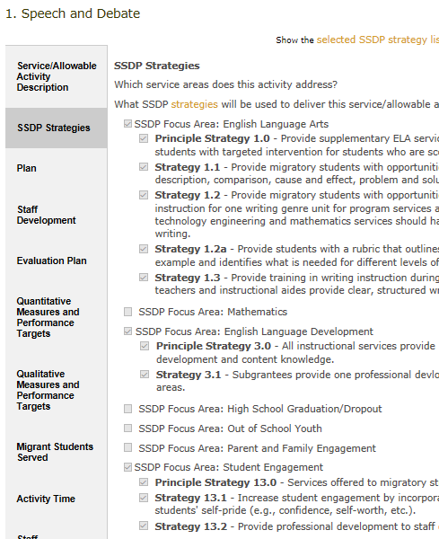
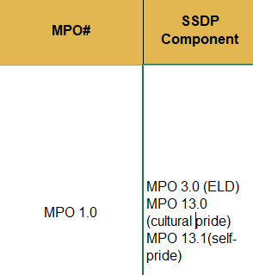
SSDP MPOs and Components
Notes:
To identify the MPOs that you’ll map to your service in MSIN, first you need to know which MPOs are collected via MSIN. Please note that when you set-up the service, MSIN will only show you specific MPOs that are collected through the system. For your Service Code Map, you’ll want to click on the SSDP Strategies tab and identify the MSIN specific MPOs and SSDP Components to include. For Speech and Debate, we are going to map the service to MPO 1.0. You’ll notice that several MPOs known as SSDP Components are also identified. On our Service Code Map, we’ll list these components in the SSDP Components column.

Slide 15
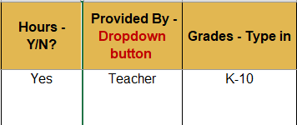
Hours, Provided by, Grades
MPOs 1.0 and 2.0 (Regular School Year and Summer) as well as MPO 7.0 have an hour requirement
Credentialed teachers are required for MPOs 1.0, 2.0, and 7.0
Some MPOs require specific grades ranges to be included like MPOs 1.0 and 2.0
Notes:
MPOs 1.0 and 2.0 (Regular School Year and Summer) as well as MPO 7.0 have an hour requirement.
Credentialed teachers are required for MPOs 1.0, 2.0, and 7.0.
Some MPOs require specific grades ranges to be included like MPOs 1.0 and 2.0.
Since this service is mapped to MPO 1.0, we know that there is an hour requirement, a teacher needs to provide instruction, and Grades K-10 should be served. These items will automatically populate in MSIN once you select MPO 1.0.

Slide 16
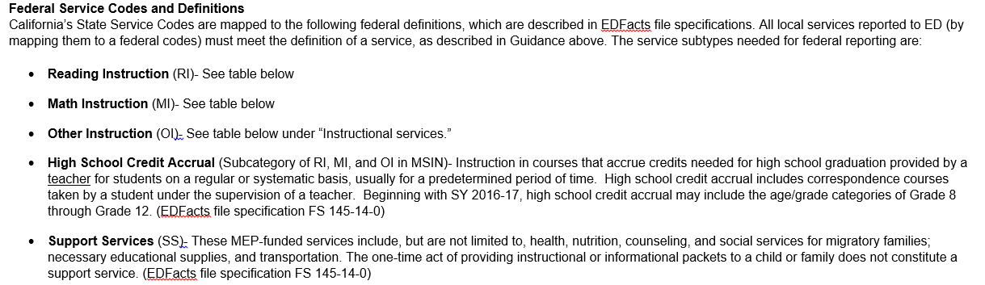
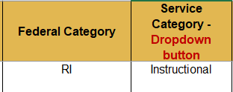
Federal and Service Categories
Please refer to the State Code document provided which includes the Federal and Service Code categories
Notes:
Because Speech and Debate includes SSDP Strategy 1.0 which focuses on both reading and writing, we will choose Reading Instruction (RI) for the Federal Category. Service Categories include Instructional and Support Services. Speech and Debate is identified as Instructional for the Service Category. Please refer to the State Code document provided which includes the Federal and Service Code categories.

Slide 17
One Service Complete!
Notes:
With these last two entries, we’ve completed the service code map for one service.

Slide 18
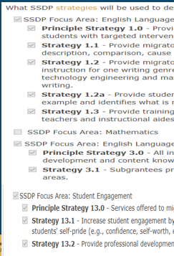


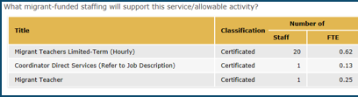
Practice #1
Notes:
Let’s do a quick practice entry. I’ve already reviewed this service and this subgrantee addressed each of the SSDP Strategies selected in the service narrative. Here is some of the information you’ll need to complete the service cope map for this one service on the bottom. I will type in the answers as noted by a participant. Although I will only select one participant to respond to this practice question, you can play along by typing your response in the Chat feature.
Answers:
Service Name – ELA Academic Intervention
Description – from the application
Local Code – can make one up
State Code – 1000
MPO – 1.0
SSDP Components – ELD, cultural pride (CP), self-pride (SP)
Required Hours – Yes
Federal Category – RI
Service Category - Instruction
Provided by – Teacher
Grades – K-10

Slide 19
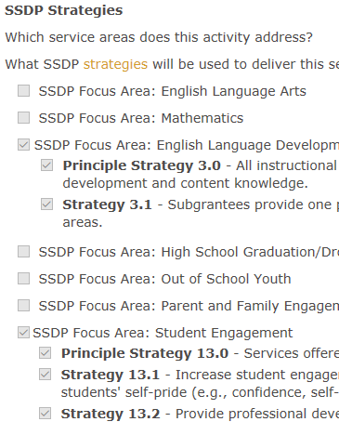

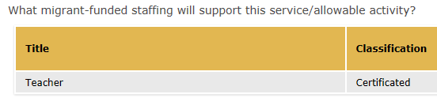
Practice #2
Notes:
Let’s do a quick practice entry. I’ve already reviewed this service and this subgrantee addressed each of the SSDP Strategies selected in the service narrative. Here is some of the information you’ll need to complete the service cope map for this one service on the bottom. I will type in the answers as noted by a participant. Although I will only select one participant to respond to this practice question, you can play along by typing your response in the Chat feature.
Answers:
Service Name – STEAM K-10th
Description – from the application
Local Code – can make one up
State Code – no state code for STEAM education
MPO – No MPO to map to for this service
SSDP Components – ELD, cultural pride (CP), self-pride (SP)
Required Hours – No
Federal Category – Other Instruction (OI)
Service Category - Instruction
Provided by – Teacher
Grades – K-10

Slide 20
Check for Understanding (1)
Notes:
Now I’m going to check for understanding. I will be using a poll so in a few seconds you will see two questions. Please answer them all as best as you can. When everyone is done I will share the results and provide you with the correct answers.
Where can I find information for the Service Name and Description?
In MSIN
In the grant application (correct answer)
On My Digital Chalkboard
2. Where can I locate the SSDP requirements for personnel, duration of service, or grade levels?
In the grant application
The SSDP Strategies identify this information
The SSDP MPOs identify this information (correct answer)

Slide 21
Regional Service Code Map
Notes:
The regional service model includes numerous reimbursable districts which requires a slightly different code mapping system for a majority of the services provided.

Slide 22
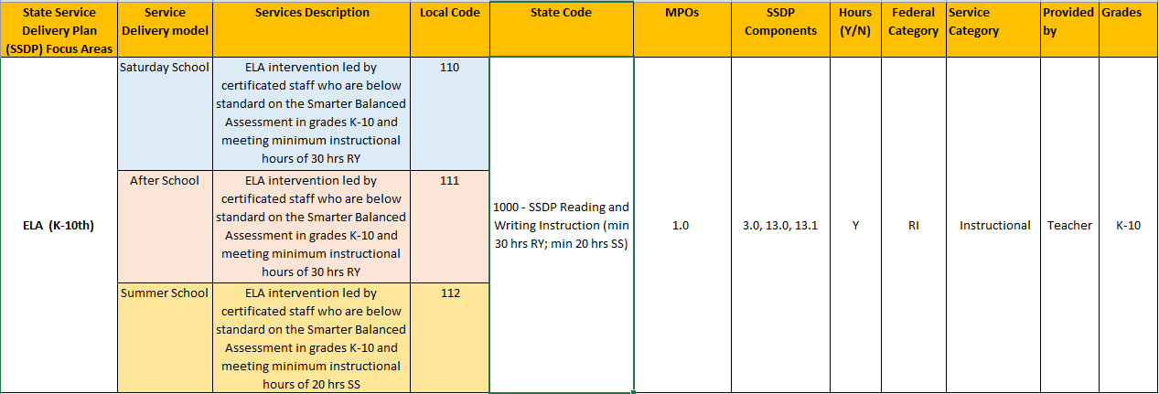
Regional Service Code Map (1)
Notes:
For regions with several reimbursable districts, it may make sense to create service “buckets.” These “buckets” include a similar description, meaning what is taught for all services within the bucket is similar and they include the same MPOs. For example, if we look at the ELA service for K-10th graders we see Saturday School, After School, and Summer School services which would be the “buckets.” These services all align directly with MPO 1.0 (i.e., there is a credentialed teacher providing reading and writing instruction to students who are below proficiency in grades K-10 and it meets the hour requirements). Although the lesson plans might not be the same, all the services in each bucket have the same service description and MPOs. This allows for some flexibility for large regions and decreases the total number of services in MSIN. Just remember that when you are creating your buckets that you need to be aware of the SSDP Components (i.e., ELD, cultural and self-pride). These SSDP Components do need to be coded properly for each bucket. You may want to require districts to offer certain SSDP Components for these services to help streamline data reporting.
Developing a regional Service Code Map in this way means that you won’t have service names and descriptions that match the application.

Slide 23
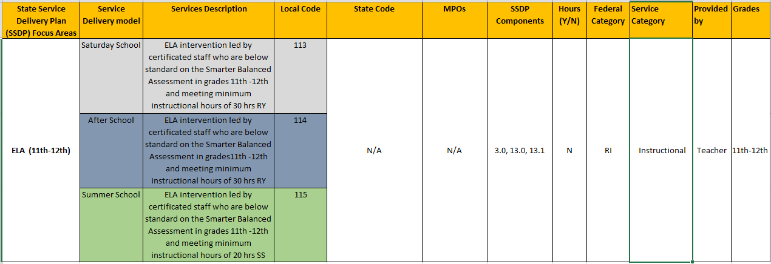
Regional Service Code Map (2)
Notes:
Here we see another example of grouping regional and district services by “buckets”, but this time the services do not specifically align with MPO 1.0 which has specific requirements like grade range and duration of service. These services are also intervention services provided to students who are identified as below standard, but are in the 11th and 12th grade. The MEO does ask that for unique services, or services only offered by the region or a reimbursable district, that you use the process described in the DFD Service Code Map section of this PowerPoint as this is the easiest way for us to verify that services were implemented in accordance to the grant application.

Slide 24
Common Errors
Including the incorrect Federal Category
Including the incorrect Service Category
Not mapping to the correct MPOs
Not including all the SSDP Components that are identified in the service
Developing a service for specific groups of students (e.g., English learners, Gifted and Talented Education, Special Education)
Notes:
I’d like to address some common errors found in MSIN.
These include:
Including the incorrect Federal Category
Including the incorrect Service Category
Not mapping to the correct MPOs
Not including all the SSDP Components that are identified in the service
Developing a service for specific groups of students (e.g., English learners, Gifted and Talented Education, Special Education)
The attachment I included in the Outlook invite titled State Service Codes with descriptions, can assist you with not making many of these errors.

Slide 25
Best Practices
Deactivate services that are no longer in use.
Print out service code map and review for accuracy against the grant application and federal and state code document.
Have a second “reviewer” go over the information to ensure that everything is correct prior to setting up services.
Notes:
Some best practices to consider include:
Deactivate services that are no longer in use.
Print out service code map and review for accuracy against the grant application and federal and state code document.
Have a second “reviewer” go over the information to ensure that everything is correct prior to setting up services.

Slide 26
MSIN Service Set-up Screen
Notes:
Now that we’ve finished the Service Code Map for our services, we can pass it along to our Data Specialist who will then set-up the services in MSIN. Because we have the Service Code Map, the data specialist will be able to easily set up each service correctly.

Slide 27

Questions?
Please take a moment and type in any questions you may have into the Chat feature.
Notes:
Please take a moment and type in any questions you may have into the Chat feature.

Slide 28
Resources
MSIN User Guides offer the following resources:
Service Set-up Webinar (for SSDP services)
Service Data Entry Webinar (for SSDP services)
How-to videos
User manuals
MSIN User Guides under Services/Service Administration/How-to Videos
Notes:
There are quite a few resources available on MSIN for setting up services and entering service data. They include:
Service Set-up Webinar (for SSDP services)
Service Data Entry Webinar (for SSDP services)
How-to videos
User manuals
You can find these resources under the MSIN User Guide in the Services/Service Administration/How-to Videos.

Slide 29
Poll (Posttest)
Let’s take a quick poll to assess our knowledge of service codes and MSIN service data entry based on the information me just reviewed. Please choose the BEST answer.
Notes:
Let’s take a quick poll to assess our knowledge of service codes and MSIN service data entry. Please choose the BEST answer.
What is a service code?
a. A service code is a unique identifier for a specific MEP service. (Correct answer)
b. A service code is a code that you use for your garage.
c. A service code is helpful in identifying various services.
2. What is a service code map?
A service cope map is an alternative to Google Maps or Waze.
A service code map identifies all of the information needed to set up services correctly in the MSIN.
A service code map contains information from the grant application to ensure all services are correctly mapped to SSDP MPOs and Components.
B and C (correct answer)
3. What elements are required for MPOs 1.0?
a. A credentialed teacher
b. A focus on reading and writing
c. Inclusion of students in grades K-10
d. 30 hours during RSY and 20 hours during SS
e. Inclusion of students who are below standard in grades K-10
f. All of the above
g. A, B, D, E (Correct answer)
4. Where can I locate the SSDP requirements for personnel, duration of service, or grade levels?
In the grant application
The SSDP Strategies identify this information
The SSDP MPOs identify this information (correct answer)

Slide 30
Bonus Content: SSDP MPO Reports
MPO Reports are used for data reporting purposes.
MPO Reports 1.0, 2.0, and 7.0 can help you identify in real-time who is in your program area and should be served.
MPO Report 8.0 tells you if pre-k services were set up correctly (all pre-k services must have a social emotional component).
Notes:
We have some additional resources, the SSDP MPO Reports, that will be released today. These reports are used for data reporting purposes. MPO Reports 1.0, 2.0, and 7.0 can help you identify in real-time who is in your program area and should be served.
MPO Report 8.0 tells you if pre-k services were set up correctly (all pre-k services must have a social emotional component).

Slide 31
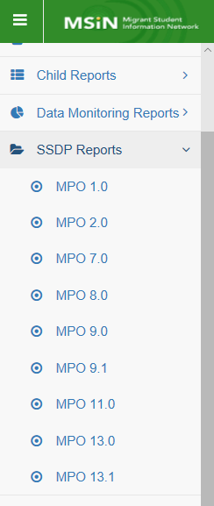
SSDP MPO Reports
Notes:
After logging on to MSIN, you’ll find the SSDP MPO Reports under SSDP Reports as shown on the slide.

Slide 32
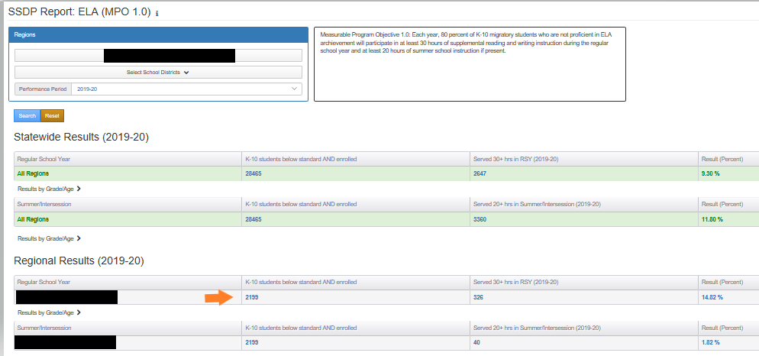
Measurable Program Objective 1.0
Notes:
Subgrantees can use the SSDP Reports to identify students in their program area who need to be served for services aligned to MPO 1.0. This information is in real-time and students can be identified by region or by individual districts. An MSIN user would need to follow these steps to get a list of students who are identified as not proficient in ELA:
Select the region
Select the district if you want district specific information
Select the performance period (these reports are updated in mid- to late November)
Click on the Search button
Once the report populates, click on the number of “K-10 students below standard AND enrolled”
You will get a list of students who are currently enrolled and below standard in grades K-10
You should use this report to target and enroll students in services aligning to MPO 1.0.

Slide 33
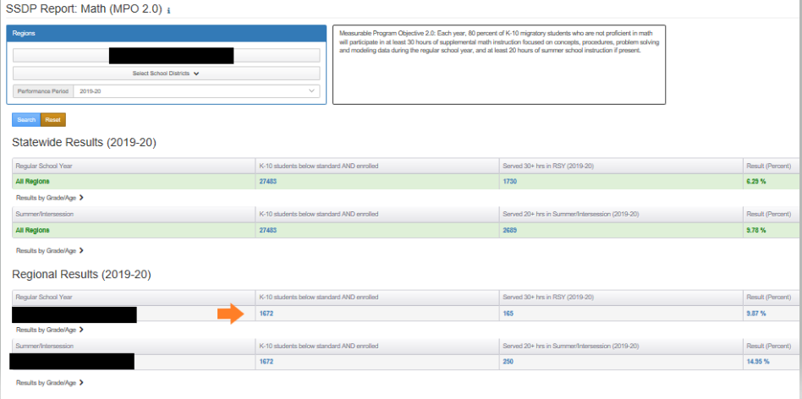
Measurable Program Objective 2.0
Notes:
Similarly, subgrantees can use the SSDP Reports to identify students in their program area who need to be served for services aligned to MPO 2.0. This information is in real-time and students can be identified by region or by individual districts. An MSIN user would need to follow these steps to get a list of students who are identified as not proficient in math:
Select the region
Select the district if you want district specific information
Select the performance period (these reports are updated in mid- to late November)
Click on the Search button
Once the report populates, click on the number of “K-10 students below standard AND enrolled”
You will get a list of students who are currently enrolled and below standard in grades K-10
You should use this report to target and enroll students in services aligning to MPO 2.0.

Slide 34
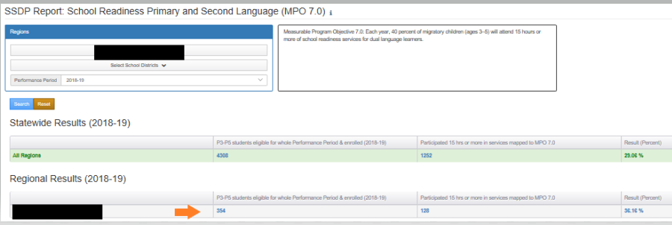
Measurable Program Objective 7.0
Notes:
To identify pre-k children in the region or within individual districts, you’ll follow the same steps:
Select the region
Select the district if you want district specific information
Select the performance period
Click on the Search button
Once the report populates, click on the number of “P3-P5 student eligible in whole Performance Period & enrolled”
You will get a list of students who are currently enrolled and are in grades P3-P5
You should use this report to target and enroll students in services aligning to MPO 7.0.

Slide 35
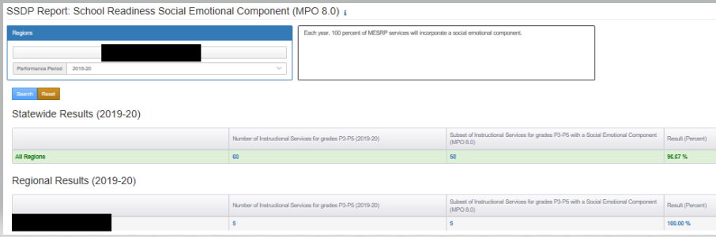
Measurable Program Objective 8.0
Notes:
Subgrantees can use the SSDP Report (MPO 8.0) to make sure they’ve set up services correctly. You can select the region, the Performance Period and then click the Search button. You’ll see the number of school readiness services that have been set-up in the second column and the number of those services with the social emotional component in column three.

Slide 36
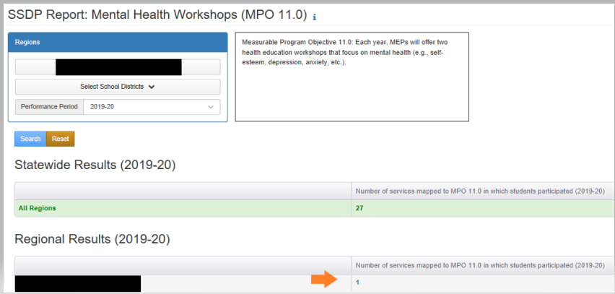
Measurable Program Objective 11.0
Notes:
The last report I’d like to review with you today is SSDP Report for MPO 11.0. Two health workshops are required for this MPO. A number of subgrantees only have one health workshop listed. This could be because all students are being added to this one service, but for us to verify that two workshops were offered, please be sure to set up a service mapped to MPO 11.0 for at least two of the health workshops that was offered in your program area.
We do have 4 additional SSDP MPO Reports currently in MSIN. Once the 2018–19 SSDP Annual Performance Reports are released, I will set up a meeting with each subgrantee to review their report and show you how to use the remaining reports.

Slide 37

Additional Questions?
Please take a moment and type in any questions you may have into the Chat feature.
Notes:
Please take a moment and type in any questions you may have into the Chat feature. I’ll take a moment to review and then respond

Slide 38
Thank you!
Melissa Mallory
Education Programs Consultant
Migrant Education Office
Phone: 916-319-0730
Email: mmallory@cde.ca.gov
Notes:
This concludes our webinar. Thank you for joining us today. If you have any additional questions, please feel free to call or email me. My contact information is on the slide. Have a wonderful rest of your day!

