Slide 1

The webinar will begin shortly. Please review the Chat and click on the Google Form link to sign-in for this meeting. Thank you!
Notes:
Melissa
10 mins prior to webinar time
Good afternoon everyone! We will begin in a few minutes. Please review the Chat and click on the Google Form link to sign-in for this meeting. Thank you.

Slide 2
A Deeper Dive into the State Service Delivery Plan
Measurable Program Objective Reports
October 4, 2022
Melissa Mallory, Education Programs Consultant
Migrant Education Office
Jose Valencia, Senior Programs Associate
WestEd
Notes:
Melissa
Good afternoon and welcome to our webinar. My name is Melissa Mallory and I am a consultant with the Migrant Education Office, or MEO, here at the CA Department of Education, or CDE. Today we will review the State Service Delivery Plan, or SSDP, Measurable Program Objective, or MPO, Reports in the Migrant Student Information Network, or MSIN. We’ll look at the key features of each report, the parameters for student inclusion in the reports and the connection between specific MPO Reports and the Individual Needs Assessment, or INA.
I’m joined by my colleague Jose Valencia, Senior Programs Associate from WestEd and Jamie Contreras, Education Programs Consultant from the MEO.
The audience for this presentation includes Directors and Coordinators/Program Managers, as these positions have access to the MSIN SSDP MPO Reports. SSDP Leads should also be made aware of this information, but depending on their MSIN Role, they may not have access to these reports.

Slide 3
Housekeeping Items
Mute your microphone.
Sign in to the Google Form attendance sheet; the link is located in the Chat.
Use the Chat feature to enter your questions. If your question is not answered during the meeting, the Migrant Education Office (MEO) will email you directly.
This PowerPoint will be available in the State Service Delivery Plan (SSDP) Continuous Improvement Google Drive folder after the webinar. You can locate this folder here: https://drive.google.com/drive/folders/1XbK2v4eNbv4Wg2O4tLZe5AjZkiGacrKx?usp=sharing
Notes:
Melissa
Before we get started, let’s review a few housekeeping items (if you haven’t already, please):
--Mute your speaker.
-Sign in to the Google Form attendance sheet; the link is located in the Chat.
-Use the Chat feature to enter your questions. If your question is not answered during the meeting, the Migrant Education Office (MEO) will email you directly.
-This PowerPoint will be available in the SSDP Continuous Improvement Google Drive folder after the webinar.

Slide 4




Facilitators
Melissa Mallory, Education Programs Consultant (EPC), Migrant Education Office (MEO)
Jose Valencia, Migrant Student Information Network (MSIN) Lead, WestEd
Jamie Contreras, EPC, MEO
Victory Garibay, MSIN Specialist, WestEd
Notes:
As we head into the fifth year of the SSDP’s implementation, I want to continue to focus on building an SSDP community so-to-speak. One definition of community is a feeling of fellowship with others, as a result of sharing common attitudes, interests, and goals. The MEO is working diligently to continue to build a community of support through trainings and professional learning networks as we work towards shared goals of helping migratory students meeting the state’s challenging academic standards and expanding their opportunities for college and careers. Part of my community of support includes these folks on the slide. I’m grateful to be joined by my colleagues…[read slide]

Slide 5
Agenda
SSDP Introduction
Measurable Program Objectives (MPO) Reports
MPO Reports that link to the Individual Needs Assessment (INA)
Best Practices
Notes:
Melissa

Slide 6
Webinar Objectives
Review the SSDP MPO Reports’ features and functions in the MSIN.
Identify how to use the SSDP MPO Reports in support of service delivery and to meet the MPOs.
Understand why certain students show up in the reports.
Notes:
Melissa
During today’s webinar we will:
Review the SSDP MPO Reports’ features and functions in the Migrant Student Information Network (MSIN).
Identify how to use the SSDP MPO Reports in support service delivery and to meet the MPOs.
Understand why certain students show up in the reports.

Slide 7

Reflection
Take a moment to think about your experiences using the existing SSDP MPO Reports in MSIN.
Has your use of the MPO Reports changed since our last MPO Report webinar (Aug. 2021) and our SSDP Annual Report meeting where we reviewed each report together? If so, how?
If you regularly use the MPO Reports and their features, please share your practice with the whole group.
Notes:
Melissa
To set the stage for our presentation, I’d like to hear from you all on how using the existing SSDP MPO Reports in MSIN have supported service delivery in your area.
Please enter any thoughts you’d like to share about your experience into the Chat feature. If anyone would like to unmute themselves to share their experience, we’d love to hear from you.

Slide 8
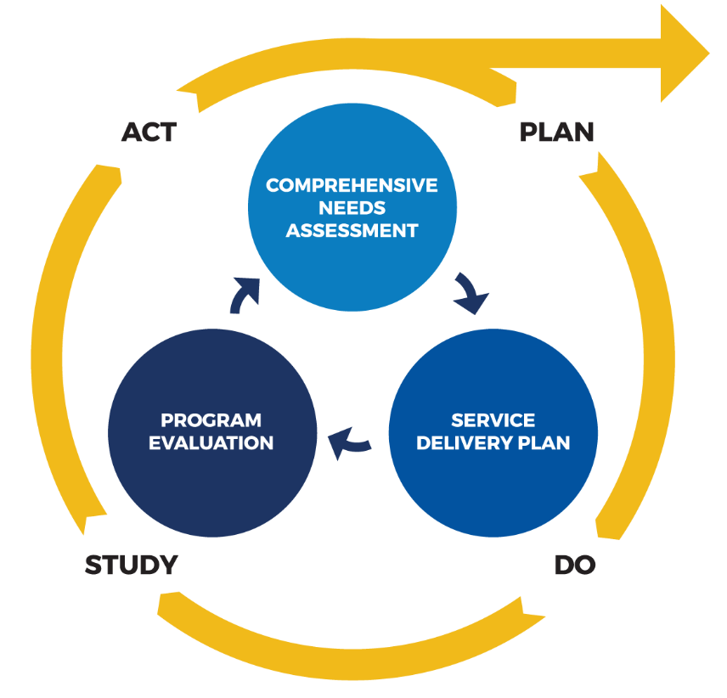
Why is the SSDP Important?
Elementary and Secondary Education Act (ESEA):
Program Purpose (3): To ensure that migratory children receive full and appropriate opportunities to meet the same challenging State academic standards that all children are expected to meet.
The Comprehensive Needs Assessment (CNA) and the SSDP, including MPOs and performance targets for each focus area, are required by ESEA as amended by the Every Student Succeeds Act.
Notes:
Melissa
The Migrant Education Program, or MEP, has several purposes – one of which is to ensure that migratory children receive full and appropriate opportunities to meet the same challenging State academic standards that all children are expected to meet. In striving for that purpose, the needs of migratory children need to be met. The comprehensive needs assessment, or CNA, identifies those needs while the SSDP identifies strategies to address these needs with the hope of providing migratory students the support needed to meet CA’s common core state standards.
Besides being required to develop and implement the SSDP, I think all of us would agree that the utmost importance of the SSDP is striving to address students’ needs. Our role as educators is to meet the child where they are and to differentiate instruction so they have increased access to content and opportunities to develop grade-specific knowledge and skills. We do that through consistent review of data to revise policies, practices, and services to efficiently and effectively serve migratory students who need specific services. Continuous improvement is an ongoing process that allows us to fine tune efforts to increase student attendance, engagement, and other practices. The development of the CNA and SSDP is the first step in the Plan-Do-Study-Act cycle.
I borrowed a clearer picture with the continuous improvement cycle for the MEP.

Slide 9
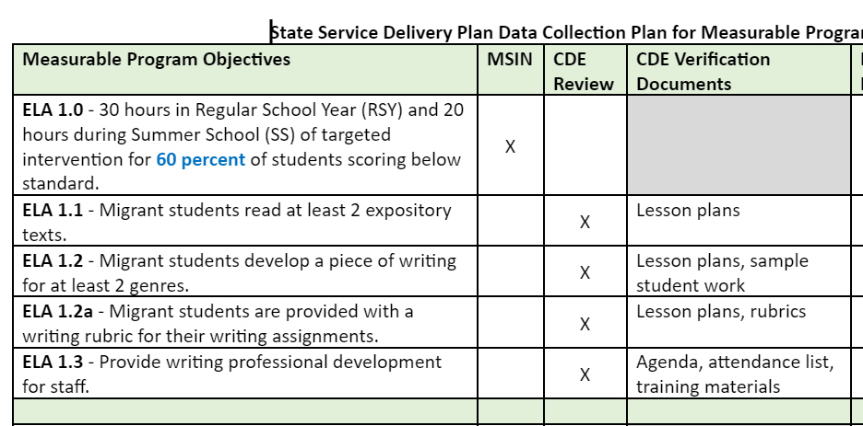
SSDP Verification
You can find the MPO Checklist in the SSDP Monitoring Resources folder within the SSDP Continuous Improvement folder found at:
https://drive.google.com/drive/folders/1Rz7CqcIW3xAX4EGVKhRHpsxdeTyNrdSH?usp=sharing
Notes:
Melissa
A little background for some of our new Directors…the SSDP is our guiding document for migrant education service delivery in California. There are nine focus areas: ELA, math, ELD, high school graduation and drop out prevention, school readiness, out-of-school youth, health, parent engagement and student engagement. Each focus area has a set of strategies and each strategy has a measurable program objective, or MPO, that measures the strategy’s implementation. Additionally, there is a performance target to evaluate overall progress on each focus area. By law, we are required to evaluate the implementation of and progress on the SSDP. The CDE does that through a two pronged approach: 1) through MSIN data and 2) through a document review done by your CDE consultant. We try to verify as many MPOs through MSIN as possible, but since MSIN is a student-centered system we aren’t able to verify all strategies and their aligning MPOs. For strategies related to instructional practice, professional development, and parent engagement, the CDE consultant reviews a set of documents to evaluate implementation. The MPO Checklist in the SSDP Monitoring Resources folder within the SSDP Continuous Improvement folder on Google Drive is helpful in identifying which MPOs are verified by the CDE, including which documents will be requested, and those verified by MSIN.
For our webinar today, we are going to focus on the Strategies and their aligning MPOs that are verified in MSIN.

Slide 10
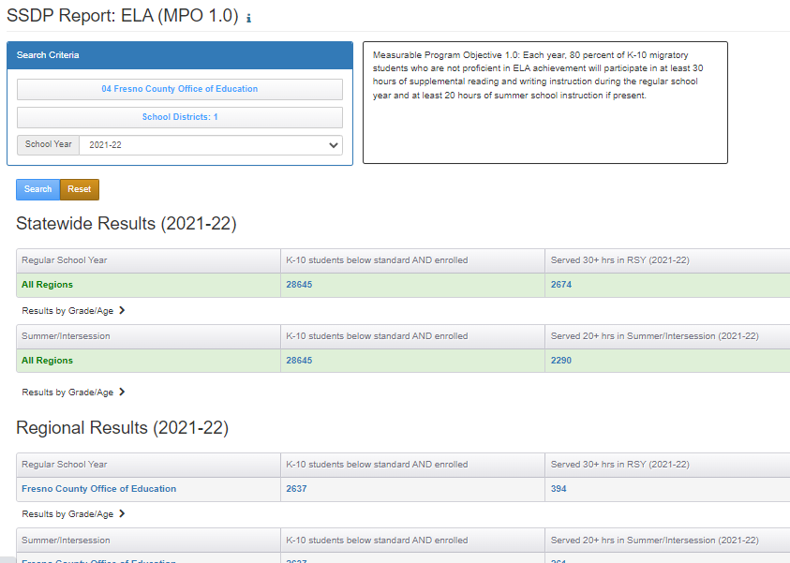
MPO 1.0 Report
Notes:
Jose
Before reviewing the report, I want to note you’ll see some regional and district data in the screenshots used today. I ran these reports about a month prior to the data close deadline, so the data that we see is most likely incomplete and does not reflect actual progress towards the MPOs.
MPO 1.0 Report identifies the percent of students who are identified as academically at-risk in English language arts, or ELA, and met the regular school year, or RSY, and summer services, or SS, hour requirement. This report allows you to identify regional and district level data and is set-up is similar to the other MPO Reports. You select the region, select districts if desired, choose the school year and search. For my example, I only selected a region.
In this example, we see the statewide and regional results for 2021-22. You’ll notice that there are two tables for each set of results: 1) one for regular school year, or RSY, and 2) one for Summer/Intersession. The second column is the denominator. I reviewed the conditions that need to be met for students to be included in the denominator during our last webinar, so I’m just going to summarize these conditions. If you want to know the exact parameters for including children in each report, you can click on the help text to the right of the report title.
The denominator is the column labeled "K-10 students below standard AND enrolled."
A child is counted in the denominator if they’re in grades K-10, scored below standard on either the CAASPP ELA or ELPAC.
The numerator for RSY is the column labeled "Served 30+ hrs in RSY." It a subset of the denominator (i.e., the children were academically at risk based on English language assessments). A child is counted in the numerator for RSY if they participated in a service mapped to MPO 1.0 and had 30 hours or more in the RSY service period.
The numerator for Summer/Intersession is the column labeled "Served 20+ hrs in Summer/Intersession.“ A child is counted in the numerator for Summer/Intersession if they participated in a service mapped to MPO 1.0 and had 20 hours or more in the S or I service period.
The "Result" percentage shown in the column to the right is based on Measurable Program Objective 1.0; please note that the MPO at the top of the report has not been updated with the revised MPOs. While this is on the list of items to address, the MSIN team has other higher priority tasks to complete. Therefore, please refer to the Amended SSDP that was sent out to the field for your MPO targets.
The result is obtained by dividing the number of children who were served (30+ hrs in RSY and 20+ hrs in S/I) by the number of children who were academically at risk in ELA (based on prior year assessment data).
In addition to checking your progress towards the MPO target, you can see specifically which students need to be served for the region by clicking on denominator. This is extremely helpful in targeting students for enrollment at the regional and district levels. For example, let’s say there’s a region with 10 districts and four of them are reimbursable districts who offer their own services for SSDP Strategy 1.0. The region serves six districts, so when they start planning for enrollment into regional services aligning to MPO 1.0, the Director or Program Manager would run the MPO 1.0 Report, select the region and those six districts they serve to identify which students need to be enrolled. This list would be given to staff charged with enrolling students. Similarly, the Director or Program Manager would run a report for each of their four reimbursable districts and give the student list to the district coordinator so they can target enrollment in their district services. Therefore it’s important to have a master calendar of services so you know when specific services begin and you can prepare regional and district staff to enroll the students with a need in ELA, prioritizing students designated as priority for service, or PFS.
Please note that after each data close deadline, WestEd tries to validate the SSID numbers for the full set of migratory children in that year. The SSID is used to match migratory children to their assessment results. If we don’t have an SSID for a child, or the number is incorrect, we will not be able to match them to their results and they will not appear in this report, even if they actually tested below standard. So if you see a student that should be included in these services, please serve them even though they won’t be included in the report. MPO 1.0 and 2.0 Reports are updated in mid-November every year after the SSID match is completed.
The accuracy of these counts depends on how accurately enrollments and services are entered in MSIN. We’ll see a few examples of how enrollments can impact the denominator throughout this presentation.

Slide 11
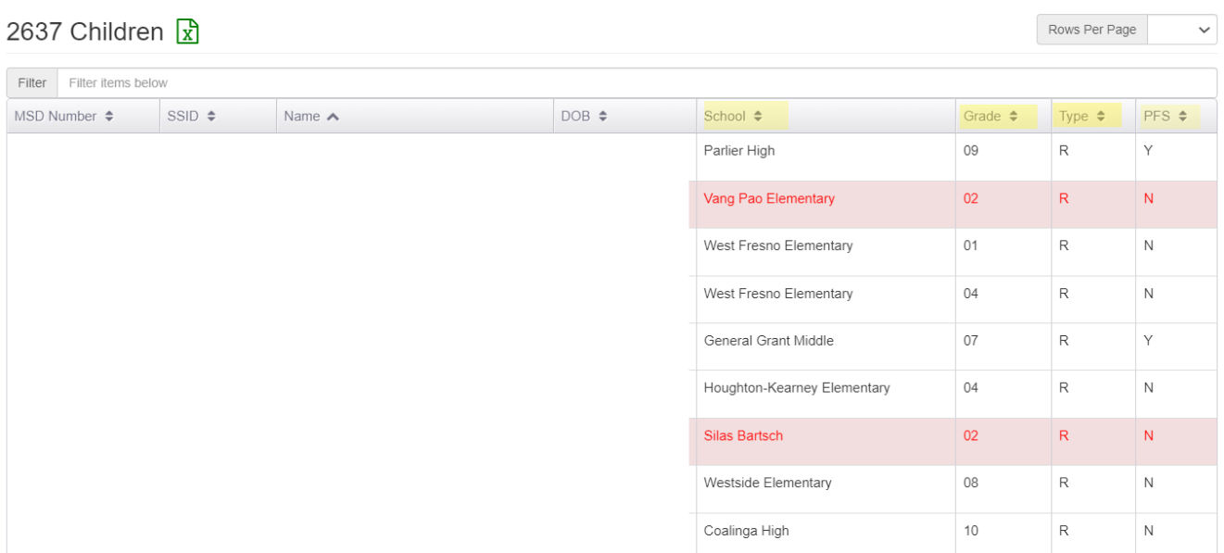
A Deeper Dive into the MPO Report 1.0
Notes:
Jose
I want to share with you some exciting updates to the child counts screen. I arrived at this screen by clicking on the denominator for RSY and a list of students popped up for the region; these are the students that need to be enrolled into services aligned to MPO 1.0. This is the list of students the Director or Program Manager needs to give to regional staff so they can target enrollment into these ELA services. And remember, you can separate the list by district when entering your search criteria and export each list to Excel to give to staff to streamline enrollment.
As you can see, I’ve redacted the PII on this list, but we still see the some child information and the column headings…you’ll notice this screen has changed slightly. Based on feedback from the field, the MEO asked the MSIN team to remove gender and add school, grade, enrollment type, and the PFS indicator. You can click on each column heading to sort by that column. We added these features to further streamline enrollment into services and this screen is available on all the MPO reports that collect student participation.
PFS- when sorting by PFS, you now have an easy way to identify students who should be contacted and enrolled first into the service.
School – sorting by school may be helpful in grouping students from the same school to easily identify students for enrollment into a regional or district service
Grade – sorting by grade may make the identification and enrollment process easier for specific classes within your ELA service.
You can also sort by Enrollment Type, or Type. I’ll review this in more detail during our review of the MPO 2.0 Report.

Slide 12
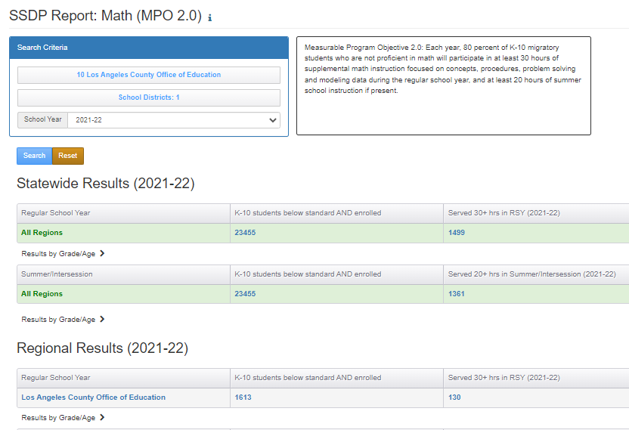
MPO 2.0 Report
Notes:
Jose
MPO 2.0 Report identifies the percent of students who are identified as academically at-risk in mathematics and met the RSY and SS hour requirement. This report also identifies students who are in the subgrantee program area and are academically at-risk in math; using this feature to identify students by district allows the subgrantee to target enrollment which will support meeting the MPO.
The denominator is the column labeled "K-10 students below standard AND enrolled."
A child is counted in the denominator if they’re in grades K-10 and below standards on the CAASSP Math or ELPAC
The numerator for RSY is the column labeled "Served 30+ hrs in RSY." It a subset of the denominator (i.e., the children were academically at risk in Math). A child is counted in the numerator for RSY if they participated in a service mapped to MPO 2.0 and had 30 hours or more in the R service period (in the selected School Year).
The numerator for Summer/Intersession is the column labeled "Served 20+ hrs in Summer/Intersession." A child is counted in the numerator for Summer/Intersession if they participated in a service mapped to MPO 2.0 and had 20 hours or more in the S or I service period. The percentage for RSY is calculated by dividing the numerator (for RSY and Summer/Intersession) by the denominator.
Just like the MPO 1.0 Report requires the SSID data match to identify a list of students, so does the MPO 2.0 Report; therefore, updated data is available at the earliest in mid-November.
If you look at the bottom of the screenshot, the arrow shows that you can click on denominator, to see which students need to be served for the region. This is extremely helpful in targeting students for enrollment at the regional and district levels as I mentioned in my previous example.

Slide 13
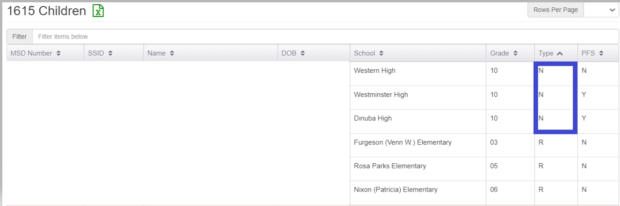
A Deeper Dive into the MPO 2.0 Report
Notes:
Jose
Here we see three students who are identified as non-attending; based on the conditions that need to be met for inclusion in the denominator, you wouldn’t initially think these students should be included. If you see some odd data, that should prompt you to review the enrollment information for the student. Let’s look at the first student’s enrollment to see if we can see what’s going on.

Slide 14
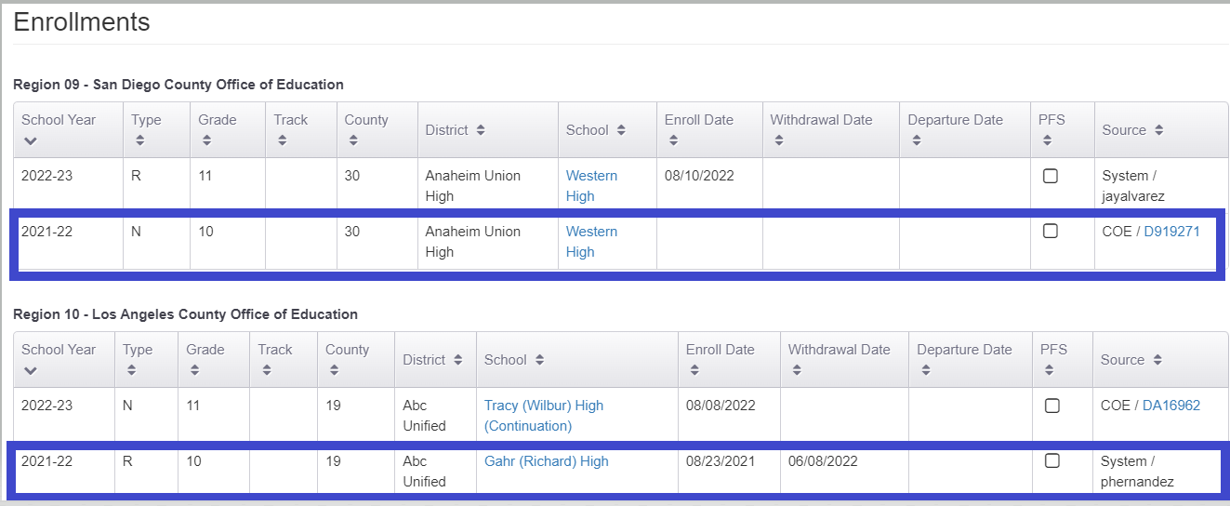
A Deeper Dive into the MPO 2.0 Report (2)
Notes:
Jose
This is the most recent enrollment information, even if it seems odd. Looking at the child’s enrollment info clears up any confusion. We see that the student was enrolled in 2021-22 as an attending 10th grader in Region 10 and as a non-attending 10th grader in Region 9. Discuss these situations when they come up to see if the enrollment information is correct or if edits need to be made. In many cases the enrollment lines will be correct.

Slide 15
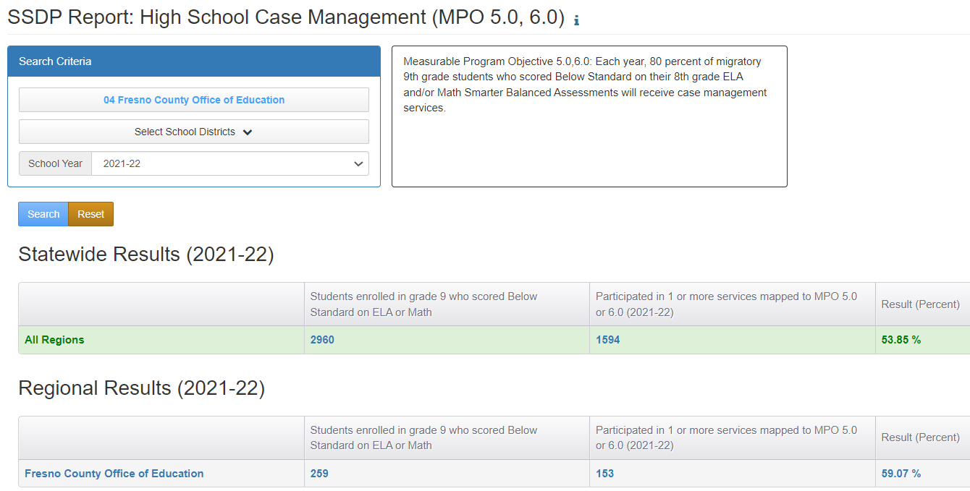
MPO 5.0/6.0 Report
Notes:
Jose
The MPO 5.0/6.0 Report calculates the percentage of 9th graders who scored below standard on ELA and/or math on their 8th grade Smarter Balanced assessment AND participated in one or more services mapped to MPO 5.0 or 6.0. This report allows you to identify regional and district level data. The report set-up is similar to the other MPO Reports. You select the region, select districts if desired, choose the school year and search.
The denominator is the column labeled "Students enrolled in grade 9 who scored Below Standard on ELA or Math." The unduplicated children counted in the denominator met the following criteria:
Are enrolled in grade 9th and scored Below Standard on CAASPP ELA or CAASPP Math in 8th grade (or earlier due to the pandemic
The numerator is the column labeled "Participated in 1 or more services mapped to MPO 5.0 or 6.0". The unduplicated children counted in the numerator met the following criteria:
Are in the denominator, and
Have one or more service participation records mapped to MPO 5.0, or MPO 6.0.
The percentage is derived by dividing the numerator by the denominator and multiplying by 100%.
You may click on the child counts to bring up the list of children who were included.

Slide 16
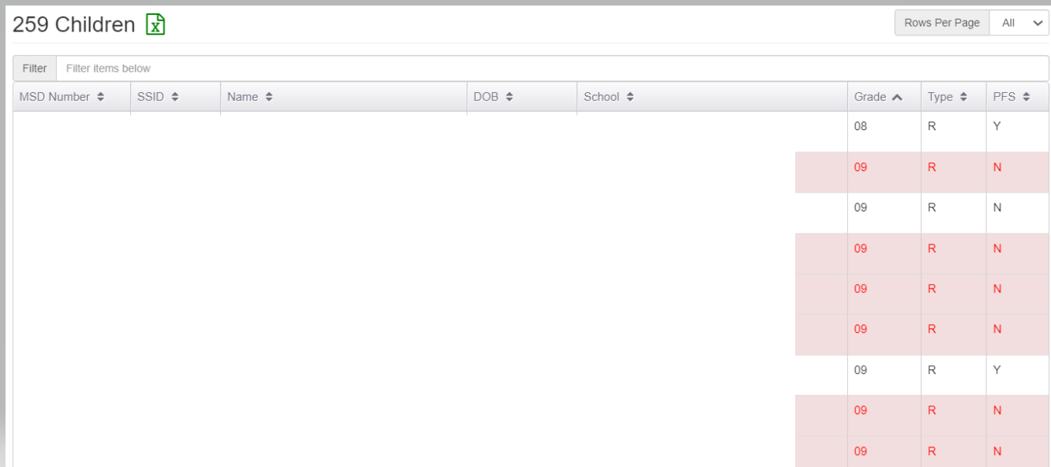
A Deeper Dive into the MPO 5.0/6.0 Report
Notes:
Jose
Again, please note that when you click on the denominator you get a list of students who should receive a case management service. Building the habit of running this report, and the others, and making sure staff are enrolling students off this report at the regional and district levels ensures that we are targeting the right students and setting us up to meet students needs and the MPO. This report should be checked regularly throughout the year to identify new students who’ve been added to the denominator.
If we take a deeper dive into the MPO 5.0/6.0 Report, we see an inconsistency in the students we’d expect to see on this list. If you recall, this report focuses on 9th grade students, but there is an 8th grader in the denominator.

Slide 17
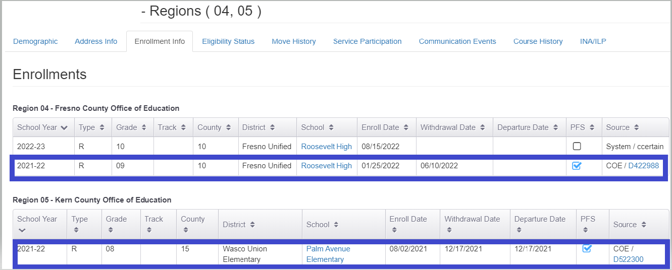
A Deeper Dive into the MPO 5.0/6.0 Report (2)
Notes:
Jose
By reviewing the student’s enrollment information, we see this is happening because the child has two enrollment lines in the 2021-22 school year; one of the them has 9th grade and the other has 8th. The data specialist should review the COE to ensure that the correct grade was included.

Slide 18
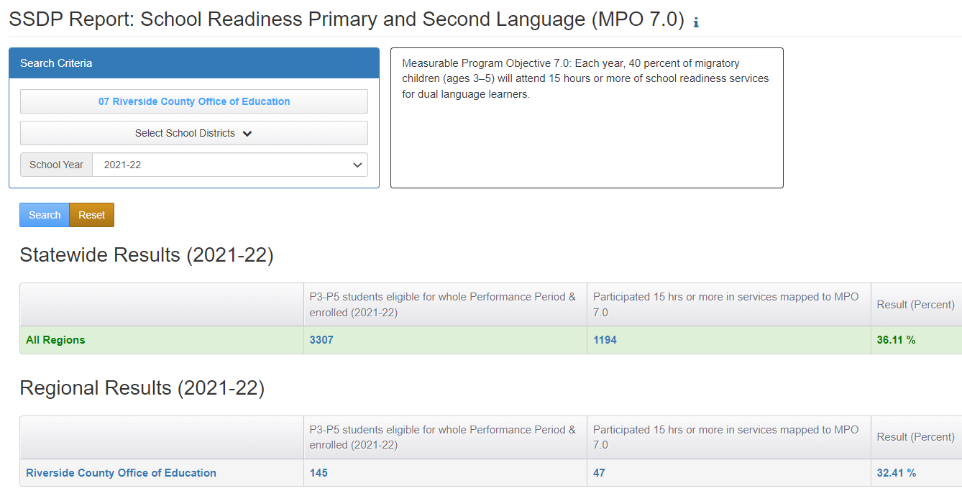
MPO 7.0 Report
Notes:
Jose
MPO 7.0 Report identifies the percent of children who participated in preschool services that align to MPO 7.0 which includes a 15 hour time requirement. Like MPOs 1.0 and 2.0, subgrantees may identify pre-k aged students in the program area which would allow subgrantees to target enrollment at the regional and district levels and thus support meeting students’ needs and the MPO.
This report calculates the percentage of Pre-K students (grades P3-P5) who participated 15 hours or more in services mapped to MPO 7.0 (i.e., school readiness service for dual language learners).
The denominator is the column labeled “P3-P5 students eligible for whole Performance Period & enrolled.” The children counted in the denominator met the following criteria:
1) Were enrolled in grades P3-P5
2) Turned 3 years old on or before 9/1 and
3) Were eligible for the whole performance period (definition: QAD was before 9/1 and EOE was after 8/31).
The numerator is the column labeled “Participated 15 hrs or more in services mapped to MPO 7.0”. The children counted in the numerator met the following criteria:
1) Are in the denominator, and
2) Participated in 1 or more service(s) mapped to MPO 7.0, and
3) Had 15 hours or more recorded in their MPO 7.0 service(s).
The percentage is derived by dividing the numerator by the denominator and multiplying by 100%.
Just like the other MPO Reports that collect student participation data, you may click on the child counts to bring up the list of children who were included. I did that and got the screenshot on the next slide.

Slide 19
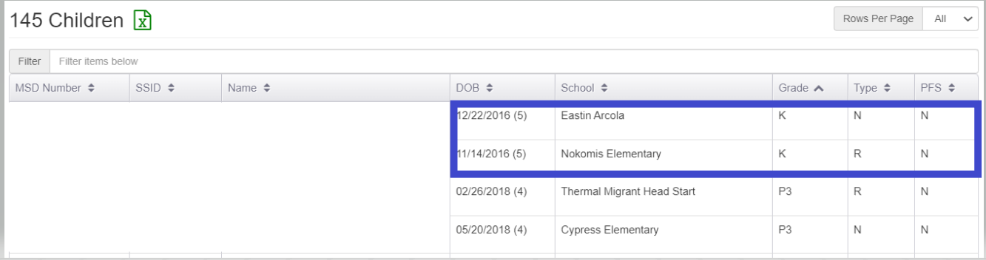
A Deeper Dive into the MPO 7.0 Report
Notes:
Jose
Let’s take a look at the student list. Reviewing the data that’s available, what stands out to you on the list of students for services aligning to MPO 7.0 pre-k services? Please enter your response into the Chat.
Yes, there’s a Kindergarten in the denominator when the denominator specifically identifies students as needing to be P3-P5. If you see something that seems off, it is a good practice to double check the child’s enrollment history by clicking on their MSD to open their child record modal. Then click on the Enrollment Info tab. Children sometimes have two or more enrollment lines in the same school year. Any one of those can have the grade which makes them appear in the MPO 7.0 Report. The multiple enrollment lines can be checked by a Data Specialist to confirm they are correct.

Slide 20
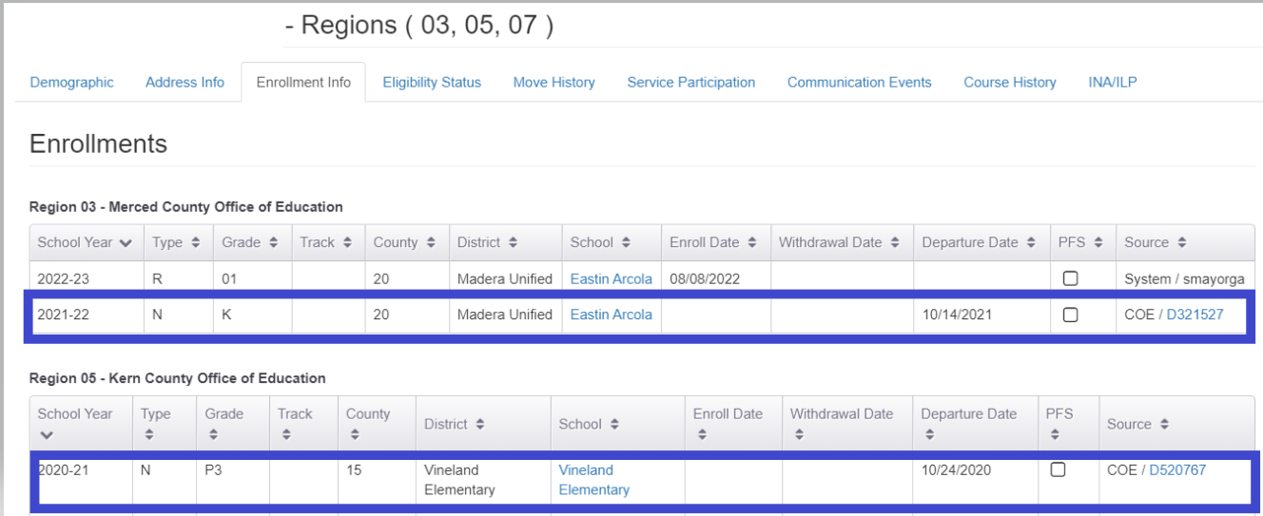
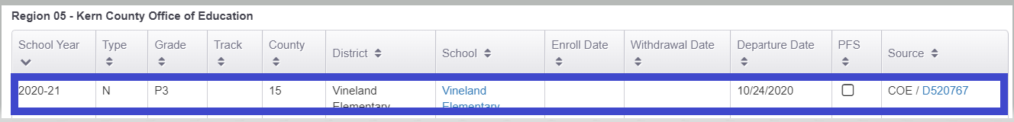
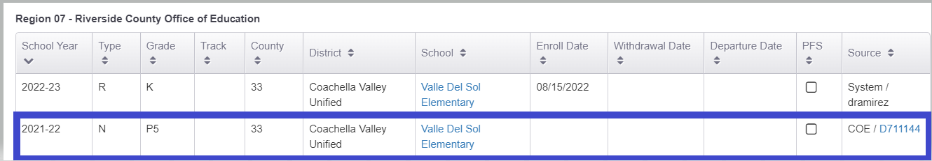
A Deeper Dive into the MPO 7.0 Report (2)
Notes:
Jose
So I clicked on the first student’s child record and selected enrollment info. This child moved three times in 2021-22. Because this student was identified as P3 in 2020-21, the student showed up in the report. The reports are only as accurate as the enrollment information, so you’ll want to double check that the information is correct.

Slide 21
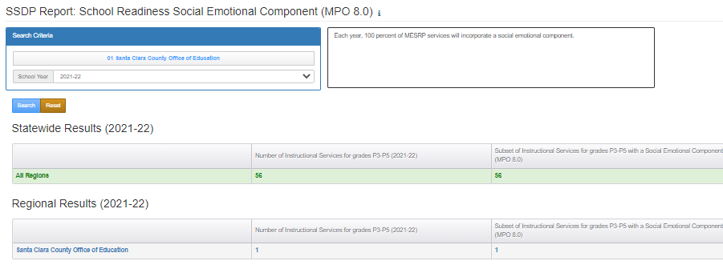
MPO Report 8.0
Notes:
Jose
MPO 8.0 Report calculates the percentage of MESRP (Migrant Education School Readiness Program) services that incorporate a Social Emotional Component (i.e., are mapped to MPO 8.0). In addition to being able to check progress on meeting the MPO, this report is helpful in identifying if any active school readiness services need to include the social emotional component or if a service was improperly set up.
The denominator is the column labeled “Number of Instructional Services for grades P3-P5.” This column shows a count of services (not children), based on how the services were set-up in the Administer Services screen. To be included here, the services are active, instructional services mapped to ages P3-P5.
The numerator is the column labeled “Subset of Instructional Services for grades P3-P5 with a Social Emotional Component.” This column shows how many of the services counted in the prior column were set-up with “Social Emotional Component” checked in the service set-up screen.
The percentage is derived by dividing the numerator by the denominator and multiplying by 100%.
Note: This report counts services (not children). Also, because services are set up at the regional level, you will not see a drop-down menu for District in the search options.

Slide 22
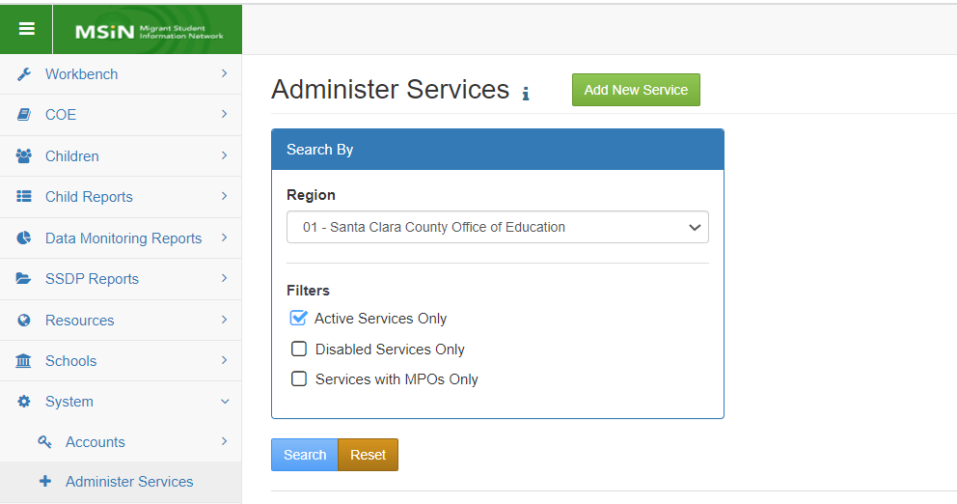
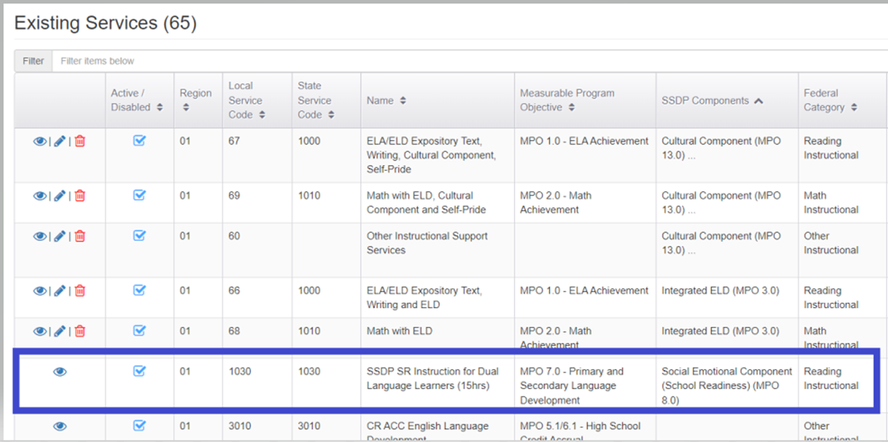
A Deeper Dive into the MPO 8.0 Report
Notes:
Jose
If the subgrantee does not include SSDP Strategy 8.0 in every school readiness service per the MPO 8.0 Report, the subgrantee should review their existing services by first selecting the System option in the Menu and then clicking on Administer Services. Viewing your region’s/DFD’s roster of services allows you to review school readiness instructional services and identify which service(s) need to incorporate this strategy. Or you might need to update an existing service in MSIN to show that it actually has a Social Emotional Component.
Note that the MPO 8.0 Report counts services rather than children. Because of this, we use the Administer Services screen to review which of the instructional services that are active in your region/DFD have the Social Emotional Component. Remember that the Administer Services page is where you can view, edit, and add new services. In contrast, the Services Report shows you which children participated in your services.
We are going to pause for a moment to check our understanding. Jamie, could you please lead us through the poll?

Slide 23

Time for a Poll!
We are going to pause for a moment to take a poll on what we’ve learned so far.
Notes:
Jamie
1. True or False: I can identify the 9th grade PFS students who need to be enrolled into case management services by clicking on the child counts/denominator in the MPO 5.0/6.0 Report.
Answer: True
2. I have a regional service and six reimbursable districts. How do I get the districts to target enrollment to students who need it (select the best answer)?
a. Districts should use the Academic Risk Report to identify students who need to be enrolled.
b. Directors and Program Managers should run the MPO Report for their districts on a regular basis, and more frequently when a lot of students enter the program area, and securely provide them with an Excel list of students to enroll.
c. Districts should just enroll any student who wants to attend in the service.
3. True or False: I can easily prioritize PFS students for enrollment in many services by running the MPO Report, clicking on the denominator, and sorting students by the PFD indicator.
Answer: True
4. Which report should I run to verify the SSDP Components are properly included in each service?
Service Report
Administer Services Report (answer)

Slide 24

Any Questions?
Notes:
Melissa
If you have any questions, please add them in the Chat. I’ll pause for a couple of minutes to see if there are any questions.
Victor is going to continue by reviewing the MPO 9.0 Report.

Slide 25
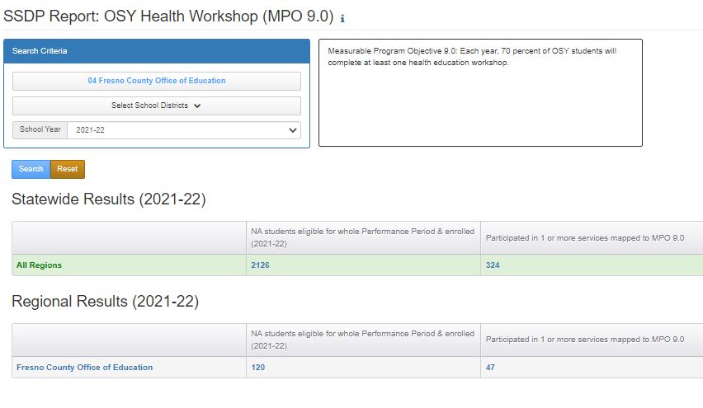
MPO 9.0 Report
Notes:
Victor
MPO 9.0 Report identifies the percent of Out-of-School Youth, or OSY, who attended a health education workshop.
The denominator is the column labeled "Grade NA students eligible for whole Performance Period & enrolled."
A child is counted in the denominator if the child was enrolled in grade NA (i.e., they were an OSY), and were eligible for the whole performance period.
The numerator is the column labeled "Participated in 1 or more services mapped to MPO 9.0." This count is a subset of the denominator. A child is counted in the numerator if they participated in one or more services mapped to MPO 9.0 (i.e., an OSY health education workshop) in the selected School Year.
The "Result" percentage is obtained by dividing the numerator by the denominator.

Slide 26
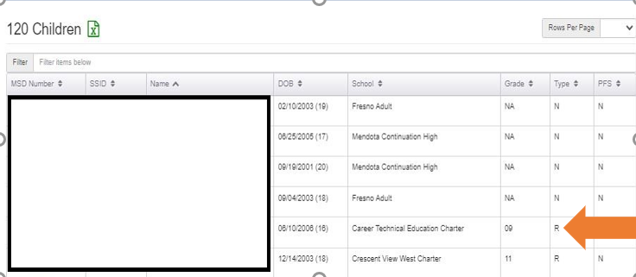
A Deeper Dive into the MPO 9.0 Report
Notes:
Victor
Let’s take a deeper dive into the MPO 9.0 Report. By clicking on the denominator you should see all the OSY non-attending students in the program area. Looking at the student list a few things jump out at me. Please identify in the Chat information that seems incorrect based on the variables included in calculating the denominator.
Yes, we see two students identified as OSY who appear to be enrolled in high school. Let’s take a look at the 9th grade student. In order to do that, you’ll need to select that student’s MSD Number.

Slide 27
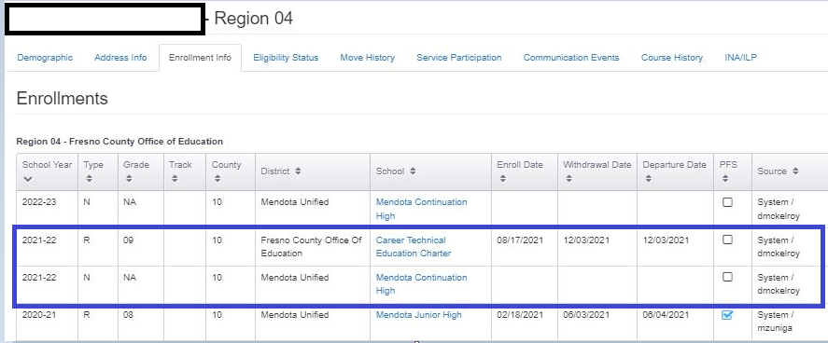
A Deeper Dive into the MPO 9.0 Report (2)
Notes:
Victor
I clicked on the child’s MSD number to access the Enrollment Info on the child modal. I want to see if I can determine why this student showed up in a report intended for OSY students. If I review the 2021-22 school year, I see two enrollment lines for this student. Because they have two enrollment lines and one is relevant to this MPO, the student shows up in the report. The accuracy of the denominator (in all reports with student participation) depends on how accurately enrollments and services are entered in MSIN. For example, if a child has two enrollment lines for the same school year with two different grades, then the child may appear in two different MPO reports (such as 9.0 [for OSY] and 5.0/6.0 [for grade 9] and that both lines could be correct. If there’s a question, please discuss with your data specialist.

Slide 28
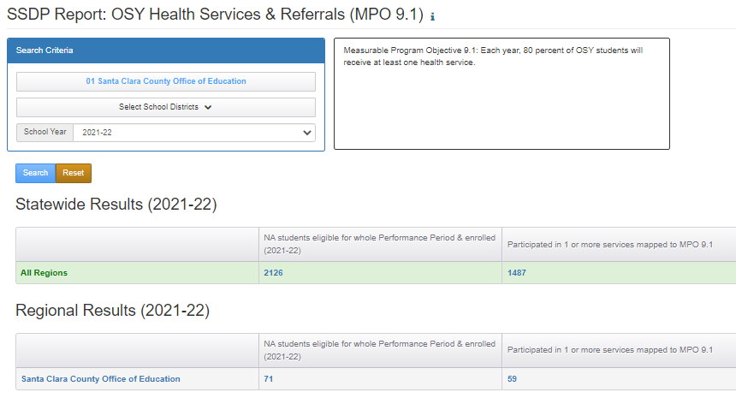
MPO 9.1 Report
Notes:
Victor
MPO 9.1 Report identifies the perfect of OSY who received at least one health service.
The denominator is the column labeled "Grade NA students eligible for whole Performance Period & enrolled."
A child is counted in the denominator if the child was enrolled in grade NA (i.e., they were an OSY), and
were eligible for the whole performance period.
The numerator is the column labeled "Participated in 1 or more services mapped to MPO 9.1." This count is a subset of the denominator and a child is counted if they participated in one or more services mapped to MPO 9.1.
The "Result" percentage is obtained by dividing the numerator by the denominator.
Note: The accuracy of these counts depends on how accurately enrollments and services are entered in MSIN.

Slide 29
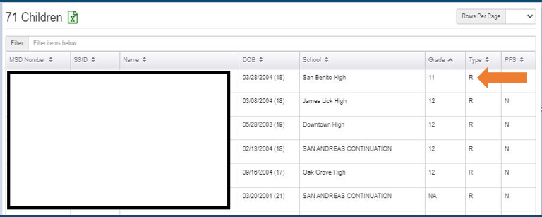
A Deeper Dive into the MPO 9.1 Report
Notes:
Victor
Here’s an example similar to the previous scenario. We see high school students in the denominator for a report that should only include OSY. Let’s review the first example…please enter into the Chat why you think this 11th grader was included in this report.
[wait for responses and then move to the next slide]

Slide 30
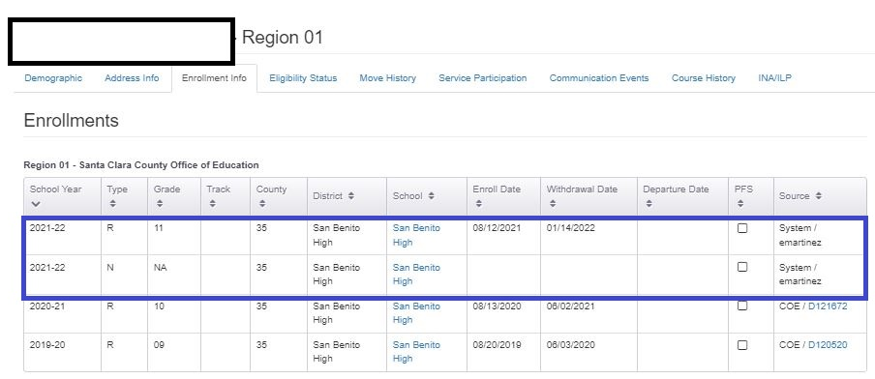
A Deeper Dive into MPO Report 9.1 (2)
Notes:
Victor
Yes, that’s correct. We see two enrollment lines for this student: one where they are considered an OSY and one where they’re identified as an 11th grader. If a child has two enrollment lines for the same year with two different grades, you’ll want to review the information with your Data Specialist. A child could legitimately have two or more enrollment lines in the same school year; it’s not that uncommon.

Slide 31
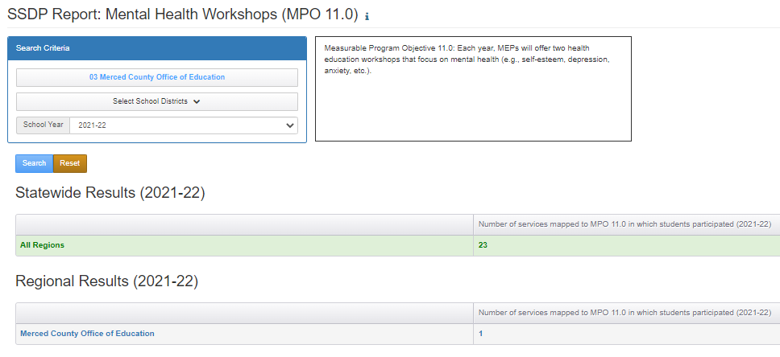
MPO 11.0 Report
Notes:
Victor
MPO 11.0 Report identifies the number of mental health workshops mapped to MPO 11.0 for which students participated in a service.
This report references the Region, District, and School Year selections and then displays a count of all the services mapped to MPO 11.0 (i.e., mental health workshops).
Services are only counted if they were actually used. This means that a region or DFD could set up a mental health workshop (mapped to MPO 11.0), but it will not get counted in this report unless children participated in the service and it was added to their child records. In addition, note that the objective is for MEP’s to offer at least 2 mental health workshops, so 2 or more services mapped to MPO 11.0 must be created using the Administer Services screen. After that, service participation data must be entered in MSIN.

Slide 32
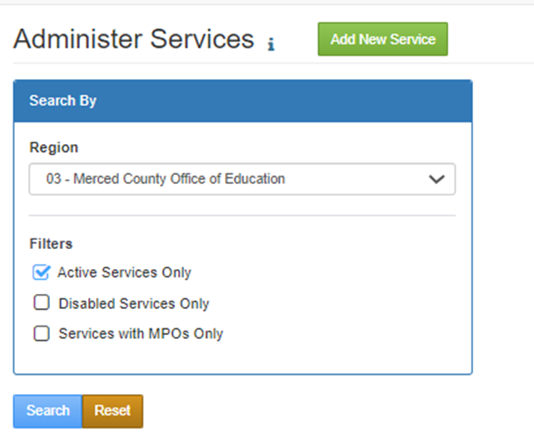
A Deeper Dive into the MPO 11.0 Report
Notes:
Victor
So I ran the MPO 11.0 Report and saw that the region only had 1 health workshop. It could be that the region set up two workshops in MSIN, held two workshops and then added student participation to only one workshop. But remember that two mental health workshops are required each year. This is a fairly easy MPO to meet as there are no percentages to strive for, you only have to offer the service and do outreach for participants. Since the region only had one service, I am going to check the Administer Services report to identify how many services were created aligning to MPO 11.0. We see that only one service has been set up. This MPO requires that two unique services be set up and that student participation from each workshop is inputted. It’s important that someone is assigned to ensure the accuracy of the services entered into MSIN and that proper planning to meet students’ needs and the MPOs is occurring.

Slide 33
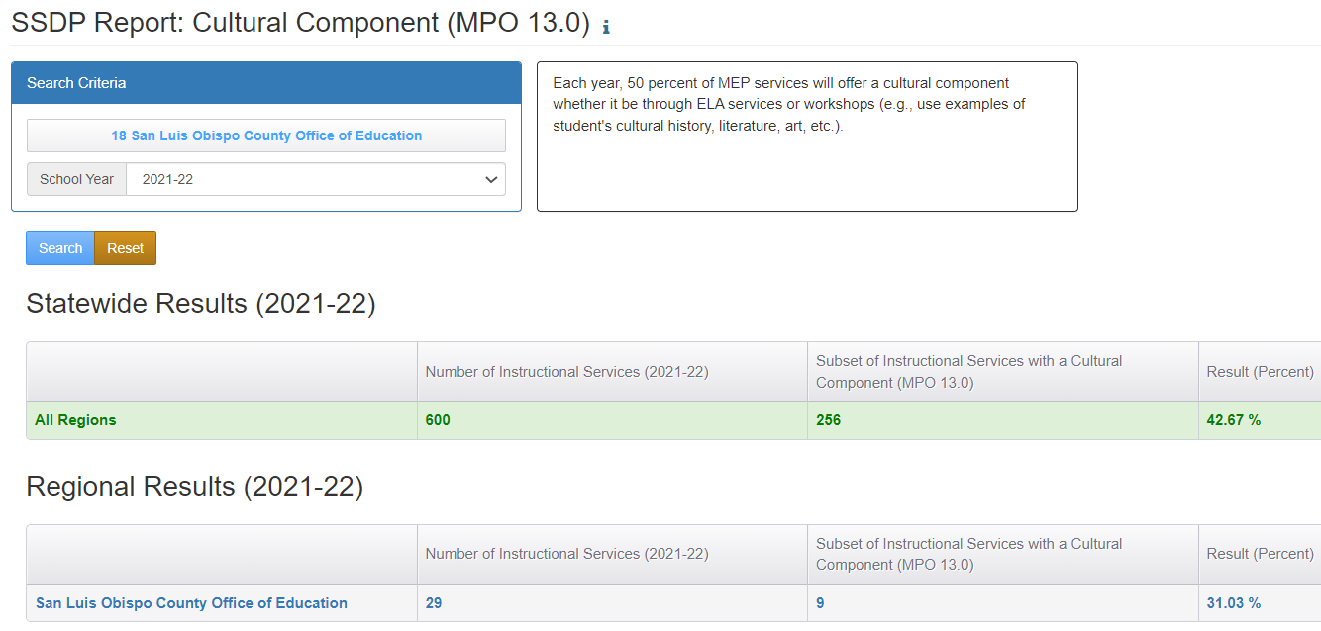
MPO 13.0 Report
Notes:
Victor
MPO 13.0 identifies the percent of instructional services, excluding credit accrual services, that includes a cultural component. Half of these services should include explicit teaching of building cultural pride and/or culturally and linguistically responsive teaching. Here we see the number of instructional services as the denominator and those services with a cultural component as the numerator. If I wanted to review the services I set up to identify which services have this SSDP Component, which report would I review? Please enter your response into the Chat.

Slide 34
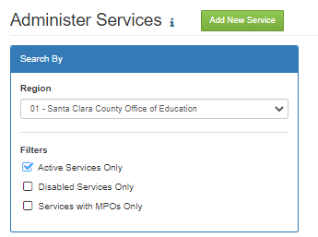
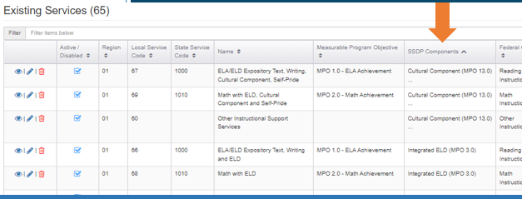
A Deeper Dive into the MPO 13.0 Report
Notes:
Victor
Those of you who said the Administer Services screen are correct. You’ll want to review all the services for three things: 1) are all of my services set up in MSIN, 2) are the services set up correctly with the right SSDP Components, and 3) are there any services to which I could add the cultural component in order to meet the students’ needs and the MPO. This is where developing and maintaining a service code map for your Data Specialist is especially helpful so they can easily review the services.
On this slide we see a partial example of the services provided by Region 1. If I sort by the SSDP Component I can view which components are included in various services. If you see an ellipses under a component in a service that means there are additional SSDP Components included. You can hover over the ellipses and you’ll see which other components were selected. From here I’d want to make sure all the services in the application are included and have the correct SSDP Components included. If all that is correct, then I’d want to see which services could include SSDP Strategy 13.0 to meet students’ needs and the MPO. I’d need to follow up with the teachers to communicate the change in service and review any lesson plans to ensure the addition was made. For any services where a cultural component was included, but not included in MSIN, you can contact the MSIN helpdesk to have them assist you with making the edit. If the cultural component was not included in the service previous, but the teacher is now implementing the strategy, you will need to create a new service as we don’t want to change the historical record of our data by incorrectly reflecting the implementation of the strategy in prior years when it was not actually implemented.

Slide 35
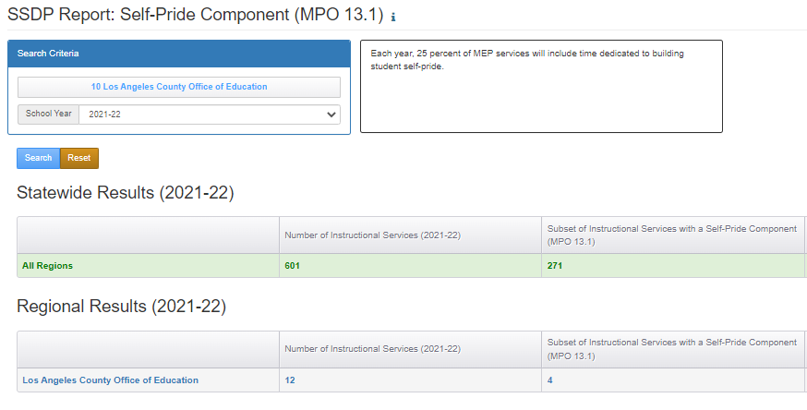
MPO 13.1 Report
Notes:
Victor
MPO 13.1 identifies the percent of instructional services, excluding credit accrual services, that includes a self-pride component. This report is similar to the previous report, except here teachers focus on explicitly teaching strategies to build self-pride. Unlike 13.0, Strategy 13.1 only requires 25% of these instructional services to include this component. Here we see Region 10 has 12 instructional services that meet the criteria and four services that include the self-pride component, so they exceeded the MPO.

Slide 36
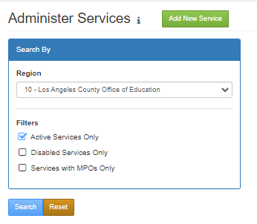
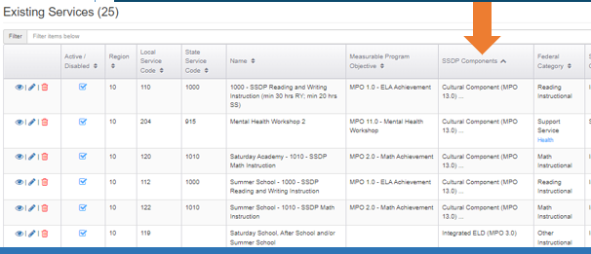
A Deeper Dive into the MPO 13.1 Report
Notes:
Victor
If your region is not meeting the MPO, you should again check the Administer Services Report and complete the process we’ve reviewed for Strategies 8.0 and 13.0.

Slide 37
Additional Questions?
Notes:
Melissa
If you have any questions, please add them in the Chat. I’ll pause for a couple of minutes to see if there are any questions.

Slide 38

Break
Let’s take a ten minute break.
Notes:
Melissa
That was a lot of information to cover. Let’s take a ten minute break. Be sure to come back on time because we are going to jump right in to reviewing the MPO reports that are linked to the Individual Needs Assessment, or INA, and you don’t want to miss any of that!

Slide 39
MPO Reports Linked to the INA
MPO 5.1/6.1
MPO 10.0
MPO 10.1
MPO 10.2
MPO 11.1
Notes:
Melissa
The following MPO reports are dependent on the information for specific questions within the INA. Therefore the information from the INA, among other factors, determine whether a student is included in the denominator of the report. The following MPOs and aligning reports are connected to specific questions in the INA:
MPO 5.1/6.1
MPO 10.0
MPO 10.1
MPO 10.2
MPO 11.1
Note: The accuracy of these counts depends on how accurately enrollments, INA/ILPs, and services are entered in MSIN. We will walk through each report in the next slides.

Slide 40
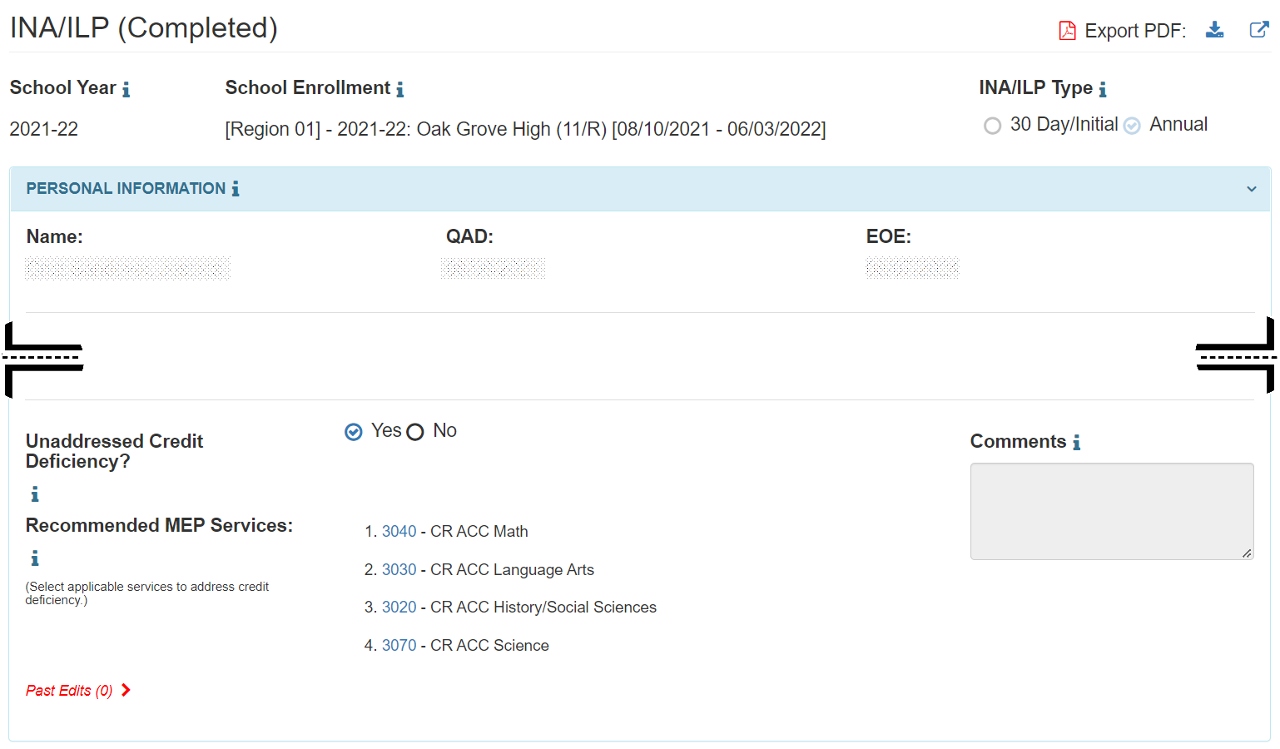
The INA and the MPO 5.1/6.1 Report
Notes:
Melissa
The screenshot focuses on the question regarding credit deficiency. Staff can select yes or no.
MPO 5.1/6.1 Report is directly connected to a question in the INA. Any 11th and 12th grade students with the “unresolved credit deficiency” marked as “yes” on the INA are included in MPO the 5.1/6.1 Report. Remember we are only selecting “unresolved credit deficiency” if we know for sure that the district is not serving a student.
Please note the Asterix next to the “Unresolved Credit Deficiency.” A friendly reminder that the questions with asterixis are questions that must be answered because they are connected to an MPO and MPO Report.

Slide 41
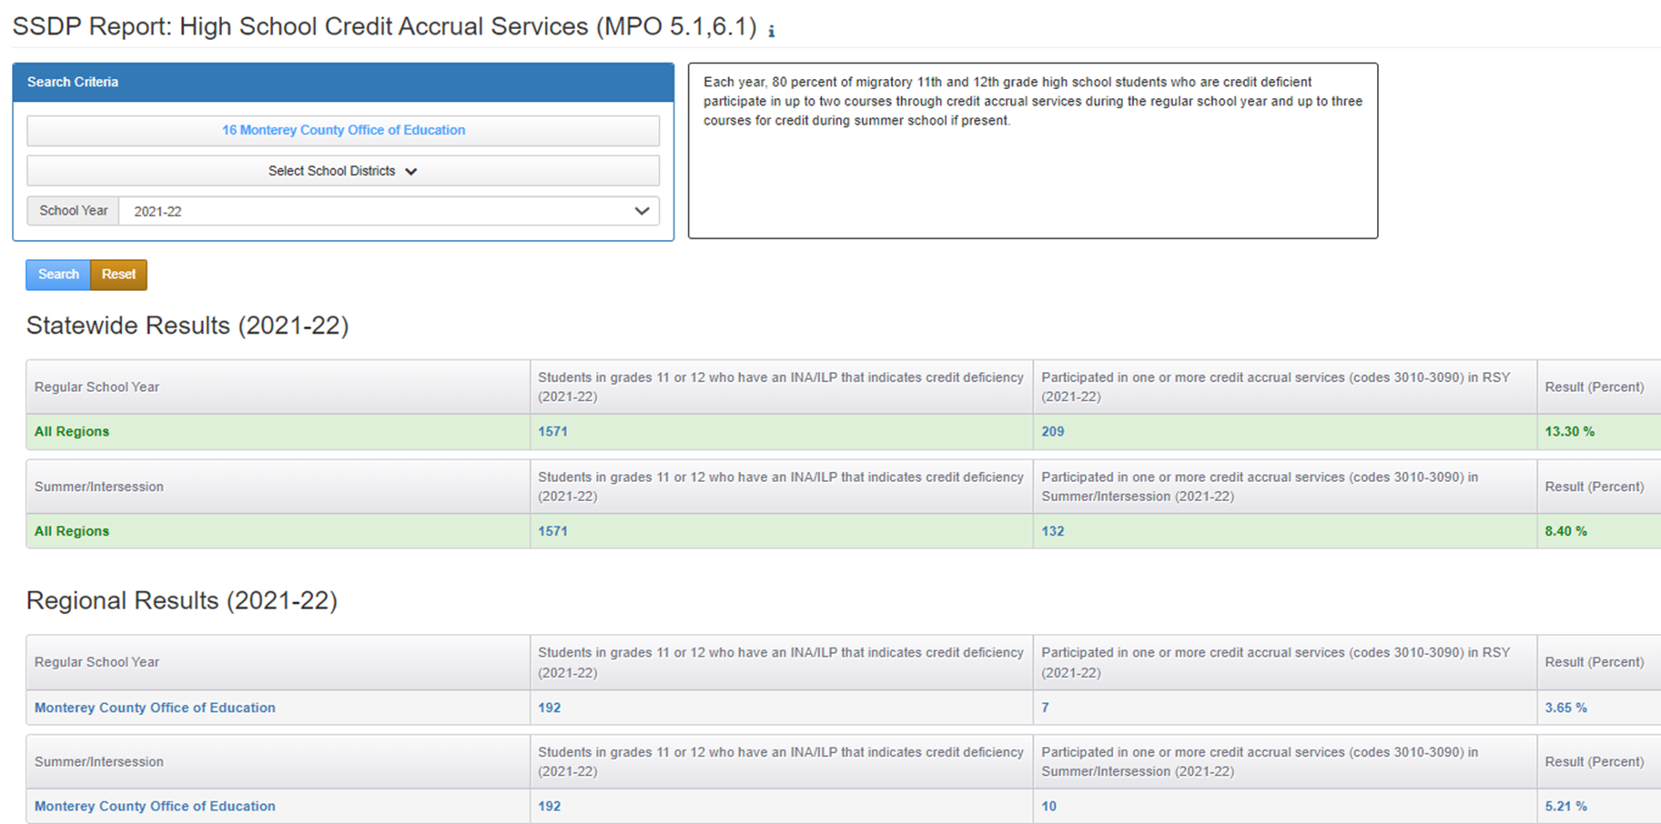
MPO 5.1/6.1 Report
Notes:
Melissa
MPO 5.1/6.1 Report calculates the percentage of grade 11 or 12 students who participated in a Credit Accrual service (3000s codes) after completing an individual needs assessment (INA)/individual learning plan (ILP) form in which they shared an unaddressed credit deficiency. This report allows you to identify regional and district level data. The report set-up is similar to the other MPO Reports. You select the region, select districts if desired, choose the performance period and search.
The report will have two sets of results:
Regular School Year (RSY) service participations.
Summer/Intersession (S/I) service participations.
The denominator is the column labeled "Students in grades 11 or 12 who have an INA/ILP that indicates credit deficiency...." A child is counted in the denominator by referencing the Region, District, and School Year selections AND by also meeting the following conditions:
Have an INA/ILP with grade 11 or 12, and
"Yes” is selected in the INA/ILP after “Credit Deficient?”, and
The INA/ILP has been completed (i.e., displays completed status).
The denominator does not include all grades. Instead, it is limited to children enrolled in grades 11 or 12 in the selected Performance Period. In addition, the denominator is calculated the same way for both regular school year (RSY) and Summer/Intersession.
The numerator for RSY (regular school year) is the column labeled "Participated in one or more credit accrual services (codes 3010-3090) in RSY...." The children included here met the following conditions:
Are in the denominator, and
Have one or more service participation records mapped to a credit accrual code (i.e., state service codes 3010-3090), and
The service participation records are in the Regular School Year (RSY) service period.
The numerator for Summer/Intersession is the column labeled "Participated in one or more credit accrual services (codes 3010-3090) in Summer/Intersession...." The children included here met the following conditions:
Are in the denominator, and
Have one or more service participation records mapped to a credit accrual code (i.e., state service codes 3010-3090), and
The service participation records are in the Summer/Intersession (S/I) service period.
The percentage is derived by dividing the numerator by the denominator and multiplying by 100%.
You may click on the child counts to bring up the list of children who were included.
Note: The accuracy of these counts depends on how accurately enrollments, INA/ILPs, and services are entered in MSIN.
If students have been identified in the fall through the INA/ILP as credit deficient, it is imperative that students be served

Slide 42
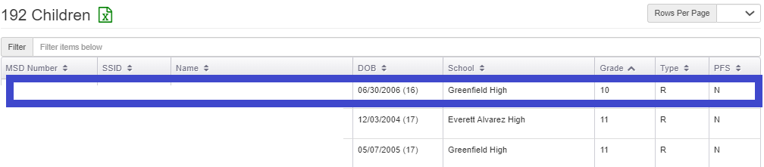
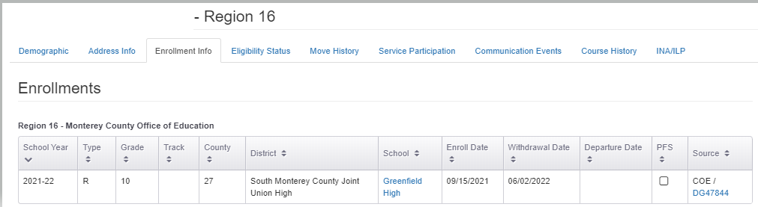
A Deeper Dive into the MPO 5.1/6.1 Report (2)
Notes:
Melissa
When I click on the denominator to see which children should be served, the top screenshot shows a partial child list that pops up and I see something peculiar, a 10th grader is showing up in the report which means that some additional investigation is needed. I clicked on the student’s MSD number and selected Enrollment Info to see if this student has two enrollment lines. This student only had one enrollment line for 2021-22. So next I’ll check the COE. The were originally enrolled as an 11th grader, via the COE. Someone later edit the enrollment line and changed the grade from 11 to 10.

Slide 43
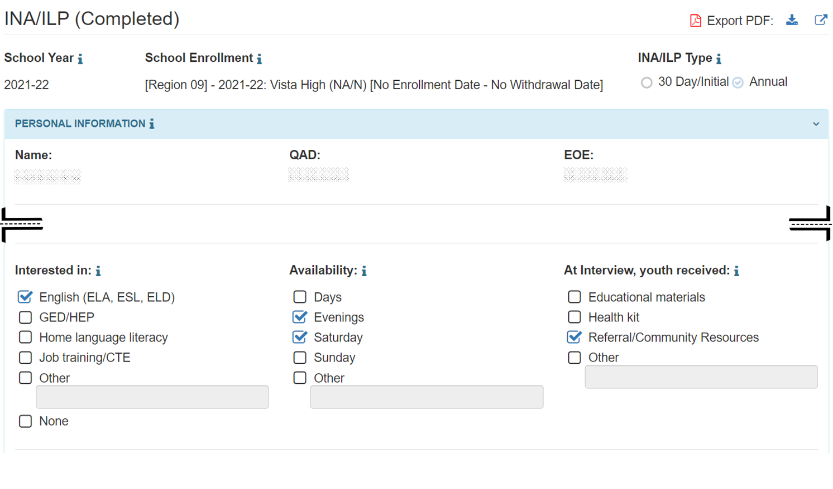
The INA and the MPO 10.0 Report
Notes:
Melissa
MPO 10.0 is also connected directly to the INA. The question “Interested in” indicates an interest in ELA services. This is required field when completing the INA/ILP for grade NA youths.

Slide 44
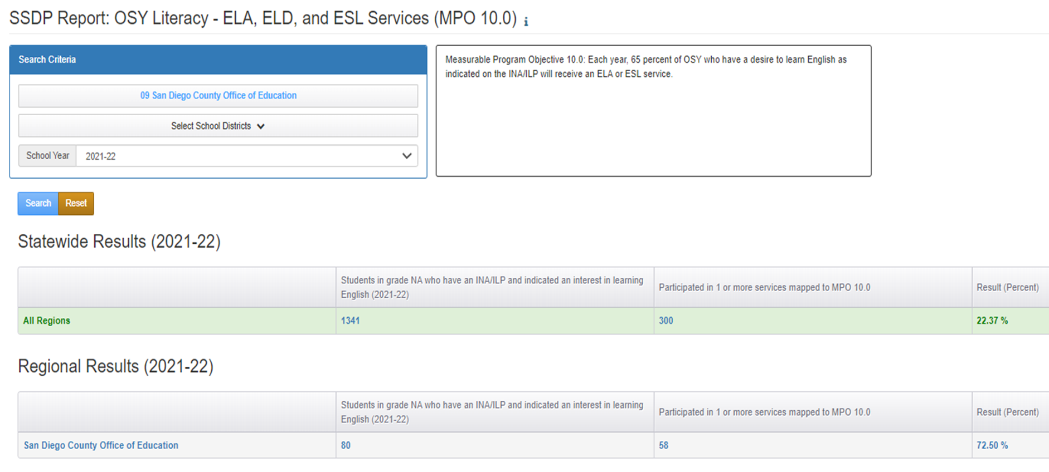
MPO 10.0 Report
Notes:
Melissa
MPO 10.0 Report calculates the percentage of OSY, which are grade NA, students who participated in an ELA, ELD, or ESL service(s) after completing an INA/ILP form where they indicated being interested in learning English (or increasing their literacy skills). This report allows you to identify regional and district level data. The report set-up is similar to the other MPO Reports. You select the region, select districts if desired, choose the performance period and search.
The denominator is the column labeled "Students in grade NA who have an INA/ILP and indicated an interest in learning English." The unduplicated children counted in the denominator have a completed INA/ILP with grade NA with “English (ELA, ESL, ELD)” is checked in the INA/ILP under "Interested In.”
The numerator is the column labeled "Participated in 1 or more services mapped to MPO 10.0". The unduplicated children counted in the numerator are in the denominator and have one or more service participation records mapped to MPO 10.0.
The percentage is derived by dividing the numerator by the denominator and multiplying by 100%.
You may click on the child counts to bring up the list of children who were included.

Slide 45
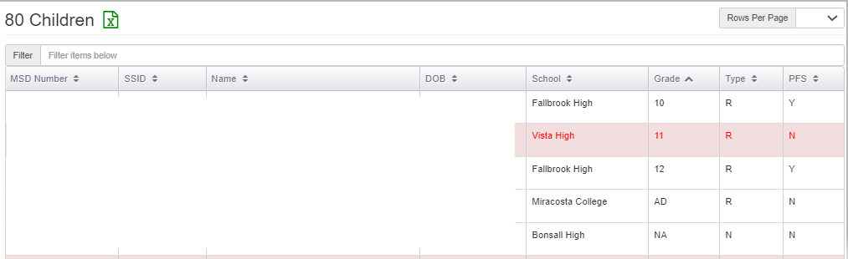
A Deeper Dive into the MPO 10.0 Report
Notes:
Melissa
When I click on the denominator to see which children should be served, I see a 10th , 11th , 12th grader and a student in grade AD are showing up in the report for OSY which means that some additional investigation is needed. I reviewed the enrollment for these students in grades 10th, 12th, and AD and found they all have two enrollment lines with one of them indicating the student was in grade NA at some point in 2021-22. Let’s take a closer look at the 11th grader.

Slide 46
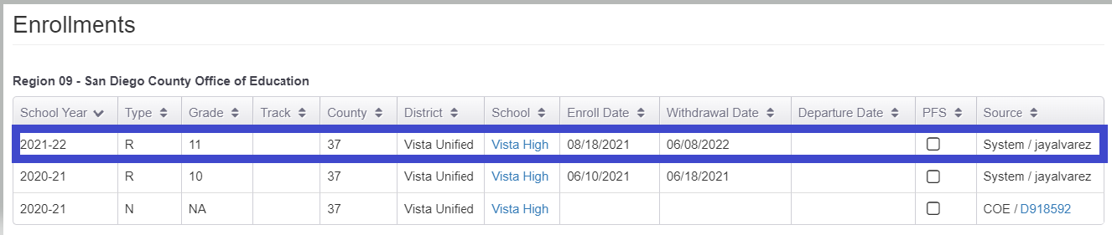
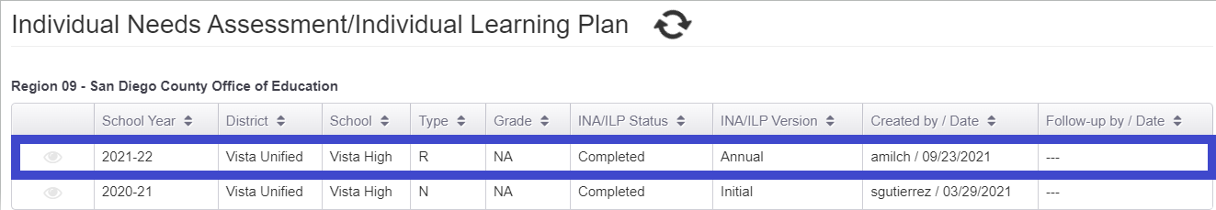
A Deeper Dive into the MPO 10.0 Report (2)
Notes:
Melissa
The 11th grader does not have two enrollment lines; we see the this student has been added to the report because they have an INA indicating that they are grade NA and thus an OSY. MSIN pulls the information from the INA to include students in the reports linked to the INA. Remember the accuracy of these reports are only as accurate as the information inputted into the system.

Slide 47
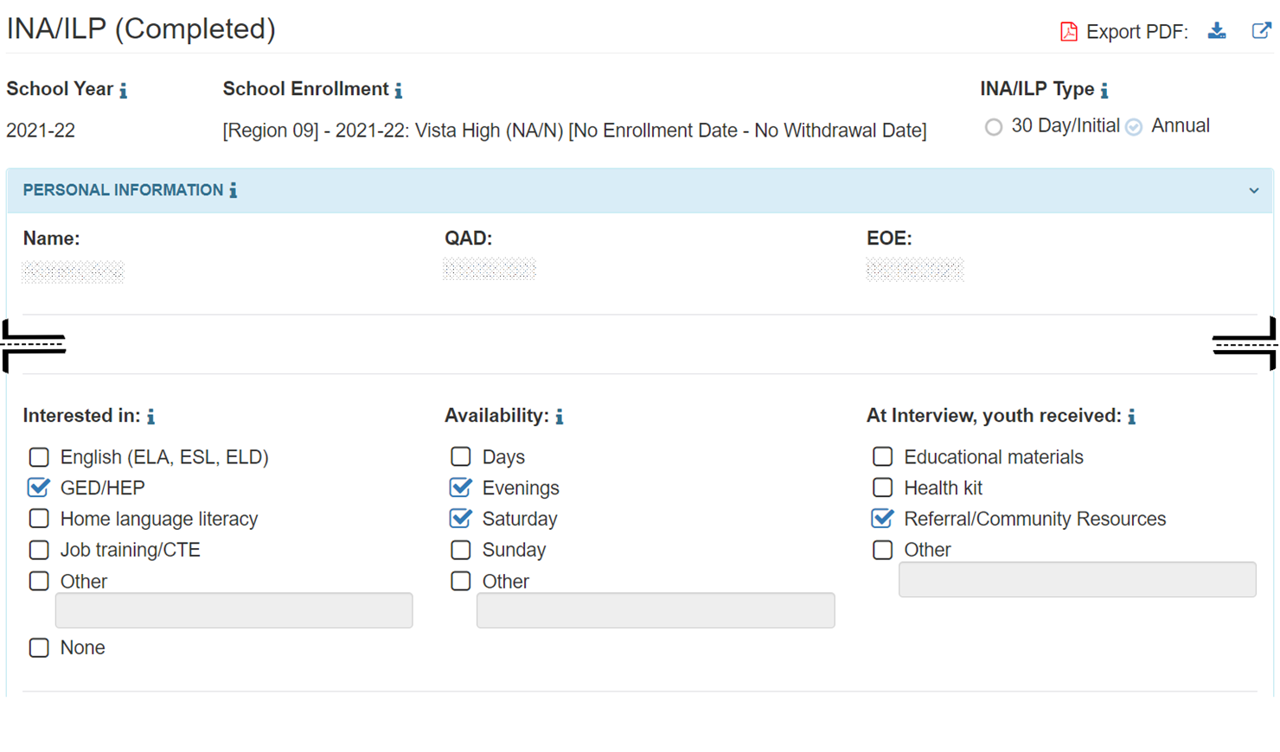
The INA and the MPO 10.1 Report
Notes:
Melissa
MPO 10.1 links to a question on the INA. The question “Interested in” indicates an interest in GED services which is specific to MPO 10.1.

Slide 48
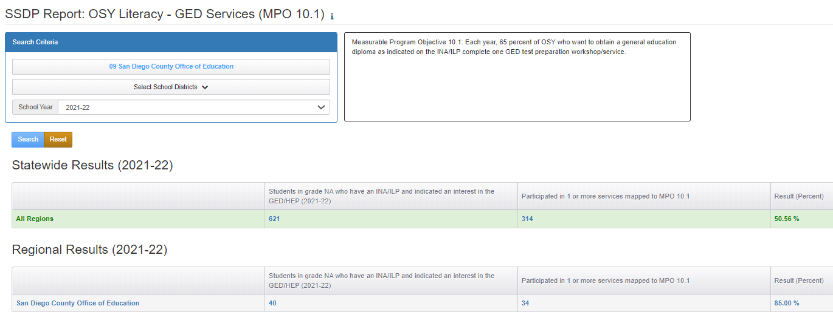
MPO 10.1 Report
Notes:
Melissa
MPO 10.1 Report calculates the percentage of OSY, which are grade NA, students who participated in a GED or HSE service(s) after completing an INA/ILP form where they indicated being interested in the GED/HEP. This report allows you to identify regional and district level data. You select the region, select districts if desired, choose the performance period and search.
The denominator is the column labeled "Students in grade NA who have an INA/ILP and indicated an interest in the GED/HEP." The unduplicated children counted in the denominator have a completed INA/ILP with grade NA, and are interested in “GED/HEP” services.
The numerator is the column labeled "Participated in 1 or more services mapped to MPO 10.1". The unduplicated children counted are in the denominator, and have one or more service participation records mapped to MPO 10.1.
The percentage is derived by dividing the numerator by the denominator and multiplying by 100%.
Now, I’m going to click on the child counts to bring up the list of children who were included.

Slide 49
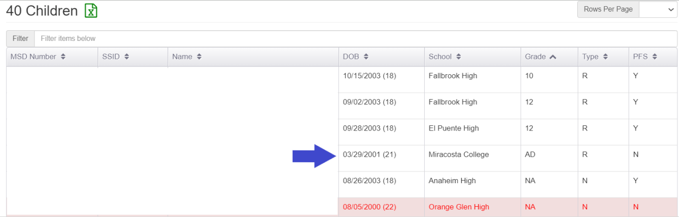
A Deeper Dive into the MPO 10.1 Report
Notes:
Melissa
Let’s explore why the AD student was included in this report.
Why do you think this student was included? Please enter your response in the Chat.

Slide 50
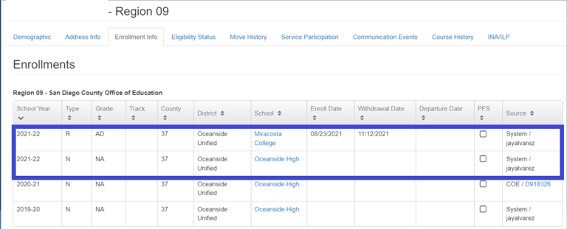
A Deeper Dive into the MPO 10.1 Report (2)
Notes:
Melissa
Yes, that’s right! This student has two enrollment lines. Again, you’ll want to check in with your data specialist, but there is probably nothing wrong with these enrollments (assuming they represent what happened with the youth).

Slide 51

The INA and the MPO 10.2 Report
Notes:
Melissa
We arrive to the last MPO in the OSY Literacy Goal area of which all strategies, and their corresponding MPOs, are linked to the INA in this goal area. MPO 10.2 is also connected to the question “Interested in” focused on home, or primary, language literacy services.

Slide 52
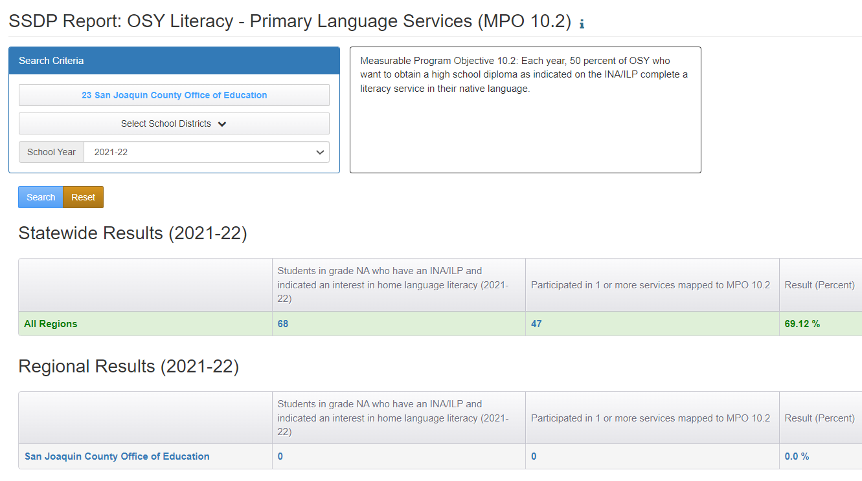
MPO 10.2 Report
Notes:
Melissa
MPO 10.2 Report calculates the percentage of grade NA students who participated in a literacy service in their native/home language after completing an INA/ILP form where they indicated being interested in home language literacy. This report allows you to identify regional and district level data. You select the region, select districts if desired, choose the performance period and search.
The denominator is the column labeled "Students in grade NA who have an INA/ILP and indicated an interest in home language literacy." The unduplicated children counted in the denominator have a completed INA/ILP with grade NA, and are interested in “Home language literacy” services
The numerator is the column labeled "Participated in 1 or more services mapped to MPO 10.2". The unduplicated children counted in the numerator if they are in the denominator, and have one or more service participation records mapped to MPO 10.2.
The percentage is derived by dividing the numerator by the denominator and multiplying by 100%.
Normally, you’d click on the child counts to bring up the list of children who were included, but this region did not have any OSY indicating a need in primary language services. But I wanted to include this example to remind you that if you do run an MPO report that is linked to the INA and the denominator includes zero students, you should stop and run the INA Report to verify that all INAs have been completed. If not, staff need to recheck these MPO reports during INA completion and again after all the INAs have been completed. In addition to being required in CA Ed Code, completing the INA is extremely important in identifying specific needs that the MEP is striving to meet. We’re not going to go into a deeper dive into the 10.2 Report as many of the examples we’ve already covered could potentially show up here as well.

Slide 53
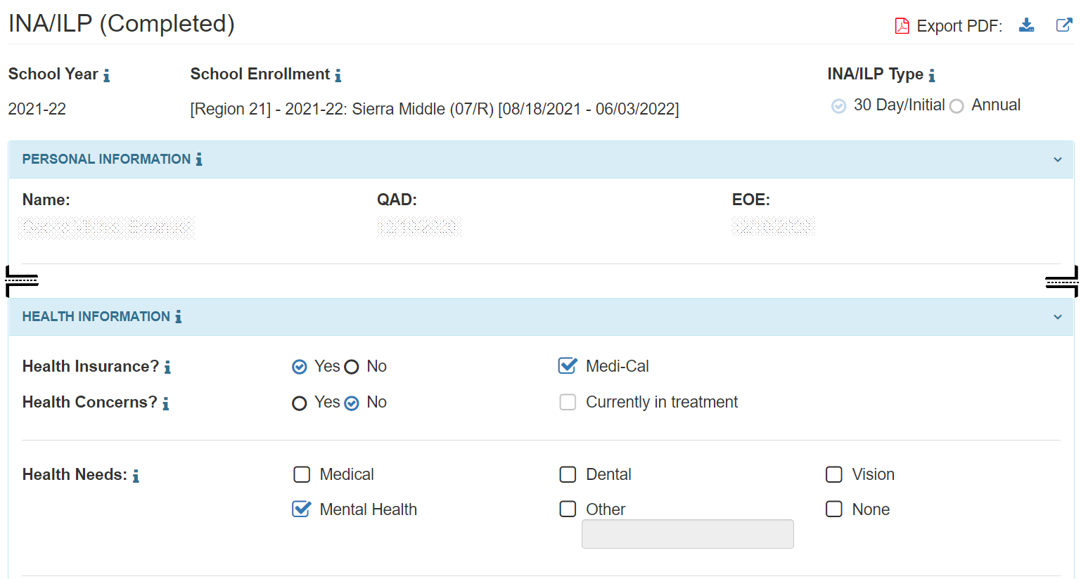
The INA and the MPO 11.1 Report
Notes:
Melissa
MPO 11.0 links to the “health needs” question in the INA for all grade levels. Any student who’s INA has “mental health” checked will be included in the MPO 11.1 Report.

Slide 54
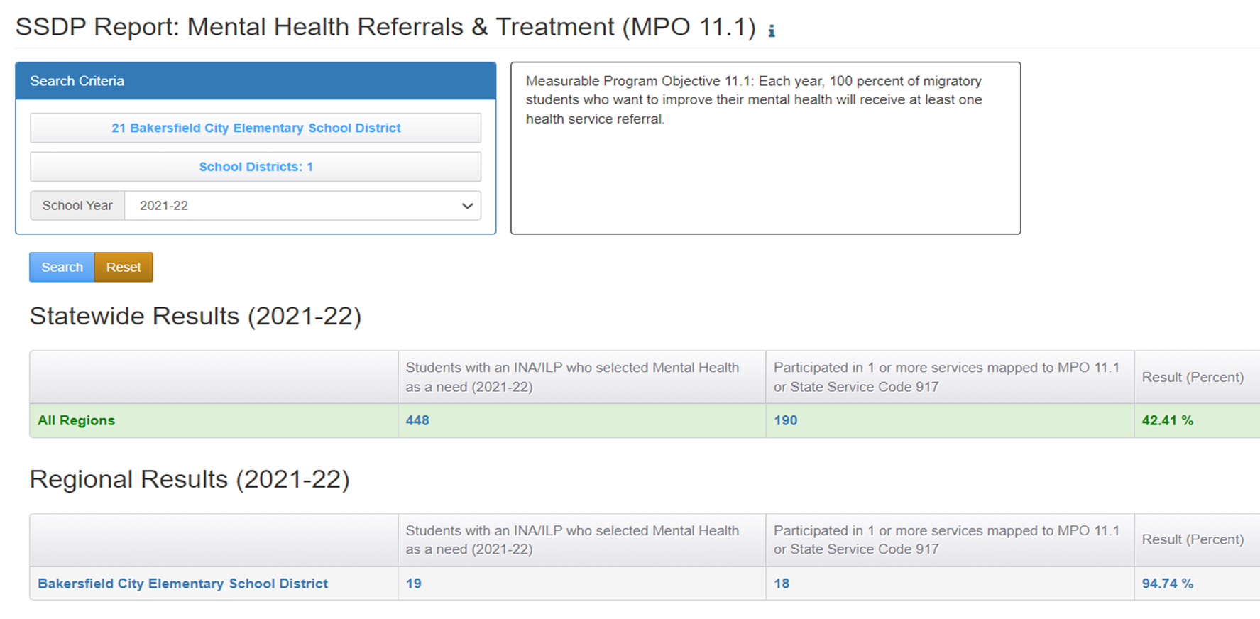
MPO 11.1 Report
Notes:
Melissa
MPO 11.1 Report calculates the percentage of all students (all grades) who participated in a mental health service after completing an INA/ILP form where they indicated a need for mental health services.
The denominator is the column labeled "Students with an INA/ILP who selected Mental Health as a need." The unduplicated children counted in the denominator have a completed INA/ILP, and “Mental Health” is selected in the INA/ILP under "Health Information:".
The numerator is the column labeled "Participated in 1 or more services mapped to MPO 11.1 or State Service Code 917". The unduplicated children counted in the numerator are in the denominator and have one or more service participation records mapped to MPO 11.1, or state code 917.
The percentage is derived by dividing the numerator by the denominator and multiplying by 100%.
You may click on the child counts to bring up the list of children who were included.

Slide 55
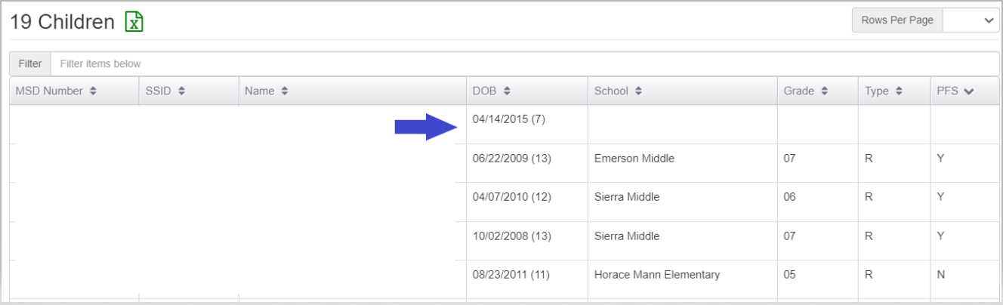
A Deeper Dive into the MPO 11.1 Report
Notes:
Melissa
Now we’re looking at the child counts from the denominator. Any guesses as to what’s going on with this first child with missing information? I’ll give you a minute to enter your responses into the Chat.

Slide 56
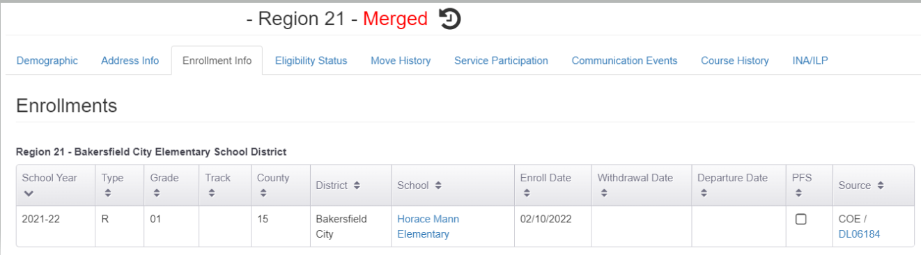
A Deeper Dive into the MPO 11.1 Report (2)
Click
Notes:
Melissa
Any time you see a student who’s missing an SSID and most other information indicates that this record has been merged with another record.

Slide 57


A Deeper Dive into the MPO 11.1 Report (3)
Notes:
Melissa
The top screenshot shows that two child records were merged on 3/9/22.
The bottom screenshot shows that the INA/ILP indicating a mental health need was created on 3/7/22, before the merge happened.
The child record merge breaks the original link between the INA/ILP and one of the records, which causes a mostly blank row in the child list.
Please treat the blank row as a prompt to double check the merge and INA/ILP history for this child, to verify that it is correct (i.e., they were correctly included in this MPO report).

Slide 58

Poll
In a couple of minutes you’ll see a pop-up poll. Please select the best answer to each question and submit your responses.
Notes:
Jamie
Shortly you’ll see a pop-up poll. Please select the best answer to each question and submit your responses.
For MPO 10.1 Report (GED services) the unduplicated children counted in the denominator met the following criteria:
A) Have an INA/ILP with grade NA, and
B) “GED/HEP” is checked in the INA/ILP under "Interested in:", and
C) The INA/ILP has been completed (completed status).
D) All of the above.
Answer: D
2. True or False? For MPO Reports for 10.0, 10.1, and 10.2, you can click on the child counts/denominator to identify which OSY need to be served for each corresponding service.
Answer: True
3. Reports that require an INA/ILP to be completed prior to identifying students who require specific services include:
A) MPO 5.0/6.0 Report
B) MPO 5.1/6.1 Report
C) MPO 10.0 Report
D) MPO 10.1 Report
E) MPO 10.2 Report
F) MPO 11.1 Report
G) MPO 5.0/6.0, 10.0, 10.1, 10.2 Reports
F) MPO 5.1/6.1, 10.0, 10.1, 10.2, and 11.1 Reports
Answer: F
4. Why does MPO 5.1/6.1 Report have two sets of results (i.e., one for RSY and one for S/I)?
A) The Migrant Education Office wanted to provide subgrantees with as much data as possible.
B) MPO 5.1/6.1 requires that subgrantees provide credit accrual services during the RSY and S/I for students who are credit deficient.
C) The WestEd MSIN team loves data and couldn’t help themselves.
D) None of the above.
Answer: B

Slide 59

Questions?
Notes:
Jamie
If you have any questions, please add them in the Chat. I’ll pause for a couple of minutes to see if there are any questions.

Slide 60
Best Practices
Use the MPO Reports’ child counts (accessed by clicking on the denominator) multiple times throughout the performance period to identify students to be served for specific services by region and individual districts. Disseminate these lists appropriately (i.e., data security, prior to service enrollment, etc.).
Monitor progress regularly to inform service changes needed to increase the opportunity to meet students’ needs and the MPOs.
Check the Help Text to identify the conditions that need to be met for a child to be included in the denominator.
Notes:
Melissa
Use the MPO Reports’ child counts (accessed by clicking on the denominator) multiple times throughout the performance period to identify students to be served for specific services by region and individual districts. Disseminate these lists appropriately (i.e., data security, prior to service enrollment, etc.).
Monitor progress regularly to inform service changes needed to increase the opportunity to meet students’ needs and the MPOs.
Check the Help Text to identify the conditions that need to be met for a child to be included in the denominator

Slide 61
Best Practices (2)
If you see some odd data in any of the MPO Reports, review the enrollment information with your Data Specialist to ensure the enrollment information is correct (as it will be in many cases).
If you run a report connected to the INA and there is no indicated need, run the INA Report to verify that all INAs have been completed. If they haven’t, you’ll want to be notified when they have and run the report again. Check all of these reports on a regular basis to identify any new children who come into the program area.
Notes:
Melissa
If you run a report connected to the INA and there is no indicated need, run the INA Report to verify that all INAs have been completed. If they haven’t, you’ll want to be notified when they have and run the report again. Check all of these reports on a regular basis to identify any new children who come into the program area.

Slide 62
Before you leave…
Please take a short survey about this webinar. The link is located in the Chat.
Notes:
Melissa
Survey Questions:
Name/Region
Before the webinar I would rate my understanding of the MPO Reports as:
An Expert
Knowledgeable
Somewhat Knowledgeable
Didn’t know a lot about them
After this webinar, I would rate my understanding of the MPO Reports as:
An Expert
Knowledgeable
Somewhat Knowledgeable
Still have a lot of questions
Prior to the webinar, I used:
All of the MPO Reports regularly
All of the MPO Reports a couple of times
Some of the MPO Reports regularly
Some of the MPO Reports a couple of times
I rarely used any of the MPO Reports
The pace of the webinar was:
Too fast
Just right
Too slow
The presenter’s knowledge of the subject:
Very knowledgeable
Knowledgeable
Somewhat knowledgeable
Not very knowledgeable
How could the presentation have been improved for your learning?
If you have any remaining questions about the MPO Reports, please identify them
What are some additional SSDP related trainings you would like to have?

Slide 63
Thank you!
Melissa Mallory
Education Programs Consultant
Migrant Education Office
mmallory@cde.ca.gov
916-319-0730
Notes:
Melissa
I’d like to thank my colleagues for their assistance during this presentation. If you have any additional questions, please contact me by email at mmallory@cde.ca.gov or by phone at 916-319-0730. Thank you for joining us today and have a wonderful rest of your week.

