Slide 1

The webinar will begin shortly. Please review the Chat and click on the Google Form link to sign-in for this meeting. Thank you!
Notes:
10 mins prior to webinar time
Good afternoon everyone! We will begin in a few minutes. Please review the Chat and click on the Google Form link to sign-in for this meeting. Thank you.

Slide 2
New State Service Delivery Plan Measurable Program Objective Reports
August 17, 2021
Melissa Mallory
Education Programs Consultant
Migrant Education Office
Notes:
Good afternoon and welcome to our webinar. Today we will review the new State Service Delivery Plan, or SSDP, Measurable Program Objective, or MPO, Reports in the Migrant Student Information Network, or MSIN. My name is Melissa Mallory and I am a consultant with the Migrant Education Office, or MEO, here at the CA Department of Education, or CDE. Thank you for joining us today!

Slide 3
Webinar Attendance
Please go into the Chat Feature and click on the Google Forms link to sign in.
Notes:
Juana
The MEO is collecting webinar attendance a little differently. If you haven’s already, please go into the Chat and click on the Google Forms link to sign in, we’d appreciate it. Since this is a new process, we’re going to pause for a few minutes to make sure that everyone can sign in. If you experience any difficulties, please identify your issue in the Chat Feature or unmute yourself to ask a question about the sign-in process. Thank you.

Slide 4
Housekeeping Items
Please enter your name, title, and region/direct-funded district.
Mute your speaker.
Use the chat feature to enter your questions. If your question is not answered during the meeting, the Migrant Education Office (MEO) will email you directly.
This PowerPoint will be sent out to participants after the webinar.
Notes:
Before we get started, let’s review a few housekeeping items (if you haven’t already):
-Please enter your name, title, and region/direct-funded district.
-Mute your speaker.
-Use the chat feature to enter your questions. If your question is not answered during the meeting, the Migrant Education Office (MEO) will email you directly.
-This PowerPoint will be sent out to participants after the webinar.

Slide 5
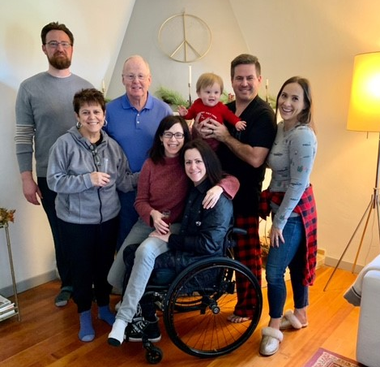
Welcome!
Melissa Mallory
Education Programs Consultant
Migrant Education Office
Multilingual Support Division
California Department of Education
Notes:
As we head into the fourth year of the SSDP’s implementation, I want to focus on building an SSDP community so-to-speak. One definition of community is a feeling of fellowship with others, as a result of sharing common attitudes, interests, and goals. I am sharing a picture of my immediate family with you all because our families are part of our community. They support us in meeting shared goals. I also wanted to share a little bit more about myself to continue to build the relationships that I have with so many of you. My husband, Ted, is the tall guy on the left. He currently works for the Department of Finance and we met in 2009 through our graduate program for public policy and administration. My mom, Judy, was a 1st and 3rd grade teacher for over 30 years and made sure we had the structure we needed to succeed. My dad, Patrick Sr., is in the blue shirt and started many one-man businesses over the years his most recent being a pool service business before retiring. My brother, Patrick, is a high school physics and engineering teacher in Chula Vista. My sister-in-law is a vice president at a public relations firm and they have a 2 ½ year old named Max. My twin sister, Allyson, is the Director of Teaching and Learning in Mapleton, CO. My family is very close and supportive. I hope that as colleagues we continue to provide a community of support as we work towards shared goals of helping migratory students meeting the state’s challenging academic standards.
The next few slides will focus on our SSDP community and include taking a look at where we’ve been and what are goals are for this year.

Slide 6
State Service Delivery Plan Leads
# | SSDP Leads | # | SSDP Leads
1 | Michelle Manriquez, Kim O’Connor | 11
2 | Sarah Williams, Julian Ocegueda | 14 | Ben DeLeon
3 | Amelia Jimenez, Rosa Mercado, Richard Braun | 16 | Karla Caliz
4 | Eddie Rodriguez, Victoria Soto | 17 | Teresa Guerra
5 | Mayra Garza | 18 | Susanne Melton
6 | Sandra Kofford, Ramon Santana | 19
7 | Maria Ponce | 21 | Deisy Galvan
8 | Anabel Gonzalez, Gloria Davalos, Javier Gonzalez, Shantall Porchia, Othoniel Figueroa-Castro, Heriberto Trevino, Tony Velasquez | 22 | Laurie Graack
9 | Elisa Ayala | 23 | Florence Fernandez
10 | Angela Fernandez | 24 | Sandra Espinoza
Notes:
With the support of MEP Directors, we’ve identified the MEP staff in all program areas serving as the lead for the State Service Delivery Plan, or SSDP, as you see on this slide. I will prepare a contact list and share it with all the SSDP leads, and Directors, so that folks can reach out to others with the hopes of furthering our continuous improvement efforts. My hope is to build more community with regards to the SSDP as we have shared attitudes and goals of meeting the needs of our migratory students.

Slide 7
Why is the SSDP Important?
Elementary and Secondary Education Act
Program Purpose (3): To ensure that migratory children receive full and appropriate opportunities to meet the same challenging State academic standards that all children are expected to meet.
The Comprehensive Needs Assessment (CNA) and the SSDP, including measurable program objectives (MPOs), are required by ESEA as amended by the Every Student Succeeds Act
Notes:
The Migrant Education Program, or MEP, has several purposes – one of which is to ensure that migratory children receive full and appropriate opportunities to meet the same challenging State academic standards that all children are expected to meet. The comprehensive needs assessment, or CNA, identifies those needs while the SSDP identifies strategies to address these needs with the hope of providing migratory students the support needed to meet CA’s common core state standards.

Slide 8
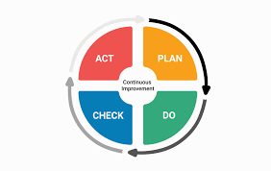
Why is the SSDP Important?
Notes:
Besides being required to develop and implement the SSDP, I think all of us would agree that the utmost importance of the SSDP is striving to address students’ needs. Our role as educators is to meet the child where they are and to differentiate instruction so they have increased access to content and opportunities to meet California’s Common Core State Standards. We do that through consistent revision of policies, practices, and services to efficiently and effectively serve migratory students who need specific services.

Slide 9
Migratory Student Achievement Data
Notes:
Thinking about the MEP’s third purpose, let’s take a quick look at the California Assessment of Student Performance and Progress, or CAASPP, for English language arts, or ELA, and math. 2018-19 CAASPP data for ELA, identifies only 29 percent of migratory students who scored as proficient. You can see that migratory students perform about ten percentage points lower that socio-economically disadvantaged, or SED, students and about 22 percentage points lower than the All Student group.
In 2018-19, only 21 percent of migratory students scored as proficient on the CAASPP math standards. Migratory students are six percent below SED students and 19 percentage points below the All Student group. Therefore, we are still striving to meet the program purpose shared on the previous screen and hence the SSDP identifies strategies for both ELA and math.

Slide 10
Accomplishments
Implementing the first SSDP with a plan of action to ensure that students’ needs are being addressed through high quality services
Building CDE and MEP staff knowledge and capacity to implement and monitor progress via webinars, resources, Migrant Student Information Network (MSIN) MPO Reports, and small group and individualized assistance
Developing an electronic standardized individual needs assessment/individual learning plan
Notes:
Before we jump into the webinar today, I’d like to take a moment to look back at all that we’ve accomplished over the past four years including our first year which consisted of creating a strategic plan for SSDP development and implementation, developing materials for the CNA and SSDP Stakeholder meetings, creating the CNA and the SSDP.
Implementing the first SSDP with a plan of action to ensure that students’ needs are being addressed through high quality services
Building CDE and MEP staff knowledge and capacity to implement and monitor progress via webinars, resources, Migrant Student Information Exchange (MSIN) MPO Reports, small group and individualized assistance
Developing an electronic standardized individual needs assessment/individual learning plan

Slide 11

Accomplishments (2)
Putting continuous improvement at the forefront of service development and delivery
Developing the subgrantee and statewide Annual Performance Progress Reports
Building the infrastructure and practices to support continuous improvement with strategies to identify various student groups, reviewing data in real-time and after each grant year
Notes:
Putting continuous improvement at the forefront of service development and delivery
Developing the subgrantee and statewide Annual Performance Progress Reports
Building the infrastructure and practices to support continuous improvement with strategies to identify various student groups, reviewing data in real-time and after each grant year

Slide 12
Goals for Year Four of the SSDP
Improve our ability to meet the SSDP MPOs and offer high quality MEP services through continuous improvement process
Review the 2019–20 and 2020–21 SSDP Annual Performance Progress Reports
Provide small group and individualized technical assistance on various areas related to the SSDP
Notes:
Since this is the first SSDP webinar for the fourth year of SSDP implementation, I’d like to review our goals for the year. Our goals for year four of the SSDP implementation include:
Continue to improve our ability to meet the SSDP measurable program objectives (MPOs) and offer high quality MEP services through continuous improvement process
Review the 2019–20 and 2020–21 SSDP Annual Performance Progress Reports
Provide small group and individualized technical assistance on various areas related to the SSDP

Slide 13
Goals for Year Four of the SSDP (2)
Collect subgrantee feedback on options to revise MPOs
Amend the SSDP to include updated performance targets and MPOs
Provide a train-the-trainers seminar on culturally and linguistically responsive professional development to all subgrantees to support MPO 13.2
Notes:
Collect subgrantee feedback on options to revise MPOs
Amend the SSDP to include updated performance targets and MPOs
Provide a train-the-trainers seminar on culturally and linguistically responsive professional development to all subgrantees to support MPO 13.2

Slide 14
Goals for Year Five of the SSDP
Continue to refine policies and practices that improve instructional and support services
Provide professional development trainings as recommended by MEP subgrantees
Provide individual, small group, and whole group technical assistance on high need areas as determined by the 2021–22 SSDP Annual Performance Progress Reports
Collect subgrantee feedback on the SSDP implementation and recommendations for the next SSDP
Notes:
2022-23 will be year five of SSDP implementation. During next grant year we will:
Continue to refine policies and practices that improve instructional and support services
Provide professional development trainings as recommended by MEP subgrantees
Provide individual, small group, and whole group technical assistance on high need areas as determined by the 2021–22 SSDP Annual Performance Progress Reports
Collect subgrantee feedback on the SSDP implementation and recommendations for the next SSDP

Slide 15

Reflecting On Our Own Experiences
Take a moment to think about your experiences using the existing SSDP MPO Reports in MSIN.
How have these reports supported service delivery in your area?
Please enter any thoughts you’d like to share about your experience into the Chat feature.
Notes:
To set the stage for our presentation, I’d like to hear from you all on how using the existing SSDP MPO Reports in MSIN have supported service delivery in your area.
Please enter any thoughts you’d like to share about your experience into the Chat feature. If anyone would like to unmute themselves to share their experience, we’d love to hear from you.

Slide 16
Audience
Directors
Coordinators/Program Managers
SSDP Leads
Notes:
The audience for this presentation includes Directors, Coordinators/Program Managers as these positions have access to the MSIN SSDP MPO Reports. SSDP Leads should also be made aware of this information, but depending on their MSIN Role, they may not have access to these reports.

Slide 17
Webinar Objectives
Review the SSDP MPO Reports in the MSIN.
Identify how to use the SSDP MPO Reports in support of service delivery and to meet the MPOs.
Notes:
During today’s webinar we will:
Review the SSDP MPO Reports in MSIN.
Identify how to use the SSDP MPO Reports in support service delivery and to meet the MPOs.

Slide 18
Existing Measurable Program Objective Reports
MPO 1.0
MPO 2.0
MPO 7.0
MPO 8.0
MPO 9.0
MPO 9.1
MPO 11.0
MPO 13.1
MPO 13.2
Notes:
Let’s take a few minutes to review the MPO Reports that have already been released and presented to the field.
MPO 1.0 Report identifies the percent of students who are identified as academically at-risk in English language arts, or ELA, and met the regular school year, or RSY, and summer services, or SS, hour requirement. This report also identifies students who are in the subgrantee program area and are academically at-risk in ELA; using this feature to identify students by district allows the subgrantee to target enrollment which will support meeting the MPO.
MPO 2.0 Report identifies the percent of students who are identified as academically at-risk in mathematics and met the RSY and SS hour requirement. This report also identifies students who are in the subgrantee program area and are academically at-risk in math; using this feature to identify students by district allows the subgrantee to target enrollment which will support meeting the MPO.
MPO 7.0 Report identifies the percent of students who participated in preschool services that align to MPO 7.0 which includes a 15 hour time requirement. Like MPOs 1.0 and 2.0, subgrantees may identify pre-k aged students in the program area which would allow subgrantees to target enrollment and thus support meeting the MPO.
MPO 8.0 Report calculates the percentage of MESRP (Migrant Education School Readiness Program) services that incorporate a Social Emotional Component (i.e., are mapped to MPO 8.0). This report is helpful in identifying if any active school readiness services need to include the social emotional component. If the subgrantee does not include SSDP Strategy 8.0 in every school readiness service, the subgrantee should run a service report to review school readiness services and identify which service(s) need to incorporate this strategy or if there was an error in service set up if that strategy is already included in the service.
MPO 9.0 Report identifies the percent of Out-of-School Youth, or OSY, who attended a health education workshop.
MPO 9.1 Report identifies the perfect of OSY who received at least one health service.
MPO 11.0 Report identifies the number of mental health workshops mapped to MPO 11.0 for which students participated in a service.
MPO 13.0 identifies the percent of instructional services, excluding credit accrual services, that includes a cultural component.
MPO 13.1 identifies the percent of instructional services, excluding credit accrual services, that includes a self-pride component.

Slide 19
New Measurable Program Objective Reports
MPO 5.0/6.0
MPO 5.1/6.1
MPO 10.0
MPO 10.1
MPO 10.2
MPO 11.1
Notes:
The following MPO reports are now ready and will be released to the field today:
MPO 5.0/6.0
MPO 5.1/6.1
MPO 10.0
MPO 10.1
MPO 10.2
MPO 11.1
We will walk through each report in the next slides.

Slide 20
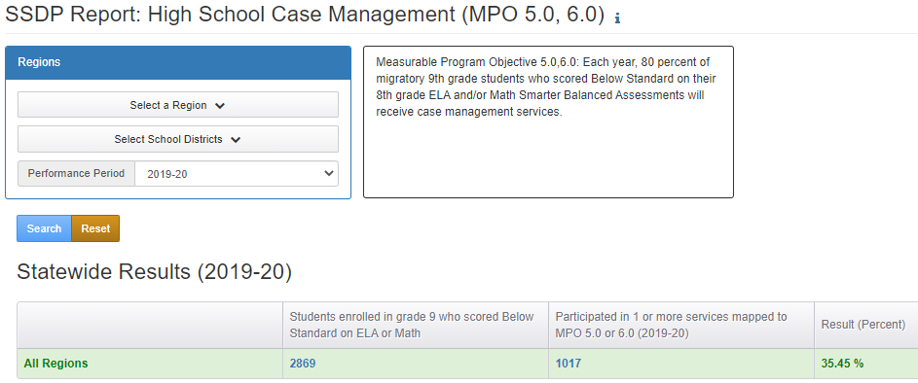
MPO 5.0/6.0 Report
Notes:
The first report we will review in MPO 5.0/6.0. This report calculates the percentage of 9th graders who scored below standard on ELA and/or math on their 8th grade Smarter Balanced assessment AND participated in one or more services mapped to MPO 5.0 or 6.0. This report allows you to identify regional and district level data. The report set-up is similar to the other MPO Reports. You select the region, select districts if desired, choose the performance period and search.
The denominator is the column labeled "Students enrolled in grade 9 who scored Below Standard on ELA or Math." The unduplicated children counted in the denominator met the following criteria:
Are enrolled in grade 9th, and
Scored Below Standard (Achievement Level of 1-2) on CAASPP ELA or CAASPP Math in 8th grade (i.e., assessments were taken while in 8th grade).
The numerator is the column labeled "Participated in 1 or more services mapped to MPO 5.0 or 6.0". The unduplicated children counted in the numerator met the following criteria:
Are in the denominator, and
Have one or more service participation records mapped to MPO 5.0, or
Have one or more service participation records mapped to MPO 6.0.
The percentage is derived by dividing the numerator by the denominator and multiplying by 100%.
You may click on the child counts to bring up the list of children who were included.

Slide 21
True or False?
Please enter “true” or “false” into the Chat feature for the following statement:
I can identify the 9th grade students who need to be enrolled into case management services by clicking on the child counts/denominator in the MPO 5.0/6.0 Report.
Notes:
Please enter “true” or “false” into the Chat feature for the following statement:
I can identify the 9th grade students who need to be enrolled into case management services by clicking on the child counts/denominator in the MPO 5.0/6.0 Report.
Answer: True

Slide 22
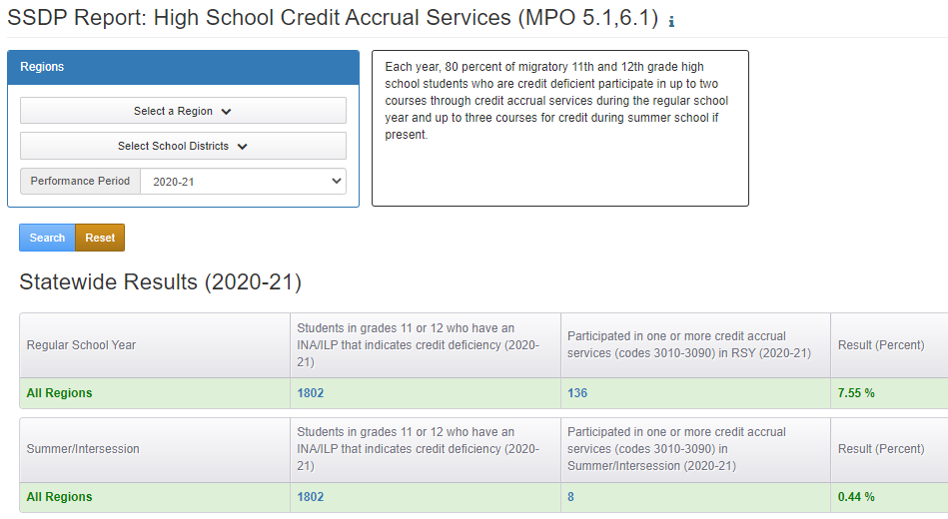
MPO 5.1/6.1 Report
Notes:
MPO 5.1/6.1 Report calculates the percentage of grade 11 or 12 students who participated in a Credit Accrual service (3000s codes) after completing an individual needs assessment (INA)/individual learning plan (ILP) form in which they shared an unaddressed credit deficiency. This report allows you to identify regional and district level data. The report set-up is similar to the other MPO Reports. You select the region, select districts if desired, choose the performance period and search.
The report will have two sets of results:
Regular School Year (RSY) service participations.
Summer/Intersession (S/I) service participations.
The denominator is the column labeled "Students in grades 11 or 12 who have an INA/ILP that indicates credit deficiency...." A child is counted in the denominator by referencing the Region, District, and School Year selections AND by also meeting the following conditions:
Have an INA/ILP with grade 11 or 12, and
"Yes” is selected in the INA/ILP after “Credit Deficient?”, and
The INA/ILP has been completed (i.e., displays completed status).
The denominator does not include all grades. Instead, it is limited to children enrolled in grades 11 or 12 in the selected Performance Period. In addition, the denominator is calculated the same way for both regular school year (RSY) and Summer/Intersession.
The numerator for RSY (regular school year) is the column labeled "Participated in one or more credit accrual services (codes 3010-3090) in RSY...." The children included here met the following conditions:
Are in the denominator, and
Have one or more service participation records mapped to a credit accrual code (i.e., state service codes 3010-3090), and
The service participation records are in the Regular School Year (RSY) service period.
The numerator for Summer/Intersession is the column labeled "Participated in one or more credit accrual services (codes 3010-3090) in Summer/Intersession...." The children included here met the following conditions:
Are in the denominator, and
Have one or more service participation records mapped to a credit accrual code (i.e., state service codes 3010-3090), and
The service participation records are in the Summer/Intersession (S/I) service period.
The percentage is derived by dividing the numerator by the denominator and multiplying by 100%.
You may click on the child counts to bring up the list of children who were included.
Note: The accuracy of these counts depends on how accurately enrollments, INA/ILPs, and services are entered in MSIN.
If students have been identified in the fall through the INA/ILP as credit deficient, it is imperative that students be served

Slide 23
Subgrantee Process
Please take a minute to think about the questions below for case management and credit recovery. Enter any comments you may have in the Chat Feature.
How do you monitor credit completion throughout the school year?
Do you meet with migratory students often enough to identify credit deficiencies immediately?
How do you ensure that migratory students, especially 11th and 12th graders, are served in a timely manner?
Notes:
Please take a minute to think about the questions below for case management and credit recovery. Enter any comments you may have in the Chat Feature.
How do you monitor credit completion throughout the school year?
Do you meet with migratory students often enough to identify credit deficiencies immediately?
How do you ensure that migratory students, especially 11th and 12th graders, are served in a timely manner?

Slide 24
True or False? (1)
Please enter “true” or “false” into the Chat feature for the following statement:
All students who take credit accrual services are counted in MPO 5.1/6.1 Report.
Notes:
Please enter “true” or “false” into the Chat feature for the following statement:
All students who take credit accrual services are counted in MPO 5.1/6.1 Report.
Answer: False. Only students who are identified as credit deficient on the INA are included in the denominator for the MPO 5.1/6.1 Report. The numerator consists of students who are included in the denominator and received credit accrual services.

Slide 25
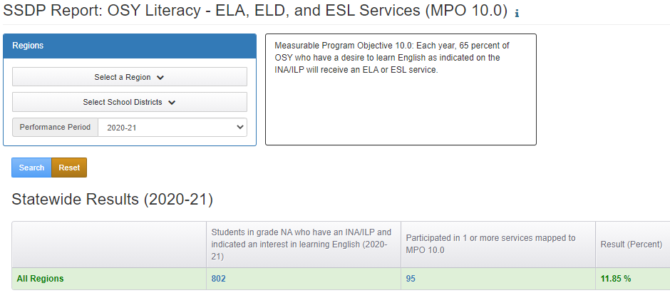
MPO 10.0 Report
Notes:
MPO 10.0 Report calculates the percentage of OSY, which are grade NA, students who participated in an ELA, ELD, or ESL service(s) after completing an INA/ILP form where they indicated being interested in learning English (or increasing their literacy skills). This report allows you to identify regional and district level data. The report set-up is similar to the other MPO Reports. You select the region, select districts if desired, choose the performance period and search.
The denominator is the column labeled "Students in grade NA who have an INA/ILP and indicated an interest in learning English." The unduplicated children counted in the denominator met the following criteria:
1) Have an INA/ILP with grade NA, and
2) “English (ELA, ESL, ELD)” is checked in the INA/ILP under "Interested in:", and
3) The INA/ILP has been completed (completed status).
The numerator is the column labeled "Participated in 1 or more services mapped to MPO 10.0". The unduplicated children counted in the numerator met the following criteria:
1) Are in the denominator, and
2) Have one or more service participation records mapped to MPO 10.0.
The percentage is derived by dividing the numerator by the denominator and multiplying by 100%.
You may click on the child counts to bring up the list of children who were included.
Note: The accuracy of these counts depends on how accurately enrollments, INA/ILPs, and services are entered in MSIN.

Slide 26

Any Questions?
Notes:
If you have any questions, please add them in the Chat. I’ll pause for a couple of minutes to see if there are any questions.

Slide 27
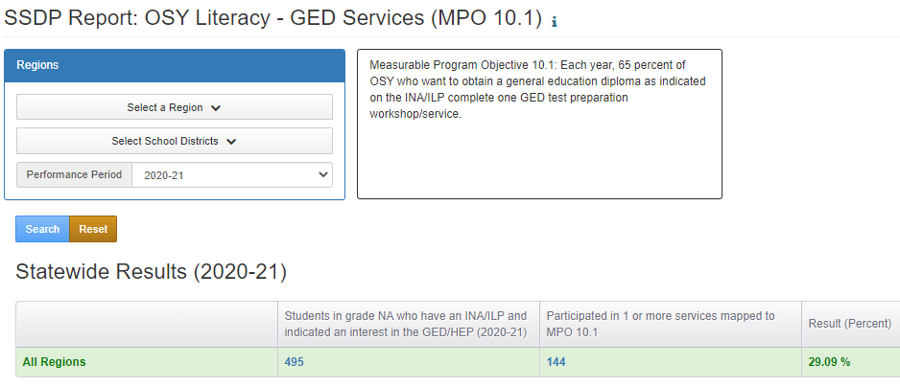
MPO 10.1 Report
Notes:
MPO 10.1 Report calculates the percentage of OSY, which are grade NA, students who participated in a GED or HSE service(s) after completing an INA/ILP form where they indicated being interested in the GED/HEP. This report allows you to identify regional and district level data. You select the region, select districts if desired, choose the performance period and search.
The denominator is the column labeled "Students in grade NA who have an INA/ILP and indicated an interest in the GED/HEP." The unduplicated children counted in the denominator met the following criteria:
1) Have an INA/ILP with grade NA, and
2) “GED/HEP” is checked in the INA/ILP under "Interested in:", and
3) The INA/ILP has been completed (completed status).
The numerator is the column labeled "Participated in 1 or more services mapped to MPO 10.1". The unduplicated children counted in the numerator met the following criteria:
1) Are in the denominator, and
2) Have one or more service participation records mapped to MPO 10.1.
The percentage is derived by dividing the numerator by the denominator and multiplying by 100%.
You may click on the child counts to bring up the list of children who were included.
Note: The accuracy of these counts depends on how accurately enrollments, INA/ILPs, and services are entered in MSIN.

Slide 28
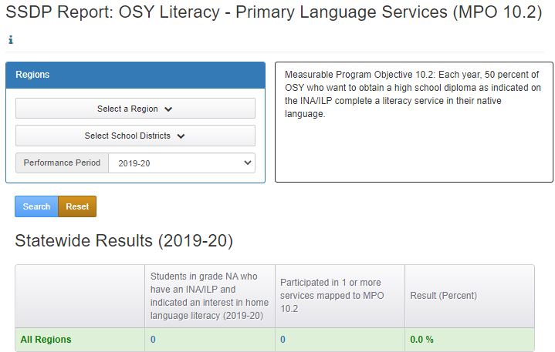
MPO 10.2 Report
Notes:
MPO 10.2 Report calculates the percentage of grade NA students who participated in a literacy service in their native/home language after completing an INA/ILP form where they indicated being interested in home language literacy. This report allows you to identify regional and district level data. You select the region, select districts if desired, choose the performance period and search.
The denominator is the column labeled "Students in grade NA who have an INA/ILP and indicated an interest in home language literacy." The unduplicated children counted in the denominator met the following criteria:
1) Have an INA/ILP with grade NA, and
2) “Home language literacy” is checked in the INA/ILP under "Interested in:", and
3) The INA/ILP has been completed (completed status).
The numerator is the column labeled "Participated in 1 or more services mapped to MPO 10.2". The unduplicated children counted in the numerator met the following criteria:
1) Are in the denominator, and
2) Have one or more service participation records mapped to MPO 10.2.
The percentage is derived by dividing the numerator by the denominator and multiplying by 100%.
You may click on the child counts to bring up the list of children who were included.
Note: The accuracy of these counts depends on how accurately enrollments, INA/ILPs, and services are entered in MSIN.

Slide 29
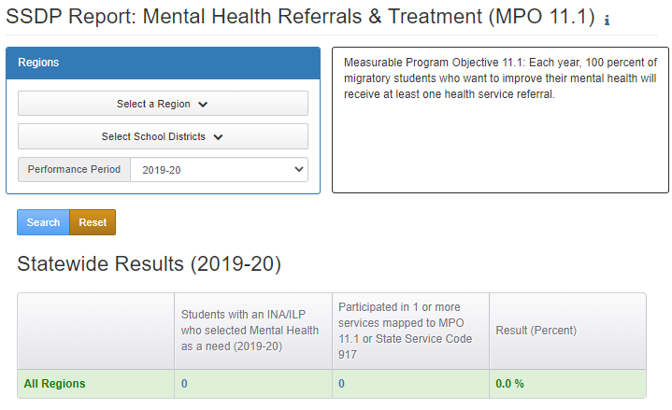
MPO 11.1 Report
Notes:
MPO 11.1 Report calculates the percentage of all students (all grades) who participated in a mental health service after completing an INA/ILP form where they indicated a need for mental health services.
The denominator is the column labeled "Students with an INA/ILP who selected Mental Health as a need." The unduplicated children counted in the denominator met the following criteria:
1) Have a completed INA/ILP, and
2) “Mental Health” is selected in the INA/ILP under "Health Information:".
The numerator is the column labeled "Participated in 1 or more services mapped to MPO 11.1 or State Service Code 917". The unduplicated children counted in the numerator met the following criteria:
1) Are in the denominator, and
2) Have one or more service participation records mapped to MPO 11.1, or
2) Have one or more service participation records mapped to state service code 917.
The percentage is derived by dividing the numerator by the denominator and multiplying by 100%.
You may click on the child counts to bring up the list of children who were included.
Note: The accuracy of these counts depends on how accurately enrollments, INA/ILPs, and services are entered in MSIN.

Slide 30

Poll
In a couple of minutes you’ll see a pop-up poll. Please select the best answer to each question and submit your responses.
Notes:
In a couple of minutes you’ll see a pop-up poll. Please select the best answer to each question and submit your responses.
For MPO 10.1 Report (GED services) the unduplicated children counted in the denominator met the following criteria:
A) Have an INA/ILP with grade NA, and
B) “GED/HEP” is checked in the INA/ILP under "Interested in:", and
C) The INA/ILP has been completed (completed status).
D) All of the above.
Answer: D
2. True or False? For MPO Reports for 10.0, 10.1, and 10.2, you can click on the child counts/denominator to identify which children need to be served for each corresponding service.
Answer: True
3. Reports that require an INA/ILP to be completed prior to identifying students who require specific services include:
A) MPO 5.0/6.0 Report
B) MPO 5.1/6.1 Report
C) MPO 10.0 Report
D) MPO 10.1 Report
E) MPO 10.2 Report
F) MPO 11.1 Report
G) MPO 5.0/6.0, 10.0, 10.1, 10.2 Reports
F) MPO 5.1/6.1, 10.0, 10.1, 10.2, and 11.1 Reports
Answer: F
4. Why does MPO 5.1/6.1 Report have two sets of results (i.e., one for RSY and one for S/I)?
A) The Migrant Education Office wanted to provide subgrantees with as much data as possible.
B) MPO 5.1/6.1 requires that subgrantees provide credit accrual services during the RSY and S/I for students who are credit deficient.
C) The WestEd MSIN team loves data and couldn’t help themselves.
D) None of the above.
Answer: B

Slide 31
Questions?
Notes:
If you have any questions, please add them in the Chat. I’ll pause for a couple of minutes to see if there are any questions.

Slide 32
Breakout Session
During the breakout session participants will be placed into groups to discuss the following question:
How will MEP staff use these reports to increase the probability of meeting each of the MPOs?
Notes:
We will now participate in a five minute breakout session. Juana will send participants into breakout rooms shortly. During your breakout session, please discuss how you will use each of six the reports to support meeting each of the corresponding MPOs. Please select a volunteer to report back to the whole group on different ways MEP staff will use the reports to target services to students and increase the likelihood of meeting the MPOs. Please remember your breakout room number as I will call on each group number to report out.
Note to Juana: Let’s have six groups with at least one consultant in each group.

Slide 33
Report Out
Please share your groups’ ideas on how to best use the reports to target students and support meeting each of the MPOs. I will ask each group for their ideas on one report.
Notes:
Please share your groups’ ideas on how to best use the reports to target students and support meeting each of the MPOs. I will ask each group for their ideas on one report.
Group one: MPO 5.0/6.0 Report
Group two: MPO 5.1/6.1 Report
Group three: MPO 10.0 Report
Group four: MPO 10.1. Report
Group five: MPO 10.2 Report
Group six: MPO 11.1 Report

Slide 34
Final Questions?
Notes:
If you have any questions, please add them in the Chat. I’ll pause for a couple of minutes to see if there are any questions.

Slide 35
Scheduled Items for Year Four
August through October: Send out survey on MPOs and possible options for revisions. Meet with SSDP Committee to review options for MPO revisions. After MPO revisions are identified, amend the SSDP to include revised MPOs and performance targets
September through November: Meet with subgrantees to review the 2019–20 SSDP Annual Performance Progress Report
September: Provide a webinar on SSDP Continuous Improvement and the CDE’s new SSDP web page
October through January: Develop 2020–21 SSDP Annual Performance Progress Reports and meet with subgrantees to review
Notes:
This slide shows the main action items that will be implemented during our fourth year of SSDP Implementation. They include:
August through October: Send out survey on MPOs and possible options for revisions. Meet with SSDP Committee to review options for MPO revisions. After MPO revisions are identified, amend the SSDP to include revised MPOs and performance targets
September through November: Meet with subgrantees to review the 2019–20 SSDP Annual Performance Progress Report
September: Provide a webinar on SSDP Continuous Improvement and the CDE’s new SSDP web page
October through January: Develop 2020–21 SSDP Annual Performance Progress Reports and meet with subgrantees to review

Slide 36
Scheduled Items for Year Four (2)
November: Provide a webinar on SSDP Strategy 2.0 and best practices
January through April: Train-the-Trainers workshops on culturally and linguistically responsive teaching
March: Provide a webinar on SSDP Strategy 13.1 and Social Media
Notes:
November: Provide a webinar on SSDP Strategy 2.0 and best practices
January through April: Train-the-Trainers workshops on culturally and linguistically responsive teaching
March: Provide a webinar on SSDP Strategy 13.1 and Social Media

Slide 37
SSDP Professional Development Feedback
The MEO would like to solicit ideas from local Migrant Education Program subgrantees on the professional development (PD) needs associated with the SSDP that the MEO could support in 2022–23.
Look for an email after the webinar to complete the four question survey. Please meet with MEP staff to identify PD needs if you haven’t already.
Notes:
The MEO would like to solicit ideas from local Migrant Education Program subgrantees on the professional development (PD) needs associated with the SSDP that the MEO could support in 2022–23.
Look for an email after the webinar to complete the four question survey. Please meet with MEP staff to identify PD needs if you haven’t already.

Slide 38
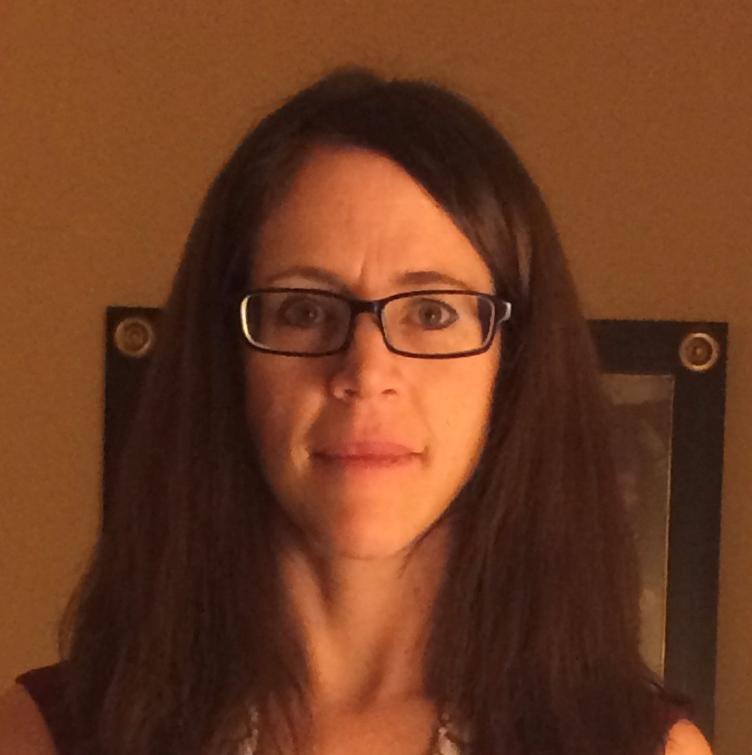
Thank you!
Melissa Mallory
Education Programs Consultant
Migrant Education Office
mmallory@cde.ca.gov
916-319-0730

