Slide 1
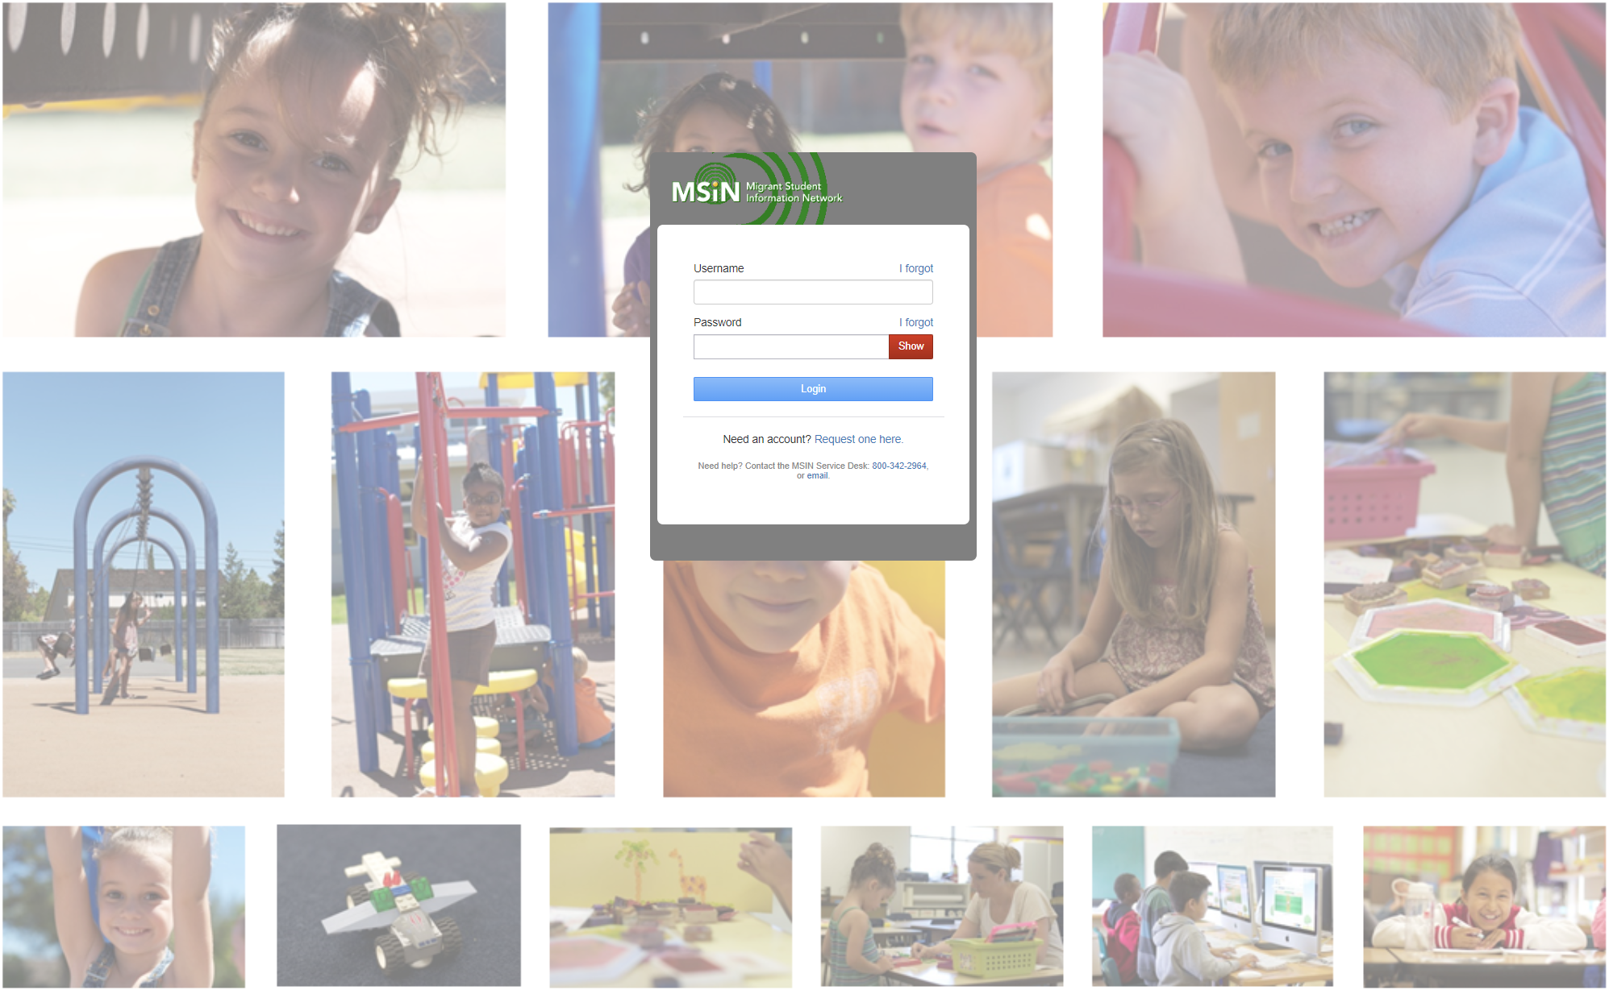
Welcome to this Migrant Student Information Network Training
We will begin shortly.
Please note your attendance by clicking the Google Forms link in the Chat and completing two questions.
Notes:
Melissa
Repeat that participants who are joining should click on the link in the chat to record their attendance in the Google Form.
Google Form: https://forms.gle/ZgqsHgevhET9DxNXA

Slide 2
Migrant Student Information Network:
Setting Up Services that Align to the State Service Delivery Plan
October 31, 2023
9:30 a.m. – 11:00 a.m.
Notes:
Lead: Melissa
Time: 30 secs.
Talking Points:
Repeat that participants who are joining should click on the link in the chat to record their attendance in the Google Form.
Google Form: https://forms.gle/ZgqsHgevhET9DxNXA

Slide 3


Housekeeping
Please mute your microphone in the main session.
Use the Q&A function to enter your questions.
Participate in breakout room activities.
The PowerPoint for this presentation can be accessed through the link provided in the chat. It will also be posted on the California MEP Help Center for those who were not able to attend today.
Notes:
Lead: Melissa
Time: 1 min.
Talking Points:
(Read or paraphrase bullets)

Slide 4




Welcome and Introductions
Session Presenters
Melissa Mallory, Education Programs Consultant, California Department of Education (CDE
Jose Valencia, Migrant Student Information Network (MSIN) Lead, WestEd
Victor Garibay, MSIN Specialist, WestEd
Nesau Azadan, Program Assistant, WestEd

Slide 5
Purpose
This webinar will review the service set-up features in the MSIN system with a focus on the addition of allowing classified staff to provide instruction within services aligned to the State Service Delivery Plan (SSDP) Measurable Program Objectives (MPOs) 1.0 and 2.0 during the regular school year (RSY) .
The target audience is Migrant Education Program (MEP) managers and staff who create local services.
Notes:
Lead: Melissa
Time: 30 sec
Talking Points:

Slide 6
Session Objectives
Participants will:
Review the definition of MEP services;
Review how to add new services, including those that impact MPOs;
Review updates to service features to record when classified staff provide MPOs 1.0 and 2.0 services during the RSY;
Share and discuss local knowledge regarding these topics; and
Review the resources available to support service-related tasks in the MSIN system.
Notes:
Lead: Melissa
Time: 30 sec
Talking Points:
(Read or paraphrase bullets)

Slide 7
Migrant Education Services
Before we begin, let’s take a moment to think about why it’s important to set up services properly in MSIN.
Using the Chat, please identify any negative impacts resulting from setting up services improperly in MSIN.
Notes:
Lead: Melissa
Time: 3 min
Talking Points:
MPO Reports may not be accurate if services aren’t set up properly (e.g., 8.0, 13.0, 13.1) and therefore the incorrect data may be captured on the SSDP Annual Performance Progress Report.
Inaccurate data may be sent to the feds (e.g., mislabeling RI, MI, OI)
Data might not reflect what is happening during the service.
The federal office may increase oversight of our data quality.
Background info (just FYI, not for presentation)
Services data is sent to the feds vis EDFacts file FS145 (https://www2.ed.gov/about/inits/ed/edfacts/eden/non-xml/fs145-19-0.docx) – This has updated definitions this year.
Summer/Intersession services are sent to MSIX as enrollments (summer/intersession program enrollments). MSIX doesn’t actually show any service data, only enrollment info.

Slide 8
Preparing to Set up New Services
Notes:
Transition Slide
Lead: Melissa
Time: 20 secs.

Slide 9
MEP Definition of Services
“Services” are a subset of all the activities that the MEP provides through its programs and projects. “Services” are those educational or educationally related activities that:
Directly benefit a migrant child;
Address a need of a migrant child consistent with the state education agency’s comprehensive needs assessment and service delivery plan;
Are grounded in scientifically based research or, in the case of support services, are a generally accepted practice; and
Are designed to enable the program to meet its measurable outcomes and contribute to the achievement of the State’s performance targets.
https://www.cde.state.co.us/migrant/mep-non-regulatory-guidance page 53
Notes:
Lead: Melissa
Time: 4 min
Talking Points:
Given the topics we are covering today, it is important to review the definition of “services” because the term has a specific meaning in the MEP.
(Read or paraphrase bullets.)
Activities related to identification and recruitment, parental involvement, program evaluation, professional development, or administration of the programs are examples of allowable activities and are not considered services. Another example would be handing out leaflets to migrant families on available reading programs as part of an effort to increase the reading skills of migrant children. Although this is an allowable activity, it is not a service because it does not meet all of the criteria for a service: (1) it does not directly benefit migrant children; (2) it is not grounded in scientifically based research; and (3) in and of itself, the activity will not increase children’s reading skills and thereby increase their ability to meet the state’s performance targets.
As a reminder, only services should be entered into MSIN 6.0.
Definition source:
U.S. Department of Education, Office of Elementary and Secondary Education, Office of Migrant Education, Non-Regulatory Guidance for the Title I, Part C Education of Migratory Children, Washington, D.C., 2017.

Slide 10
Gather Reference Materials
Before adding a new service, it is extremely helpful to gather reference materials, such as the following:
Regional Application and District Service Agreements or a Service Code Map developed from the applications
Align active services with recent grant applications
  Align service names
  Align service descriptions
  Check service code mapping (local to state service codes)
  Check applicable MPO and SSDP Component mapping
Notes:
Lead: Melissa
Time: 1 min.
Talking Points:
(Read or paraphrase bullets.)

Slide 11
Gather Reference Materials (2)
Before adding a new service, it is extremely helpful to gather reference materials, such as the following (continued):
SSDP (most recent amended version)
State Service Codes spreadsheet
  Home page→ User Guides→ Services→ Services Administration
SSDP service set-up “how-to” videos on MSIN
  Videos do not include how-to demonstrations for the new services aligned to MPOs 1.0 and 2.0 for RSY, but are still extremely helpful.
Service-related user guides on MSIN
Notes:
Lead: Melissa
Time: 1 min
Talking Points:
(Read or paraphrase bullets.)
In addition, you can resolve any doubts by testing service set-up and entry on the Training MSIN website.

Slide 12

Questions?
Notes:
Lead: Team
Time: 3 mins
Answer a few questions about the MEP services definition versus allowable activities.

Slide 13
Checking for Understanding
  Next, you will see a pop-up window with questions and response options.
  There are two questions for this section, answer them as best you can.
  If you are participating as a group, enter what the majority of the group chooses.
  You will get a warning when the poll is about to close.
Notes:
Lead: Victor
Time: 5 min.
Talking Points:
When setting up a service I need to make sure the following match the grant application (as much as possible):
a. Service names
b. Number of staff
c. Service descriptions
d. A and C (answer)
2. To be considered a “service” the program must:
a. Directly benefit a migrant child
b. Address a need of a migrant child consistent with the state education agency’s (SEA) comprehensive needs assessment and service delivery plan
c. Are grounded in scientifically based research or, in the case of support services, are a generally accepted practice
d. Are designed to enable the program to meet its measurable outcomes and contribute to the achievement of the State’s performance targets
e. All of the above (answer)

Slide 14
Setting Up New Services for MPOs 1.0 and 2.0 with Classified Staff Providing Instruction
Notes:
Transition Slide
Lead: Melissa
Time: 20 secs.

Slide 15
California Education Code
Section 54444.3. (a) Each operating agency receiving federal Title I Migrant Education funding shall conduct summer school programs for eligible migrant children…
(4) That instructional programs are taught by staff with cultural training or background and understanding of the special needs of migrant children, and who are properly credentialed for the subjects and grade levels to which they are assigned.
https://leginfo.legislature.ca.gov/faces/codes_displaySection.xhtml?lawCode=EDC&sectionNum=54444.3.
Notes:
Lead: Melissa
Time: 30 sec
Talking Points:

Slide 16
Common Service Setup Scenarios
The subgrantee would like to use an existing State Service Code “as is.” No setup is needed.
The subgrantee considers their local service to be a variation of an existing State Service Code.
The subgrantee thinks their local service is different from all State Service Codes but still addresses an MPO.
The subgrantee thinks their local service does not match a State Service Code or an MPO, but it meets the definition of “service” provided in Guidance.
Notes:
Lead: Melissa
Time: 3 min
Talking Points:
There are a few ways to approach setting up new services.
Here we have a list of common service setup scenarios.
(Read or paraphrase the slide bullets.)
For our presentation today, we will focus on scenario 2 where a local service is a variation of an existing State Service Code.
Additional reference info (do not read during the live presentation):
Scenario 1: No setup needed because these state codes have been pre-set (reference document with state service codes and descriptions). Just ensure that the service is active (will have a checkmark when viewed in the Administer Services screen).
Scenario2: On the Creating Service screen, the user creates a local service name (#2), description (#3) and local code (#4), then selects an existing State code (#5) to populate most other options on the page.
Scenario 3: On the Creating Service screen, the user creates a local service name (#2), description (#3) and local code (#4), then skips over #5 (State Service Code) and selects the appropriate MPO (#6) to populate most other options on the page.
Scenario 4: On the Creating Service screen, the user creates a local service name (#2), description (#3) and local code (#4), then they skip #5 and #6, manually enter #7 (SSDP Component), skip #8 (Require Service Hours; not user selectable), and manually enter #9 (Federal Category), which populates most of the remaining fields. This sounds complex but it is straightforward when making selections on the screen.
For all of these, we recommend practicing on the Training MSIN website (https://trainingmsin.wested.org).

Slide 17
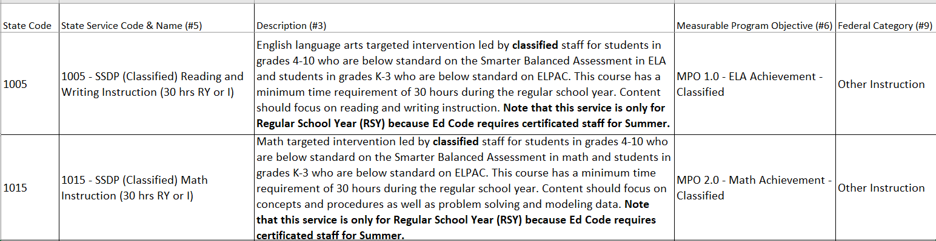
New State Service Codes
After you review the definitions, please indicate in the Chat whether you can use these new state codes as-is based on what you know about the other MPOs.
Notes:
Lead: Melissa
Time: 3 min
Talking Points:
Answer: No, you cannot use the codes as-is because these two codes address core content areas, so at the very least integrated ELD (MPO 3.0) needs to be added.

Slide 18
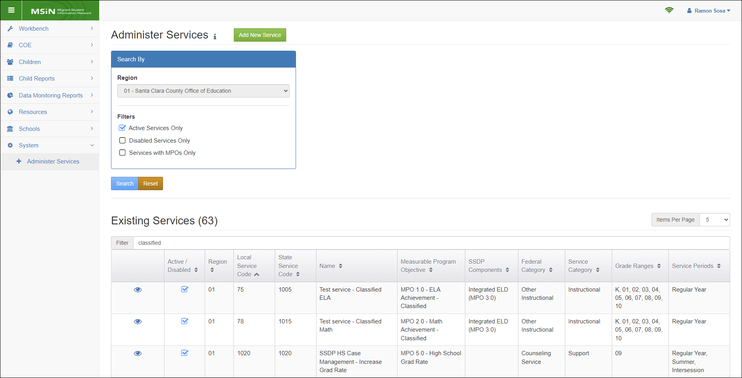
New Service Setup Window
Notes:
Lead: Jose
Time: 2 min
Talking Points:
Review the location of the Administer Services menu
Point out the location of the “Add New Service” button.

Slide 19
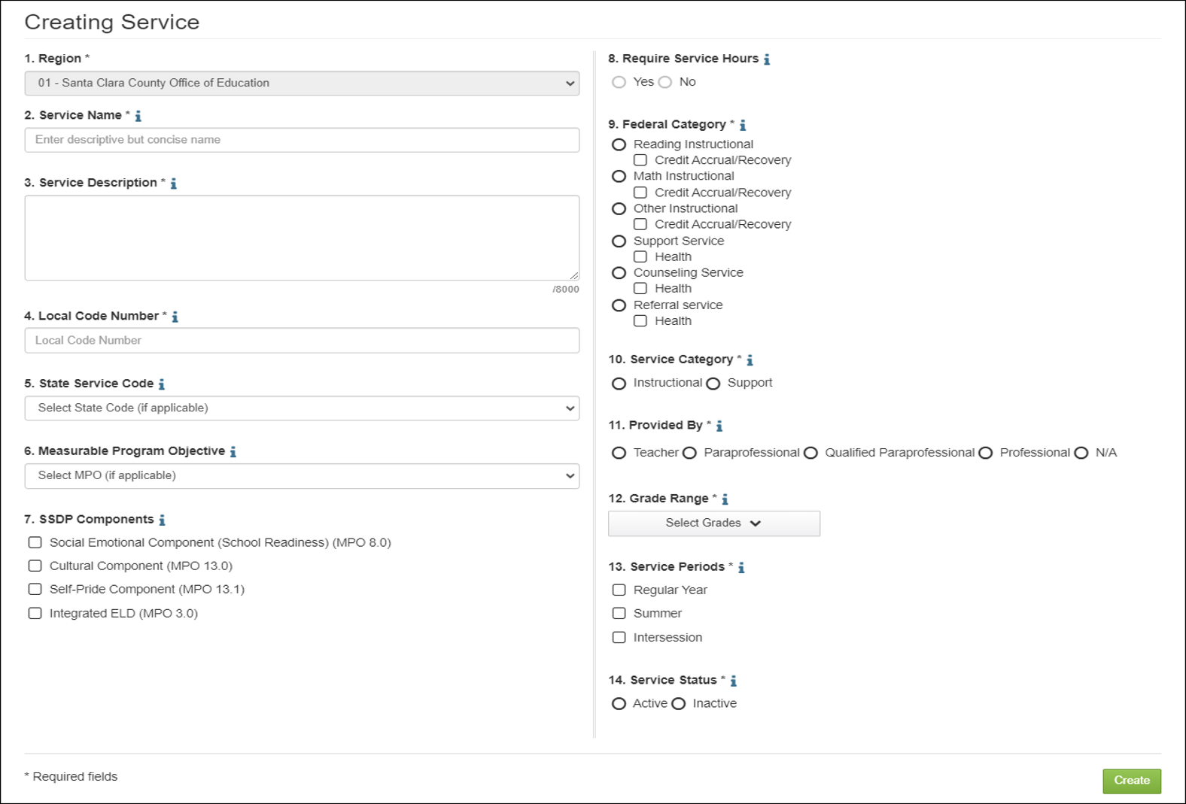
Service Setup Fields
Notes:
Lead: Jose
Time: 4 min
Talking Points:
The best way to learn how this screen works is to practice creating services on the Training MSIN website. This is our number one recommendation.
For today, we would like to emphasize a few key items.
The required fields have an asterisk next to the field title. You cannot save the new service without completing all required fields.
Notice that every field has a help text icon (i), containing definitions and instructions.
All the MPOs that can be collected through MSIN, as services, have been added to the drop-down menu in #6.
Some MPOs require the collection of service hours (MPO 1.0, 2.0, & 7.0); depending on the MPO selection, #8 will automatically be marked yes or no.
All MPOs specify particular grades; the drop-down menu in #12 displays which grades may receive the service.
Number 13 is a new field that was created to support the addition of the new state codes for the amended MPOs 1.0 and 2.0 which now allow for classified staff to provide instruction during the RSY. We had to include this field as MPO and MPO 1.0 and 2.0 services taught by classified staff may only occur in the RSY given the CA Ed Code requirement Melissa reviewed earlier in this presentation.
This service set-up screen has a lot of preset mapping to ensure that selections are logically consistent. This improves data quality.
Again, we strongly recommend getting familiar with this screen on the Training MSIN website.

Slide 20
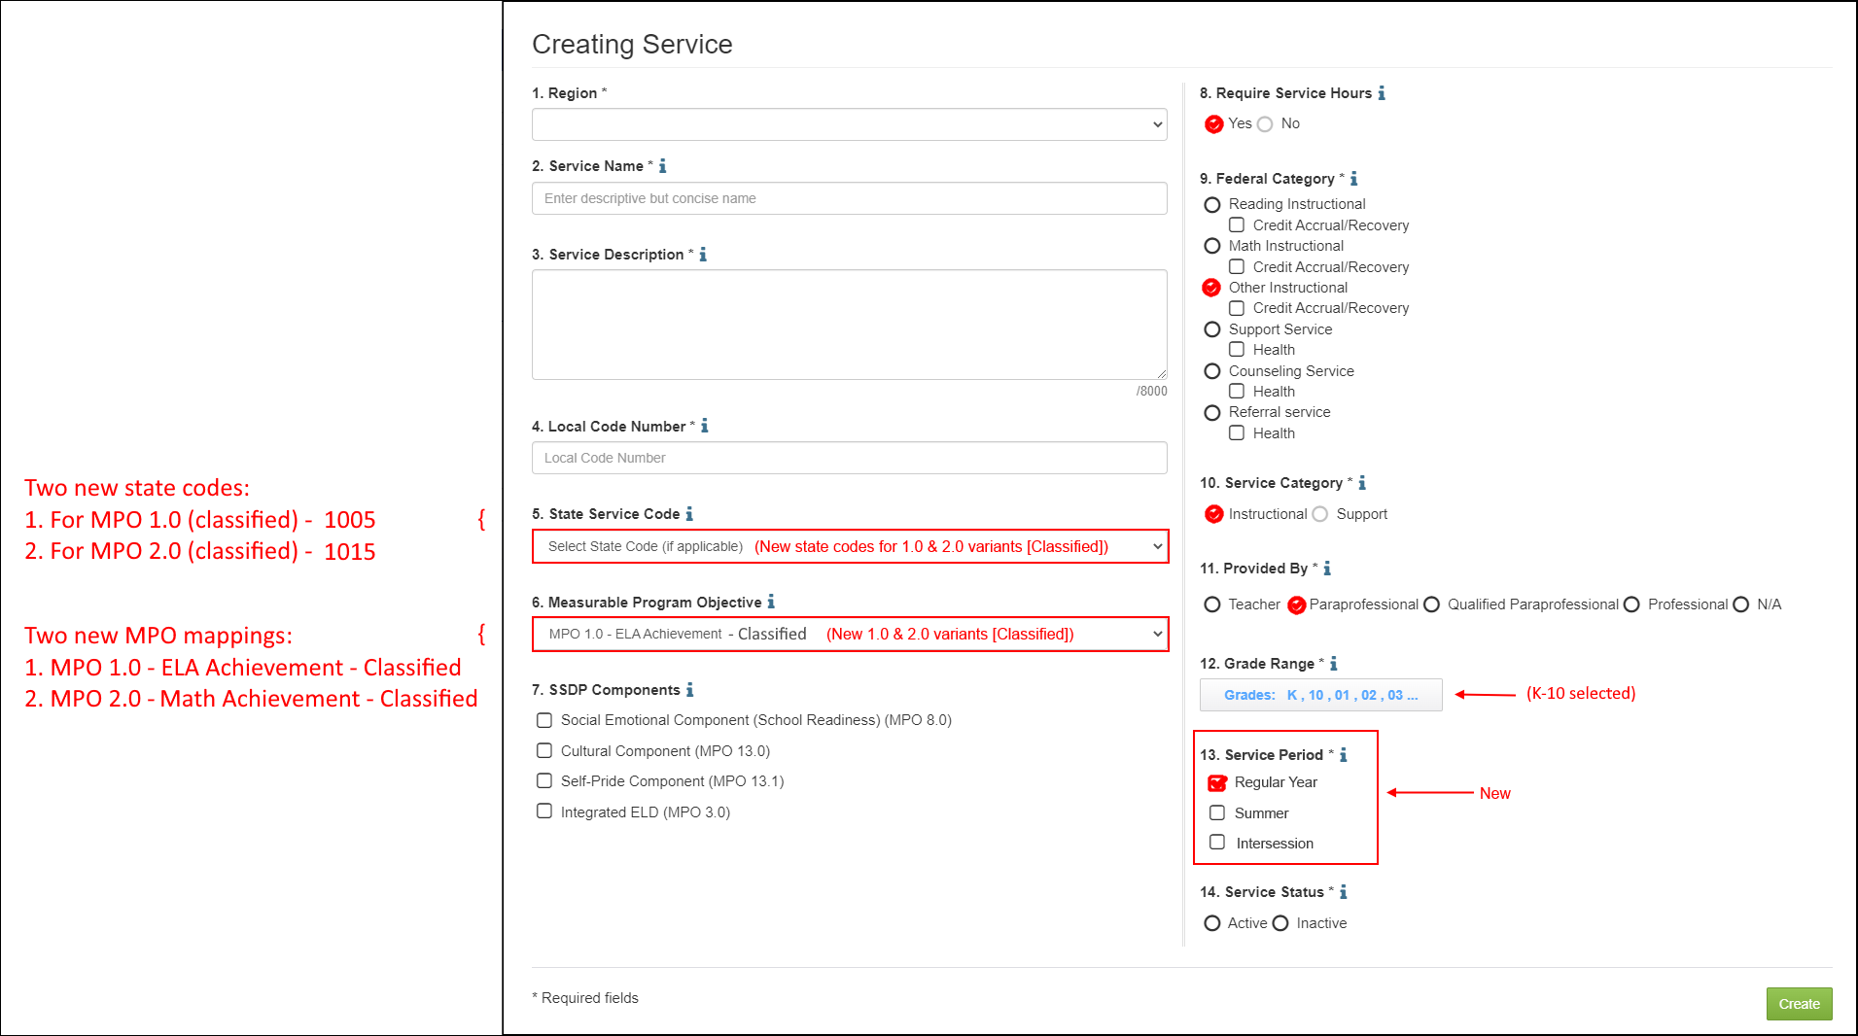
Service Setup Screen Revisions (1)
Notes:
Lead: Jose
Time: 8 min
Talking Points:
Explain that there are two new state codes (1005 and 1015) that you can map to. But they cannot be used “as-is” since MPO 3.0 requires integrated ELD for all services that address core content areas and these new services are for ELA and math.
Subgrantees can create their own new local codes and map them to the new state codes or MPOs that are for classified staff (and therefore only apply to the Regular Year service period, not Summer).
Explain that the items with red checkmarks are the default selections for the new state codes and the MPO mappings.
Briefly demonstrate on MSIN how the fields are automatically selected when a new local code is mapped either to a state code (#5) or an MPO (#6).

Slide 21
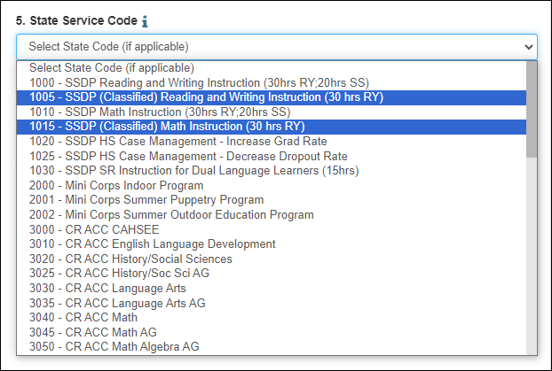
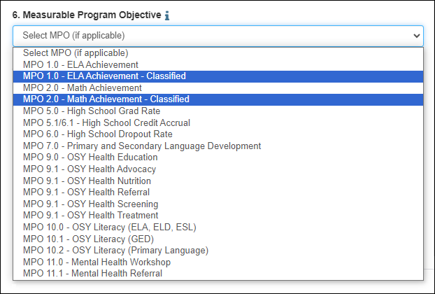
Service Setup Screen Revisions (2)
Notes:
Lead: Jose
Time: 2 min
Talking Points:
Closeup of new State Service Code options
Closeup of new MPO options

Slide 22
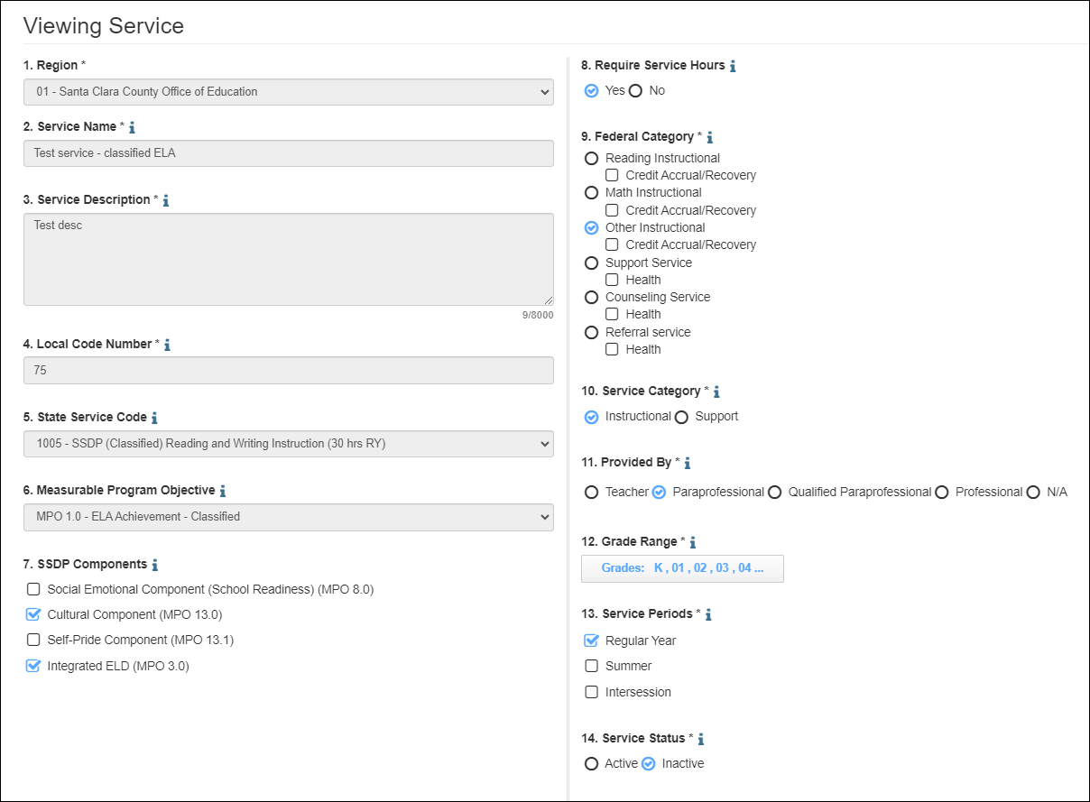
Example: Code for Classified Staff
Notes:
Lead: Jose
Time: 3 min
Talking Points:
Here is an example of a new local code (75) that was mapped to State Service Code 1005 (for Classified staff).
Walk through example.

Slide 23
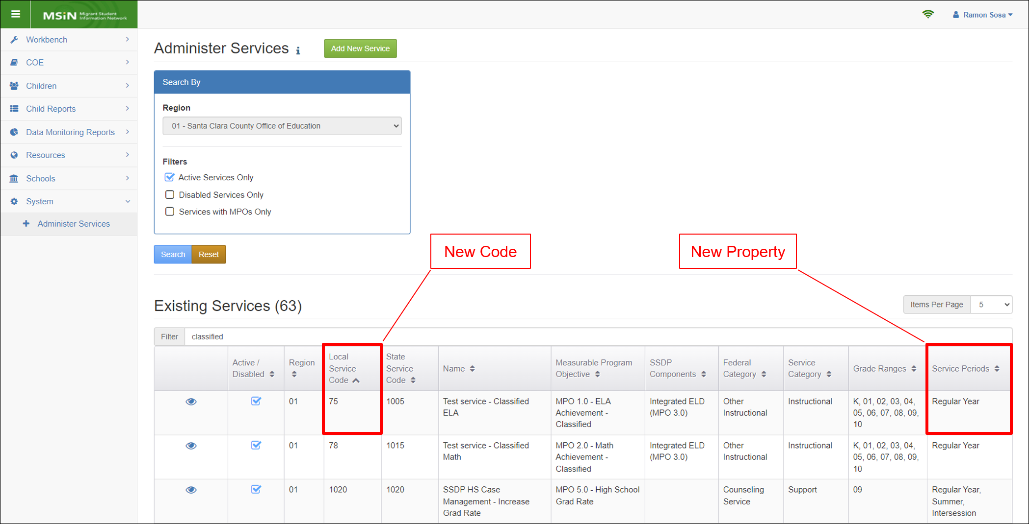
Example: Code for Classified Staff (2)
Notes:
Lead: Jose
Time: 1 min
Talking Points:
Point out how the new code appears, including the new service period property.

Slide 24
Increased Service Setup Flexibility
Because of the new Service Period property, you can limit services to only the applicable period(s)—Regular Year, Summer, or Intersession.
For new local codes, you can select the applicable service period(s).
Existing local codes are currently set to all three service periods, but you can request edits via the MSIN Service Desk.
  Note that state codes cannot be changed (they come pre-set based on CDE’s specifications).
Notes:
Lead: Jose
Time: 3 min
Talking Points:

Slide 25
Recap: Key Steps for New Services
As you set up new MPO 1.0 and 2.0 services for classified staff, keep in mind the following key steps:
Choose an unused local code number
Map it to either 1005 or 1015 (which will automatically populate most other fields), and
Check applicable SSDP components (select Integrated ELD and any others that apply to the service)
Notes:
Lead: Jose
Time: 3 min
Talking Points:
Read/paraphrase slide content

Slide 26
Questions? (2)
Notes:
Lead: Team
Time: 3 mins
Answer a few questions about setting up services and/or the collaborative activity.

Slide 27
Check for Understanding (2)
  Next, you will see a pop-up window with questions and response options.
  There are three questions for this section; answer them as best you can.
  You will get a warning when the poll is about to close.
Notes:
Lead: Victor
Time: 4 min
Poll Questions:
1) True or False: If you offer an MPO 1.0 and/or 2.0 service with classified staff providing instruction, integrated ELD must still be included and therefore selected when you set up these services in MSIN.
a. True [answer]
b. False
c. I don’t know
2) Which of the following statements is/are true?
a. All the fields in the service setup window have help text icons which open definitions and instructions.
b. When setting up a new service, grade range is a required field.
c. You can’t enter services for anyone over 18 years old because they are already adults.
d. A and B [answer]
e. I don’t know
3) What is new in the Service Set-up screen?
a. Two new state codes for classified staff
b. The service period property
c. A and B (answer)
d. I don’t know

Slide 28
Service Entry Considerations
Notes:
Transition Slide
Lead: Victor
Time: 20 secs.

Slide 29
Service Setup Affects Service Entry
How a service is set up determines if end users will see it when they try to enter service participation data.
Specifically, when entering services, staff will only see:
Services that apply to the child’s grade, and
Services that apply to the selected service period
The second bullet is new, so you may get questions from the field about why a service they expected to see in the Service Name dropdown menu is not displayed as an option.
Notes:
Lead: Victor
Time: 2 min
Talking Points:

Slide 30
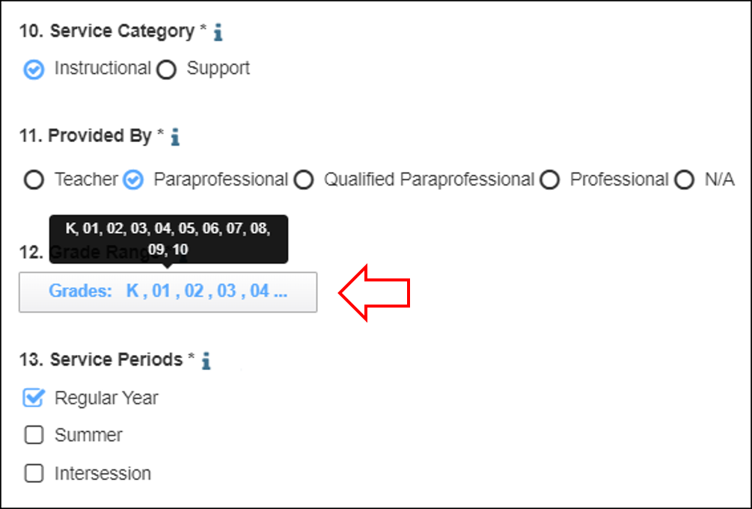
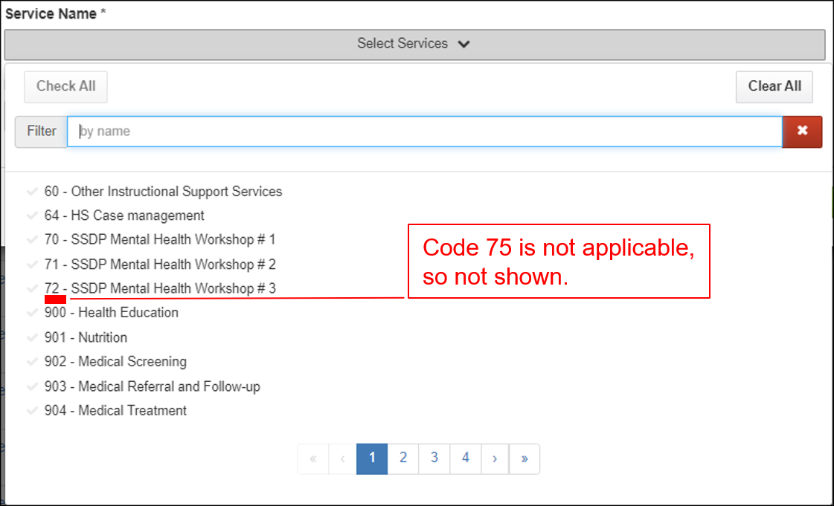
Impact of Grade on Service Entry
For example, Region 1’s ELA service provided by Classified staff, code 75, is setup for students in grades K-10 only.
As a result, when entering services for a student in grade 11 or 12, you will not see code 75 in the Service Name field.

Slide 31
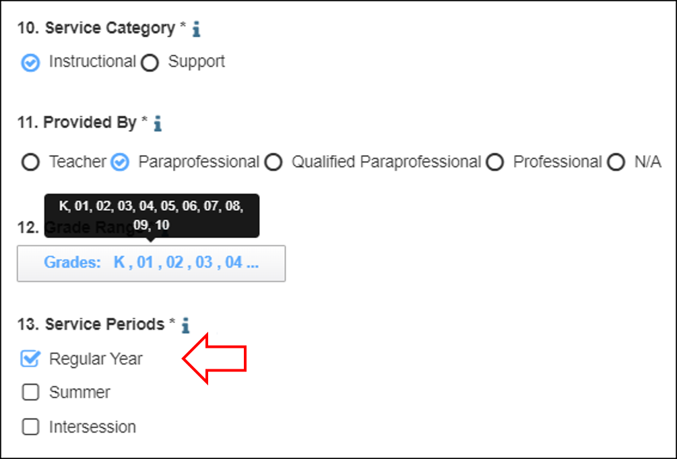
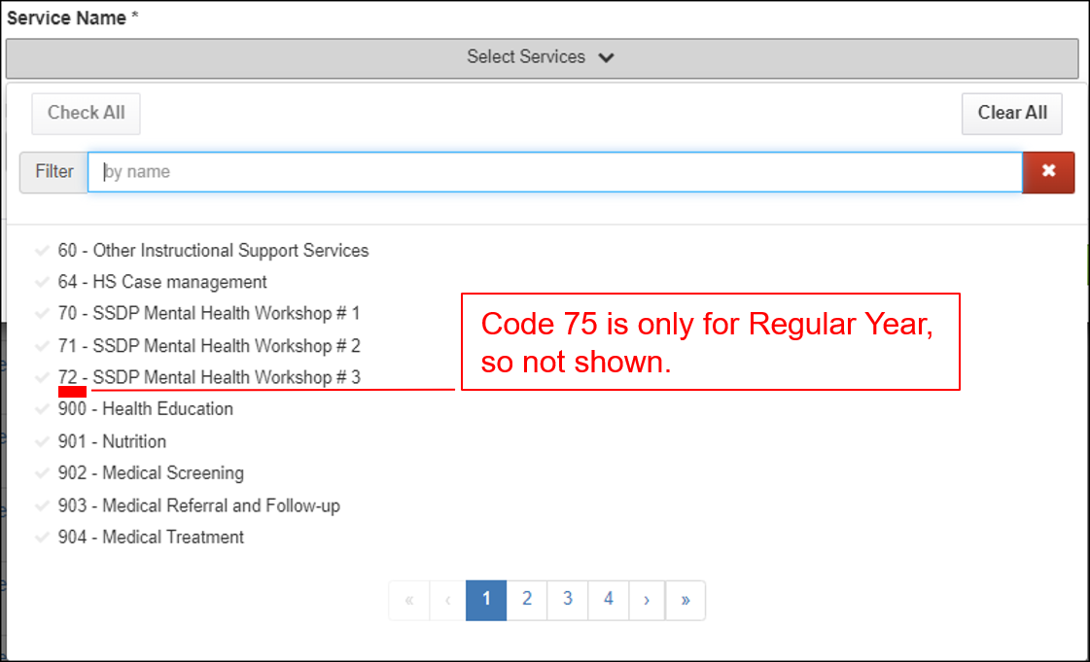
Impact of Service Period on Service Entry
For example, Region 1’s ELA service provided by Classified staff, code 75, is setup for Regular Year only.
When entering services, if you select Summer or Intersession, then you will not see code 75.

Slide 32
Resources and Next Steps
Notes:
Transition Slide
Lead: Melissa
Time: 10 secs.

Slide 33
Resources
Subgrantees may use this presentation to review requirements and recommendations.
User guides and how-to videos for the features covered today are available on the California MEP Help Center: https://mephelpcenter.wested.org/hc/en-us/categories/5774679512468-MSIN
If any questions arise, please consult with your local management team first. Specific questions about MPOs should be submitted to your CDE consultant or Melissa Mallory. Other questions or concerns can be submitted to the MSIN Service Desk.
Notes:
Lead: Melissa
Time: 2 min
Talking Points:
In addition to the user guides, remember that definitions, rules, and other information is readily accessible within most screens by clicking the “i” icon next to field titles.
Finally, don’t forget that the Training MSIN site is always available so that you can practice and brush up on system features.

Slide 34
Questions? (3)
Notes:
Lead: Team
Time: 3 mins
Answer a few questions about this session’s topics and/or the final collaborative activity.

Slide 35
Contact Information
Melissa Mallory
Education Programs Consultant
California Department of Education
mmallory@cde.ca.gov
916-319-0730
__________________________________________________
MSIN Service Desk
MSINsupport@wested.org
1-800-342-2964, option 2
Notes:
Lead: Melissa
Time: 30 sec
Talking Points:
Thank participants for attending.

