Slide 1
Welcome Migrant Education Program Directors and Staff
The webinar will begin shortly. Please use the link provided in the Chat to sign-in for today’s webinar. Thank you.
Notes:
Lead: Victor
Time: 5 min. & 2 min. before webinar starts
Talking Points: Read slide
Attendance link: https://forms.gle/hT5QH7TQX4DtYhWQ8

Slide 2
Migrant Student Information Network Webinar
Revisiting the Individual Needs Assessment/Individual Learning Plan
October 5, 2023
10:00 a.m. – 12:00 p.m.
Notes:
Lead: Victor
Time: 30 secs.
Talking Points:
Repeat that participants should sign-in using the Google Form provided in the chat.
If you have questions during the webinar, please enter them into the Q&A feature so we can easily track them.
Webinar is approximately 2 hours long
Attendance link: https://forms.gle/hT5QH7TQX4DtYhWQ8

Slide 3
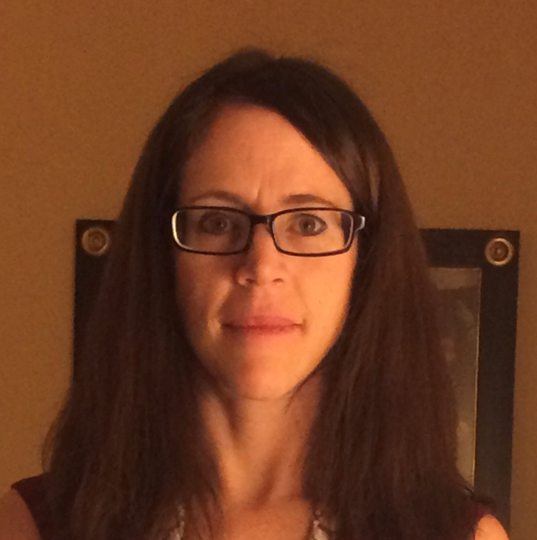



Welcome and Introductions
Session Facilitators
Melissa Mallory, Education Programs Consultant, California Department of Education (CDE)
Jose Valencia, Migrant Student Information Network (MSIN) Lead, WestEd
Victor Garibay, MSIN Specialist, WestEd
Nesau Azadan, Program Assistant, WestEd
Notes:
Lead: Melissa
Time: 2 min
Talking Points:
Welcome participants
Facilitators and WestEd staff introduce themselves.
If you have any questions during the presentation, please enter them into the Q&A feature.

Slide 4
Purpose
This webinar will review how to complete the Individual Needs Assessments (INAs) and Individual Learning Plans (ILPs) and how the INA is directly connected to selected measurable program objectives (MPOs) within the State Service Delivery Plan (SSDP).
The target audience is Migrant Education Program (MEP) Directors and any staff who complete INAs and ILPs.
Notes:
Lead: Melissa
Time: 2 min
Talking Points:

Slide 5
Session Objectives
Participants will
  Learn about MEP INA/ILP requirements;
  Understand how the statewide INA/ILP was created;
  Become familiar with the INA/ILP workflow;
  Learn the different form layouts for different grade levels;
  Understand the nuance of certain questions and how to properly respond to them to ensure data accuracy;
  Review applicable data privacy and security considerations; and
  Receive resources to train MSIN users locally.
Notes:
Lead: Melissa
Time: 1 min
Talking Points:
Read bullets

Slide 6
Requirements, Development, and Best Practices
Notes:
Transition Slide
Lead: Melissa
Time: 20 secs.

Slide 7
Federal Guidance on Needs Assessments
  “Local operating agencies conduct individual needs assessments to:
  determine the needs of migrant students and how those needs relate to the priorities established by the State;
  design local services; and
  select students for the receipt of those services.”
U.S. Department of Education, Office of Elementary and Secondary Education, Office of Migrant Education, Non-Regulatory Guidance for the Title I, Part C Education of Migratory Children, Washington, D.C., 2017. Pg. 43.
Notes:
Lead: Melissa
Time: 2 min
Talking Points:
Non-regulatory guidance provides general reasons why individual needs assessments (INA) are useful to local operating agencies.

Slide 8
California Education Code
  “54443.1. Migrant education programs shall include all of the following:
  (a) An individual assessment of the educational and relevant health needs of each participating pupil within 30 days of enrollment...
  (d) A brief individual learning plan listing the services to be provided to each pupil shall be provided in writing or at a parent conference to the parent or guardian of each participating pupil, annually and each time the pupil moves to a new district.”
This guidance addresses the legal requirements and recommended best practices governing INA practices. The guidance itself is non-binding and does not have the effect of law. Legal obligations are set forth in the applicable statutes and case law.
Notes:
Lead: Melissa
Time: 2 minutes
Talking Points:
California established additional requirements for INAs:
Specified both educational and relevant health needs
Specified that the INA was for “participating pupils”
Specified that the INA should be completed within 30 days of enrollment in the MEP. We call this the initial 30 day INA. Since there was some different interpretations of the timeline, we reviewed this Ed Code with our Legal team. For students who remained in the program area, an annual INA/ILP can be completed. The CDE does encourage you to complete INA/ILPs for students who remained in your area for the next school year as soon as possible so those needs can be met by the program.
California also added a requirement to create an individual learning plan (ILP) for each student:
Annually or each time the student moves,
And provide a copy to the parent/guardian.

Slide 9
How the Statewide INA/ILP was Created
  While developing the Comprehensive Needs Assessment (CNA) and SSDP. The CNA/SSDP Committee identified a need for a standardized INA/ILP.
  The CDE staff gathered existing INAs and ILPs from subgrantees, including versions for PreK children, attending children (i.e., students), and non-attending youths (i.e., Out-of-School Youths [OSY]).
  The CDE staff consolidated elements from the subgrantee versions to form a single document with the INA and ILP components together (i.e., INA/ILP).
  The CDE proposed a statewide version of the INA/ILP and solicited additional feedback from the subgrantee committee before finalizing it.
  WestEd used the paper version of the Statewide INA/ILP as a template to create the web-form version in MSIN 6.0.
Notes:
Lead: Melissa
Time: 4 min
Talking Points:
Read bullet points

Slide 10
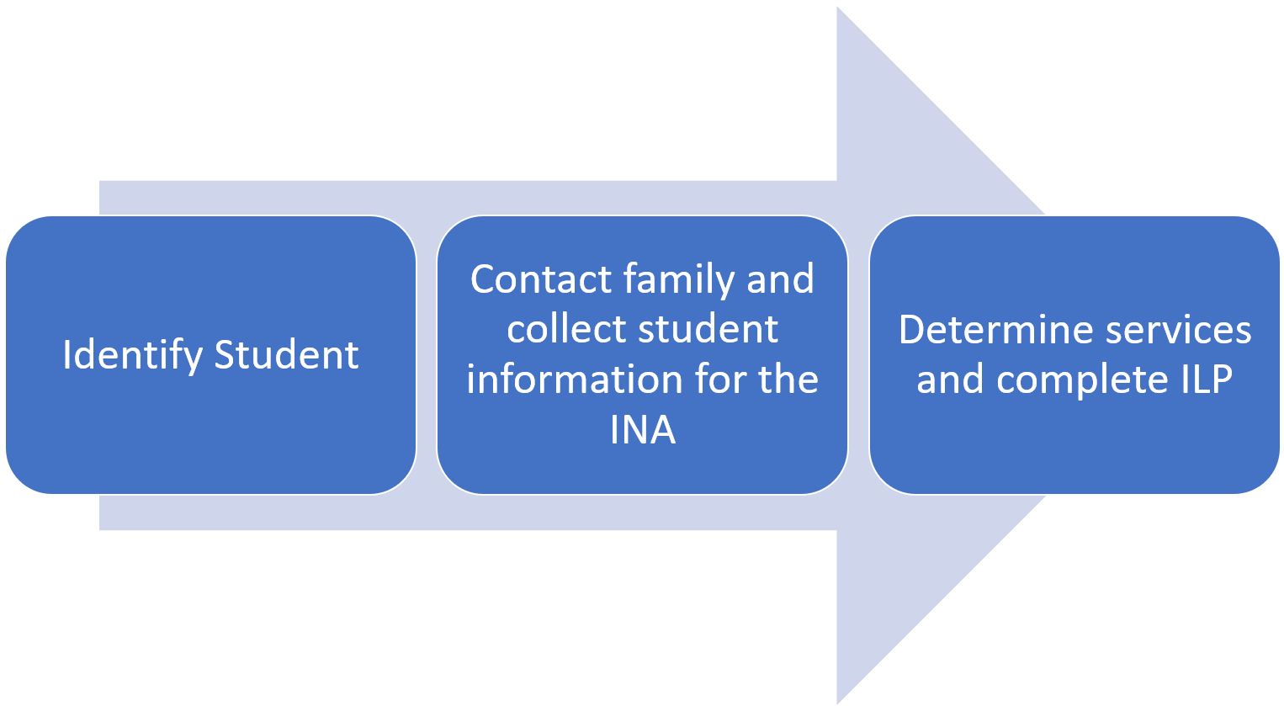
INA/ILP Development Process
Notes:
Lead: Melissa
Time: 2 min
Talking Points:
Review slide

Slide 11
Best Practices for INA/ILP Implementation (1)
New Student
  Within 30 days of identifying a migrant student, complete an INA by recording any relevant student data from student records and by contacting the student and family.
  Use the INA to determine what services to provide to the student and family. Complete the ILP.
  Once the INA/ILP is complete, provide parents with a copy of the form.
Returning Student
  Create a new INA for the new school year. Contact student and family after the start of school year.
  Use the INA data to determine which services to provide to the student and family. Complete the ILP portion of the form.
  Once the INA/ILP is complete, provide parents with a copy of the form.
Notes:
Lead: Melissa
Time: 2 min
Talking Points:
Read bullet points
The next two slides offer a visual for implementation based on guidance from the Migrant Education Office.

Slide 12
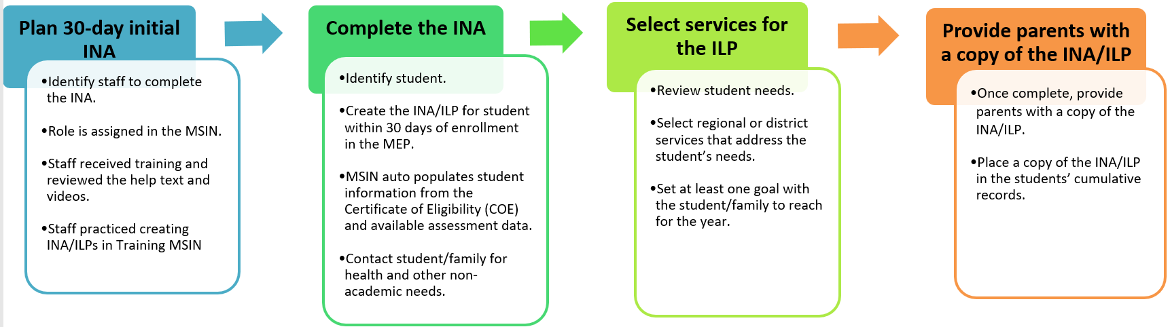
Best Practices for INA/ILP Implementation (2)
New Student Initial/30 day INA
Notes:
Lead: Melissa
Time: 4 min
Talking Points:
A new student is a student who arrives in the program area from another region or district after the start of the performance period.
Read bullets under each heading.

Slide 13
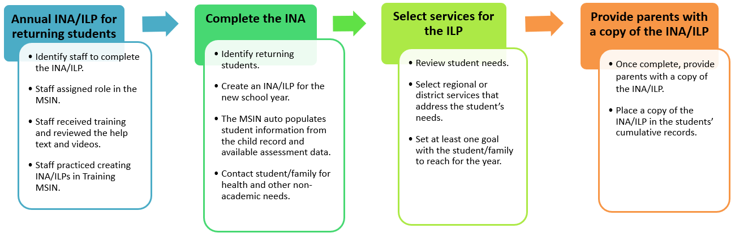
Best Practices for INA/ILP Implementation (3)
Returning Student INA/ILP
Notes:
Lead: Melissa
Time: 4 min
Talking Points:
A returning student is a student who had an initial INA/ILP done by the region or district and is about to start a new school year within the same region or district.
Read bullets under each heading.

Slide 14

Questions?
Notes:
Lead: Team
Time: 3 mins
Use Q&A feature in Zoom

Slide 15
Check for Understanding
  Next, you will see a pop-up window with questions and response options.
  There are three questions for this section, answer them as best you can.
  If you are participating as a group, enter what the majority of the group chooses.
  You will get a warning when the poll is about to close.
Notes:
Lead: Victor
Time: 6 min
Talking Points:
Show polling questions, as follows:
1) Per California Education Code, INAs should:
Include an assessment of educational needs
Include an assessment of educational and health needs [answer]
Be considered optional
All of the above
2) In California, an INA/ILP for each participating child needs to be provided to parents/guardians annually.
True [answer]
False
3) A subgrantee committee provided input to develop the statewide INA/ILP form.
True [answer]
False

Slide 16
INA/ILP Workflow
Notes:
Transition Slide
Lead: Jose
Time: 20 secs.

Slide 17
INA/ILP Workflow (2)
The INA/ILP forms are created and stored in each migratory child’s statewide record.
This format is similar to how individual enrollments and services are currently entered and displayed in the MSIN.
A migratory child’s statewide record can be opened in many ways, including:
  Using the Search Children screen;
  Using the Enrollment Report (by clicking the Migrant Student Directory [MSD] numbers); and
  Using any screen or report in the MSIN that displays the MSD numbers as clickable links.
Notes:
Lead: Jose
Time: 2 mins
Talking Points:
Read bullets
Explain the similarity of INA/ILP storage, creation, and editing relative to enrollments and services.
Like the COE form in MSIN, the preference is for INA/ILPs to be created and stored electronically within the system, instead of using paper versions. However, it is a good backup strategy to have paper forms just in case a laptop fails, or connectivity is interrupted. Any paper versions can be entered into MSIN upon returning to the office.

Slide 18
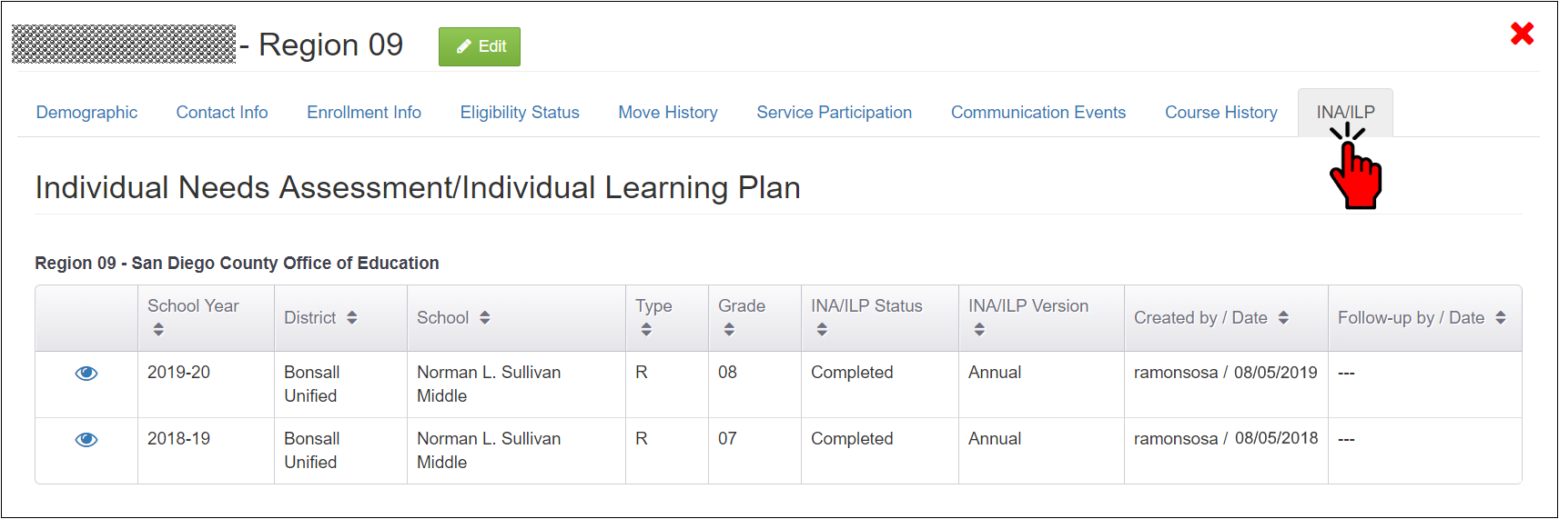
INA/ILP Workflow (3)
When opened, a child’s statewide record, known as the Child Record Modal, looks like a pop-up window with tabs along the top. The steps to access the INA/ILPs are:
Search for a child and open their Child Record Modal; and
Click on the INA/ILP tab to view the child’s existing records.
Notes:
Lead: Jose
Time: 3 mins
Talking Points:
Read bullets
Review the layout
Point out the view (eye) icon, which allows MSIN users to open the INA/ILP in view mode, even if they cannot create or edit INA/ILPs.

Slide 19
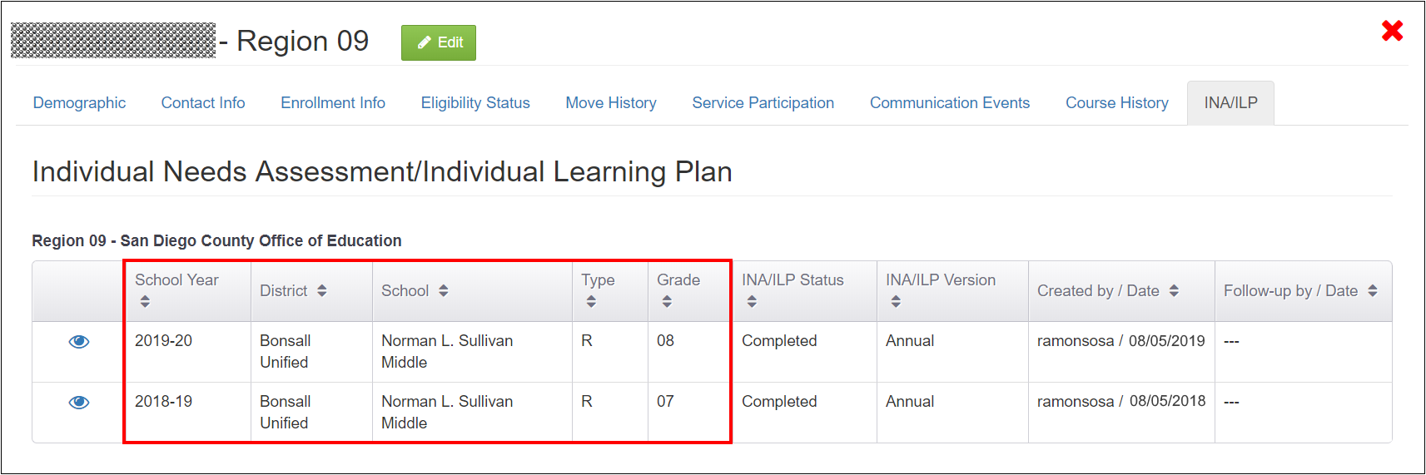
Every INA/ILP Links To An Enrollment
Note that every INA/ILP record (i.e., row) links to enrollment information (e.g., school year, district, school, type, and grade). This ensures that the child/youth is enrolled first. The grade is especially important because it controls the INA/ILP form layout so that only applicable sections appear.
Notes:
Lead: Jose
Time: 4 mins
Talking Points:
Read slide text
This is very similar to how services work. An enrollment line is needed first (so we know what district, school, grade the child belongs in), then additional data (like the INA/ILP information) can be added to a specific time (school year) and place (school).
Review the screenshot – items within red box

Slide 20
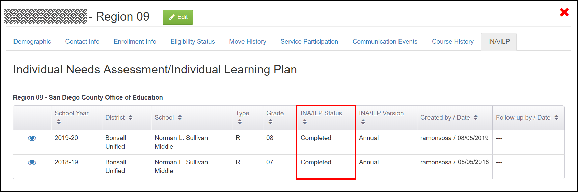
INA/ILP Statuses
An INA/ILP form can be in one of two statuses, Started or Completed.
Started: The form was created, but one or more required fields (marked with an asterisk) is/are incomplete.
Completed: All required fields are complete.
Notes:
Lead: Jose
Time: 2 min.
Talking Points:
Read slide text
If a required field does not have a response, the system will remind you every time the form is saved. The system will also surround the section in a red outline if it contains an incomplete required field.
Review the screenshot – items within red box

Slide 21
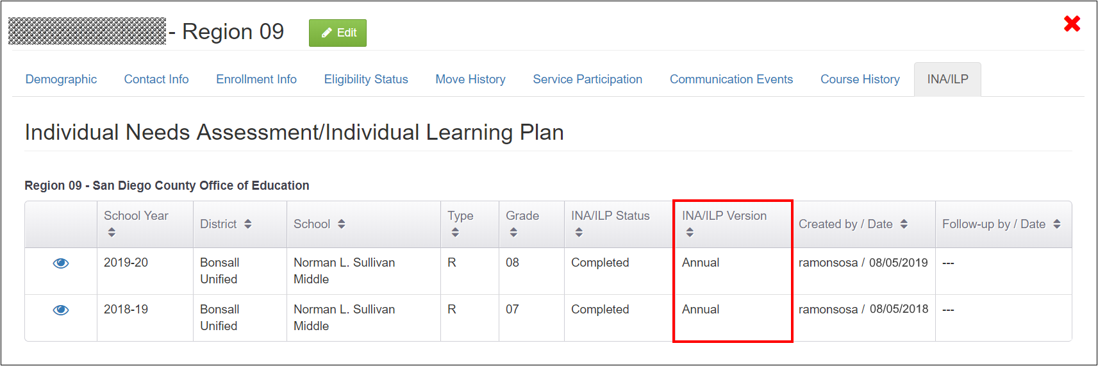
INA/ILP Versions
There are two INA/ILP versions, per California Education Code.
30 Day/Initial: Version for children/youth who are newly enrolled in the MEP.
Annual: Version for previously identified children/youth, to be completed every school year, while they are eligible for the MEP.
Notes:
Lead: Jose
Time: 3 mins
Talking Points:
Read slide text
Review the screenshot – items within red box

Slide 22
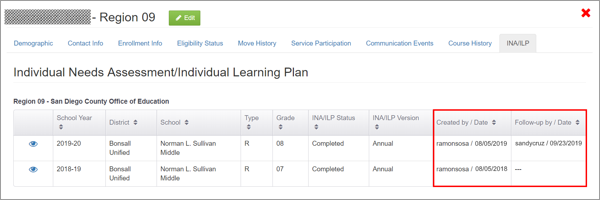
Created By and Follow-up By
After a MEP staff person creates an INA/ILP form, it can be updated by other MEP staff members, as needed.
Created By: The MSIN user and date when the form was created.
Follow-up By: The MSIN user and date when the form was last updated. A history of all follow-ups is stored within the form.
Notes:
Lead: Jose
Time: 3 mins
Talking Points:
Read slide text
An INA/ILP form has one initial creator but can have several follow-ups. This screen displays the most recent follow-up and the form itself has the entire follow-up history.
Users with the Data Specialist role will be able to create, edit, and delete INA/ILPs by default (since they need full access to the statewide child record). We will talk about a new role specifically for INA/ILP work later in the presentation. For now, we want you to focus on this particular screen.
Review the screenshot – items within red box

Slide 23
Questions? (2)
Notes:
Lead: Team
Time: 3 mins
Use Q&A feature in Zoom

Slide 24
Check for Understanding (2)
  Next, you will see a pop-up window with questions and response options.
  There are three questions for this section, answer them as best you can.
  If you are participating as a group, enter what the majority of the group chooses.
  You will get a warning when the poll is about to close.
Notes:
Lead: Victor
Time: 6 min
Talking Points:
Show polling questions, as follows:
INA/ILP forms are created and stored in each migratory child’s Communication Events.
True
False [answer]
2) If a child’s grade is incorrect in their enrollment line, that is not a problem because grades do not matter to in the INA/ILP form.
True
False [answer]
3) If an INA/ILP Status is “Started,” that means:
The MSIN user selected the correct enrollment line.
One or more required fields is incomplete. [answer]
The form version is “30-Day/Initial” rather than “Annual.”
All of the above

Slide 25
How does the INA Link to Specific MPO Reports?
Notes:
Transition Slide
Lead: Victor
Time: 20 secs.

Slide 26
Reports That Depend on INA/ILPs
MPO 1.0
MPO 2.0
MPO 5.0/6.0
MPO 5.1/6.1*
MPO 7.0
MPO 8.0
MPO 9.0
MPO 9.1
MPO 10.0*
MPO 10.1*
MPO 10.2*
MPO 11.0
MPO 11.1*
MPO 13.0
MPO 13.1
Notes:
Lead: Victor
Time: 2 min.
Talking Points:
The reports with an Asterix rely on completed INA/ILP forms.
Let’s review some important background information about these forms.
When an INA/ILP is created, the user must reference an existing enrollment line, which includes the grade level, and this determines the form version as mentioned in the previous slide. Questions about needs will vary according to the child’s grade.
The MPO reports highlighted in this slide reference specific questions in the INA/ILP forms which we’ll review in a moment.
MPO 5.1/6.1 is for secondary students enrolled in grades 11 or 12, who have a completed INA/ILP indicating that they need credit recovery services from the MEP.
MPO 10.0 is for youths enrolled in grade NA (OSY), who have a completed INA/ILP indicating that they are interested in “English (ELA, ESL, ELD.”
MPO 10.1 is for youths enrolled in grade NA (OSY), who have a completed INA/ILP indicating that they are interested in “GED/HEP.”
MPO 10.2 is for youths enrolled in grade NA (OSY), who have a completed INA/ILP indicating that they are interested in “Home language literacy.”
MPO 11.1 is for children and youths in all grades, who have a completed INA/ILP indicating that they need “Mental Health” services.
As we review each form, we will take a closer look at the INA/ILP responses that cause children to be included in these five MPO reports.

Slide 27
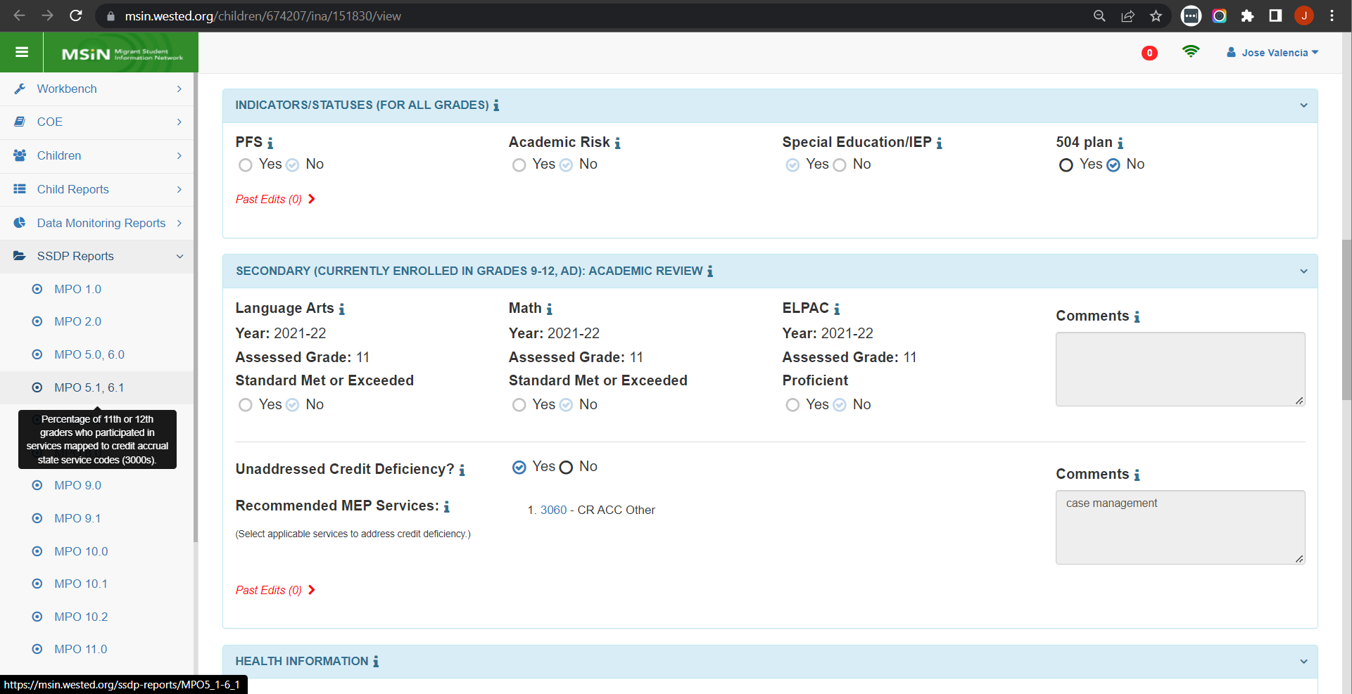
MPO 5.1/6.1 Linked to INA/ILP
Notes:
Lead: Victor
Time: 1 min
Talking Points:
The MPO 5.1/6.1 Report is specifically about currently enrolled grade 11 or 12 secondary students.
To be included in the report denominator, the student’s completed INA/ILP must have “Yes” selected after the question about having an “unaddressed credit deficiency.”
Selecting “Yes” means that the student needs the MEP to step in to provide a credit recovery service because the district is not already providing this.
If a student is receiving applicable district services, then “No” should be selected (because the MEP does not need to step in or supplant).

Slide 28
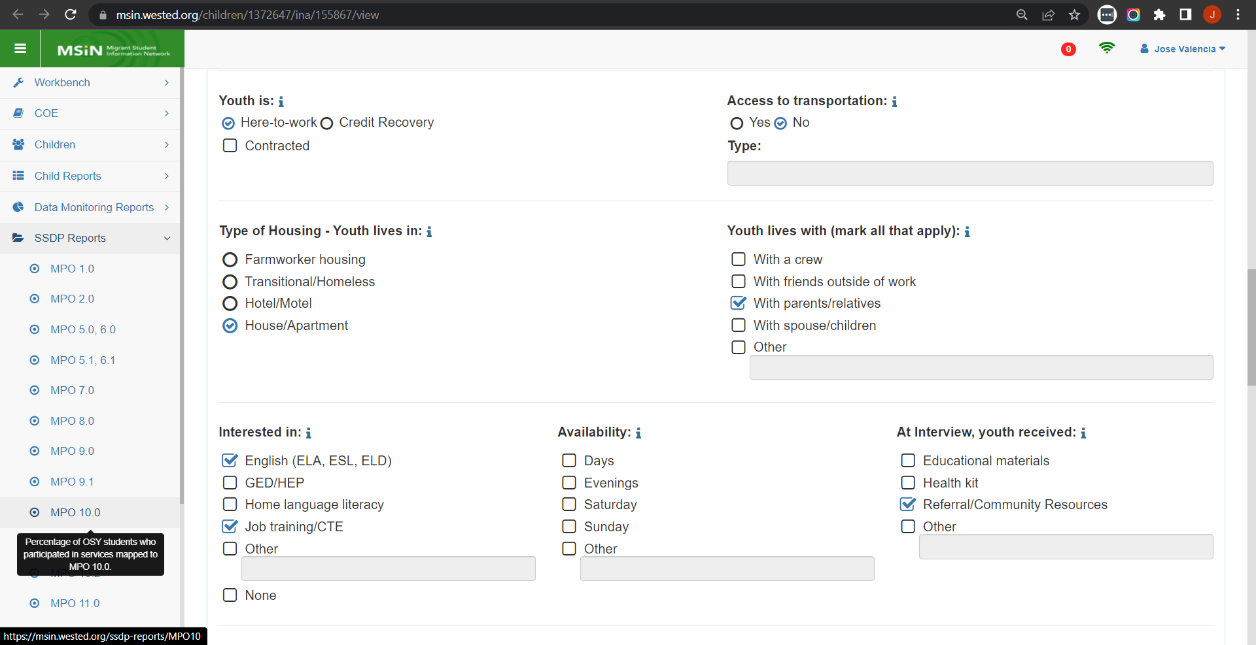
MPO 10.0 Linked to INA/ILP
Notes:
Lead: Victor
Time: 1 min
Talking Points:
The MPO 10.0 Report is specifically about currently enrolled youths in grades NA (OSY) or AD (Adult Education).
To be included in the report denominator, the youth’s completed INA/ILP must have a checkmark next to “English (ELA, ESL, ELD).”
When filling out the INA/ILP form, the MEP staff person interviewing the youth should consider if they are interested in actually attending a service (not just a passing interest in the subject).
If the youth is not planning to actually attend a MEP service, then we suggest leaving this box unchecked.

Slide 29
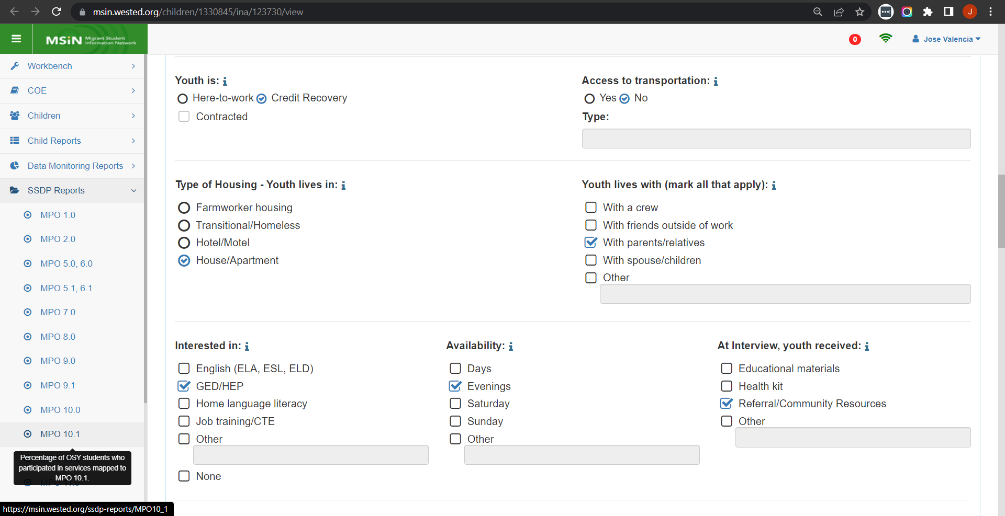
MPO 10.1 Linked to INA/ILP
Notes:
Lead: Victor
Time: 1 min
Talking Points:
The MPO 10.1 Report is specifically about currently enrolled youths in grades NA (OSY) or AD (Adult Education).
To be included in the report denominator, the youth’s completed INA/ILP must have a checkmark next to “GED/HEP.”
When filling out the INA/ILP form, the MEP staff person interviewing the youth should consider if they are interested in actually attending a service (not just a passing interest in the subject).
If the youth is not planning to actually attend a MEP service, then we suggest leaving this box unchecked.

Slide 30
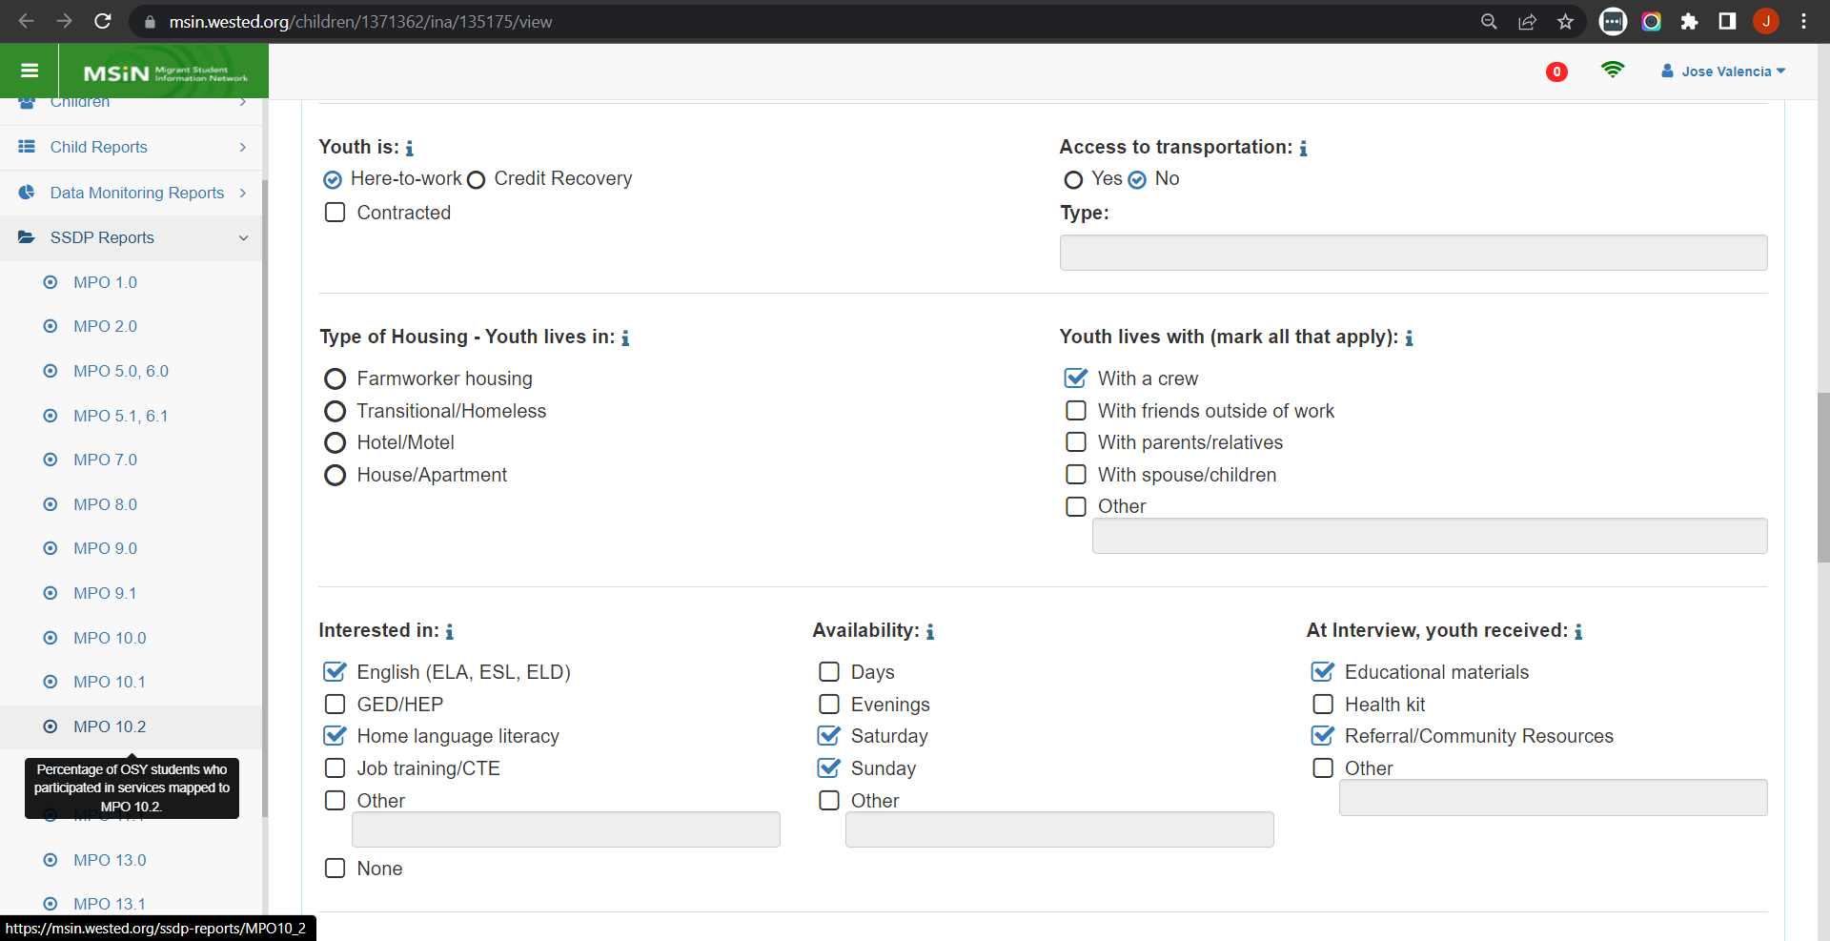
MPO 10.2 Linked to INA/ILP
Notes:
Lead: Victor
Time: 1 min
Talking Points:
The MPO 10.2 Report is specifically about currently enrolled youths in grades NA (OSY) or AD (Adult Education).
To be included in the report denominator, the youth’s completed INA/ILP must have a checkmark next to “Home language literacy.”
When filling out the INA/ILP form, the MEP staff person interviewing the youth should consider if they are interested in actually attending a service (not just a passing interest in the subject).
If the youth is not planning to actually attend a MEP service, then we suggest leaving this box unchecked.

Slide 31
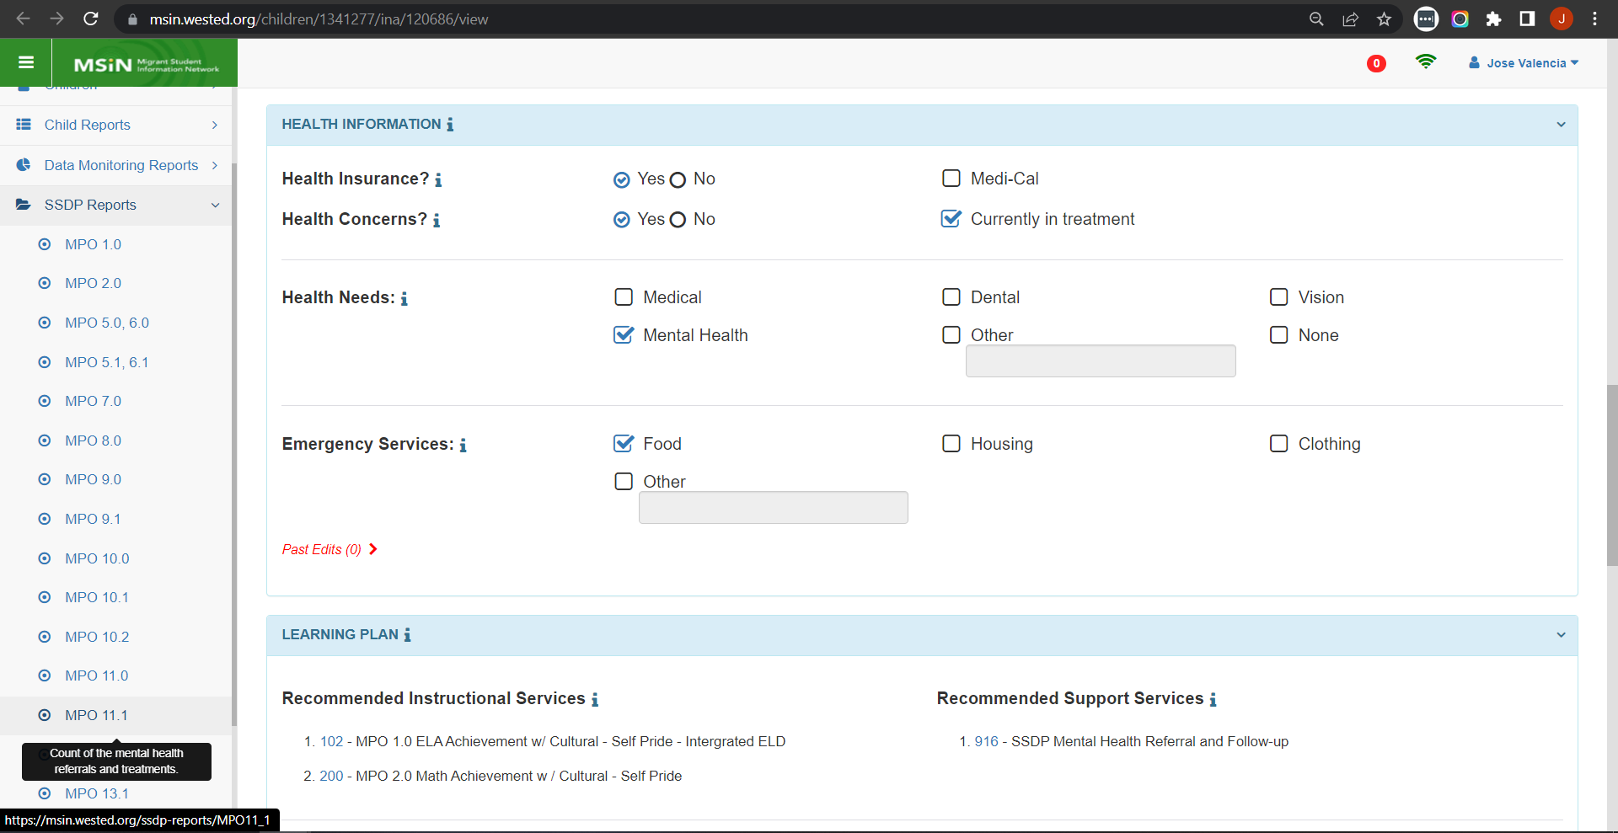
MPO 11.1 Linked to INA/ILP
Notes:
Lead: Victor
Time: 1 min
Talking Points:
The MPO 11.1 Report is about currently enrolled children and youths in any grade. This item appears in all four INA/ILP form versions.
To be included in the report denominator, the child’s or youth’s completed INA/ILP must have a checkmark next to “Mental Health” (as a health need).
When filling out the INA/ILP form, the MEP staff person interviewing the parent or youth should consider if the child or youth is likely to actually participate in a mental health service.
If the child or youth is not going to access a mental health service or referral provided by the MEP, then consider leaving this box unchecked.

Slide 32
Creating an INA/ILP
Notes:
Transition Slide
Lead: Jose
Time: 20 secs.

Slide 33
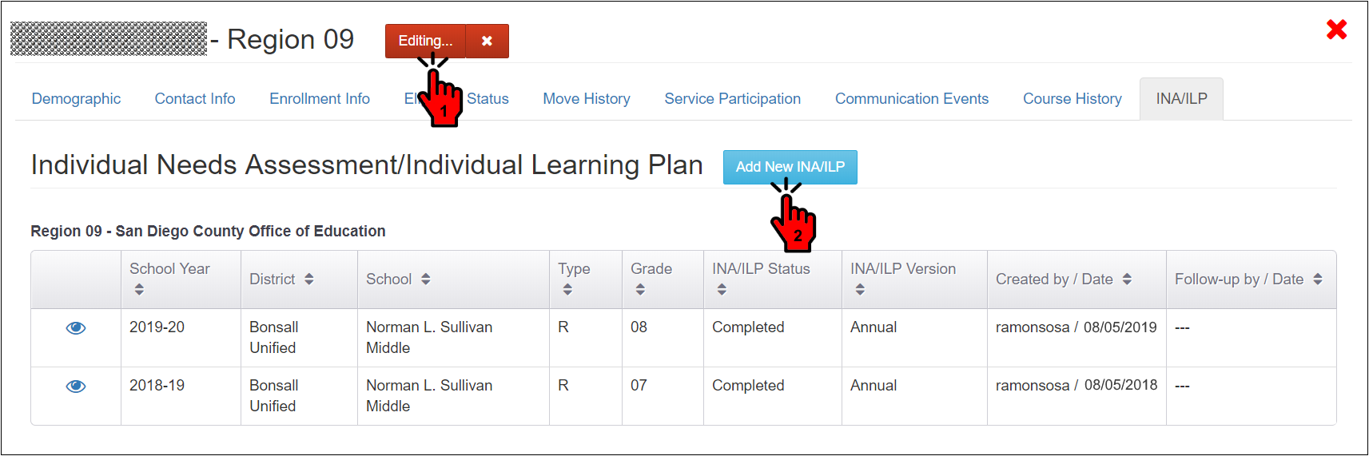
Creating a New INA/ILP
New INA/ILP forms are created by entering edit mode (1) and then clicking the “Add New INA/ILP” button (2). This will load the form on a separate tab in your browser.
Notes:
Lead: Jose
Time: 2 mins
Talking Points:
Read slide text; point out order shown in screenshot.

Slide 34
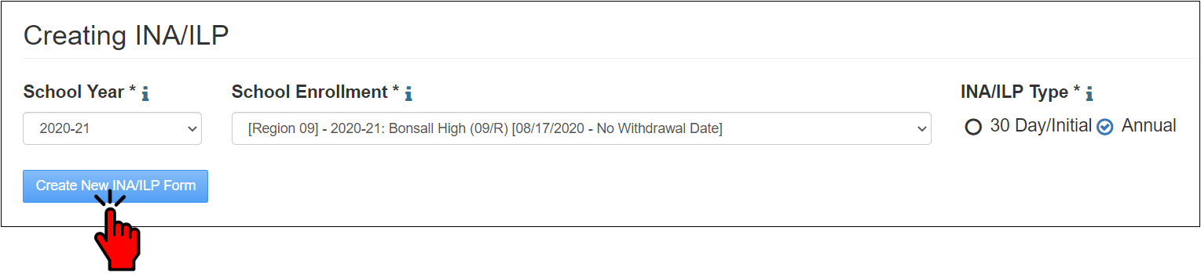
Creating a New INA/ILP (2)
An INA/ILP form must be linked to an existing valid enrollment line. This ensures that the child/youth is eligible to receive services. Choose the most current enrollment line in your region.
The enrollment line also provides the grade, so the system can display the applicable form sections and pre-populate child information.
The INA/ILP Type (30-Day/Initial or Annual) must be selected.
Notes:
Lead: Jose
Time: 4 mins
Talking Points:
Read slide text
Use the pointer to show the grade level within the selected School Enrollment line.
Emphasize the “i” icons that contain “help text” (definitions, instructions, tips).

Slide 35
INA/ILP Form Sections for All Grades (1)
INA/ILPs for all grade levels will have the following sections:
Personal Information: Displays name, date of birth, student IDs, etc. (pre-populated from the statewide child record).
Indicators: Displays Priority for Service (PFS), Academic Risk, and Special Education statuses; the user can add a 504 Plan indicator, if applicable.
Health Information: Gathers health information and needs.
Learning Plan: Records the user’s suggested subgrantee services to address the child’s/youth’s needs.
Interviewee: Records the name of the person providing the information and their relationship to the child/youth.
Notes:
Lead: Jose
Time: 4 mins
Talking Points:
Ask audience to refer to their paper INA/ILP form.
This item were sent to pre-registered participants, or you can click on the link in the chat.
Read bullet items.
These items are common to all grades and will show up in all INA/ILPs.

Slide 36
INA/ILP Form Sections for All Grades (2)
INA/ILPs for all grade levels will have the following sections (continued)
Created By and Follow-up By: Records name and date for the MEP staff who created and updated the INA/ILP.
Comments: Records additional comments (optional).
Notes:
Lead: Jose
Time: 1 mins
Talking Points:
Read bullet items.
These items are common to all grades and will show up in all INA/ILPs.

Slide 37
Demonstration of Two Grade Groups
Demonstration with a fictitious secondary school student.
  View of the MSIN INA/ILP screen
Demonstration with a fictitious OSY.
  View of the MSIN INA/ILP screen
  Demonstration videos for all grade spans can be found at: https://mephelpcenter.wested.org/hc/en-us/articles/7919139080596-How-To-Videos-Child-Records-Individual-Needs-Assessment-Individual-Learning-Plan-INA-ILP-
Notes:
Transition Slide
Lead: Jose
Time: 1 min intro; ~8 minutes per demonstration (about 16 minutes total)
On the Help Center you'll find a demo for each age group. For this presentation we will do a demonstration for the high school and OSY INA forms.

Slide 38
Questions? (3)
Notes:
Lead: Team
Time: 3 mins
Use Q&A feature in Zoom

Slide 39
Check for Understanding (3)
  Next, you will see a pop-up window with questions and response options.
  There are three questions for this section, answer them as best you can.
  If you are participating as a group, enter what the majority of the group chooses.
  You will get a warning when the poll is about to close.
Notes:
Lead: Victor
Time: 5 min
Talking Points:
Show polling questions, as follows:
1) When creating an INA/ILP, it must be linked to an existing valid enrollment line.
True [answer]
False
2) Based on the child’s/youth’s grade, some INA/ILPs will have a Learning Plan and others will not.
True
False [answer]
3) If the child is in secondary school, you must indicate whether or not they have an unaddressed credit deficiency.
True [answer]
False

Slide 40
Additional Considerations and Next Steps
Notes:
Transition Slide
Lead: Melissa
Time: 20 secs.

Slide 41
Additional Instructions and Considerations
It is appropriate to include completing the INA/ILP during case management services for students in 9th grade (MPO 5.0/6.0).
Consider completing the INA in case management services for 10th through 12th graders as well (not aligned to MPO 5.0 and 6.0).
MPO 5.1/6.1 – The “Unaddressed Credit Deficiency” question is a bit tricky. Case management staff should confirm that there actually is a need that the core instructional program is not fulfilling.
MPOs 10.0, 10.1, 10.2 – When speaking to the OSY, discuss the significance of them identifying a need on the INA. If an OSY is not seriously considering enrolling in services offered or will be staying a very short period of time and won’t be able to enroll in services, then the “Interested in” box shouldn’t be checked.
Notes:
Lead: Melissa
Time: 4 minutes

Slide 42
Additional Instructions and Considerations (2)
MPO 11.1 – Sometimes mental health needs are identified through the INA process, but somewhere in the process the MEP verifies that the core instructional program is already providing mental health services. If this is the case, and like credit recovery there is no unaddressed need, the local MEP may update the INA by removing the mental health checkmark and add a note to the comments that the school is meeting this need.
Notes:
Lead: Melissa
Time: 1 minute

Slide 43
Additional Instructions and Considerations (3)
For youth/parents who do not wish to complete the INA/ILP – please start the INA/ILP for the child/youth so you can identify which services the child/youth should be referred to. If a parent does not want to provide information or be interviewed:
Discuss the importance of the INA/ILP with the parent.
Ask if you could possibly call back to complete the INA/ILP with them if the timing is bad.
If the parent is adamant that they do not want to be interviewed to complete the INA, please take notes in the INA. It won’t be marked as completed, but starting the INA coupled with the notes documenting the parents’ reluctance to complete the INA/ILP shows that the local MEP is committed to implementing the law according to California Education Code.
Notes:
Lead: Melissa
Time: 2 minutes

Slide 44
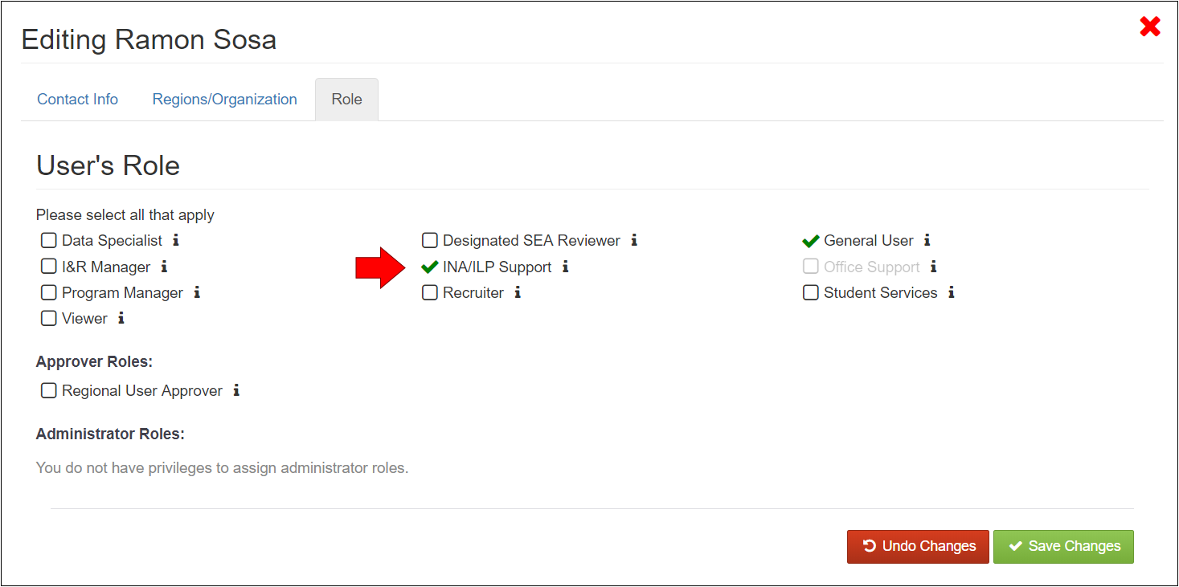
INA/ILP Support Role
The INA/ILP Support Role was added when the INA/ILP was created so that subgrantees can give local users the ability to create, edit, and delete INA/ILPs.
Local Regional User Approver(s) can add this new role to local MSIN users.
Notes:
Lead: Melissa
Time: 2 mins
Talking Points:
Read bullets
Melissa will add more notes, if needed.

Slide 45
Data Privacy and Security
Both within the MSIN and in paper form, the INA/ILP contains Personally Identifiable Information (PII). As a result, be sure to follow all State and local measures for protecting student data, including (but not limited to):
Never share access to the MSIN (i.e., your username and password).
Consider your location when viewing confidential data (i.e., anything in MSIN). Others should not be able to see what is on your screen.
Do not email electronic versions (e.g., PDFs) of the INA/ILP unless they are encrypted per CDE standards.
Store paper INA/ILPs in a secure location (e.g., locked cabinet).
Shred paper INA/ILPs that have been updated/replaced (the MSIN stores electronic versions).
Notes:
Lead: Melissa
Time: 5 mins
Talking Points:
These items apply to currently existing paper INA/ILPs, new INA/ILPs created in MSIN, and printouts of INA/ILPs in MSIN.
From Elizabeth Wisnia’s presentation on data privacy and security:
“If PII must be collected, CDE is responsible for protecting such data from unauthorized access. If data is collected and stored electronically; passwords, encryption, and other means for electronically limiting access to PII should be employed. If hard copies of the data are collected, such results should be stored in a secure, locked area that is only accessed by authorized personnel. Anyone with access to the data should be properly trained on privacy laws and policies related to data privacy.”
“Occasionally, you may have a legitimate need to print/work with hard copies of confidential data. In such instances, consider where you might securely store such data when the data is not in use. Hard copies of confidential data should only ever be in one of three places: (1) In your hands, (2) In a locked cabinet/secure room, (3) In the shredder. Treat hard copies of confidential data like cash. If you wouldn’t leave a $100 bill sitting unattended and exposed in an insecure location such as your vacant desk, you shouldn’t leave confidential data there either.”
“In this era of smart phones and other ever-present photo/recording devices, please also consider acceptable locations to peruse confidential data. If you’re in a public coffee shop or have a desk with a window that faces a busy street (for example), consider moving to a private location or reconfiguring your desk so that those with too much curiosity or nefarious intentions won’t have access to the confidential information you are reviewing.”
Melissa will select which sentences to use or add her own.

Slide 46
Suggestions For Completing INA/ILPs
Take inventory of which MEP staff currently work on INA/ILPs and assign them the “INA/ILP Support” role in MSIN.
Consider modifying your current INA/ILP workflow to keep as much of it as possible within MSIN (paperless).
Consider assigning INA/ILP work by school and grade level; this will allow MEP staff to use the Enrollment Report, or any other student report, as a worklist.
Develop local policies and procedures for printing and securing INA/ILPs (such as when they are added to student cumulative record folders at schools or district offices).
Any paper INA/ILPs created must be entered into MSIN.
Notes:
Lead: Melissa
Time: 4 mins
Talking Points:
Read bullet points.

Slide 47
Questions? (4)
Notes:
Lead: Team
Time: 3 mins
Use Q&A feature in Zoom

Slide 48
Check for Understanding (4)
  Next, you will see a pop-up window with questions and response options.
  There are three questions for this section, answer them as best you can.
  If you are participating as a group, enter what the majority of the group chooses.
  You will get a warning when the poll is about to close.
Notes:
Lead: Victor
Time: 5 min
Talking Points:
Show polling questions, as follows:
1) In the Learning Plan section of the INA/ILP, you must add non-MEP services and goals for the student.:
True
False [answer]
2) Only MSIN users with the Data Specialist role will be able to create and edit INA/ILPs.
True
False [answer]
3) For efficiency, it is a good idea to print out all your completed INA/ILPs and keep them on top of your desk so they are really handy.
True
False [answer]

Slide 49

Next Steps for Subgrantees
Notes:
Transition Slide
Lead: Melissa
Time: 10 seconds

Slide 50
Goals For INA/ILPs
  Integrate the electronic INA/ILP into your current workflow to meet California Education Code requirements.
  Assign and give local staff the “INA/ILP Support” role.
  Note that INA/ILP completion impacts the following MPO reports:
    MPO 5.1/6.1 Report: High School Credit Accrual Services
    MPO 10.0 Report: OSY Literacy – English Language Arts (ELA), English Language Development (ELD), and English as a Second Language (ESL) Services
    MPO 10.1 Report: OSY Literacy - GED Services
    MPO 10.2 Report: OSY Literacy - Primary Language Services
    MPO 11.1 Report: Mental Health Referrals & Treatment
Notes:
Lead: Melissa
Time: 2 min
Talking Points:
Read bullet points.

Slide 51

Resources
  Subgrantees may use this presentation and supporting materials to train local MEP staff.
  Past INA/ILP webinars and materials, including the INA/ILP Report user guide, can be found in the California MEP Help Center: https://mephelpcenter.wested.org/
  If any questions arise, subgrantees may contact the MSIN Service Desk to receive assistance.
Notes:
Lead: Melissa
Time: 1 min
Talking Points:
This PowerPoint and any supporting materials will be posted on the California MEP Help Center (https://mephelpcenter.wested.org/).
Remember that definitions, rules, and other information is readily accessible by clicking the “i” icon next to most titles and fields in MSIN pages and modals.
Subgrantees may contact their CDE consultant and/or the MSIN Service Desk if questions come up in the future.

Slide 52
Contact Information
Melissa Mallory
Education Programs Consultant
California Department of Education
mmallory@cde.ca.gov
916-319-0730
_____________________________________________________________
MSIN Service Desk
MSINsupport@wested.org
1-800-342-2964, option 2
Notes:
Lead: Melissa
Time: 30 sec
Talking Points:
Thank WestEd technical staff who assisted with the webinar.
Thank participants for attending.

