Slide 1
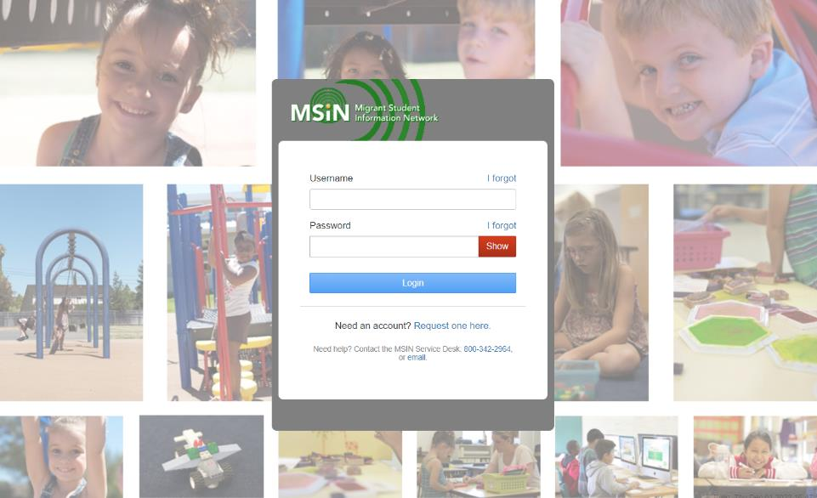
Welcome to the
Migrant Student Information Network
2023 Training
We will begin shortly.
Please enter your name and region/district in the chat.

Slide 2
Migrant Student Information Network:
Key Topics for Data Specialists
January 24, 2023
1:00 p.m. – 2:30 p.m.

Slide 3



Welcome and Introductions
Session Presenters:
Stephanie Lynch, Education Research and Evaluation Consultant, California Department of Education (CDE)
Jose Valencia, Migrant Student Information Network (MSIN) Lead, WestEd
Victor Garibay, MSIN Specialist, WestEd
Notes:
Lead: Stephanie
Time: 3 mins.
Talking Points:
Welcome participants.
Presenters introduce themselves

Slide 4
Purpose
This webinar will focus on managing child records in the MSIN system, from the perspective of Data Specialists. Its purpose is to collectively review how enrollments and services affect the Measurable Program Objective (MPO) reports so that subgrantees can edit them to obtain accurate results.
The target audience is MEP staff with the Data Specialist role.
Notes:
Lead: Stephanie
Time: 1 min
Talking Points:
(Read or paraphrase bullets)
The session content was written for experienced MSIN users who have a working background as active Data Specialists. If you are a new Data Specialist, some ideas might be challenging, so we encourage you to work with your local team to clear up any doubts.

Slide 5
Session Objectives
Participants will:
know Data Specialists’ unique responsibilities;
review the Enrollment Info tab in the Child Record Modal, especially how enrollments affect the MPO reports;
review the Service Participation tab in the Child Record Modal, especially how services affect the MPO reports;
share and discuss local knowledge regarding these topics; and
review the resources available to support Data Specialists.
Notes:
Lead: Stephanie
Time: 1 min
Talking Points:
(Read or paraphrase bullets)

Slide 6


Housekeeping
Please mute your microphone in the main session.
Use the Q&A function to enter your questions.
Participate in breakout room activities.
The PowerPoint for this presentation can be accessed through the link provided in the chat. It will also be posted on the California MEP Help Center for those who were not able to attend today.
Notes:
Lead: Stephanie
Time: 1 min.
Talking Points:
(Read or paraphrase bullets then pass the mic to Victor for the next slide)

Slide 7
The Data Specialist Role in MSIN
Notes:
Transition Slide
Lead: Victor
Time: 20 secs.

Slide 8
Data Specialist Role Abilities
For children/youth in their own region/Direct-funded District (DFD), Data Specialists can:
view and edit child records (i.e., an edit button is available in most tabs within the Child Record Modal);
view/enter/edit/delete individual child enrollment lines and use the Group Enrollment feature to complete annual re-enrollments;
view/enter/edit/delete individual child service participation lines and use the Group Services feature to complete service entry for groups of children after the end of each term;
view and create regional/DFD service codes using the Administer Services features;
Notes:
Lead: Victor
Time: 1 min
Talking Points:
The next two slides contain an overview of the tasks typically performed by Data Specialists.
(Read or paraphrase bullets)

Slide 9
Data Specialist Role Abilities (2)
view/enter/edit/delete Communication Events for individual children and groups;
view/enter/edit/delete partial Course History for secondary students who moved away mid-year, when applicable;
view/enter/edit/delete Individual Needs Assessment/Individual Learning Plan (INA/ILP) forms;
view school information and resolve Provisional Schools;
resolve duplicate child records in the MSIN so that other system components can produce accurate unduplicated child counts (i.e., Category 1 and 2 counts); and
view all Child Reports and Data Monitoring Reports.
Notes:
Lead: Victor
Time: 1 min
Talking Points:
(Continued reading bullets)
As we can see, Data Specialists perform a greater number of critical tasks in MSIN than any other user role.
We consider them the local data experts.

Slide 10
Unique Responsibilities
Data Specialists are responsible for entering accurate information in the MSIN.
Data Specialists, with local managers, are also responsible for ensuring that information entered by other users in their region/DFD is accurate.
To assist with these Quality Assurance (QA) tasks, the MSIN is equipped with data monitoring reports specifically for QA and the ability to download reports (for review and analysis using Excel).
At the subgrantee level, MEP Directors and other managers typically ask Data Specialists to pull reports and review their contents for various purposes. Other local users may also request data-related support.
To summarize, Data Specialists are local data experts who are expected to know and understand their local information.
Notes:
Lead: Victor
Time: 1 min
Talking Points:
(Read or paraphrase bullets)

Slide 11
What’s New This Year?
Users with the Data Specialist role in MSIN now have access to the MPO reports, allowing them to:
check which children are included in the percentage calculations; and
support local colleagues when they have specific questions.
The child lists in the MPO reports now have more columns so that users have more ways to sort the information.
Notes:
Lead: Victor
Time: 1 min
Talking Points:
(Read or paraphrase bullets)
The first minor change was implemented because of a pattern we saw through the MSIN Service Desk. Data Specialists were trying to support local managers, but they could not see the reports directly to help answer questions.
The second change, adding more columns to the child lists, was made because CDE needs to disaggregate the information by PFS status and it was not a heavy lift to add a few additional columns during this update (like school, enrollment type, and grade). We will see more on this during the presentation.

Slide 12
Child Records: Enrollment Info
Notes:
Transition Slide
Lead: Jose
Time: 20 secs.

Slide 13
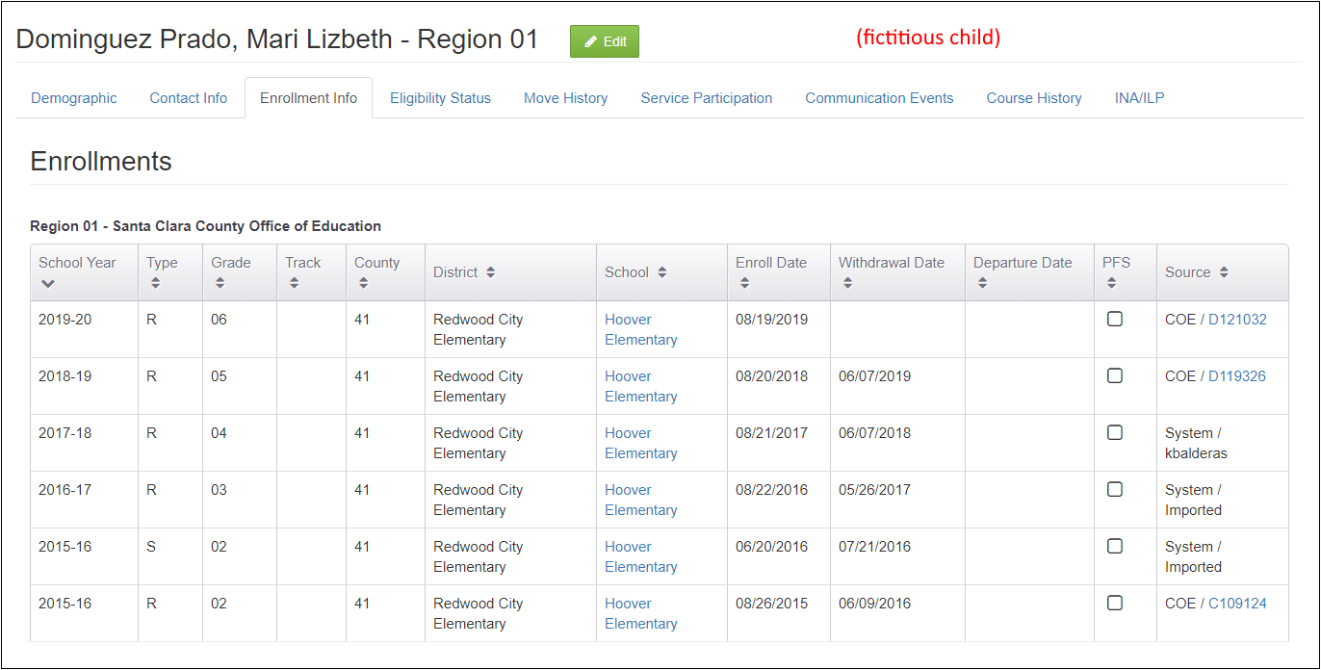
Editing the Enrollment Info Tab
Notes:
Lead: Jose
Time: 1 min
Talking Points:
Notice the green “Edit” button along the top. This allows you, as a Data Specialist, to make changes in this tab.
We will only cover a few key points about enrollments during this presentation because of limited time.
There is a comprehensive MSIN user guide on working with enrollments posted on the MSIN home page and on the new California MEP Help Center.
All Data Specialists should read the guide carefully and make sure they understand all definitions and instructions.
Let’s start with a brief review of why enrollment data is so important in MSIN.
* The example shown here is a fictitious child in the testing server.

Slide 14
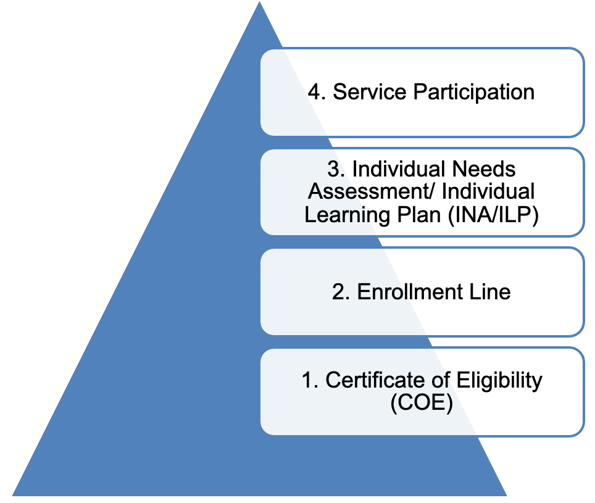
Enrollment Dependencies
An assessed child participates in services
An enrolled child is assessed for needs.
An eligible child is enrolled in the MEP.
A verified COE confers eligibility.
Notes:
Lead: Jose
Time: 3 min
Talking Points:
The information entered in MSIN is structured a certain way. Like a pyramid, there is a foundation and everything else builds on that.
The foundation is the Certificate of Eligibility (COE). Before anything else can happen, we need a verified COE to confer eligibility for the MEP to the children listed in the COE form.
An eligible child can be enrolled in the MEP (via an enrollment line).
Ideally, the enrolled child will be assessed, and services will be planned for them based on their needs.
The assessed child will participate in MEP services.
Notice that these are all inputs in MSIN. We enter a COE which contains an initial enrollment line, then a re-enrollment line in subsequent years, then an INA/ILP, and ultimately, we can enter service participation data. These different types of information depend on each other. These dependent layers help us keep the data in MSIN logically consistent.
(Ask questions: Can I re-enroll a child with expired COE? Can I create an INA/ILP for a child who does not have an enrollment line in the target school year?)
To recap, COEs are the foundation of all data entry in MSIN and enrollments lines are the critical second layer on top of the foundation.
All these inputs are necessary so that we can get important outputs. In the next slide we will summarize the inputs and outputs related to enrollments.

Slide 15
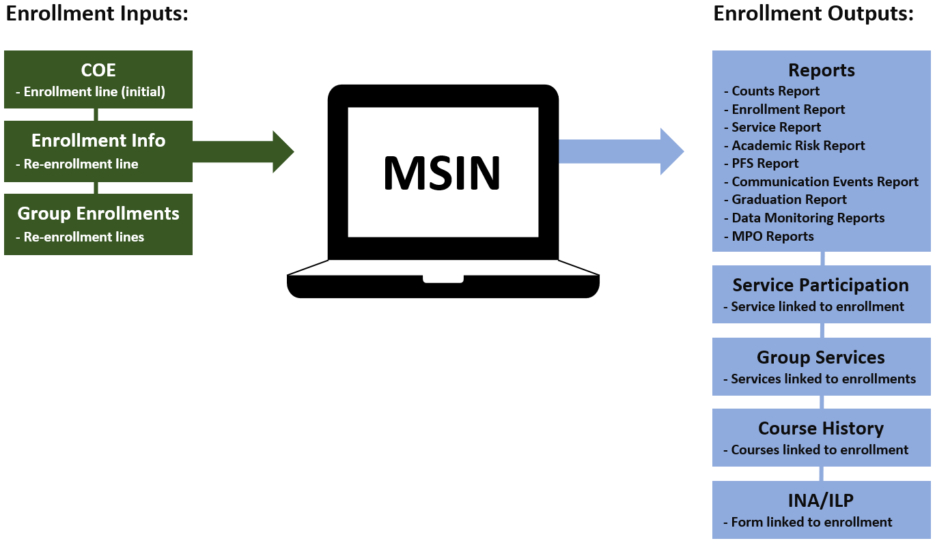
Enrollment Inputs and Outputs
Notes:
Lead: Jose
Time: 2 min
Talking Points:
The green boxes represent how enrollment information enters MSIN. (Go over each green box)
The blue boxes represent the places in MSIN where that enrollment information appears again, for various purposes. (Go over each blue box)
As you can see, enrollment information is used in many places throughout the system.

Slide 16
Enrollments and MPO Reports
In general, having accurate enrollment lines is very important because they affect your MPO results.
Enrollments are how we know a child is present and could be in the denominator (i.e., children we should serve because they have a need in this area).
  Adding or Deleting an enrollment line can add or delete a child from an MPO report.
Be aware that some children have complex enrollments because they move often, and this could make them appear in multiple MPO reports.
Notes:
Lead: Jose
Time: 1 min
Talking Points:
Let’s take a closer look at one of the report outputs that we mentioned earlier, the MPO Reports.
We are covering this topic because the Data Advisory Committee recommended it and we have also seen many related questions come in through the MSIN Service Desk.
(Read bullets)
Next, we’re going to take a look at examples that demonstrate each of these bullet points.

Slide 17
Reports With Enrollment Dependencies
MPO 1.0
MPO 2.0
MPO 5.0/6.0
MPO 5.1/6.1*
MPO 7.0
MPO 8.0
MPO 9.0
MPO 9.1
MPO 10.0*
MPO 10.1*
MPO 10.2*
MPO 11.0
MPO 11.1*
MPO 13.0
MPO 13.1
Notes:
Lead: Jose
Time: 1 min.
Talking Points:
In this list, the highlighted reports depend on enrollments.
For example, the first criterion for including children in the MPO 1.0 and 2.0 reports is that they must have an enrollment line with grades K-10. For the MPO 5.0/6.0 report, which is about case management services, the first criterion for including children is that they must have an enrollment line with grade 9. Similarly, each highlighted report has criteria that depends on enrollment data.
The reports with an Asterix rely on completed INA/ILPs, which partly depend on enrollments. When an INA/ILP is created, the user must reference an existing enrollment line and this determines the form version based on the grade.

Slide 18
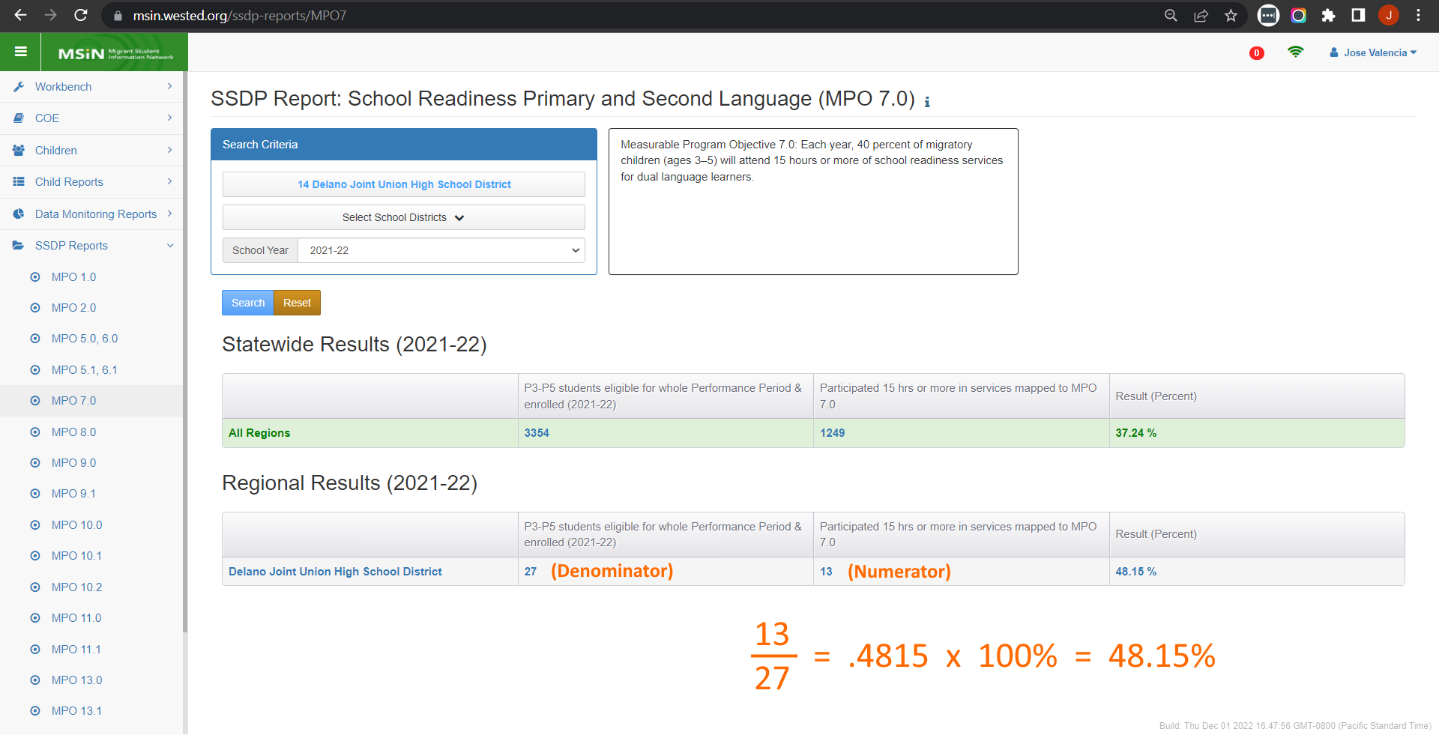
Understanding Report Calculations
Notes:
Lead: Jose
Time: 2 min
Talking Points:
Using this report as an example, let’s start at the top and review the big picture.
Each report has the MPO, or goal, in black text. This is copied verbatim from the SSDP document. The MPO text gives us an idea of what the report is meant to show.
Like this MPO, most others will also have a target percentage.
The math is straightforward (review the example calculation in orange).
The dominator (27) is the group of children we should serve, and the numerator (13) includes those who were served.
You may ask: “So, how does a child end up in each group?” We will cover that in the next slide.

Slide 19
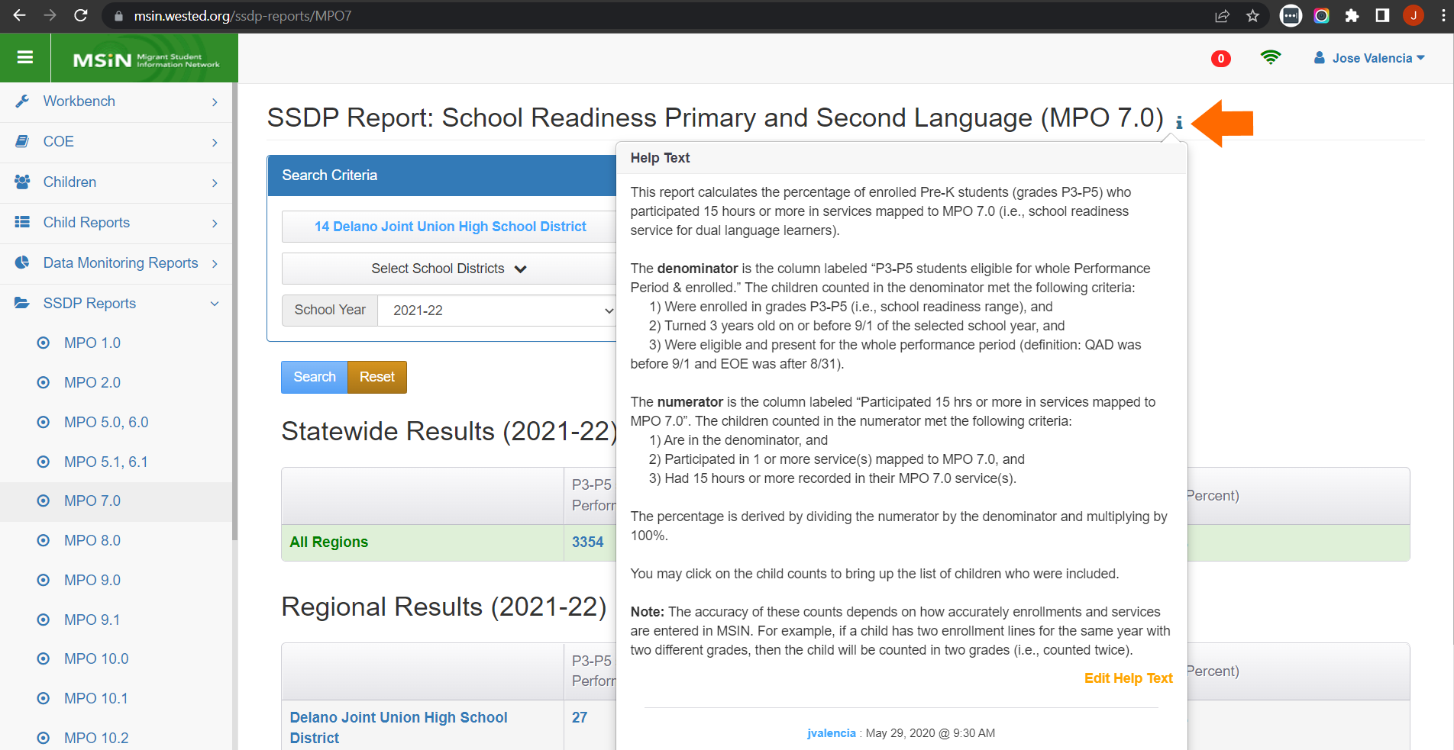
Understanding Report Criteria
Notes:
Lead: Jose
Time: 1 min
Talking Points:
It’s always good to check the help text because it lists the criteria needed to include a child.

Slide 20
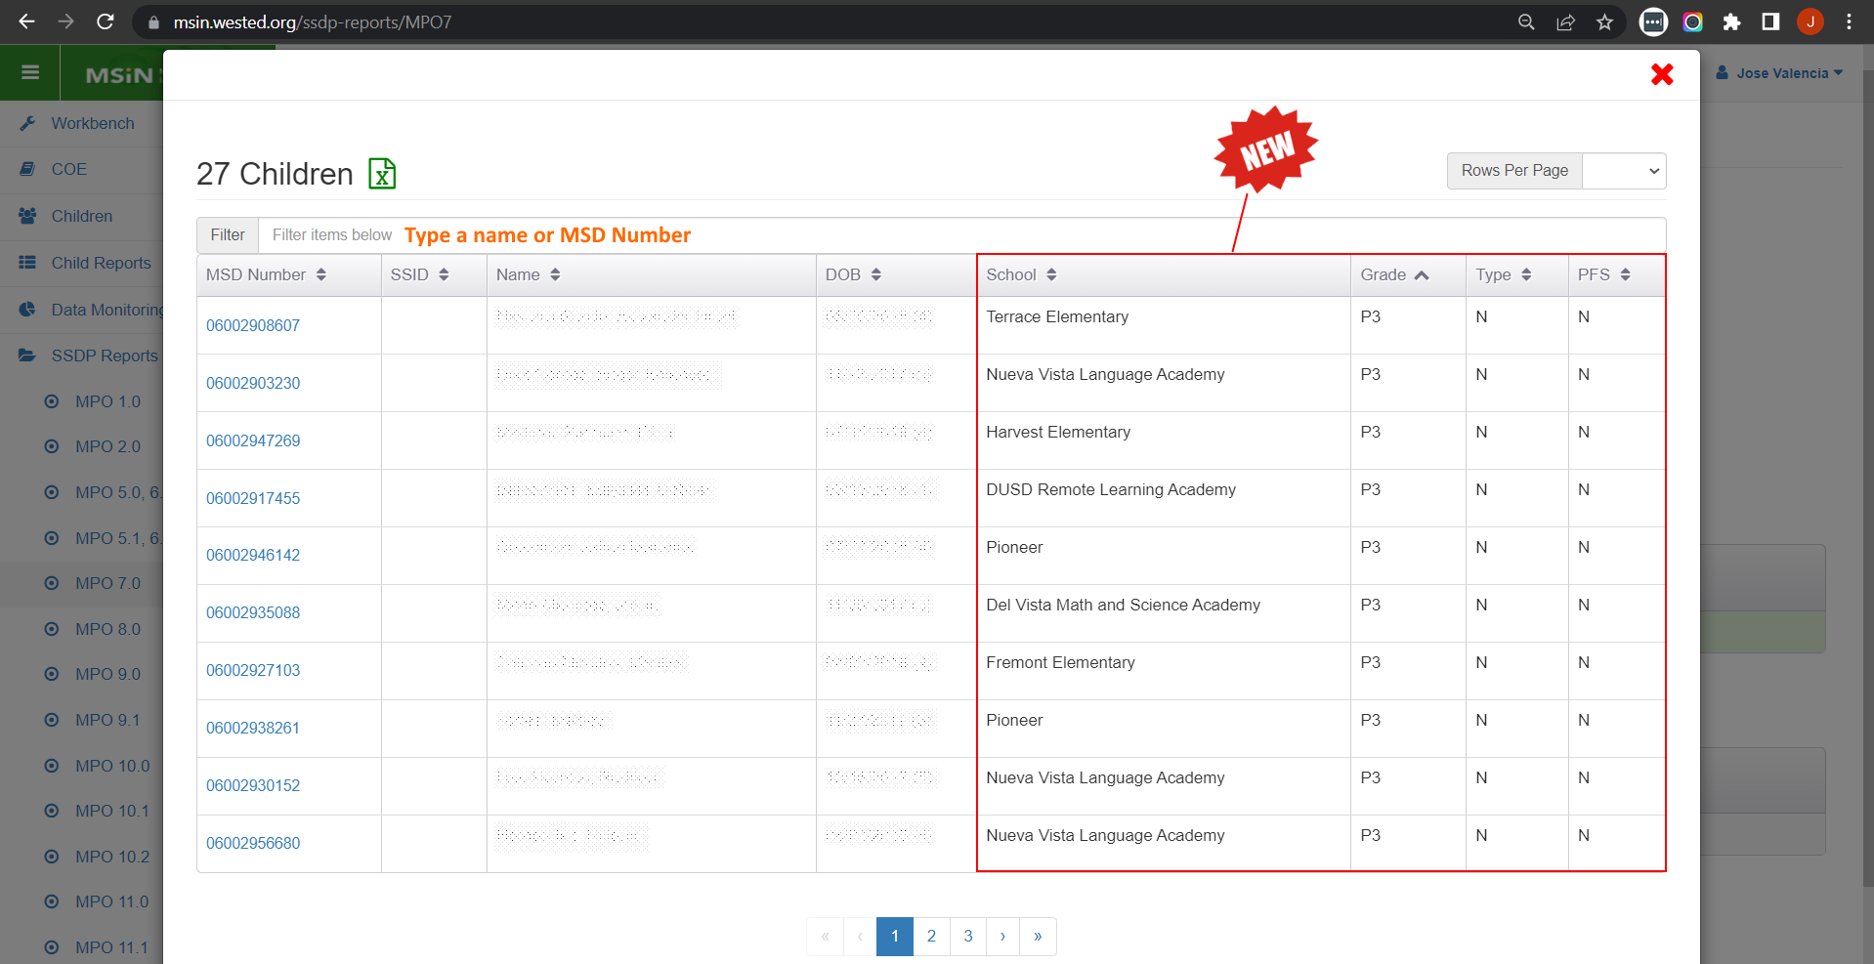
Using Child Lists in MPO Reports
Notes:
Lead: Jose
Time: 1 min
Talking Points:
Clicking on the denominator count brings up a window showing exactly which children are included.
To look for a specific child, you can type their name or MSD Number in the filter field, just above the table.
This year, CDE requested the addition of a column for PFS, and we were able to add three more useful columns as well (school, grade, and Enrollment Type.
The child list is exportable, so you manipulate the information in Excel.
To recap, this is the list of children who have a current enrollment and meet the other criteria for the denominator. They are the children we should serve to meet the MPO goal.

Slide 21
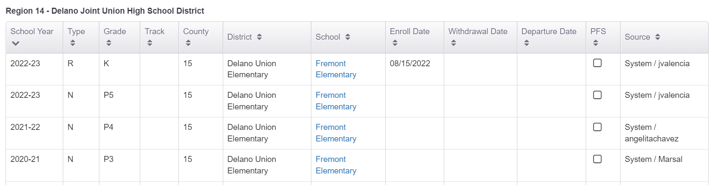
Fixing Enrollment Errors
Example: If a child was included in the MPO 7.0 report because of an incorrect grade, you can delete the enrollment line to remove the child from the report denominator.
Notes:
Lead: Jose
Time: 2 min
Talking Points:
Here we have an example where we need to determine which enrollment line is correct.
(Walk through the circled enrollment lines.)
As a data specialist, I could consult with a colleague who works at the district and ask for their help.
Or, if I have access to the district database, I could look up the student directly.
If I happen to find that the child is in Kindergarten or Transitional Kinder, then removing the line with the P5 would remove the child from the MPO 7.0 Report for 2022-23. (Click next for animation that crosses out the P5 line).
In general, we recommend collaborating with your team to fix enrollment errors, as needed.

Slide 22
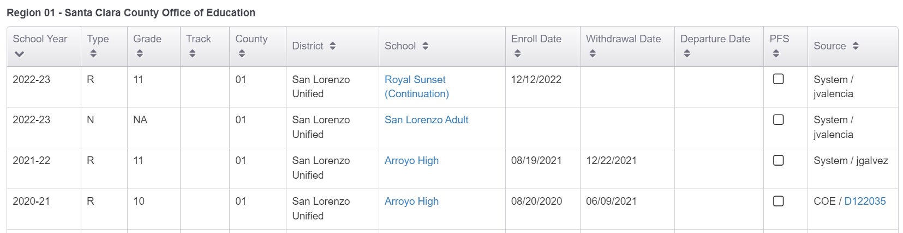
Recognizing Complex Enrollments
Example: A youth dropped out of school and became an OSY in 2022-23. Later in the year, they decided to return to school and recuperate missing credits. This youth could be on two MPO reports, one for grade NA (e.g., MPO 9.1) and another for grade 11 (e.g., MPO 5.1/6.1).
Notes:
Lead: Jose
Time: 2 min
Talking Points:
Sometimes children have unique circumstances the lead to complex enrollments.
Let’s take a look at this example.
(Walk through the enrollments, beginning with 2021-22).
This case is meant to illustrate that reviewing a child’s enrollment history can help us understand why they appear, or don’t appear, in specific MPO reports.

Slide 23
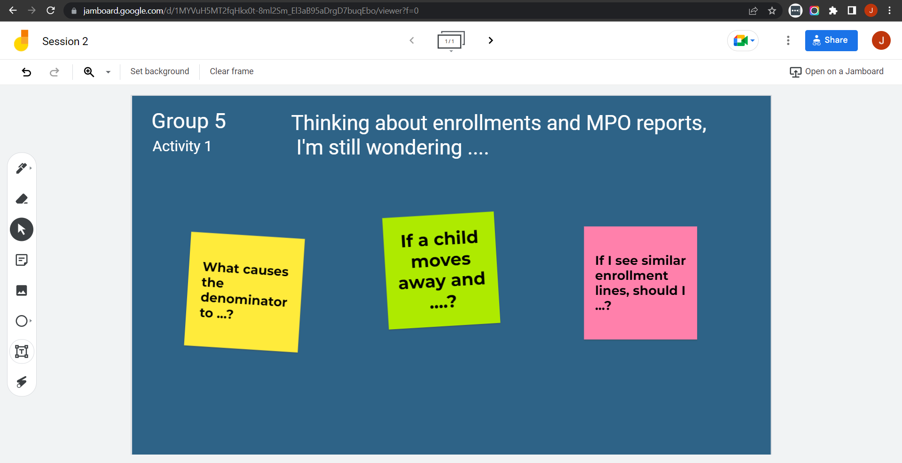
Collaborative Activity 1
Notes:
Lead: Jose
Time: 2 mins.
Talking Points:
This activity is focused on gathering remaining questions and discussing them.
(Explain that participants will be placed in breakout rooms with 5-6 collaborators. [Randomly assigned.])
(Demonstrate the activity using Jamboard.)

Slide 24
Activity 1 Instructions
In your Breakout Room (BR), take 2 minutes to introduce yourselves (name, region/DFD, and job title).
Open the chat window to view the instructions and links.
Click on the Jamboard link that matches your BR number (e.g., BR 5 should go to Jamboard group 5).
Keep two windows open: your BR in Zoom and your activity 1 slide in Jamboard.
Add post-its (sticky notes) with your questions.
Discuss your questions with the group.
Notes:
Lead: Jose & Nesau
Time: 8 mins.
Talking Points:
(Read instructions on the slide.)
Paste the instructions link in the chat.
Send to Breakout rooms – 7 minutes

Slide 25

Questions?
Notes:
Lead: Team
Time: 4 mins

Slide 26
Check for Understanding
  Next, you will see a pop-up window with questions and response options.
  There are two questions for this section; answer them as best you can.
  You will get a warning when the poll is about to close.
Notes:
Lead: Victor
Time: 4 min
Poll Questions:
1) True or False: Most information that is entered in MSIN must be linked to a child’s existing enrollment lines.
True [answer]
False
I don’t know
2) True or False: Only a couple of MPO reports depend on having accurate enrollment lines.
True
False [answer]
I don’t know

Slide 27

Break
Time for a break.
Notes:
3-minute break
Stretch, grab coffee or tea, take a bio break

Slide 28
Child Records: Service Participation
Notes:
Transition Slide
Lead: Victor
Time: 20 secs.
As we reviewed earlier, Data Specialist do so much in MSIN. We could spend a full day talking about the details. But given our limited time together, we are going to focus on just two more of the most important data categories: Services and Course History.

Slide 29
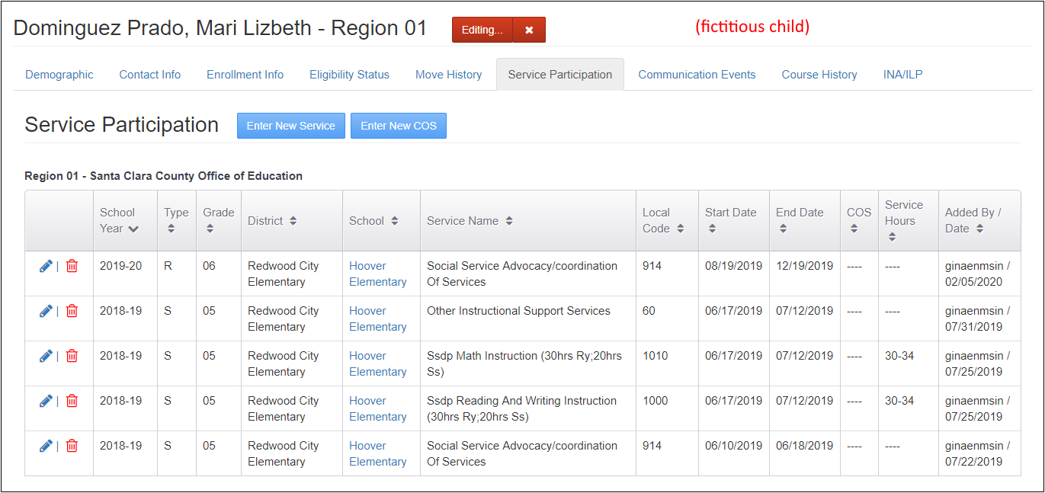
Editing the Service Participation Tab
Notes:
Lead: Victor
Time: 1 min
Talking Points:
Now we will continue with the Service Participation tab.
(Briefly review the buttons/icons in the screenshot)
There is a user guide for entering services on the MSIN homepage and the California MEP Help Center. Please read it carefully and make sure you understand all definitions and instructions.
* The example shown here is a fictitious child in the testing server.

Slide 30
Service Participation Dependencies
3. Enrollments and Services appear as options in service entry screens
4. Service Participation data appears in services reports
2. Service Administration
1. Enrollment line
Notes:
Lead: Victor
Time: 2 min
Talking Points:
Like the pyramid we used for Enrollments, this graphic representation is read from bottom to top.
Before you can enter services, two things need to be in place:
The child must have an enrollment line in the applicable school year, and
The service must be set up and active (via the Service Administration screen).
Generally, Data Specialists complete re-enrollments in the early Fall and work with their management teams to ensure that the correct services are in MSIN and are active.
Once the set-up work is complete, then number 3 is possible, where MEP staff with the Student Services role can begin entering service participation information for children that are currently enrolled).
Finally, after services are entered, that information contributes to the Service Report, which can be run after-the-fact to double check service participation data at the school, district, and regional levels (number 4).

Slide 31
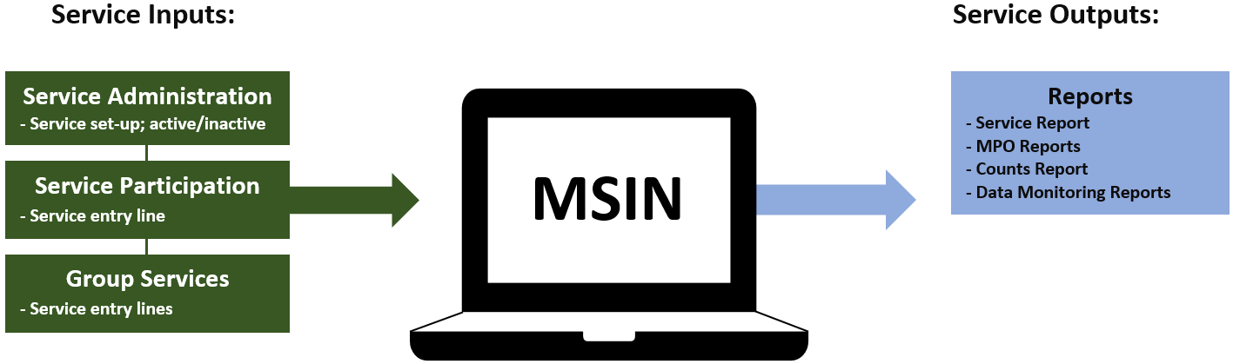
Service Participation Inputs and Outputs
Notes:
Lead: Victor
Time: 1 min
Talking Points:
This diagram shows the Service Participation inputs and outputs.
The green boxes represent how service information enters MSIN. (Go over each green box)
The blue boxes represent the places in MSIN where that service information appears again. (Go over each blue box)
Next, we will briefly review the data entry screens used to enter services.

Slide 32
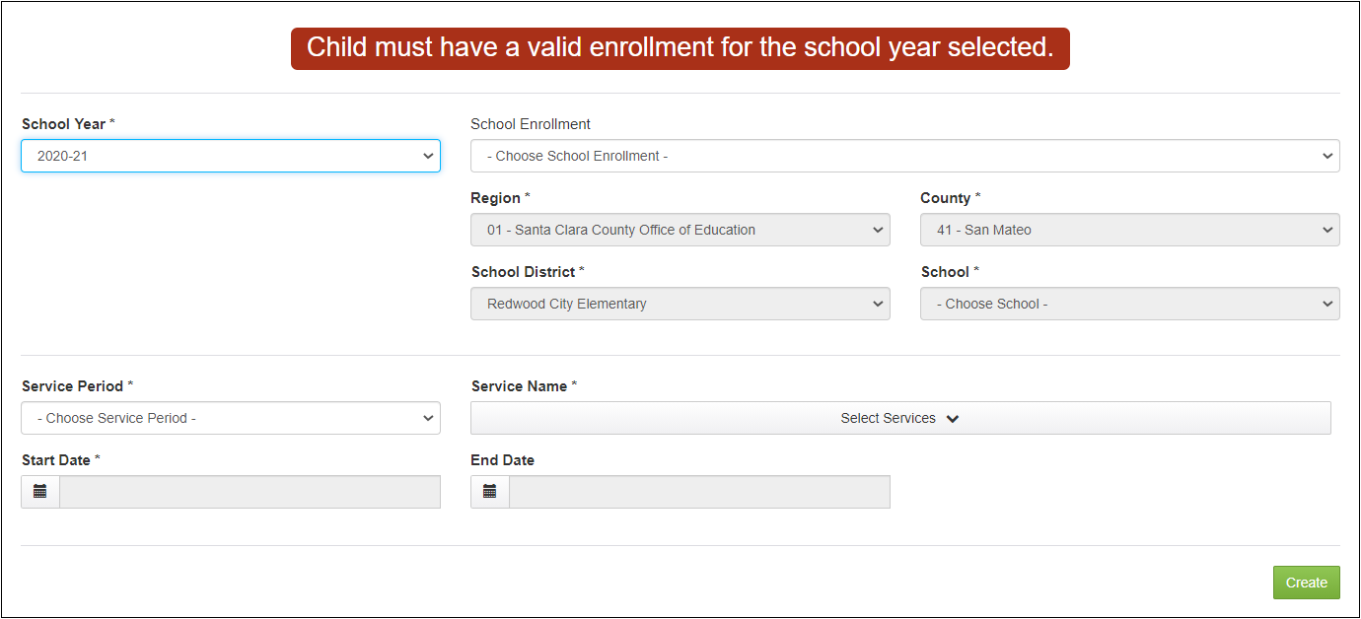
Service Participation Data Entry
Notes:
Lead: Victor
Time: 2 min
Talking Points:
As explained earlier, notice that a new service participation entry is always linked to an existing enrollment line.
Once an enrollment line is selected, the four grey fields are populated automatically using the enrollment line info (Region, County, School District, School).
Next, the user selects the Service Period, which can be Regular Year, Summer, or Intersession. This selection should be based on the school’s calendar.
The user can now select one or more services that were provided during the same date range.
Lastly, the user enters the State Date and End Date for the service(s). Note that these dates must “fit inside” the enrollment dates, for logical consistency. If the child is non-attending and does not have enrollment dates, then the service dates must fall within the school year.
Consult the MSIN user guide on entering services for exact date limits.
The system will also display the date limits when the user clicks on these fields.

Slide 33
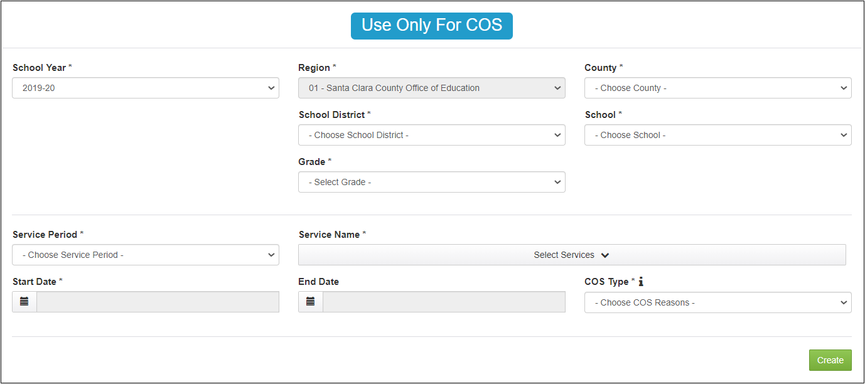
Continuation of Services Data Entry
Notes:
Lead: Victor
Time: 2 min
Talking Points:
Continuation of Services (COS) is a set of special exceptions for continuing to serve certain children whose eligibility for the MEP has expired.
There are three types: COS1, COS2, and COS3. Consult the MSIN user guide for specific definitions that come from Guidance.
In contrast to the prior screen, this one does not load enrollment lines because you would only use this screen if the child’s eligibility has already expired, so linking to a valid COE and enrollment line is not needed.
Only the Region field populates based on the user’s account. The remaining fields must be selected to indicate the school (i.e., MEP project) that provided services and the child’s grade level.
Service Period and Service Name work the same way as the service entry screen.
In a COS entry, the Start Date must be after the EOE (End of Eligibility) date in the same school year. This ensures that only COS information is entered.
The End Date has a limit based on the selected school year.
Lastly, a COS type must be selected (e.g., COS1, COS2, or COS3).
COS entries appear in the Student Services Report, with the appropriate label, because they are a type of service provided by the MEP.

Slide 34
Reports With Service Dependencies
MPO 1.0 (add hours)
MPO 2.0 (add hours)
MPO 5.0/6.0
MPO 5.1/6.1
MPO 7.0 (add hours)
MPO 8.0 (service setup)
MPO 9.0
MPO 9.1
MPO 10.0
MPO 10.1
MPO 10.2
MPO 11.0 (service setup)
MPO 11.1
MPO 13.0 (service setup)
MPO 13.1 (service setup)
Notes:
Lead: Victor
Time: 2 min.
Talking Points:
All MPO reports depend on service data, in one way or another.
The bolded reports depend on entering student participation in services (using the screens we just covered).
Others, like MPO 8.0, look at how services are set up. The MPO 8.0 Report does not capture student participation; instead, it shows the percentage of school readiness service codes that have a “social emotional component”. Similarly, the MPO 13.0 Report does not capture student participation; instead, it shows the percentage of instructional service codes that have a “cultural component”. These reports are counting services, not students.
This is an important distinction to remember. And the help text is always there to reference if we forget.
The purpose of this slide is simply to show that service data strongly impacts your MPO report results.
Lastly, note that three reports (1.0, 2.0, 7.0) have an additional requirement for a minimum number of hours. We will see an example in the next slide.

Slide 35
Numerator Criteria
Notes:
Lead: Victor
Time: 1 min
Talking Points:
We saw this screenshot of an MPO 7.0 Report earlier, but now we will point out the criteria for the numerator.
For a child to be included in the numerator, they .... (read underline parts).
In this case, having at least 15 hours or more in services mapped to MPO 7.0 is a key requirement.

Slide 36
Common Questions About Services
If a large group of students were served, why would an MPO report not reflect all those services?
  The report denominator shows which students should be served.
  The report numerator shows which students in the denominator participated in a service mapped to the MPO.
If a child gets multiple service entries with hours, do the hours get added together?
  If the services are mapped to the same MPO, the hours do get added together.
  The system adds the lower figures in each hour range.
  COS entries are also added, if applicable.
Notes:
Lead: Victor
Time: 1 min
Talking Points:
Here we have two of the most common questions we get about services and MPO reports.
(Read bullets)
We will cover each of these in more detail in the next slides.

Slide 37
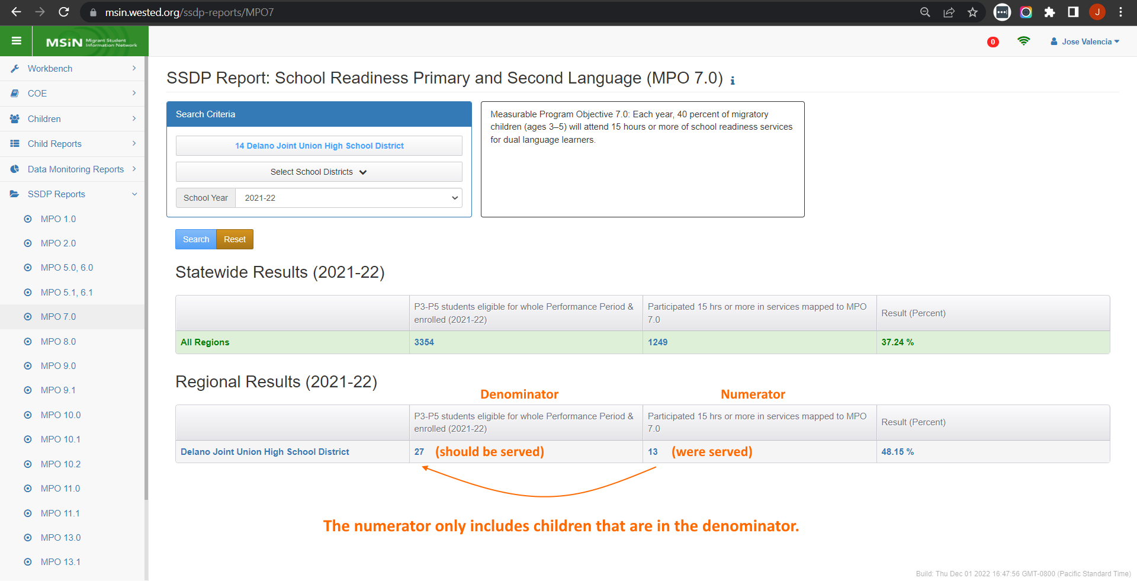
Understanding the Numerator
Notes:
Lead: Victor
Time: 1 min
Talking Points:
In this screenshot, the number 13 only includes children who are in the target group, meaning the 27 in the denominator.
Another way of saying this is that the numerator will be a subset of the denominator.
If we serve children who are not in the denominator, then they will not be shown in the numerator.
As a Data Specialist, this will probably be a popular clarification that you will need to explain to your colleagues.
We understand that other children may also need services, but the MPO percentage is based on this group of 27, so they should be prioritized for services.

Slide 38
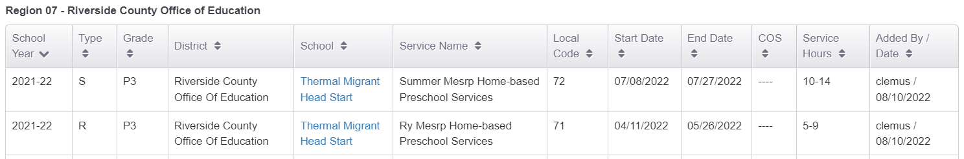
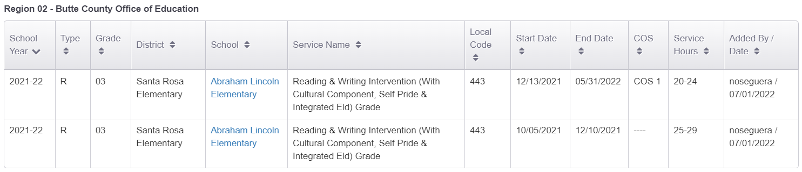
Multiple Services, Same MPO
Example 1 (MPO 7.0 – MESRP Services)
Example 2 (MPO 1.0 – ELA Services)
Notes:
Lead: Victor
Time: 2 min
Talking Points:
If multiple services with participation hours are entered, then the lower numbers in the ranges are added together (review example 1).
In the first example, we can see that the first service participation has an hours range from 10-14 and the second service participation line has a range of 5-9 hours. If we add the lower number in the ranges, which are 10 and 5, we get 15 hours. Since we are using MPO 7.0 in the first example, this student has met the hours required to be in the numerator.
This also applies to COS entries (review example 2).
In the second example, we are going to add the lower numbers in the range which are 20 and 25, which gives us 45 hours total. Since we are using MPO 1.0 for this example, this student has met the hours required to be in the numerator.

Slide 39
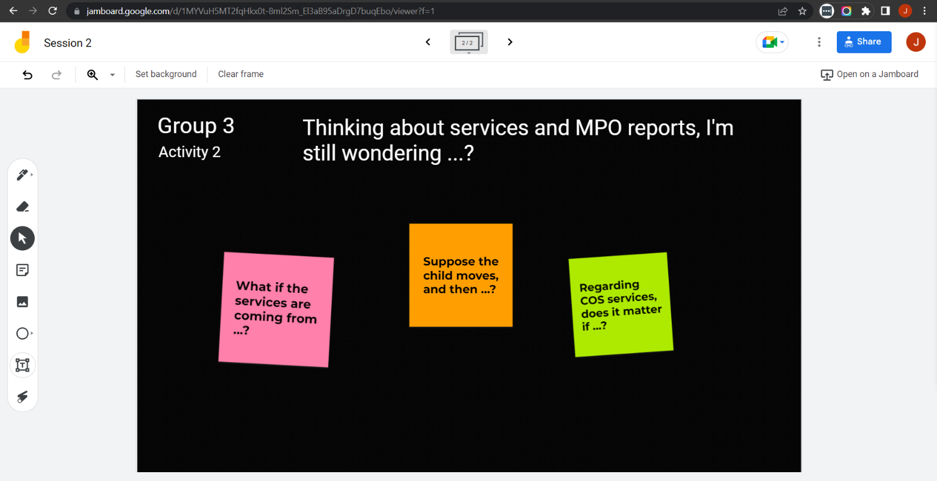
Collaborative Activity 2
Notes:
Lead: Victor
Time: 1 mins.
Talking Points:
This activity is the same as the first one, except now we are talking services.
(Explain that participants will be placed in breakout rooms with 5-6 collaborators. [Randomly assigned.])

Slide 40
Activity 2 Instructions
In your Breakout Room (BR), take 2 minutes to introduce yourselves (name, region/DFD, and job title).
Open the chat window to view the instructions and links.
Click on the Jamboard link that matches your BR number (e.g., BR 3 should go to Jamboard group 3).
Keep two windows open: your BR in Zoom and your activity 2 slide in Jamboard.
Add post-its (sticky notes) with your questions.
Discuss your questions with the group.
Notes:
Lead: Victor & Nesau
Time: 8 mins.
Talking Points:
(Read instructions on the slide.)
Paste the instructions link in the chat.
Send to Breakout rooms – 7 minutes

Slide 41
Questions? (2)
Notes:
Lead: Team
Time: 4 mins

Slide 42
Check for Understanding (2)
  Next, you will see a pop-up window with questions and response options.
  There are two questions for this section; answer them as best you can.
  You will get a warning when the poll is about to close.
Notes:
Lead: Victor
Time: 4 min
Poll Questions:
1) True or False: In the MPO reports, the numerator can only include children that are in the denominator.
True [answer]
False
I don’t know
2) True or False: If a child participates in multiple services that are mapped to the same MPO, the system adds the lower numbers in the hours ranges.
True [answer]
False
I don’t know

Slide 43
Resources and Closing Activity
Notes:
Transition Slide
Lead: Stephanie
Time: 10 secs.

Slide 44
Resources
Subgrantees may use this presentation to review requirements and recommendations.
User guides and how-to videos for the features covered today are available on the MEP Help Center: MSIN – California Migrant Education Program Help Center
If any questions arise, Data Specialists should consult with their supervisors first. Remaining questions or concerns can be submitted to the MSIN Service Desk.
Notes:
Lead: Stephanie
Time: 1 min
Talking Points:
In addition to the user guides, remember that definitions, rules, and other information is readily accessible within most screens by clicking the “i” icon next to field titles.
Finally, don’t forget that the Training MSIN site is always available so that you can practice and brush up on system features.

Slide 45
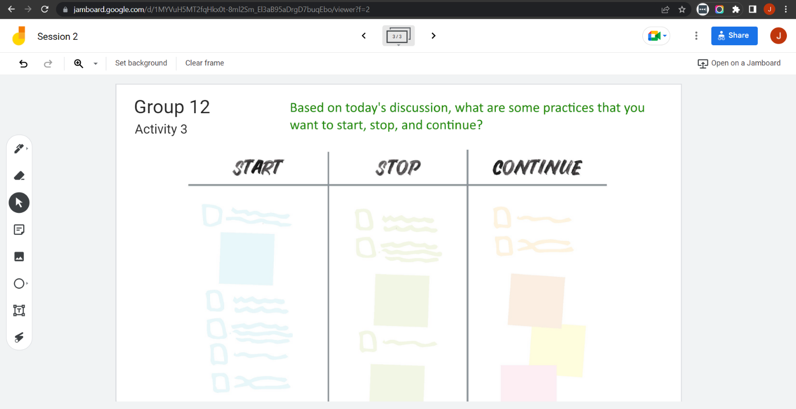
Collaborative Activity 3
Notes:
Lead: Stephanie
Time: 1 mins.
Talking Points:
Our last collaborative activity for this session is meant for you to reflect and discuss any key points that you’re thinking of integrating into your local practices going forward. This activity is called “Start – Stop – Continue.”
Explain that participants will be placed in breakout rooms with 5-6 collaborators. [Randomly assigned; not the same group members as in Activity 1 or 2.]

Slide 46
Activity 3 Instructions
In your Breakout Room (BR), take 2 minutes to introduce yourselves (name, region/DFD, and job title).
Open the chat window to view the instructions and links.
Click on the Jamboard link that matches your BR number (e.g., BR 12 should go to Jamboard group 12).
Keep two windows open: your BR in Zoom and your activity 3 slide in Jamboard.
Add a post-it (sticky note) or text in each of the categories.
Discuss anything that you find surprising or unexpected.
Notes:
Lead: Stephanie & Nesau
Time: 8 mins.
Talking Points:
(Read instructions on the slide.)
Paste the instructions link in the chat.
Send to Breakout rooms – 7 minutes

Slide 47
Questions? (3)
Notes:
Lead: Team
Time: 3 mins

Slide 48
Contact Information
Stephanie Lynch
Education Research and Evaluation Consultant
California Department of Education
slynch@cde.ca.gov
916-319-0410
__________________________________________________
MSIN Service Desk
MSINsupport@wested.org
1-800-342-2964, option 2
Notes:
Lead: Juli
Time: 30 sec
Talking Points:
Thank participants for attending.

