Slide 1
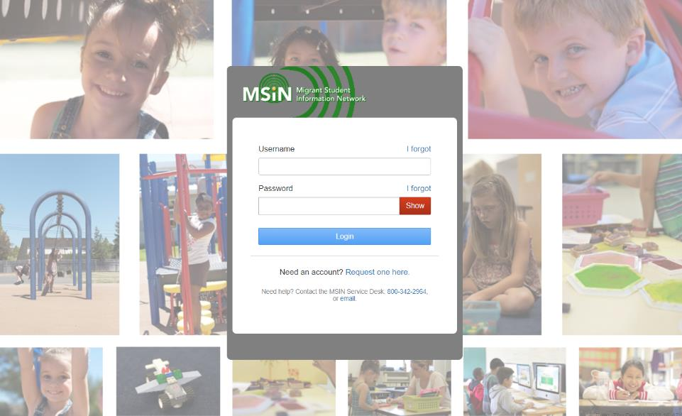
Welcome to the
Migrant Student Information Network
2023 Training
We will begin shortly.
Please enter your name and region/district in the chat.
Notes:
Lead: Victor

Slide 2
Migrant Student Information Network:
Using Reports to Plan Program Participation
January 24, 2023
3:00 p.m. – 4:30 p.m.
Notes:
Lead: Victor

Slide 3
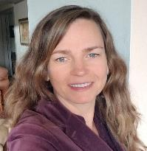
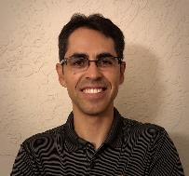

Welcome and Introductions
Session Presenters:
Juli Auld, Administrator of the Migrant Education Program (MEP), California Department of Education (CDE)
Jose Valencia, Migrant Student Information Network (MSIN) Lead, WestEd
Victor Garibay, MSIN Specialist, WestEd
Notes:
Lead: Juli
Time: 3 mins.
Talking Points:
Welcome participants.
Presenters introduce themselves

Slide 4
Purpose
This webinar will review selected reports in the MSIN system that help managers plan program participation and meet the State Service Delivery Plan (SSDP) Measurable Program Objectives (MPOs). Its purpose is to encourage the use of MPO reports to identify target populations so that objective percentages increase.
The target audience is MEP managers and supervisors.
Notes:
Lead: Juli
Time: 1 min
Talking Points:
(Read or paraphrase bullets)
The session content was written for experienced MSIN users who already have a working knowledge of the reports in the MSIN system. If you are not familiar with a report or concept we cover today, we encourage you to work with your local team to clear up any doubts.

Slide 5
Session Objectives
Participants will:
review how child lists in the MPO reports can help managers plan program participation;
review how the Initial Needs Assessments/Individual Learning Plans (INA/ILPs) affect the MPO reports;
learn tips to help troubleshoot MPO report results;
share and discuss local knowledge regarding these topics; and
review the resources about these reports in the MSIN system.
Notes:
Lead: Juli
Time: 1 min
Talking Points:
(Read or paraphrase bullets)

Slide 6


Housekeeping
Please mute your microphone in the main session.
Use the Q&A function to enter your questions.
Participate in breakout room activities.
The PowerPoint for this presentation can be accessed through the link provided in the chat. It will also be posted on the California MEP Help Center for those who were not able to attend today.
Notes:
Lead: Juli
Time: 1 min.
Talking Points:
(Read or paraphrase bullets)

Slide 7
Planning Program Participation
Notes:
Transition Slide
Lead: Jose
Time: 20 secs.

Slide 8
Reports That Include Child Lists
Based on Current Enrollment
MPO 1.0
MPO 2.0
MPO 5.0/6.0
MPO 5.1/6.1*
MPO 7.0
MPO 8.0
MPO 9.0
MPO 9.1
MPO 10.0*
MPO 10.1*
MPO 10.2*
MPO 11.0
MPO 11.1*
MPO 13.0
MPO 13.1
Notes:
Lead: Jose
Time: 2 min.
Talking Points:
The highlighted reports shown here create lists of children who should be served because they have a specific need(s).
Each report looks at children who are currently enrolled and meet other MPO criteria.
For example, the MPO 5.0/6.0 report, which is about case management services, includes children who are currently enrolled in grade 9 and were below standard in grade 8 in CAASPP ELA or Math.
Similarly, each highlighted report (bold text) creates a list of children who are currently enrolled and should be served.
We recommend using these ready-made lists to invite these specific children to your services that are mapped to the MPOs.
Looking at the slide, we can see that the majority of the reports (11/15) tell us exactly which children to invite to our services.
We will come back to the reports with an Asterix, which also rely on specific INA/ILP responses.
For now, the key point is that most reports only include children who are currently enrolled in the applicable grade(s).

Slide 9
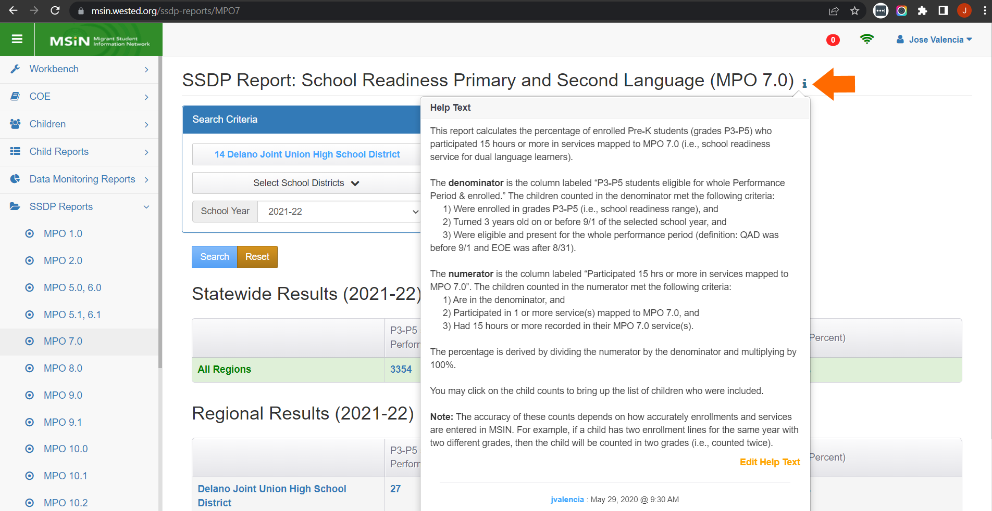
Understanding Report Criteria
Notes:
Lead: Jose
Time: 1 min
Talking Points:
It’s always good to check the help text because it lists the criteria needed to include a child.
For example, in this screenshot of the MPO 7.0 Report, the Help Text tells us that the first criterion for inclusion is that the child is currently enrolled in grades P3-P5.

Slide 10
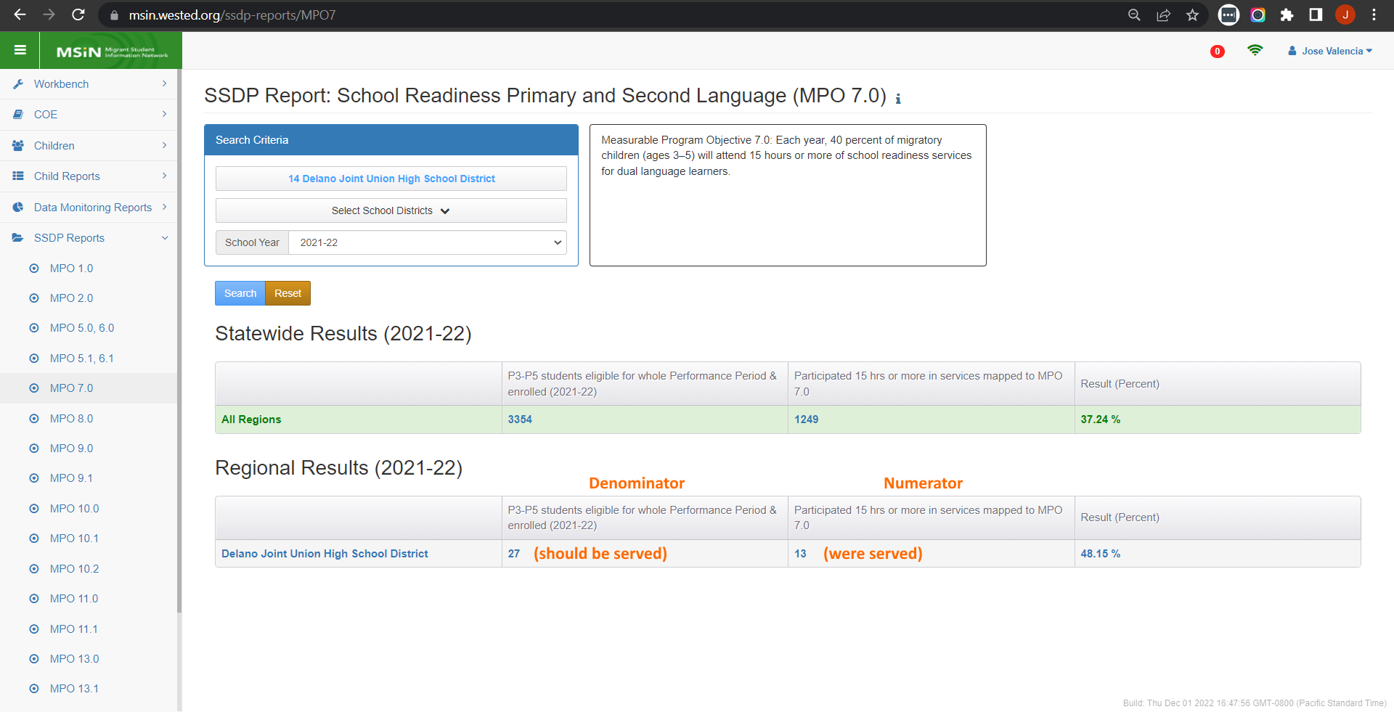
Understanding the Denominator
Notes:
Lead: Jose
Time: 1 min
Talking Points:
Looking at the results in the report, the dominator (27) is the group of children we should serve. And the numerator (13) includes those who were served.
When planning program participation (i.e., which children get invited to specific services), we should focus on the denominator first and foremost.

Slide 11
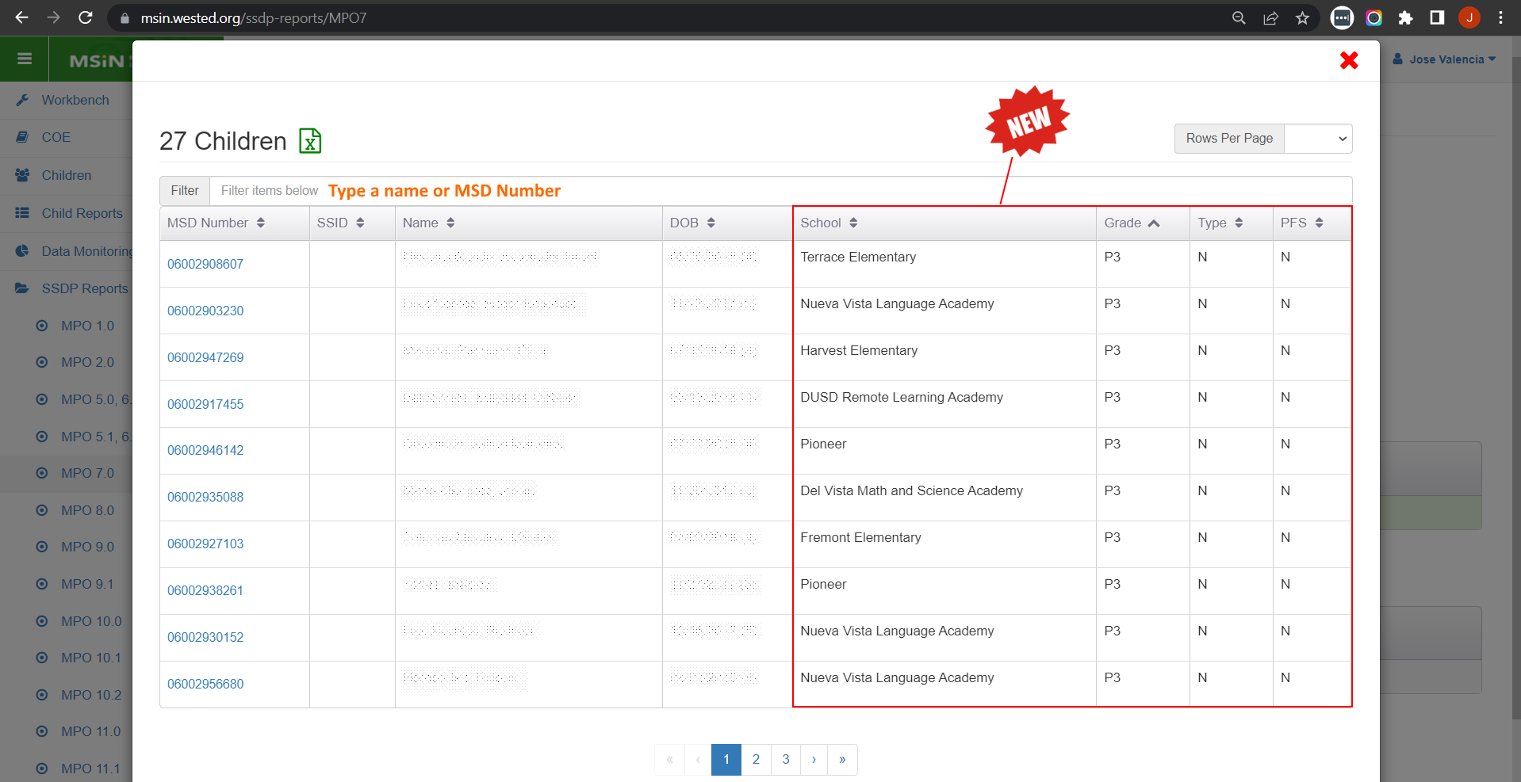
Using Child Lists in MPO Reports
Notes:
Lead: Jose
Time: 1 min
Talking Points:
Clicking on the denominator count brings up a window showing exactly which children are included.
To look for a specific child, you can type their name or MSD Number in the filter field, just above the table.
This past year (July 2022), CDE requested the addition of a column for PFS, and we were able to add three more useful columns as well (school, grade, and Enrollment Type0.
The child list is exportable, so you can manipulate the information in Excel.
To recap, this is the list of children who have a current enrollment and meet the other criteria for the denominator. They are the children we should serve to meet the MPO goal.

Slide 12
Child List Creation Options
Whole region/DFD (default selection on search page)
By district (select district drop-down option on search page)
By school (download denominator list and sort by School)
By grade (download denominator list and sort by Grade)
By PFS status (download denominator list and sort by PFS)
By Enrollment Type (download denominator list and sort by Type)
Notes:
Lead: Jose
Time: 1 min
Talking Points:
(Read and explain each bullet.)

Slide 13
MPOs Requiring Service Hours
Three MPOs require a minimum number of service hours to meet the objective.
  MPO 1.0 – ELA Achievement (30 hrs. Regular School Year; 20 hrs. Summer)
  MPO 2.0 – Math Achievement (30 hrs. Regular School Year; 20 hrs. Summer)
  MPO 7.0 – Primary and Secondary Language Development (15 hrs.)
Notes:
Lead: Jose
Time: 1 min
Talking Points:
(Read items on slide.)
The hours requirements make these three MPO’s especially notable and more labor intensive.
For the MPO 7.0 (P3-P5 children), the denominator list begins populating as soon as children are re-enrolled (i.e., in the current year, or currently enrolled).
For the MPO 1.0 and 2.0 reports, the denominator lists begin populating as soon as assessment results become available in MSIN (assuming each child is also currently enrolled in grades K-10). This delay is something we should factor into our planning.

Slide 14
INA/ILPs and MPO Reports
Notes:
Transition Slide
Lead: Victor
Time: 20 secs.

Slide 15
Reports That Depend on INA/ILPs
MPO 1.0
MPO 2.0
MPO 5.0/6.0
MPO 5.1/6.1*
MPO 7.0
MPO 8.0
MPO 9.0
MPO 9.1
MPO 10.0*
MPO 10.1*
MPO 10.2*
MPO 11.0
MPO 11.1*
MPO 13.0
MPO 13.1
Notes:
Lead: Victor
Time: 2 min.
Talking Points:
The reports with an Asterix rely on completed INA/ILP forms.
Let’s review some important background information about these forms.
When an INA/ILP is created, the user must reference an existing enrollment line, which includes the grade level, and this determines the form version.
There are four INA/ILP form versions. The reason for this is that questions about needs will vary according to the child’s grade. The four INA/ILP versions are:
Pre-Kinder: grades P3-P5
Elementary: grades K-8
Secondary: grades 9-12
Youths/young adults: grades NA and AD
The MPO reports highlighted in this slide reference specific questions in the INA/ILP forms.
MPO 5.1/6.1 is for secondary students enrolled in grades 11 or 12, who have a completed INA/ILP indicating that they need credit recovery services from the MEP.
MPO 10.0 is for youths enrolled in grade NA (OSY), who have a completed INA/ILP indicating that they are interested in “English (ELA, ESL, ELD.”
MPO 10.1 is for youths enrolled in grade NA (OSY), who have a completed INA/ILP indicating that they are interested in “GED/HEP.”
MPO 10.2 is for youths enrolled in grade NA (OSY), who have a completed INA/ILP indicating that they are interested in “Home language literacy.”
MPO 11.1 is for children and youths in all grades, who have a completed INA/ILP indicating that they need “Mental Health” services.
Next, we will take a closer look at the INA/ILP responses that cause children to be included in these five MPO reports.

Slide 16
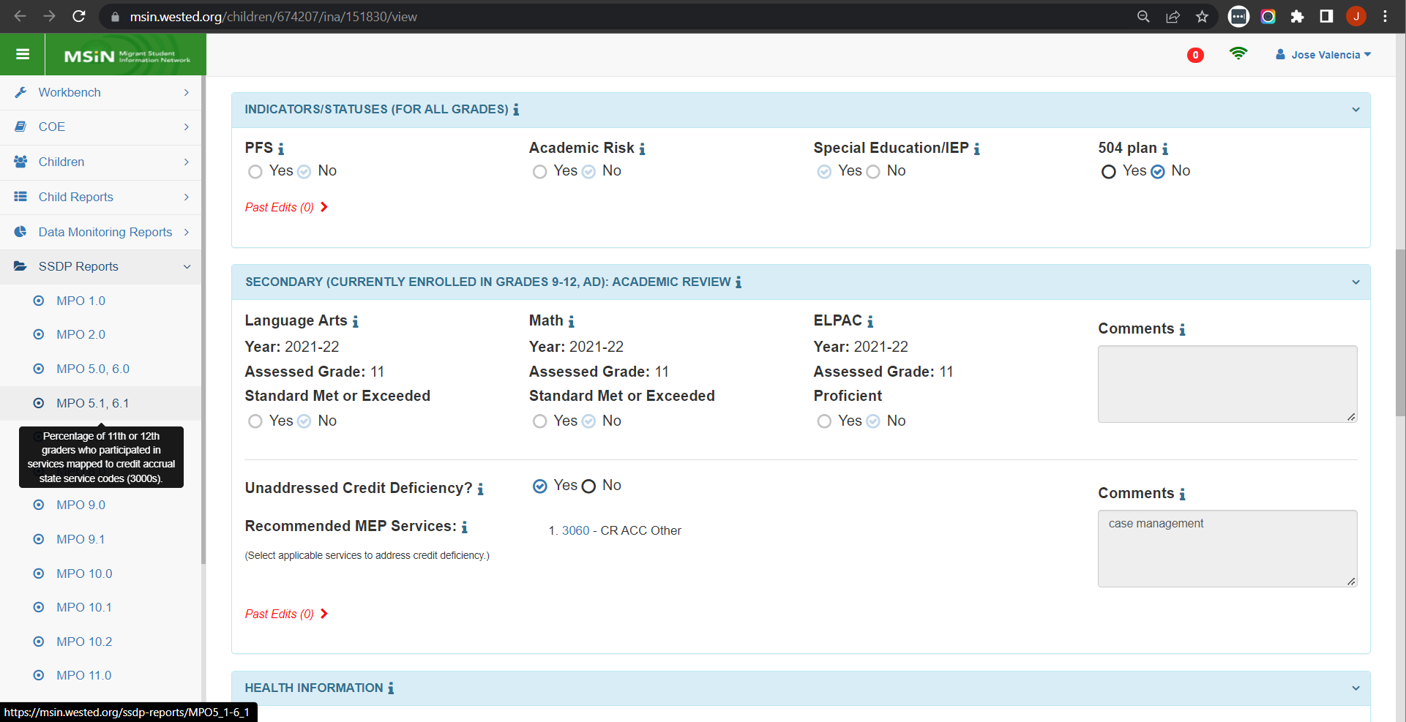
MPO 5.1/6.1 Linked to INA/ILP
Notes:
Lead: Victor
Time: 1 min
Talking Points:
The MPO 5.1/6.1 Report is specifically about currently enrolled grade 11 or 12 secondary students.
To be included in the report denominator, the student’s completed INA/ILP must have “Yes” selected after the question about having an “unaddressed credit deficiency.”
Selecting “Yes” means that the student needs the MEP to step in to provide a credit recovery service because the district is not already providing this.
If a student is receiving applicable district services, then “No” should be selected (because the MEP does not need to step in or supplant).

Slide 17
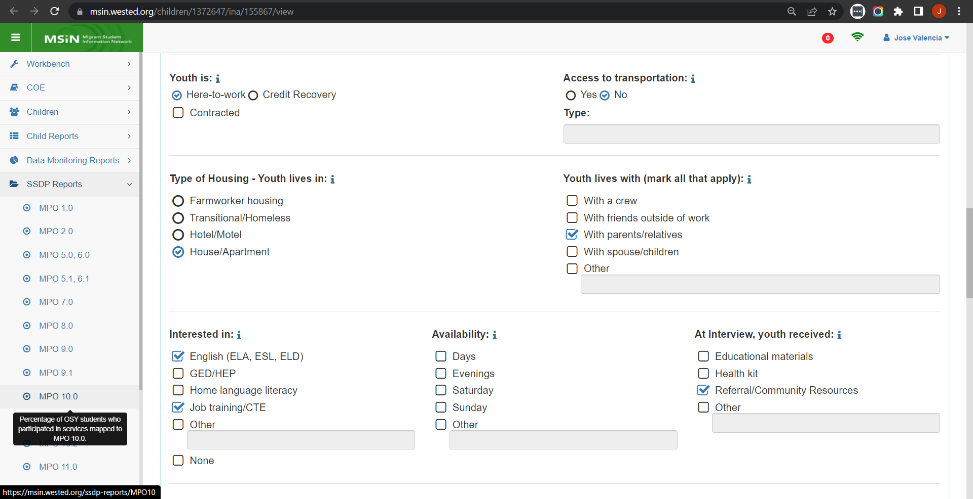
MPO 10.0 Linked to INA/ILP
Notes:
Lead: Victor
Time: 1 min
Talking Points:
The MPO 10.0 Report is specifically about currently enrolled youths in grades NA (OSY) or AD (Adult Education).
To be included in the report denominator, the youth’s completed INA/ILP must have a checkmark next to “English (ELA, ESL, ELD).”
When filling out the INA/ILP form, the MEP staff person interviewing the youth should consider if they are interested in actually attending a service (not just a passing interest in the subject).
If the youth is not planning to actually attend a MEP service, then we suggest leaving this box unchecked.

Slide 18
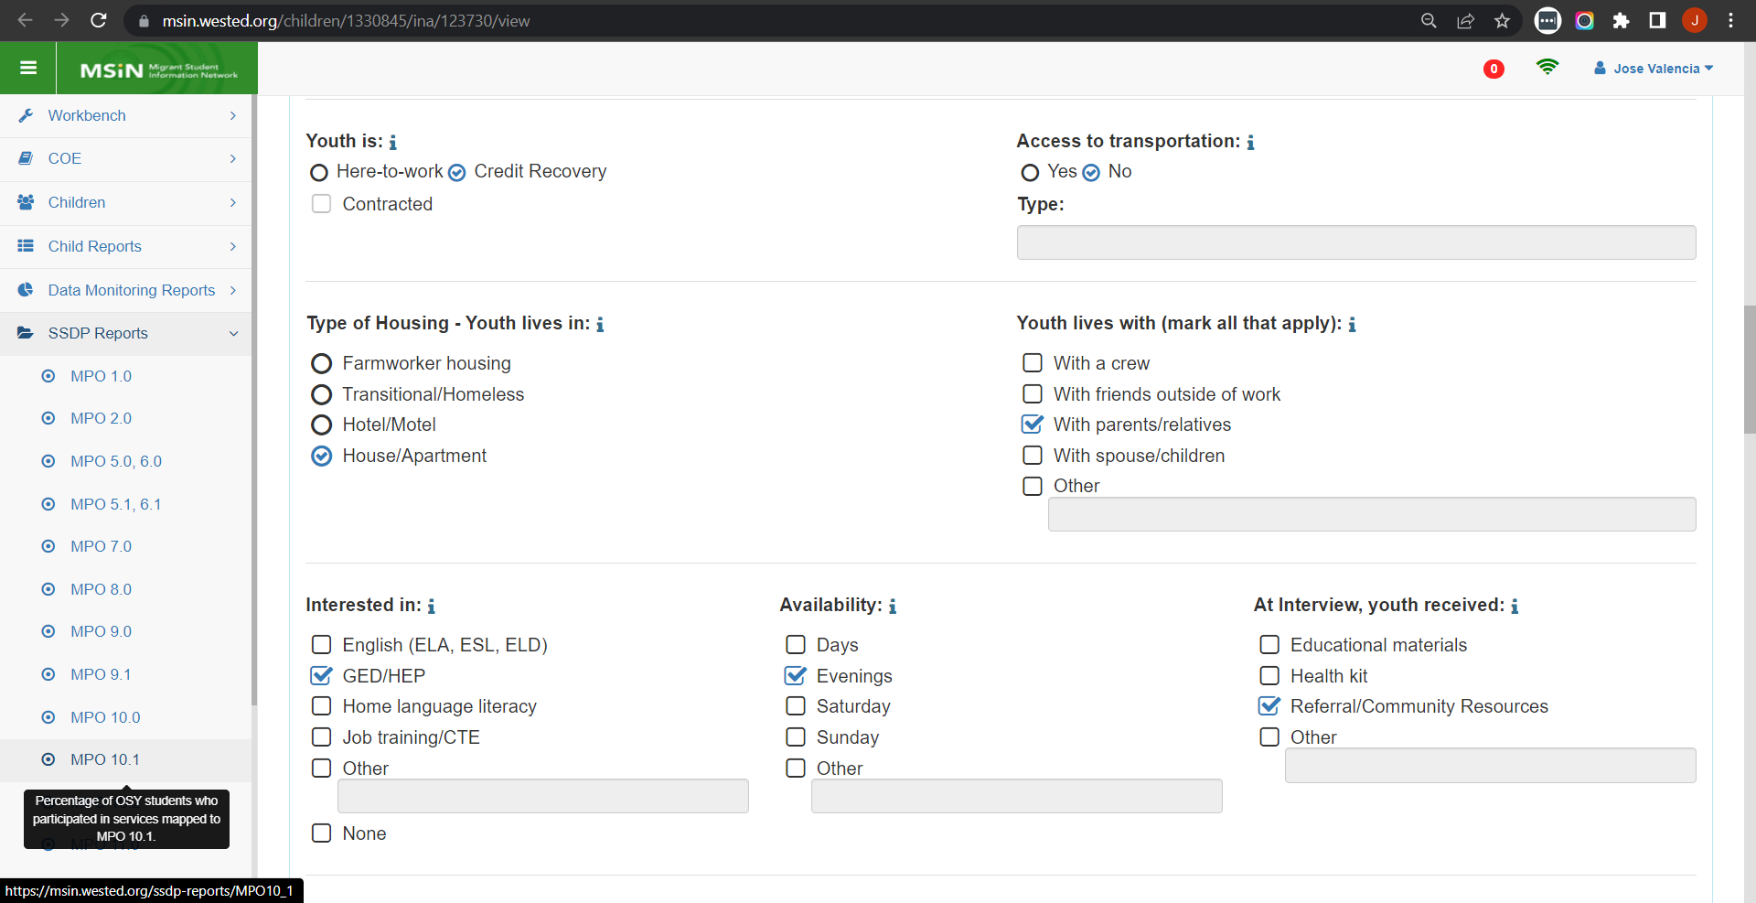
MPO 10.1 Linked to INA/ILP
Notes:
Lead: Victor
Time: 1 min
Talking Points:
The MPO 10.1 Report is specifically about currently enrolled youths in grades NA (OSY) or AD (Adult Education).
To be included in the report denominator, the youth’s completed INA/ILP must have a checkmark next to “GED/HEP.”
When filling out the INA/ILP form, the MEP staff person interviewing the youth should consider if they are interested in actually attending a service (not just a passing interest in the subject).
If the youth is not planning to actually attend a MEP service, then we suggest leaving this box unchecked.

Slide 19
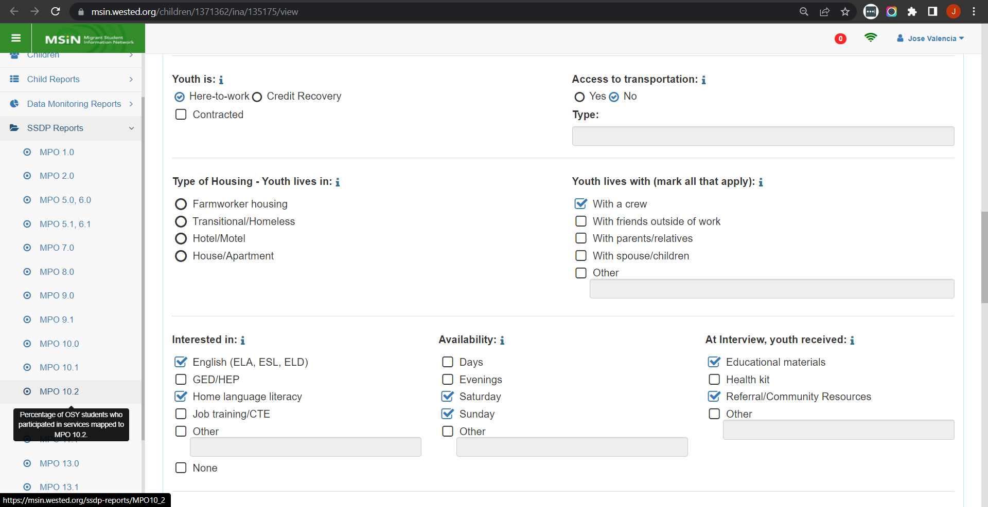
MPO 10.2 Linked to INA/ILP
Notes:
Lead: Victor
Time: 1 min
Talking Points:
The MPO 10.2 Report is specifically about currently enrolled youths in grades NA (OSY) or AD (Adult Education).
To be included in the report denominator, the youth’s completed INA/ILP must have a checkmark next to “Home language literacy.”
When filling out the INA/ILP form, the MEP staff person interviewing the youth should consider if they are interested in actually attending a service (not just a passing interest in the subject).
If the youth is not planning to actually attend a MEP service, then we suggest leaving this box unchecked.

Slide 20
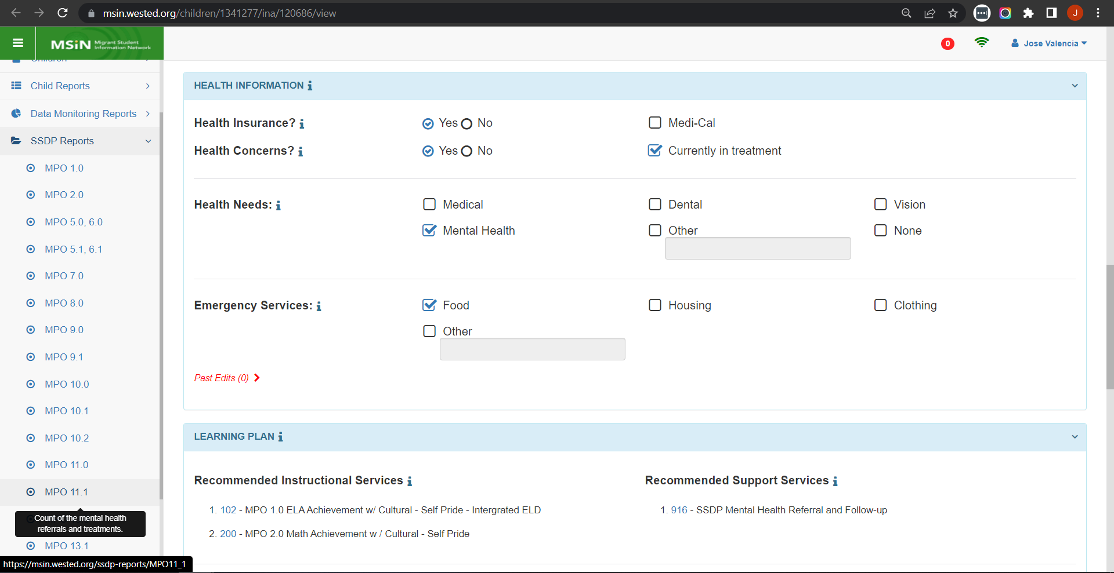
MPO 11.1 Linked to INA/ILP
Notes:
Lead: Victor
Time: 1 min
Talking Points:
The MPO 11.1 Report is about currently enrolled children and youths in any grade. This item appears in all four INA/ILP form versions.
To be included in the report denominator, the child’s or youth’s completed INA/ILP must have a checkmark next to “Mental Health” (as a health need).
When filling out the INA/ILP form, the MEP staff person interviewing the parent or youth should consider if the child or youth is likely to actually participate in a mental health service.
If the child or youth is not going to access a mental health service or referral provided by the MEP, then consider leaving this box unchecked.

Slide 21
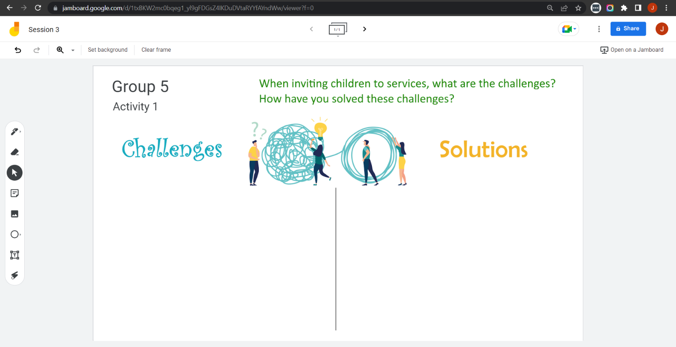
Collaborative Activity 1
Notes:
Lead: Victor
Time: 2 mins.
Talking Points:
This collaborative activity is focused on sharing challenges and solutions you have found when inviting children to participate in services (to meet MPO goals).
(Explain that participants will be placed in breakout rooms with 5-6 collaborators [Randomly assigned]).

Slide 22
Activity 1 Instructions
In your Breakout Room (BR), take 2 minutes to introduce yourselves (name, region/DFD, and job title).
Open the chat window to view the instructions and links.
Click on the Jamboard link that matches your BR number (e.g., BR 5 should go to Jamboard group 5).
Keep two windows open: your BR in Zoom and your Activity 1 slide in Jamboard.
Add post-its (sticky notes) with your responses.
Discuss what you posted with the group.
Notes:
Lead: Victor & Nesau
Time: 8 mins.
Talking Points:
(Read instructions on the slide.)
Paste the link to instructions in the chat.
Send to Breakout rooms – 7 minutes

Slide 23

Questions?
Notes:
Lead: Team
Time: 5 mins

Slide 24
Check for Understanding
  Next, you will see a pop-up window with questions and response options.
  There are two questions for this section; answer them as best you can.
  You will get a warning when the poll is about to close.
Notes:
Lead: Victor
Time: 4 min
Poll Questions:
1) Which of the following statements is/are true?
a. Most MPO reports depend on a child’s current enrollment
b. Most MPO reports create a list of the children who should be served
c. Most MPO reports allow you to sort child lists by school, grade, and PFS status
d. All of the above (a, b, and c) [answer]
e. I don’t know
2) True or False: When filling out the INA/ILP form, the MEP staff person should consider if the child or youth actually intends to participate in the related service.
a. True [answer]
b. False
c. I don’t know

Slide 25

Break
Time for a break.
Notes:
3-minute break
Stretch, grab coffee or tea, take a bio break

Slide 26
Troubleshooting MPO Report Results
Notes:
Transition Slide
Lead: Jose
Time: 20 secs.

Slide 27
Popular Issue & Guiding Questions
Issue: Children were served, but they are not showing up in the MPO report and the percentage is lower than expected.
Key questions to answer:
  Is each child in the report denominator (group that should be served based on a need in this area)? Are they currently enrolled?
  Have they met all the criteria to be in the denominator?
  Is the service code they received mapped to the MPO?
  For MPOs 1.0, 2.0, and 7.0, did the child receive the required number of hours?
  Have they met all the criteria to be in the numerator?
Notes:
Lead: Jose
Time: 2 min
Talking Points:
(Read slide content.)
Notice that we always come back to the criteria, which is found in the Help Text (or “i”) next to each MPO report title.
Next, we will cover the most common reasons that children are excluded from the denominator.

Slide 28
Causes of Denominator Exclusions
The child is not currently enrolled.
The child’s enrollment line has the wrong grade.
For reports that depend on assessment results (1.0, 2.0, 5.0/6.0) the child is not below standard.
For reports that depend on INA/ILPs, the child’s form in not in Completed status.
Other denominator criteria were not met (see Help Text).
Notes:
Lead: Jose
Time: 3 min
Talking Points:
Let’s suppose that you are expecting to see a child in the denominator list, but they are not present. Here are the most likely reasons the child was excluded.
(Read slide content. For each item above, provide the corresponding example below.)
For example, if you’re looking at the MPO 7.0 Report for grades P3-P5, the child needs to have an enrollment line for the current year with a P3-P5 grade. Most of these children are non-attending, so the family is typically called, which is known as an Annual Verication or Annual Contact, to make sure they are still in the area before re-enrolling them in MSIN.
Using the MPO 7.0 Report as an example, if the child is enrolled in grade K in the current year, then they will not appear in this report because it is only for P3-P5. This sometimes happens when a child enrolls in transitional kinder, which is denoted by grade K in MSIN.
Using the MPO 5.0/6.0 Report as an example, sometimes a child in grade 9 was not below standard in grade 8. To confirm, you can always look for them in the Academic Risk Report. If they are not listed, or not below standard in CAASPP ELA or Math, then they will not be in denominator list.
As Victor covered, 5 of the MPO reports depend on specific INA/ILP responses. Before children can be added to the denominator lists in these reports, their INA/ILP forms need to be finished, with all the required fields filled in and saved (i.e., Completed).
Using the MPO 7.0 Report as an example, one criterion is that the child must be at least 3 years old before 9/1 of the selected school year. This is based on their date of birth. If this is not true, then the child will be excluded from the denominator list.
To summarize, if you don’t see a child that you expected to find in an MPO report’s denominator list, it’s probably because of one (or more) of the reasons shown on this slide.
Next, we will cover the most common reasons that children are excluded from the numerator.

Slide 29
Causes of Numerator Exclusions
The child may have been served, but they are not included in the numerator because they are not in the denominator (the numerator is always a subset of the denominator).
For reports that require hours (1.0, 2.0, 7.0), the minimum hours were not entered by local staff.
If the child received multiple services with hours, the system adds the lower numbers in the ranges and this sum did not meet the hours requirement.
Other numerator criteria were not met (see Help Text).
Notes:
Lead: Jose
Time: 2 min
Talking Points:
Like in the previous slide, let’s suppose that you are expecting to see a child in the numerator list, but they are not showing up.
(Read slide content. For each item above, provide the corresponding example below.)
This one was covered in previous slide because it’s the explanation to our most popular MSIN Service Desk question about MPO reports. If you expect to see a child in the numerator list but they are missing, the first thing to check is whether they are still in the denominator. It could be that a child’s information has changed (such as an enrollment line change) and this removed them from the denominator (so they cannot be in numerator).
Services, including hours, are something you can check directly in a child record (via the Service Participation tab) or by running your Service Report. The minimum number of hours must be met or exceeded for the child to be in the numerator list (assuming all other criteria are met).
For example, suppose that a child received two services mapped to MPO 1.0 during the regular school year (RSY). If the first service was entered as 15-19 hours for RSY and the second service was entered as 10-14 hours for RSY, then the system will add the lower numbers, 15 and 10, to get 25. This does not meet the minimum of 30 hours for RSY.
We come back to this often because each MPO is unique, and criteria can differ significantly.

Slide 30
Troubleshooting Tips
Review and understand each MPO report’s criteria.
Focus on the things subgrantees can control;
  Enrollments – You can add or delete a child from the denominator by adding or deleting an enrollment line.
  INA/ILP forms – You can add or delete a child from the denominator by adding or deleting an INA/ILP with different selections.
  Services – You can add or delete a child from the numerator by adding or deleting a service line.
Notes:
Lead: Jose
Time: 3 min
Talking Points:
(Read slide content. For each item, provide one or two examples.)

Slide 31
Troubleshooting Tips (2)
Work collaboratively with your local Data Specialist(s) to resolve any questions about a child’s inclusion or exclusion in an MPO report.
After your Regional Application or District Service Agreement is approved, check to ensure that your local codes are aligned and correctly mapped to the MPOs.
Use other reports in MSIN to confirm why children were included or excluded in the MPO reports (Enrollment Report, Academic Risk Report, INA/ILP Report, Service Report).
Notes:
Lead: Jose
Time: 2 min
Talking Points:
(Read slide content.)
As an example of #3, I can confirm the MPO 11.1 denominator results by using the INA/ILP Report to see exactly which children/youth wanted to participate in mental health services [MPO 11.1]. (quiz question) You can use this report for any of the 5 MPO reports that depend on INA/ILP responses.

Slide 32
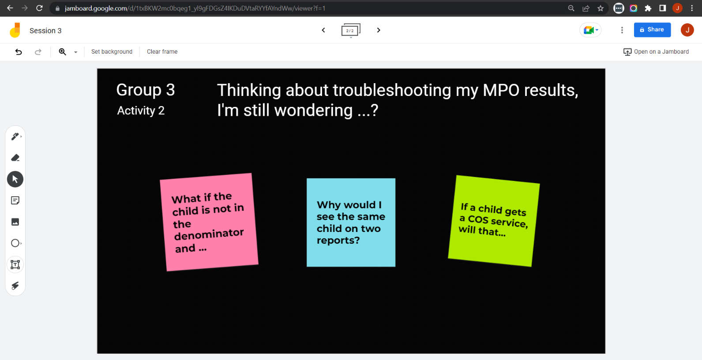
Collaborative Activity 2
Notes:
Lead: Jose
Time: 2 mins.
Talking Points:
The purpose of this activity is to discuss any remaining questions you may have about troubleshooting your MPO results.
(Explain that participants will be placed in breakout rooms with 5-6 collaborators [Randomly assigned; not the same group members as in Activity 1.]).

Slide 33
Activity 2 Instructions
In your Breakout Room (BR), take 2 minutes to introduce yourselves (name, region/DFD, and job title).
Open the chat window to view the instructions and links.
Click on the Jamboard link that matches your BR number (e.g., BR 3 should go to Jamboard group 3).
Keep two windows open: your BR in Zoom and your activity 2 slide in Jamboard.
Add post-its (sticky notes) with your questions.
Discuss your questions with the group.
Notes:
Lead: Jose & Nesau
Time: 8 mins.
Talking Points:
(Read instructions on the slide.)
Paste the instructions link in the chat.
Send to Breakout rooms – 7 minutes

Slide 34
Questions? (2)
Notes:
Lead: Team
Time: 5 mins

Slide 35
Check for Understanding (2)
  Next, you will see a pop-up window with questions and response options.
  There are two questions for this section; answer them as best you can.
  You will get a warning when the poll is about to close.
Notes:
Lead: Victor
Time: 4 min
Poll Questions:
1) True or False: The most important tip is to review and understand each MPO report’s criteria.
a. True [answer]
b. False
c. I don’t know
2) Which of the following statements is/are true?
a. You can use the INA/ILP Report in MSIN to confirm which children and youth wanted to participate in mental health services.
b. Enrollments have no impact on most MPO reports.
c. There are three MPOs that require a minimum number of hours: 1.0, 2.0, and 7.0.
d. A and C [answer]
e. I don’t know

Slide 36
Resources and Closing Activity
Notes:
Transition Slide
Lead: Juli
Time: 10 secs.

Slide 37
Resources
Subgrantees may use this presentation to review requirements and recommendations.
User guides and how-to videos for the features covered today are available on the MEP Help Center: MSIN – California Migrant Education Program Help Center
Webinars and other resources can be found here: Google Drive folder for CDE’s MPO webinars and other SSDP resources
If any questions arise, please consult with your local management team first. Policy questions about MPOs should be submitted to your CDE consultant or Melissa Mallory. MSIN questions or concerns can be submitted to the MSIN Service Desk.
Notes:
Lead: Juli
Time: 1 min
Talking Points:
In addition to the user guides, remember that definitions, rules, and other information is readily accessible within most screens by clicking the “i” icon next to the report titles.
Don’t forget that the Training MSIN site is always available so that you can practice and brush up on system features.
The SSDP folder has all the MPO Report webinars, service code map webinar, and service code map template with examples for both DFDs and Regions.

Slide 38
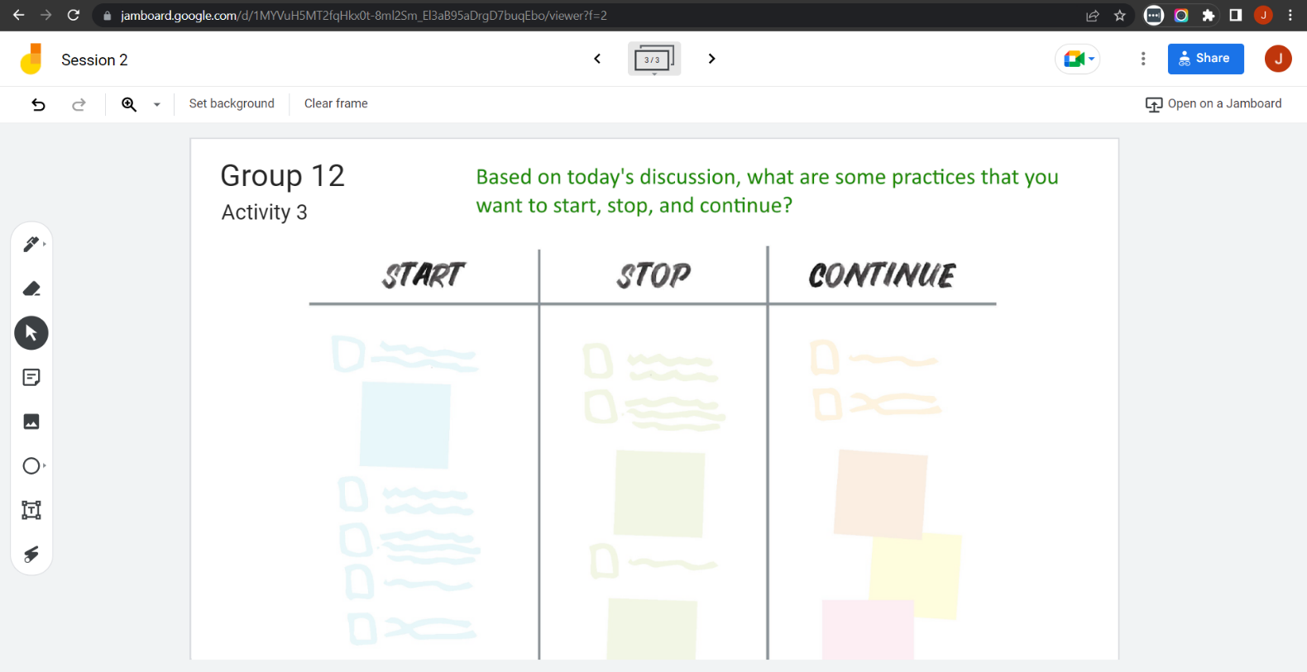
Collaborative Activity 3
Notes:
Lead: Juli
Time: 1 mins.
Talking Points:
Our last collaborative activity for this session is meant for you to reflect and discuss any key points that you’re thinking of integrating into your local practices going forward. This activity is called “Start – Stop – Continue.”
(Explain that participants will be placed in breakout rooms with 5-6 collaborators [Randomly assigned; not the same group members as in Activity 1 or 2.])

Slide 39
Activity 3 Instructions
In your Breakout Room (BR), take 2 minutes to introduce yourselves (name, region/DFD, and job title).
Open the chat window to view the instructions and links.
Click on the Jamboard link that matches your BR number (e.g., BR 12 should go to Jamboard group 12).
Keep two windows open: your BR in Zoom and your activity 3 slide in Jamboard.
Add a post-it (sticky note) or text in each of the categories.
Discuss anything that you find surprising or unexpected.
Notes:
Lead: Juli & Nesau
Time: 8 mins.
Talking Points:
(Read instructions on the slide.)
Paste the instructions link in the chat.
Send to Breakout rooms – 7 minutes

Slide 40
Questions? (3)
Notes:
Lead: Team
Time: 3 mins

Slide 41
Contact Information
Stephanie Lynch
Education Research and Evaluation Consultant
California Department of Education
slynch@cde.ca.gov
916-319-0410
__________________________________________________
MSIN Service Desk
MSINsupport@wested.org
1-800-342-2964, option 2
Notes:
Lead: Juli
Time: 30 sec
Talking Points:
Thank participants for attending.

